Slide 1
TF&GAN
Bowen.Du

Slide 2
What is Tensorflow
Tensorflow = Tensor + flow
Tensor: 张量,其本质就是任意维度的数组.一个向量就是一个1维的Tensor,一个矩阵就是2维的Tensor.
flow: graph中的数据流

Slide 3
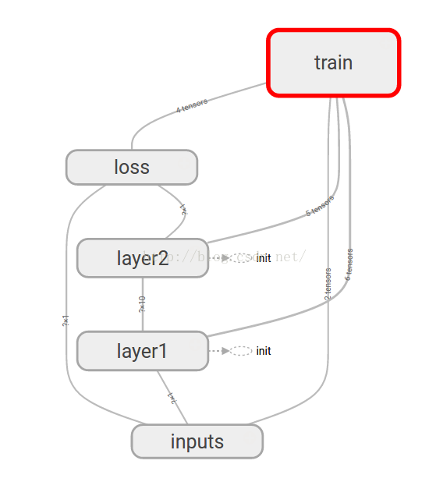
Tensorflow Graph
Tensorflow是一个基于图的计算系统
使用TF的时候:
1. 创建Tensor
2. 添加Operation
3. 执行计算

Slide 4
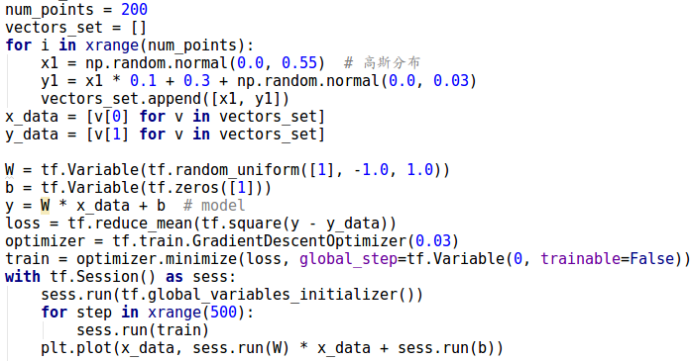
Tensorflow Demo

Slide 5
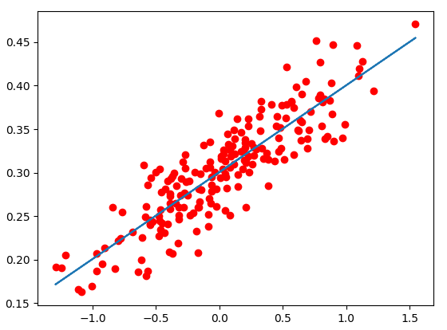
Tensorflow Demo

Slide 6
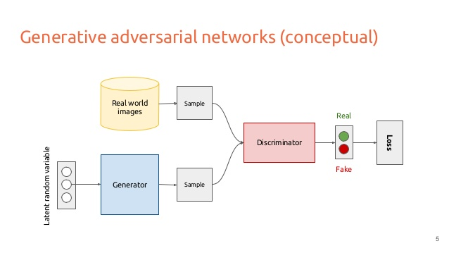
What is GAN?

Slide 7
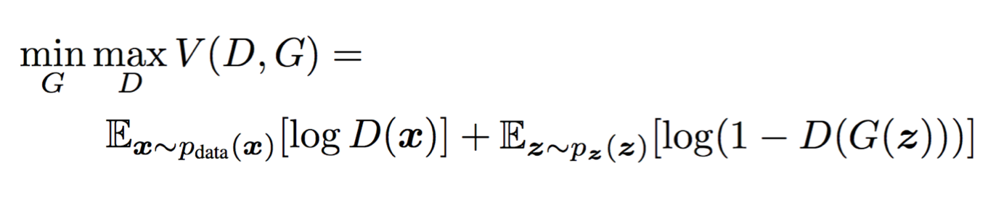
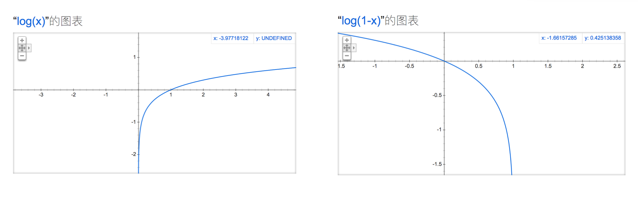
loss functions in GAN

Slide 8
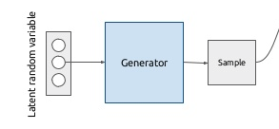
GAN Generator
# G net
with tf.variable_scope('Generator'):
G_in = tf.placeholder(tf.float32, [None, num_ideas])
G_l1 = tf.layers.dense(G_in, 128, tf.nn.relu)
G_out = tf.layers.dense(G_l1, num_points)

Slide 9
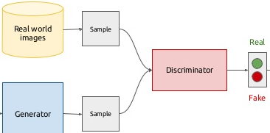
GAN Discriminator
# D net
with tf.variable_scope('Discriminator'):
real_data = tf.placeholder(tf.float32, [None, num_points], name='real_in')
D_in_real = tf.layers.dense(real_data, 128, tf.nn.relu, name='l')
D_prob_real = tf.layers.dense(D_in_real, 1, tf.nn.sigmoid, name='out')
D_in_fake = tf.layers.dense(G_out, 128, tf.nn.relu, name='l', reuse=True)
D_prob_fake = tf.layers.dense(D_in_fake, 1, tf.nn.sigmoid, name='out', reuse=True)

Slide 10
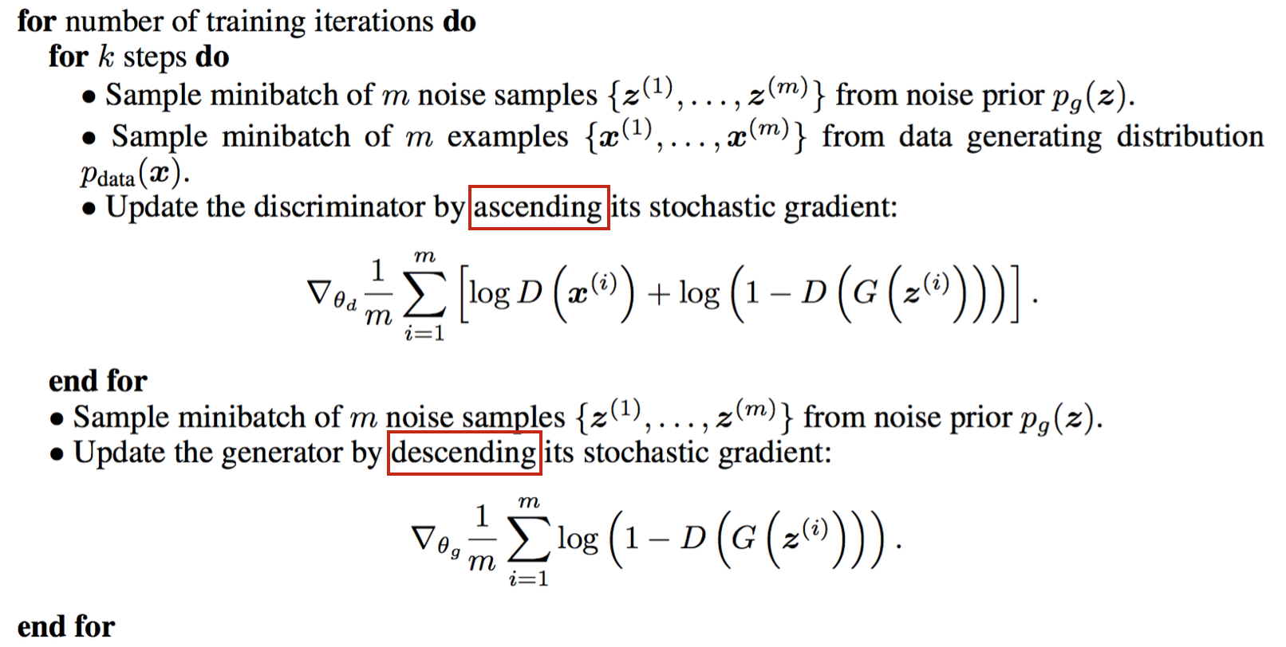
GAN training

Slide 11
GAN loss
D_loss = tf.reduce_mean(-tf.log(D_prob_real) - tf.log(1 - D_prob_fake))
G_loss = tf.reduce_mean(tf.log(1 - D_prob_fake))

Slide 12
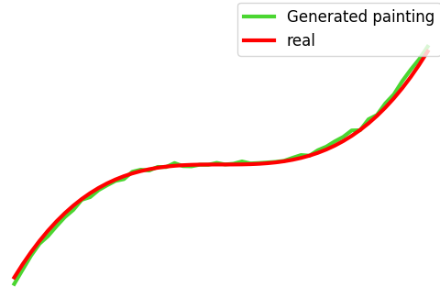
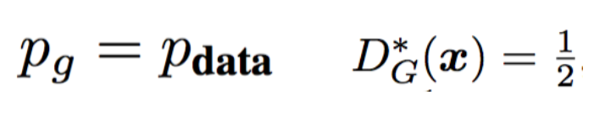
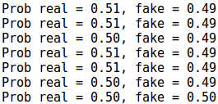
GAN Result

Slide 13
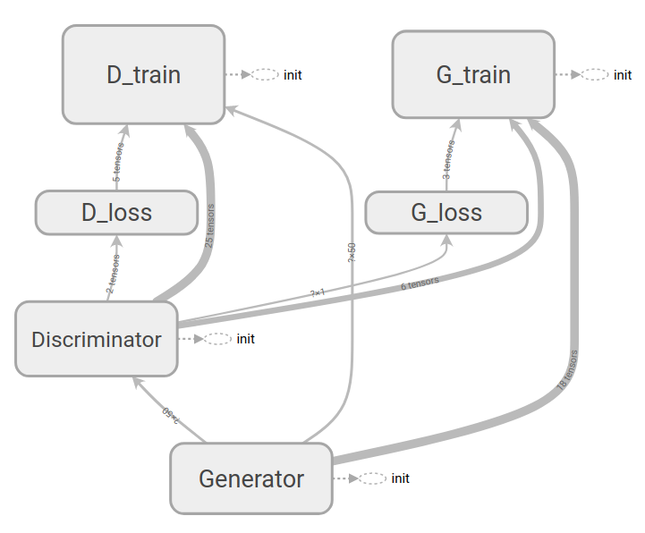
GAN graph
tensorboard --logdir="/dir/"

Slide 14
Reference
深入探索生成对抗网络（一）
生成对抗网络101 终极入门与通俗解析
GAN (Generative Adversarial Nets 生成对抗网络)
Tensorboard 可视化好帮手
tensorflow-generative-model-collections

