Slide 1
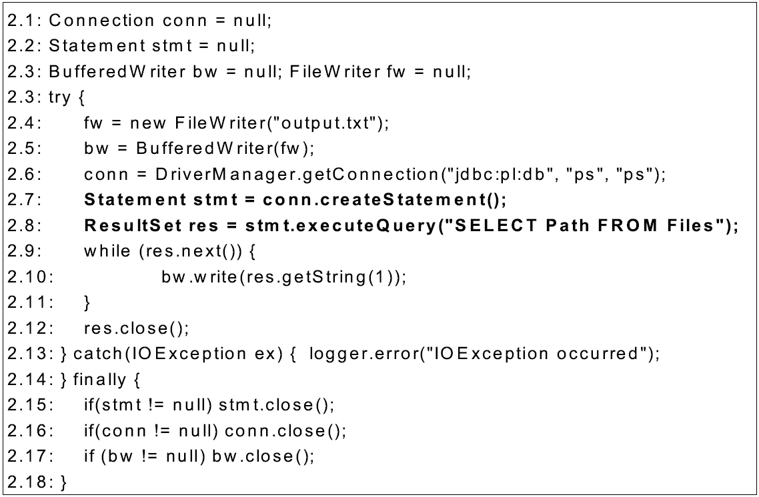
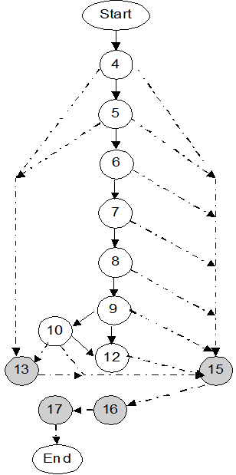
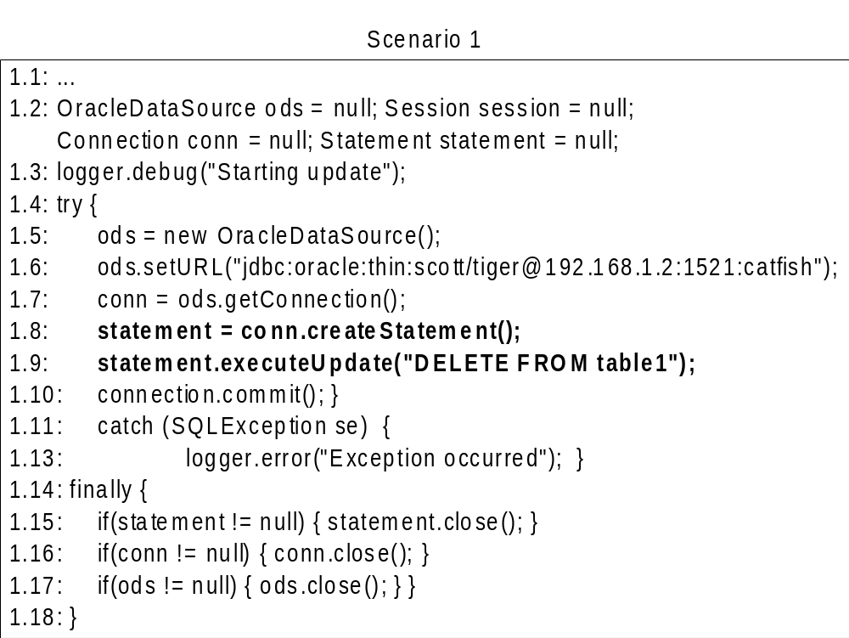
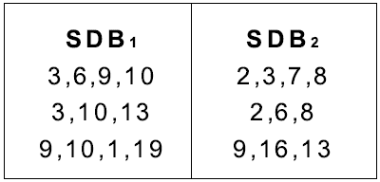
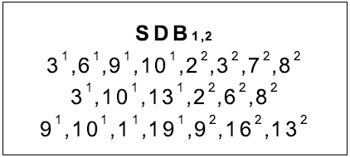
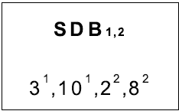
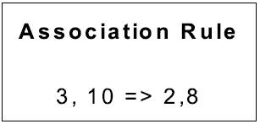
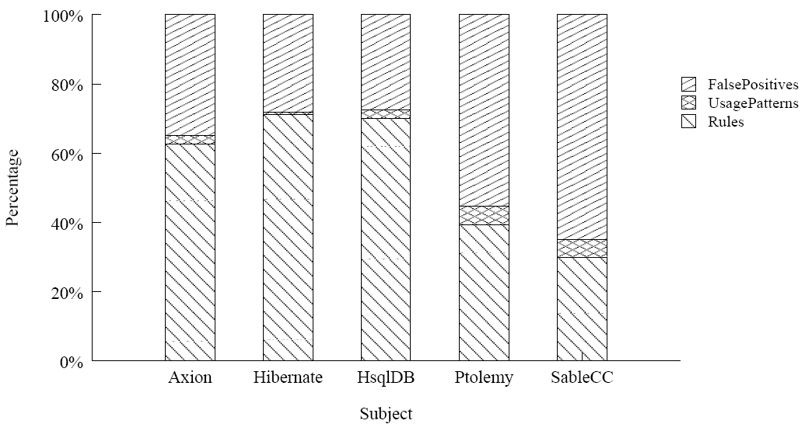
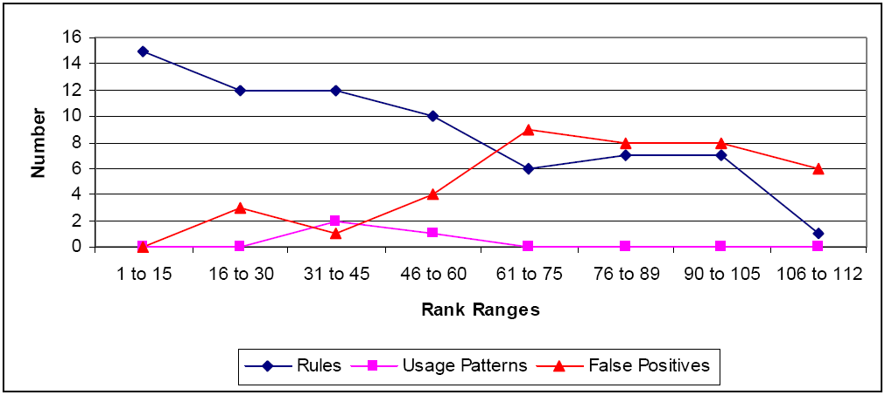
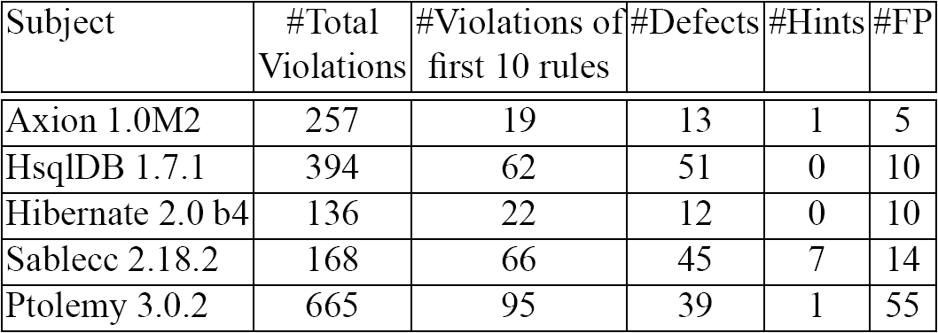

Mining Exception-Handling Rules as Conditional
Association Rules
Suresh Thummalapenta
sthumma@ncsu.edu
Tao Xie
xie@csc.ncsu.edu
Problem
Approach
Programmers often reuse APIs of existing frameworks or libraries to achieve high efficiency
  APIs throw exceptions during runtime errors
    Example: Session API of Hibernate framework throws HibernateException
  APIs expect client applications to implement recovery actions after exceptions occur
Example: Session API expect client application to rollback uncommitted transactions after HibernateException occurs
Failure to handle exceptions results in Fatal issues:
  Example: Database lock won't be released if the transaction is not rolled back
“ 4 -> 5 “ : Normal edge
“ 5 -> 13 “ : Exception edge
A trace for Node 7
  4 -> 5 -> 6 -> 7 -> 15 -> 16 -> 17
Trace includes 3 parts
Normal: 4 -> 5 -> 6
Function Call: 7
Exception: 15 -> 16 -> 17
Filtered trace
6 -> 7 -> 15 -> 16
Challenges
Lack of Specifications: Automatic static or runtime verification tools require the knowledge of specifications that must be obeyed while reusing the API methods. These specifications are often not available due to lack of documentation
Example
Trace Miner
Input: Two sequence databases SDB1 and SDB2 with 1- to-1 mapping
Objective: Get association rules
Annotate sequences to get a single combined database
Apply frequent sequence mining algorithm
[Wang and Han ICDE04]
Transform mined sequences into association rules
Defect : No rollback done when SQLException occurs
Simple Specification:
  Connection Creation => Connection Rollback
Formal specification:
  FCc1 FCc2 FCa => FCe1
  FCc1 -> OracleDataSource.getConnection
  FCc2 -> Connection.createStatement
  FCa -> Statement.executeUpdate
  FCe1 -> Connection.rollback
Evaluation
Real Rules
Distribution of Rules for Axion
Approach
Code Downloader: Leverage a code search engine to gather relevant code examples for all classes of the input application
Code Analyser: Analyse code examples using heuristics as code examples are often partial and construct exception flow graphs
Trace Generator: static traces from flow graphs
Trace Miner: Generate conditional association rules by mining static traces
Anomaly Detector: Detect violations of rules in the input application
Open Source
Repositories
Code Search
Engine
Code
Analyzer
Exception
Flow Graphs
Class 1
Class 2
…
Code
Downloader
Local Source
Code Repository
Trace Generator
Detected Violations
Application
Scanner
Conditional
Association
Rules
Trace Miner
Static
Traces
HsqlDB developers responded on the first 10 reported defects
  Accepted 7 defects
  Accepted 3 defects
Reason given by HsqlDB developers for rejected defects
  “Although it can throw exceptions in general, it should not throw with HsqlDB, So it is fine”
Input
Application
Anomaly
Detector
VIOLATIONS
To appear In Proceedings of 31st International Conference on Software Engineering (ICSE), Vancouver, Canada, May 16 – 24, 2009
This work is supported in part by NSF grant CCF-0725190 and ARO grant W911NF-08-1-0443.

