Slide 1


PARSEWeb: A Programmer Assistant for Reusing Open Source Code on the Web
Suresh Thummalapenta and Tao Xie
Department of Computer Science
North Carolina State University
Raleigh, USA
Automated Software Engineering 2007

Slide 2

Motivation
Programmers commonly reuse APIs of existing frameworks or libraries
  Advantages: Low cost and high efficiency of development
  Challenges: Complexity and lack of documentation
Frame
works

Slide 3

Problem
While reusing APIs of existing open source frameworks or libraries, programmers often
  know what type of object they need
  but do not know how to write code for getting that object
Query: “Source →Destination”
How to use these APIs?

Slide 4
Example Task from Eclipse Programming
Task: How to parse code in a dirty editor?
Query: IEditorPart -> ICompilationUnit
PARSEWeb Solution:
IEditorPart iep = ...
IEditorInput editorInp = iep.getEditorInput();
IWorkingCopyManager wcm = JavaUI.getWorkingCopyManager();
ICompilationUnit icu = wcm.getWorkingCopy(editorInp);
Difficulties:
a. Needs an instance of IWorkingCopyManager
b. Needs to invoke a static method of JavaUI for getting the preceding instance

Slide 5
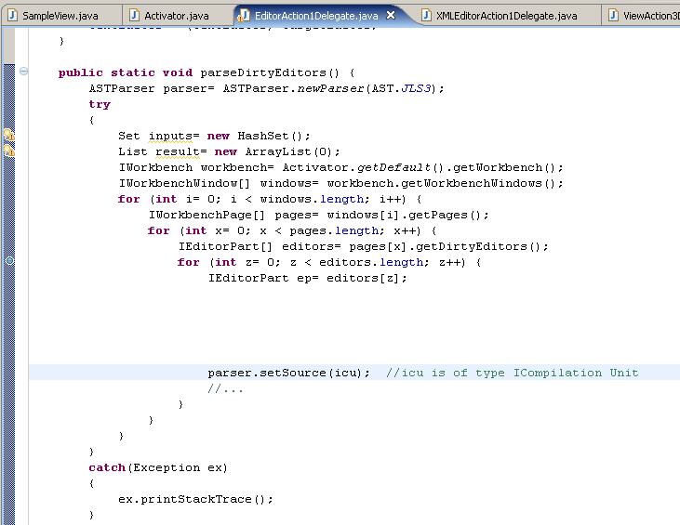
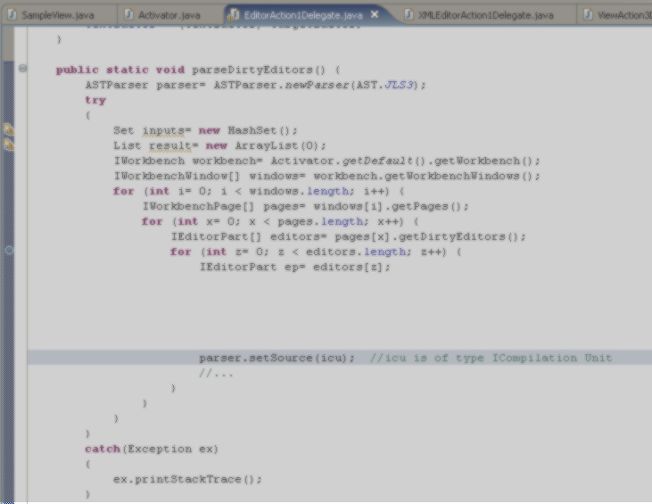

Example Task from Eclipse Programming
Task: How to parse code in a dirty editor of Eclipse?
Open Source Projects on web
MIS 1
MIS 2
...
…
MIS k
1
2
…
N
Mine
…
Extract
FMIS 1
FMIS 2
…
FMIS n
Query:
“IEditorPart
-> ICompilationUnit”
?
Suggest
*MIS: Method-Invocation sequence, FMIS: Frequent MIS

Slide 6

PARSEWeb Overview
Phase 1
Code
Downloader
Code
Search Engine
Query
Open Source Projects
Local Source
Code Repository
Code
Analyzer
Method
Invocation
Sequences
Phase 2
Final Method
Invocation
Sequences
Clustered
Method Invocation
Sequences
Sequence
Post
processor
Query
Splitter
Phase 3

Slide 7
PARSEWeb : Code Downloader
Phase 1
Code
Downloader
Code
Search Engine
Query
Open Source Projects
Local Source
Code Repository
Code
Analyzer
Method
Invocation
Sequences
Phase 2
Final Method
Invocation
Sequences
Clustered
Method Invocation
Sequences
Sequence
Post
processor
Query
Splitter
Phase 3

Slide 8
Code Downloader
Accepts queries of form [Source → Destination]
Interacts with a code search engine such as Google code search to gather related code samples
Stores gathered code samples (source files) in a repository, referred as “Local Source Code Repository”
Gathered code samples are partial and not compilable as code search engines retrieve individual source files instead of entire projects

Slide 9
Advantages of Google code search
A commercial code search engine that provides convenient open APIs for the third party libraries to send queries programmatically
Has been consistently improved and maintained
Has public forums that provides good support

Slide 10
Challenges with Google code search
Challenge: returns HTML files with source code embedded inside the file
Our solution: developed a light-weight transformer in Perl to convert HTML files to source code files such as Java, C, etc.,

Slide 11
Other available Code Search Engines
Krugle: http://www.krugle.com/
Koders: http://www.koders.com/
Codase: http://www.codase.com/
JExamples: http://www.jexamples.com/
  etc.,

Slide 12
PARSEWeb: Code Analyzer
Phase 1
Code
Downloader
Code
Search Engine
Query
Open Source Repositories
Local Source
Code Repository
Code
Analyzer
Method
Invocation
Sequences
Phase 2
Final Method
Invocation
Sequences
Clustered
Method Invocation
Sequences
Sequence
Post
processor
Query
Splitter
Phase 3

Slide 13
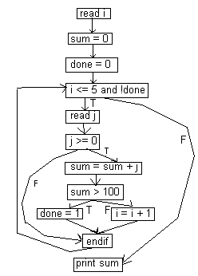
Code Analyzer
Analyze statically the partial code samples stored in the Local Source Code Repository
Resolve types in code samples through type heuristics
Collect [Source → Destination] method sequences

Slide 14
Analysis of Code Samples
Not all code samples contain main method or driver code that can serve as an entry point
  consider all public methods as entry points
Deal with local method calls by inlining methods, originally proposed in MAPO [ Xie and Pei MSR06]
Deal with conditionals/loops by traversing control flow graphs

Slide 15
Type Heuristics
Inferring fully qualified class names
  import javax.jms.QueueSession;
  import java.util.*;
  Public class test {
  public QueueSession qsObj;
  public Integer intObj;
  public Iterator iter;
  …
  Fully qualified name of QueueSession is “javax.jms.QueueSession”, inferred through lookup of import statement
  Fully qualified name of Integer is “java.lang.Integer”, inferred through loading of a class by appending “java.lang” to the class name
  Cannot infer the fully qualified name of “Iterator”

Slide 16
Type Heuristics
Infer the receiver type in expression “X.Y”
  Lookup the declaration of X in local variables or member variables. If not, “X” is a class name and Y is a static member
Infer the receiver type in expression “M1().Y”
  Check the return type of M1() method declaration, if not available locally, the receiver type cannot be inferred

Slide 17
Type Heuristics
Infer the return type of a method invocation in an assignment statement such as “Queue qObj = createQueueSession()”
  Lookup the type of the variable on the left hand side. The return type is the same as or a sub class of Queue
Infer the return type of a method invocation in a return statement such as
public QueueSession test()‏
{ ...
return connect.createQueueSession(false,int);
}
- Lookup the return type of the enclosing method declaration

Slide 18
Type Heuristics
Inferring types with multiple method invocations
    Queue qObj = connect.m1();
    Stack sObj = connect.m1().m2();
  The receiver type of m2() can be inferred from the lookup of the return type of m1()‏

Slide 19
Type Heuristics
Infer types with multiple method invocations
  Queue qObj = connect.m1().m2();
  Not possible to infer the receiver type of m2() and the return type of m1() However, receiver type and return type of m1().m2() can be inferred

Slide 20
PARSEWeb: Sequence Postprocessor
Phase 1
Code
Downloader
Code
Search Engine
Query
Open Source Repositories
Local Source
Code Repository
Code
Analyzer
Method
Invocation
Sequences
Phase 2
Final Method
Invocation
Sequences
Clustered
Method Invocation
Sequences
Sequence
Post
processor
Query
Splitter
Phase 3

Slide 21

Sequence Postprocessor
Candidate sequences produced by the code analyzer may be too many
Solutions:
Cluster similar sequences
  Clustering heuristics are developed
Rank sequences
  Ranking heuristics are developed

Slide 22
Clustering Heuristics
Method-invocation sequences with the same set of statements can be considered similar, although the statements are in different order.
e.g., ''2 3 4 5'' and ''2 4 3 5 ''
Method-invocation sequences with minor differences measured by an attribute cluster precision value can be considered similar.
e.g., ''8 9 6 7'' and ''8 6 10 7 '' can be considered similar under cluster precision value one

Slide 23
Ranking Heuristics
Heuristic 1: Higher frequency -> Higher rank
Heuristic 2: Shorter length -> Higher rank

Slide 24
PARSEWeb: Query Splitter
Phase 1
Code
Downloader
Code
Search Engine
Query
Open Source Repositories
Local Source
Code Repository
Code
Analyzer
Method
Invocation
Sequences
Phase 2
Final Method
Invocation
Sequences
Clustered
Method Invocation
Sequences
Sequence
Post
Processor
Query
Splitter
Phase 3

Slide 25

Query Splitter
Lack of code samples that give candidate method-invocation sequences in the results of code search engines
  Required method-invocation sequences are split among different source files
Solution:
  Split the user query into multiple queries
  Compose the results for each split query

Slide 26
Query Splitting Example
1. User query: “org.eclipse.jface.viewers.IStructuredSelection->java.io.ObjectInputStream”
Results: None
2. Query: “java.io.ObjectInputStream”
Results: 3.
Most used immediate sources are: java.io.InputStream, java.io.ByteArrayInputStream, java.io.FileInputStream
3. Three Queries to be fired:
“org.eclipse.jface.viewers.IStructuredSelection-> java.io.InputStream” Results: 1
“org.eclipse.jface.viewers.IStructuredSelection-> java.io.ByteArrayInputStream” Results: 5
“org.eclipse.jface.viewers.IStructuredSelection-> java.io.FileInputStream” Results: None

Slide 27
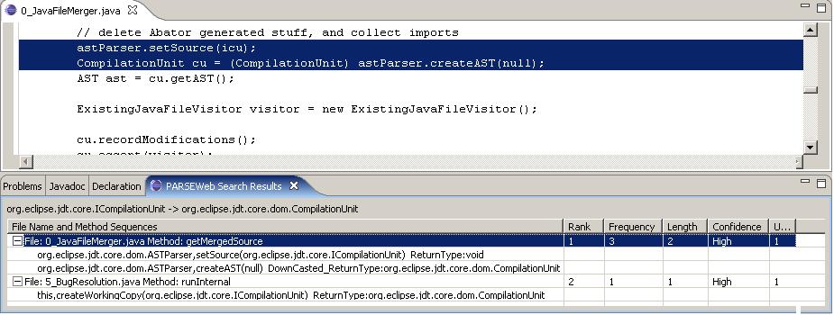
Eclipse Plugin

Slide 28
Evaluations
Real Programming Problems: To address problems posted in developer forums
Real Projects: To show that solutions recommended by PARSEWeb are
  available in real projects
  better than solutions recommended by related tools PROSPECTOR, Strathcona, and Google Code Search averagely

Slide 29
Real Programming Problems
Jakarta BCEL user forum, 2001
Problem: “How to disassemble java byte code”
Query: “Code → Instruction”
Solution Sequence:
FileName:2_RepMIStubGenerator.java MethodName: isWriteMethod Rank:1 NumberOfOccurrences:1
Code,getCode() ReturnType:#UNKNOWN#
CONSTRUCTOR,InstructionList(#UNKNOWN#) ReturnType:InstructionList
InstructionList,getInstructions() ReturnType:Instruction
Solution Sample Code:
Code code;
InstructionList il = new InstructionList(code.getCode());
Instruction[] ins = il.getInstructions();

Slide 30
Real Programming Problems
Dev 2 Dev Newsgroups, 2006
Problem: “how to connect db by sessionBean”
Query: javax.naming.InitialContext → java.sql.Connection
Solution Sequence:
FileName:3 AddressBean.java MethodName:getNextUniqueKey Rank:1
NumberOfOccurrences:34
javax.naming.InitialContext,lookup(java.lang.String)‏
ReturnType:javax.sql.DataSource
javax.sql.DataSource,getConnection()‏
ReturnType:java.sql.Connection

Slide 31
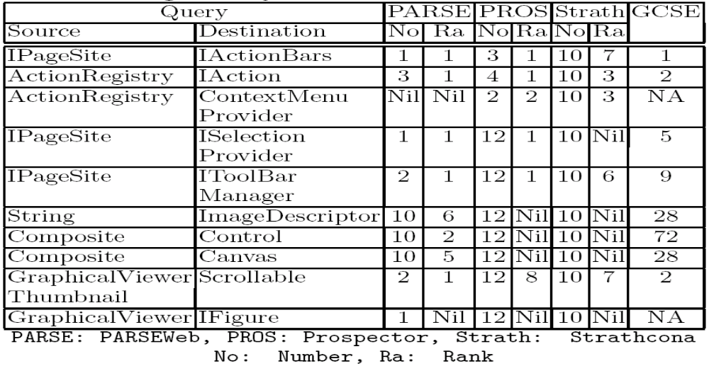
Real Project: Logic
Source File: LogicEditor.java
SUMMARY-> PARSEWeb: 8/10, Prospector: 6/10, Strathcona: 5/10
Notes:
Here explain the criteria where a new object is instantiated and the selected query is the maximal possible query.

Slide 32
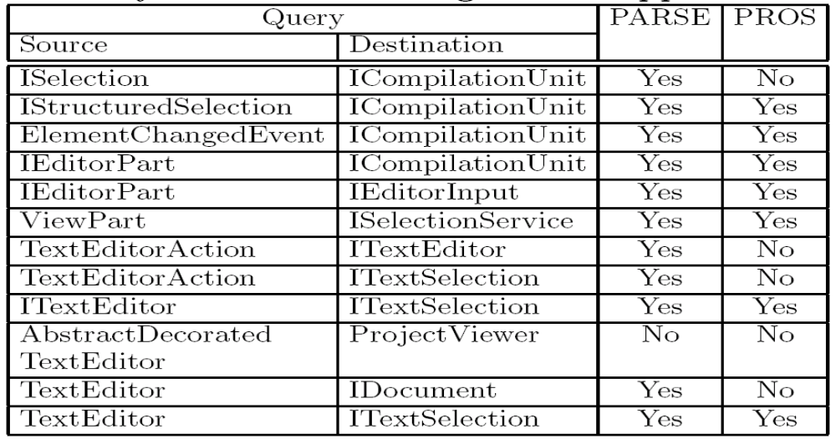
Comparison with Prospector
12 specific programming tasks taken from XSnippet approach.
SUMMARY-> PARSEWeb: 11/12, Prospector: 7/12

Slide 33
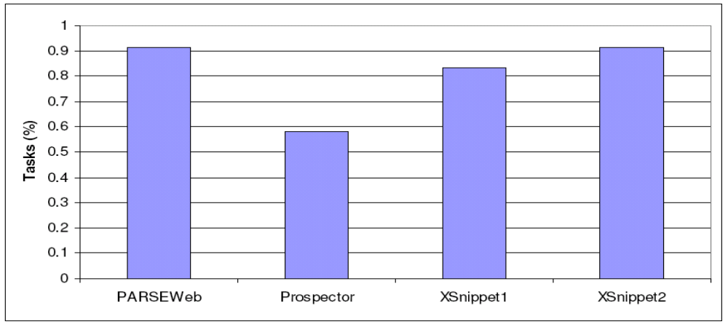
Comparison with Other Tools
Percentage of tasks successfully completed by PARSEWeb,
Prospector, and XSnippet

Slide 34
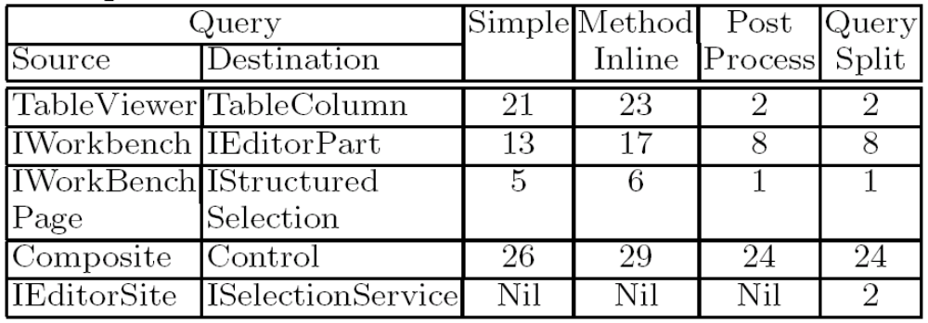
Significance of Internal Techniques
*Legend:
Method inline: Method inlining
Post Process: Sequence Post Processor
Query Split: Query Splitter

Slide 35
Related Work
Jungloid mining: Helping to navigate the API jungle [Mandelin et al. PLDI 05]
Using structural context to recommend source code examples [Holmes and Murphy ICSE 05]
XSnippet: Mining for sample code [Sahavechaphan and Claypool OOPSLA 06]
MAPO: Mining API usages from open source repositories [Xie and Pei MSR 06]

Slide 36
Future Work
Interacts with a single code search engine, i.e., Google code search
  Plan to interact with other code search engines
Requires both Source and Destination objects
  Plan to infer Source from the code context
Type heuristics cannot infer types in a few scenarios
  Eg:
  QueueSession session = factory.createQueueConnection().
  createQueueSession(false, Session.AUTO);
  → Cannot infer the return type of createQueueConnection and the receiver type of createQueueSession

Slide 37
Conclusion
An approach that detects hotspots in a given framework. These hotspots serve as starting points for the programmers unfamiliar with the framework

Slide 38
Questions?
T. Xie Mining Program Source Code

