Slide 1


PARSEWeb: A Programmer Assistant for Reusing Open Source Code on the Web
Suresh Thummalapenta and Tao Xie
Department of Computer Science
North Carolina State University
Raleigh, USA
Automated Software Engineering 2007

Slide 2

Motivation
Programmers commonly reuse APIs of existing frameworks or libraries
  Advantages: Low cost and high efficiency of development
  Challenges: Complexity and lack of documentation
Frame
works

Slide 3

Problem
While reusing APIs of existing open source frameworks or libraries, programmers often
  know what type of object they need
  but do not know how to write code for getting that object
Query: “Source →Destination”
How to use these APIs?

Slide 4
Example Task from Eclipse Programming
Task: How to parse code in a dirty editor?
Query: IEditorPart -> ICompilationUnit
PARSEWeb Solution:
IEditorPart iep = ...
IEditorInput editorInp = iep.getEditorInput();
IWorkingCopyManager wcm = JavaUI.getWorkingCopyManager();
ICompilationUnit icu = wcm.getWorkingCopy(editorInp);
Difficulties:
a. Needs an instance of IWorkingCopyManager
b. Needs to invoke a static method of JavaUI for getting the preceding instance

Slide 5
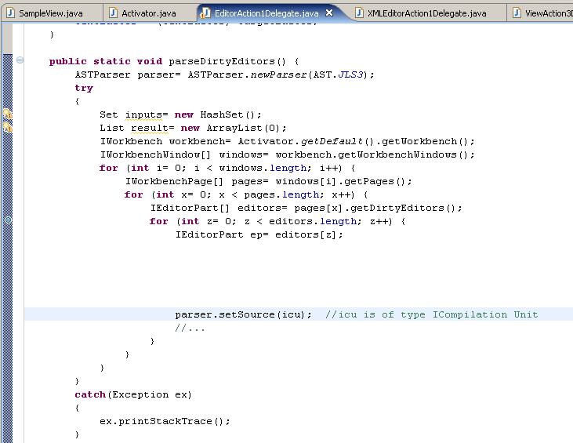
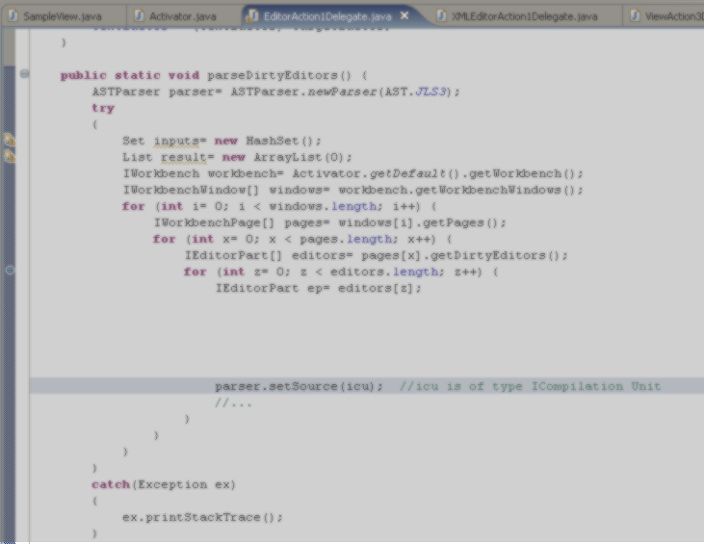

Example Task from Eclipse Programming
Task: How to parse code in a dirty editor of Eclipse?
Open Source Projects on web
MIS 1
MIS 2
...
…
MIS k
1
2
…
N
Mine
…
Extract
FMIS 1
FMIS 2
…
FMIS n
Query:
“IEditorPart
-> ICompilationUnit”
?
Suggest
*MIS: Method-Invocation sequence, FMIS: Frequent MIS

Slide 6

PARSEWeb Overview
Phase 1
Code
Downloader
Code
Search Engine
Query
Open Source Projects
Local Source
Code Repository
Code
Analyzer
Method
Invocation
Sequences
Phase 2
Final Method
Invocation
Sequences
Clustered
Method Invocation
Sequences
Sequence
Post
processor
Query
Splitter
Phase 3

Slide 7
PARSEWeb : Code Downloader
Phase 1
Code
Downloader
Code
Search Engine
Query
Open Source Projects
Local Source
Code Repository
Code
Analyzer
Method
Invocation
Sequences
Phase 2
Final Method
Invocation
Sequences
Clustered
Method Invocation
Sequences
Sequence
Post
processor
Query
Splitter
Phase 3

Slide 8

Code Downloader
Accepts queries of form [Source → Destination]
Interacts with a code search engine to gather related code samples
Stores gathered code samples (source files) in a repository, referred as “Local Source Code Repository”

Slide 9
PARSEWeb: Code Analyzer
Phase 1
Code
Downloader
Code
Search Engine
Query
Open Source Repositories
Local Source
Code Repository
Code
Analyzer
Method
Invocation
Sequences
Phase 2
Final Method
Invocation
Sequences
Clustered
Method Invocation
Sequences
Sequence
Post
processor
Query
Splitter
Phase 3

Slide 10
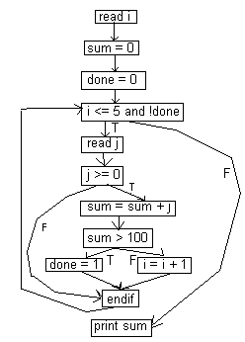
Code Analyzer
Collect [Source → Destination] method sequences by analyzing code samples statically
  Deal with local method calls by inlining methods
  Deal with conditionals/loops by traversing control flow graphs
Resolve types in code samples
  Challenges: Gathered code samples are not compilable
  Solutions: heuristics are developed

Slide 11
Type Heuristics
How do I get the return type of createQueueSession method?
Example 1:
QueueConnection connect;
QueueSession session = connect.createQueueSession(false,int)
Example 2:
public QueueSession test()
{ ...
return connect.createQueueSession(false,int);
}

Slide 12
PARSEWeb: Sequence Postprocessor
Phase 1
Code
Downloader
Code
Search Engine
Query
Open Source Repositories
Local Source
Code Repository
Code
Analyzer
Method
Invocation
Sequences
Phase 2
Final Method
Invocation
Sequences
Clustered
Method Invocation
Sequences
Sequence
Post
processor
Query
Splitter
Phase 3

Slide 13

Sequence Postprocessor
Candidate sequences produced by the code analyzer may be too many
Solutions:
Cluster similar sequences
  Clustering heuristics are developed
Rank sequences
  Ranking heuristics are developed

Slide 14
Clustering Heuristics
Method-invocation sequences with the same set of statements can be considered similar, although the statements are in different order.
e.g., ''2 3 4 5'' and ''2 4 3 5 ''
Method-invocation sequences with minor differences measured by an attribute cluster precision value can be considered similar.
e.g., ''8 9 6 7'' and ''8 6 10 7 '' can be considered similar under cluster precision value one

Slide 15
Ranking Heuristics
Heuristic 1: Higher frequency -> Higher rank
Heuristic 2: Shorter length -> Higher rank

Slide 16
PARSEWeb: Query Splitter
Phase 1
Code
Downloader
Code
Search Engine
Query
Open Source Repositories
Local Source
Code Repository
Code
Analyzer
Method
Invocation
Sequences
Phase 2
Final Method
Invocation
Sequences
Clustered
Method Invocation
Sequences
Sequence
Post
Processor
Query
Splitter
Phase 3

Slide 17

Query Splitter
Lack of code samples that give candidate method-invocation sequences in the results of code search engines
  Required method-invocation sequences are split among different source files
Solution:
  Split the user query into multiple queries
  Compose the results for each split query

Slide 18
Query Splitting Example
1. User query: “org.eclipse.jface.viewers.IStructuredSelection->java.io.ObjectInputStream”
Results: None
2. Query: “java.io.ObjectInputStream”
Results: 3.
Most used immediate sources are: java.io.InputStream, java.io.ByteArrayInputStream, java.io.FileInputStream
3. Three Queries to be fired:
“org.eclipse.jface.viewers.IStructuredSelection-> java.io.InputStream” Results: 1
“org.eclipse.jface.viewers.IStructuredSelection-> java.io.ByteArrayInputStream” Results: 5
“org.eclipse.jface.viewers.IStructuredSelection-> java.io.FileInputStream” Results: None

Slide 19
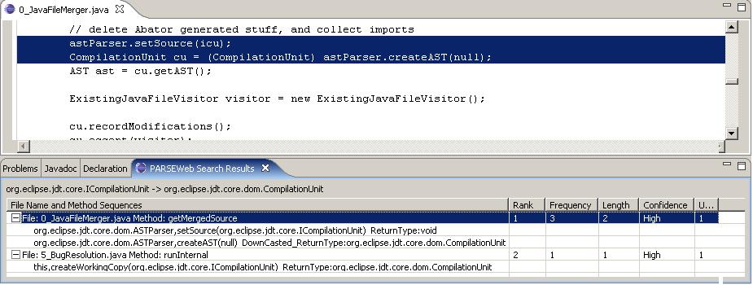
Eclipse Plugin

Slide 20
Evaluations
Real Programming Problems: To address problems posted in developer forums
Real Projects: To show that solutions recommended by PARSEWeb are
  available in real projects
  better than solutions recommended by related tools PROSPECTOR, Strathcona, and Google Code Search averagely

Slide 21
Real Programming Problems
Jakarta BCEL user forum, 2001
Problem: “How to disassemble java byte code”
Query: “Code → Instruction”
Solution Sequence:
FileName:2_RepMIStubGenerator.java MethodName: isWriteMethod Rank:1 NumberOfOccurrences:1
Code,getCode() ReturnType:#UNKNOWN#
CONSTRUCTOR,InstructionList(#UNKNOWN#) ReturnType:InstructionList
InstructionList,getInstructions() ReturnType:Instruction
Solution Sample Code:
Code code;
InstructionList il = new InstructionList(code.getCode());
Instruction[] ins = il.getInstructions();

Slide 22
Real Programming Problems
Dev 2 Dev Newsgroups, 2006
Problem: “how to connect db by sessionBean”
Query: javax.naming.InitialContext → java.sql.Connection
Solution Sequence:
FileName:3 AddressBean.java MethodName:getNextUniqueKey Rank:1
NumberOfOccurrences:34
javax.naming.InitialContext,lookup(java.lang.String)
ReturnType:javax.sql.DataSource
javax.sql.DataSource,getConnection()
ReturnType:java.sql.Connection

Slide 23
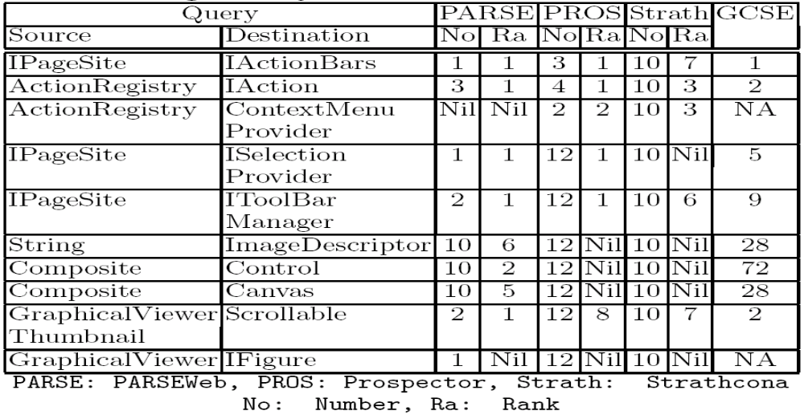
Real Project: Logic
Source File: LogicEditor.java
SUMMARY-> PARSEWeb: 8/10, Prospector: 6/10, Strathcona: 5/10
Notes:
Here explain the criteria where a new object is instantiated and the selected query is the maximal possible query.

Slide 24
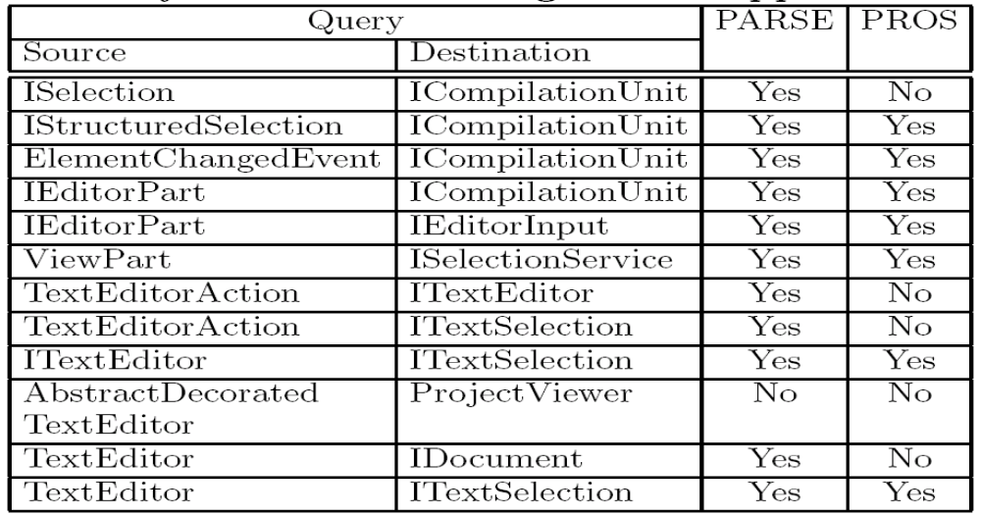
Comparison with Prospector
12 specific programming tasks taken from XSnippet approach.
SUMMARY-> PARSEWeb: 11/12, Prospector: 7/12

Slide 25
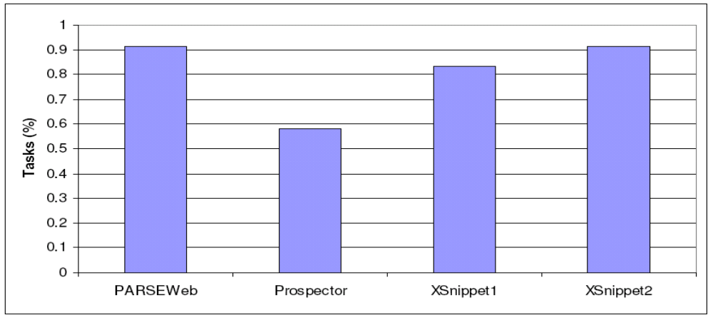
Comparison with Other Tools
Percentage of tasks successfully completed by PARSEWeb,
Prospector, and XSnippet

Slide 26
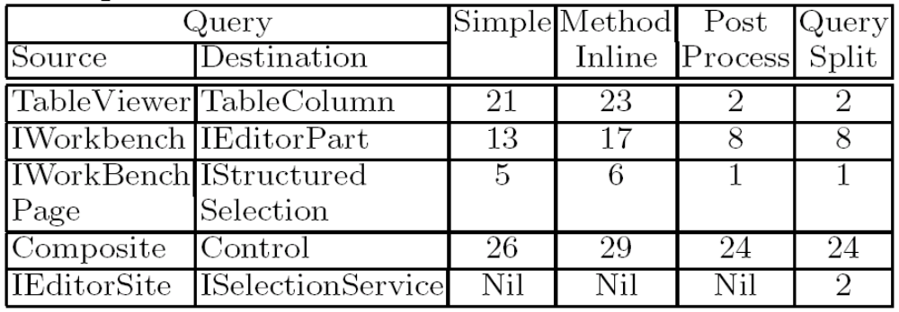
Significance of Internal Techniques
*Legend:
Method inline: Method inlining
Post Process: Sequence Post Processor
Query Split: Query Splitter

Slide 27
Related Work
Jungloid mining: Helping to navigate the API jungle [Mandelin et al. PLDI 05]
Using structural context to recommend source code examples [Holmes and Murphy ICSE 05]
XSnippet: Mining for sample code [Sahavechaphan and Claypool OOPSLA 06]
MAPO: Mining API usages from open source repositories [Xie and Pei MSR 06]

Slide 28
Future Work
Interacts with a single code search engine, i.e., Google code search
  Plan to interact with other code search engines
Requires both Source and Destination objects
  Plan to infer Source from the code context
Type heuristics cannot infer types in a few scenarios
  Eg:
  QueueSession session = factory.createQueueConnection().
  createQueueSession(false, Session.AUTO);
  → Cannot infer the return type of createQueueConnection and the receiver type of createQueueSession

Slide 29
Conclusion
An approach that tries to address problems faced by programmers in reusing APIs of existing frameworks or libraries by accepting queries of the form
“Source → Destination “
and by suggesting frequent method-invocation sequences as solutions
Addressed two problems posted in developer forums and compared with existing related tools Prospector and Strathcona

Slide 30
Questions?
T. Xie Mining Program Source Code

