Slide 1
  SpotWeb: Detecting Framework Hotspots and Coldspots via Mining Open Source Code on the Web
Suresh Thummalapenta and Tao Xie
North Carolina State University
Raleigh, USA
Automated Software Engineering 2008

Slide 2

Motivation
Programmers commonly reuse APIs of existing frameworks or libraries
  Advantages: Low cost and high efficiency of development
  Challenges: Complexity and lack of documentation
  Consequences:
    Programmers unfamiliar to the framework or library spend more efforts in reusing APIs
Frame
works

Slide 3

Motivation
Is every class or method has the same importance?
→ No
A few classes and methods are often used compared to other classes and methods (Hotspots)
  → org.apache.log4j.Logger
A few classes and methods are rarely used (Coldspots)
  →org.apache.log4j.helpers.PatternParser.LiteralPatternConverter
Our objective is to detect hotspots and coldspots in a given framework to assist users unfamiliar to the framework
Log4j has 207 public classes and 1543 methods

Slide 4
Example Hotspots of JUnit Framework
public class SRDAOTestCase extends TestCase {
private SRDAO dao = null;...
public SRDAOTestCase() {
super(); ... }
protected void setUp() throws Exception {
dao = (SRDAO)context.getBean("SRDAO");
... }
public void tearDown() throws Exception {
dao = null; }
public void testF() { ... }
public void testB() { ... }
}
JUnit is a de facto standard unit testing framework for Java
Our approach detected 14 classes as hotspot classes in the JUnit framework
junit.framework.
TestSuite
junit.framework.
TestCase
<init>(Class)
addTest(Test)
<init>()
<init>(String)
addTestSuite(Class)
setName(String)
getName()
TEMPLATE_HOOK
getName()
setName(String)
setUp()
tearDown()
public class MyTestSuite {
...
public static Test suite() {
TestSuite suite = new TestSuite("axis");
suite.addTest(new SRDAOTestCase());
return suite;
}
...
}
TestCase class inherits from the Test class
white: template, gray: hook
Notes:
Having dependencies help users to figure out the order of how to use those classes or methods.

Slide 5
Outline
Advantages of hotspots and coldspots
Overview of the approach
Detection of hotspots
Detection of coldspots
Evaluation
Conclusion and Future work

Slide 6
Hotspots and Coldspots
Advantages of hotspots
  New users can inspect hotspots to understand commonly reused classes and methods
  Users may have more confidence or tendencies in reusing hotspots as bugs in these hotspots may be fewer
  Developers or maintainers can choose to invest their improvement efforts on these hotspots
Advantages of coldspots
  Coldspots can serve as caveats as there can be difficulties in identifying related code examples

Slide 7
Overview of SpotWeb
Requires domain knowledge of how the framework is reused by applications
Various open source projects on the web can help acquire such domain knowledge for existing frameworks
Open Source Projects on web
Classes
Interfaces
Input
Framework
Relevant Code
Examples
Hotspots
Coldspots
Usage Metrics

Slide 8
Relevant Code Examples
Interact with a code search engine to collect relevant code examples
Construct a query for each class of the input framework
  Example: Constructed query for the TestSuite class of the JUnit framework is “lang:java junit.framework.TestSuite”
Our approach uses Google code search as underlying code search engine
  Example: Google code search returns 76,400 code examples for the preceding query

Slide 9
Usage Metrics
Usage Metrics characterize how entities such as classes or methods are used
  Classes:
    Instantiations and extensions
  Interfaces:
    Implementations
  Exception classes:
    Instantiations and usages in catch blocks
  Methods (static and non-static):
    Invocations, overrides, or implementations
  Constants:
    References
Notes:
Each entity of the framework has a different type of usages. For example, an interface is implemented. These entities are like fine-grained level..

Slide 10
Example: JUnit Framework
class TestSuite {
TestSuite (String a1) { … }
addTest (Test arg1) { … }
getName() { … }
final static constC1;
}
class TestResult {
TestResult () { … }
addError (Test, Throwable) { … }
startTest (Test) { … }
final static constC2;
}
Interface Test {
abstract countTestCases ();
abstract run(TestResult result);
}
class ExceptClass
extends Exception
{
}

Slide 11
Example: JUnit Framework
class TestSuite {
/*IN = 10,EX=2*/
TestSuite (String a1) { … }
addTest (Test arg1) { … }
getName() { … }
final static constC1;
}
class TestResult {
TestResult () { … }
addError (Test, Throwable) { … }
startTest (Test) { … }
/*IN = 1,OV = 2,IM = 0*/
final static constC2;
}
Class TestSuite instantiated (IN) for 10 times and extended (EX) for 2 times
Interface Test {
abstract countTestCases ();
/* IM = 20 */
abstract run(TestResult result);
}
Method startTest is invoked (IN) for once and overridden (OV) for 2 times
class ExceptClass
extends Exception
{
}
Method countTestCases is implemented (IM) for 20 times

Slide 12
Detection of Hotspots
Compute a common metric, say usage metric (UM), for each entity from specific metrics of those entities
Entity | UM
TestSuite () | 10
addTest () | 8
getName () | 8
constC1 | 6
TestResult () | 6
addError () | 3
startTest () | 3
constC2 | 1
countTestCases () | 12
run () | 12
ExceptClass() | 9
Entity | UM | Rank
countTestCases () | 12 | 1
run() | 12 | 1
TestSuite() | 10 | 3
ExceptClass() | 9 | 4
addTest() | 8 | 5
getName() | 8 | 5
constC1 | 6 | 7
TestResult() | 6 | 8
addError() | 3 | 9
startTest() | 3 | 10
constC2 | 1 | 11
sort
Select entities in top Hotspot Threshold (HT) percentage as hotspot entities

Slide 13
Detection of Hotspots
Rank 1
Interface Test { /*IM=12*/
abstract countTestCases ();
abstract run(TestResult result);
}
Hotspot entities are grouped into their declaring classes or interfaces
Each hotspot class or interface is classified as a hook or a template
Hooks represent flexible parts of the framework where users can define a new behavior
  Example: Interface Test
Templates represent immutable parts of the framework
Example: Class TestSuite
Rank 3
class TestSuite { /*IN = 10,EX=2*/
TestSuite (String a1) { … }
addTest (Test arg1) { … }
getName() { … }
}
Rank 4
class ExceptClass
extends Exception
{
}
*Legend: IN: Instances, EX: Extensions, IM: Implementations
Notes:
Classification of hook or template gives an immediate hint to the user of how to reuse that class.

Slide 14
Detection of Hotspots
Rank 1
Interface Test { /*IM=12*/
abstract countTestCases ();
abstract run(TestResult result);
}
Classify each hotspot class, say C_{i,} into a hook or template based on number of instantiations and extensions
  Example: TestSuite is a template
An interface is always classified as a hook
  Example: Test is a hook
An exception class is always classified as a template
Rank 3
class TestSuite { /*IN = 10,EX=2*/
TestSuite (String a1) { … }
addTest (Test arg1) { … }
getName() { … }
}
Rank 4
class ExceptClass
extends Exception
{
}
*Legend: IN: Instances, EX: Extensions, IM: Implementations

Slide 15
Detection of Hotspots
Rank 1, Type: Hook
Interface Test { /*IM=12*/
abstract countTestCases ();
abstract run(TestResult result);
}
Identify dependencies among hotspots
  Dependencies are captured based on method arguments
Two types of dependencies are captured: TEMPLATE_TEMPLATE and TEMPLATE_HOOK
  TestSuite has a TEMPLATE_HOOK dependency on Test as addTest of TestSuite has an argument of type Test
  ( TestSuite → Test)
Rank 3, Type: Template
class TestSuite { /*IN = 10,EX=2*/
TestSuite (String a1) { … }
addTest (Test arg1) { … }
getName() { … }
}
Rank 4, Type: Template
class ExceptClass
extends Exception
{
}
*Legend: IN: Instances, EX: Extensions, IM: Implementations
Notes:
Having dependencies help users to figure out the order of how to use those classes or methods.

Slide 16
Detection of Coldspots
Classes and methods that are rarely used are identified as coldspots
Algorithm for detecting coldspots:
  Input: A method M_{i} of a class C_{j}
  Output: Is the method a coldspot or not?
  1: Return false if the method is reused at least once;
  2: if C_{j} is an interface
  Return true if all implemented methods of M_{i} are coldspots;
  Otherwise return false;
  3: if M_{i} is abstract
  Return true if all overridden methods of M_{i} are coldspots;
  Otherwise return false;
  4: Return true if all callers of M_{i} are coldspots
  Otherwise return false;
Example coldspot in JUnit: junit.runner.Sorter.Swapper
Notes:
Give the example of abstract method to explain why we need this recursive algorithm

Slide 17
Evaluation
RQ1: What is the percentage of hotspot and coldspot classes in each subject framework?
  Help characterize the reuse efforts of the framework
RQ2: Is the subset of classes and methods detected as hotspots indeed useful?
  Help show that our approach can reduce the efforts of users
RQ3: What is the effectiveness of our hotspot detection in terms of precision and recall?
  Compare with the available documentation
  Compare with a previous related approach
Notes:
Give the example of abstract method to explain why we need this recursive algorithm

Slide 18
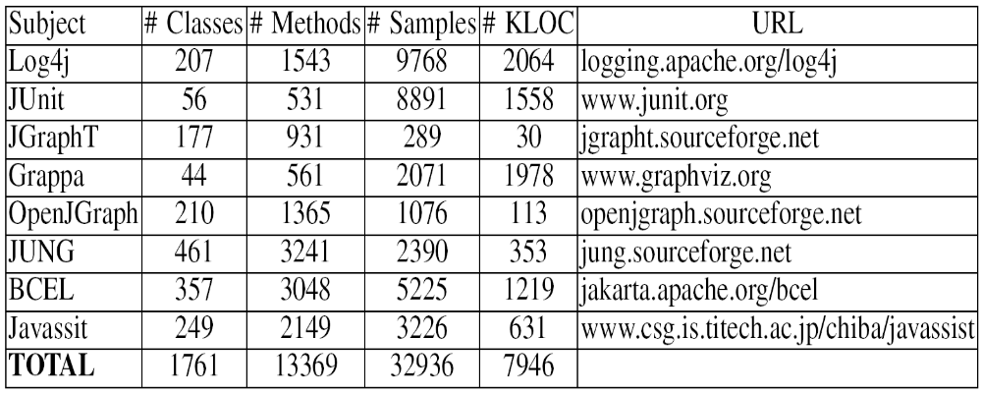
Subjects
Used eight popular frameworks for detecting hotspots and coldspots
Analyzed 7 million lines of code gathered from open source projects on the web
Notes:
Give the example of abstract method to explain why we need this recursive algorithm

Slide 19
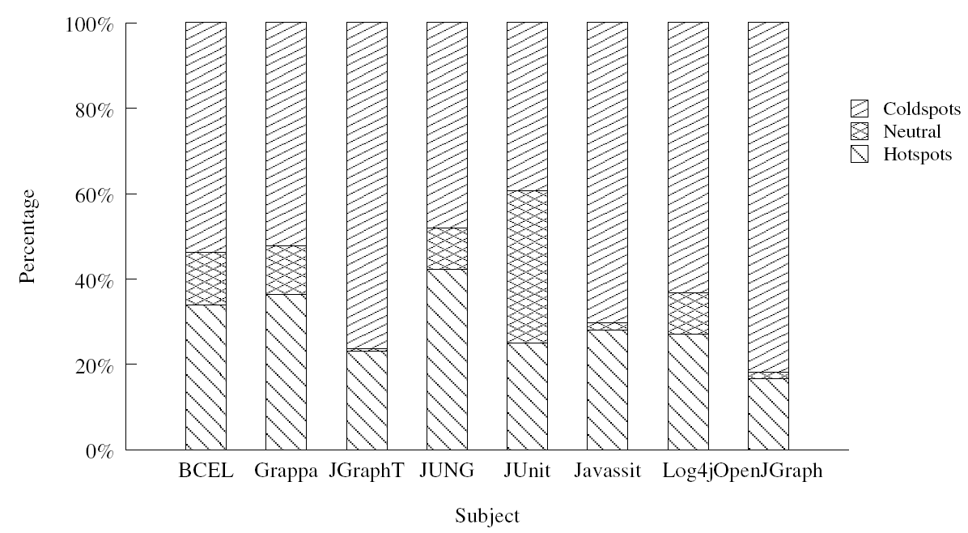
RQ1: Statistics of Hotspots and Coldspots
What is the percentage of hotspot and coldspot classes in each subject framework?
On average
percentage of hotspots range from 16% to 42%
percentage of coldspots range from 39% to 82%
results indicate that a class is either reused heavily or never reused
Notes:
Talk about the reuse efforts as a part of this result. Some may question about Neutral category… prepare a diplomatic answer…

Slide 20
RQ1: Statistics of Hotspots and Coldspots
Example hotspot classes detected with four graph libraries JGraphT, JUNG, OpenJGraph, and Grappa
Each graph library provides several different types of graphs
  Example: JUNG library provides DirectedGraph, ArchetypeGraph, HyperGraph, etc.,.
Popular graph types detected by our approach:
  JGraphT: DefaultListenableGraph
  JUNG: DirectedSparseGraph
  OpenJGraph: DirectedGraphImpl
  Grappa: Graph
Notes:
Talk about the reuse efforts as a part of this result. Some may question about Neutral category… prepare a diplomatic answer…

Slide 21
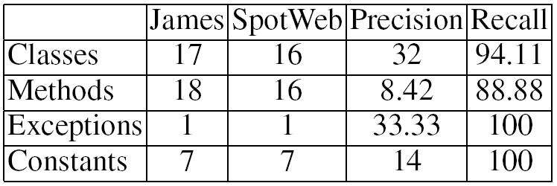
RQ2: Utilities of Hotspots
Is the subset of classes and methods detected as hotspots indeed useful in helping effective framework reuse?
  Subject: DNSJava (154 classes and 1224 methods)
  Classified all DNSJava reusing applications (except James application) as training applications and James application as a test application
  Result: SpotWeb detected 47 classes, 190 methods, 3 exceptions, and 50 constants as hotspots
Notes:
Talk about the reuse efforts as a part of this result. Some may question about Neutral category… prepare a diplomatic answer… Highlight the recall part. Precision is still fine and we can discuss in the next slide

Slide 22
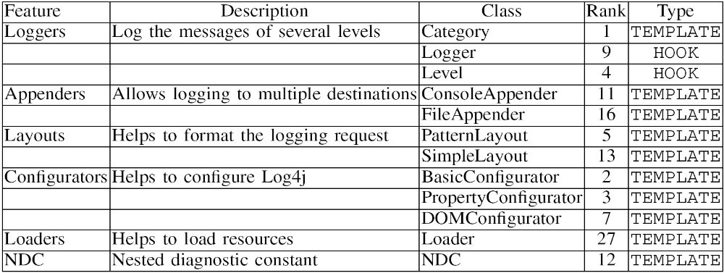
RQ3a: Effectiveness of Hotspot Detection
What is effectiveness of hotspot detection in terms of precision and recall?
  Subject: Log4j (207 classes and 1543 methods)
  Compared detected hotspots with online documentation
  Result: SpotWeb detected 56 classes as hotspot classes with a threshold value (HT) of 15%.
    Recall: 100% and Precision: 21.42%
Notes:
Main point is except “Loader” Class, all other top 11 classes are ranked among top 16 classes.

Slide 23
RQ3b: Effectiveness of Hotspot Detection
Comparison with a previous related approach [Viljamaa FSE03] for the JUnit framework
  Viljamaa’s approach detected 7 classes as hotspots
  SpotWeb detected 5 classes among these 7 classes.
    Missing two classes are ExceptionTestCase and ActiveTestSuite (not available in documentation)
  SpotWeb also detected 4 new classes and several new methods that are not detected by Viljamaa’s approach (also described in documentation)
    New classes are Assert, TestResult, TestFailure and new methods such as tearDown of TestCase class
  The results show that SpotWeb performs better than Viljamaa’s approach
  Unlike Viljamaa’s approah, SpotWeb does not require the users to have initial knowledge of the framework
Notes:
Main point is except “Loader” Class, all other top 11 classes are ranked among top 16 classes.

Slide 24
Conclusion and Future Work
An approach that assists programmers, who are unfamiliar to a framework, by detecting hotspots and coldspots
SpotWeb addresses major problems faced by previous approaches by not requiring any manual efforts and by collecting related code examples through a code search engine
We evaluated SpotWeb with eight popular frameworks and also compared with a previous related approach
Future work:
  Explore other applications of hotspots such as prioritization of bug reports based on hotspots

Slide 25
Questions?

