Slide 1
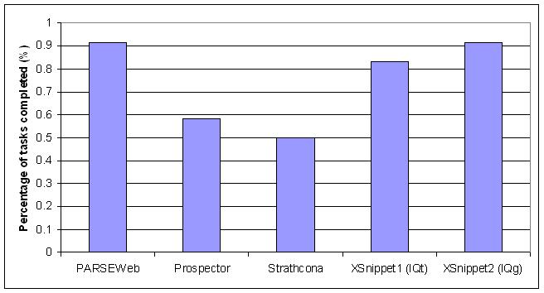
Exploiting Code Search Engines to
Improve Programmer Productivity & Quality
Suresh Thummalapenta
(Advisor: Dr. Tao Xie)
sthumma@ncsu.edu
Motivation
Application 1: PARSEWeb [1]
Results
Programmers commonly reuse APIs of existing frameworks or libraries
Advantages: Low cost and high efficiency of development
Challenges: Complexity and lack of documentation
Consequences: Low programmer productivity and defects in the API client code
Problem: Programmers often know what type of object (destination) that they need but do not know how to get that object with a specific method invocation sequence from a known object (source)
Solution: Gather relevant code samples with source and destination objects from a CSE and mine frequent method invocation sequences
Example
Question: How to parse the code in a dirty editor of Eclipse IDE?
Query: IEditorPart -> ICompilationUnit
Solution sequence:
IEditorPart iep;
IEditorInput editorInp = iep.getEditorInput();
IWorkingCopyManager wcm = JavaUI.getWorkingCopyManager();
ICompilationUnit icu = wcm.getWorkingCopy(editorInp);
PARSEWeb
Real programming problem from Jakarta BCEL user forum, 2001
Question: “How to disassemble Java byte code”
Query: “Code → Instruction”
Solution Sequence:
Code code;
InstructionList il = new InstructionList(code.getCode());
Instruction[] ins = il.getInstructions();
Our Approach
Comparison with related tools Prospector, Strathcona, and XSnippet
Framework
NEGWeb
Mine common patterns of API reuse from existing applications on the web by exploiting a code search engine (CSE)
Productivity:
  Suggest mined common patterns that help programmers in reusing APIs of a framework
  Identify a framework’s hotspots that can serve as starting points in reusing APIs of a framework
Mined patterns of 5 open source applications with a low percentage of false positives, confirmed 3 defects in the literature, and found 3 new defects in Columba
Mined condition patterns of Java Util package: Rules: 56.25% (36/64), Usage patterns: 26.56% (17/64), and False positives: 17.18% (11/64)
Highlights of Columba case study: All 3 defects are detected by top 10 patterns and no false positives among the violations detected by top 10 patterns
    A real defect detected in Columba
  private String removeDoubleEntries(String input) {
  Pattern sP = Pattern.compile("s*(<[^s<>]+>)s*");
  ArrayList entries = new ArrayList();
  Matcher matcher = sP.matcher(input);
  while (matcher.find()) {
  entries.add(matcher.group(1));
  }
  Iterator it = entries.iterator(); ...
  String last = (String) it.next();
  }
  Violated pattern: “next PRE_METHOD BOOLEAN hasNext”
  Support: 0.929
  Description: The code results in NullPointerException, if the input string does not match with the regular expression.
Query
Code
Downloader
Code
Search Engine
Open Source Applications on the web
Local Source
Code Repository
Code
Analyzer
Directed
Acyclic Graphs
Interacts with a code search engine and gathers relevant code samples, which are often partial and not compilable.
Quality:
  Apply mined patterns of API reuse to detect violations in the API client code
Analyzes partial code samples statically through heuristics and transforms the code samples into an intermediate form represented as directed acyclic graphs. A sample heuristic is shown below:
Q: How to get the return type of method call “createSession” in the partial code sample below?
  public QueueSession test () { … return connect.createSession(false);… }
  Return type: Same as or a subtype of the return type of the enclosing method test.
SpotWeb
Log4j hotspots: Recall 100%
    Precision 16.21% ( 11 out of 12 classes in top 16 )
JUnit hotspots: Recall 100%
    Precision 26.08% ( 5 out of 6 classes in top 7 )
Application 2: NEGWeb [2]
Application 3: SpotWeb [3]
Future Directions
Problem: Neglected conditions (missing conditions that check the receiver, arguments, or return objects) are quite common among the defects in the API client code
Solution:
  Mine condition patterns of receiver, arguments, or return objects around the call sites of a given API by using dominance and data-dependency relationships
  Apply mined condition patterns to detect violations in the API client code
Example
Problem: Programmers unfamiliar to a given framework often face challenges in identifying where to start for reusing APIs of the framework
Solution: Compute usage metrics for each class and method, and analyze the metrics to identify starting points (referred as hotspots) of the given framework
Latitudinal Program Analysis: Analyze code bases locally and exploit a code search engine to gather similar code locations elsewhere to validate/ improve local analysis/inference
Develop a new application to detect exception-related errors while reusing the APIs of a given framework
Sample Code
01:public static void verifyBCEL(String cName) {
04: Verifier verf = …
05: if(verf != null) {
06: vr0 = verf.doPass1();
07: if(vr0 != VerificationResult.VR_OK)
08: return;
09: vr1 = verf.doPass2();
10: if (vr1 == VerificationResult.VR_OK) {
11: …
12: for(mId=0; mId<jc.getMethods().length; mId++) {
13 vr2 = verf.doPass3a(mId);
14: vr3 = verf.doPass3b(mId);
15: …
16: }
17: }
18:}
Extracted Condition Patterns
Method | Pattern Type | Condition Type | Additional Info.
doPass1 | RECEIVER | NULLITY
doPass1 | RETURN | CONST_EQUAL | VerificationResult,VR_OK
doPass2 | PRE_METHOD | CONST_EQUAL | doPass1
doPass3a | ARGUMENT | GEN_EQUALITY | 0 < Arguments < # methods
doPass3a | PRE_METHOD | CONST_EQUAL | doPass2
References
Example: Computed usage metrics for the TestSuite class of the JUnit framework
Class: junit.framework.TestSuite
Invocations: 165, Extensions: 32, Implements: 0
Methods:
void,addTestSuite(java.lang.Class)
Invocations: 42, Overrides: 1, Implements: 0
[1] S. Thummalapenta and T. Xie. “PARSEWeb: A Programmer Assistant for Reusing Open Source Code on the Web”, ASE 2007
[2] S. Thummalapenta and T. Xie. “NEGWeb: Static Defect Detection via Searching Billions of Lines of Open Source Code”, NCSU TR-2007-24, 2007
[3] S. Thummalapenta and T. Xie. “SpotWeb: Characterizing Framework API Usages Through a Code Search Engine”, NCSU TR-2007-34, 2007

