Slide 1


Exploiting Code Search Engines to Improve Programmer Productivity and Quality
Suresh Thummalapenta
Advisor: Dr. Tao Xie
Department of Computer Science
North Carolina State University
sthumma@ncsu.edu
Student Research Competition
October 23, 2007

Slide 2
Motivation
Programmers commonly reuse APIs of existing frameworks or libraries
  Advantages: Low cost and high efficiency of development
  Challenges: Complexity and lack of documentation
  Consequences:
    Low programmer productivity
    Defects in the API client code

Slide 3
Approach
Mine common patterns of API reuse from existing applications on the web by exploiting a code search engine
How we address productivity?
  Suggest mined common patterns that help programmers in reusing APIs of a framework
  Identify a framework’s hotspots that can serve as starting points in reusing APIs of a framework
How we address quality?
  Apply mined patterns of API reuse to detect violations in the API client code

Slide 4
Approach contd…
[ASE 07]
How shall I write API client code to implement my task?
Application 1
PARSEWeb
Framework
How can I find bugs in my API client code?
Where to start for reusing APIs of an open source framework or library?
Application 2
Application 3
NEGWeb
SpotWeb

Slide 5
Framework
Open Source Projects
on the Web
Code
Downloader
Query
Code
Downloader
Code
Search Engine
Local Source
Code Repository
Code
Analyzer
Code
Analyzer
Directed
Acyclic Graphs
Interacts with a code search engine and gathers partial relevant code samples.
Analyzes partial code samples statically through heuristics.
A sample heuristic: How to get the return type of createQueueSession?
public QueueSession test() { ...
return connect.createQueueSession(false,int); }
The return is the same as or a subtype of enclosing method declaration test.

Slide 6
Application 1: PARSEWeb
Problem: Programmers often
        know what type of object they need
        but don’t know how to write code to get that object
Example task: How to parse code in a dirty editor in Eclipse IDE programming?
Query: IEditorPart → ICompilationUnit
PARSEWeb Solution:
IEditorPart iep = ...
IEditorInput editorInp = iep.getEditorInput();
IWorkingCopyManager wcm = JavaUI.getWorkingCopyManager();
ICompilationUnit icu = wcm.getWorkingCopy(editorInp);
Difficulties:
a. Needs an instance of IWorkingCopyManager
b. Needs to invoke a static method of JavaUI for getting the preceding instance
[S. Thummalapenta and T. Xie ASE 07]

Slide 7
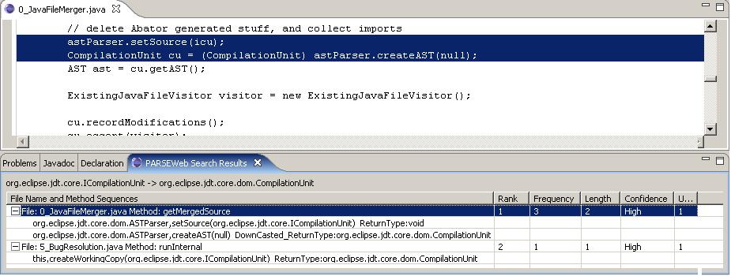
Application 1: PARSEWeb
Snapshot of the PARSEWeb Eclipse plugin
[S. Thummalapenta and T. Xie ASE 07]

Slide 8
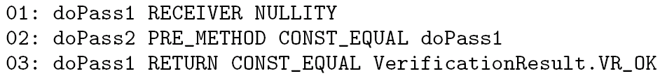
Application 2: NEGWeb
Problem: Neglected conditions (missing conditions on receiver, arguments or return objects of an API) are often in the API client code
Solution: Mine condition patterns for APIs and detect violations of patterns
01:public static void verifyBCEL(String cName) {
04: Verifier verf = …
05: if(verf != null) {
06: vr0 = verf.doPass1();
07: if(vr0 != VerificationResult.VR_OK)
08: return;
09: vr1 = verf.doPass2();
10: if (vr1 == VerificationResult.VR_OK) {
11: …
16: }
17: }
18:}
Conditions extracted by NEGWeb:

Slide 9
Application 3: SpotWeb
Problem: Programmers unfamiliar to a framework face challenges in identifying where to start for reusing APIs of the framework
Solution: Computes usage metrics for all classes and methods and uses the computed metrics to identify starting points (referred as hotspots) of the given framework
Example:
Computed usage metrics for the TestSuite class of the JUnit framework
Class: junit.framework.TestSuite
Instances: 165, Extensions: 32, Implements: 0
Methods:
void,addTestSuite(java.lang.Class)
Invocations: 42, Overrides: 1, Implements: 0

Slide 10
Results
PARSEWeb with related tools Strathcona [Holmes and Murphy ICSE 05] & Prospector [Mandelin et al. PLDI 05] for 12 tasks of Eclipse programming:
  PARSEWeb: 91% (11/12)
  Strathcona: 50% (6/12)
  Prospector: 58% (7/12)
SpotWeb:
  Log4j hotspots: Recall 100%
  Precision 16.21% (11 out of 12 classes in top 16)
  JUnit hotspots: Recall 100%
  Precision 26.08% (5 out of 6 classes in top 7)
Notes:
Q: Can you provide some examples of the tasks?

Slide 11
Results contd…
NEGWeb
  Summary
    Mined patterns of 5 open source applications with a low percentage of false positives
    Confirmed 3 defects in the literature
    Found 3 new defects in Columba
  Mined condition patterns of Java Util Packages
    Rules: 56.25% (36/64)
    Usage Patterns: 26.56% (17/64)
    False positives: 17.18% (11/64)
  Highlights of Columba case study
    All 3 defects are detected by top 10 patterns
    No false positives among the violations detected by top 10 patterns

Slide 12
Conclusion
Designed a generic framework by exploiting a code search engine. Developed three applications and showed that the applications can perform better than existing related tools
  PARSEWeb: mines API usage patterns for type queries
  NEGWeb: mines condition patterns around APIs
  SpotWeb: identifies starting points of a framework
In future work, we plan to develop a new application to detect exception-related errors while reusing the APIs of a given framework

Slide 13
Questions?
References:
[1] S. Thummalapenta and T. Xie. “PARSEWeb: A Programmer Assistant for Reusing Open Source Code on the Web”, ASE 2007
[2] S. Thummalapenta and T. Xie. “NEGWeb: Static Defect Detection via Searching Billions of Lines of Open Source Code”, NCSU TR-2007-24, 2007
[3] S. Thummalapenta and T. Xie. “SpotWeb: Characterizing Framework API Usages Through a Code Search Engine”, NCSU TR-2007-34, 2007

