Slide 1
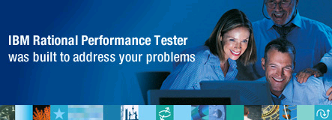

2008 IBM Faculty Award Project
Deep Root-Cause Performance Analysis: Integration and Navigation from a Load Testing Tool
Tao Xie
Department of Computer Science
North Carolina State University
http://ase.csc.ncsu.edu/
Ph.D. Student: Nuo Li
In collaboration with IBM RPT team: Kent Siefkes, David Chadwick, Joseph Toomey, et al.

Slide 2
Background
NCSU Automated Software Engineering Group
  Automated Software Testing
  Mining Software Engineering Data
Collaborations/interactions with IBM besides this award
  2001 Myself: Summer Internship at IBM Research
  (Jinsight: software visualization for performance analysis)
  2006-: 2 students full-time at IBM, parttime students
  2006 Mithun Archaya: Summer Internship at IBM Research
  2008 Kunal Taneja: Summer Internship at IBM Research
  2008 Yoonki Song: Summer Internship/Co-op at IBM RPT
  Initiating a collaborative project on SOA testing with IBM Research

Slide 3
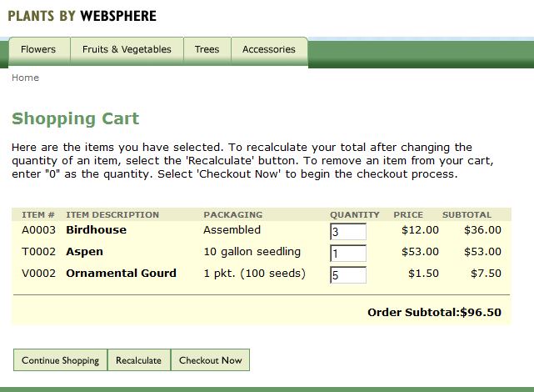
Sample WebSphere App Server
Can the server be running normally for 100, 1000, 10000 users, …?
http://ase.csc.ncsu.edu:9082/PlantsByWebSphere/
Notes:
Sample application
http://ase.csc.ncsu.edu:9082/PlantsByWebSphere/
→Shopping cart

Slide 4

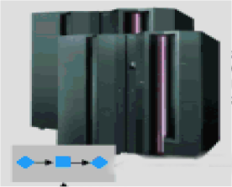
Manual Performance Testing
transaction
Servers
request
response
☹

Slide 5
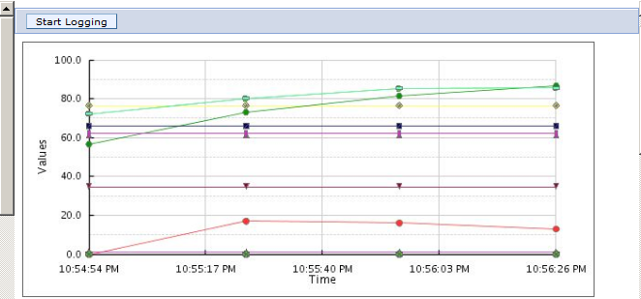
Monitoring Server Performance with Tivoli Performance Viewer
https://ase.csc.ncsu.edu:9046/ibm/console/login.do?action=secure
Notes:
the performance data for our server, where our application (Page 1) runs.
https://ase.csc.ncsu.edu:9046/ibm/console/login.do?action=secure
→Tivoli Performance Viewer > server1

Slide 6

Performance Testing with RPT
transaction
Servers
request
response
☺

Slide 7
Performance Testing with RPT
transaction
Servers
request
events/traces
response
☺
ARM-instrumented/profiled
Performance testing
  Create loads to expose problems and observe failures
Performance analysis/diagnosis
  Locate the root causes of the observed failures

Slide 8
Performance Testing with RPT
Deep root-cause performance analysis requires correlation of
  Test info from client: e.g., IBM Rational Performance Tester
  Trace info from server: e.g., ARM-instrumented/profiled one
transaction
Servers
request
events/traces
response
☺☺
ARM-instrumented/profiled

Slide 9
Motivation
Challenge 1: Can we conduct performance analysis on servers without ARM instrumentation?
  If so, enable RPT to be applied on larger scope of servers
Challenge 2: Can we collect partial traces instead of full traces at the server side?
  If so, incur lower overhead on the servers, making performance analysis more precise
Solution: deep root-cause performance analysis
  integration and navigation from a load testing tool

Slide 10
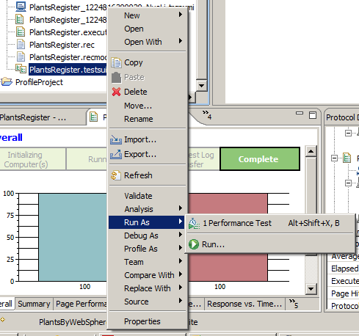
Start a Performance Test from IBM RPT
Notes:
Start a performance test
The following pages show the pictures got from RPT

Slide 11
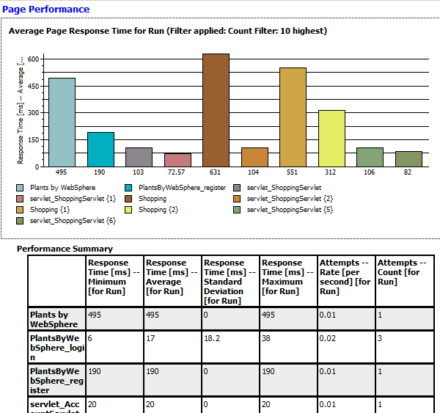
Sample Performance Testing Results

Slide 12
ARM-Instrumented Server
transaction
Servers
request
ARM events
response
ARM-instrumented
ARM events being sent to IBM RPT
  Start time and completion time of the ARM transaction: helping determine whether a performance problem is present
  Metadata: e.g., transaction type

Slide 13
VM-Profiled Server
transaction
Servers
request
Traces
response
VM Profiled
Traces being sent to IBM RPT
  Method invocations/object interactions
  Memory usage
  …

Slide 14
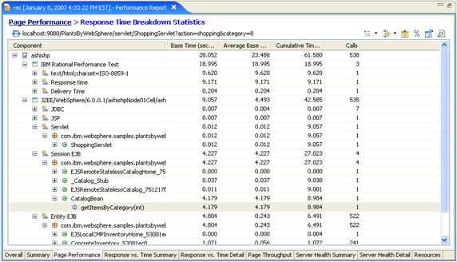
Response Time Breakdown
[Patel 07]

Slide 15
Pros/Cons of ARM/Profiling
[Patel 07]
Feature | ARM | VM Profiling
Provides correlation btw client and server | Yes | No☹
Works on any server | No☹ | Yes
Affects application performance in profiling mode | Small effect | Large effect ☹
Collects memory information and object interactions, etc. | No☹ | Yes
No doubts both should be used together; two issues still remain…

Slide 16
Phase 1: Performance Analysis in the Absence of ARM
Problem: Not every application server is ARM-instrumented
Objective: Support performance analysis on servers without ARM instrumentation
Proposed Approach: learn the start and end point of a transaction or a request with carefully controlled performance tests (as training data)

Slide 17
Steps in the Proposed Approach
Step 1: Serialize the issuing of multiple (same or similar) requests from RPT
Step 2: Collect full traces with RPT on the servers w/o ARM instrumentation
Step 3: Develop a new tool (in Java) to read in performance tests and traces and identify the start and end point of a transaction or a request among the collected method executions

Slide 18
Phase 2: Performance Analysis with Sampled Traces
Problem: Full tracing too expensive and making performance analysis imprecise
Objectives: Support performance analysis with the steps in Phase 1
  Except that sampled traces are used in the actual performance testing
Proposed Approach: Develop techniques to recover info (available in full traces and necessary for performance analysis) from sampled traces

Slide 19
Issues to be Addressed
  With sampled traces, how to match the sampled method calls with the start and end points identified in the learning phase?
      Develop robust matching techniques (e.g., looking at the context of a method call in the sampled traces)
  How to recover information from sampled traces?
      Using a union of sampled traces collected so far to recover an approximated (static) call graph

Slide 20
Educational Activities
  David Chadwick (IBM RPT) gave a guest lecture at CSC 510 (Graduate Software Engineering) in 2008 Spring
  A similar guest lecture being planed for CSC 712 (Graduate Software Testing and Reliability) in 2008 Fall
  IBM RPT is available from VCL for students to use
  A sample WebSphere Application Server available for research and teaching installed at our server: http://ase.csc.ncsu.edu:9082/PlantsByWebSphere/

Slide 21
Summary
  Phase 1: Performance Analysis in the Absence of ARM
    Benefits: enable RPT to be applied on larger scope of servers
  Phase 2: Performance Analysis with Sampled Traces
    Benefits: incur lower overhead on the servers
  Long-term: intelligent support for performance analysis
  Being carried out in close collaboration with IBM RPT team
  Another collaboration on SOA testing being initiated with IBM T.J Watson Research Center (Amit Paradkar)
  http://ase.csc.ncsu.edu/
  Thank IBM’s support and IBM RPT team’s collaboration

Slide 22
Questions?
  http://ase.csc.ncsu.edu/

Slide 23
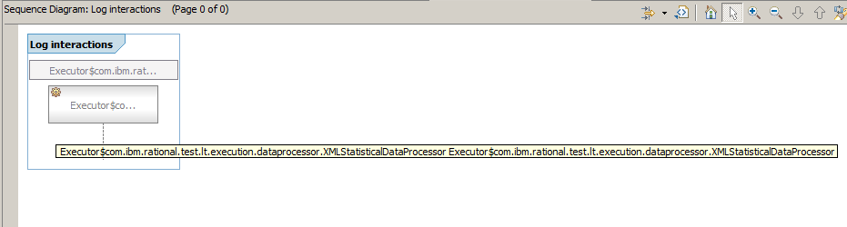
Log interactions
Notes:
Log interactions View. I’m not sure what this is. Seems no relation to our work.
In http://help.eclipse.org/help32/index.jsp?topic=/org.eclipse.tptp.platform.doc.user/ref/resqlgin.htm, it’s said:
The Log interactions diagram displays interactions among log records that occur during the execution of an application. This view shows correlations between log records from a single log file or across multiple log files.

Slide 24
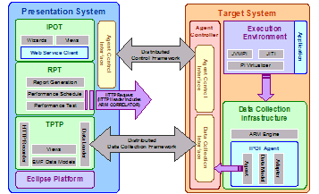
System architecture using the data collection infrastructure
[Patel 07]
Notes:
The role of the DCI is to transform and forward to the client the Application Response Measurement (ARM) standard events that are reported to the IBM® Tivoli® ARM engine by an ARM-instrumented application (see Figure 1).

Slide 25
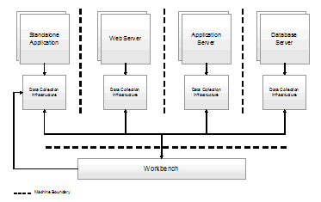
Data collection infrastructure for a distributed environment
[Patel 07]
Notes:
The role of the DCI is to transform and forward to the client the Application Response Measurement (ARM) standard events that are reported to the IBM® Tivoli® ARM engine by an ARM-instrumented application (see Figure 1).

Slide 26
Monitoring Server Performance with Tivoli Performance Viewer
https://ase.csc.ncsu.edu:9046/ibm/console/login.do?action=secure
Notes:
the performance data for our server, where our application (Page 1) runs.
https://ase.csc.ncsu.edu:9046/ibm/console/login.do?action=secure
→Tivoli Performance Viewer > server1

Slide 27
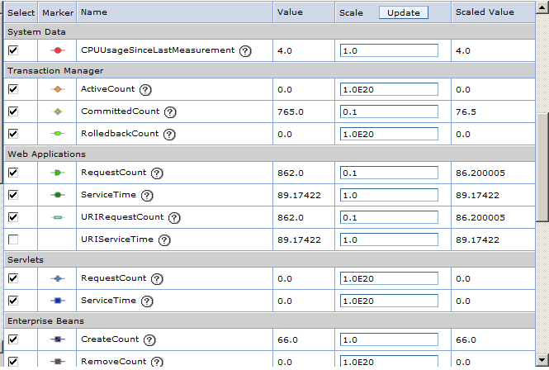
Summary Reports and Info on Specific Performance Modules
Notes:
summary reports and information on specific performance modules for our server, where our application (Page 1) runs.
https://ase.csc.ncsu.edu:9046/ibm/console/login.do?action=secure
→Tivoli Performance Viewer > server1

Slide 28
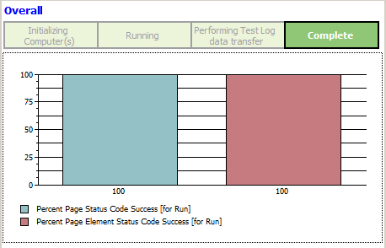
Performance Testing Result Overview
Notes:
Overview of the performance testing results
Page 5 – 8 are related to performance testing results.
There are more performance testing result views, I didn’t take all of them.

Slide 29
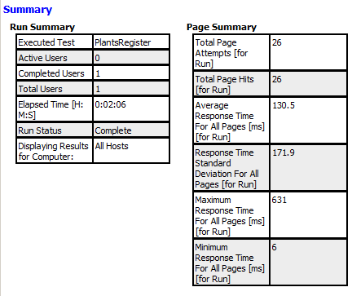
Performance Testing Result Summary
Notes:
Summary of the performance testing results

Slide 30
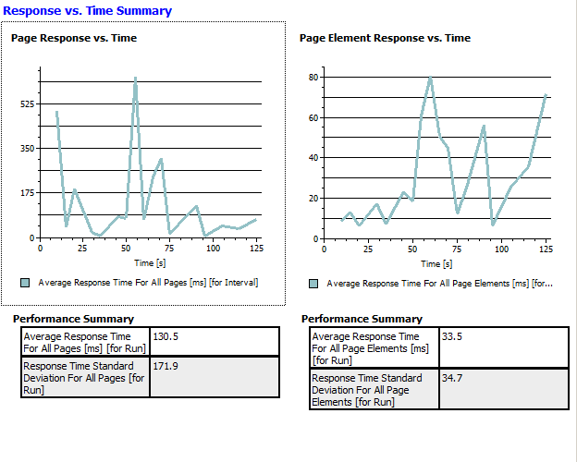
Other Performance Testing Results

Slide 31
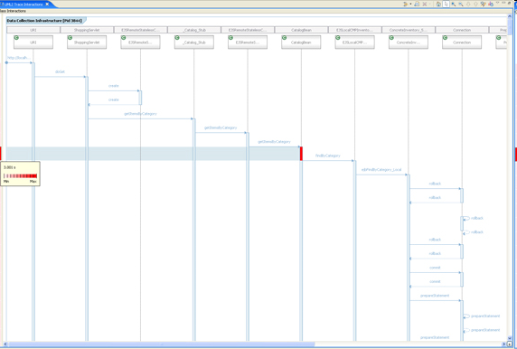
UML Sequence Diagram
http://www.ibm.com/developerworks/rational/library/07/0515_patel2/rtb_report_UML.jpg
Notes:
After Page 10, the pictures are copied from http://www.ibm.com/developerworks/rational/library/07/0515_patel2/index.html.
The UML Sequence Diagram view presents a sequence of causal dependent events, where events are defined as method entries and exits, as well as outbound calls and return calls (see Figure 20). Specifically, it presents interactions between class instances. Those interactions have the form of method calls and call returns. The implementation of the Trace Interaction tool extends that definition to one that generalizes actors of interactions, as well as their means. In other words, the views provided by the tool are able to present not only the interactions of classes and class instances, but also interactions among threads, processes, and hosts. This extended use of the execution flow notation is motivated by the need to provide a hierarchy of data representation, which is necessary for large-scale, distributed traces.
Figure 20. UML Sequence Diagram view
http://www.ibm.com/developerworks/rational/library/07/0515_patel2/rtb_report_UML.jpg

Slide 32
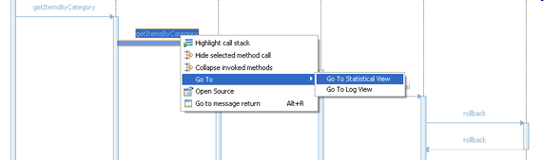
View-linking Service btw UML Sequence Diagram and Statistical or Log Views
http://www.ibm.com/developerworks/rational/library/07/0515_patel2/rtb_report_UML_rclick.jpg
Notes:
A view-linking service is available for assisting in correlating application trace events, as shown in the UML Sequence Diagram view and the statistical and log views (see Figure 21). Correlation is computed using timestamps of two events. If an exact match is not found during correlation, the next event with the closest timestamp to the event being correlated is selected, within acceptable range.
Figure 21. View-linking service between UML Sequence Diagram and statistical or log views
http://www.ibm.com/developerworks/rational/library/07/0515_patel2/rtb_report_UML_rclick.jpg

Slide 33
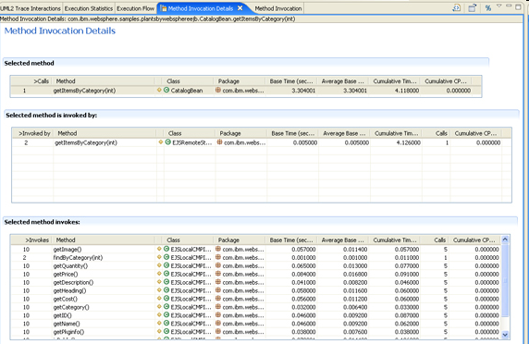
Method Invocation Details
http://www.ibm.com/developerworks/rational/library/07/0515_patel2/rtb_report_methodDetails.jpg
Notes:
Method Invocation Details: Provides statistical data about a selected method, including information about the invoker method and the methods invoked by the selected method. You can open this view (Figure 24) on a selected method in any of the profiling views, such as the Method Invocation, Execution Flow, or Execution Statistics views.
The Method Invocation Details view displays:
Selected method: Shows details, including the number of times that the selected method is called, the class and package information, and the time taken by this method.
Selected method invoked by: Shows details of each method that calls the selected method, including the number of calls to the selected method and the number of times that the selected method is invoked by the caller.
Selected method invokes: Shows details of each method invoked by the selected method, including the method name invoked, the number of times the method is invoked, the number of calls from the selected method to the invoked method, package and class information for the invoked method, and the time spent on the invoked method.
Figure 24. Method Invocation Details view
http://www.ibm.com/developerworks/rational/library/07/0515_patel2/rtb_report_methodDetails.jpg

Slide 34
Steps in the Proposed Solution
Step 1: Serialize the issuing of multiple (same or similar) requests from RPT:
  Start issuing the subsequent request only after the response from the current request is received (feature to be developed by the RPT team)
Step 2: Collect full traces with RPT on the servers w/o ARM instrumentation
Step 3: Develop a new tool (in Java) to read in performance tests and traces in the format of Eclipse Modeling Framework (EMF) and identify the start and end point of a transaction or a request among the method execution on the server side.

Slide 35
Phase 2: Performance Analysis with Sampled Traces
Motivation: Full tracing on servers may be too expensive and can make performance analysis imprecise
Repeat the steps in Phase 1 except that in the learning phase, we use full traces, and in the actual performance testing phase, we use sampled traces.
Consider to use existing profiling tools that support statistically sampled profiling, such as Sun JVM, YourKit, IBM JVM, Jinsight
Develop techniques to recover info (available in full traces and necessary for performance analysis) from sampled traces

Slide 36
Issues to be Investigated
  With sampled traces, can the efficiency of RPT be improved over full traces? How much?
  With sampled traces, how can we match the sampled method calls with the start and end points identified in the learning phase?
      Develop some robust matching techniques by looking at the context of a method call in the sampled traces.
  How to recover information from sampled traces?
      Using a union of sampled traces collected so far to recover an approximated (static) call graph

