Slide 1
  MSeqGen: Object-Oriented Unit-Test Generation via Mining Source Code
  Suresh Thummalapenta and Tao Xie
  North Carolina State University
  Nikolai Tillmann, Jonathan de Halleux, and Wolfram Schulte
  Microsoft Research, Redmond
  This work is supported in part by NSF grant CCF-0725190 and ARO grant W911NF-08-1-0443

Slide 2
Object-Oriented (OO) Testing

Slide 3
Object-Oriented (OO) Testing
Objective: achieve high structural coverage of method under test (MUT)‏
Problem: requires desirable object states for receiver and arguments of MUT to cover complex logics in code
Solution: generate method-call sequences that can produce different object states
Challenge: generate method-call sequences that achieve desirable object states

Slide 4
Existing State-of-the-Art
Bounded exhaustive: generates sequences upto a small bound
  Problem: often require longer sequences than small bound
Random: randomly combine calls to generate sequences
  Problem: often face challenges due to large search space
Evolutionary: accepts an initial set and evolves to produce new sequences
  Problem: process is still random and shares the same limitations of random approaches
Dynamic Symbolic Execution (DSE): accepts skeletons and generates sequences
  Problem: requires skeletons as input from programmer

Slide 5
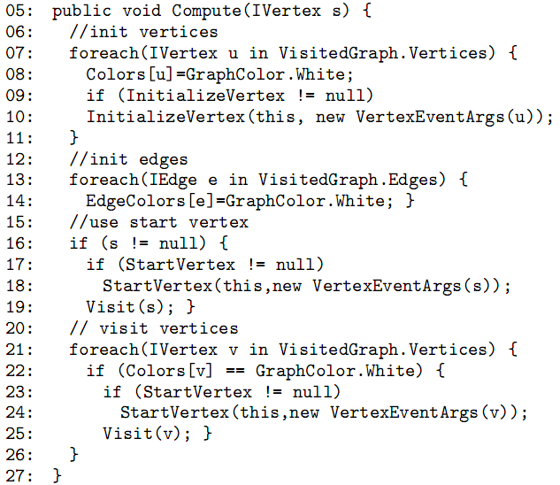
Why State-of-the-Art is not Good?
Desired object state to reach lines 8, 14, 22: graph instance should include vertices and edges

Slide 6
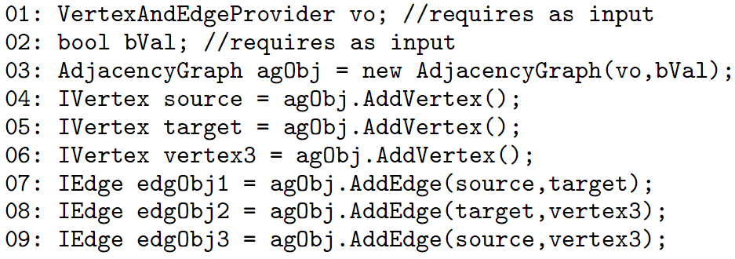
Why State-of-the-Art is not Good?
A solution method-call sequence for generating graph instance with vertices and edges

Slide 7
Why State-of-the-Art is not Good?
Randoop (a random testing tool)
  Incorporates feedback from previously constructed sequences while generating new sequences
  Achieved 31.82% branch coverage
  Reason for low coverage: Not able to generate graph with vertices and edges
Pex (a DSE-based testing tool)
  Uses a heuristic based approach based on methods of the class under test that modify its fields
  Achieved 45.45% branch coverage
  Reason for low coverage: Not able to generate graph with vertices and edges

Slide 8
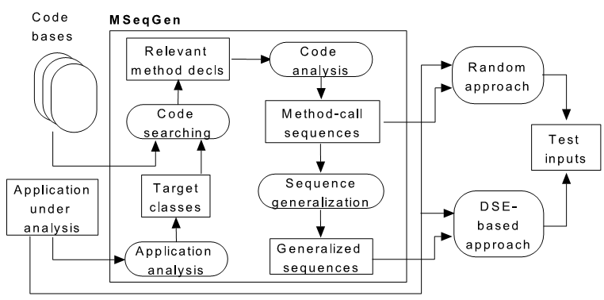
MSeqGen Approach
Three major steps
  Code searching: searches for relevant code portions using a text based keyword search
  Code analysis: analyzes searched code portions to extract method-call sequences
  Sequence Generalization: replaces constant values with symbolic values. Why?

Slide 9
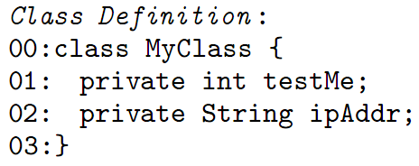
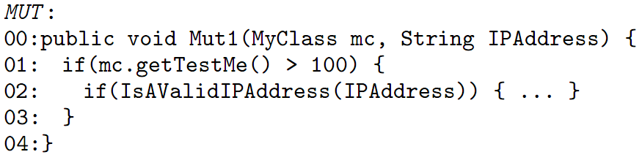
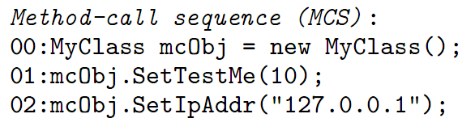
Why Sequence Generalization?
Often constant values in sequences can be different from actual values required to achieve desirable object states
An example Class and a method under test
An example sequence
Question: Is this sequence help reach Statement 2 of the MUT?

Slide 10
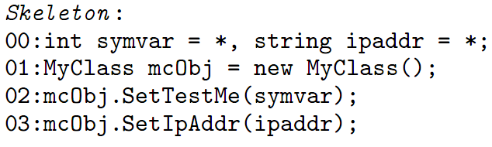
Why Sequence Generalization?
Convert sequences into skeletons by replacing concrete values with symbolic values
Generated Skeleton
Use DSE-based approaches to generate concrete value for symvar based on constraints in MUT
Challenges with DSE-based approaches: Difficult to generate concrete values for variables such as doubles, IPAddress, or URLs
  Solution: Preserve constant values along with symbolic values

Slide 11
Improvement of State-of-the-Art
Randoop (a random testing tool)
  Without assistance from MseqGen: achieved 31.82% branch coverage
  With assistance from MseqGen: achieved 86.36% branch coverage
Pex (a DSE-based testing tool)
  Without assistance from MseqGen: achieved 45.45% branch coverage
  With assistance from MseqGen: achieved 86.36% branch coverage

Slide 12
Evaluation
Subjects:
  QuickGraph
  Facebook
Research Questions:
  RQ1: Can our approach assist Randoop (random testing tool) in achieving higher code coverages?
  RQ2: Can our approach assist Pex (DSE-based testing tool) in achieving higher code coverages?

Slide 13
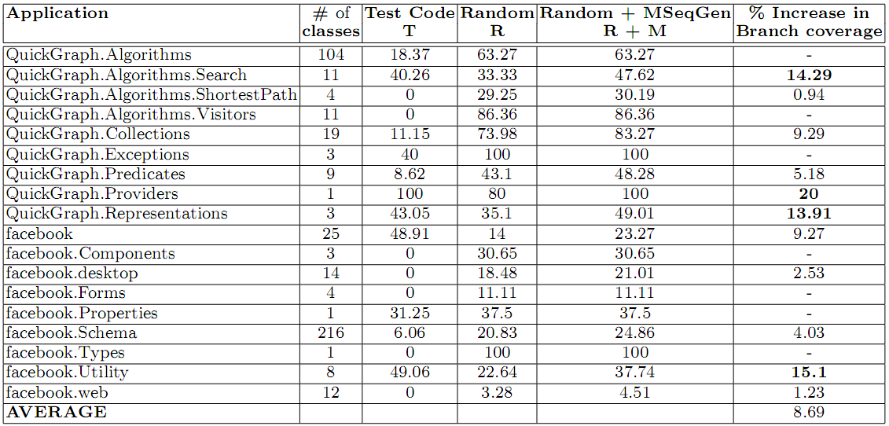
RQ1: Assisting Randoop

Slide 14
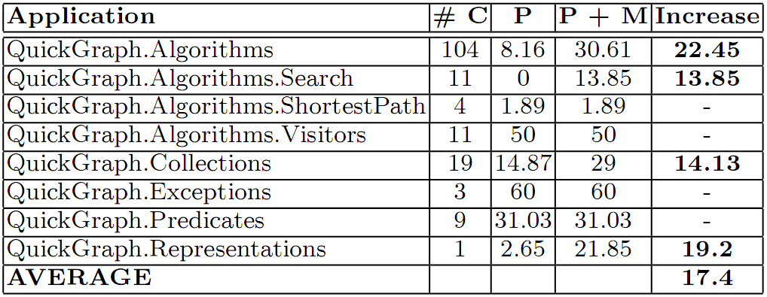
RQ2: Assisting Pex
Legend:
  #c: number of classes
  P: branch coverage achieved by Pex
  P + M: branch coverage achieved by Pex and MSeqGen

Slide 15
Conclusion
A first approach that addresses the problem of method-call sequence generation via mining existing code bases
Enhanced two state-of-the-art approaches. With the assistance from our approach:
  A random approach achieved 8.69% (maximum 20%) higher branch coverage
  A DSE-based approach achieved 17.4% (maximum 22.45%) higher branch coverage
Future work: use evolutionary approaches with mined sequences as an initial set

