Slide 1

Mining Gigabytes of Dynamic Traces for Test Generation
Suresh Thummalapenta
North Carolina State University
Peli de Halleux and Nikolai Tillmann
Microsoft Research
Scott Wadsworth
Microsoft

Slide 2
Unit Test
A unit test is a small program with test inputs and test assertions
void AddTest()
{
HashSet set = new HashSet();
set.Add(7);
set.Add(3);
Assert.IsTrue(set.Count == 2);
}
Many developers write unit tests by hand
Test Scenario
Test Data
Test Assertions
Notes:
Unit tests are good, but how can we improve. Immediate thing comes here is..to make primitive types as parameters

Slide 3
Parameterized Unit Test (PUT)
void AddSpec(int x, int y)
{
HashSet set = new HashSet();
set.Add(x);
set.Add(y);
Assert.AreEqual(x == y, set.Count == 1);
Assert.AreEqual(x != y, set.Count == 2);
}
Parameterized Unit Tests separate two concerns:
The specification of externally visible behavior (assertions)
The selection of internally relevant test inputs (coverage)
Use dynamic symbolic execution to generate unit tests

Slide 4
Dynamic Symbolic Execution By Example
Choose next path
Code to generate inputs for:
Solve
Execute&Monitor
Constraints to solve
a!=null
a!=null &&
a.Length>0
a!=null &&
a.Length>0 &&
a[0]==123456890
Input
null
{}
{0}
{123…}
Observed constraints
a==null
a!=null &&
!(a.Length>0)
a==null &&
a.Length>0 &&
a[0]!=1234567890
a==null &&
a.Length>0 &&
a[0]==1234567890
void CoverMe(int[] a)
{
if (a == null) return;
if (a.Length > 0)
if (a[0] == 1234567890)
throw new Exception("bug");
}
a==null
F
T
a.Length>0
Done: There is no path left.
F
T
Pex is used for dynamic symbolic execution
a[0]==123…
F
T
Notes:
Not seen in practice..because of loops that may lead to infinite paths.

Slide 5
Challenges
Writing test scenarios for PUTs or unit tests manually is expensive
Can we automatically generate test scenarios?
Challenging due to large search space of possible scenarios and relevant scenarios are quite small
Solution: use dynamic traces for generating test scenarios
Why dynamic: precise and include concrete values
Relevant scenarios
Possible scenarios

Slide 6

Approach
Developed by .NET CLR test team
Our approach includes three major phases
Capture: Record dynamic traces and generate test scenarios for PUTs. Dynamic traces:
Realistic scenarios of API calling sequences
Concrete values passed to such APIs
Minimize: Minimize test scenarios by filtering out duplicates
Only a few scenarios are unique
Explore: Generate new regression unit tests from PUTs
Use Pex for generating unit tests
Addresses scalability issues with a distributed setup
Large number of scenarios, leading to scalability issues
6

Slide 7
Capture: Dynamic Traces → PUTs
.NET Base Class Libraries
Developed by .NET CLR Team
mscorlib
System
System.Xml
…
A dynamic trace captured during program execution
TagRegex tagex = new TagRegex();
Match mc = ((Regex)tagex).Match(“<%@ Page..\u000a”,108);
Capture cap = (Capture) mc;
int indexval = cap.Index;
Application
Profiler
Parameterized unit test
public static void F_1(string VAL_1, int VAL_2, out int OUT_1)
{
TagRegex tagex = new TagRegex();
Match mc = ((Regex)tagex).Match(VAL_1, VAL_2);
Capture cap = (Capture) mc;
OUT_1 = cap.Index;
}
Dynamic Traces
Decomposer
Sequence Generalizer
Seed unit test
public static void T_1()
{
int index;
F_1(“<%@ Page..\u000a”, 108, out index);
}
PUTs
Seed unit tests
7
Notes:
-> Currently, PUTs are designed to take only primitive types as arguments. In future, we plan to transform so that PUTs can take non-primitive types also as arguments

Slide 8
Capture: Why Seed Unit Tests?
To exploit new feature in Pex that uses existing seed unit tests for reducing exploration time [Inspired by “Automated Whitebox Fuzz Testing” by Godefroid et al. NDSS08]
PUT
Unit tests
void CoverMe(int[] a)
{
if (a == null) return;
if (a.Length > 0)
if (a[0] == 1234567890)
throw new Exception("bug");
}
void unittest1()
{
CoverMe(new int[] {20});
}
void unittest2()
{
CoverMe(new int[] {});
}
a==null
a==null
F
T
F
T
a.Length>0
a.Length>0
F
T
T
F
a[0]==123…
a[0]==123…
F
T
F
T
8

Slide 9
Capture: Complex PUT
public static void F_1(string VAL_1, Formatting VAL_2, int VAL_3, string VAL_4, string VAL_5,
WhitespaceHandling VAL_6, string VAL_7, string VAL_8, string VAL_9, string VAL_10, bool VAL_11)
{
Encoding Enc = UTF8;
XmlWriter writer = (XmlWriter)new XmlTextWriter(VAL_1,Enc);
((XmlTextWriter)writer).Formatting = (Formatting)VAL_2;
((XmlTextWriter)writer).Indentation = (int)VAL_3;
((XmlTextWriter)writer).WriteStartDocument();
writer.WriteStartElement(VAL_4);
StringReader reader = new StringReader(VAL_5);
XmlTextReader xmlreader = new XmlTextReader((TextReader)reader);
xmlreader.WhitespaceHandling = (WhitespaceHandling)VAL_6;
bool chunk = xmlreader.CanReadValueChunk;
XmlNodeType Local_6372024_10 = xmlreader.NodeType;
XmlNodeType Local_6372024_11 = xmlreader.NodeType;
bool Local_6372024_12 = xmlreader.Read();
int Local_6372024_13 = xmlreader.Depth;
XmlNodeType Local_6372024_14 = xmlreader.NodeType;
string Local_6372024_15 = xmlreader.Value;
((XmlTextWriter)writer).WriteComment(VAL_7);
bool Local_6372024_17 = xmlreader.Read();
int Local_6372024_18 = xmlreader.Depth;
XmlNodeType Local_6372024_19 = xmlreader.NodeType;
string Local_6372024_20 = xmlreader.Prefix;
string Local_6372024_21 = xmlreader.LocalName;
string Local_6372024_22 = xmlreader.NamespaceURI;
((XmlTextWriter)writer).WriteStartElement(VAL_8,VAL_9,VAL_10);
XmlNodeType Local_6372024_24 = xmlreader.NodeType;
bool Local_6372024_25 = xmlreader.MoveToFirstAttribute();
writer.WriteAttributes((XmlReader)xmlreader,VAL_11);
}
9
Notes:
-> Currently, PUTs are designed to take only primitive types as arguments. In future, we plan to transform so that PUTs can take non-primitive types also as arguments

Slide 10
Capture: Statistics
.NET Base Class Libraries
mscorlib
System
System.Xml
…
Application
Profiler
Statistics
Size: 1.50 GB
Traces: 433,809
Average trace length: 21 method calls Maximum trace length: 52 method calls
Number of PUTs: 433,809
Number of seed unit tests: 433,809 Duration: 1 Machine day
Dynamic Traces
Decomposer
Sequence Generalizer
PUTs
Seed unit tests
10
Notes:
-> Currently, PUTs are designed to take only primitive types as arguments. In future, we plan to transform so that PUTs can take non-primitive types also as arguments

Slide 11
Minimize: PexShrinker and PexCover
→ Filters out duplicate PUTs and seed unit tests to help Pex in generating regression tests
PUTs
Seed Unit Tests
PexShrinker
→ Detects duplicate PUTs
Uses static analysis
Compares PUTs instruction-by-instruction
PexShrinker
Minimized
PUTs
Seed unit tests
PexCover
Detects duplicate seed unit tests
Duplicate test exercises the same execution path as some other test
Uses dynamic analysis
Uses path coverage information
PexCover
Minimized
PUTs
Minimized Seeds
11
Notes:
-> Currently, PUTs are designed to take only primitive types as arguments. In future, we plan to transform so that PUTs can take non-primitive types also as arguments

Slide 12
Shrinker
void TestMe1(int arg1, int arg2, int arg3)
{
if (arg1 > 0)
Console.WriteLine("arg1 > 0"); /*Statement 1*/
else
Console.WriteLine("arg1 <= 0"); /*Statement 2*/
if (arg2 > 0)
Console.WriteLine("arg2 > 0"); /*Statement 3*/
else
Console.WriteLine("arg2 <= 0"); /*Statement 4*/
for (int c = 1; c <= arg3; c++) {
Console.WriteLine(“loop”) /*Statement 5*/
}
}
void TestMe2(int arg1, int arg2, int arg3)
{
if (arg1 > 0)
Console.WriteLine("arg1 > 0"); /*Statement 1*/
else
Console.WriteLine("arg1 <= 0"); /*Statement 2*/
if (arg2 > 0)
Console.WriteLine("arg2 > 0"); /*Statement 3*/
else
Console.WriteLine("arg2 <= 0"); /*Statement 4*/
for (int c = 1; c <= arg3; c++) {
Console.WriteLine(“loop”) /*Statement 5*/
}
}
public void UnitTest1()
{
TestMe(1, 1, 1);
}
public void UnitTest2()
{
TestMe(1, 10, 1);
}
public void UnitTest3()
{
TestMe(5, 8, 2);
}
Path: 1 → 3 → 5
Path: 1 → 3 → 5
Path: 1 → 3 → 5 → 5
12

Slide 13


PexCover: Duplicate Unit Test
void TestMe(int arg1, int arg2, int arg3)
{
if (arg1 > 0)
Console.WriteLine("arg1 > 0"); /*Statement 1*/
else
Console.WriteLine("arg1 <= 0"); /*Statement 2*/
if (arg2 > 0)
Console.WriteLine("arg2 > 0"); /*Statement 3*/
else
Console.WriteLine("arg2 <= 0"); /*Statement 4*/
for (int c = 1; c <= arg3; c++) {
Console.WriteLine(“loop”) /*Statement 5*/
}
}
public void UnitTest1()
{
TestMe(1, 1, 1);
}
public void UnitTest2()
{
TestMe(1, 10, 1);
}
public void UnitTest3()
{
TestMe(5, 8, 2);
}
Path: 1 → 3 → 5
Path: 1 → 3 → 5
Path: 1 → 3 → 5 → 5
13

Slide 14
PexCover
A light-weight tool for detecting duplicate unit tests
Based on Extended Reflection
Can handle gigabytes of tests (~ 500,000)
Generates multiple projects based on heuristics
Generates two reports:
Coverage report report
Test report report
Supports popular unit test frameworks: Visual studio, XUnit, NUnit, and MBUnit
Ready for DELIVERY
14

Slide 15
Minimize: Statistics
PUTs
Seed Unit Tests
Machine configuration:
Xeon 2 CPU @ 2.50 GHz, 8 cores
RAM 16GB
PexShrinker
PexShrinker
Total PUTs: 433,089
Minimized PUTs: 68,575
Duration: 45 min
Minimized
PUTs
Seed Unit Tests
PexCover
Total UTs: 410,600
(Ignored ~20,000 tests due to an issue in CLR)
Number of projects: 943
Minimized UTs: 128,185
Duration: ~ 5 hours
PexCover
Minimized
PUTs
Minimized Seeds
15
Notes:
-> Currently, PUTs are designed to take only primitive types as arguments. In future, we plan to transform so that PUTs can take non-primitive types also as arguments

Slide 16
Explore: Regression Test Generation
A sequence captured during program execution
TagRegex tagex = new TagRegex();
Match mc = ((Regex)tagex).Match(“<%@ Page..\u000a”,108);
Capture cap = (Capture) mc;
int indexval = cap.Index;
Regression Tests (Total: 86)
Generated test 1
[PexRaisedException(typeof(ArgumentNullException))]
public static void F_102()
{
int i = default(int);
F_1 ((string)null, 0, out i);
}
Parameterized unit test
public static void F_1(string VAL_1, int VAL_2, out int OUT_1)
{
TagRegex tagex = new TagRegex();
Match mc = ((Regex)tagex).Match(VAL_1, VAL_2);
Capture cap = (Capture) mc;
OUT_1 = cap.Index;
}
Generated test 2
public static void F_103()
{
int i = default(int);
F_1 ("\0\0\0\0\0\0\0<\u013b\0", 7, out i);
PexAssert.AreEqual<int>(0, i);
}
Generated test 3
[PexRaisedException(typeof(ArgumentOutOfRangeException))]
public static void F_110()
{
int i = default(int);
F_1("", 1, out i);
}
Seed Unit test
public static void T_1()
{
int index;
F_1(“<%@ Page..\u000a”, 108, out index);
}
…
16
Notes:
-> Currently, PUTs are designed to take only primitive types as arguments. In future, we plan to transform so that PUTs can take non-primitive types also as arguments

Slide 17
Explore: Addressing scalability issues
Use a distributed setup
Runs forever in iterations
Each iteration is bounded by parameters such as timeout
Doubles parameters in further iterations
Use existing unit tests as a seed for first iteration (inspired by “Automated whitebox fuzz testing” Godefroid et al. NDSS08)
Use generated tests in iteration X as a seed for iteration X + 1
17
Notes:
-> Currently, PUTs are designed to take only primitive types as arguments. In future, we plan to transform so that PUTs can take non-primitive types also as arguments

Slide 18

Explore: Distributed Setup
Exploration tasks
…
Minimized
PUTs
P1
P2
P3
P4
An iteration is finished when all exploration tasks are finished
Unit Tests
Computers
…
PexCover
System.Web.RegularExpressions.TagRegexRunner1.Go
Iteration | Run Timeout | Constraint Timeout | … | Block Coverage
1 | 3 | 2 | … | 80
2 | 6 | 4 | … | 191
3 | 9 | 6 | … | 191
4 | 12 | 8 | … | 193
Coverage &
Test reports
Merged
18
Notes:
-> Currently, PUTs are designed to take only primitive types as arguments. In future, we plan to transform so that PUTs can take non-primitive types also as arguments

Slide 19
Research Questions
Do regression tests generated by our approach achieve higher code coverage?
Compare initial coverage achieved by dynamic traces (base coverage) and new coverage achieved by generated tests
Do existing unit tests help achieve higher coverage than without using the tests?
Compare coverages with/without using existing tests as seeds
Does more machine power help achieve higher coverage (when to stop?)
Compare coverages achieved after first and second iterations

Slide 20
Experiment Setup
Applied our approach on 10 .NET 2.0 base libraries
Already extensively tested for several years
>10,000 public methods
>100,000 basic blocks
Sandbox
Restriction of access to external resources (files, registry, unsafe code, …) pic
Machines
Configuration | Number
Xeon 2 CPU @ 2.50 GHz, 8 cores, 16 GB RAM | 1
Quad core 2 CPU @ 1.90 GHz, 8 cores, 8 GB RAM | 2
Intel Xeon CPU @2.40 GHz, 1 GB RAM | 6

Slide 21
Results Overview
Four runs: with/without seeds, Iteration 1 and 2.
Each run took ~2 days
10 .NET 2.0 base libraries: mscorlib, System, System.Windows.Forms, System.Drawing, System.Xml, System.Web.RegularExpressions, System.Configuration, System.Data, System.Web, System.Transactions
Base Coverage: 22111 blocks
S.No | Run Type | Iteration | # Generated Tests | Block Coverage | % increase from Base
1 | Without Seeds | 1 | 248,306 | 21920 | ~0%
2 | Without Seeds | 2 | 412,928 | 23176 | 4.8%
3 | With Seeds | 1 | 376,367 | 26939 | 21.83%
4 | With Seeds | 2 | 501,799 | 27485 | 24.30%
Coverage comparison report: mergedcov.html

Slide 22
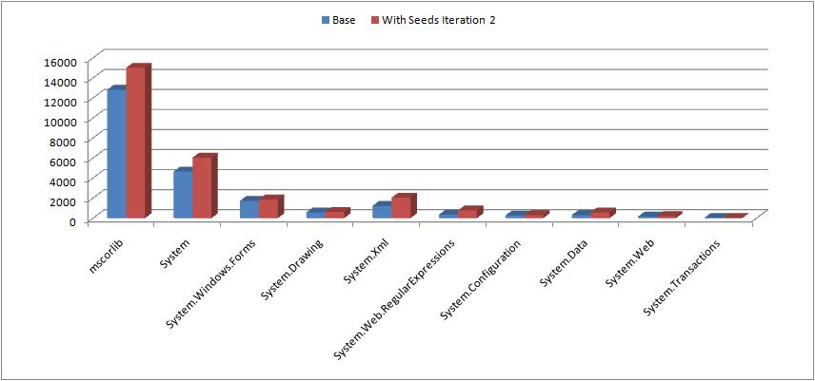
RQ1: Base vs. With Seeds Iteration 2
Do generated regression tests achieve higher code coverage?
Generated regression tests achieved 24.30% more coverage than the Base

Slide 23
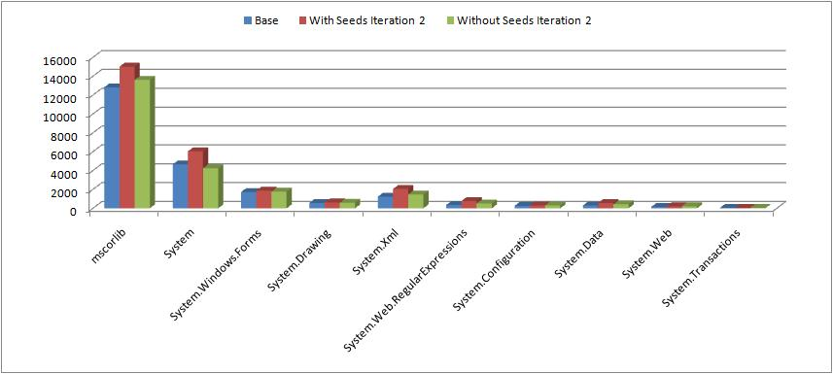
RQ2: Base, With / Without Seeds Iteration 2
Do seed unit tests help achieve more coverage than without using seeds?
Using seeds: achieved 18.6% more coverage than without using the tests
Without using seeds: achieved 4.80% more coverage than Base

Slide 24
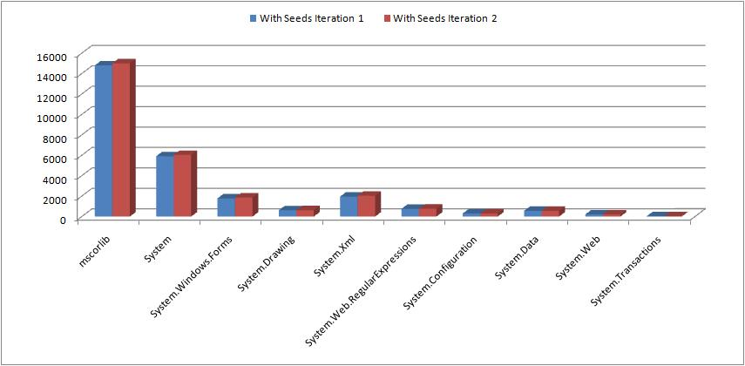
RQ3: With Seeds Iteration 1 vs. Iteration 2
Does more machine power help to achieve more coverage?
With seeds, Iteration 2 achieved 2.0% more coverage than Iteration 1

Slide 25
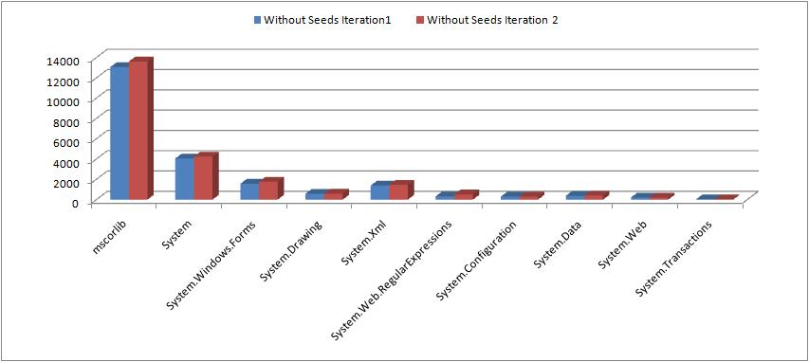
RQ3: Without Seeds Iteration 1 vs. Iteration2
Does more machine power help to achieve more coverage?
With out seeds, Iteration 2 achieved 5.73% more coverage than Iteration 1

Slide 26
Conclusion
An approach that automatically generates regression unit tests from dynamic traces
A tool, called PexCover, that can detect duplicate unit tests
A distributed setup that addresses scalability issues
Our regression tests achieved 24.30% higher coverage than initial coverage by dynamic traces
Ongoing and Future work
Analyze exceptions exceptions.html
Generate new sequences using evolutionary or random approaches
Improve regression detection capabilities

Slide 27
Thank You

Slide 28
Results Overview
Four runs: with/without seeds, Iteration 1 and 2.
Each run took ~2 days
10 .NET 2.0 base libraries: mscorlib, System, System.Windows.Forms, System.Drawing, System.Xml, System.Web.RegularExpressions, System.Configuration, System.Data, System.Web, System.Transactions
S.No. | Run Type | Iteration | # Generated Tests | Dynamic Coverage (Covered/Reached) (%)
1 | Without Seeds | 1 | 248,306 | 21920/31730 (69.08%)
2 | Without Seeds | 2 | 412,928 | 23176/32838 (70.58%)
3 | With Seeds | 1 | 376,367 | 26939/36845 (73.11%)
4 | With Seeds | 2 | 501,799 | 27485/37081 (74.12%)
Dynamic Coverage:
Covered blocks / Total number of blocks in all methods reached so far
Coverage comparison report: mergedcov.html

Slide 29
Challenges
Writing PUTs manually is expensive
Can we automatically generate Test Scenarios for PUTs?
Automatic method-sequence generation approaches can help?
Bounded-exhaustive [Khurshid et al. TACAS03, Xie et al. ASE04]
Evolutionary [Tonella ISSTA04, Inkumsah & Xie ASE08]
Random [Pacheco et al. ICSE07]
Heuristic [Tillmann & Halleux TAP08]
Not able to achieve high code coverage [Thummalapenta et al. FSE09]
Either random or rely on implementations of method calls
Do not use how method calls are used in practice
How to address scalability issues in dynamic symbolic execution of large number of PUTs?
Notes:
→ Q: Do we need to talk about assertions in the PUTs? May be it is worth to mention that we are currently interested in regression tests rather than assertions in PUTs

Slide 30
Approach
PUTs
(68,575)
UTs
(501,799)
Dynamic
Traces
(433,809)
PUTs
(433,809)
UTs
(433,809)
PUTs
(68,575)
UTs
(128,185),
Minimize
by removing
redundancy
among PUTs and UTs
Maximize with new non-redundant UTs
Legend: UT: Unit Test
30
Notes:
-> Mention more details about traces like how they look?
Currently, PUTs are designed to take only primitive types as arguments. In future, we plan to transform so that PUTs can take non-primitive types also as arguments.. The existing tests mainly exercise happy paths, but our generated tests exercise all paths…

