Slide 1
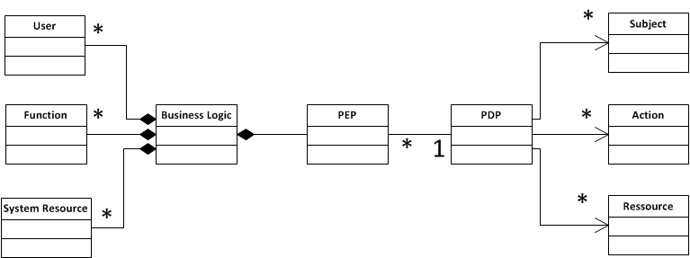
Business Logic
Decision Logic

