Slide 1
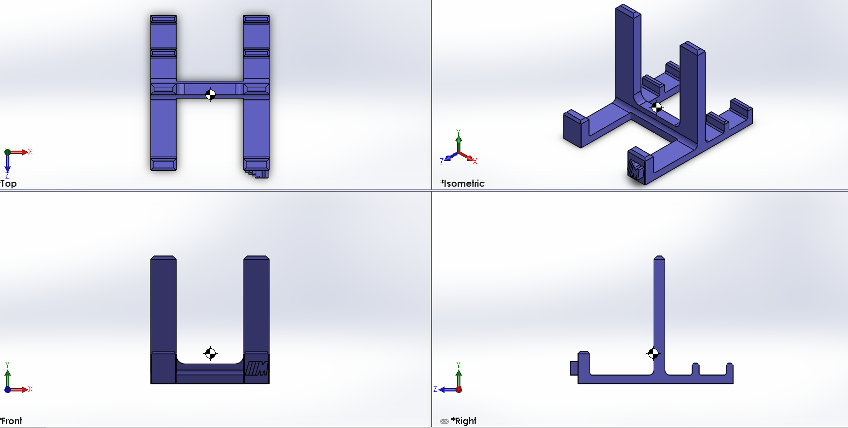
Print Time: 1h, 36m
Model Material(in^3): 2.241
Support Material(in^3): 0.239
ASSIGNMENT 9.2: Cell Phone Stand
WAIS SHAHBAZ
NOV. 20, 2018
MARS

Slide 2
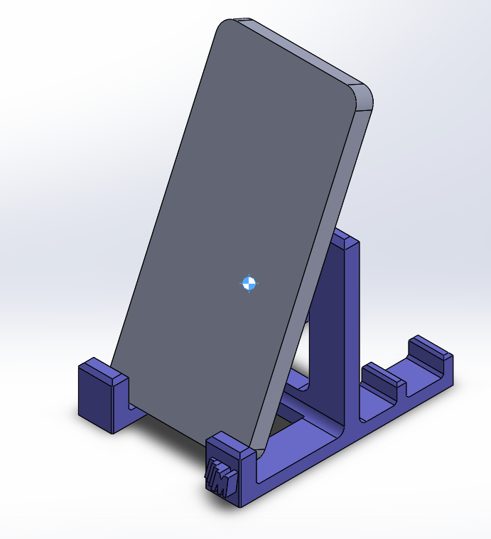
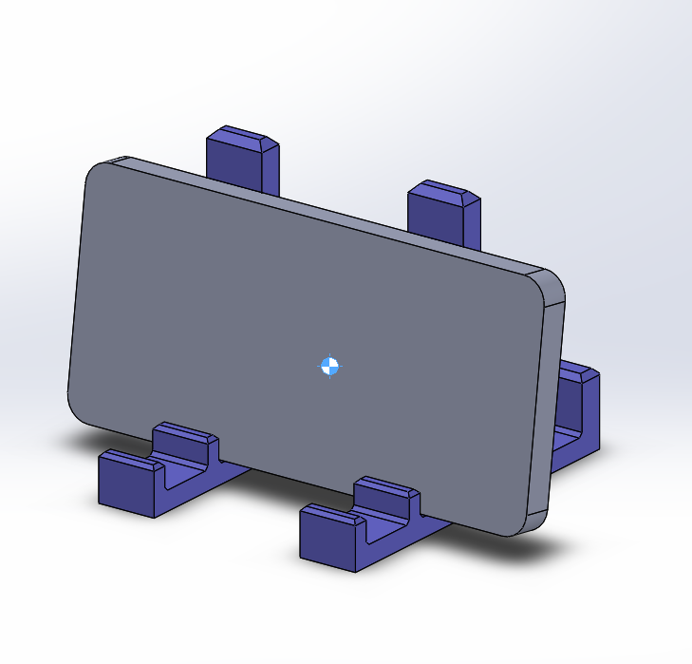
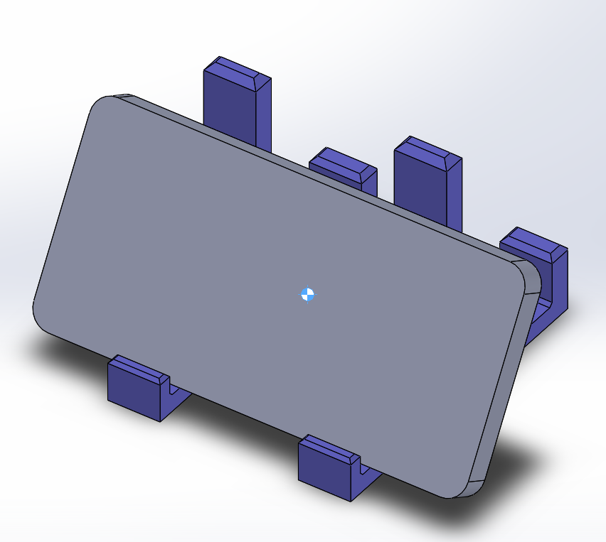
ASSIGNMENT 9.2: Cell Phone Stand
WAIS SHAHBAZ
NOV. 20, 2018
MARS

