Slide 1
Lab 4: IMU Activity and Gesture Recognition
Shanmu Wang

Slide 2
Big Picture: What Are We Building?
Human motion → IMU sensor → ESP32 → USB serial → Python → plots/classifier

Slide 3
What is an IMU?
IMU = Inertial Measurement Unit
Measures motion without a camera
Common in phones, watches, drones, game controllers
Common applications:
Motion tracking
Vibration monitoring
…

Slide 4
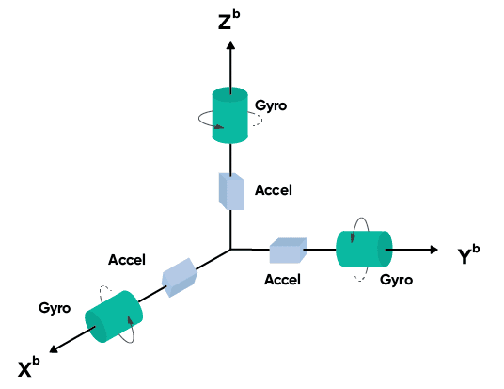
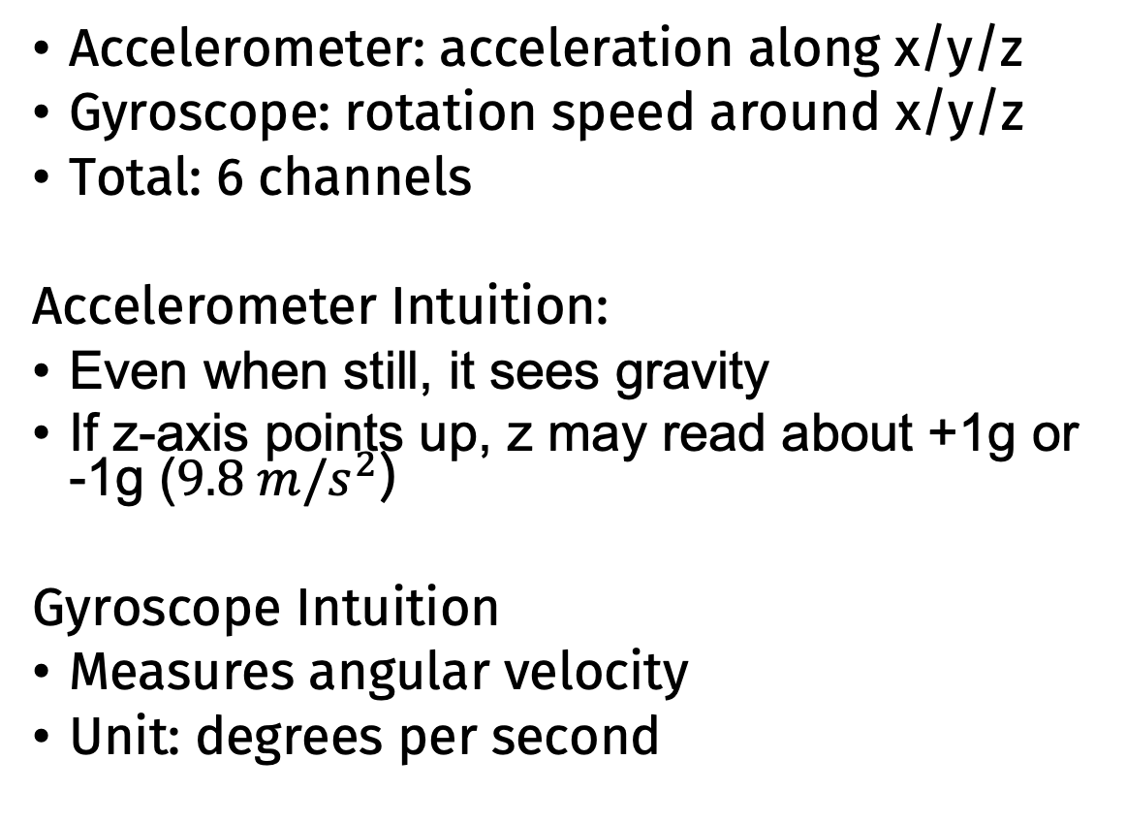
What Does Our IMU Measure?
Accelerometer: acceleration along x/y/z
Gyroscope: rotation speed around x/y/z
Total: 6 channels
Accelerometer Intuition:
Even when still, it sees gravity
If z-axis points up, z may read about +1g or -1g ($9.8 m/s^{2}$)
Gyroscope Intuition
Measures angular velocity
Unit: degrees per second

Slide 5

ESP32: MCU

Slide 6
MCU: Micro-Control Unit
A tiny computer for controlling hardware
Has CPU, memory, GPIO pins, timers, communication interfaces
ESP32 as Our MCU
Runs firmware code
Reads data from the IMU sensor
Sends text data to laptop through USB serial

Slide 7
How Does ESP32 Talk to the Sensor?
Sensors usually do not “print” data directly
MCU asks the sensor for data
Communication protocol: I2C

Slide 8
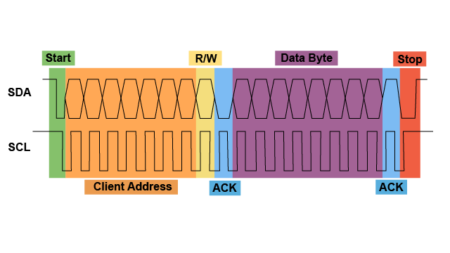
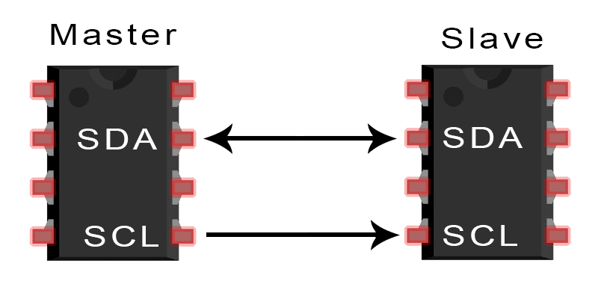
I2C: Inter-Integrated Circuit
Two-wire communication bus
SDA: data line
SCL: clock line
ESP32 controls the clock and requests data from the IMU sensor

Slide 9
Why Does I2C Need a Clock?
Clock tells both devices when to read/write each bit
Without a clock, devices may disagree about timing
Analogy: people passing notes at a fixed rhythm

Slide 10
What Is Serial Port Communication?
After ESP32 reads IMU data, it sends text to laptop
USB serial behaves like a stream of characters
Python reads one line at a time
accel[g] x=0.012 y=-0.034 z=0.998 | gyro[dps] x=0.10 y=-0.20 z=0.05

Slide 11
What Does Build & Flash Do?
Build:
Converts human-written code into machine code
Source code → compiler → binary firmware
Flash:
Uploads compiled firmware to ESP32 memory
After flashing, ESP32 runs the program by itself

