Slide 1
Proposal Presentation
Home Automation System
Group ID:
18-088

Slide 2
Our Team …
Name | IT Number
O.Y. Navarathneraja | IT 15050786
A.R.J. Akwaththa | IT15093660
H.M.P.H. Halpe | IT15052902
W.S.H. Boteju | IT14034114

Slide 3
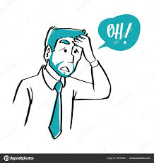

Have you ever experienced, the dreadful feeling of leaving the Iron or Light ON or the Door Unlocked … ??
If Yes, then…. That’s what our Research is all about….

Slide 4
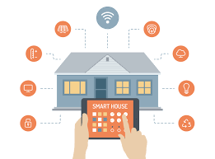
What is Home Automation?
Referred to as “Internet of Things”
Gives access to control devices in your Home from a mobile device, from anywhere.
With Home Automation, we can dictate how a device reacts, when it should react , and why it should react…

Slide 5

Knowledge Gap…
Busy Time schedules
No Time
Forgetfulness
Makes tasks more convenient
Reduce Power Consumption / Energy Efficient
Control over devices remotely
Increase Home Security , Ensuring Peace of Mind..
Power Failures/ Lighting resulting is Damaged Appliances.
Save money

Slide 6

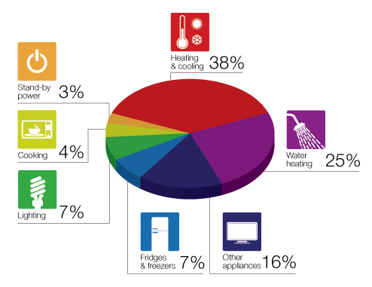
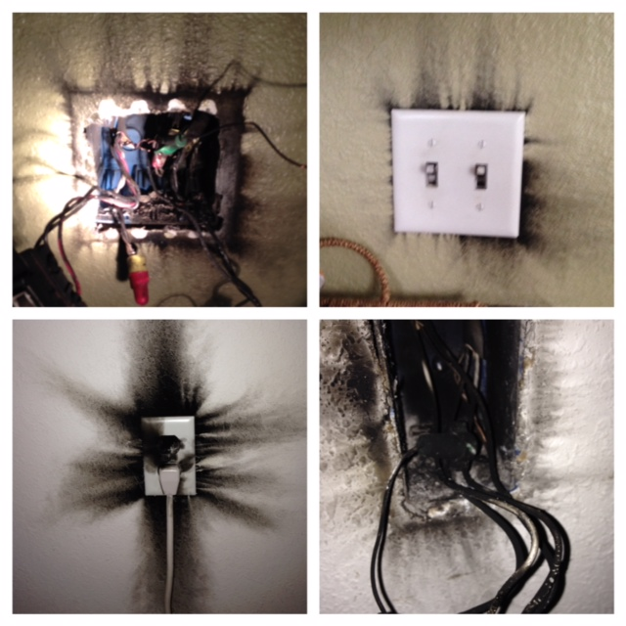

Slide 7

Our Solution…
A Home Automation that is;
Reliable
Cost-effective
Multi-functional
Highly energy Efficient
Ensure Peace of Mind
Easily Synchronize with existing sensors
Alert Notifications mobile device

Slide 8

Our System will the ability to…
Control the Status of Indoor Lights
Control the Status of Fan / AC
Lock or Unlock Doors and Windows
Automating the Status of Outdoor Lights
Automating the Garage Door and Light, when the correct vehicle is approaching.
Protecting High technical appliances from power outages or Lighting storms.
Protecting the Home and the system application from any kind of attacks.

Slide 9
Comparison with Existing Products
FEATURES | Bluetooth home automation | GSM | Email interactive | Voice recognition | ZigBee | EnOcean | Home 365 AUTOMATION
Garage Door Automated Control. |  |  |  | ✔ |  |  | ✔ Opens and Close by monitoring the vehicle
UV Light Detection and Switch on/off Light accordingly |  |  |  | ✔
Indoor Temperature Monitoring to operate AC or Fan | ✔ |  | ✔ | ✔ | ✔ | ✔ . | ✔ Depending on the people count, the AC and Fan is controlled

Slide 10
Comparison with Existing Products
FEATURES | Bluetooth home automation | GSM | Email interactive | Voice recognition | ZigBee | EnOcean | Home 365 AUTOMATION
Detect Open Doors or Windows, and Control Locking them remotely. | ✔ | ✔ | ✔ | ✔ | ✔ | ✔ | ✔
Detect On Lights and Off them accordingly, vise versa. | ✔ | ✔ | ✔ | ✔ | ✔ | ✔ | ✔
Manage High tech appliance, during power failures and avoid circuit burns. |  |  |  |  |  |  | ✔
Send Alert Notifications to the mobile app | ✔ | ✔ |  |  |  |  | ✔

Slide 11
Benefits of our system
Easy to Install , step by step procedure.
Cost Effective
Simple and manageable application (i.e No switching between platforms, to control different functionalities)
Automated Garages door opening, to increase flexibility and reduce Time and Effort for the Owners.
Automated Exterior lighting control
Help warn off intruders,
Avoid getting injured, trying to find the light switches, in the dark.

Slide 12
The Key Pillars for our Research..
Machine Learning
An application of artificial intelligence (AI )
Provides systems ability to;
Automatically learn and
Improve from experience without being explicitly programmed.

Slide 13
The Key Pillars for our Research..
Internet of Things
(IOT)
Network of physical devices, vehicles, home appliances embedded with electronics, software, sensors, actuators, and connectivity.
By Assigning an IP address, therefore enabling these objects to connect and exchange data, over the network.

Slide 14
The Key Pillars for our Research..
Image Processing
Method to convert an image into digital form and perform some operation on it.
To get an enhanced image
To extract useful information.

Slide 15
Applying Key Pillars to the Functionalities.
Key Pillars | Functionalities
Internet of Things | Door Window Controlling Landscape And interior Lighting Control Managing High technical appliances Temperature Control
Image Processing | Garage Door Control Security Measures
Machine Learning | Temperature Control Landscape And interior Lighting Control Managing High technical appliances Door Window Controlling
Server Communication | Alerts , Push Notifications

Slide 16
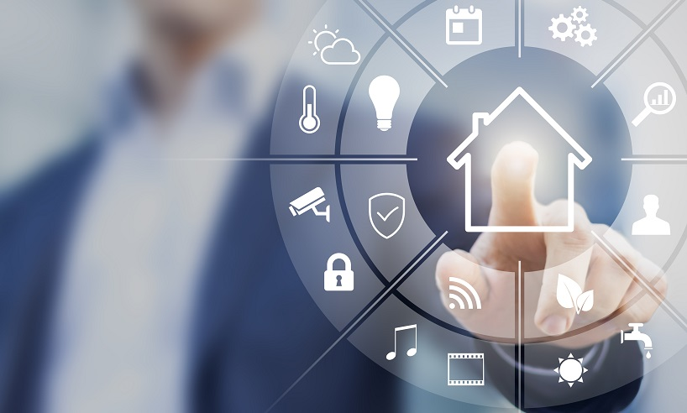
Home Automation System Consists of….
Research Project Components
Hardware components
Web-based system application

Slide 17
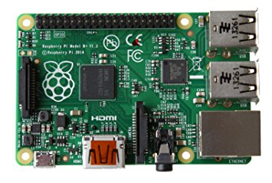
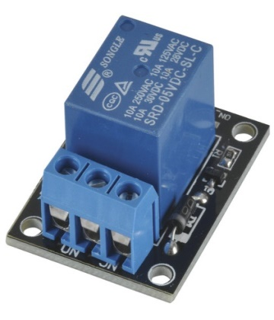
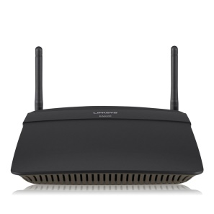
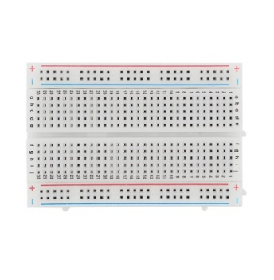
Hardware Components
Raspberry pi
Relays to control 120-240V devices
Router
Breadboard

Slide 18
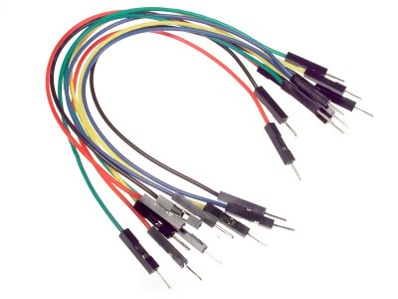
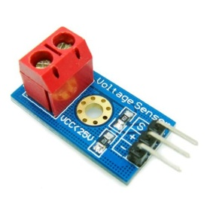
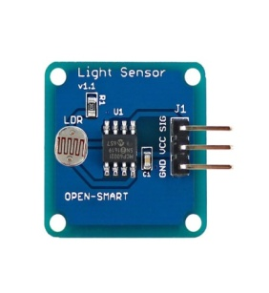
Hardware Components
Wires
Sensors
Web cameras
WiFi Shield

Slide 19
Web-based application
Technologies used to create the web application is;
Bootstrap framework
HTML 5
JavaScript
PHP
Notes:
Implementing a web app responsive to mobile and tablet

Slide 20
Device Monitoring and Control
Monitoring the status of the devices.
Controlling the basic actions of home devices.
Monitoring surveillance feeds and Hence, acts accordingly.
Technologies Used;
Raspberry Pi
Python
Open CV

Slide 21
Self Evaluation Plan…

Slide 22
Automated Garage gate Controlling and Surrounding Light Control
Image processing to detect and capture the License plate number of the residence vehicles.
Open the Garage gate when the vehicle is couple of meters away.
Check if the vehicle is at a safe distance, once inside the garage, and close the garage gate.
Automatically switch on the Home Porch Light, when nearing dusk.
Switch on the garage light, if the light is limited, when the vehicle is approaching.
Create and handle the Interface management of the house exterior (i.e Garage Gate and Lights)

Slide 23
Interior Lighting and Temperature Control
Machine learning to detect time and automate switching the status of the house lights.
Monitor the temperate and count of people in a room, and operate the AC or Fan.
Create and handle the Interface of the house Interior and Cooling System (i.e Lights, AC, Fan)

Slide 24
Managing and Controlling High Technical Appliances
When there is power failures, Detect the energy flow, Monitor and Handle the current flow of High Tech Appliances (refrigerator, routers, washing machines etc), once the power comes back.
Manage which appliances need to be switched back on.
Create and handle the Interface management of the house High Technical Appliances.
Notes:
Electricity

Slide 25
Remotely Controlling Doors and Windows
Sensor Communication to Detect Open Doors or Windows in the House.
Alert the Owners via the Server and Application and Lock the relevant Doors and windows.
Ensuring the Security of the Implemented System, securing the Internet connection with Firewall protection.
Create and handle the Interface management of the house Interior (i.e Doors and Windows)

Slide 26
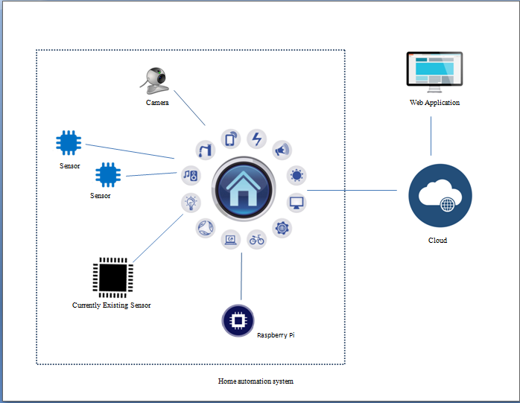
High-level System Architecture

Slide 27
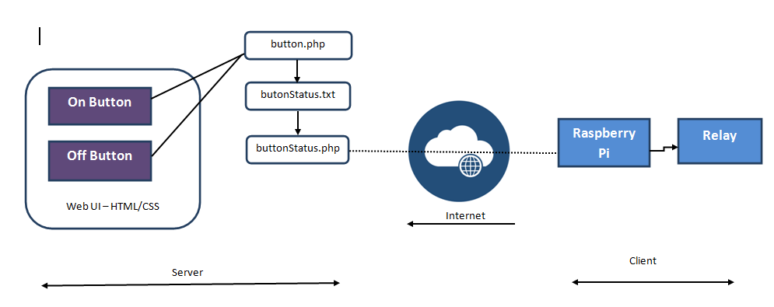
Raspberry Pi Home Automation Block Diagram

Slide 28
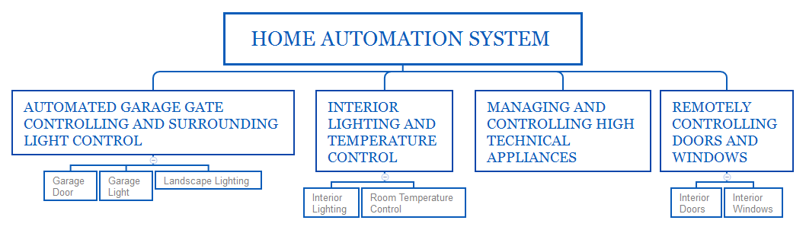
Work Break-down Structure

Slide 29
Commercialization
Cost Effective
Protect appliances from damage due to Power failures / Lighting
Most importantly,
The ability of our application to Synchronies and Integrate with existing Sensors, using NEST APIs
Provide
More efficiency
Maximum Control

Slide 30
Questions & Answers…
Thank You…

Slide 31
Web application
Server
User
Command signal
Electrical signals forwarded to the appliance
Processing by microcontroller
Action
Electrical signal
Appliance control

