Slide 1
Lecture 4 Model Order Selection
EE-uy 4563/EL-GY 9123: Introduction to machine learning
Prof. Sundeep rangan (with modification by Yao Wang)

Slide 2
Learning Objectives
Understand the concept of model class and model order
Visually identify overfitting and underfitting of a model in a scatterplot
Determine if there is under-modeling for a given true function and model class
Understand the concept of bias, variance and the irreducible error for a model
Know how to compute each from synthetically generated data
Understand the cross-validation process
Use it to assess the test error for a given model
Use it to select an optimal model order and for feature selection

Slide 3
Outline
Motivating example: What polynomial degree should a model use?
Bias and variance
Cross-validation
Extension to feature selection

Slide 4
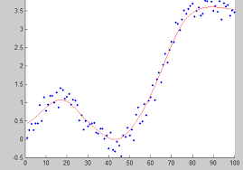
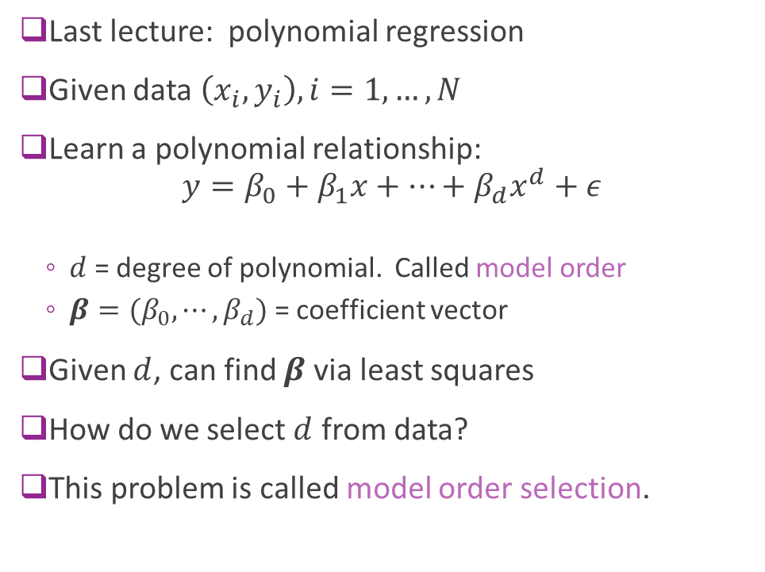
Polynomial Fitting
Last lecture: polynomial regression
Given data $\left(x_{i},y_{i}\right), i=1,…, N$
Learn a polynomial relationship: $y=β_{0}+β_{1}x+⋯+β_{d}x^{d}+ε$
$d$ = degree of polynomial. Called model order
$β=(β_{0},⋯,β_{d})$ = coefficient vector
Given $d$, can find $β$ via least squares
How do we select $d$ from data?
This problem is called model order selection.

Slide 5
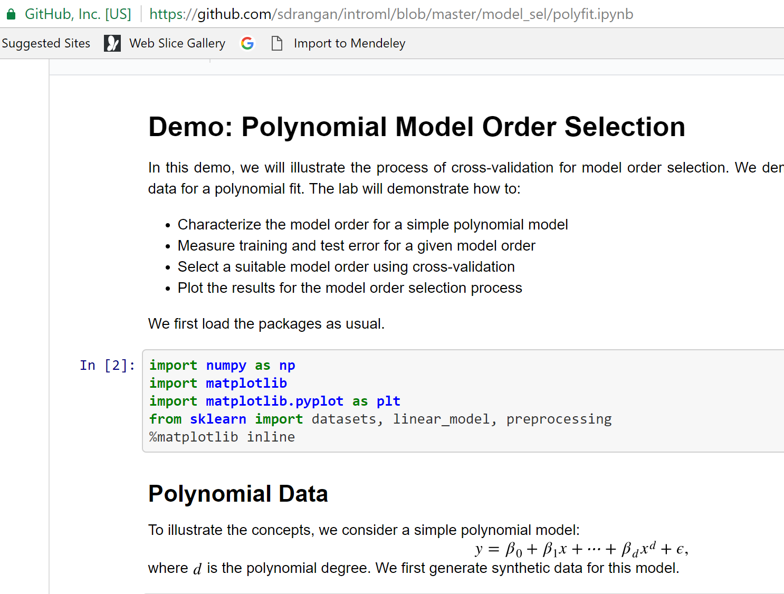
Demo on Github
Demo on github: https://github.com/sdrangan/introml/blob/master/unit03_model_sel/demo03_1_polyfit.ipynb

Slide 6
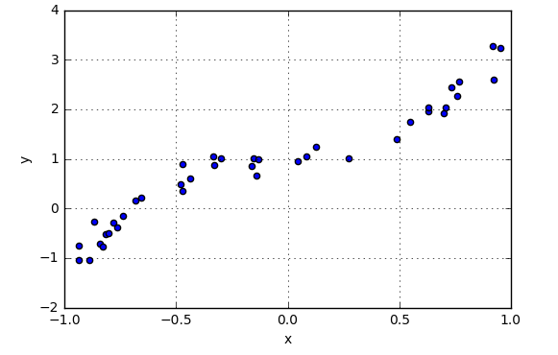
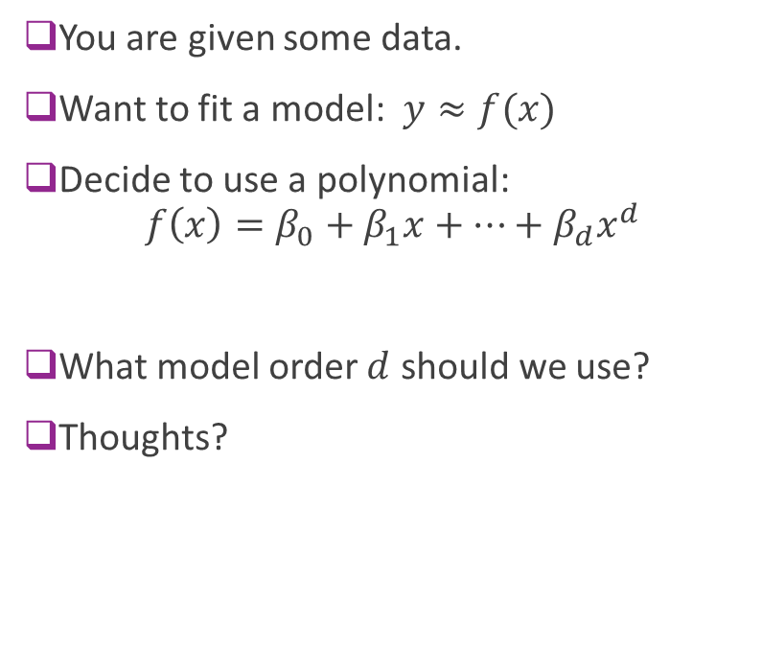
Example Question
You are given some data.
Want to fit a model: $y≈f(x)$
Decide to use a polynomial: $f\left(x\right)=β_{0}+β_{1}x+⋯+β_{d}x^{d}$
What model order $d$ should we use?
Thoughts?

Slide 7
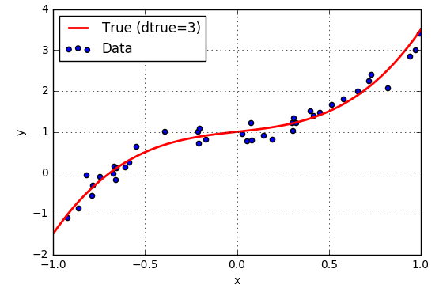
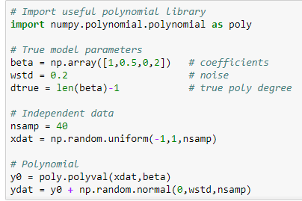
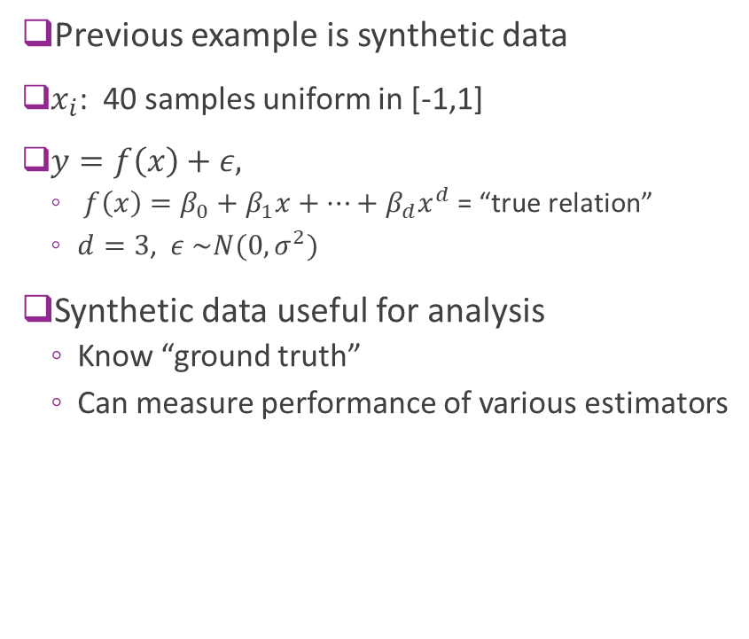
Synthetic Data
Previous example is synthetic data
$x_{i}$: 40 samples uniform in [-1,1]
$y=f\left(x\right)+ε,$
$f\left(x\right)=β_{0}+β_{1}x+⋯+β_{d}x^{d}$ = “true relation”
$d=3$, $ε \sim N(0,σ^{2})$
Synthetic data useful for analysis
Know “ground truth”
Can measure performance of various estimators

Slide 8
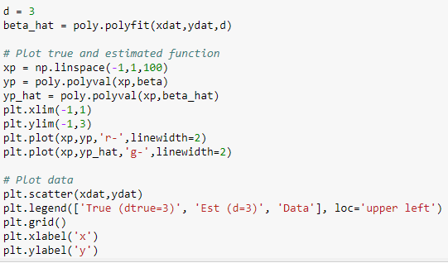
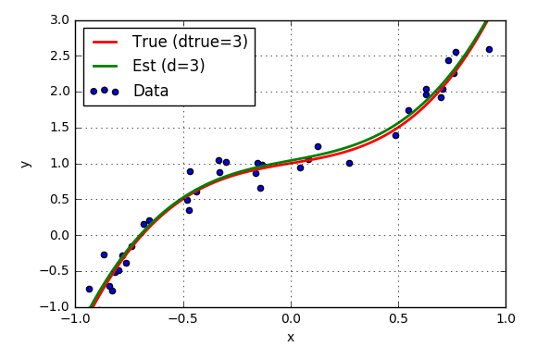
Fitting with True Model Order
Suppose true polynomial order, d=3, is known
Use linear regression
numpy.polynomial package
Get very good fit

Slide 9
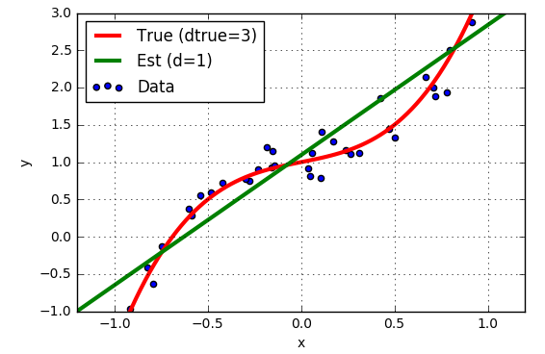
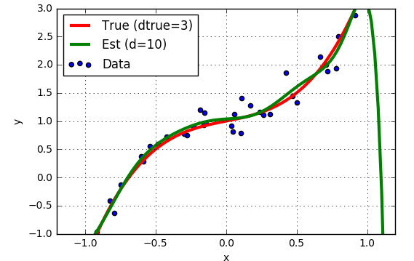
But, True Model Order not Known
Suppose we guess the wrong model order?
d=1 “Underfitting”
d=10 “Overfitting”

Slide 10
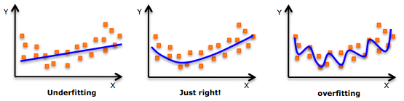
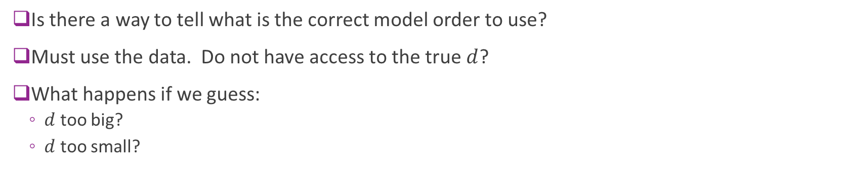
How Can You Tell from Data?
Is there a way to tell what is the correct model order to use?
Must use the data. Do not have access to the true $d$?
What happens if we guess:
$d$ too big?
$d$ too small?

Slide 11
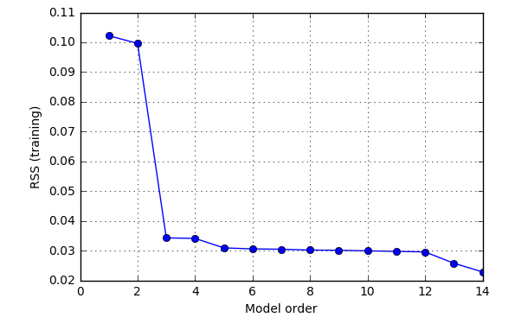
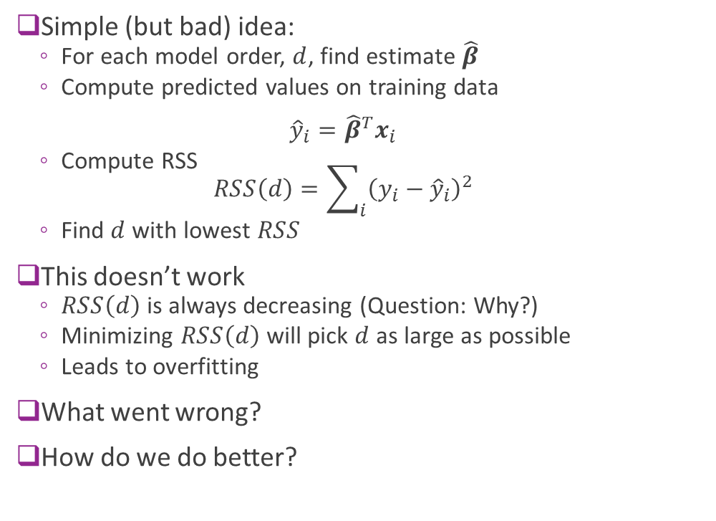
Using RSS on Training Data ?
Simple (but bad) idea:
For each model order, $d$, find estimate $\hat{β}$
Compute predicted values on training data ${\hat{y}}_{i}={\hat{β}}^{T}x_{i}$
Compute RSS $RSS\left(d\right)=\sum_{i}{{\left(y_{i}−{\hat{y}}_{i}\right)}^{2}}$
Find $d$ with lowest $RSS$
This doesn’t work
$RSS\left(d\right)$ is always decreasing (Question: Why?)
Minimizing $RSS\left(d\right)$ will pick $d$ as large as possible
Leads to overfitting
What went wrong?
How do we do better?

Slide 12
Outline
Motivating Example: What polynomial degree should a model use?
Bias and variance
Cross-validation

Slide 13
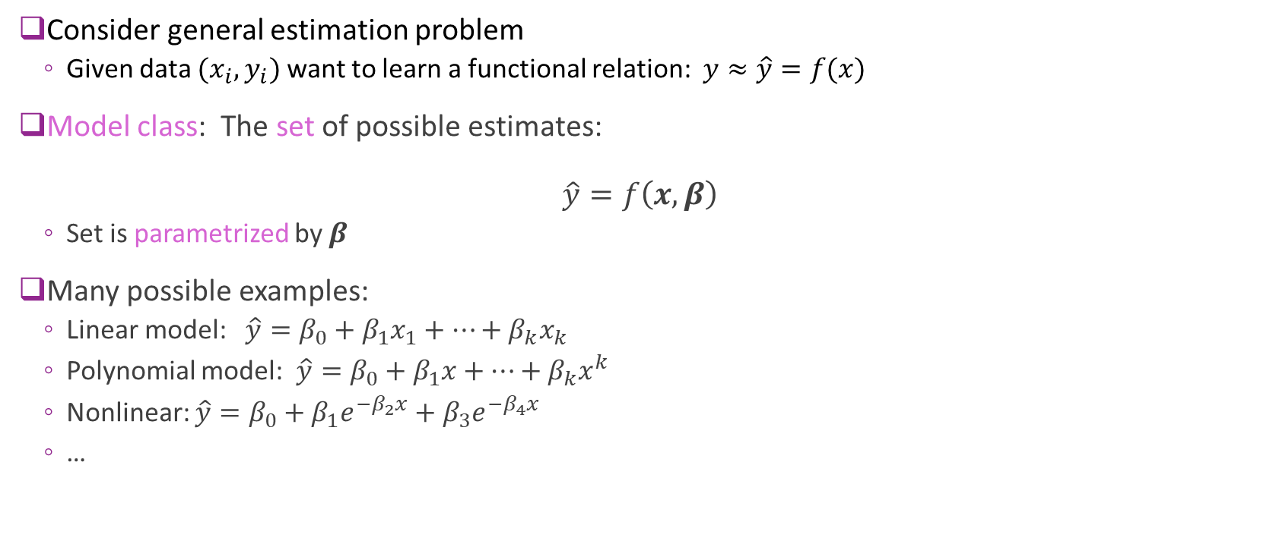
Model Class
Consider general estimation problem
Given data $(x_{i},y_{i})$ want to learn a functional relation: $y≈\hat{y}=f(x)$
Model class: The set of possible estimates: $\hat{y}=f\left(x,β\right)$
Set is parametrized by $β$
Many possible examples:
Linear model: $\hat{y}=β_{0}+β_{1}x_{1}+⋯+β_{k}x_{k}$
Polynomial model: $\hat{y}=β_{0}+β_{1}x+⋯+β_{k}x^{k}$
Nonlinear: $\hat{y}=β_{0}+β_{1}e^{−β_{2}x}+β_{3}e^{−β_{4}x}$
…

Slide 14

Model Class and True Function
Analysis set-up:
Learning algorithm assumes a model class: $\hat{y}=f\left(x,β\right)$
But, data has true relation: $y=f_{0}\left(x\right)+ε, ε\sim N(0,σ_{ε}^{2})$
Will quantify three key effects:
Irreducible error
Under-modeling
Over-fitting

Slide 15
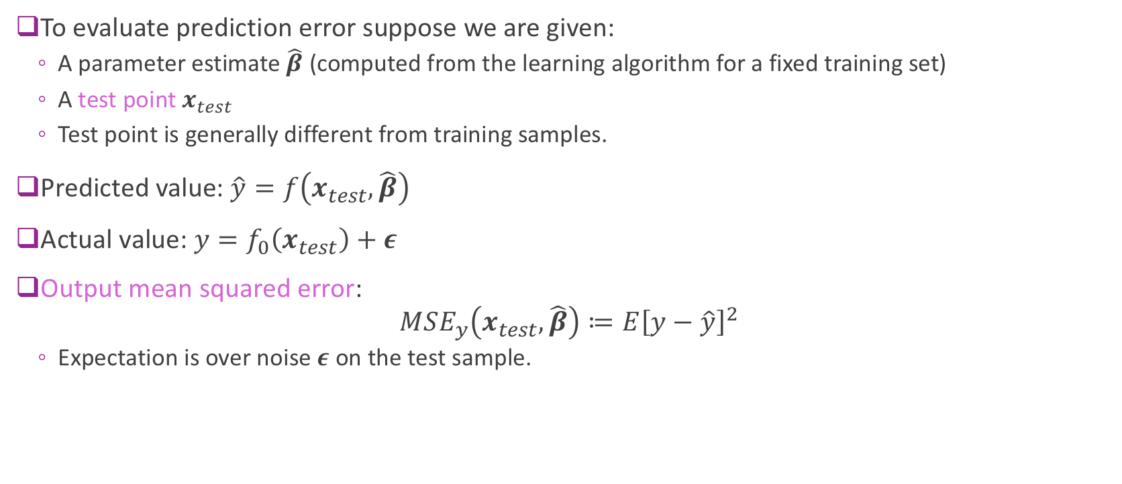
Output Mean Squared Error
To evaluate prediction error suppose we are given:
A parameter estimate $\hat{β}$ (computed from the learning algorithm for a fixed training set)
A test point $x_{test}$
Test point is generally different from training samples.
Predicted value: $\hat{y}=f\left(x_{test},\hat{β}\right)$
Actual value: $y=f_{0}\left(x_{test}\right)+ε$
Output mean squared error: $MSE_{y}\left(x_{test},\hat{β}\right)≔E{\left[y−\hat{y}\right]}^{2}$
Expectation is over noise $ε$ on the test sample.

Slide 16
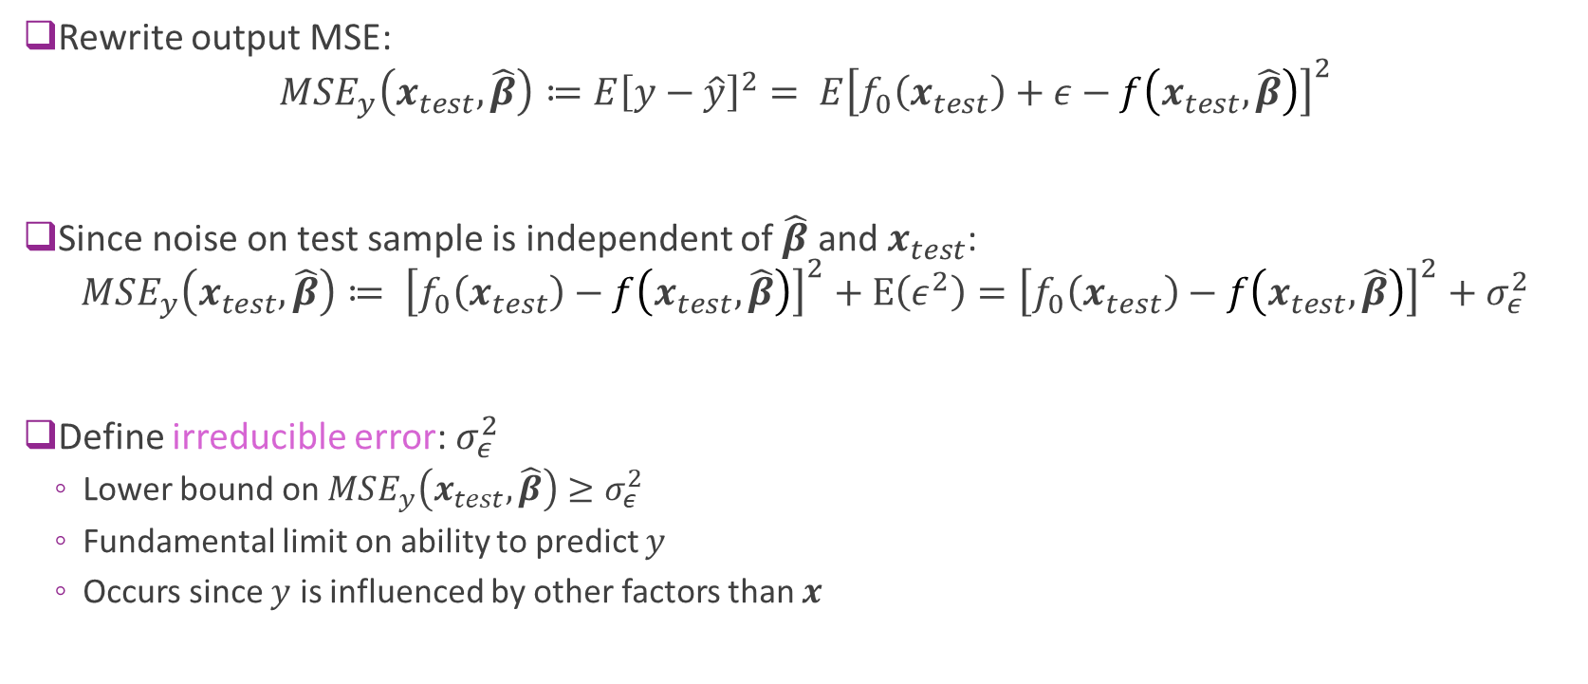
Irreducible Error
Rewrite output MSE: $MSE_{y}\left(x_{test},\hat{β}\right)≔E{\left[y−\hat{y}\right]}^{2}= E{\left[f_{0}\left(x_{test}\right)+ε−f\left(x_{test},\hat{β}\right)\right]}^{2}$
Since noise on test sample is independent of $\hat{β}$ and $x_{test}$: $MSE_{y}\left(x_{test},\hat{β}\right)≔ {\left[f_{0}\left(x_{test}\right)−f\left(x_{test},\hat{β}\right)\right]}^{2}+E\left(ε^{2}\right)={\left[f_{0}\left(x_{test}\right)−f\left(x_{test},\hat{β}\right)\right]}^{2}+σ_{ε}^{2}$
Define irreducible error: $σ_{ε}^{2}$
Lower bound on $MSE_{y}\left(x_{test},\hat{β}\right)≥σ_{ε}^{2}$
Fundamental limit on ability to predict $y$
Occurs since $y$ is influenced by other factors than $x$

Slide 17

Under-Modeling
Definition: A true function $f_{0}\left(x\right)$ is in the model class $\hat{y}=f\left(x,β\right)$ if: $f_{0}\left(x\right)=f\left(x,β_{0}\right) for all x$ for some parameter $β_{0}$.
$β_{0}$ called the true parameter
Under-modeling: When $f_{0}\left(x\right)$ is not in the model class

Slide 18
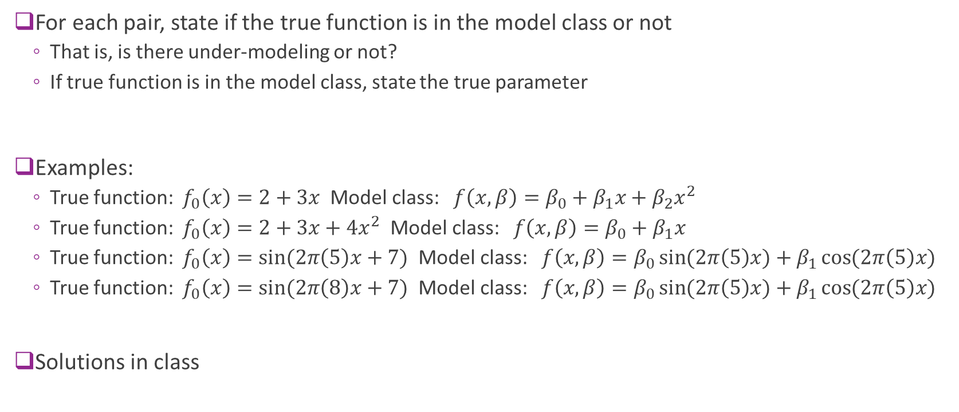
Sample Question
For each pair, state if the true function is in the model class or not
That is, is there under-modeling or not?
If true function is in the model class, state the true parameter
Examples:
True function: $f_{0}\left(x\right)=2+3x$ Model class: $f\left(x,β\right)=β_{0}+β_{1}x+β_{2}x^{2}$
True function: $f_{0}\left(x\right)=2+3x+4x^{2}$ Model class: $f\left(x,β\right)=β_{0}+β_{1}x$
True function: $f_{0}\left(x\right)=\sin{(2π\left(5\right)x+7)}$ Model class: $f\left(x,β\right)=β_{0}\sin{(2π\left(5\right)x)}+β_{1}\cos{(2π\left(5\right)x)}$
True function: $f_{0}\left(x\right)=\sin{(2π\left(8\right)x+7)}$ Model class: $f\left(x,β\right)=β_{0}\sin{(2π\left(5\right)x)}+β_{1}\cos{(2π\left(5\right)x)}$
Solutions in class

Slide 19
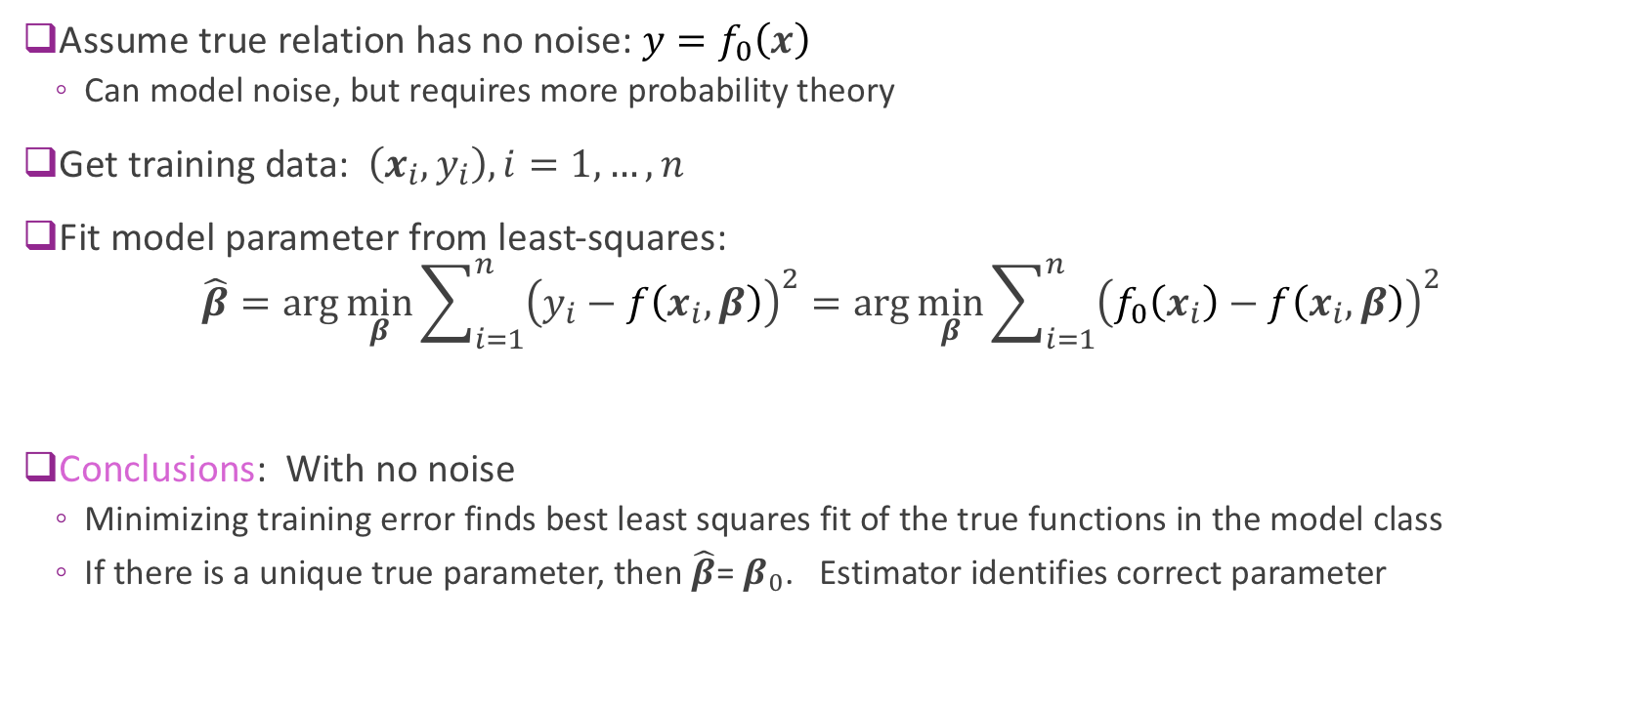
Analysis of Under-Modeling: Noise-Free Case
Assume true relation has no noise: $y=f_{0}\left(x\right)$
Can model noise, but requires more probability theory
Get training data: $\left(x_{i},y_{i}\right), i=1,…,n$
Fit model parameter from least-squares: $\hat{β}=\arg{\min_{β}{\sum_{i=1}^{n}{{\left(y_{i}−f\left(x_{i},β\right)\right)}^{2}}}}=\arg{\min_{β}{\sum_{i=1}^{n}{{\left(f_{0}\left(x_{i}\right)−f\left(x_{i},β\right)\right)}^{2}}}}$
Conclusions: With no noise
Minimizing training error finds best least squares fit of the true functions in the model class
If there is a unique true parameter, then $\hat{β}$= $β_{0}$. Estimator identifies correct parameter

Slide 20
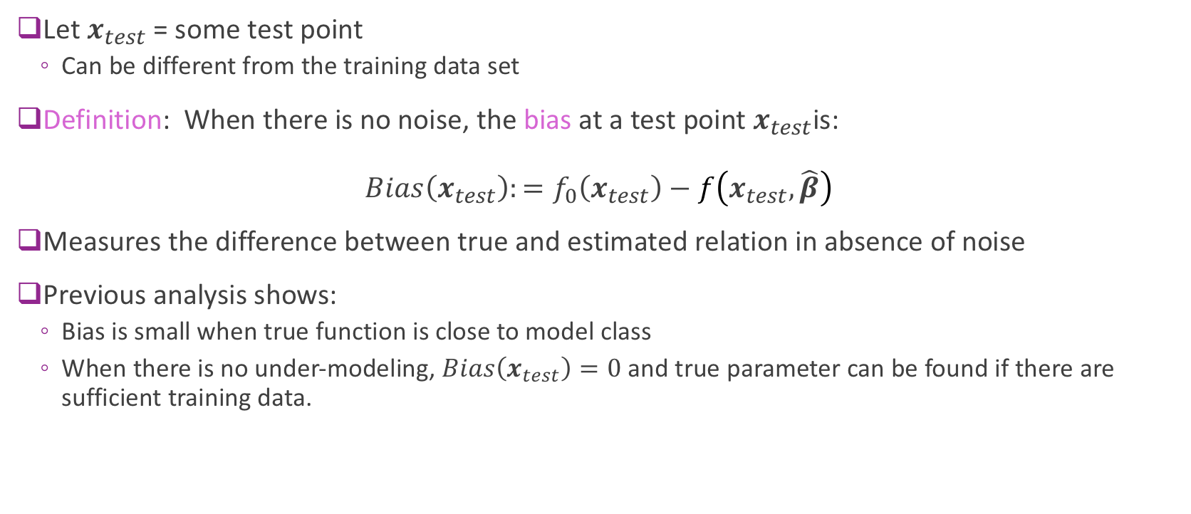
Bias: Noise-Free Case
Let $x_{test}$= some test point
Can be different from the training data set
Definition: When there is no noise, the bias at a test point$x_{test}$is: $Bias\left(x_{test}\right):=f_{0}\left(x_{test}\right)−f\left(x_{test},\hat{β}\right)$
Measures the difference between true and estimated relation in absence of noise
Previous analysis shows:
Bias is small when true function is close to model class
When there is no under-modeling, $Bias\left(x_{test}\right)=0$ and true parameter can be found if there are sufficient training data.

Slide 21
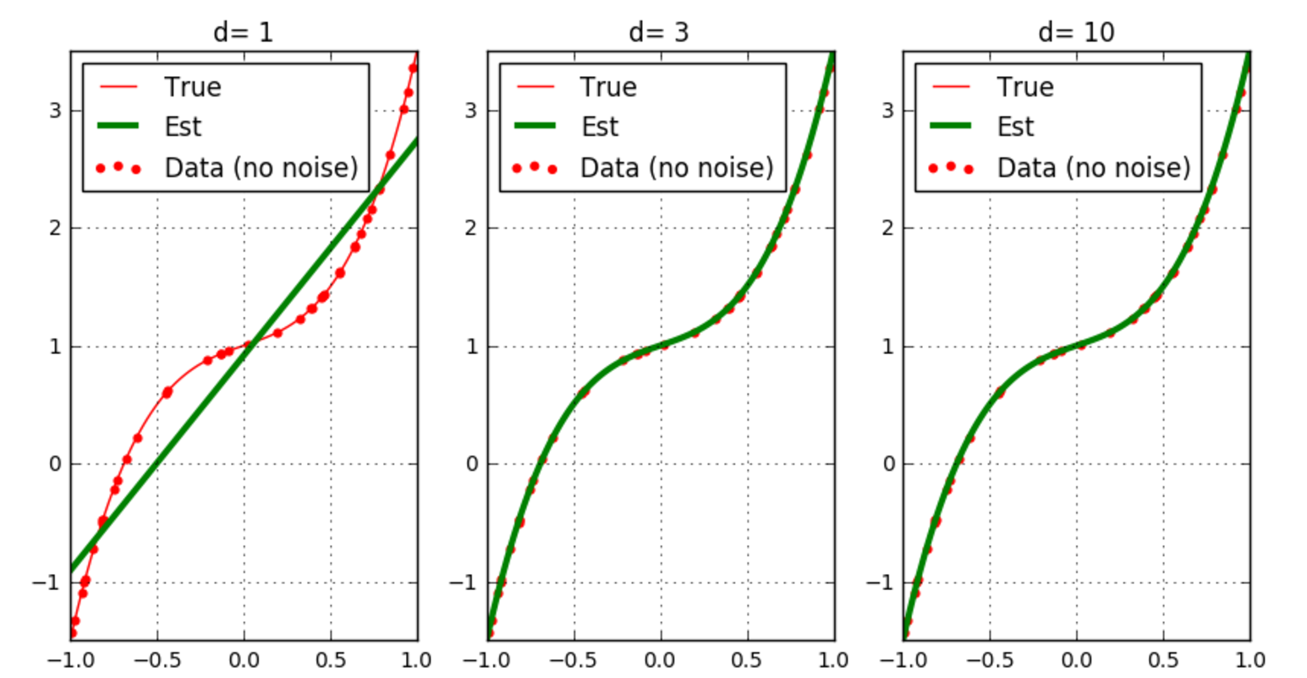
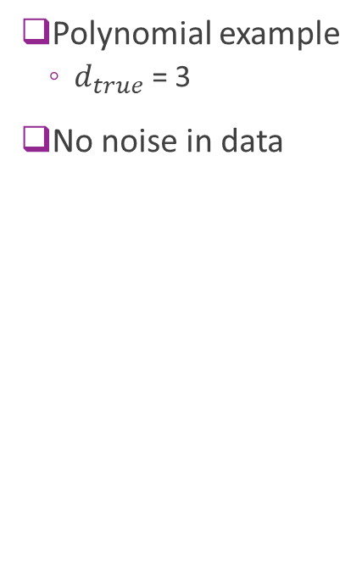
Bias Visualized
Polynomial example
$d_{true}$ = 3
No noise in data
Bias(x)
Model has bias
No bias
No bias

Slide 22
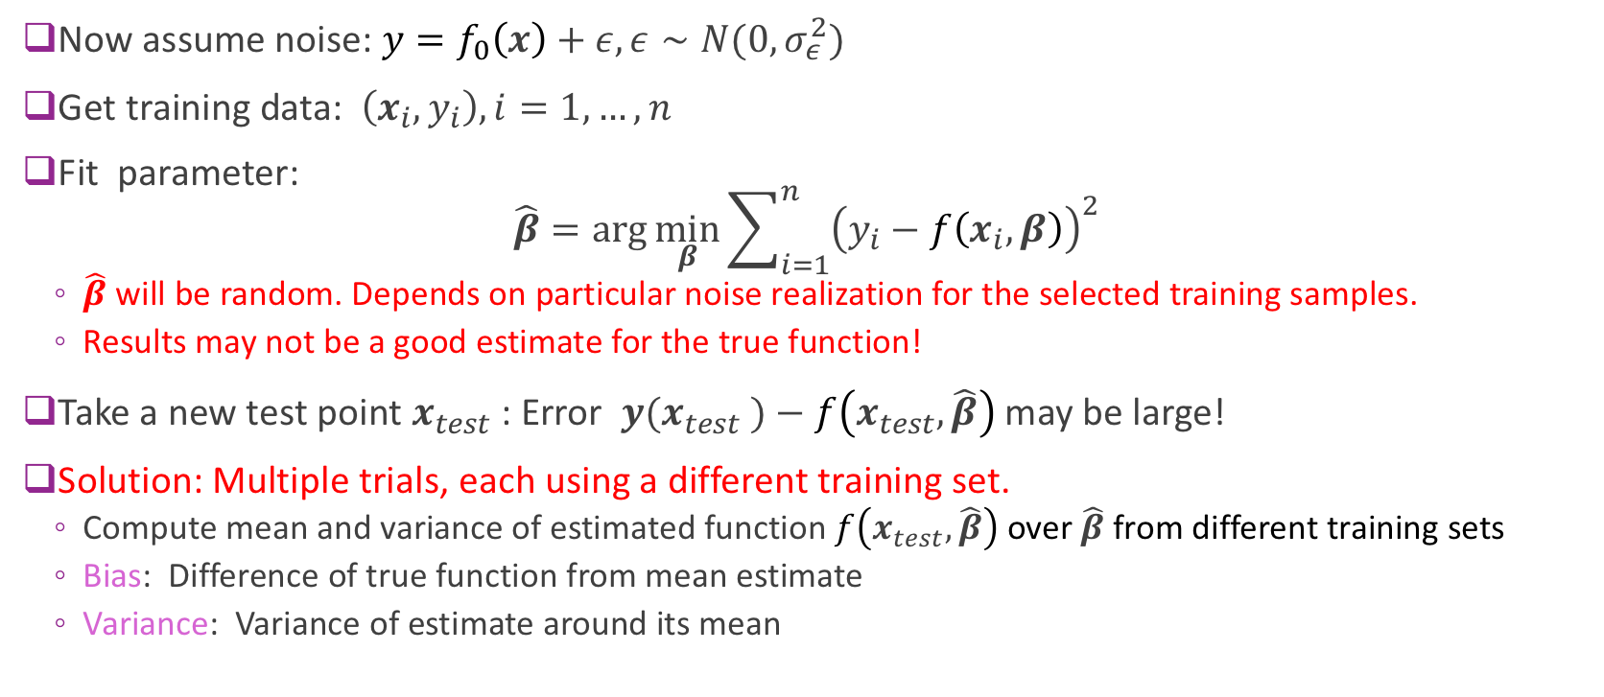
Analysis with Noise (Advanced)
Now assume noise: ${y=f}_{0}\left(x\right)+ε,ε∼N(0,σ_{ε}^{2})$
Get training data: $\left(x_{i},y_{i}\right), i=1,…,n$
Fit parameter: $\hat{β}=\arg{\min_{β}{\sum_{i=1}^{n}{{\left(y_{i}−f\left(x_{i},β\right)\right)}^{2}}}}$
$\hat{β}$ will be random. Depends on particular noise realization for the selected training samples.
Results may not be a good estimate for the true function!
Take a new test point $x_{test}$ : Error ${y(x}_{test} )−$ $f\left(x_{test},\hat{β}\right)$may be large!
Solution: Multiple trials, each using a different training set.
Compute mean and variance of estimated function $f\left(x_{test},\hat{β}\right)$ over $\hat{β}$from different training sets
Bias: Difference of true function from mean estimate
Variance: Variance of estimate around its mean

Slide 23
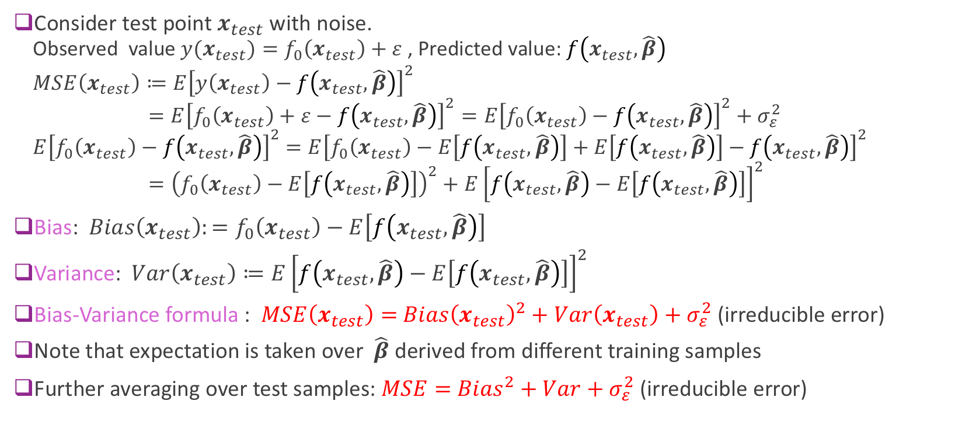
Bias-Variance Formula (Advanced)
Consider test point $x_{test}$ with noise.
Observed value${ y{(x}_{test})=f}_{0}\left(x_{test}\right)+ε$, Predicted value: $f\left(x_{test},\hat{β}\right)$
$$MSE\left(x_{test}\right)≔E{\left[y\left(x_{test}\right)−f\left(x_{test},\hat{β}\right)\right]}^{2}$$
$=E{\left[f_{0}\left(x_{test}\right)+ε−f\left(x_{test},\hat{β}\right)\right]}^{2}={E{\left[f_{0}\left(x_{test}\right)−f\left(x_{test},\hat{β}\right)\right]}^{2}+σ}_{ε}^{2}$
$E{\left[f_{0}\left(x_{test}\right)−f\left(x_{test},\hat{β}\right)\right]}^{2}$ $=E{\left[f_{0}\left(x_{test}\right)−E\left[f\left(x_{test},\hat{β}\right)\right]+E\left[f\left(x_{test},\hat{β}\right)\right]−f\left(x_{test},\hat{β}\right)\right]}^{2}$
$={\left(f_{0}\left(x_{test}\right)−E\left[f\left(x_{test},\hat{β}\right)\right]\right)}^{2}+E{\left[f\left(x_{test},\hat{β}\right)−E\left[f\left(x_{test},\hat{β}\right)\right]\right]}^{2}$
Bias: $Bias\left(x_{test}\right):=f_{0}\left(x_{test}\right)−E\left[f\left(x_{test},\hat{β}\right)\right]$
Variance: $Var\left(x_{test}\right)≔E{\left[f\left(x_{test},\hat{β}\right)−E\left[f\left(x_{test},\hat{β}\right)\right]\right]}^{2}$
Bias-Variance formula : $MSE\left(x_{test}\right)=$ ${Bias\left(x_{test}\right)}^{2}+Var\left(x_{test}\right)+σ_{ε}^{2}$ (irreducible error)
Note that expectation is taken over $\hat{β}$ derived from different training samples
Further averaging over test samples: $MSE=$ ${Bias}^{2}+Var+σ_{ε}^{2}$ (irreducible error)

Slide 24
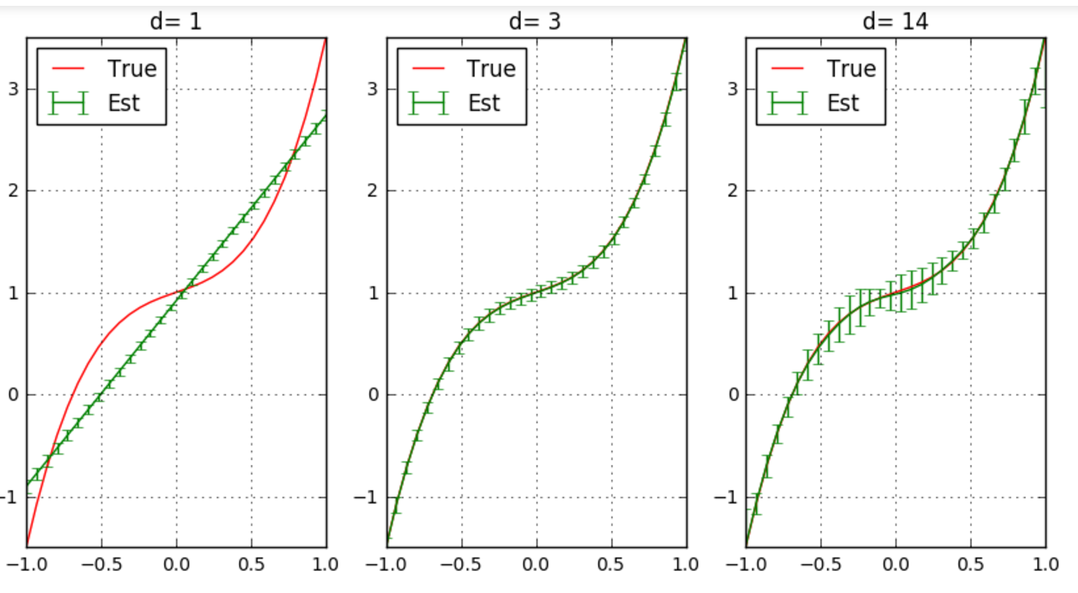
Bias and Variance Illustrated
Polynomial ex
Mean and std dev of estimated functions
100 trials
Solid line: mean estimate among all trials
Error bars: 1 STD
Low variance, High bias
High variance, Zero bias

Slide 25
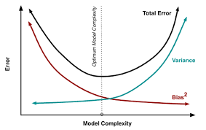
Bias-Variance Tradeoff
Optimal model order depends on:
Amount of samples available
Underlying complexity of the relation
Floor is the noise variance
Simpler models
Less parameters
Under-fitting
Richer models
More parameters
Over-fitting

Slide 26
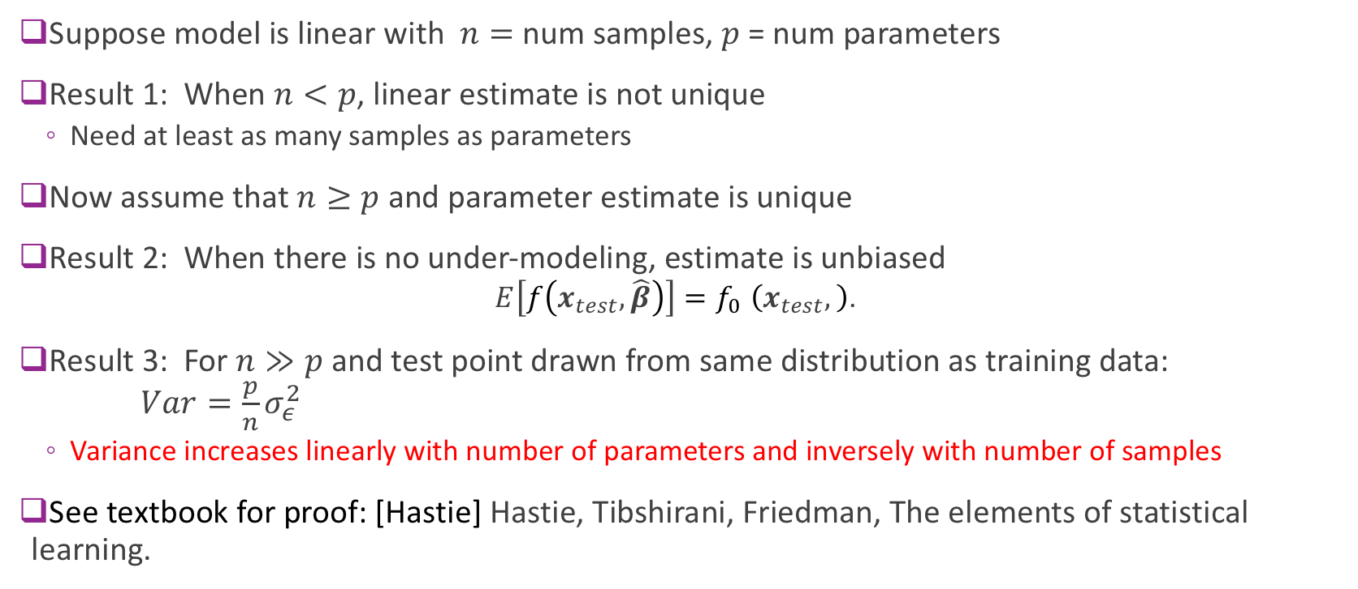
Results for Linear Models
Suppose model is linear with $n=$ num samples, $p$ = num parameters
Result 1: When $n<p$, linear estimate is not unique
Need at least as many samples as parameters
Now assume that $n≥p$ and parameter estimate is unique
Result 2: When there is no under-modeling, estimate is unbiased
$$E\left[f\left(x_{test},\hat{β}\right)\right]{=f}_{0}\left(x_{test},\right)\text{.}$$
Result 3: For $n≫p$ and test point drawn from same distribution as training data: $Var=\frac{p}{n}σ_{ε}^{2}$
Variance increases linearly with number of parameters and inversely with number of samples
See textbook for proof: [Hastie] Hastie, Tibshirani, Friedman, The elements of statistical learning.

Slide 27
Outline
Motivating Example: What polynomial degree should a model use?
Bias and variance
Cross-validation

Slide 28
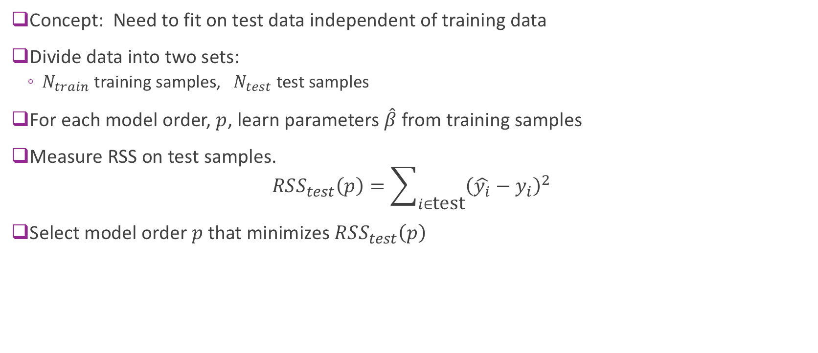
Cross Validation
Concept: Need to fit on test data independent of training data
Divide data into two sets:
$N_{train}$ training samples, $N_{test}$ test samples
For each model order, $p$, learn parameters $\hat{β}$ from training samples
Measure RSS on test samples. $RSS_{test}\left(p\right)=\sum_{i∈\text{test}}{{\left(\hat{y_{i}}−y_{i}\right)}^{2}}$
Select model order $p$ that minimizes $RSS_{test}\left(p\right)$

Slide 29
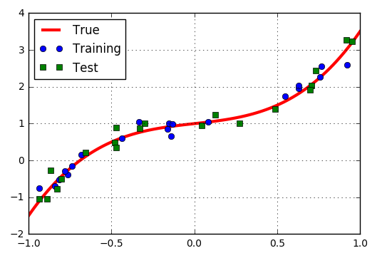
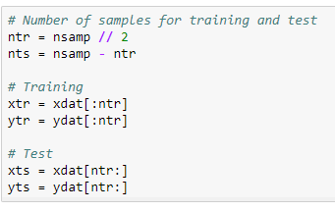
Polynomial Example: Training Test Split
Example: Split data into 20 samples for training, 20 for test

Slide 30
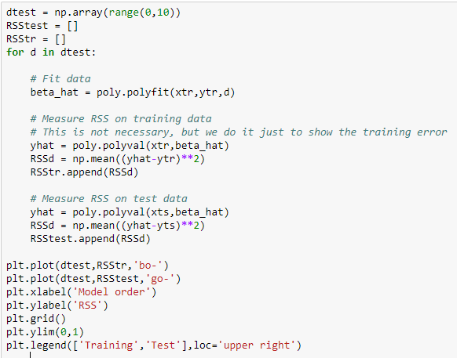
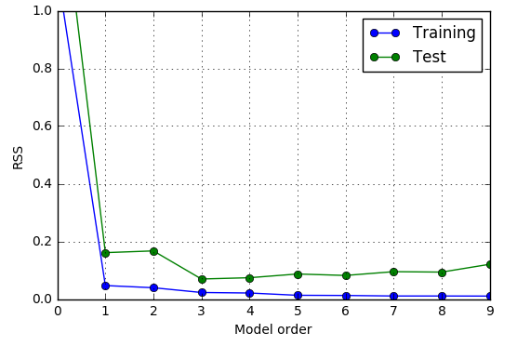
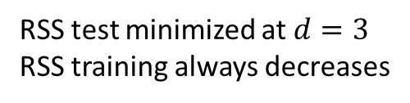
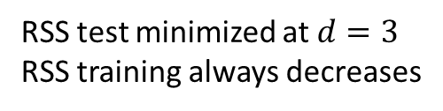
Finding the Model Order
Estimated optimal model order = 3
RSS test minimized at $d=3$
RSS training always decreases
RSS test minimized at $d=3$
RSS training always decreases

Slide 31
Problems with Simple Train/Test Split
Test error could vary significantly depending on samples selected
Only use limited number of samples for training
Problems particularly bad for data with limited number of samples

Slide 32
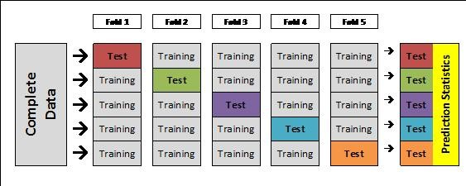
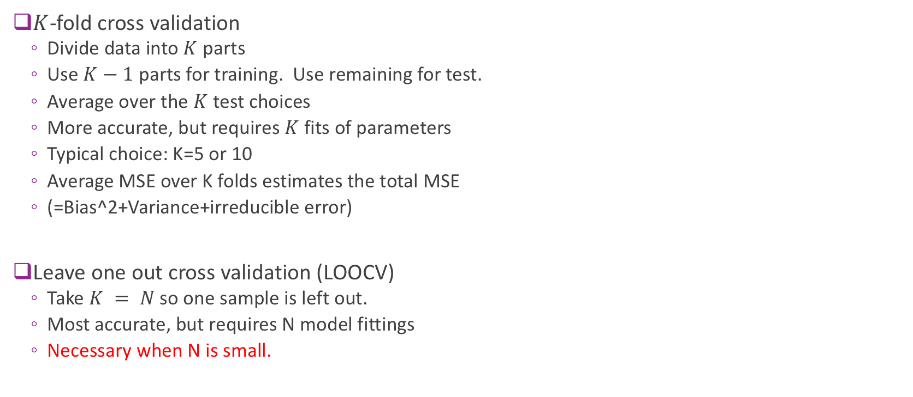
K-Fold Cross Validation
$K$-fold cross validation
Divide data into $K$ parts
Use $K−1$ parts for training. Use remaining for test.
Average over the $K$ test choices
More accurate, but requires $K$ fits of parameters
Typical choice: K=5 or 10
Average MSE over K folds estimates the total MSE
(=Bias^2+Variance+irreducible error)
Leave one out cross validation (LOOCV)
Take $K = N$so one sample is left out.
Most accurate, but requires N model fittings
Necessary when N is small.
From http://blog.goldenhelix.com/goldenadmin/cross-validation-for-genomic-prediction-in-svs/

Slide 33
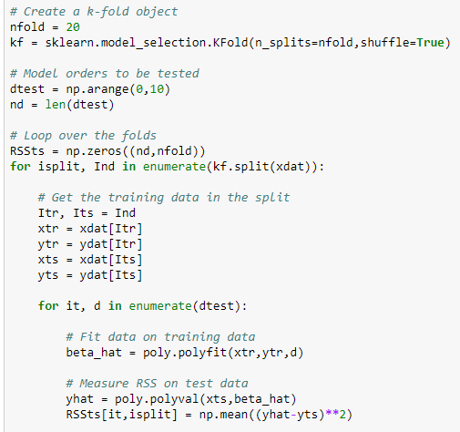
Polynomial Example
Use sklearn Kfold object
Loop
Outer loop: Over K folds
Inner loop: Over D model orders
Measure test error in each fold and order
Averaging test errors from K folds for each model order
Find the model order with the minimal average test errors
Can be time-consuming

Slide 34
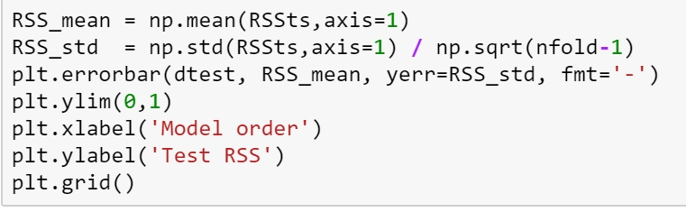
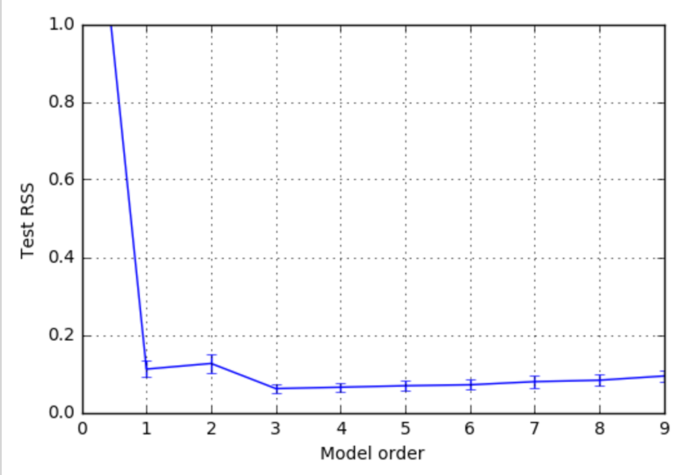

Polynomial Example CV Results
For each model order d
Compute mean test RSS over K folds
Compute standard error (SE) of test RSS
SE=STD of mean RSS=RSS std/ $\sqrt{K−1}$
(expectation over different realizations
of data in each fold)
Simple model selection
Select d with lowest mean test RSS
For this example
Estimate model order = 3

Slide 35
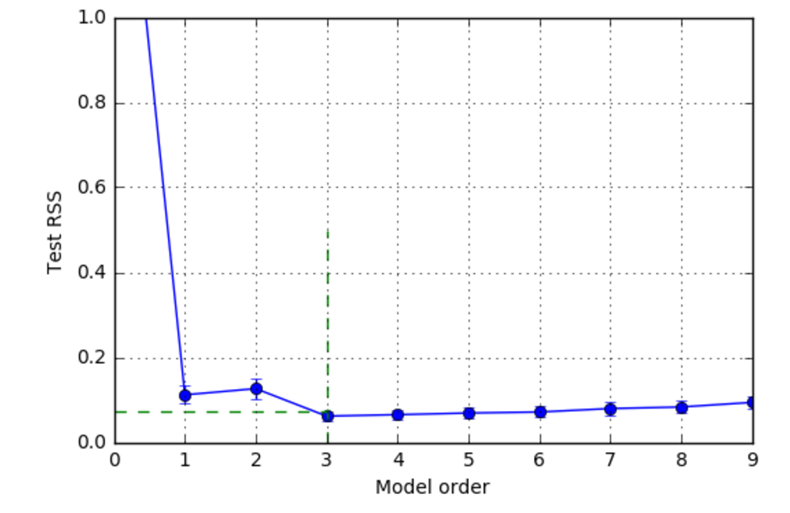
One Standard Error Rule
Previous slide: Select d to minimize mse_mean[d]
Problem: Often over-predicts model order
One standard deviation rule
Use simplest model within one SE of minimum
Detailed procedure:
Find d0 to minimize mse_mean[d]
Set mse_tgt = mse_mean[d0] + mse_std[d0]
Find minimal dopt s.t. mse_mean[dopt] <= mse_tgt
mse_tgt
Optimal model order

Slide 36
Feature selection as model selection
So far we discussed how to select the order of a fitting polynomial as a model selection problem.
More generally, given many features, only a subset of the features may be useful for predicting the target. How do we select the useful features?
With linear regression, each possible feature subset corresponds to a different model, and the feature number is the model order!
Higher feature number leads to low bias but higher variance!
We can use the approach for polynomial order selection to solve the feature selection problem.

Slide 37

Exhaustive search for feature selection
Suppose you want to consider feature subset of size up to $p$
For all possible feature subsets of size 1 to $p$: use cross validation to find mean RSS mean and standard deviation for each feature subset.
Choose the subset with the minimal RSS mean, or use the one standard error rule.

Slide 38
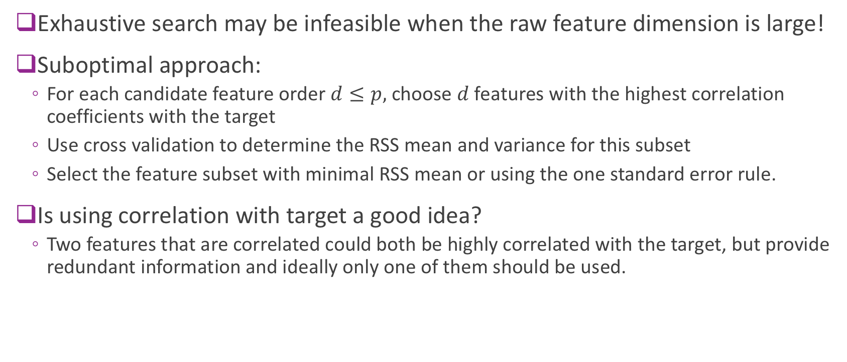
Feature selection based on correlation with target
Exhaustive search may be infeasible when the raw feature dimension is large!
Suboptimal approach:
For each candidate feature order $d≤p,$ choose $d$ features with the highest correlation coefficients with the target
Use cross validation to determine the RSS mean and variance for this subset
Select the feature subset with minimal RSS mean or using the one standard error rule.
Is using correlation with target a good idea?
Two features that are correlated could both be highly correlated with the target, but provide redundant information and ideally only one of them should be used.

Slide 39
Greedy feature selection
Forward-Stepwise Selection
Select one feature from all features that provides the lowest RSS with cross validation
Select one new feature from all remaining features, so that previously chosen features plus the new feature provides the lowest RSS
Repeat until the maximum feature number is reached, or when the RSS starts to increase
Backward-Stepwise
First use all features and find the RSS (using cross validation)
Remove one feature and find the new RSS. Go through all possible features to remove.
Find the one that leads to the least RSS increase. Remove this feature.
Repeat the above, remove one from the remaining features, to find the next most important feature.
Except exhaustive search, can all lead to suboptimal solution
We will discuss the method of LASSO in the next lecture for feature selection.

Slide 40
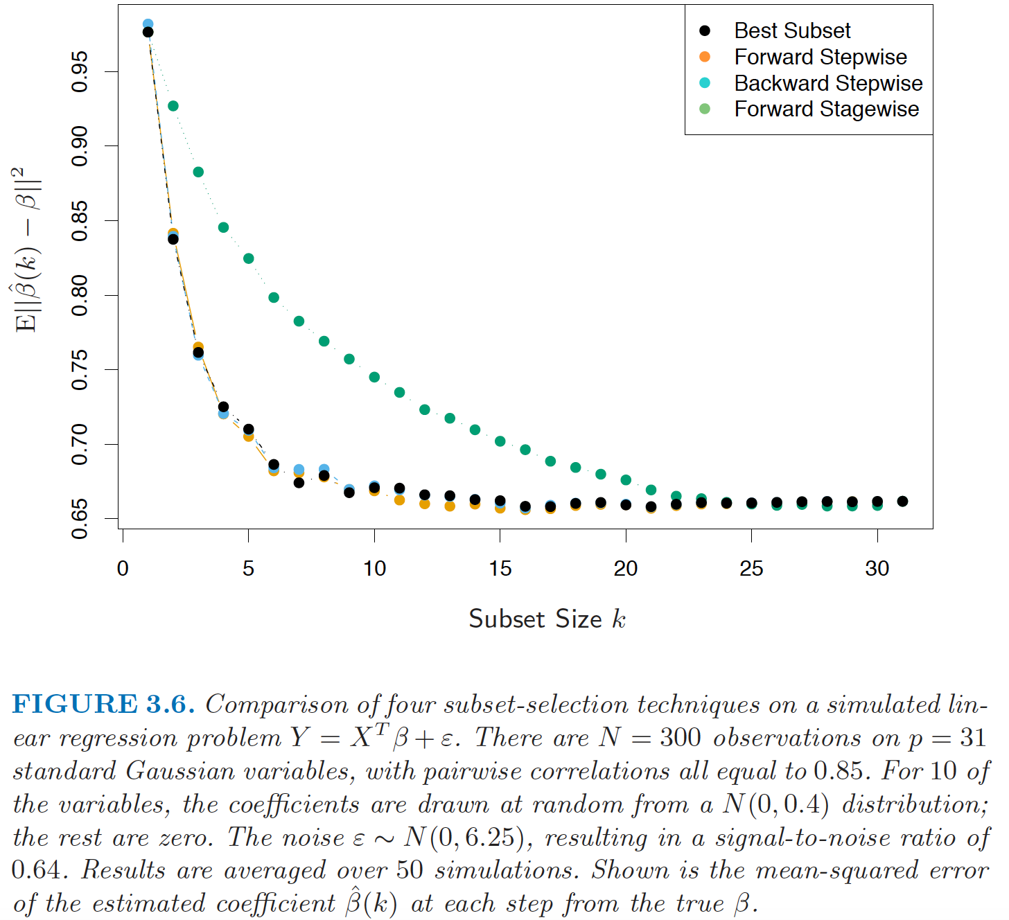
Comparison of feature selection methods
Figure from [Hastie2008]: Hastie, Tibshirani, Friedman, The elements of statistical learning.
For more on this subject, see Sec. 3.3

Slide 41
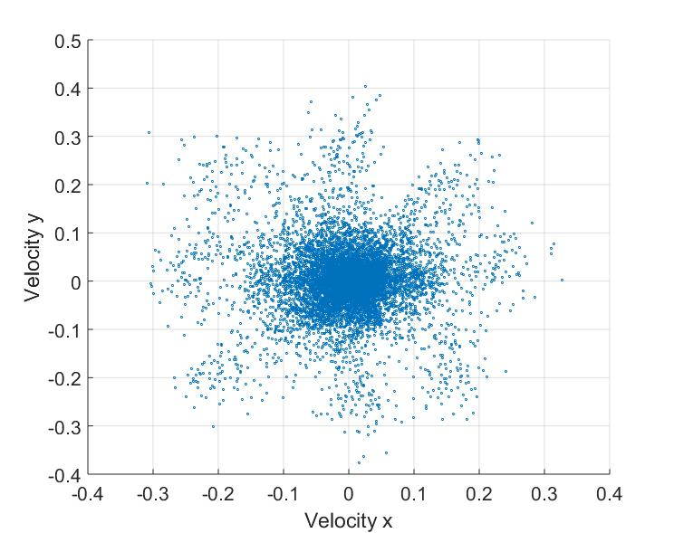
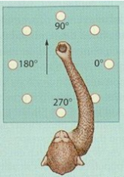


Lab: Neural ECoG Data
Record arm motion
Read a monkey’s brain!
Predict hand motion from electrode measurements (number of spikes in each neuron)
Feature selection
Which neuron signals predict arm motion?
Use correlation to select candidate feature subsets
Data from https://crcns.org/
Open source website on neural data
Great for projects
Arm velocity
Velocity y
Velocity x
Spikes
Neuron
Record spikes (ECoG in M1)
Time

Slide 42
What you should know from this lecture
Understand the concept of model class and model order
Visually identify overfitting and underfitting of a model in a scatterplot
Determine if there is under-modeling for a given true function and model class
Understand the concept of bias, variance and the irreducible error for a model
Know how to compute each from synthetically generated data
Understand the cross-validation process
Use it to assess the test error for a given model
Use it to select an optimal model order and for feature selection

