Slide 1
RESEARCH PRESENTATION · POST-QUANTUM CRYPTOGRAPHY × FEDERATED LEARNING
CB-SAFE: Code-Based Post-Quantum Secure Aggregation for Byzantine-Robust Federated Learning
Md Wahiduzzaman Suva (26-94088-2) · Esm-e Moula Chowdhury Abha (26-94089-2)
Department of Computer Science, American International University–Bangladesh
1 / 12

Slide 2
INTRODUCTION
What this research is about
▪ The setting: federated learning (FL) trains one shared model across many devices; data never leaves the client, only model updates travel.
▪ What we are trying to do: keep those updates private against future quantum computers AND keep training correct when some clients are malicious.
▪ What we propose: CB-SAFE, a secure-aggregation framework whose post-quantum protection comes from a code-based scheme (HQC) instead of the usual lattices, extended with a poisoning defense.
Clients train locally (private data)
encrypted updates
Server aggregates (sees no individual update)
new global model
Better shared model, privacy intact
Threats: quantum + poisoning
CB-SAFE · Suva & Chowdhury · AIUB
2 / 12

Slide 3
BACKGROUND
The problem: three threats meet in one protocol
▪ Updates leak. Gradient-inversion attacks reconstruct private training images from a single client's update, so updates must be hidden.
▪ Secure aggregation hides them with pairwise masks that cancel in the sum, but its key exchange breaks once a quantum computer exists (“harvest now, decrypt later”).
▪ All post-quantum fixes use one math family (lattices) and hiding updates also blinds the server to poisoned updates from malicious clients.
Privacy threat: updates reveal training data
Quantum threat: key exchange breaks (Shor)
Poisoning threat: malicious clients flip the model
FL secure aggregation must survive all three at once
CB-SAFE · Suva & Chowdhury · AIUB
3 / 12

Slide 4
CLOSELY RELATED WORK
How the closest peer-reviewed paper solves it
PQSF: “Post-quantum secure privacy-preserving federated learning”, Zhang et al., Scientific Reports 14, 2024 (peer-reviewed)
▪ Their solution: the Bonawitz-style masking protocol, made quantum-safe with lattice cryptography: a lattice multi-stage secret-sharing scheme reconstructs the masks, so the server still learns only the sum of updates.
▪ What works: peer-reviewed evidence that post-quantum secure aggregation is practical in FL; our confidentiality layer follows the same masking pattern.
Gap 1 · Lattice-only One cryptanalytic advance breaks everything
Gap 2 · No robustness A poisoned update passes straight through the sum
Gap 3 · Hard-wired primitive Cannot swap the KEM when standards evolve
CB-SAFE targets exactly these gaps. (2026 preprints confirm the gap is live: lattice+reputation and quantum-hardware approaches, but none is code-based.)
CB-SAFE · Suva & Chowdhury · AIUB
4 / 12

Slide 5
OUR PROPOSAL
CB-SAFE: one training round, end to end
Code-based (HQC) key setup happens once; every round then runs entirely on cheap masks.
Cluster 1 (c clients, masked)
masks cancel
Server sees ONLY k cluster sums S₁ … Sₖ (never an individual)
inspect sums
Robust aggregation + CB-SAFE+ defense (flag & exclude attackers)
Global model
Cluster 2 (c clients, masked)
⋮ (k clusters)
ONE-TIME: HQC (code-based KEM) key setup (pluggable: swap in ML-KEM/Kyber with one config line)
EVERY ROUND: fresh masks from stored secrets: zero KEM bytes on the wire
CB-SAFE · Suva & Chowdhury · AIUB
5 / 12

Slide 6
PROPOSAL · CONFIDENTIALITY LAYER
Hide every update, pay for crypto only once
▪ Each client adds secret masks to its update; within a cluster the masks cancel, so the sum is exact but individuals stay hidden (anonymity set = cluster size).
▪ Guarantee (proved): the server, even colluding with some clients, learns nothing beyond each cluster's sum.
▪ Dropouts handled: secret-sharing recovers the masks of clients who disconnect mid-round.
SETUP (once) publish HQC public keys, establish pairwise secrets
EVERY ROUND derive fresh masks locally (no new crypto traffic)
SERVER sums per cluster, masks vanish
stored secrets
masked update
CB-SAFE · Suva & Chowdhury · AIUB
6 / 12

Slide 7
PROPOSAL · CB-SAFE+ DEFENSE
Catch attackers the server never sees individually
▪ Key insight: a poisoned cluster sum looks normal in size but pushes the model the wrong way; a tiny server-side dataset (200 samples) exposes it: applying that sum raises the loss.
▪ Repetition identifies individuals: clusters are reshuffled every round, so a real attacker is inside a flagged cluster almost every round while honest clients are flagged only occasionally.
1 · Reshuffle new random clusters every round
2 · Probe does each cluster sum raise root-set loss?
3 · Flag mark suspicious cluster sums
4 · Score suspicion += 1 for all members of flagged clusters
5 · Exclude persistent suspects are removed from training
Flags are computed from sums the server already holds, so the defense leaks nothing extra (proved).
CB-SAFE · Suva & Chowdhury · AIUB
7 / 12

Slide 8
EVALUATION METHODOLOGY
How we evaluate: five KPI families
KPI | What it measures | How
Communication overhead | bytes per client: one-time setup vs every round | counted from real protocol messages (liboqs)
Computation time | key setup, masking, unmasking wall-clock | measured per round on real hardware
Utility | test accuracy vs plain FedAvg (must match) | CIFAR-10, non-IID, 30 clients, 40 rounds
Robustness | accuracy & attack success rate vs attacker fraction f | sign-flip, label-flip, backdoor at f = 10–30%
Identification quality | attackers caught / honest clients wrongly excluded | vs ground truth across all runs
Baselines: plain FedAvg, lattice (ML-KEM) variant, and four standard robust rules (mean, trimmed mean, median, Multi-Krum), all at matched NIST security levels.
CB-SAFE · Suva & Chowdhury · AIUB
8 / 12

Slide 9
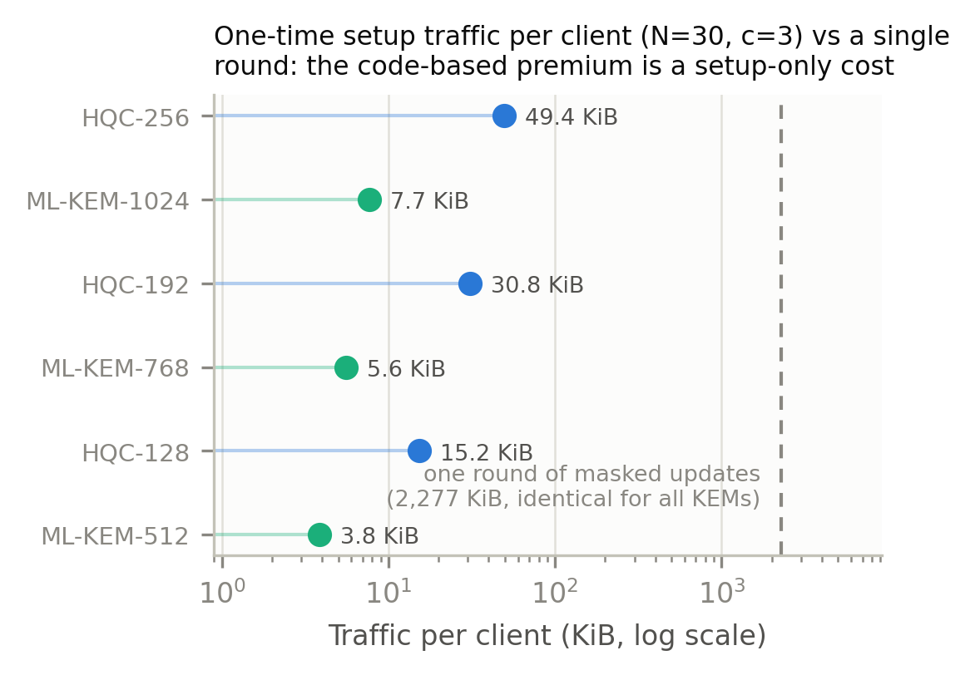
EVALUATION · KPI 1 & 2 (COST)
The code-based premium is a one-time constant
▪ Every round costs the same for all six KEMs: 2,277 KiB per client; the update itself dominates.
▪ Setup (once): HQC 15.2 KiB vs ML-KEM 3.8 KiB per client, under 0.03% of 40 rounds' traffic.
▪ Time: 2.0 s one-time key setup for 30 clients; ~26 ms masking per round vs ~21 s of training.
▪ Takeaway: cryptographic diversity is practically free once keys are reused.
Even the heaviest HQC setup is ~2% of ONE round's traffic (log scale).
CB-SAFE · Suva & Chowdhury · AIUB
9 / 12

Slide 10
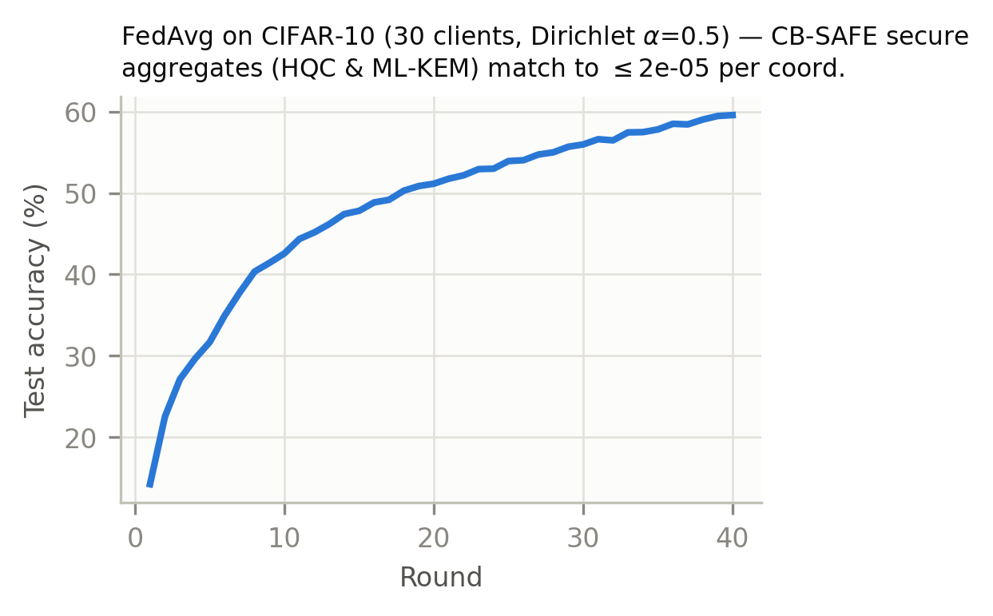
EVALUATION · KPI 3 (UTILITY)
Privacy provably costs no accuracy
▪ 59.0% on non-IID CIFAR-10 (30 clients, 40 rounds), identical for plain, HQC, and ML-KEM runs.
▪ Why identical: secure sums matched plain sums in every round to 2.28×10⁻⁵, exactly the rounding limit; the crypto changes nothing else.
▪ Dropout recovery verified live in rounds 10 and 20, including graceful exclusion of a below-threshold cluster.
One accuracy curve serves all three configurations.
CB-SAFE · Suva & Chowdhury · AIUB
10 / 12

Slide 11
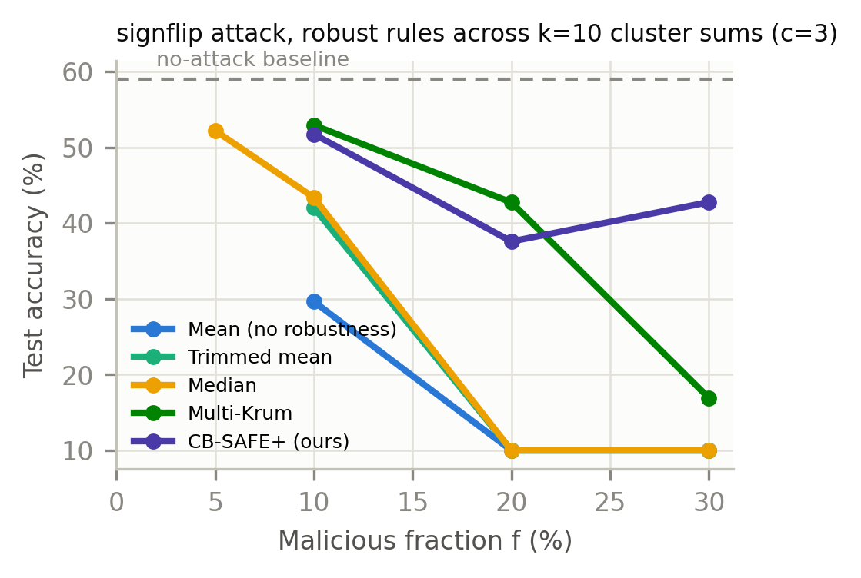
EVALUATION · KPI 4 & 5 (ROBUSTNESS)
Standard rules collapse; CB-SAFE+ recovers
▪ Why rules fail: averaging inside a cluster disguises the poison (the sum has a normal size, just the wrong direction), so trimmed mean and median fall to 10% (random guessing) at f ≥ 20%.
▪ CB-SAFE+ result: catches 8 of 9 attackers at f = 30% with zero honest clients wrongly excluded, recovering 42.8% where every static rule reads 10–17%.
▪ Honest limits: stealthy backdoors evade all sum-level defenses (93–97% attack success for every rule); Multi-Krum stays stronger at f = 20%.
Sign-flip attack: accuracy vs attacker fraction, per aggregation rule.
CB-SAFE · Suva & Chowdhury · AIUB
11 / 12

Slide 12
CONCLUSION
Takeaways & what's next
▪ Diversity delivered: the first code-based post-quantum secure aggregation for FL, at a one-time cost under 0.03% of traffic.
▪ New understanding: secure aggregation launders poisoning; defenses must use signals that survive summation, accumulated over rounds.
▪ New defense: CB-SAFE+ identifies individual attackers from group observations only, with zero extra privacy leakage.
▪ Open problems: stealthy backdoors, actively malicious servers, adaptive attackers.
▪ In progress: multi-seed statistics, a second dataset, 100-client scale; implementation released open-source.
CB-SAFE · Suva & Chowdhury · AIUB
12 / 12

