Slide 1
CALM-Net
Tangent-space features for EEG movement-intent decoding
Final manuscript presentation
Md Wahiduzzaman Suva [26-94088-2]
Esme Moula Chowdhury Abha [26-94089-2]
Supervisor: Dr. Muhammad Hasibur Rashid Chayon

Slide 2
Problem Statement
A convolutional EEG decoder reduces each window to log band power, which is the diagonal of its spatial covariance. Everything off the diagonal, how the channels covary, is discarded before the first layer sees it.
The question this paper answers is whether that discarded structure carries usable movement-intent information, and what it costs to read it.
51 participants, five cohorts, one training pipeline.
Two lower-limb exoskeleton cohorts, a treadmill cohort, a motor-execution cohort and BCI Competition IV-2a.
The answer is not uniform. The structure helps on four cohorts and fails on the fifth, and the recording protocol says which case applies before any model is trained.

Slide 3
Key Challenges
1
Second-order structure is thrown away
A log-power stem keeps the diagonal of the covariance and discards the rest. Whether that loses anything is an empirical question, not a settled one.
2
A reference that adapts can adapt wrongly
Reading the off-diagonal needs a reference covariance. Updating it on the test stream tracks the session, but it also tracks whichever class is streaming.
3
Failure has to be predictable before training
A component that helps on four cohorts and fails on the fifth is only useful if the protocol says in advance which case applies.

Slide 4
Objectives and Outcomes
O1
Read the covariance, not just its diagonal
Outcome: a tangent-space branch beside the log-power stem. It raises balanced accuracy on four of five cohorts, by +0.064 on the held-out cohort C where all 20 of 20 participants improve (p = 8.8e-5).
O2
State when the adapting reference is admissible
Outcome: Condition 1. The estimator memory must outlast a class block and stay below the drift timescale. Read from the protocol, it separates all five cohorts with nothing fitted.
O3
Report what the component costs
Outcome: the branch adds 238,028 parameters to a 19,505-parameter stem path, and on cohort A it triples the spurious-activation rate. Both are reported, not hidden.
Question answered: does the covariance structure a log-power stem discards carry movement intent, and when can a test-time reference be trusted to read it?

Slide 5
Literature Review
Lower-limb exoskeleton BCI
NeuroRex dataset [Sarkar 2026]
Deep-learning control [Ferrero 2024]
Exo error potentials [Soriano 2025]
Robot-assisted gait [Tortora 2023]
EEG decoders
EEGNet [Lawhern 2018]
ShallowFBCSPNet [Schirrmeister 2017]
EEG-Conformer [Song 2023]
Riemannian and alignment
Riemannian geom. [Barachant 2012]
Euclidean alignment [He 2020]
Riemannian Procrustes [Rodrigues 2019]
Test-time adaptation
Tent [Wang 2021]
Correlated streams [Gong 2022]
Reject option [Geifman 2019]
RESEARCH GAP
Riemannian methods estimate their reference over a complete recording, so the recording must exist before the decoder can run. Test-time adaptation removes that constraint but degrades on temporally correlated streams. No prior work states, from the protocol alone, when an in-network adapting reference is safe.
Citations shown as [first author, year]; full entries are on the References slide.

Slide 6
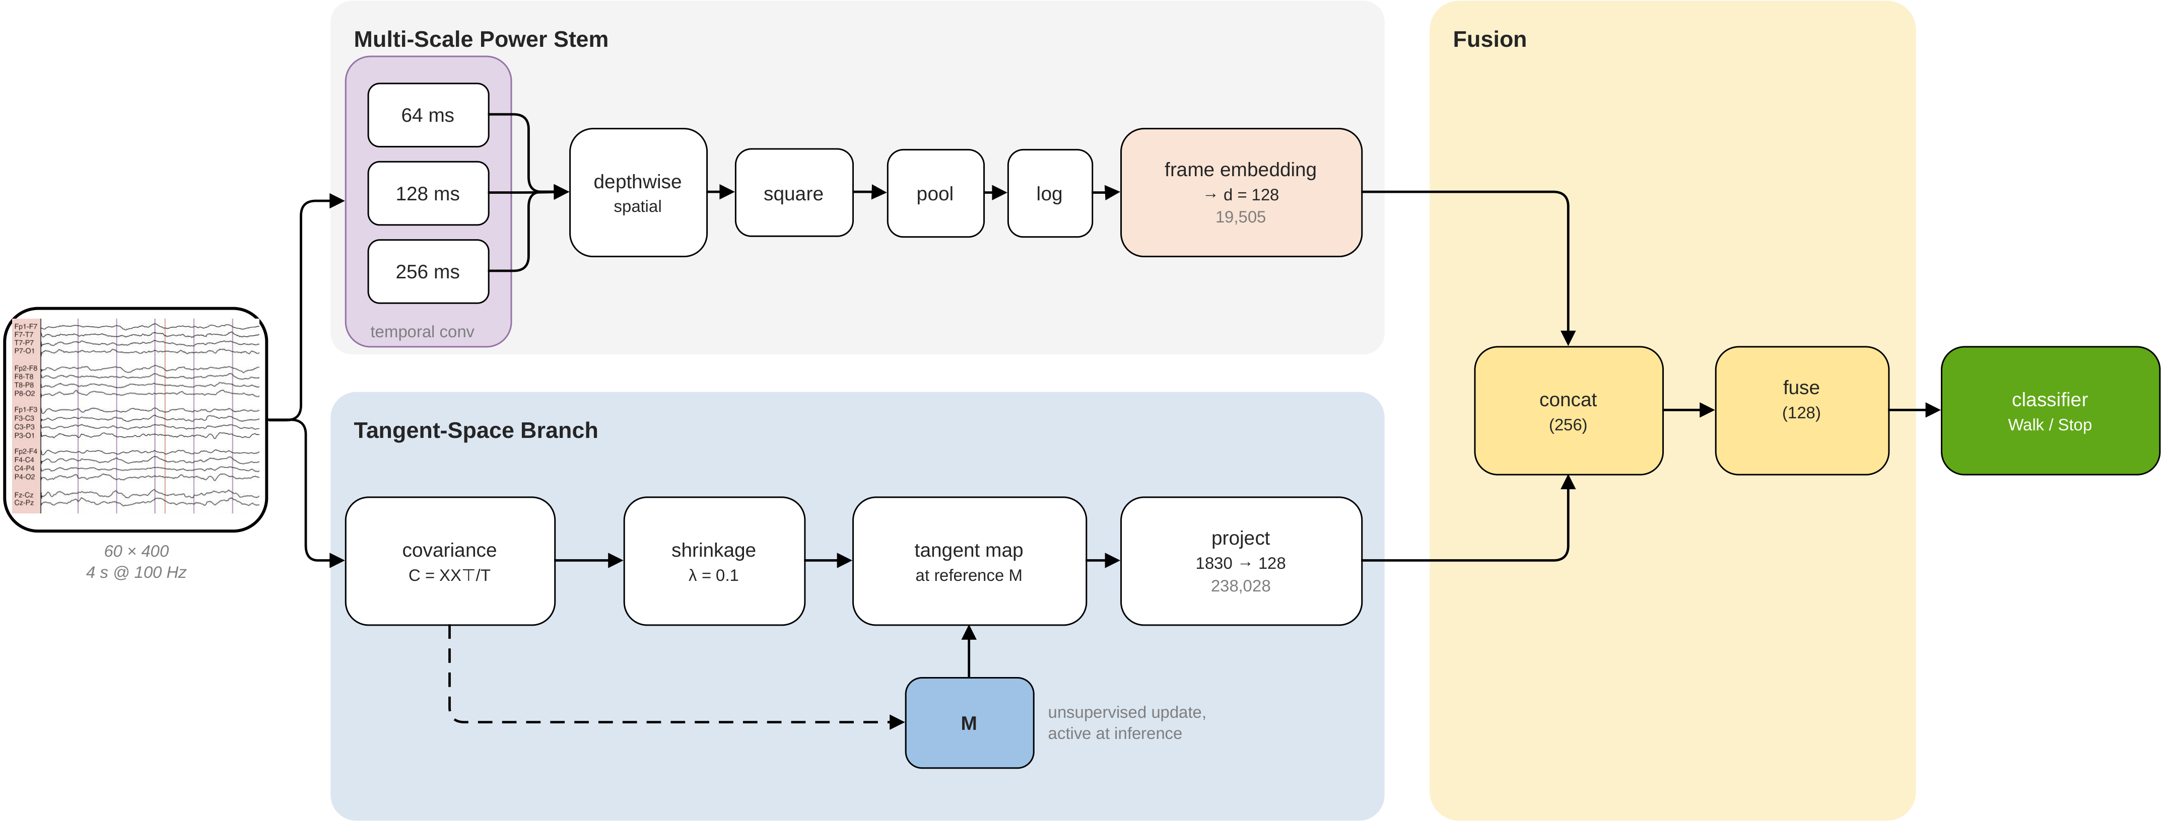
Decoder Architecture
Reported model, 290,943 parameters: a multi-scale log-power stem reads the diagonal of each window's covariance, a tangent-space branch reads the rest of it at a running reference M, and the two are concatenated into one linear classifier. The reference updates without labels and stays active at inference.

Slide 7
Core Idea and Hypothesis
• Read the off-diagonal: each window's covariance C is shrunk and mapped to the tangent space at a reference M, giving vec(log(M⁻¹ᐟ² C M⁻¹ᐟ²)).
• The reference adapts: M is a running mean over incoming windows, label-free, still updating at test time.
• Estimator memory: the momentum m sets a memory of μ = N/m windows, 160 at the default N = 32, m = 0.2.
• The failure mode: when one class streams for longer than μ, M becomes that class and whitening removes the very variance that separates the classes.
CONDITION 1 τ_blk < μ < τ_drift. The branch is admissible only where the estimator memory outlasts a class block and stays below the session-drift timescale. Both sides are fixed before training.

Slide 8
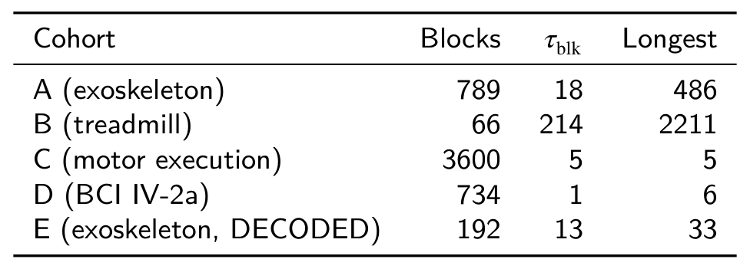
Datasets and Evaluation Protocol
A exoskeleton 7 participants, 9 sessions over weeks
B treadmill 8 participants, 3 trials, independent lab
C motor execution 20 participants, held out from every design decision
D BCI IV-2a 9 participants, two sessions on different days
E exoskeleton 7 participants, DECODED / EUROBENCH
Block length τ_blk is read from the label sequence alone, before training: A 18, B 214, C 5, D 1, E 13 windows.

Slide 9
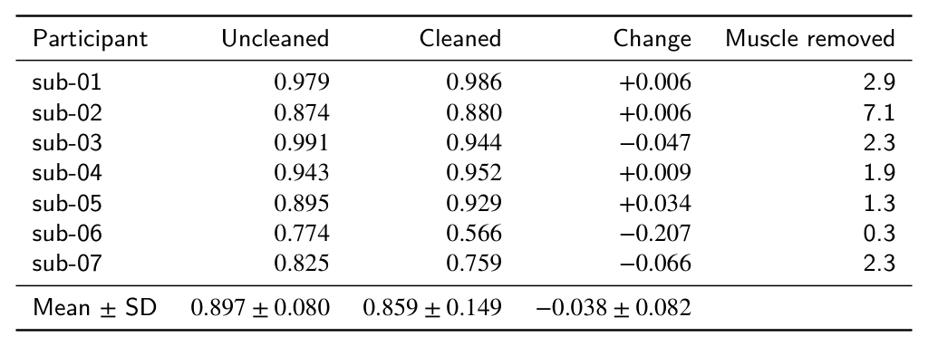
Artefact Control
Walk and stop differ in movement, so the accuracy could be artefact.
Retraining the reported model after ICA cleaning [Pion-Tonachini 2019]: 0.897 to 0.859 (p = 0.58, four of seven unchanged or better). The mean is carried by one participant; without sub-06 it is −0.010.
The change does not follow the muscle components removed (ρ = +0.05), where dependence on muscle artefact would be negative.
Constrains the artefact account. It does not exclude it.

Slide 10
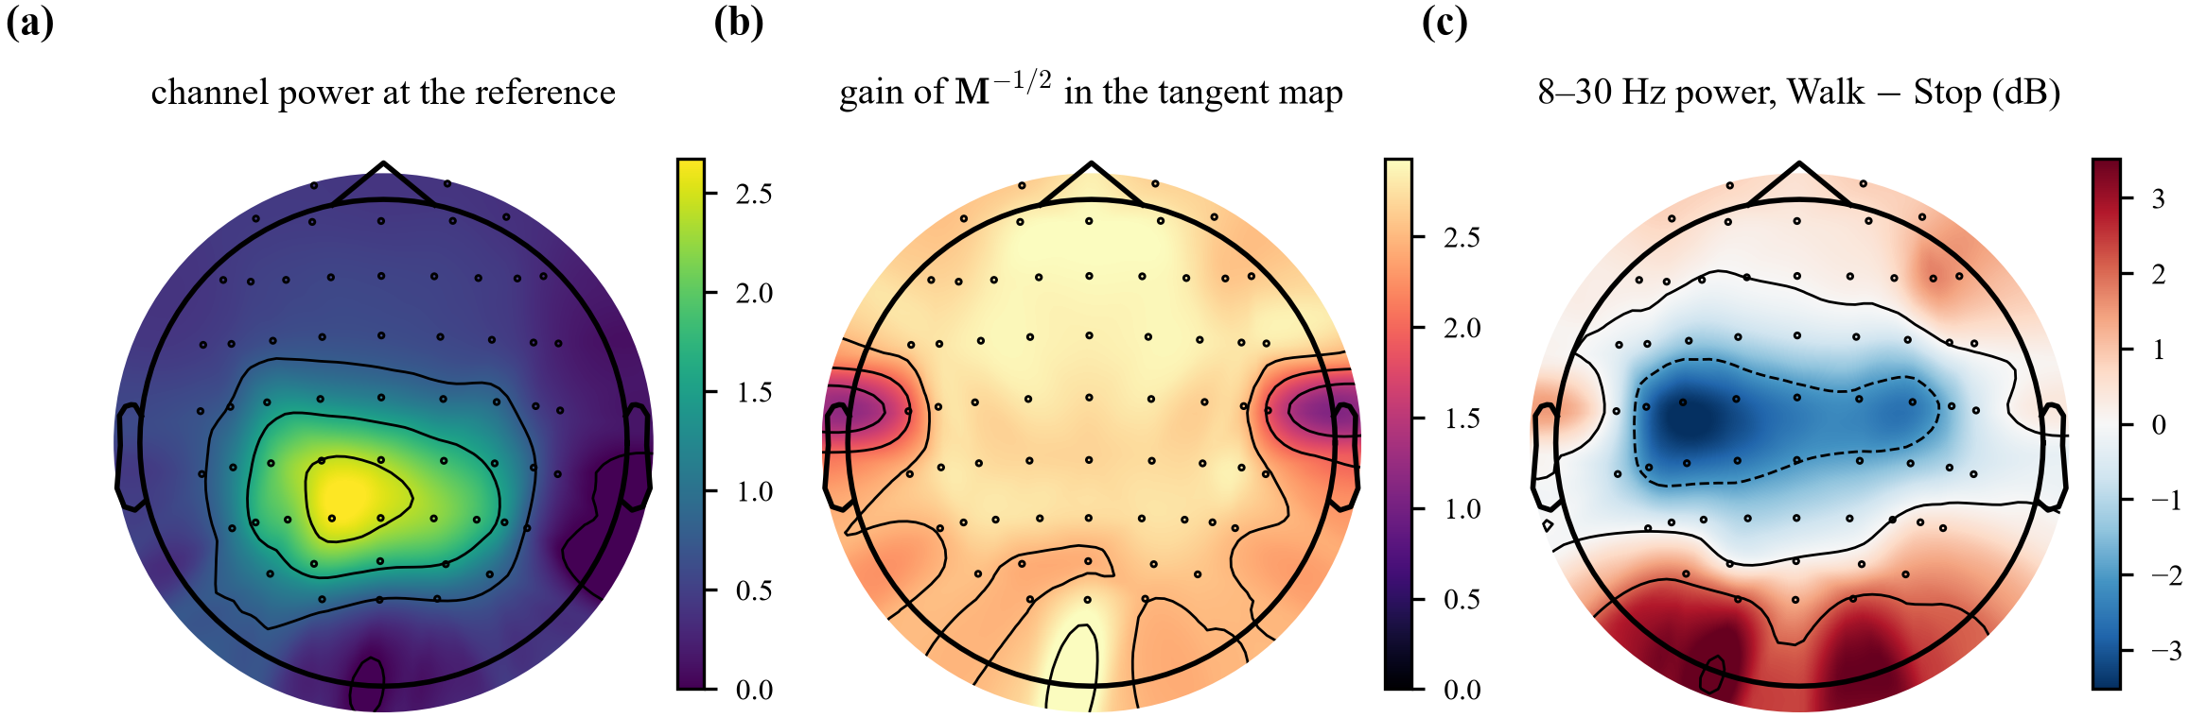
Scalp Topography of the Reference
The branch's own reference: it amplifies the frontocentral midline most (AFz, Fz at 2.9) and the temporal sites most exposed to jaw and neck muscle least (T7, T8 at 1.9). Band power falls over left sensorimotor cortex during walking (C3 −3.5 dB), the sign of mu and beta desynchronisation; gross artefact would raise it.

Slide 11
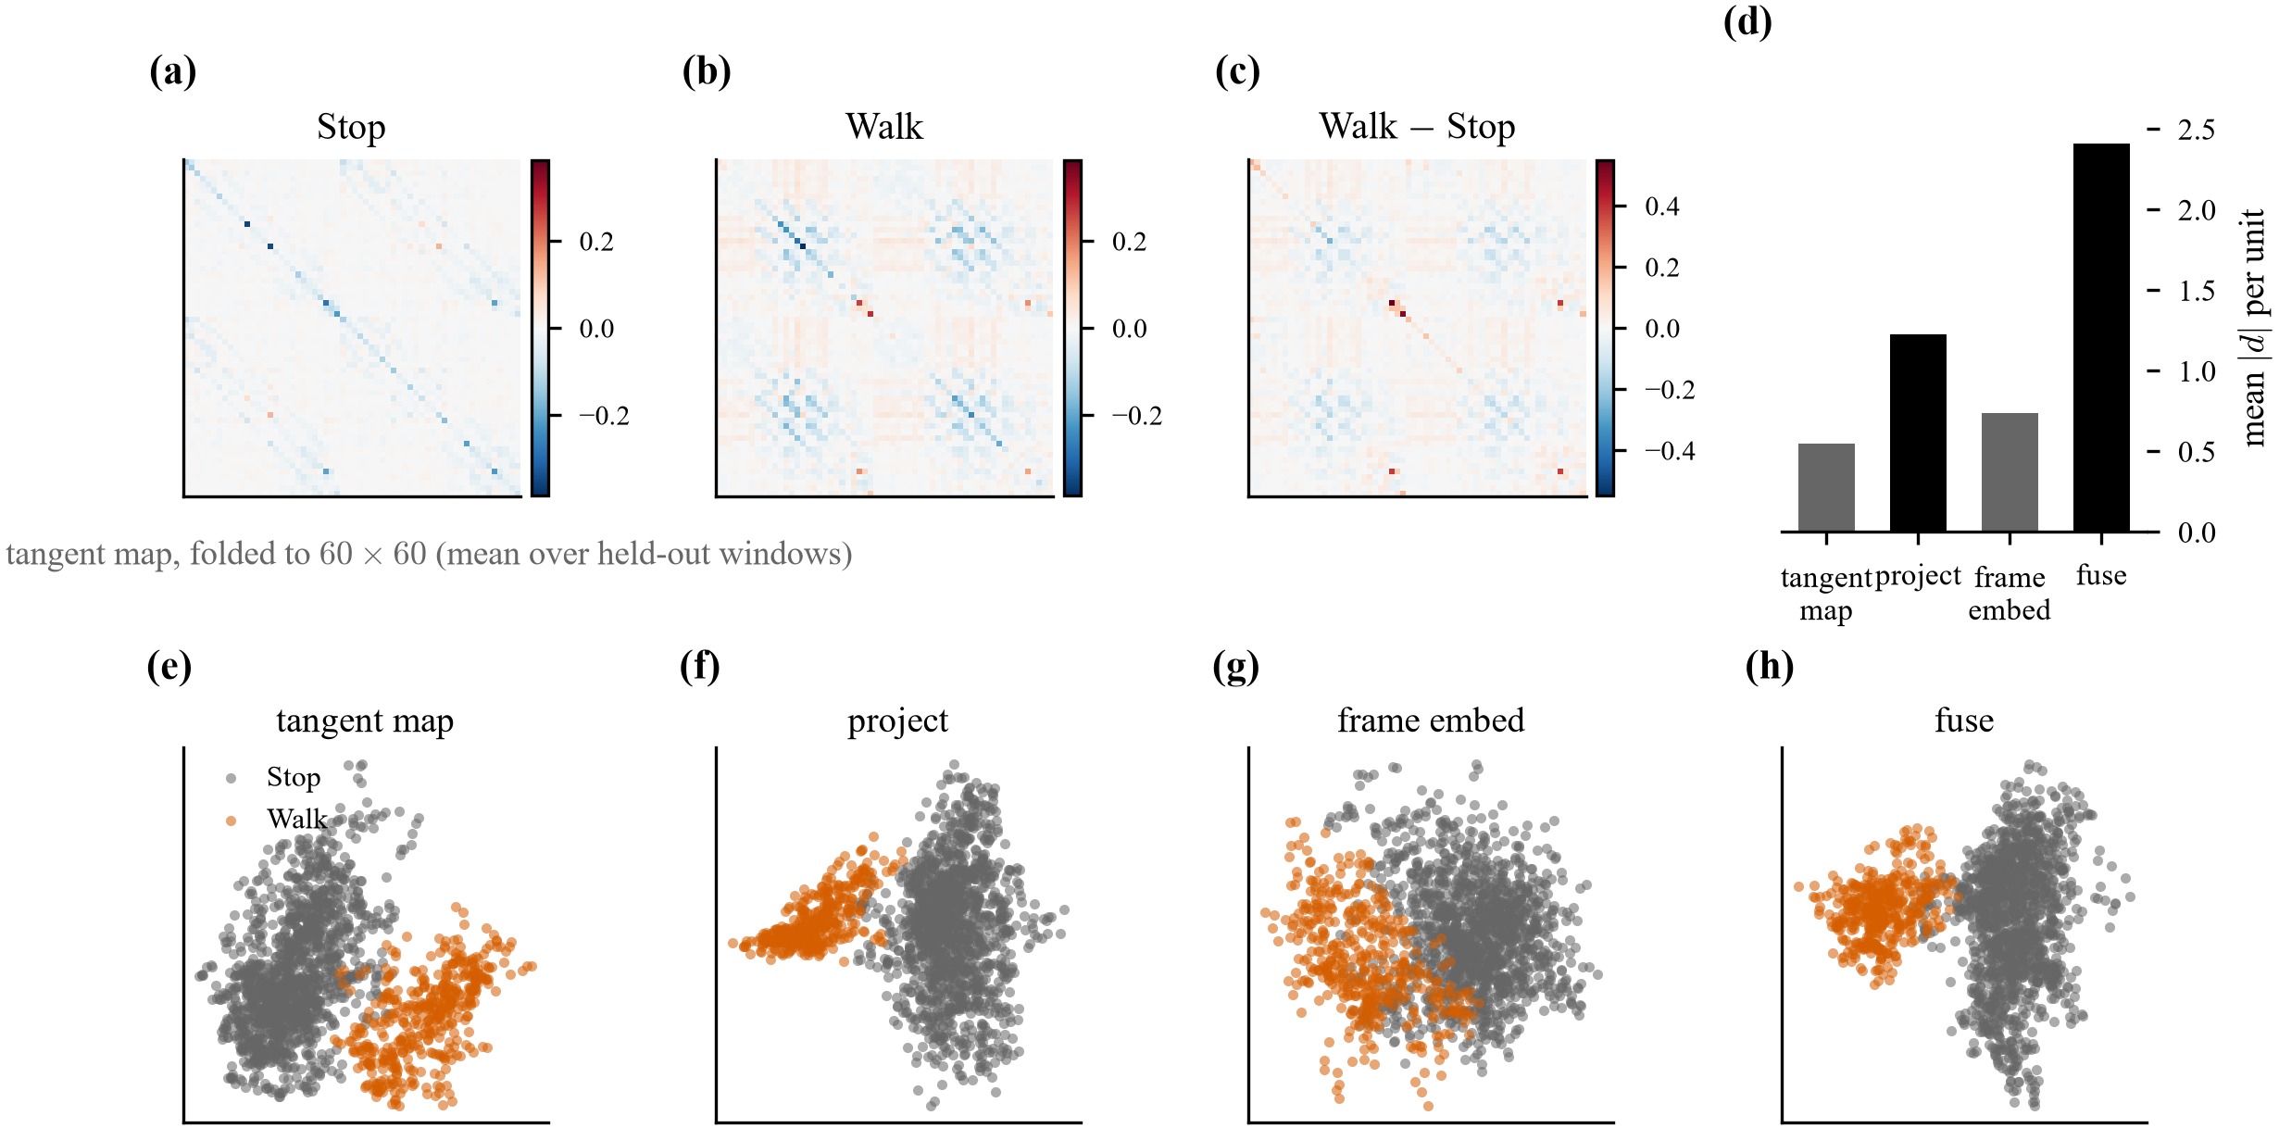
Learned Representations
Measured, not drawn: forward hooks on a trained model, on held-out windows. The tangent map carries structure off the diagonal, which the stem discards. Class separation grows along both paths and is largest after fusion (2.41, against 1.22 for the branch and 0.74 for the stem), so the two are complementary in the model's own activations.

Slide 12
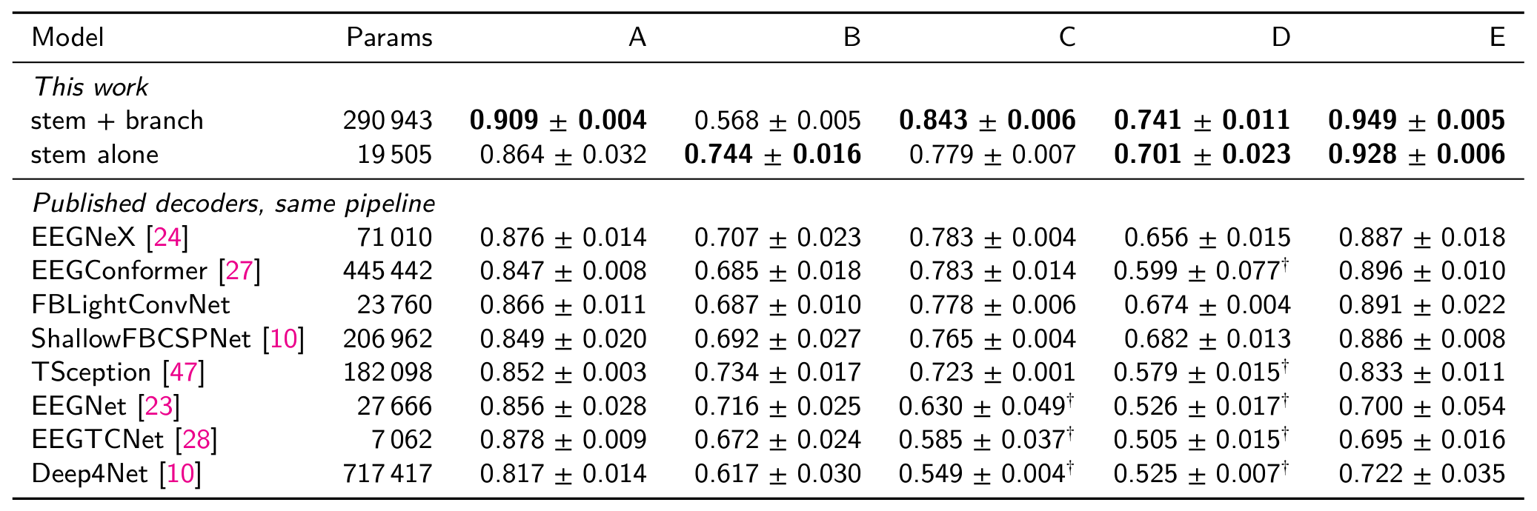
Comparison with Published Decoders
One pipeline, shared splits, seeds and metric code, no per-model tuning. On cohort C the reported model reaches 0.843 against 0.783 for the strongest published decoder, and the stem it is built on reaches 0.779.

Slide 13
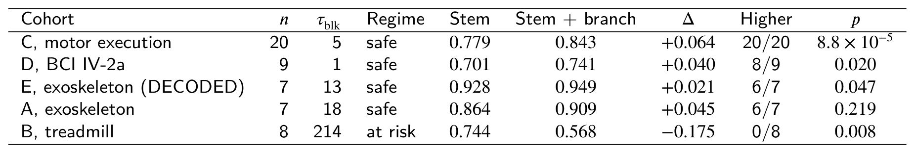
Branch versus Stem Across Cohorts
Four cohorts gain, one fails. The branch adds +0.045 on A, +0.064 on C, +0.040 on D and +0.021 on E, and costs 0.175 on B. Cohort B is the one whose class blocks (214 windows) outlast the estimator memory (160), which Condition 1 names in advance.

Slide 14
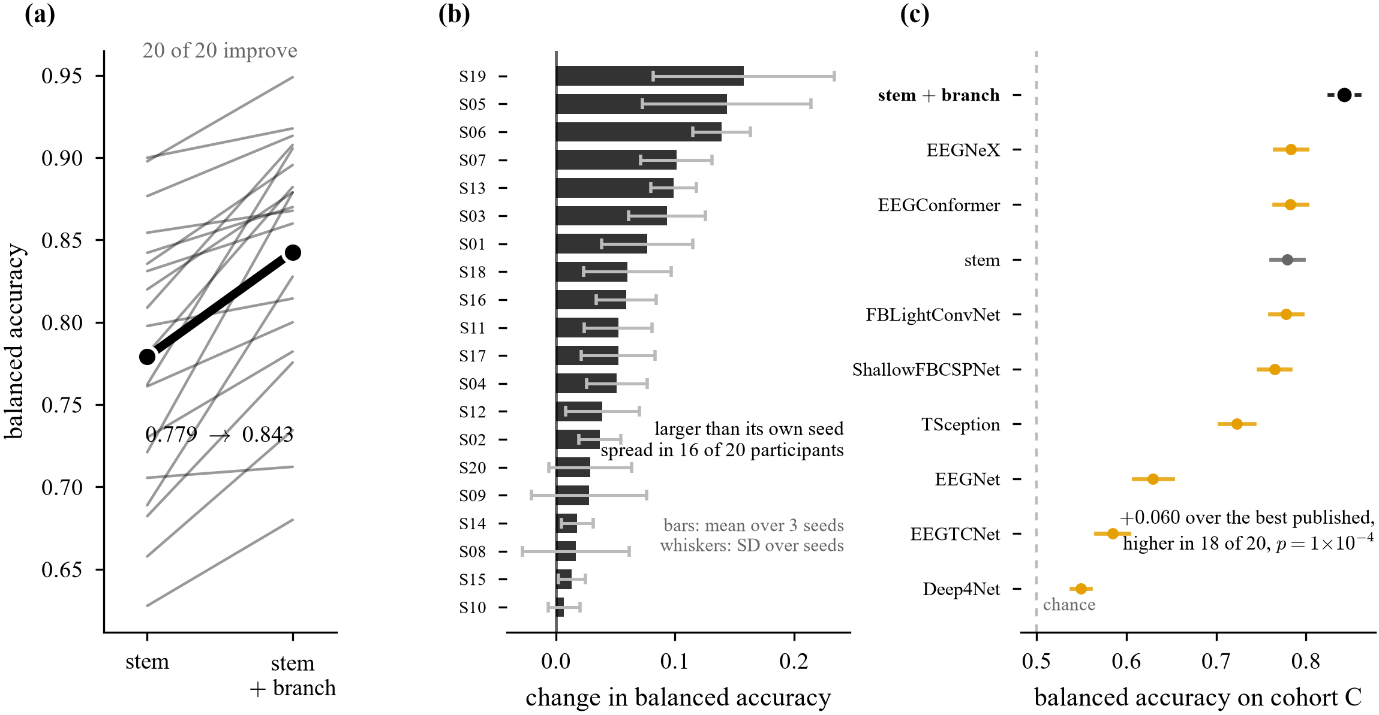
Results on the Held-Out Cohort
Consistent, above the noise, and ahead of the field. (a) all 20 participants improve, mean +0.064 (p = 8.8 × 10⁻⁵). (b) the change exceeds that participant's own spread across seeds in 16 of the 20. (c) it leads the strongest published decoder on this cohort by +0.060, higher in 18 of 20 (p = 1.3 × 10⁻⁴). Calibration error falls from 0.075 to 0.062 on the same runs.

Slide 15
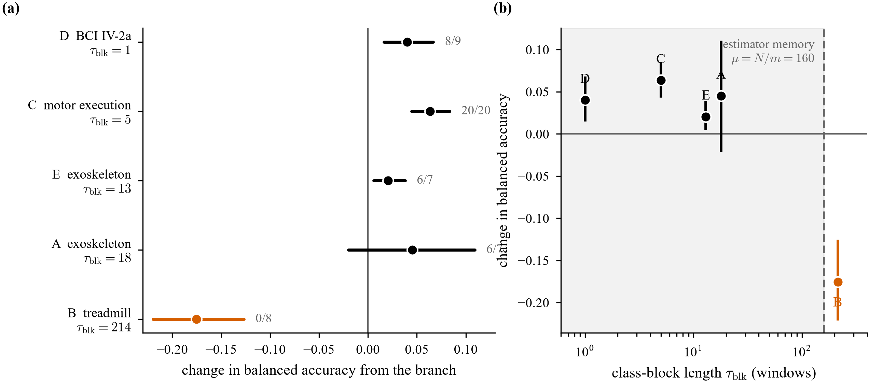
Effect Size Against Class-Block Length
Nothing is fitted here: block length comes from the protocol and the memory from the optimiser settings. Plotting the effect against τ_blk separates the four cohorts that gain from the one that fails, at the memory boundary μ = 160.

Slide 16
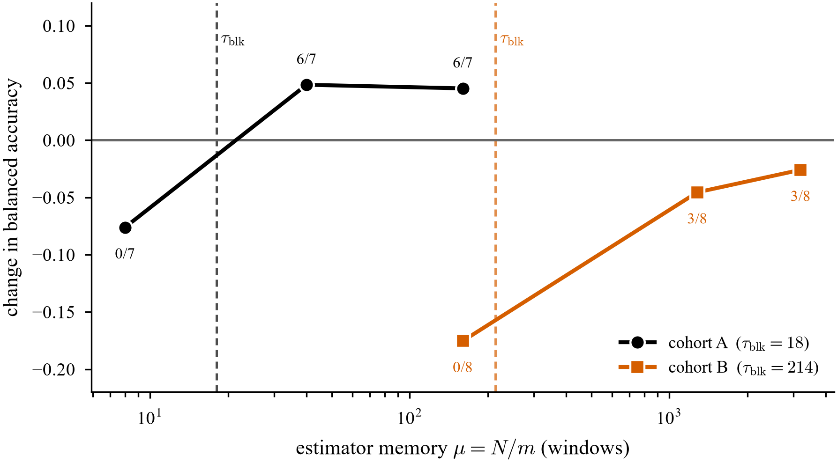
Direct Manipulation of the Estimator Memory
One cohort, one variable: moving the estimator memory across the block length switches the effect off and on. On cohort A it is +0.045 at μ = 160, +0.048 at 40 and −0.076 at 8, worse in every participant. Enlarging μ on the failing cohort recovers 74 % of the loss.

Slide 17
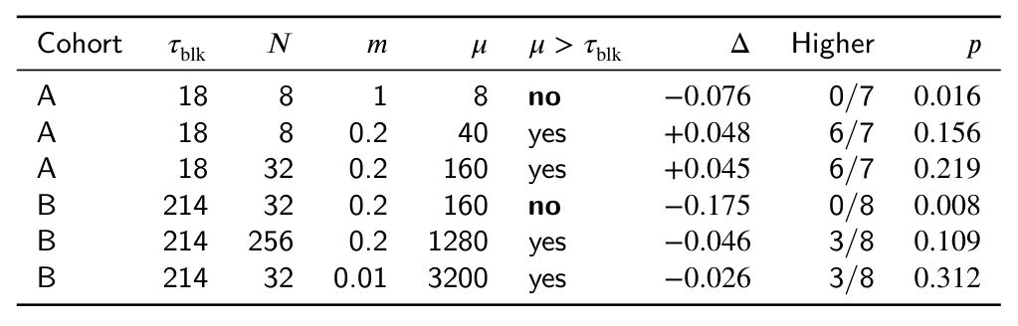
Estimator Memory and Block Length: Summary
The condition gives an ordering and a direction.
It does not give a rate a practitioner could set. A stronger prescription, setting the rate from the block length with a margin of two, was pre-registered and falsified: at the memory it prescribes cohort B reaches 0.650, against 0.744 for the stem alone.
The upper bound of the condition is not measured here.

Slide 18
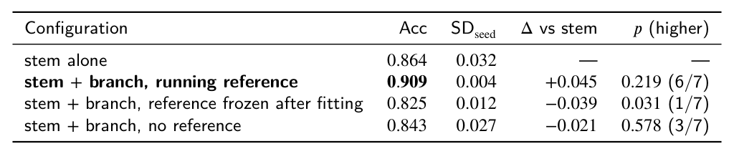
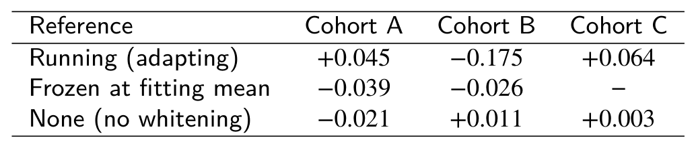
Ablation Study
Every row is a choice the architecture makes. The branch raises accuracy and cuts the seed spread about nine-fold. Freezing the reference after fitting or removing it entirely both cost accuracy, so the adapting reference is where the gain comes from.

Slide 19
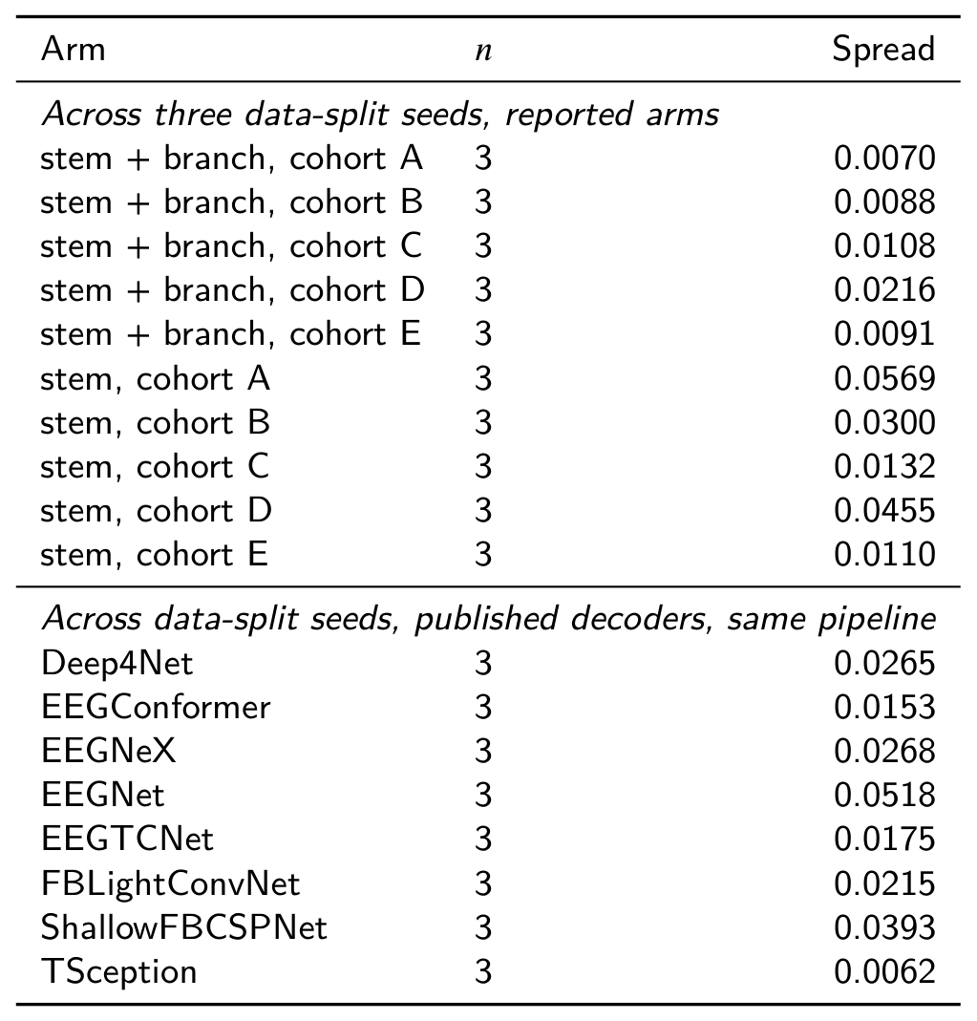
Measurement Noise and Ranking Criteria
What can be ranked, and what cannot.
Across three data-split seeds the reported model spans 0.007 to 0.022 depending on the cohort, and the stem spans 0.011 to 0.057. The stem is the noisier arm on all five cohorts, so the branch does not buy its accuracy with a less stable fit.
Differences below 0.02 are not interpreted anywhere in this work.

Slide 20
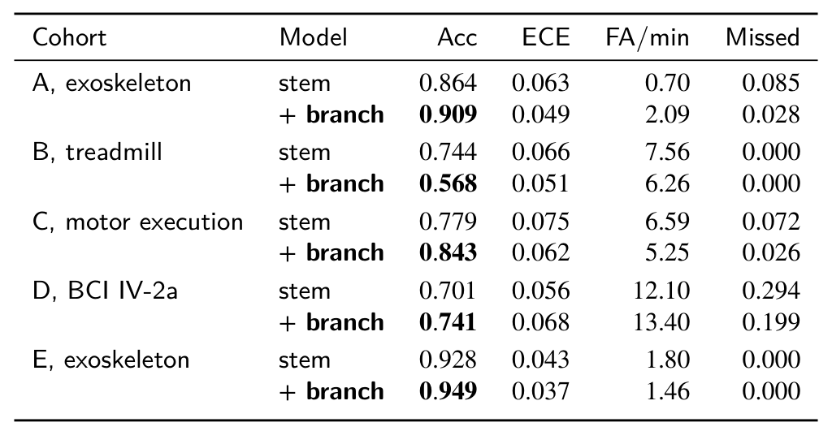
Control-Relevant Outcome Measures
Balanced accuracy is not what a wearer experiences.
Calibration improves on four of five cohorts and the missed-onset rate falls on four, so the accuracy is not bought with a worse-behaved posterior.
The exception is cohort A, where spurious walk commands rise from 0.70 to 2.09 per minute of standing. For a device that moves a wearer's legs that is a real cost, and it is reported rather than the accuracy alone.

Slide 21
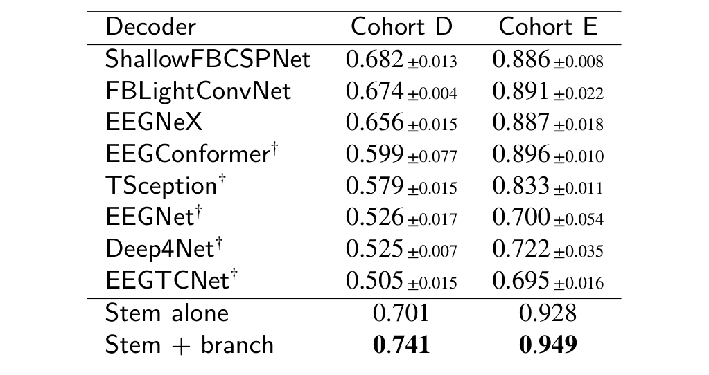
Results on Cohorts D and E
The branch leads every published decoder on both.
0.741 against 0.682 for the strongest on cohort D, and 0.949 against 0.896 on cohort E. The stem alone also clears them, so the ordering does not depend on the branch; what the branch adds is the margin.
Cohort D needs a caveat the margin hides: five of its eight decoders are left near chance on at least one seed, which its ~100 fitting windows per participant explain. Only the three that trained are load-bearing.

Slide 22
Limitations
• The boundary was found after the fact: it separates all five cohorts with nothing fitted, but was identified after A, B and C had been run. Only D and E were prospective.
• No artefact rejection for this configuration: the ICA control constrains the artefact account on seven participants and does not exclude it. A power contrast is not an artefact rejection.
• Cohort size: 7, 8, 20, 9 and 7 participants. Between-subject SD of 0.06 to 0.13 is large relative to the differences between arms.
• The branch is not compact: 238,028 parameters against a 19,505-parameter stem path, so no parameter-efficiency claim is made.
THE TEST THAT WOULD SETTLE IT choose a protocol whose class blocks fall between 18 and 214 windows, register the prediction, and run it once.

Slide 23
Conclusion
The covariance structure a log-power stem discards does carry movement intent. A tangent-space branch raises balanced accuracy on four of five cohorts, and on 20 of 20 participants of a cohort held out from every design decision.
Where it fails, it fails predictably: the estimator memory against the class-block length separates all five cohorts with nothing fitted.
The condition is the part worth building on, and the part least finished.
It yields no rate a practitioner could set, and its upper side has never been measured.
Next: a protocol whose class blocks fall between 18 and 214 windows, with the prediction registered before the run. That is the experiment that would turn an ordering into a rate.

Slide 24
References
Works cited on these slides, keyed to their [author, year] tags.
[Sarkar 2026] S. Sarkar et al., “EEG-controlled exoskeleton for walking and standing: a longitudinal multimodal dataset,” Sci. Data, 2026. (OpenNeuro ds007788)
[Ferrero 2024] L. Ferrero et al., “Brain-machine interface based on deep learning to control a lower-limb robotic exoskeleton,” J. NeuroEng. Rehabil., 21(48), 2024.
[Soriano 2025] P. Soriano-Segura, M. Ortiz et al., “Characterization of error-related potentials during exoskeleton command via deep learning,” J. NeuroEng. Rehabil., 2025.
[Tortora 2023] S. Tortora et al., “Cortical and muscular activity under robot-assisted gait modes during exoskeleton walking,” 2023.
[Luu 2017] T. P. Luu et al., “Real-time EEG-based brain-computer interface to a virtual avatar enhances cortical involvement in human treadmill walking,” Sci. Rep., 7:8895, 2017.
[Schalk 2004] G. Schalk et al., “BCI2000: a general-purpose brain-computer interface (BCI) system,” IEEE TBME, 51(6):1034-1043, 2004.
[Brunner 2008] C. Brunner et al., “BCI Competition 2008 – Graz data set A,” Graz University of Technology, 2008. (BNCI2014-001)
[Lawhern 2018] V. J. Lawhern et al., “EEGNet: a compact CNN for EEG-based brain-computer interfaces,” J. Neural Eng., 15(5), 2018.
[Schirrmeister 2017] R. T. Schirrmeister et al., “Deep learning with convolutional neural networks for EEG decoding and visualization,” Hum. Brain Mapp., 38(11):5391-5420, 2017.
[Song 2023] Y. Song et al., “EEG Conformer: convolutional transformer for EEG decoding and visualization,” IEEE TNSRE, 31:710-719, 2023.
[Barachant 2012] A. Barachant et al., “Multiclass brain-computer interface classification by Riemannian geometry,” IEEE TBME, 59(4), 2012.
[He 2020] H. He and D. Wu, “Transfer learning for brain-computer interfaces: a Euclidean space data alignment approach,” IEEE TBME, 67(2):399-410, 2020.
[Rodrigues 2019] P. L. C. Rodrigues et al., “Riemannian Procrustes analysis: transfer learning for brain-computer interfaces,” IEEE TBME, 66(8):2390-2401, 2019.
[Wang 2021] D. Wang et al., “Tent: fully test-time adaptation by entropy minimization,” ICLR, 2021.
[Gong 2022] T. Gong et al., “NOTE: robust continual test-time adaptation against temporal correlation,” NeurIPS, 2022.
[Pion-Tonachini 2019] L. Pion-Tonachini et al., “ICLabel: an automated electroencephalographic independent component classifier,” NeuroImage, 198:181-197, 2019.

