Slide 1
Appendix
Backup slides for Q&A — evidence, method detail, evaluation plan

Slide 2
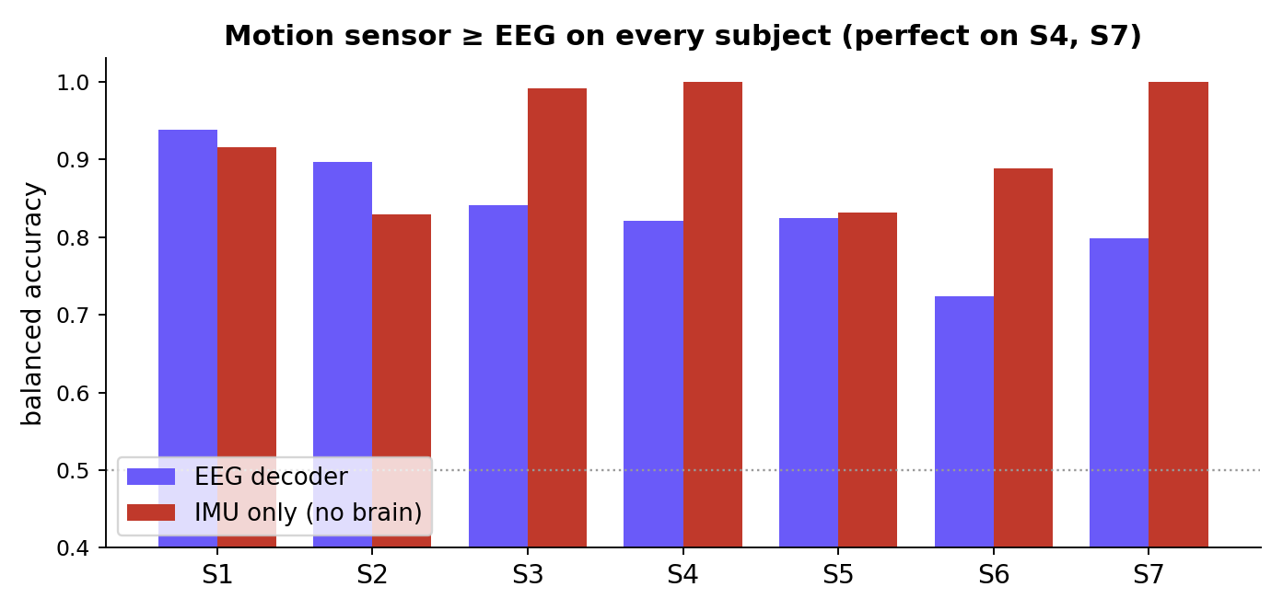
EVIDENCE · THE CONFOUND IS NOT AN AVERAGE
A motion sensor beats EEG on every subject
IMU-only mean 0.92 vs EEG 0.84
Perfect (1.00) for S4 and S7 — you cannot get 1.00 on a biological signal; that is the label read twice.
The walk/stop label is a function of the exoskeleton's motion.
CALM-Net · Appendix (backup) B1

Slide 3
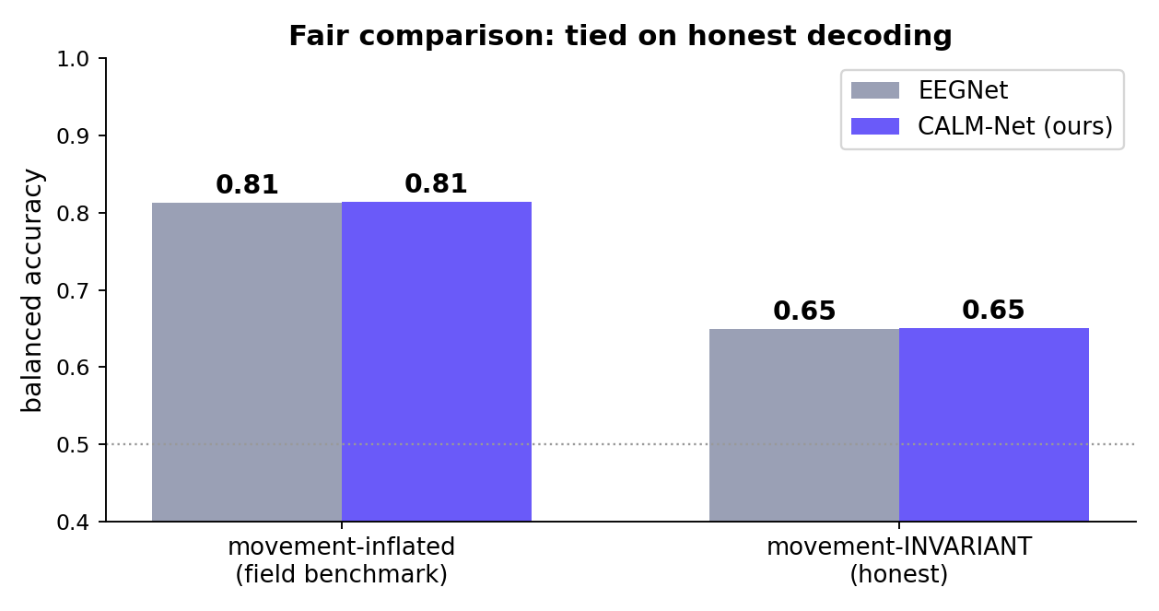
FAIR COMPARISON · ARE WE BEHIND EEGNET?
No — the gap was the confound, not the model
When EEGNet is put through the SAME movement-invariant test, it also falls to 0.65.
The famous 13-point “gap” to EEGNet is entirely the confound: inflated-EEGNet vs invariant-us. On equal footing, honest decoding is tied.
Our edge is elsewhere: calibration, coverage guarantee, and safety.
CALM-Net · Appendix (backup) B2

Slide 4
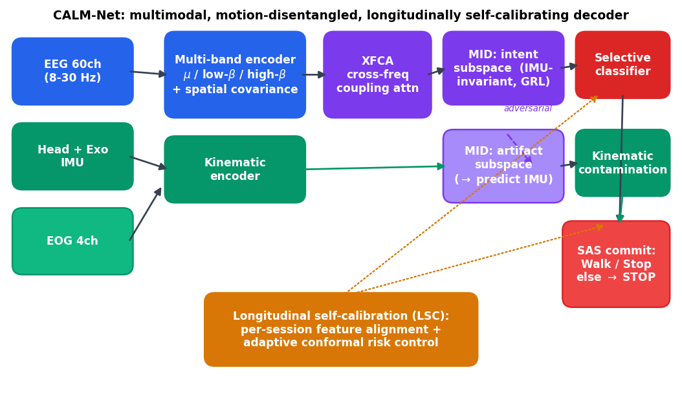
PROPOSED METHOD · DETAIL
CALM-Net, four stages
• Encoder — multi-band spatial features from EEG + head/exo IMU + EOG.
• MID — adversarial + HSIC penalty force the intent code to be independent of the IMU.
• LSC — temperature scaling + adaptive conformal → distribution-free coverage under drift.
• SAS — commit only if confident, unambiguous, and uncontaminated; else safe STOP.
CALM-Net · Appendix (backup) B3

Slide 5
METHOD · MOTION-INVARIANT DISENTANGLEMENT
How we remove movement from the neural code
• Target φ(M): a 12-D descriptor of head + exo IMU (accel/gyro magnitude, mean/std/max).
• Split: the representation is divided into an intent subspace and an artefact subspace.
• Adversary (gradient reversal): the encoder is trained so the intent code CANNOT predict φ(M).
• HSIC penalty: a nonlinear independence term drives intent ⟂ movement (beyond linear decorrelation).
• Artefact head: the other subspace is trained TO predict φ(M), absorbing the movement.
• Result: the classifier reads only the intent subspace → provably movement-invariant decisions.
CALM-Net · Appendix (backup) B4

Slide 6
METHOD · GUARANTEE + EVALUATION PLAN
How we stay calibrated, and how we test it
Longitudinal self-calibration
• Temperature scaling for honest confidence on a held-out split.
• Split + adaptive conformal updates the threshold online: q ← q + η(α − err).
• Guarantee prediction-set coverage tracks its target as the signal drifts.
Evaluation protocol
• Longitudinal split — train early sessions, test later ones (no leakage).
• Balanced accuracy + ECE + Brier — accuracy and calibration.
• Coverage @ target + wrong-walk rate — the safety metrics.
• Movement-invariance probe — intent→IMU R² confirms honesty.
• Baselines — EEGNet, EEG-Conformer, and the IMU-only control.
CALM-Net · Appendix (backup) B5

Slide 7
DATASET & KEY REFERENCES
NeuroRex (OpenNeuro ds007788)
7 healthy adults × 9 sessions over 14–80 days · 60-ch EEG + 4 EOG @ 100 Hz · head & exoskeleton IMUs · exoskeleton feedback logs · Walk vs Stop motor imagery · BIDS, CC0.
Selected references
Sarkar et al. (2026) — NeuroRex dataset. Scientific Data.
Lawhern et al. (2018) — EEGNet. J. Neural Eng.
Song et al. (2023) — EEG Conformer. IEEE TNSRE.
Ganin et al. (2016) — Domain-adversarial training (gradient reversal). JMLR.
Gibbs & Candès (2021) — Adaptive conformal inference. NeurIPS.
Geifman & El-Yaniv (2019) — SelectiveNet. ICML.
CALM-Net · Appendix (backup) B6

Slide 8
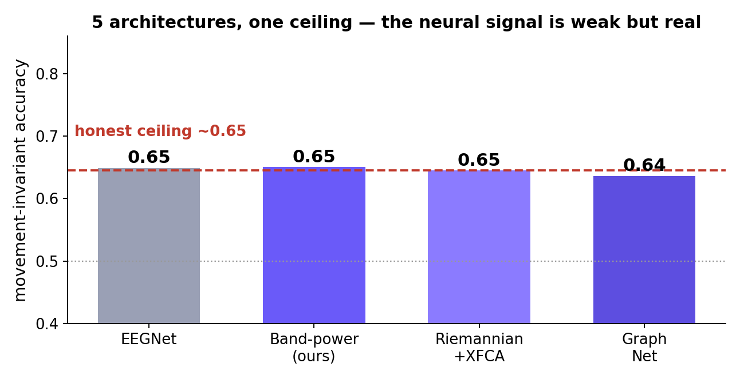
RESULT · ARCHITECTURE STUDY
We tried 5 architectures — none beats the ceiling
EEGNet, band-power, Riemannian + attention, and a graph net over the scalp geometry — all land at ~0.65 when made movement-invariant.
The bottleneck is not the model. The movement-invariant neural signal is simply weak — and equal for every architecture.
CALM-Net · Appendix (backup) B7

Slide 9
RESULT · WE TRIED TO RAISE THE CEILING
Five independent attempts — all confirm it
• Stronger disentanglement (HSIC): richer model’s accuracy collapses to 0.65 — its lead was leakage.
• Pre-movement window: the IMU still scores 0.94 at the transition — no movement-free window exists.
• EEG + IMU fusion: equals IMU-only (0.92); EEG adds nothing over the motion sensor.
• 5× more training data: helps weak subjects reach the ceiling, but never exceeds it.
• Graph over electrode geometry: a new prior, still ~0.65 invariant.
The ceiling is real: this is a movement benchmark, not a brain-decoding benchmark. That is the finding.
CALM-Net · Appendix (backup) B8

Slide 10
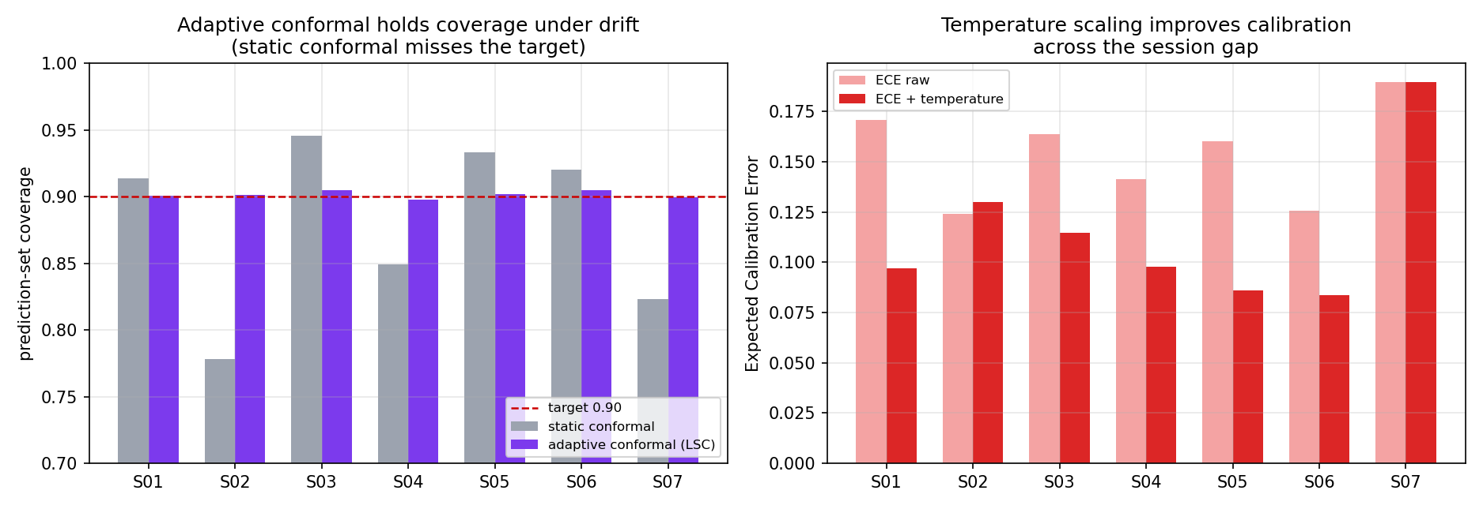
RESULT · WHAT CALM-NET ACTUALLY DELIVERS
The win is trustworthiness, not accuracy
✓ Coverage guarantee held on all 7 subjects (0.90) as the signal drifts — static conformal fails.
✓ Calibration improved across the session gap (ECE 0.15 → 0.11).
✓ Wrong-walk error cut 3× (0.14 → 0.05) — the dangerous error, controlled.
CALM-Net · Appendix (backup) B9

