Slide 1
CALM-Net
A Calibrated, Abstaining, Longitudinal EEG Decoder for Safe Lower-Limb Exoskeleton Control
Md Wahiduzzaman Suva [26-94088-2]
Esme Moula Chowdhury Abha [26-94089-2]

Slide 2
Problem Statement
For someone who cannot walk after a spinal cord injury or stroke, an exoskeleton driven by their own brain activity restores mobility. Only non-invasive EEG requires no surgery, so it is the only version most patients could ever use.
A confident wrong “walk” command at the top of a staircase is a fall, not a rounding error.
Accuracy is the wrong target. A machine that moves your legs needs honest confidence and the ability to stop.

Slide 3
Key Challenges
1
What is actually decoded?
The exoskeleton moves the wearer during walking, so accuracy can reflect movement rather than neural intent.
2
The signal drifts
EEG is non-stationary; a decoder calibrated one day is miscalibrated the next, over weeks of use.
3
No reject option
Deployed decoders must guess every input; they cannot abstain to a safe stop when unsure.

Slide 4
Objectives
O1
Movement-invariant intent
Decode neural intent provably invariant to the exoskeleton’s own motion.
O2
Calibrated across time
Stay honestly calibrated across weeks of drift, without full retraining.
O3
Abstain with a guarantee
Reject low-confidence inputs to a safe stop, with a distribution-free guarantee.
Overarching question: can we trade inflated accuracy for trustworthy, verifiable closed-loop control?

Slide 5
Literature Review
Lower-limb exoskeleton BCI
NeuroRex dataset [Sarkar 2026]
Deep-learning control [Ferrero 2024]
Exo error potentials [Soriano 2025]
Robot-assisted gait [Tortora 2023]
Motor-imagery decoders
EEG-Conformer [Song 2023]
EEGNet [Lawhern 2018]
Riemannian geom. [Barachant 2012]
Calibration, uncertainty
Adaptive conformal [Gibbs 2021]
Conformal pred. [Angelopoulos 2023]
EEG uncertainty [Tveter 2024]
Drift and abstention
Deep adaptation [Zhang 2023]
Reject-option [Hendrickx 2024]
Selective class. [Geifman 2017]
RESEARCH GAP
Rich multimodal exoskeleton datasets now exist, yet no prior work joins movement disentanglement, cross-session calibration, and safety-asymmetric abstention in one closed-loop decoder.
Citations shown as [first author, year]; the paper cites 11 lower-limb exoskeleton BCI works and 41 references in total.

Slide 6
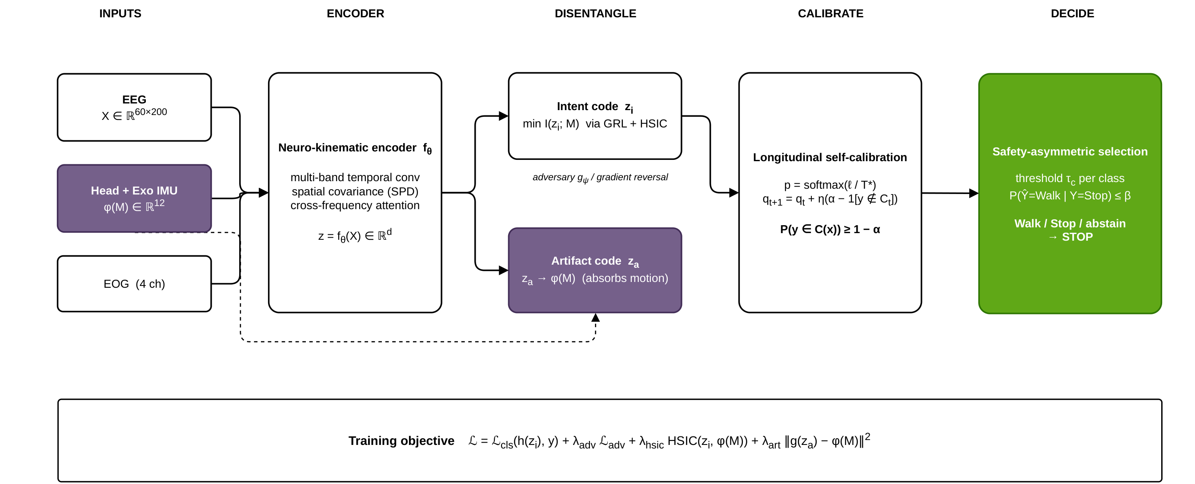
Proposed Method: CALM-Net Architecture
A multimodal pipeline: a neuro-kinematic encoder, motion-invariant disentanglement, longitudinal self-calibration, and a safety-asymmetric decision that defaults to Stop.

Slide 7
Proposed Method: Core Idea and Hypothesis
• Record movement alongside EEG: the head and exoskeleton IMUs give a 12-D motion signal.
• Adversarial disentanglement (MID): force the neural code to be statistically independent of that motion.
• Decide from the invariant part only: the classifier never sees the movement-coupled features.
• Add honesty and safety: temperature scaling with adaptive conformal, then abstain to Stop when unsure.
HYPOTHESIS Disentangling movement, calibrating across sessions, and abstaining under uncertainty yields an honest, safe decoder that trades inflated accuracy for trustworthy control.

Slide 8
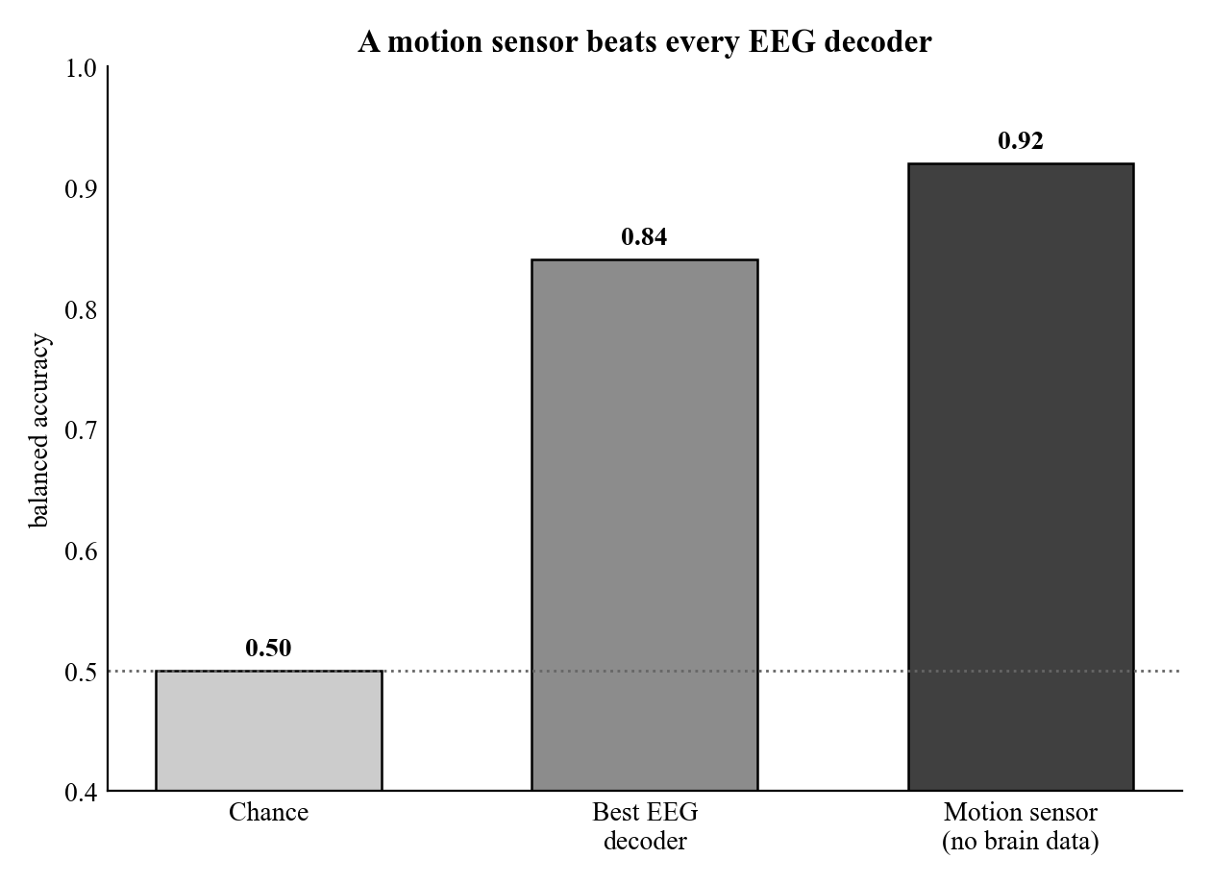
Preliminary Analysis: Movement Confound
The exoskeleton physically moves the wearer during walk.
A motion sensor with no brain data scores 0.92, above the best EEG decoder (0.84).
So the reported accuracy is largely the confound. This is exactly why we decode a movement-invariant signal.

Slide 9
Preliminary Results: Architectures Compared
Balanced accuracy, mean over 7 subjects, identical longitudinal protocol. For reference, an IMU sensor with no brain data scores 0.84.
 | EEGNet | Band-power | Riemannian | Graph net | Conformer
Parameters | 4.8 k | 4.0 k | — | 8.4 k | 341 k
Standard protocol | 0.81 | 0.81 | 0.81 | 0.84 | 0.83
Movement-invariant | 0.65 | 0.65 | 0.65 | 0.69 | —
Motion recoverable R² | −0.38 | −0.31 | −0.47 | −0.04 | —
Motion R² below zero means the exoskeleton’s motion is no longer recoverable from the neural code.
Takeaway: every neural architecture collapses to about 0.65 once movement is removed, and none clearly wins.
The contribution is the framework, not raw accuracy: adaptive-conformal coverage held at 0.90 (7 / 7) and wrong-walk error fell from 0.14 to 0.05.

Slide 10
Per-Subject Results
Full CALM-Net pipeline, longitudinal (train on sessions 1 to 3, test on the later 6). Coverage target 0.90.
Subject | Span (days) | IMU-only | Invariant acc. | Coverage
S01 | 21 | 0.86 | 0.79 | 0.90
S02 | 15 | 0.79 | 0.52 | 0.90
S03 | 14 | 0.98 | 0.77 | 0.91
S04 | 35 | 0.96 | 0.70 | 0.90
S05 | 44 | 0.89 | 0.66 | 0.90
S06 | 80 | 0.56 | 0.70 | 0.91
S07 | 39 | 0.83 | 0.73 | 0.90
Mean |  | 0.84 | 0.69 | 0.90
S03: a motion sensor alone scores 0.98, yet the movement-invariant decode is 0.77; the gap is the confound being removed.
S06: motion is uninformative (0.56), yet EEG still decodes 0.70, genuine neural signal. Coverage holds near 0.90 for every subject, across spans up to 80 days.

Slide 11
References
Works cited in the literature review, keyed to the [author, year] tags on slide 5.
[Sarkar 2026] S. Sarkar et al., “EEG-controlled exoskeleton for walking and standing: a longitudinal multimodal dataset,” Sci. Data, 2026. (OpenNeuro ds007788)
[Ferrero 2024] L. Ferrero et al., “Brain-machine interface based on deep learning to control a lower-limb robotic exoskeleton,” J. NeuroEng. Rehabil., 21(48), 2024.
[Soriano 2025] P. Soriano-Segura, M. Ortiz et al., “Characterization of error-related potentials during exoskeleton command via deep learning,” J. NeuroEng. Rehabil., 2025.
[Tortora 2023] S. Tortora et al., “Cortical and muscular activity under robot-assisted gait modes during exoskeleton walking,” 2023.
[Song 2023] Y. Song et al., “EEG Conformer: convolutional transformer for EEG decoding and visualization,” IEEE TNSRE, 31:710-719, 2023.
[Lawhern 2018] V. J. Lawhern et al., “EEGNet: a compact CNN for EEG-based brain-computer interfaces,” J. Neural Eng., 15(5), 2018.
[Barachant 2012] A. Barachant et al., “Multiclass brain-computer interface classification by Riemannian geometry,” IEEE TBME, 59(4), 2012.
[Gibbs 2021] I. Gibbs and E. Candès, “Adaptive conformal inference under distribution shift,” NeurIPS, 2021.
[Angelopoulos 2023] A. N. Angelopoulos and S. Bates, “Conformal prediction: a gentle introduction,” Found. Trends Mach. Learn., 16(4), 2023.
[Tveter 2024] M. Tveter et al., “Advancing EEG prediction with deep learning and uncertainty estimation,” Brain Inform., 11(27), 2024.
[Zhang 2023] X. Zhang et al., “Priming cross-session motor-imagery classification with a universal deep domain-adaptation framework,” Neurocomputing, 556, 2023.
[Hendrickx 2024] K. Hendrickx et al., “Machine learning with a reject option: a survey,” Mach. Learn., 113(5), 2024.
[Geifman 2017] Y. Geifman and R. El-Yaniv, “Selective classification for deep neural networks,” NeurIPS, 2017.

