Slide 1
CALM-Net
Label-Free Covariance Alignment for Longitudinal EEG Decoding
Midterm Presentation
Md Wahiduzzaman Suva [26-94088-2]
Esme Moula Chowdhury Abha [26-94089-2]
Supervisor: Dr. Muhammad Hasibur Rashid Chayon

Slide 2
Introduction
Lower-limb exoskeletons controlled by non-invasive EEG can restore walking for people with spinal cord injury or stroke. A decoder is trained once but must operate across sessions recorded over several weeks.
Changes in electrode placement and impedance between sessions alter the EEG signal statistics that a trained decoder relies on.
This work: a compact EEG decoder that adapts to each new session without labels, evaluated on three EEG datasets.

Slide 3
Research Challenges
1
Session drift
Electrode position and impedance change between sessions, shifting the signal statistics a trained decoder depends on.
2
Movement artefact
Walking produces motion and muscle activity that can mix with the EEG recording.
3
Reliable decisions
Exoskeleton control needs consistent accuracy across sessions and well-calibrated confidence.

Slide 4
Research Objectives
O1
Adaptive alignment
Design an alignment layer that corrects session drift without labels, during training and at test time.
O2
Accurate and calibrated decoding
Achieve accuracy comparable to published decoders with a compact model and calibrated confidence.
O3
A design rule for adaptation
Derive and validate a rule, read from the recording protocol, that sets the adaptation rate of the alignment layer.
Research question: can a compact decoder adapt to session drift without labels while remaining accurate and reliable?

Slide 5
Literature Review
Exoskeleton BCI
[Sarkar 2026] Released a longitudinal dataset of seven healthy participants walking and standing with an EEG-controlled exoskeleton over nine sessions, with synchronised EEG, EOG, inertial and exoskeleton recordings.
[Ferrero 2024] Achieved closed-loop, asynchronous walk and stop control of a lower-limb exoskeleton with a deep-learning decoder; transfer learning shortened the calibration recorded in each session.
[Soriano 2025] Characterised error-related potentials evoked while commanding a lower-limb exoskeleton and detected them with deep learning, as a safety signal for the interface.
[Tortora 2023] Examined how cortical and muscular activity change across robot-assisted gait modes during exoskeleton walking.
EEG decoding models
[Schirrmeister 2017] Showed that deep and shallow convolutional networks decode movement-related EEG, with the shallow network learning the band-power features of filter-bank common spatial patterns.
[Lawhern 2018] Introduced EEGNet, which uses depthwise and separable convolutions to reduce the parameter count by an order of magnitude and performs well across four BCI paradigms.
[Song 2023] Proposed EEG Conformer, which adds a transformer encoder to a convolutional stem so that local and long-range temporal features are learned together.
SUMMARY
Exoskeleton control from EEG is well established, and compact convolutional decoders are the standard models. Their spatial filters are learned during training and stay fixed in later sessions.
Citations shown as [first author, year]; full entries are listed on the References slide.

Slide 6
Literature Review (Continued)
Covariance-based alignment
[Barachant 2012] Represented each EEG trial by its spatial covariance matrix and classified trials by Riemannian distance to the mean covariance of each class.
[He 2020] Proposed Euclidean alignment, which whitens the trials of each subject or session by the inverse square root of their mean covariance, so that recordings become comparable without labels.
[Rodrigues 2019] Proposed Riemannian Procrustes analysis, which re-centres, stretches and rotates covariance distributions to transfer a classifier between subjects and sessions.
Test-time adaptation and selective prediction
[Wang 2021] Proposed Tent, which updates the normalisation parameters of a network on unlabelled test data by minimising the entropy of its predictions.
[Gong 2022] Proposed NOTE for temporally correlated test streams, combining instance-aware batch normalisation with a prediction-balanced memory of test samples.
[Geifman 2019] Proposed SelectiveNet, which trains a classifier together with a selection head that abstains on uncertain inputs at a chosen coverage.
RESEARCH GAP
Existing alignment methods operate offline on complete recordings. This work places alignment inside the network, adapts it online without labels, and provides a rule for choosing its adaptation rate.
Citations shown as [first author, year]; full entries are listed on the References slide.

Slide 7
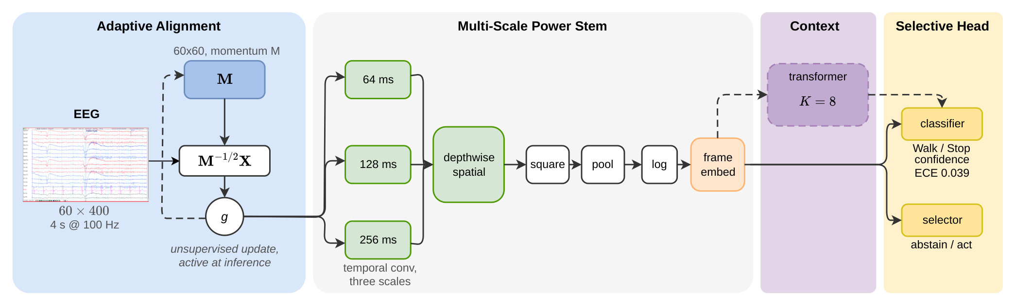
Proposed Architecture
Proposed decoder (24,181 parameters): an adaptive alignment layer, a multi-scale power stem, an optional cross-epoch context module and a selective classification head.

Slide 8
Adaptive Alignment Method
• Running covariance estimate: an exponential moving average of the spatial covariance of incoming EEG windows.
• Whitening: each window is multiplied by the inverse square root of that estimate before feature extraction.
• Label-free adaptation: the estimate continues to update on new sessions without labels.
• Adaptation rate rule: the estimator memory is set longer than the class block length of the recording protocol.
KEY IDEA Session drift is corrected inside the network, and the recording protocol determines the adaptation rate before training.

Slide 9
Datasets and Experimental Setup
A
Exoskeleton EEG [Sarkar 2026]
7 participants, 9 sessions over several weeks. Trained on sessions 1 to 3 and tested on sessions 4 to 9.
B
Treadmill walking [Luu 2017]
8 participants with 3 trials each, recorded in an independent laboratory.
C
Motor execution [Schalk 2004]
20 participants from PhysioNet EEGMMIDB, with the analysis plan registered before training.
Protocol: 8 to 30 Hz filtering, AdamW optimisation with early stopping, and three data-split seeds; seven published decoders trained with identical settings.

Slide 10
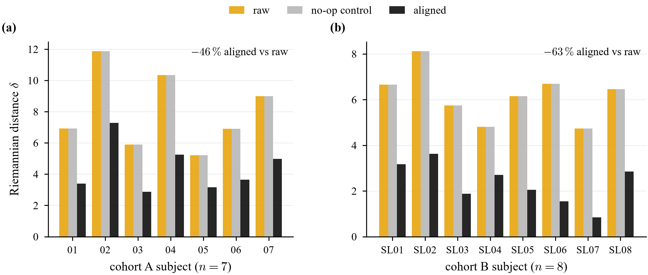
Session Drift Reduction
Drift reduced in all 15 participants: the alignment layer reduces the covariance distance between sessions by 45.9 % on cohort A and 62.5 % on cohort B, while a control without updates leaves it unchanged.

Slide 11
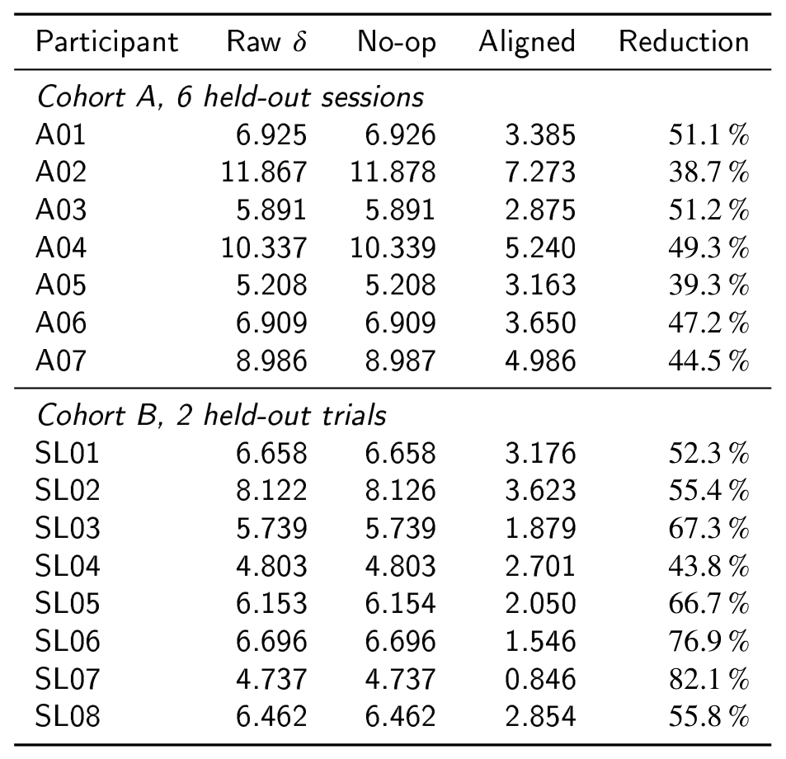
Per-Participant Drift Reduction
Riemannian distance between the training-session covariance and the test sessions, before and after alignment.
Cohort A: 38.7 to 51.2 % reduction for each participant.
Cohort B: 43.8 to 82.1 % reduction for each participant.

Slide 12
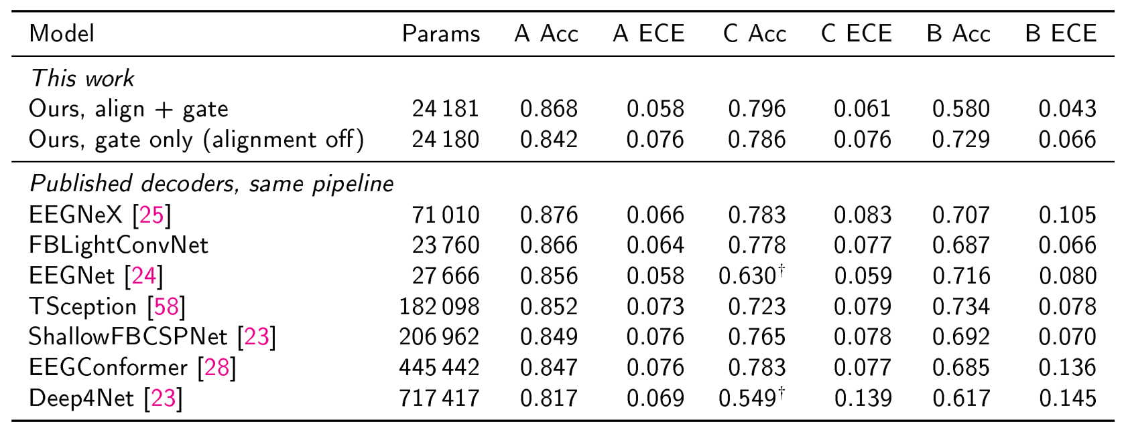
Comparison with Baseline Models
Balanced accuracy (Acc) and expected calibration error (ECE), mean over three data-split seeds; all models trained in the same pipeline.
† below 0.55 accuracy for at least five of twenty participants on one seed.
Cohort A: 0.868 balanced accuracy, comparable to the best baseline (0.876), with fewer parameters than six of the seven baselines.
Cohorts C and B: highest accuracy on cohort C (0.796); on cohort B, with alignment set by the protocol rule, 0.729, second of eight models.

Slide 13
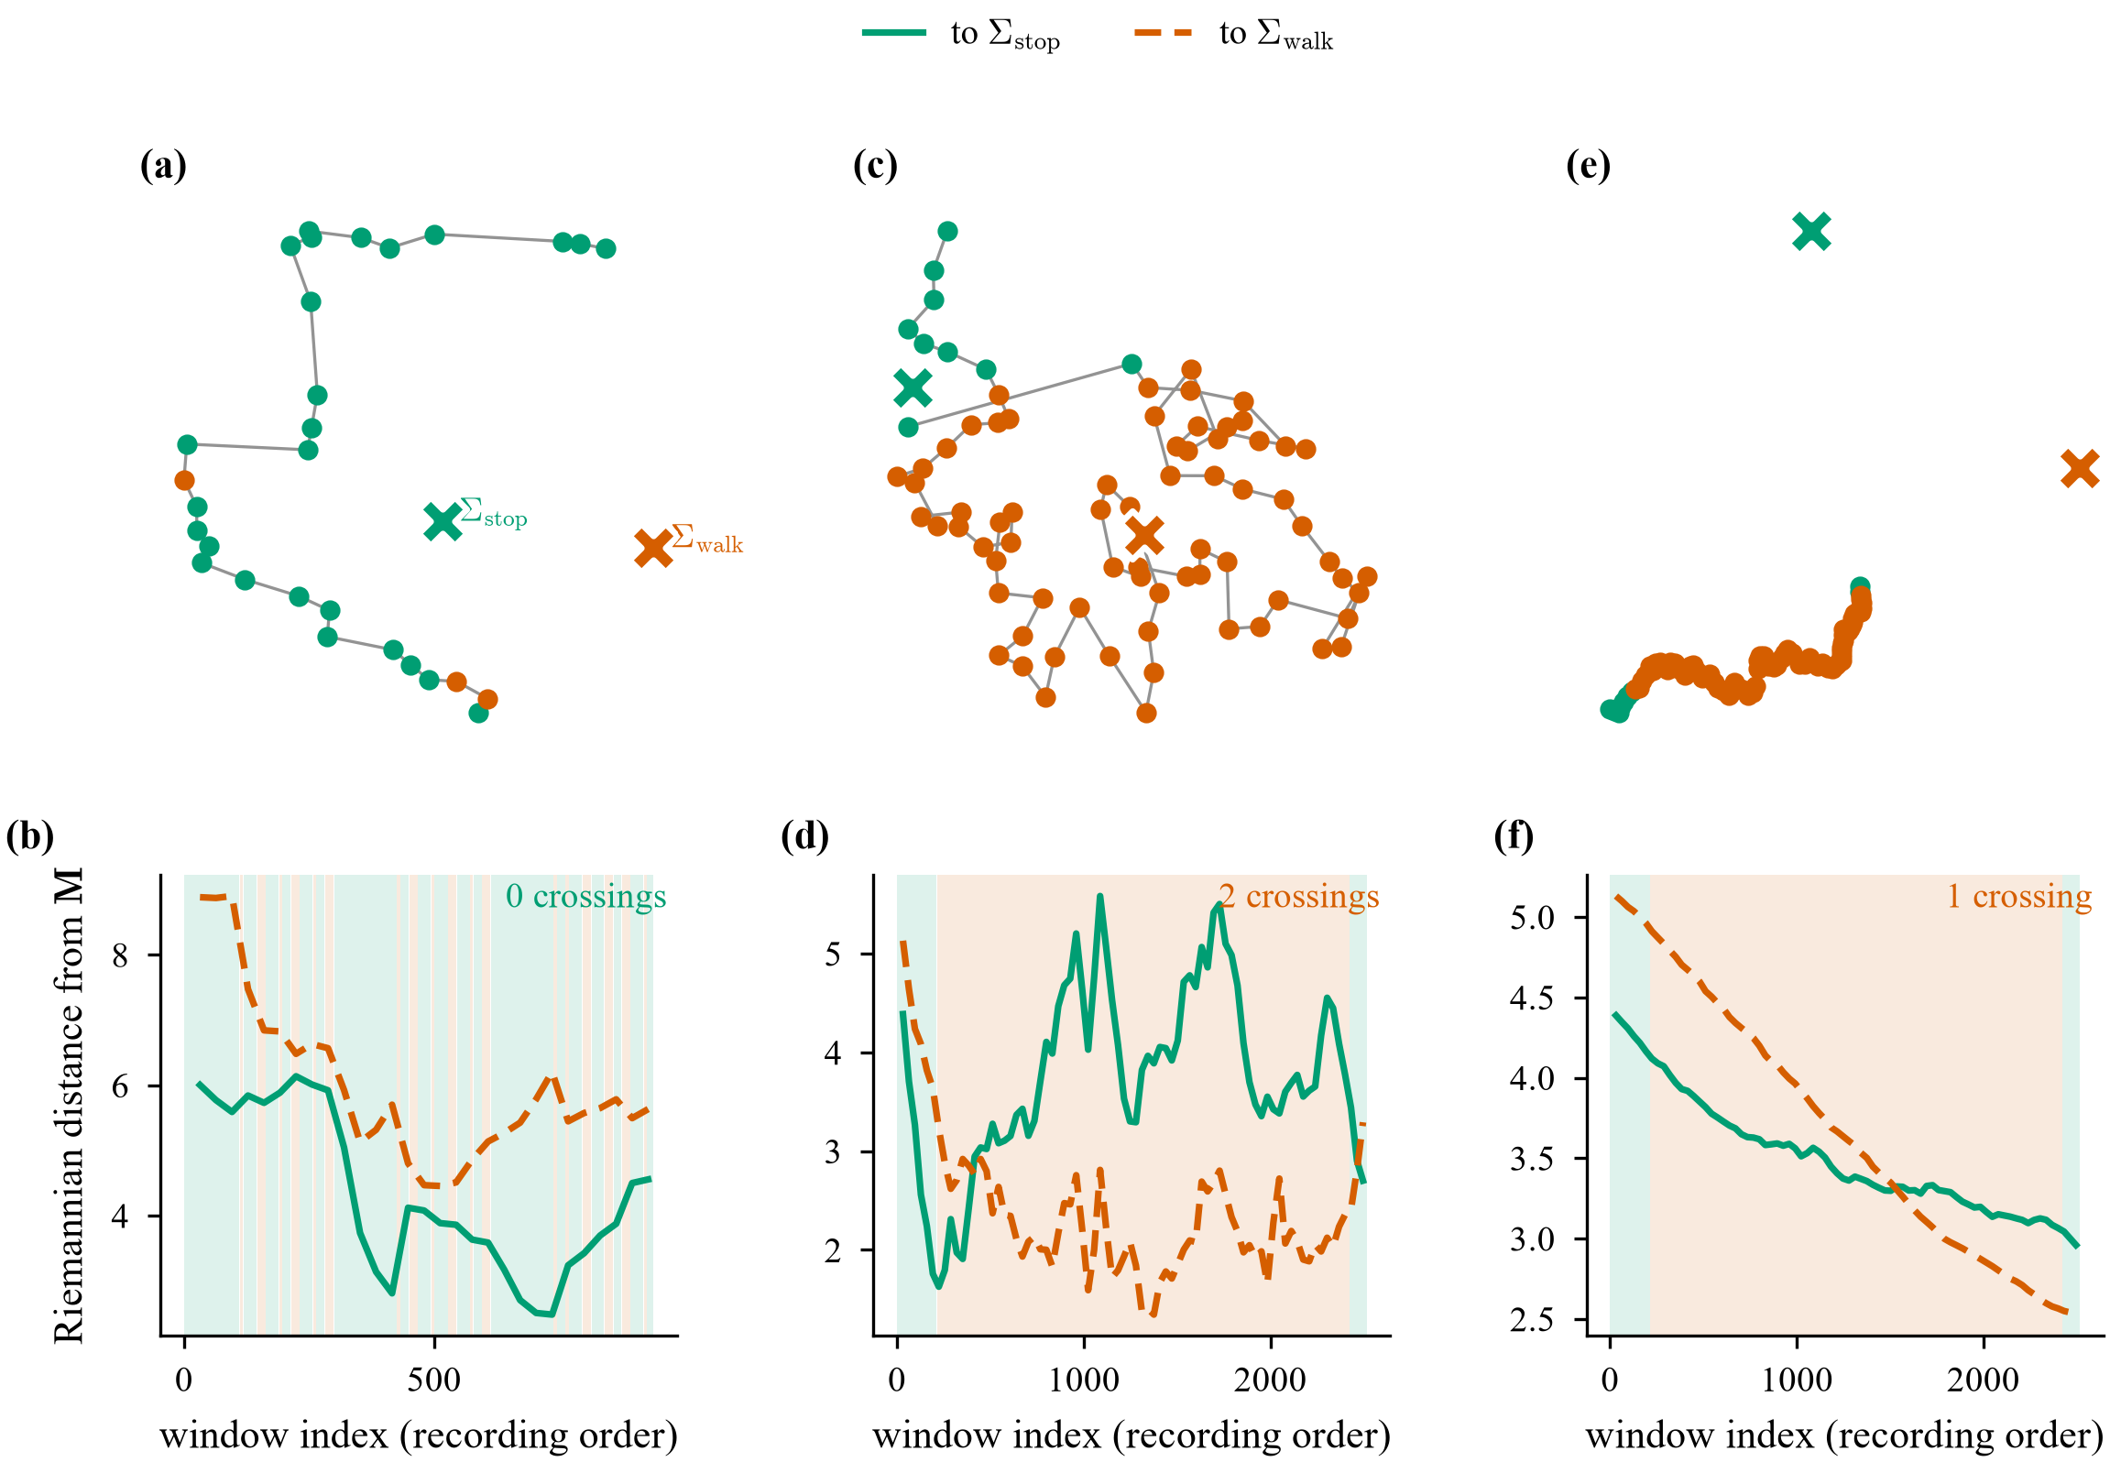
Alignment Estimate During Recording
Estimate trajectory, one participant per cohort: with short class blocks (cohort A) the estimate stays between the class covariances; with long class blocks (cohort B) it follows the active class, the case the adaptation rate rule addresses.

Slide 14
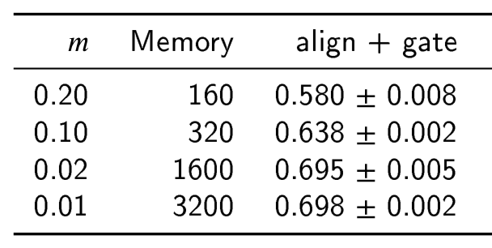
Adaptation Rate Analysis
Cohort B, three data-split seeds: balanced accuracy of align + gate at four adaptation rates.
Effect of the rate: lengthening the estimator memory from 160 to 3200 windows raises accuracy from 0.580 to 0.698, as the adaptation rate rule predicts.
Protocol rule: when class blocks are longer than the estimator memory, the rule selects the configuration without alignment, which reaches 0.729 on this cohort.

Slide 15
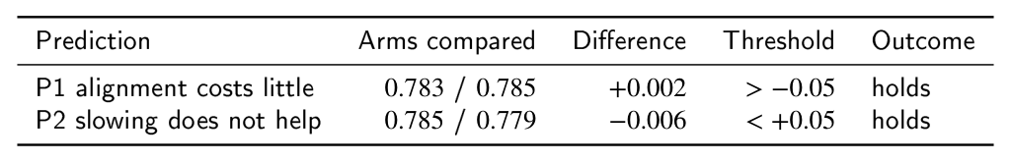
Prospective Validation on Cohort C
Predictions registered before any model was trained on cohort C; balanced accuracy, seed 0.
Both predictions confirmed: enabling alignment preserved accuracy (+0.002), and a slower adaptation rate brought no change, as the rule predicts for short class blocks.
Replication: two additional data-split seeds support the same conclusions.

Slide 16
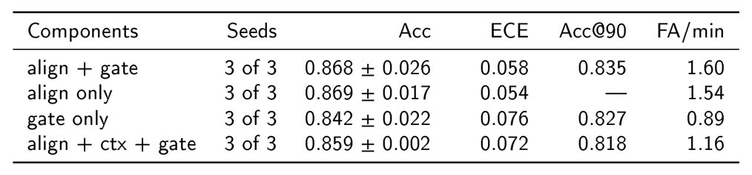
Ablation Study
Cohort A, three data-split seeds.
FA/min: spurious activations per minute of standing. Acc@90: accuracy at 90 % coverage.
Alignment layer: adding alignment raises balanced accuracy from 0.842 (gate only) to 0.868.
Cross-epoch context: reduces spurious activations from 1.60 to 1.16 per minute of standing.

Slide 17
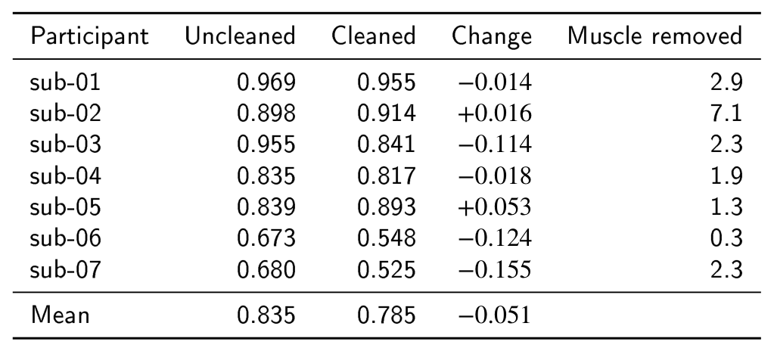
Artefact Analysis
Accuracy after ICA artefact removal
Eye, muscle and other non-neural components were removed with ICLabel [Pion-Tonachini 2019] before retraining the decoder.
Mean balanced accuracy remains at 0.785, well above chance, and the change for each participant is unrelated to the number of muscle components removed.
The results are consistent with decoding from neural EEG activity.

Slide 18
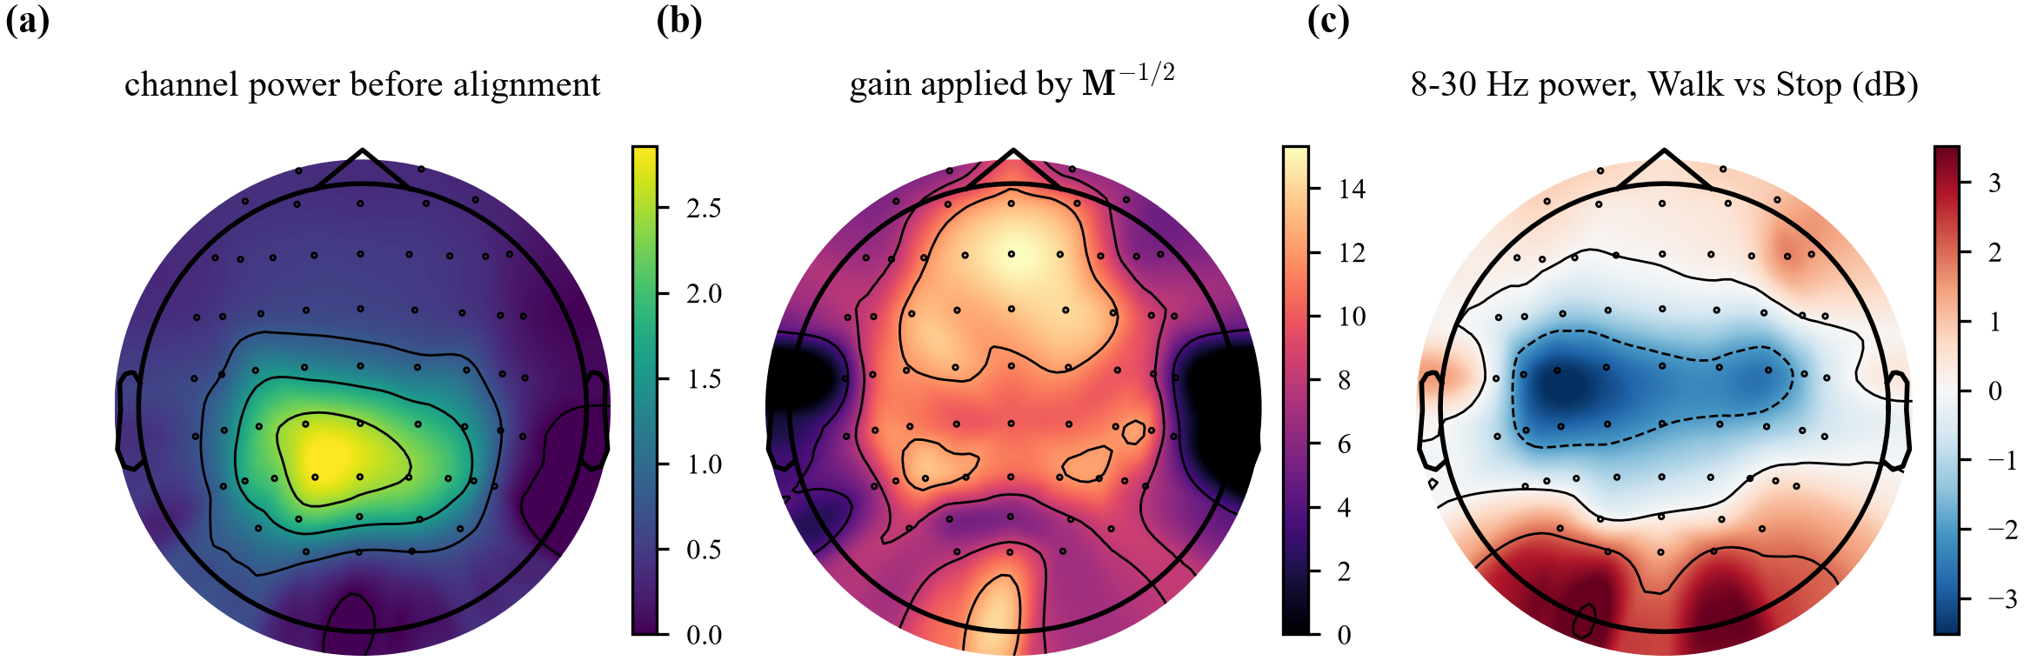
Scalp Topography
One participant, 8 to 30 Hz power: power decreases over sensorimotor electrodes during walking, consistent with mu and beta desynchronisation during movement.

Slide 19
Limitations and Future Work
• Cohort size: the three datasets include 7, 8 and 20 participants.
• Offline evaluation: all results are from recorded datasets; closed-loop testing is planned.
• Architecture development: the architecture is under active development, and further variants will be evaluated.
• Adaptation rate selection: the rate is currently set by a rule and could be learned from data.
FUTURE WORK Real-time evaluation with an exoskeleton, larger cohorts, and recording protocols designed to refine the adaptation rate rule.

Slide 20
Conclusion
This work presents a compact EEG decoder with an adaptive alignment layer that corrects session drift without labels.
The decoder reduces session drift by 46 % to 63 %, achieves accuracy comparable to published decoders, and follows a protocol-based rule confirmed prospectively.
Outlook: the approach supports longitudinal use of EEG-controlled exoskeletons with less recalibration.

Slide 21
References
Works cited on these slides, keyed to their [author, year] tags.
[Sarkar 2026] S. Sarkar et al., “EEG-controlled exoskeleton for walking and standing: a longitudinal multimodal dataset,” Sci. Data, 2026. (OpenNeuro ds007788)
[Ferrero 2024] L. Ferrero et al., “Brain-machine interface based on deep learning to control asynchronously a lower-limb robotic exoskeleton,” J. NeuroEng. Rehabil., 21(48), 2024.
[Soriano 2025] P. Soriano-Segura, M. Ortiz et al., “Characterization of error-related potentials during the command of a lower-limb exoskeleton based on deep learning,” J. NeuroEng. Rehabil., 2025.
[Tortora 2023] S. Tortora et al., “Cortical and muscular activity under robot-assisted gait modes during exoskeleton walking,” 2023.
[Luu 2017] T. P. Luu et al., “Real-time EEG-based brain-computer interface to a virtual avatar enhances cortical involvement in human treadmill walking,” Sci. Rep., 7:8895, 2017.
[Schalk 2004] G. Schalk et al., “BCI2000: a general-purpose brain-computer interface (BCI) system,” IEEE TBME, 51(6):1034-1043, 2004.
[Lawhern 2018] V. J. Lawhern et al., “EEGNet: a compact CNN for EEG-based brain-computer interfaces,” J. Neural Eng., 15(5), 2018.
[Schirrmeister 2017] R. T. Schirrmeister et al., “Deep learning with convolutional neural networks for EEG decoding and visualization,” Hum. Brain Mapp., 38(11):5391-5420, 2017.
[Song 2023] Y. Song et al., “EEG Conformer: convolutional transformer for EEG decoding and visualization,” IEEE TNSRE, 31:710-719, 2023.
[He 2020] H. He and D. Wu, “Transfer learning for brain-computer interfaces: a Euclidean space data alignment approach,” IEEE TBME, 67(2):399-410, 2020.
[Rodrigues 2019] P. L. C. Rodrigues et al., “Riemannian Procrustes analysis: transfer learning for brain-computer interfaces,” IEEE TBME, 66(8):2390-2401, 2019.
[Barachant 2012] A. Barachant et al., “Multiclass brain-computer interface classification by Riemannian geometry,” IEEE TBME, 59(4), 2012.
[Wang 2021] D. Wang et al., “Tent: fully test-time adaptation by entropy minimization,” ICLR, 2021.
[Gong 2022] T. Gong et al., “NOTE: robust continual test-time adaptation against temporal correlation,” NeurIPS, 2022.
[Geifman 2019] Y. Geifman and R. El-Yaniv, “SelectiveNet: a deep neural network with an integrated reject option,” ICML, 2019.
[Pion-Tonachini 2019] L. Pion-Tonachini et al., “ICLabel: an automated electroencephalographic independent component classifier, dataset, and website,” NeuroImage, 198:181-197, 2019.

