Slide 1
Label-free covariance alignment for longitudinal EEG decoding
Updated manuscript
Esm E Moula Chowdhury Abha [26-94089-2]
Md Wahiduzzaman Suva [26-94088-2]
Supervisor: Dr. Muhammad Hasibur Rashid Chayon

Slide 2
What Changed Since the Midterm
The movement-leakage measure was confounded. A decoder carrying no movement information at all still scored R² = 0.863, because walk and stop differ in movement by definition. The invariance claim was withdrawn and replaced by a probe conditioned on the label.
Abstention did not work. Declining the least-confident 10 % of windows lowers accuracy in 14 of 18 arms. It is reported as a negative result.
The contribution moved to longitudinal drift. When an in-network alignment layer helps across sessions, and when it harms.
External validation was added. An independent second cohort, and a third cohort tested against a prediction registered before any model was trained.

Slide 3
A Decoder Must Keep Working for Weeks
An exoskeleton decoder is fitted once and used for weeks. Electrode impedance, montage and skin contact change between sessions, and the second-order statistics every spatial filter depends on drift with them.
Correcting the drift inside the network, without labels, removes the per-session calibration block.
The question. A running estimate adapts to whatever is currently streaming. Under which recording protocols is that safe?

Slide 4
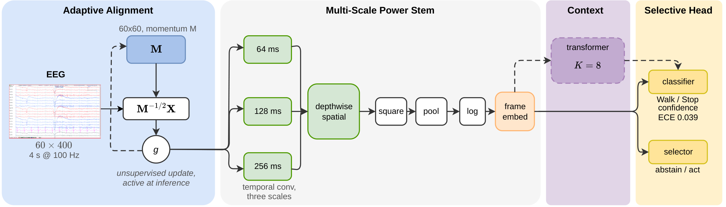
Architecture
Adaptive alignment whitens each window by a running covariance estimate, updated without labels at inference. Multi-scale power stem preserves log-power ratios. 24,181 parameters in the proposed configuration.

Slide 5
Three Cohorts
 | Cohort A | Cohort B | Cohort C
Source | OpenNeuro ds007788 | Treadmill MoBI | PhysioNet EEGMMIDB
Task | Exoskeleton walk / stop | Treadmill walk / stand | Rest / movement
Participants | 7 | 8 | 20
Channels | 60 | 64 | 64
Class block (windows) | 18 | 309 | 5
Role | Development | External validation | Registered prediction
The class-block length, measured in windows, is the property that turns out to decide whether in-network alignment helps.

Slide 6
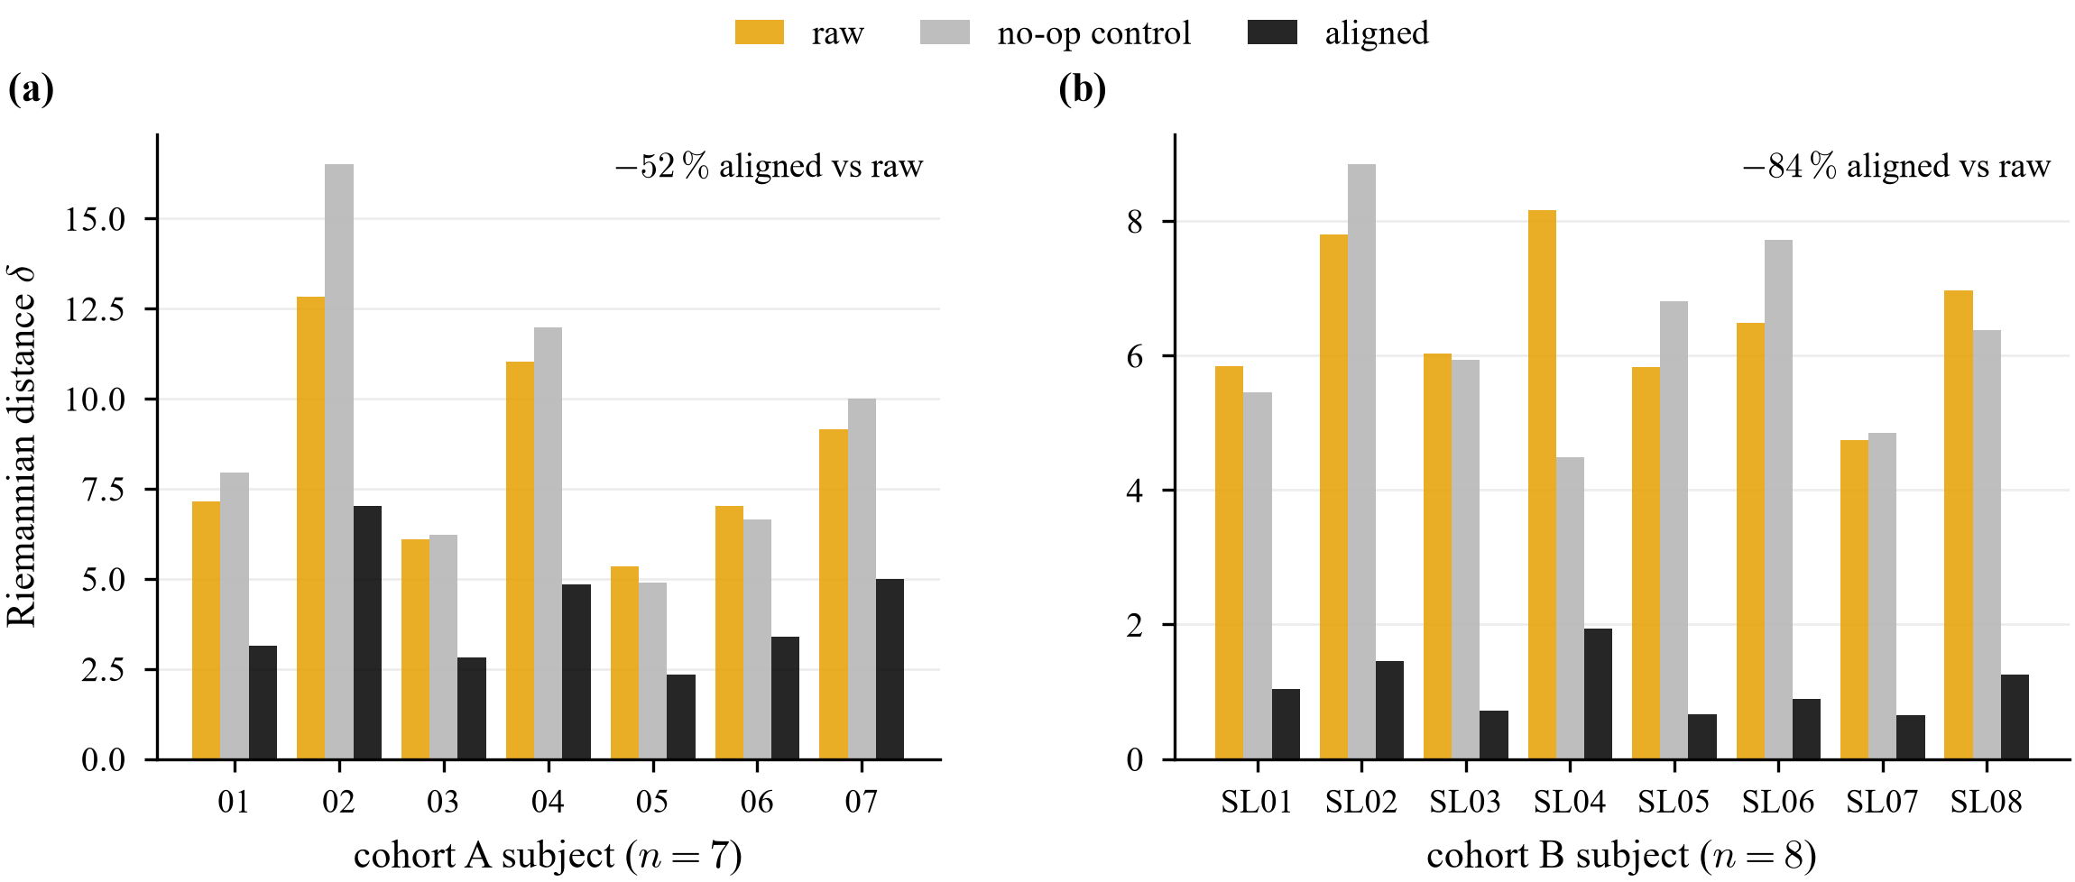
Alignment Removes Session Drift
52.0 ± 4.5 % on cohort A and 83.9 ± 3.9 % on cohort B reduction in session-to-session covariance distance, in 15 of 15 participants, p ≤ 10⁻⁴.

Slide 7
Decoder Accuracy on Cohort A
Configuration | Balanced acc. | ECE | Parameters
Align + gate (proposed) | 0.901 | 0.039 | 24,181
Align + context + gate | 0.878 | 0.074 | 618,997
Context + gate | 0.827 | 0.091 | n/a
Stem only | 0.827 | 0.082 | n/a
ATCNet, same pipeline | 0.913 | n/a | 45,478
0.901 at 53 % of ATCNet's parameters. Removing alignment costs 0.074 on this cohort. Seven participants, nine sessions each, fitted on sessions 1–3 and tested on sessions 4–9 recorded weeks later.

Slide 8
Is the Accuracy Neural
Three separate lines of evidence
No motion input. The IMU is used only to score leakage after the fact.
8–30 Hz band. Excludes the 1–2 Hz gait cycle and most muscle activity above 30 Hz.
Leakage probe. Injecting 2 % motion reaches 0.903 accuracy and moves the probe to +0.067. The proposed decoder reaches 0.901 with the probe at −0.068.
ICA artefact control
ICLabel removes eye, muscle, heart, line-noise and channel-noise components, then the proposed decoder is retrained on the cleaned signal.
Uncleaned 0.835 Cleaned 0.785
Change −0.051 p = 0.22, n = 7
Most accuracy survives. Four of seven participants are unchanged or improve.
Losses do not track muscle. The participant with the most muscle removed improves; one with almost none removed loses most.
Seven participants: evidence against muscle dependence, short of proof.

Slide 9
External Validation
Configuration | Cohort A | Cohort B
Align + gate | 0.901 | 0.581
Align + context + gate | 0.878 | 0.626
Context + gate (no alignment) | 0.827 | 0.792
Stem only | 0.827 | 0.737
The decoder transfers. Without alignment it reaches 0.792 on an independent laboratory's data, with different sensors and reversed class balance.
The alignment layer inverts. It adds 0.074 on cohort A and costs 0.211 on cohort B.

Slide 10
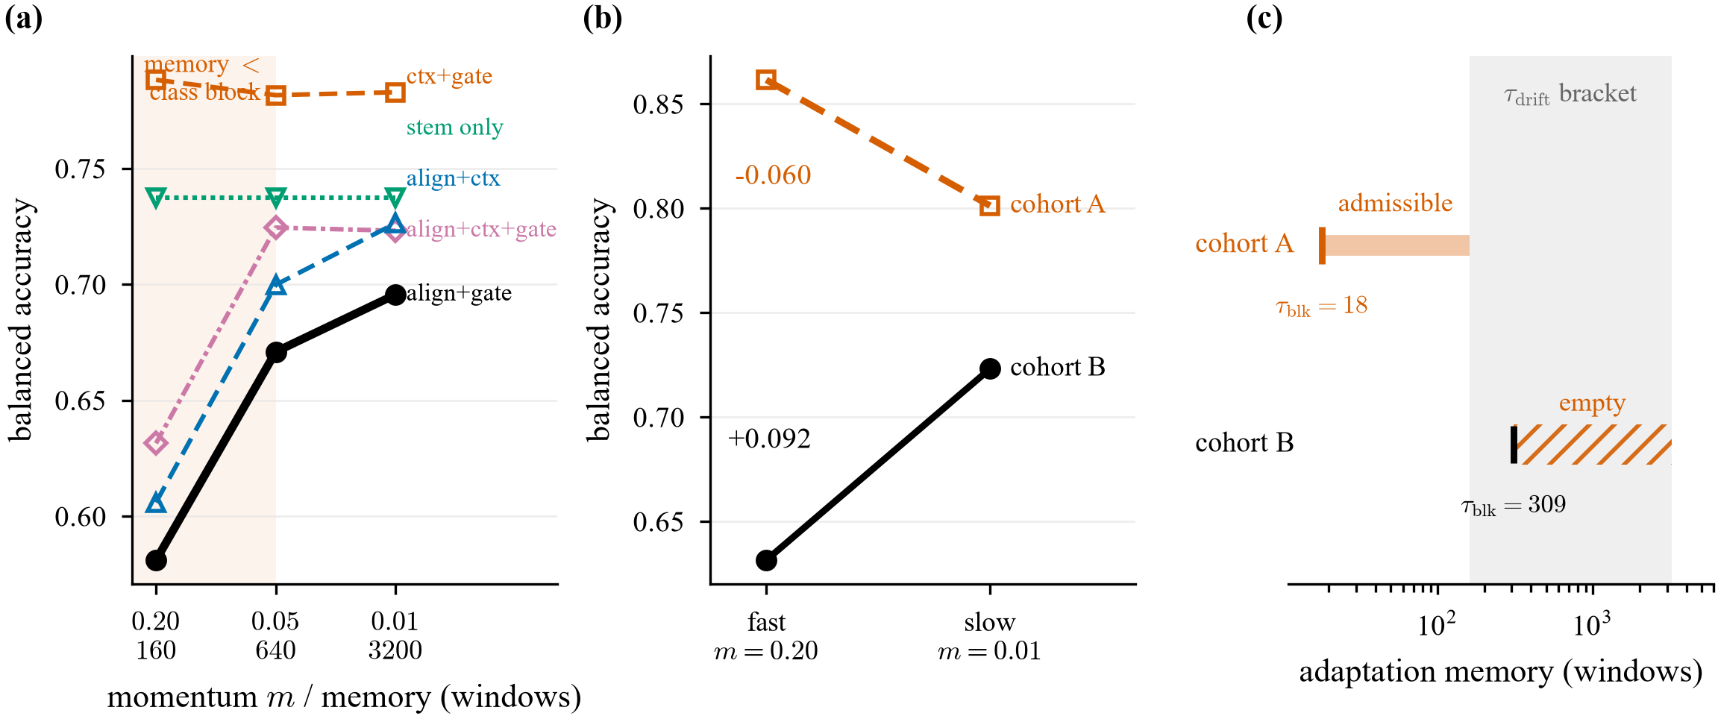
The Estimator Tracks the Streaming Class
Cohort B presents each class in blocks of 309 windows, longer than the estimator's 160-window memory. The estimate converges to the current class and whitens away the difference between classes. Slowing adaptation recovers 0.090 to 0.098 on every arm that uses alignment and exactly 0.000 on the arms that do not.

Slide 11
The Admissible Rate Band
τ_block < μ < τ_drift
Lower bound. The estimator's memory must outlast a class block, or it tracks the class.
Upper bound. It must adapt faster than the session drifts, or it has nothing to correct.
One model, one switch. Cohort A (18 < 160) enables alignment and reaches 0.901. Cohort B (309 > 160) disables it and reaches 0.792. Both bounds come from the recording protocol, before any training.
A learned gate cannot find this switch itself. The failure appears only at test time, so no training gradient contains it.

Slide 12
A Prediction Registered in Advance
Cohort C, PhysioNet EEGMMIDB. Class blocks of 5 windows, far inside the 160-window memory. The prediction and its thresholds were committed to version control before any model was trained on this cohort.
Prediction | Rule | Observed | Verdict
P1 Alignment costs little | mean difference > −0.05 | +0.002 | Confirmed
P2 Slowing does not help | mean difference < +0.05 | −0.006 | Confirmed
Why P2 matters. On cohort B, slowing adaptation recovered 0.090. The condition predicts the same intervention does nothing here, because there is no class tracking to stop.
Paired over 20 participants. Direction counts and Wilcoxon tests are reported but do not change the verdict.

Slide 13
Results Reported as Negative
The selective head
Declining uncertain windows lowers accuracy in 14 of 18 arms. It adds no accuracy either: alignment alone reaches 0.883, with the head 0.884.
The no-op control
It is not inert. It moves distance by −28.8 % to +45.0 % per participant, because trace normalisation after a fixed map breaks affine invariance.
Temporal smoothing
Its gains are consistent in sign, 6 of 7 participants, but do not survive Holm correction at n = 7. Only the shuffled control does.
Calibration (ECE 0.039) is a separate result and stands.

Slide 14
Limitations and Next Steps
Limitations
• Headline ablation is a single seed.
• Condition 1 was formulated after cohort B; cohort C is its first advance test.
• No published decoder has been run on cohort B.
• The leakage probe cannot register artefact constant within a class.
Next
• Multi-seed headline, about 47 GPU hours.
• A cohort whose blocks outlast drift, to test the empty band.
• Published baselines on cohort B.
• Measure the drift timescale directly, without a decoder.

Slide 15
Methods Corrected Since Submission
Setting | Submitted | Corrected to match the code
Band-pass | 0.5–40 Hz | 8–30 Hz, zero-phase
Artefact step | none | EOG regression on cohort A
Optimiser | Adam, lr 10⁻³ | AdamW, lr 3×10⁻⁴, wd 10⁻², one-cycle
Early stopping | not stated | patience 12
Leakage bound | stated for the decoder | measured on tangent features
Found while checking the pipeline overnight. None changes a reported number; each would have stopped a reviewer reproducing the work. The true band excludes more artefact than the submitted text claimed.

