Slide 1
METHOD PRESENTATION · POST-QUANTUM CRYPTOGRAPHY × FEDERATED LEARNING
CB-SAFE: Code-Based Post-Quantum Secure Aggregation for Byzantine-Robust Federated Learning
Md Wahiduzzaman Suva (26-94088-2) · Esm-e Moula Chowdhury Abha (26-94089-2)
Department of Computer Science, American International University–Bangladesh

Slide 2
OUTLINE
What this talk covers
▪ Problem statement, background and motivation (1–2).
▪ Closest related work (FedGT), its method, limitations, and why we selected it (3–6).
▪ Our proposed idea, and the component we take from each source paper (7–10).
▪ How we combine them, previous-vs-proposed, what is genuinely new (11–13).
▪ How the selection meets the required parameters, and the key contribution (14–15).
CB-SAFE · Suva & Chowdhury · AIUB

Slide 3
PROBLEM STATEMENT
Three threats collide in one protocol
▪ Federated learning shares model updates, not raw data; but those updates leak private training data.
▪ Secure aggregation hides updates behind masks, yet its key exchange breaks under a quantum computer (harvest-now, decrypt-later).
▪ Every post-quantum fix today is lattice-only (a monoculture); and hiding updates also blinds the server to poisoned ones.
▪ Goal: one protocol that is private, post-quantum with crypto diversity, AND Byzantine-robust.
[2] Bonawitz et al., Practical Secure Aggregation, ACM CCS 2017.
CB-SAFE · Suva & Chowdhury · AIUB
1 / 15

Slide 4
BACKGROUND / MOTIVATION
Why the problem is hard and timely
▪ Secure aggregation = pairwise masks that cancel in the sum; the server sees only the aggregate, never an individual.
▪ Quantum threat: Shor's algorithm breaks classical key exchange, and traffic recorded today is decryptable later.
▪ Crypto diversity: NIST selected the code-based KEM HQC in 2025 to hedge a lattice break; that diversity has not reached FL.
▪ Robustness tension: privacy hides exactly the per-client signal that poisoning defenses need.
[3] NIST IR 8545, 2025 (HQC); [4] Shor, SIAM J. Comput., 1997.
CB-SAFE · Suva & Chowdhury · AIUB
2 / 15

Slide 5
CLOSEST RELATED WORK
FedGT: malicious-client ID under secure aggregation
▪ FedGT (IEEE TIFS 2025) is the closest peer to our robustness mechanism.
▪ Idea: group clients into overlapping test groups; the server sees only group aggregates, so privacy is preserved.
▪ A statistical test flags groups that contain malicious clients; a decoder then identifies and removes the culprits.
▪ It borrows from group testing: find a few defectives with far fewer pooled tests than testing everyone.
[1] Xhemrishi, Östman, Wachter-Zeh, Graell i Amat, FedGT, IEEE TIFS, vol. 20, 2025.
CB-SAFE · Suva & Chowdhury · AIUB
3 / 15

Slide 6
EXISTING METHOD
How FedGT identifies attackers
▪ An assignment matrix A groups n clients into m overlapping groups (the parity-check structure of a code).
▪ Each group is securely aggregated; a test on the group aggregate is positive if any member is malicious (a syndrome bit).
▪ A COMP / Neyman-Pearson decoder infers the defective vector (which clients are malicious) from the group test results.
▪ Flagged clients are excluded; the remaining clean clients are aggregated into the global model.
[1] Xhemrishi et al., FedGT, IEEE TIFS 2025.
CB-SAFE · Suva & Chowdhury · AIUB
4 / 15

Slide 7
LIMITATIONS
Where FedGT leaves gaps (our angle)
▪ Crypto: it treats secure aggregation as a black box, with no post-quantum layer, in a lattice-only field.
▪ Cost: it needs a server validation set and per-round group testing over fixed overlapping groups.
▪ Single-round decode: it identifies attackers from one round's tests, using no information across rounds.
▪ Unexplained failure: it does not characterize WHY ordinary robust aggregation breaks once updates are hidden.
[1] Xhemrishi et al., FedGT, IEEE TIFS 2025.
CB-SAFE · Suva & Chowdhury · AIUB
5 / 15

Slide 8
WHY THIS PAPER
Why FedGT is our basis (selection parameters)
▪ Venue quality: IEEE TIFS, a Q1 security journal. Recency: published 2025.
▪ Relevance: it solves our exact sub-problem, malicious-client identification under secure aggregation.
▪ Method strength: its group testing outperforms the geometric median (RFA) and Multi-Krum in its own study.
▪ Reproducible: public code and a clearly specified protocol, giving a solid, buildable foundation.
[1] Xhemrishi et al., FedGT, IEEE TIFS 2025.
CB-SAFE · Suva & Chowdhury · AIUB
6 / 15

Slide 9
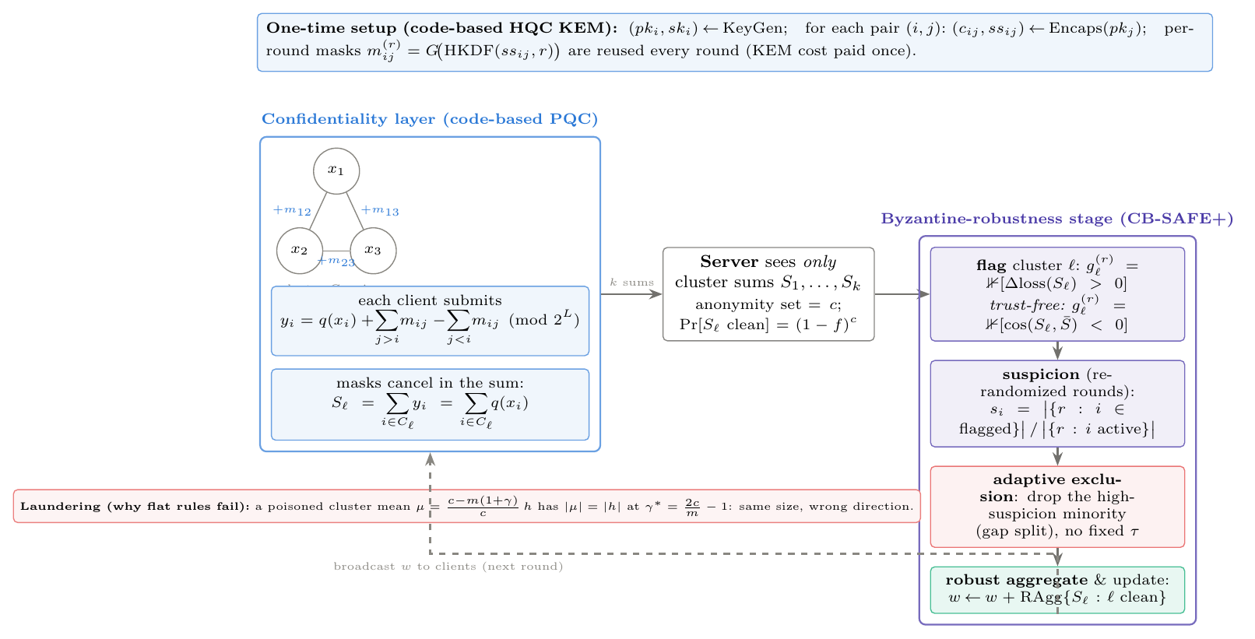
OUR PROPOSAL
CB-SAFE: code-based, private, and robust
▪ Hide updates within clusters using a code-based (HQC) masking protocol: the server sees only cluster sums.
▪ Run group testing ACROSS re-randomized clusters over rounds to identify attackers (CB-SAFE+).
▪ Confidentiality lives below the cluster boundary; robustness operates above it; post-quantum by construction.
This work.
CB-SAFE · Suva & Chowdhury · AIUB
7 / 15

Slide 10
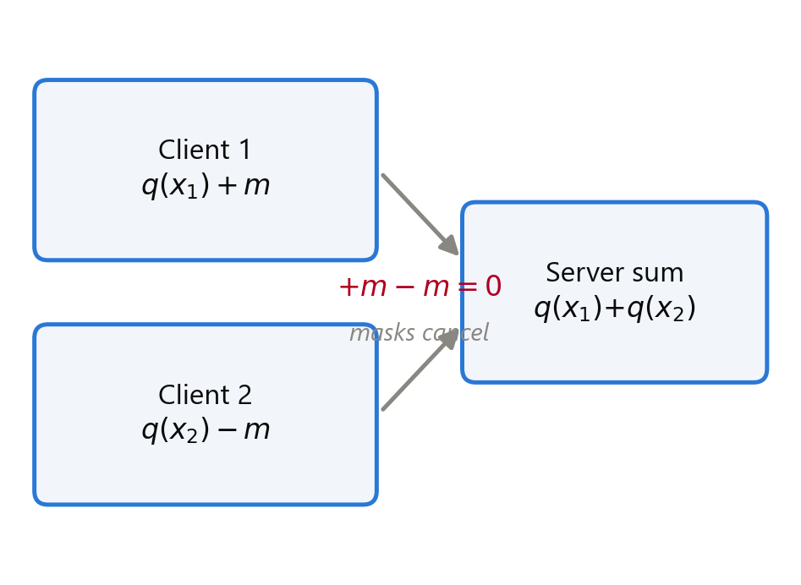
COMPONENT 1 / 3
Taken from secure aggregation: masking
▪ We adopt Bonawitz-style double masking: pairwise masks cancel in the cluster sum, so individuals stay hidden.
▪ Dropout resilience via Shamir secret sharing of the self-masks.
▪ Our change: masks are seeded from a KEM, so per-round traffic carries no cryptographic bytes at all.
[2] Bonawitz et al., Practical Secure Aggregation, ACM CCS 2017.
CB-SAFE · Suva & Chowdhury · AIUB
8 / 15

Slide 11
COMPONENT 2 / 3
Taken from FedGT: group testing for detection
▪ We adopt the core idea: identify malicious clients from GROUP-level observations, never from individual updates.
▪ The groups are the privacy-preserving cluster sums (the pools); a probe flags contaminated pools.
▪ Our change: tests repeat over re-randomized clusters and accumulate across rounds (temporal group testing), instead of a single-round decode.
[1] Xhemrishi et al., FedGT, IEEE TIFS 2025.
CB-SAFE · Suva & Chowdhury · AIUB
9 / 15

Slide 12
COMPONENT 3 / 3
Taken from NIST PQC: a code-based KEM (HQC)
▪ We adopt HQC, the code-based KEM NIST selected in 2025, for post-quantum confidentiality.
▪ Its security rests on syndrome decoding of quasi-cyclic codes, not on lattices: genuine cryptographic diversity.
▪ Our change: HQC sits behind a KEM-agnostic interface, so one can swap in ML-KEM with a single configuration line.
[3] NIST IR 8545, 2025 (HQC selection).
CB-SAFE · Suva & Chowdhury · AIUB
10 / 15

Slide 13
COMBINATION
How the three ideas fit together
Like combining a blue shirt and mustard pants: masking + group testing + code-based crypto become one framework.
▪ HQC-seeded masking (from [2], [3]) hides updates inside clusters, so the server sees only cluster sums.
▪ Group testing (from [1]) then runs ACROSS those cluster sums, over re-randomized rounds, to name the attackers.
▪ Net design: privacy below the cluster boundary, robustness above it, code-based post-quantum crypto throughout.
▪ On top we add our own pieces (next slides): the laundering theorem and a server root-loss probe.
[1] FedGT 2025; [2] Bonawitz 2017; [3] NIST IR 8545 2025.
CB-SAFE · Suva & Chowdhury · AIUB
11 / 15

Slide 14
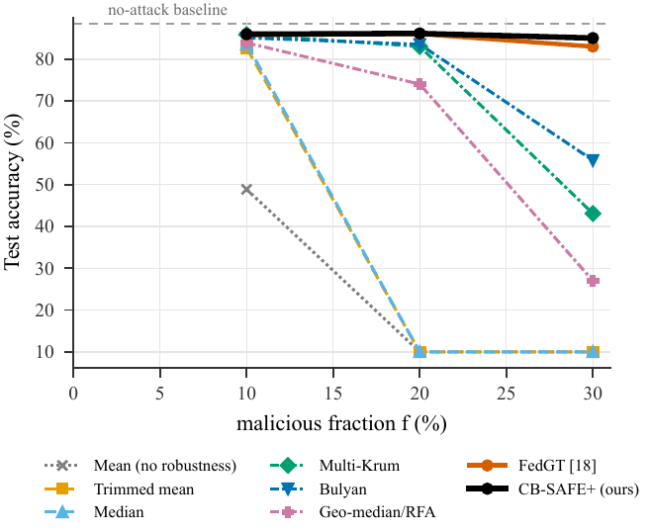
COMPARISON
Previous (FedGT) vs proposed (CB-SAFE)
▪ Crypto: FedGT is crypto-agnostic (no PQC) → CB-SAFE is code-based post-quantum.
▪ Detection: FedGT uses single-round COMP + a validation set → CB-SAFE uses temporal accumulation + a root-loss probe (plus a trust-free variant with no root data).
▪ Theory: FedGT gives no failure model → CB-SAFE proves the laundering boundary.
▪ Results: accuracy ties FedGT, with fewer false exclusions (0.0/0.7/0.3 vs 1.3/3.3/1.3) and ~4× lower cost.
[1] Xhemrishi et al., FedGT, IEEE TIFS 2025.
CB-SAFE · Suva & Chowdhury · AIUB
12 / 15

Slide 15
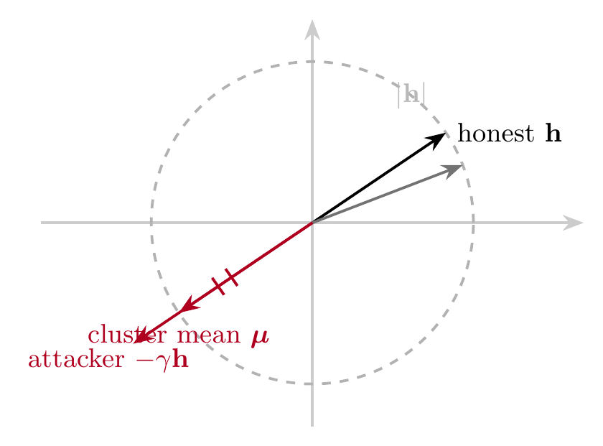
WHAT IS NEW
Our genuinely new contributions
▪ First code-based post-quantum secure aggregation for FL: cryptographic diversity beyond lattices.
▪ The laundering theorem: at γ*=2c/m−1 a poisoned cluster mean is magnitude-invisible, which explains why robust rules fail.
▪ Temporal group testing over re-randomized clusters with a root-loss probe: identifies attackers the server never sees individually.
▪ A trust-free variant that needs no root dataset, a capability FedGT does not offer.
This work; root-loss probe inspired by [5] Cao et al., FLTrust, NDSS 2021.
CB-SAFE · Suva & Chowdhury · AIUB
13 / 15

Slide 16
PARAMETERS
How the selection meets the required criteria
▪ Venue and recency: the basis paper FedGT is Q1 (IEEE TIFS), 2025; supporting sources are top-tier (ACM CCS, NIST).
▪ Relevance: every borrowed idea maps directly onto a component of our exact problem.
▪ Method strength: we match the SOTA (FedGT) on robustness at ~4× lower cost, add PQC, and prove the failure mechanism.
▪ Breadth and rigor: validated on four datasets and two modalities, three seeds, with significance testing.
[1] FedGT 2025; [2] Bonawitz 2017; [3] NIST IR 8545 2025.
CB-SAFE · Suva & Chowdhury · AIUB
14 / 15

Slide 17
SUMMARY
What we took, changed, and made new
▪ Took: masking [2], group testing [1], and a code-based KEM [3].
▪ Changed: temporal group testing over re-randomized clusters; HQC-seeded, KEM-agnostic masking.
▪ New: the laundering theorem, the first code-based PQ secure aggregation, and trust-free detection.
▪ Payoff: private, post-quantum, and Byzantine-robust FL that ties the state of the art at lower cost.
[1] FedGT 2025; [2] Bonawitz 2017; [3] NIST IR 8545 2025.
CB-SAFE · Suva & Chowdhury · AIUB
15 / 15

Slide 18
REFERENCES
References
[1] M. Xhemrishi, J. Östman, A. Wachter-Zeh, A. Graell i Amat. FedGT: Identification of malicious clients in federated learning with secure aggregation. IEEE Trans. Inf. Forensics Security, vol. 20, 2025.
[2] K. Bonawitz et al. Practical secure aggregation for privacy-preserving machine learning. ACM CCS, 2017.
[3] National Institute of Standards and Technology. Status report on the fourth round of the NIST PQC standardization process (HQC selection). NIST IR 8545, 2025.
[4] P. W. Shor. Polynomial-time algorithms for prime factorization and discrete logarithms on a quantum computer. SIAM J. Comput., 1997.
[5] X. Cao, M. Fang, J. Liu, N. Z. Gong. FLTrust: Byzantine-robust federated learning via trust bootstrapping. NDSS, 2021.
CB-SAFE · Suva & Chowdhury · AIUB

