Slide 1
RESEARCH PRESENTATION · POST-QUANTUM CRYPTOGRAPHY × FEDERATED LEARNING
CB-SAFE: Code-Based Post-Quantum Secure Aggregation for Byzantine-Robust Federated Learning
Md Wahiduzzaman Suva (26-94088-2) · Esm-e Moula Chowdhury Abha (26-94089-2)
Department of Computer Science, American International University–Bangladesh

Slide 2
INTRODUCTION
What this research is about
▪ The setting: federated learning (FL) trains one shared model across many devices; data never leaves the client, only model updates travel.
▪ What we are trying to do: keep those updates private against future quantum computers AND keep training correct when some clients are malicious.
▪ What we propose: CB-SAFE, a secure-aggregation framework whose post-quantum protection comes from a code-based scheme (HQC) instead of the usual lattices, extended with a poisoning defense.
Clients train locally (private data)
encrypted updates
Server aggregates (sees no individual update)
new global model
Better shared model, privacy intact
Threats: quantum + poisoning
CB-SAFE · Suva & Chowdhury · AIUB
1 / 15

Slide 3
BACKGROUND
The problem: three threats meet in one protocol
▪ Updates leak. Gradient-inversion attacks reconstruct private training images from a single client's update, so updates must be hidden.
▪ Secure aggregation hides them with pairwise masks that cancel in the sum, but its key exchange breaks once a quantum computer exists (“harvest now, decrypt later”).
▪ All post-quantum fixes use one math family (lattices) and hiding updates also blinds the server to poisoned updates from malicious clients.
Privacy threat: updates reveal training data
Quantum threat: key exchange breaks (Shor)
Poisoning threat: malicious clients flip the model
FL secure aggregation must survive all three at once
CB-SAFE · Suva & Chowdhury · AIUB
2 / 15

Slide 4
CLOSELY RELATED WORK
How the closest peer-reviewed paper solves it
PQSF: “Post-quantum secure privacy-preserving federated learning”, Zhang et al., Scientific Reports 14, 2024 (peer-reviewed)
▪ Their solution: the Bonawitz-style masking protocol, made quantum-safe with lattice cryptography: a lattice multi-stage secret-sharing scheme reconstructs the masks, so the server still learns only the sum of updates.
▪ What works: peer-reviewed evidence that post-quantum secure aggregation is practical in FL; our confidentiality layer follows the same masking pattern.
Gap 1 · Lattice-only One cryptanalytic advance breaks everything
Gap 2 · No robustness A poisoned update passes straight through the sum
Gap 3 · Hard-wired primitive Cannot swap the KEM when standards evolve
CB-SAFE targets exactly these gaps. The closest robustness peer, FedGT (TIFS 2025), also tests group sums but is not post-quantum; CB-SAFE matches its detection at lower cost and adds code-based confidentiality.
CB-SAFE · Suva & Chowdhury · AIUB
3 / 15

Slide 5
CONTRIBUTIONS
What this paper contributes
▪ First code-based (HQC) post-quantum secure aggregation for FL: cryptographic diversity beyond lattices.
▪ A quantified privacy–robustness trade-off: clean-cluster probability (1−f)^c ties the anonymity set to robustness.
▪ The laundering effect: a proved boundary γ*=2c/m−1 where poisoning becomes magnitude-invisible.
▪ CB-SAFE+: temporal group testing that identifies attackers from group-level observations, at zero extra leakage.
▪ Evaluation on four datasets and two modalities; ties the SOTA (FedGT) at lower cost. Open-source.
CB-SAFE · Suva & Chowdhury · AIUB
4 / 15

Slide 6
APPROACH OVERVIEW
CB-SAFE: one training round, end to end
Code-based (HQC) key setup happens once; every round then runs entirely on cheap masks.
Cluster 1 (c clients, masked)
masks cancel
Server sees ONLY k cluster sums S₁ … Sₖ (never an individual)
inspect sums
Robust aggregation + CB-SAFE+ defense (flag & exclude attackers)
Global model
Cluster 2 (c clients, masked)
⋮ (k clusters)
ONE-TIME: HQC (code-based KEM) key setup (pluggable: swap in ML-KEM/Kyber with one config line)
EVERY ROUND: fresh masks from stored secrets: zero KEM bytes on the wire
CB-SAFE · Suva & Chowdhury · AIUB
5 / 15

Slide 7
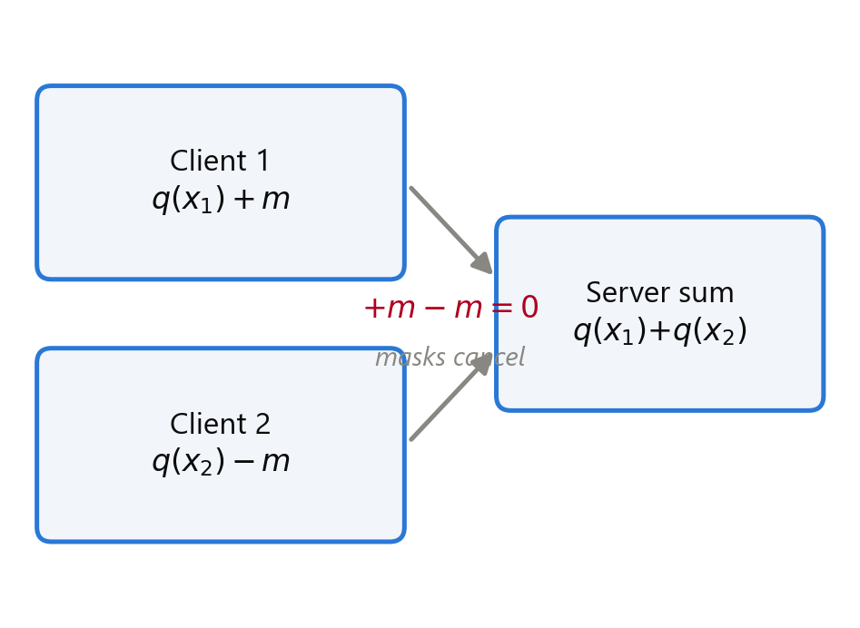
METHOD · CONFIDENTIALITY LAYER
Hide every update, pay for crypto only once
▪ Masks cancel within a cluster: the sum is exact, individuals stay hidden (anonymity set = cluster size).
▪ Proved: the server, even colluding with some clients, learns nothing beyond each cluster sum.
▪ Dropouts: secret-sharing recovers the masks of clients who leave mid-round.
SETUP (once) publish HQC public keys, establish pairwise secrets
EVERY ROUND derive fresh masks locally (no new crypto traffic)
SERVER sums per cluster, masks vanish
stored secrets
masked update
CB-SAFE · Suva & Chowdhury · AIUB
6 / 15

Slide 8
GUARANTEE · PRIVACY
Provable confidentiality of masked aggregation
Leakage is exactly the per-cluster sum, and nothing else.
▪ Theorem 1: an honest-but-curious server, even colluding with up to t−1 members of a cluster, learns nothing beyond each cluster's sum.
▪ Proof idea: IND-CCA2 KEM gives uniform pairwise secrets; the PRG/KDF give uniform masks; Shamir shares below threshold reveal nothing.
▪ Anonymity set = cluster size c. Re-randomizing clusters every round preserves the per-round guarantee.
▪ CB-SAFE+ flags are computed from sums the server already holds, so the defense adds no leakage.
CB-SAFE · Suva & Chowdhury · AIUB
7 / 15

Slide 9
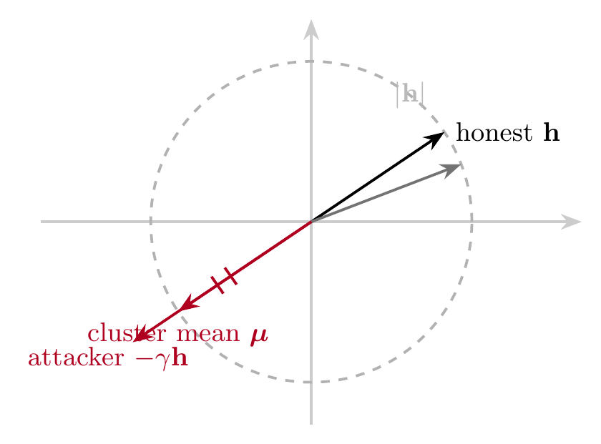
KEY FINDING · LAUNDERING
Secure aggregation can launder poisoning
▪ Proposition 1: with m amplified sign-flips in a cluster of size c, the cluster mean is μ = (c−m(1+γ))/c · h.
▪ At γ*=2c/m−1 the poisoned mean has the SAME magnitude as an honest update but opposite direction.
▪ So magnitude- and order-statistic rules (trimmed mean, median, even RFA) cannot see it and collapse to chance.
▪ Detection must therefore use signals that survive averaging: direction and repetition over rounds.
CB-SAFE · Suva & Chowdhury · AIUB
8 / 15

Slide 10
METHOD · CB-SAFE+ DEFENSE
Catch attackers the server never sees individually
▪ Key insight: a poisoned cluster sum is normal in size but points the wrong way; a 200-sample server set exposes it (loss goes up).
▪ Repetition finds individuals: clusters reshuffle each round, so a true attacker sits in a flagged cluster almost always, honest clients only rarely.
1 · Reshuffle new random clusters every round
2 · Probe does each cluster sum raise root-set loss?
3 · Flag mark suspicious cluster sums
4 · Score suspicion += 1 for all members of flagged clusters
5 · Exclude persistent suspects are removed from training
Flags are computed from sums the server already holds, so the defense leaks nothing extra (proved).
CB-SAFE · Suva & Chowdhury · AIUB
9 / 15

Slide 11
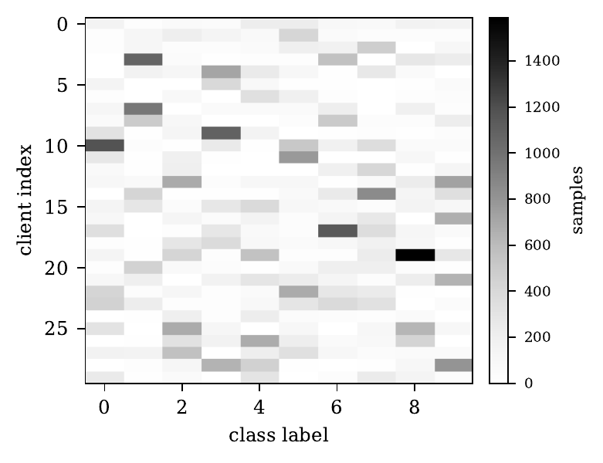
EVALUATION METHODOLOGY
How we evaluate: five KPI families
KPI | What it measures | How
Communication overhead | bytes per client: one-time setup vs every round | counted from real protocol messages (liboqs)
Computation time | key setup, masking, unmasking wall-clock | measured per round on real hardware
Utility | test accuracy vs plain FedAvg (must match) | CIFAR-10, non-IID, 30 clients, 40 rounds
Robustness | accuracy & attack success rate vs attacker fraction f | sign-flip, label-flip, backdoor at f = 10–30%
Identification quality | attackers caught / honest clients wrongly excluded | vs ground truth across all runs
Non-IID split (Dirichlet a=0.5): highly uneven per-client class counts.
Baselines: plain FedAvg and the lattice (ML-KEM) variant, plus eight robust rules at matched NIST levels: mean, trimmed mean, median, Multi-Krum, Bulyan, geometric-median (RFA), FLTrust, and the SOTA group-testing method FedGT (TIFS 2025).
CB-SAFE · Suva & Chowdhury · AIUB
10 / 15

Slide 12
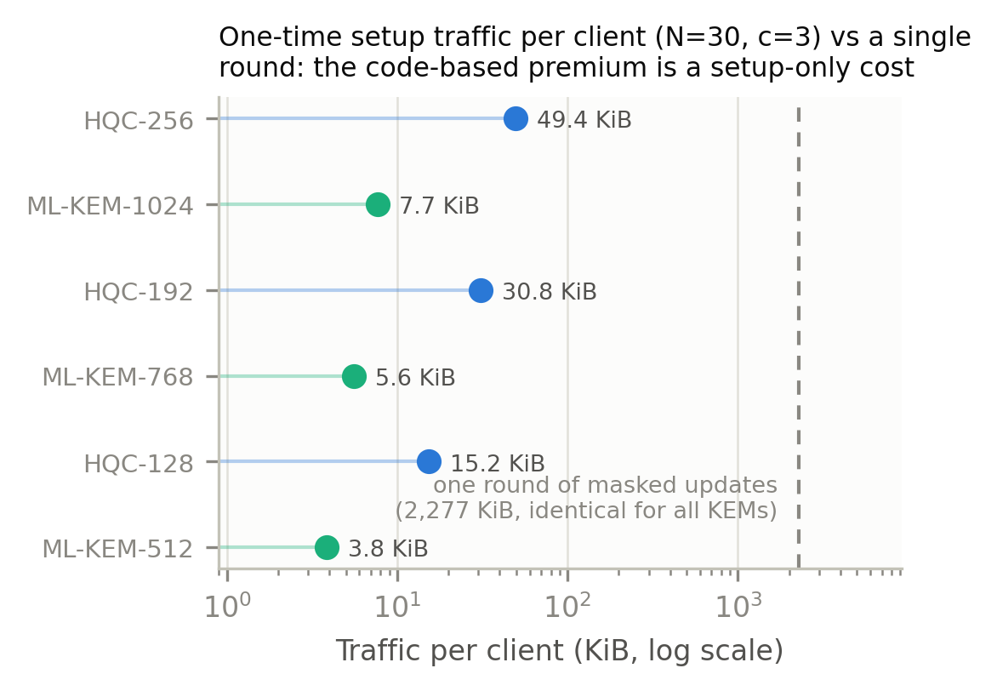
EVALUATION · KPI 1 & 2 (COST)
The code-based premium is a one-time constant
▪ Every round costs the same for all six KEMs: 2,277 KiB per client; the update itself dominates.
▪ Setup (once): HQC 15.2 KiB vs ML-KEM 3.8 KiB per client, under 0.03% of 40 rounds' traffic.
▪ Time: 2.0 s one-time key setup for 30 clients; ~26 ms masking per round vs ~21 s of training.
▪ Takeaway: cryptographic diversity is practically free once keys are reused.
Even the heaviest HQC setup is ~2% of ONE round's traffic (log scale).
CB-SAFE · Suva & Chowdhury · AIUB
11 / 15

Slide 13
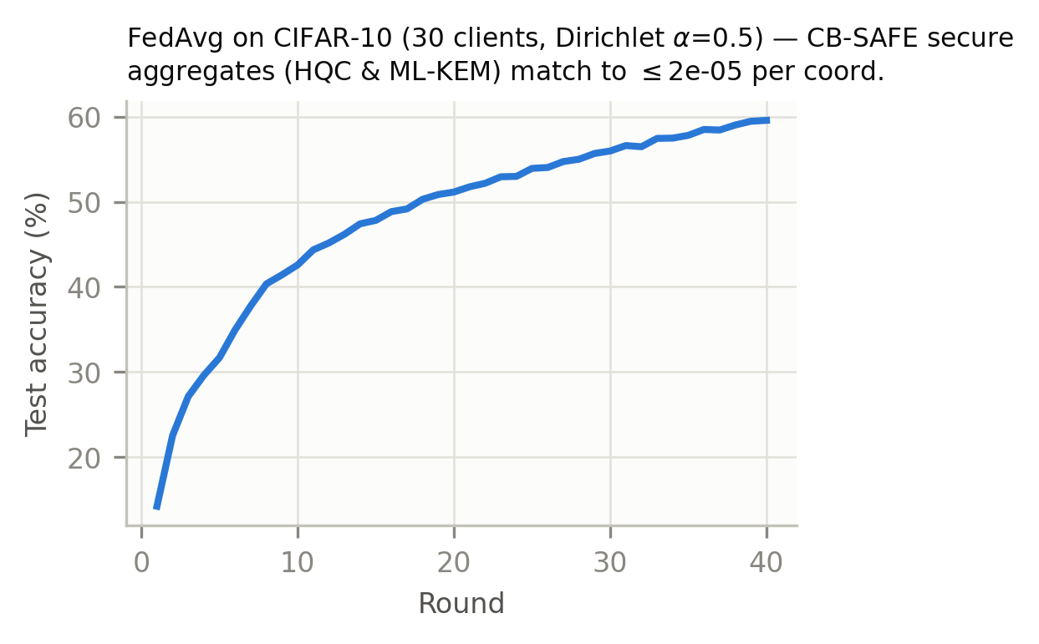
EVALUATION · KPI 3 (UTILITY)
Privacy provably costs no accuracy
▪ 59.0% on non-IID CIFAR-10 (30 clients, 40 rounds), identical for plain, HQC, and ML-KEM runs.
▪ Why identical: secure sums matched plain sums in every round to 2.28×10⁻⁵, exactly the rounding limit; the crypto changes nothing else.
▪ Dropout recovery verified live in rounds 10 and 20, including graceful exclusion of a below-threshold cluster.
One accuracy curve serves all three configurations.
CB-SAFE · Suva & Chowdhury · AIUB
12 / 15

Slide 14
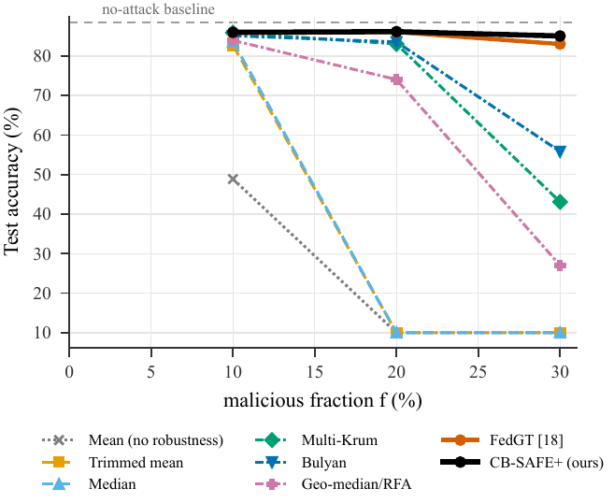
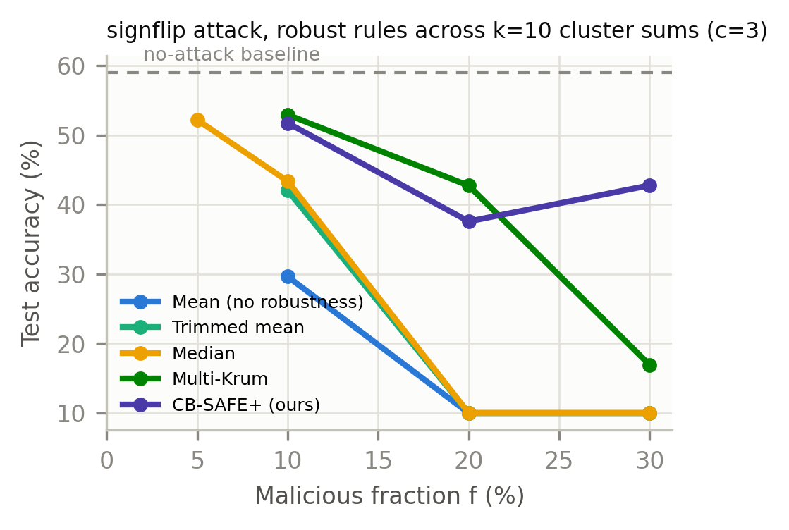
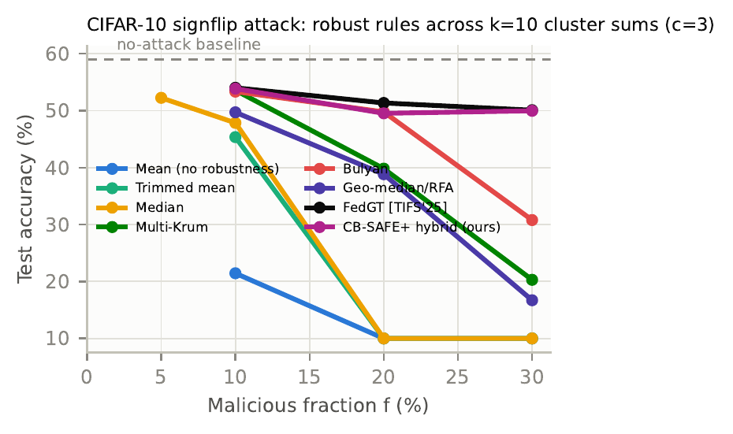
EVALUATION · KPI 4 & 5 (ROBUSTNESS)
Standard rules collapse; CB-SAFE+ recovers
▪ Why rules fail: cluster averaging disguises the poison (normal size, wrong direction), so mean, trimmed mean, median and even the robust geometric median (RFA) fall to ~10% (random) at f ≥ 20%; Multi-Krum and Bulyan degrade but hold longer.
▪ Ties the state of the art: at f = 30% CB-SAFE+ holds ~85% accuracy (FashionMNIST), matching FedGT (TIFS 2025), while catching 3/3, 6/6, 9/9 attackers with far fewer false exclusions (0.0 / 0.7 / 0.3 vs FedGT 1.3 / 3.3 / 1.3).
▪ Generalizes across domains: the same collapse-and-recover pattern holds on EMNIST (85% at f = 30%) and tabular Edge-IIoTset (62%); stealthy backdoors remain an open limit for all sum-level defenses.
Sign-flip attack on FashionMNIST: accuracy vs attacker fraction across eight rules; only CB-SAFE+ and FedGT stay near the clean baseline.
CB-SAFE · Suva & Chowdhury · AIUB
13 / 15

Slide 15
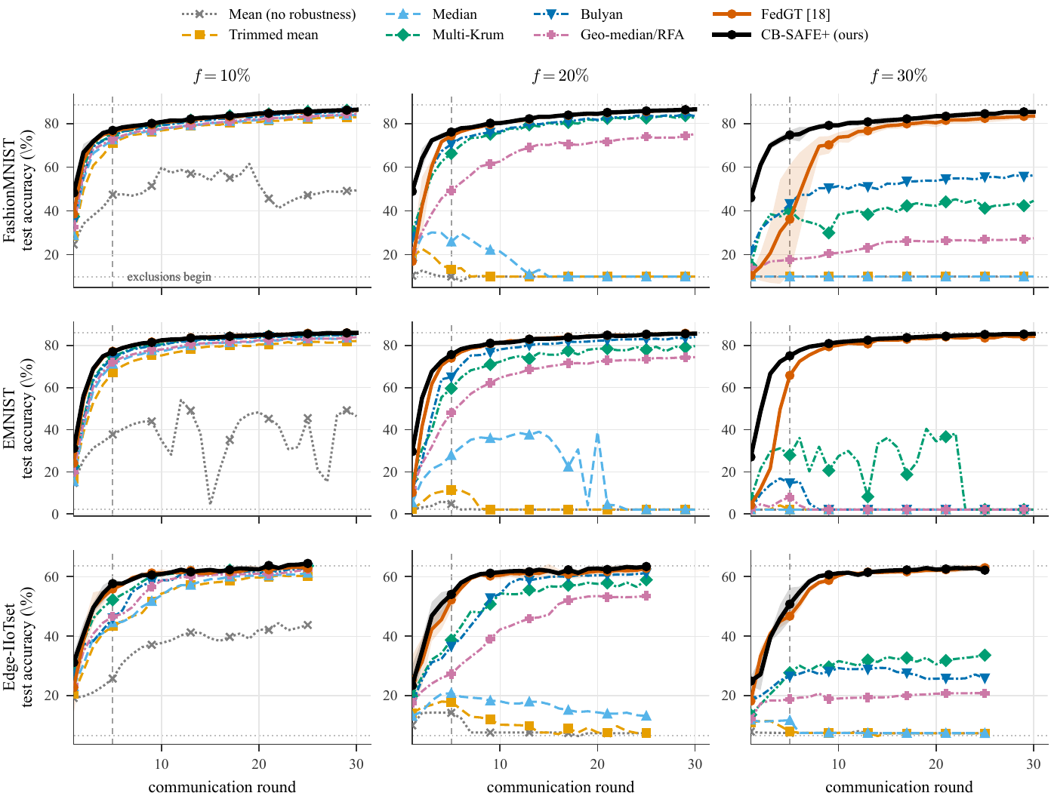
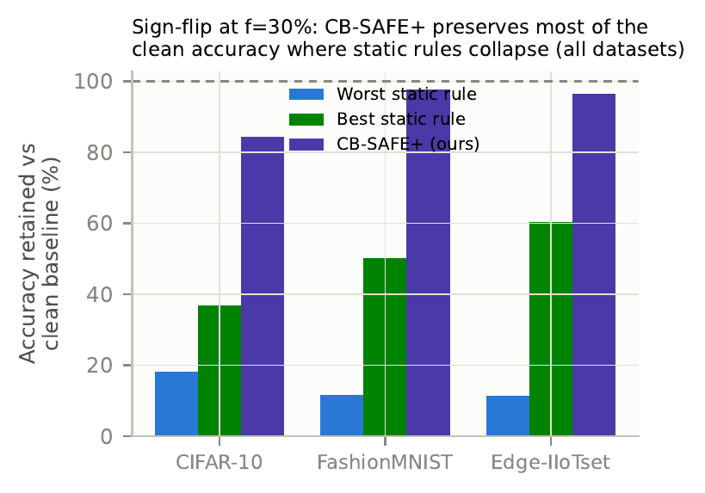
RESULTS · GENERALIZATION
Same story across domains, round by round
▪ Cross-domain: the collapse-and-recover pattern replicates on EMNIST (85% at f=30%) and tabular Edge-IIoTset (62%).
▪ Cluster-size dial: larger c enlarges the anonymity set but shifts the median's breakdown frontier left, exactly as (1−f)^c predicts.
▪ Overlap helps: overlapping re-randomized clusters extend CB-SAFE+ recovery to higher f.
▪ Statistical rigor: 3 seeds on CIFAR-10/FashionMNIST/Edge-IIoTset, paired t-test with Holm correction.
CB-SAFE · Suva & Chowdhury · AIUB
14 / 15

Slide 16
CONCLUSION
Takeaways & what's next
▪ Diversity delivered: the first code-based post-quantum secure aggregation for FL, at a one-time cost under 0.03% of traffic.
▪ New understanding: secure aggregation launders poisoning; defenses must use signals that survive summation, accumulated over rounds.
▪ New defense: CB-SAFE+ identifies individual attackers from group observations only, tying FedGT at ~4x lower cost with zero extra privacy leakage.
▪ Open problems: stealthy backdoors, actively malicious servers, adaptive attackers.
▪ Validated across four datasets (CIFAR-10, FashionMNIST, EMNIST, Edge-IIoTset); 100-client scale in progress; implementation released open-source.
CB-SAFE · Suva & Chowdhury · AIUB
15 / 15

Slide 17
REFERENCES
References
[1] McMahan et al., Communication-efficient learning, AISTATS 2017.
[2] Bonawitz et al., Practical secure aggregation, CCS 2017.
[3] Bell et al., Secure single-server aggregation, CCS 2020.
[4] Xhemrishi et al., FedGT, IEEE TIFS 2025.
[5] Cao et al., FLTrust, NDSS 2021.
[6] Blanchard et al., Krum, NeurIPS 2017.
[7] Yin et al., Byzantine-robust distributed learning, ICML 2018.
[8] El Mhamdi et al., Bulyan, ICML 2018.
[9] Pillutla et al., RFA (geometric median), IEEE TSP 2022.
[10] Shor, Quantum factoring, SIAM J. Comput. 1997.
[11] McEliece, Code-based cryptosystem, JPL DSN 1978.
[12] NIST IR 8545, PQC round-4 status, 2025 (HQC).
[13] NIST FIPS 203, ML-KEM, 2024.
[14] Bagdasaryan et al., Backdoor FL, AISTATS 2020.
[15] Ferrag et al., Edge-IIoTset, IEEE Access 2022.
Full list (47 refs) in the manuscript.
CB-SAFE · Suva & Chowdhury · AIUB

