Slide 1
POST-QUANTUM CRYPTOGRAPHY × FEDERATED LEARNING
CB-SAFE: Code-Based Post-Quantum Secure Aggregation for Byzantine-Robust Federated Learning
Md Wahiduzzaman Suva (26-94088-2) · Esm-e Moula Chowdhury Abha (26-94089-2)
Department of Computer Science, American International University–Bangladesh

Slide 2
Introduction
▪ Federated learning shares model updates, not raw data, yet those updates still leak private training data.
▪ Secure aggregation [2] hides updates behind masks, but its key exchange breaks under a quantum computer (harvest-now, decrypt-later).
▪ Every post-quantum fix today is lattice-only, a monoculture; and hiding updates also blinds the server to poisoned ones.
▪ Goal: one protocol that is private, post-quantum with crypto diversity, and Byzantine-robust.
[2] K. Bonawitz, V. Ivanov, B. Kreuter, A. Marcedone, H. B. McMahan, S. Patel, D. Ramage, A. Segal, and K. Seth, "Practical secure aggregation for privacy-preserving machine learning," in Proc. ACM CCS, 2017, pp. 1175–1191.
1 / 24

Slide 3
Background and Motivation
▪ Secure aggregation = pairwise masks that cancel in the sum; the server sees only the aggregate, never an individual.
▪ Quantum threat: Shor's algorithm [4] breaks classical key exchange, and traffic recorded today is decryptable later.
▪ Crypto diversity: NIST selected the code-based KEM HQC in 2025 [3] to hedge a lattice break; that diversity has not reached FL.
▪ Robustness tension: privacy hides exactly the per-client signal that poisoning defenses need.
[3] National Institute of Standards and Technology, "Status report on the fourth round of the NIST post-quantum cryptography standardization process," NIST IR 8545, Mar. 2025.
[4] P. W. Shor, "Polynomial-time algorithms for prime factorization and discrete logarithms on a quantum computer," SIAM J. Comput., vol. 26, no. 5, pp. 1484–1509, 1997.
2 / 24

Slide 4
Related Work
▪ Secure aggregation lets the server learn only the sum, hiding each client's update [2]; later designs cut its overhead.
▪ Byzantine-robust aggregation resists poisoning but ignores privacy: coordinate-wise median [6] and Multi-Krum [7].
▪ Group testing identifies a few malicious clients from pooled tests; FedGT [1] brings this idea to secure-aggregation FL.
▪ Gap: no prior work delivers code-based post-quantum confidentiality and Byzantine robustness together.
[1] M. Xhemrishi, J. Östman, A. Wachter-Zeh, and A. Graell i Amat, "FedGT: Identification of malicious clients in federated learning with secure aggregation," IEEE Trans. Inf. Forensics Security, vol. 20, pp. 2577–2592, 2025.
[2] K. Bonawitz, V. Ivanov, B. Kreuter, A. Marcedone, H. B. McMahan, S. Patel, D. Ramage, A. Segal, and K. Seth, "Practical secure aggregation for privacy-preserving machine learning," in Proc. ACM CCS, 2017, pp. 1175–1191.
[6] D. Yin, Y. Chen, R. Kannan, and P. Bartlett, "Byzantine-robust distributed learning: Towards optimal statistical rates," in Proc. ICML, 2018, pp. 5650–5659.
[7] P. Blanchard, E. M. El Mhamdi, R. Guerraoui, and J. Stainer, "Machine learning with adversaries: Byzantine tolerant gradient descent," in Proc. NeurIPS, 2017, pp. 119–129.
3 / 24

Slide 5
Related Work: Closest Peer (FedGT)
▪ FedGT [1] (IEEE TIFS, 2025) is the closest peer to our robustness mechanism.
▪ Idea: group clients into overlapping test groups; the server sees only group aggregates, so privacy is preserved.
▪ A statistical test flags groups that contain malicious clients; a decoder then identifies and removes the culprits.
▪ Borrowed from group testing: find a few defectives with far fewer pooled tests than testing everyone.
[1] M. Xhemrishi, J. Östman, A. Wachter-Zeh, and A. Graell i Amat, "FedGT: Identification of malicious clients in federated learning with secure aggregation," IEEE Trans. Inf. Forensics Security, vol. 20, pp. 2577–2592, 2025.
4 / 24

Slide 6
Methodology (Base Paper)
▪ In FedGT [1], an assignment matrix groups n clients into m overlapping groups (the parity-check structure of a code).
▪ Each group is securely aggregated; a test on the group aggregate is positive if any member is malicious.
▪ A COMP / Neyman-Pearson decoder infers which clients are malicious from the group test results.
▪ Flagged clients are excluded; the remaining clean clients are aggregated into the global model.
[1] M. Xhemrishi, J. Östman, A. Wachter-Zeh, and A. Graell i Amat, "FedGT: Identification of malicious clients in federated learning with secure aggregation," IEEE Trans. Inf. Forensics Security, vol. 20, pp. 2577–2592, 2025.
5 / 24

Slide 7
Limitations
▪ Crypto: FedGT [1] treats secure aggregation as a black box, with no post-quantum layer, in a lattice-only field.
▪ Cost: it needs a server validation set and per-round group testing over fixed overlapping groups.
▪ Single-round decode: it identifies attackers from one round's tests, using no information across rounds.
▪ Unexplained failure: it does not characterize why ordinary robust aggregation breaks once updates are hidden.
[1] M. Xhemrishi, J. Östman, A. Wachter-Zeh, and A. Graell i Amat, "FedGT: Identification of malicious clients in federated learning with secure aggregation," IEEE Trans. Inf. Forensics Security, vol. 20, pp. 2577–2592, 2025.
6 / 24

Slide 8
Research Question and Objective
Can one protocol be private, post-quantum, and Byzantine-robust at the same time?
▪ RQ1 Can code-based (non-lattice) cryptography secure FL aggregation at a practical cost?
▪ RQ2 Why do robust aggregation rules fail once updates are hidden inside secure cluster sums?
▪ RQ3 Can malicious clients be identified from group-level observations alone, without a validation set?
▪ Objective Design CB-SAFE(+) to answer all three, and validate it on four datasets against eight baselines.
7 / 24

Slide 9
Proposed Method
One framework that is private, post-quantum, and Byzantine-robust at the same time.
▪ Hide updates within clusters using a code-based (HQC) masking protocol [2]: the server sees only cluster sums.
▪ Run group testing [1] across re-randomized clusters over rounds to identify attackers (CB-SAFE+).
▪ Confidentiality lives below the cluster boundary; robustness operates above it; post-quantum by construction.
[1] M. Xhemrishi, J. Östman, A. Wachter-Zeh, and A. Graell i Amat, "FedGT: Identification of malicious clients in federated learning with secure aggregation," IEEE Trans. Inf. Forensics Security, vol. 20, pp. 2577–2592, 2025.
[2] K. Bonawitz, V. Ivanov, B. Kreuter, A. Marcedone, H. B. McMahan, S. Patel, D. Ramage, A. Segal, and K. Seth, "Practical secure aggregation for privacy-preserving machine learning," in Proc. ACM CCS, 2017, pp. 1175–1191.
8 / 24

Slide 10
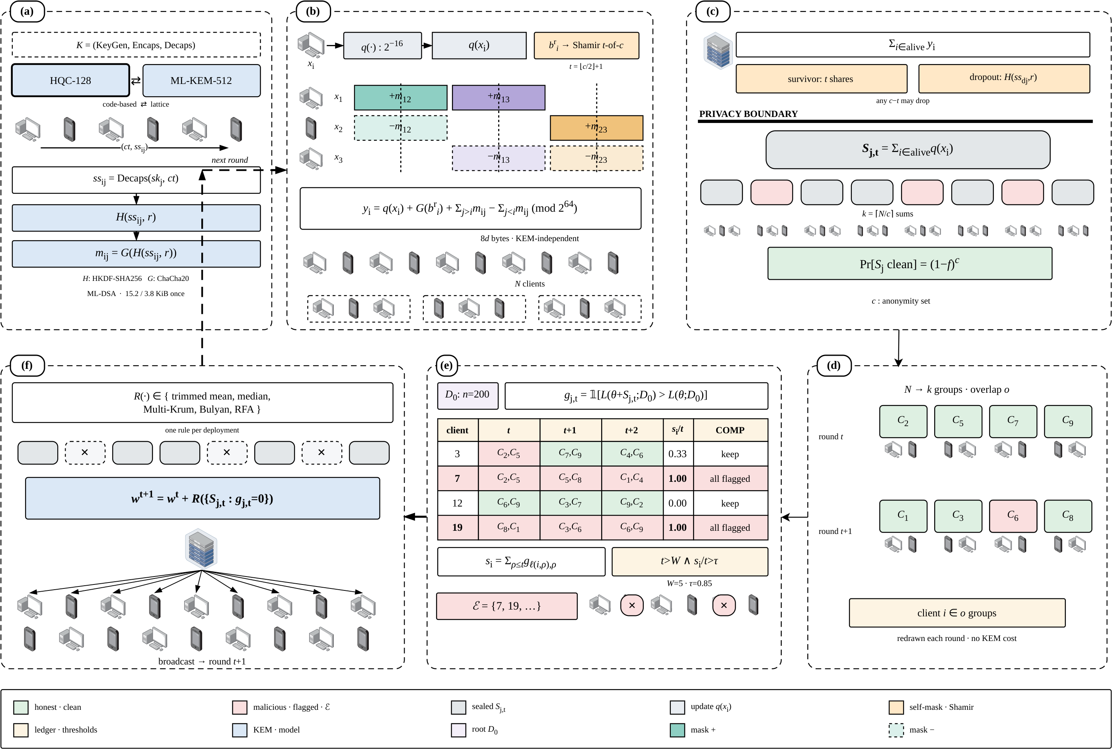
System Architecture (Ours)
One training round: confidentiality within clusters [2], temporal group testing over re-randomized clusters [1], robust aggregation.
[1] M. Xhemrishi, J. Östman, A. Wachter-Zeh, and A. Graell i Amat, "FedGT: Identification of malicious clients in federated learning with secure aggregation," IEEE Trans. Inf. Forensics Security, vol. 20, pp. 2577–2592, 2025.
[2] K. Bonawitz, V. Ivanov, B. Kreuter, A. Marcedone, H. B. McMahan, S. Patel, D. Ramage, A. Segal, and K. Seth, "Practical secure aggregation for privacy-preserving machine learning," in Proc. ACM CCS, 2017, pp. 1175–1191.
9 / 24

Slide 11
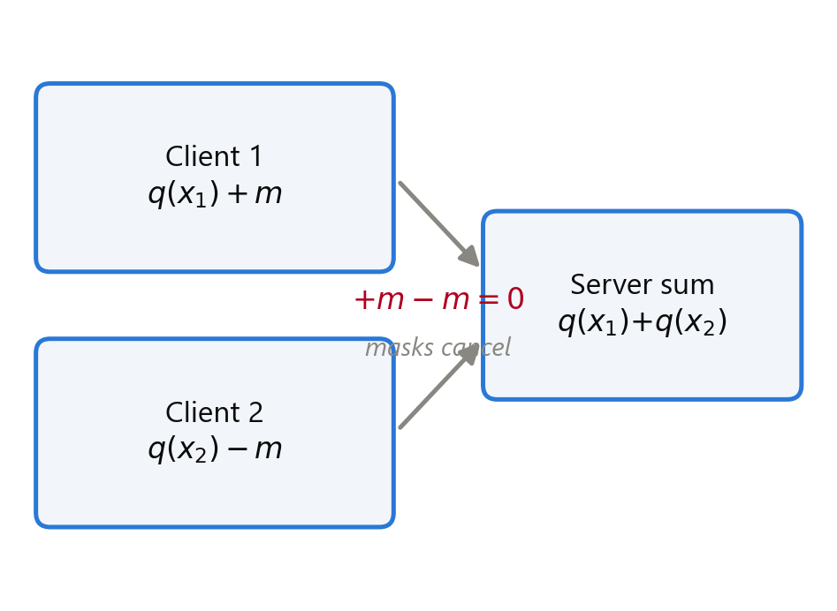
Methodology (Ours): Masking
▪ We adopt Bonawitz-style double masking [2]: pairwise masks cancel in the cluster sum, so individuals stay hidden.
▪ Dropout resilience via Shamir secret sharing of the self-masks.
▪ Our change: masks are seeded from a KEM, so per-round traffic carries no cryptographic bytes at all.
[2] K. Bonawitz, V. Ivanov, B. Kreuter, A. Marcedone, H. B. McMahan, S. Patel, D. Ramage, A. Segal, and K. Seth, "Practical secure aggregation for privacy-preserving machine learning," in Proc. ACM CCS, 2017, pp. 1175–1191.
10 / 24

Slide 12
Methodology (Ours): Detection
▪ We adopt the core idea from FedGT [1]: identify malicious clients from group-level observations, never from individual updates.
▪ The groups are the privacy-preserving cluster sums (the pools); a probe flags contaminated pools.
▪ Our change: tests repeat over re-randomized clusters and accumulate across rounds (temporal group testing).
[1] M. Xhemrishi, J. Östman, A. Wachter-Zeh, and A. Graell i Amat, "FedGT: Identification of malicious clients in federated learning with secure aggregation," IEEE Trans. Inf. Forensics Security, vol. 20, pp. 2577–2592, 2025.
11 / 24

Slide 13
Methodology (Ours): Cryptography
▪ We adopt HQC, the code-based KEM NIST selected in 2025 [3], for post-quantum confidentiality.
▪ Its security rests on syndrome decoding of quasi-cyclic codes, not lattices: genuine cryptographic diversity.
▪ Our change: HQC sits behind a KEM-agnostic interface, so ML-KEM [9] swaps in with one configuration line.
[3] National Institute of Standards and Technology, "Status report on the fourth round of the NIST post-quantum cryptography standardization process," NIST IR 8545, Mar. 2025.
[9] National Institute of Standards and Technology, "Module-lattice-based key-encapsulation mechanism standard," FIPS 203, Aug. 2024.
12 / 24

Slide 14
Methodology (Ours): Integration
Masking + group testing + a code-based KEM become one coherent framework.
▪ HQC-seeded masking [2], [3] hides updates inside clusters, so the server sees only cluster sums.
▪ Group testing [1] then runs across those cluster sums, over re-randomized rounds, to name the attackers.
▪ Net design: privacy below the cluster boundary, robustness above it, code-based crypto throughout.
▪ On top we add our own pieces: the laundering theorem and a server root-loss probe.
[1] M. Xhemrishi, J. Östman, A. Wachter-Zeh, and A. Graell i Amat, "FedGT: Identification of malicious clients in federated learning with secure aggregation," IEEE Trans. Inf. Forensics Security, vol. 20, pp. 2577–2592, 2025.
[2] K. Bonawitz, V. Ivanov, B. Kreuter, A. Marcedone, H. B. McMahan, S. Patel, D. Ramage, A. Segal, and K. Seth, "Practical secure aggregation for privacy-preserving machine learning," in Proc. ACM CCS, 2017, pp. 1175–1191.
[3] National Institute of Standards and Technology, "Status report on the fourth round of the NIST post-quantum cryptography standardization process," NIST IR 8545, Mar. 2025.
13 / 24

Slide 15
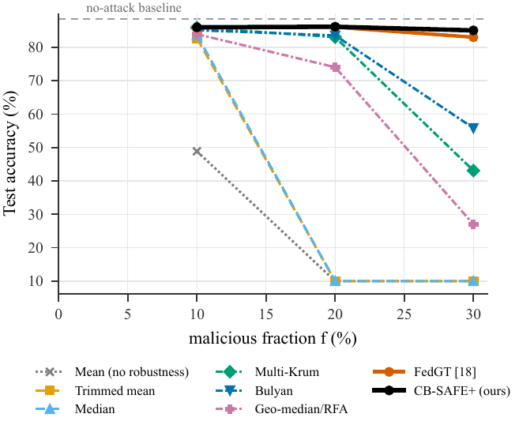
Comparison
▪ Crypto: FedGT [1] is crypto-agnostic → CB-SAFE is code-based post-quantum.
▪ Detection: FedGT uses single-round COMP + a validation set → CB-SAFE uses temporal accumulation + a root-loss probe.
▪ Theory: FedGT gives no failure model → CB-SAFE proves the laundering boundary.
▪ Results: accuracy ties FedGT with fewer false exclusions and ~4× lower cost.
[1] M. Xhemrishi, J. Östman, A. Wachter-Zeh, and A. Graell i Amat, "FedGT: Identification of malicious clients in federated learning with secure aggregation," IEEE Trans. Inf. Forensics Security, vol. 20, pp. 2577–2592, 2025.
14 / 24

Slide 16
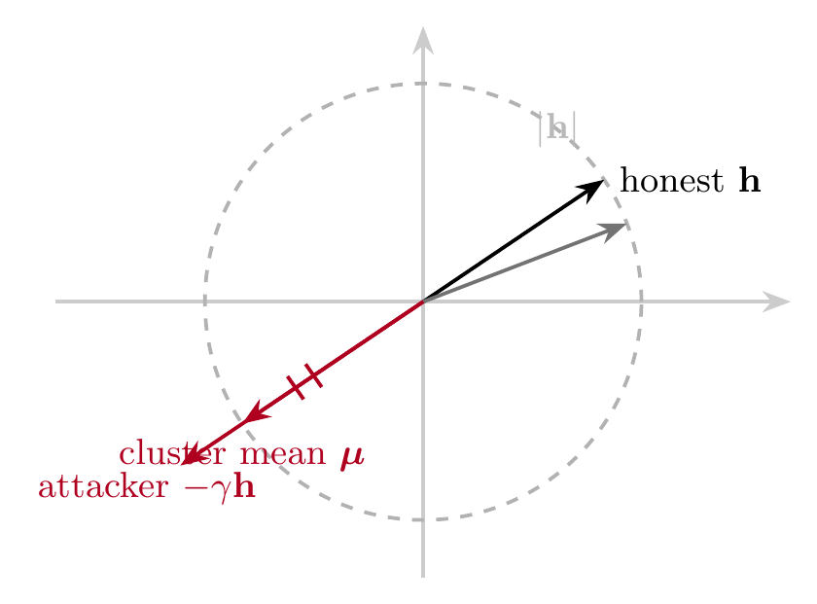
Contributions
▪ First code-based post-quantum secure aggregation for FL: cryptographic diversity beyond lattices.
▪ The laundering theorem: at γ*=2c/m−1 a poisoned cluster mean is magnitude-invisible, explaining why robust rules fail.
▪ Temporal group testing over re-randomized clusters (extending FedGT [1]) with a root-loss probe [5]: identifies attackers the server never sees.
▪ A trust-free variant that needs no root dataset, a capability FedGT does not offer.
[1] M. Xhemrishi, J. Östman, A. Wachter-Zeh, and A. Graell i Amat, "FedGT: Identification of malicious clients in federated learning with secure aggregation," IEEE Trans. Inf. Forensics Security, vol. 20, pp. 2577–2592, 2025.
[5] X. Cao, M. Fang, J. Liu, and N. Z. Gong, "FLTrust: Byzantine-robust federated learning via trust bootstrapping," in Proc. NDSS, 2021.
15 / 24

Slide 17
Summary
End of the method presentation; the full-paper results and figures follow.
▪ Took: masking [2], group testing [1], and a code-based KEM [3].
▪ Changed: temporal group testing over re-randomized clusters; HQC-seeded, KEM-agnostic masking.
▪ New: the laundering theorem, the first code-based PQ secure aggregation, and trust-free detection.
▪ Payoff: private, post-quantum, and Byzantine-robust FL that ties the state of the art at lower cost.
[1] M. Xhemrishi, J. Östman, A. Wachter-Zeh, and A. Graell i Amat, "FedGT: Identification of malicious clients in federated learning with secure aggregation," IEEE Trans. Inf. Forensics Security, vol. 20, pp. 2577–2592, 2025.
[2] K. Bonawitz, V. Ivanov, B. Kreuter, A. Marcedone, H. B. McMahan, S. Patel, D. Ramage, A. Segal, and K. Seth, "Practical secure aggregation for privacy-preserving machine learning," in Proc. ACM CCS, 2017, pp. 1175–1191.
[3] National Institute of Standards and Technology, "Status report on the fourth round of the NIST post-quantum cryptography standardization process," NIST IR 8545, Mar. 2025.
16 / 24

Slide 18
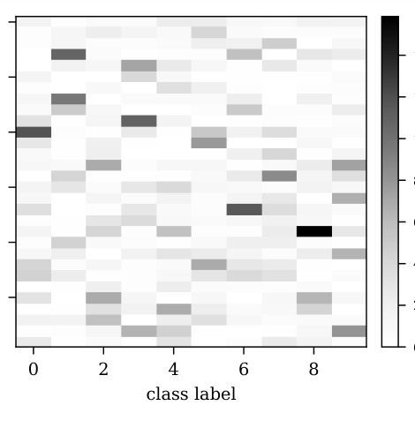
Experimental Setup
▪ Images: CIFAR-10, FashionMNIST, EMNIST-balanced (47 classes). Tabular: Edge-IIoTset (IoT intrusion).
▪ Non-IID split via a Dirichlet(0.5) partition; 30 communication rounds; clusters of size c = 3.
▪ Attacks: sign-flip (laundering), label-flip, backdoor. Baselines: mean, trimmed, median [6], Krum, Bulyan, RFA, FLTrust, FedGT [1].
[1] M. Xhemrishi, J. Östman, A. Wachter-Zeh, and A. Graell i Amat, "FedGT: Identification of malicious clients in federated learning with secure aggregation," IEEE Trans. Inf. Forensics Security, vol. 20, pp. 2577–2592, 2025.
[6] D. Yin, Y. Chen, R. Kannan, and P. Bartlett, "Byzantine-robust distributed learning: Towards optimal statistical rates," in Proc. ICML, 2018, pp. 5650–5659.
17 / 24

Slide 19
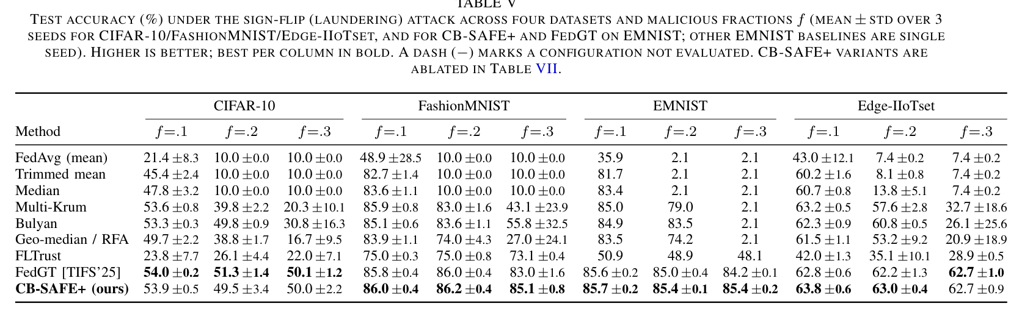
Results: Robustness
Sign-flip test accuracy across four datasets (from the paper, Table V).
▪ Under sign-flip at f ≥ 0.2 every coordinate-wise rule collapses to chance; CB-SAFE+ holds and ties FedGT [1].
[1] M. Xhemrishi, J. Östman, A. Wachter-Zeh, and A. Graell i Amat, "FedGT: Identification of malicious clients in federated learning with secure aggregation," IEEE Trans. Inf. Forensics Security, vol. 20, pp. 2577–2592, 2025.
18 / 24

Slide 20
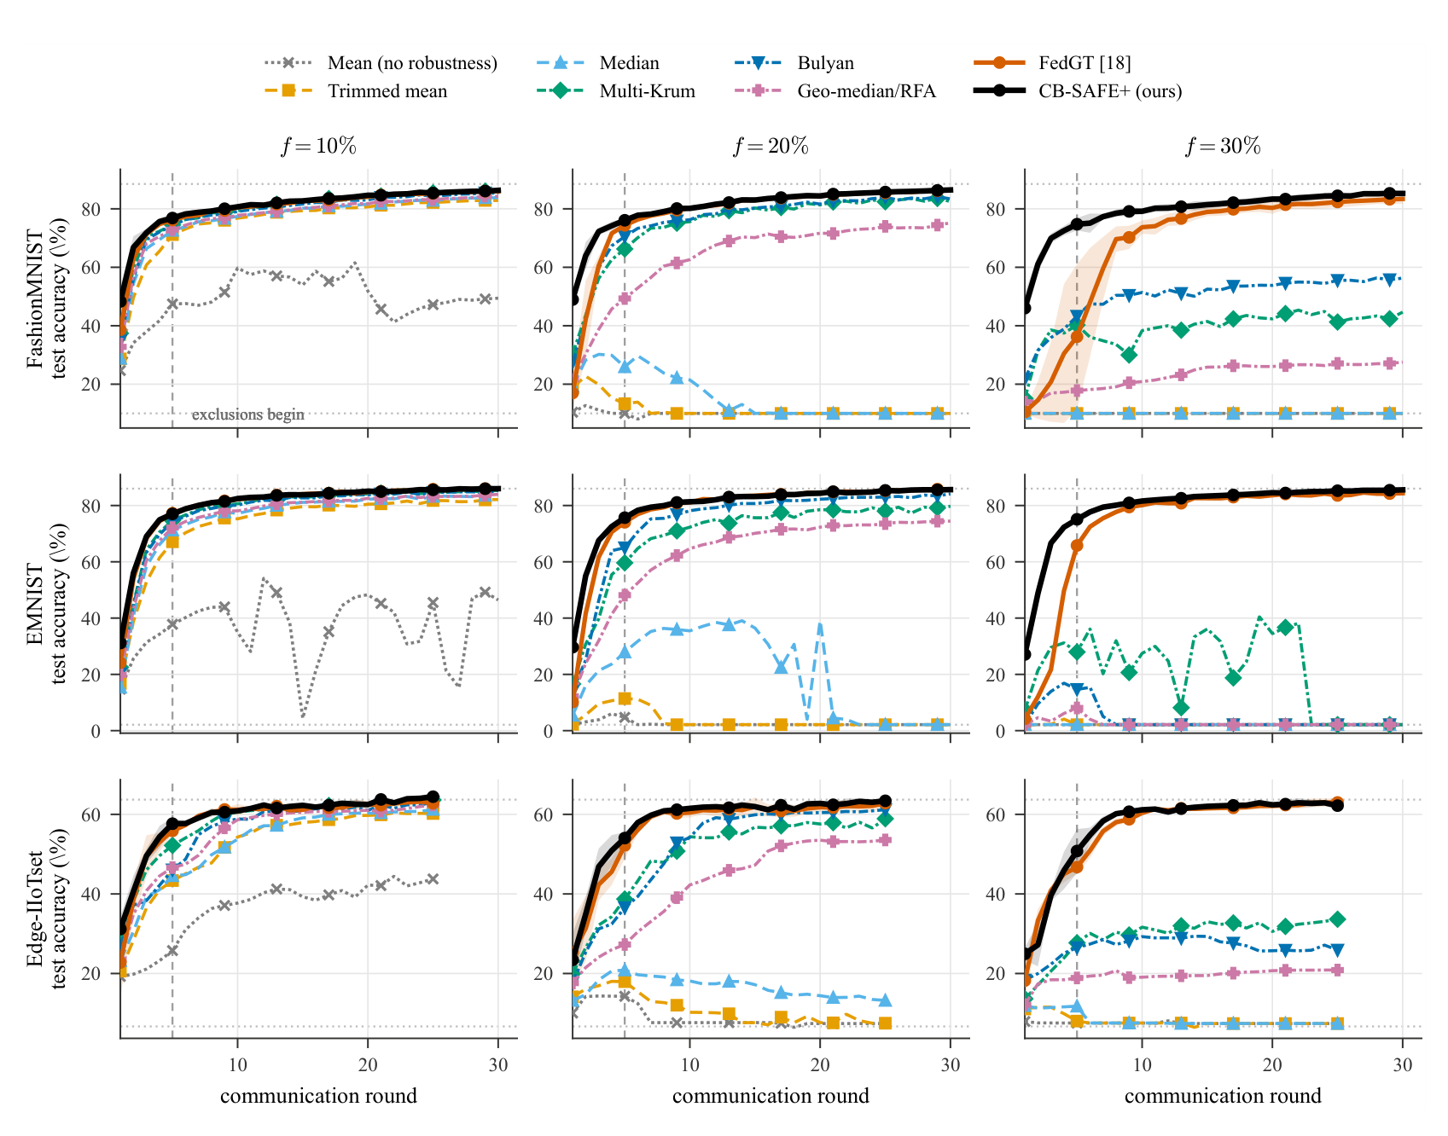
Results: Training Dynamics
Accuracy vs. round for eight rules incl. FedGT [1], over three datasets and three malicious fractions; CB-SAFE+ tracks the clean baseline while the others diverge (paper, Fig. 7).
[1] M. Xhemrishi, J. Östman, A. Wachter-Zeh, and A. Graell i Amat, "FedGT: Identification of malicious clients in federated learning with secure aggregation," IEEE Trans. Inf. Forensics Security, vol. 20, pp. 2577–2592, 2025.
19 / 24

Slide 21
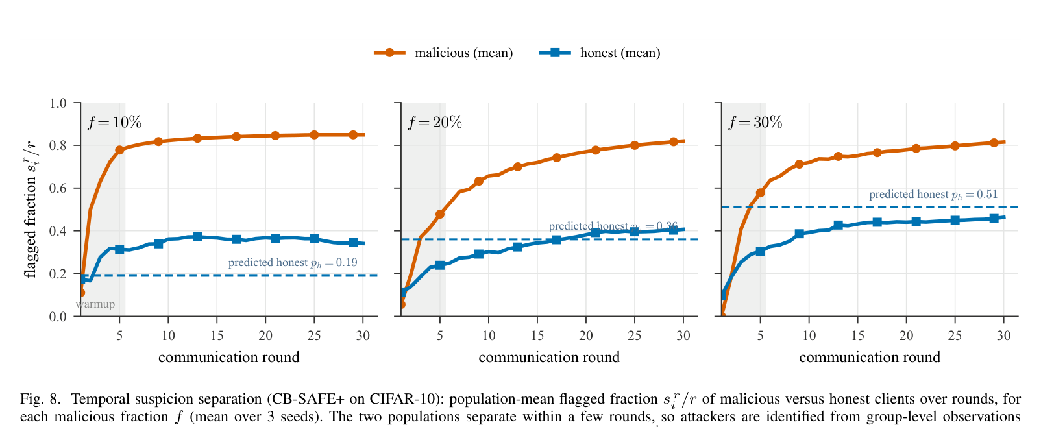
Results: Detection
Temporal suspicion separation (from the paper, Fig. 8).
▪ Malicious and honest suspicion separate within a few rounds; attackers are named from group-level observations alone, following the group-testing idea of FedGT [1].
[1] M. Xhemrishi, J. Östman, A. Wachter-Zeh, and A. Graell i Amat, "FedGT: Identification of malicious clients in federated learning with secure aggregation," IEEE Trans. Inf. Forensics Security, vol. 20, pp. 2577–2592, 2025.
20 / 24

Slide 22
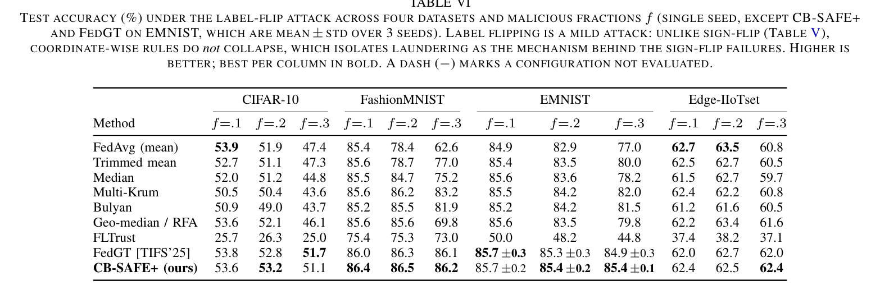
Results: Generalization
Label-flip test accuracy (from the paper, Table VI); CB-SAFE+ matches FedGT [1] and leads at the hardest setting (f=0.3).
▪ Label-flip is milder: no coordinate-wise rule collapses, which isolates laundering as the cause of the sign-flip failures.
[1] M. Xhemrishi, J. Östman, A. Wachter-Zeh, and A. Graell i Amat, "FedGT: Identification of malicious clients in federated learning with secure aggregation," IEEE Trans. Inf. Forensics Security, vol. 20, pp. 2577–2592, 2025.
21 / 24

Slide 23
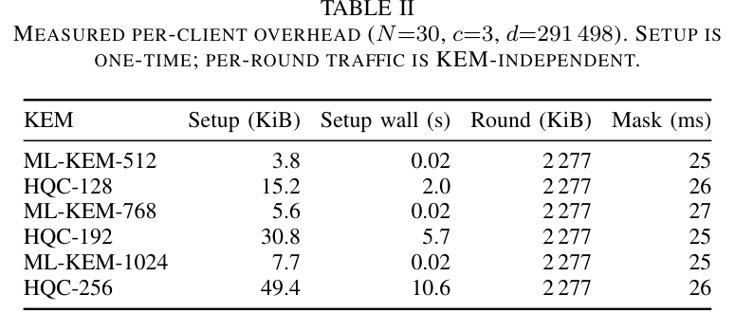
Results: Efficiency
Measured per-client overhead (from the paper, Table II).
▪ Code-based (HQC [3]) confidentiality gives crypto diversity beyond lattices; ML-KEM [9] swaps in unchanged.
▪ One-time setup is paid once and stays under 0.03% of total traffic; per-round bytes are KEM-independent.
[3] National Institute of Standards and Technology, "Status report on the fourth round of the NIST post-quantum cryptography standardization process," NIST IR 8545, Mar. 2025.
[9] National Institute of Standards and Technology, "Module-lattice-based key-encapsulation mechanism standard," FIPS 203, Aug. 2024.
22 / 24

Slide 24
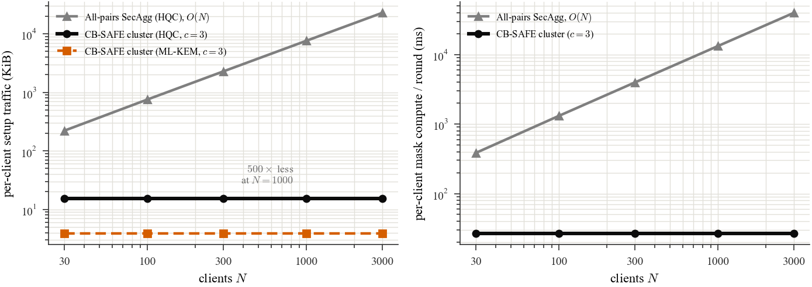
Results: Scalability
Per-client cost vs client population (from the paper).
▪ CB-SAFE masks only within clusters of c=3, so each client keeps c−1 partners: per-client cost is flat in N, unlike all-pairs secure aggregation [2] which grows O(N).
▪ At N=1000, one-time setup is 15.2 KiB (HQC) vs 7.4 MiB for all-pairs — a 500× reduction; the privacy law (1−f)^c and the laundering bound are per-cluster, so guarantees are N-independent.
[2] K. Bonawitz, V. Ivanov, B. Kreuter, A. Marcedone, H. B. McMahan, S. Patel, D. Ramage, A. Segal, and K. Seth, "Practical secure aggregation for privacy-preserving machine learning," in Proc. ACM CCS, 2017, pp. 1175–1191.
23 / 24

Slide 25
Conclusion
▪ CB-SAFE unifies code-based PQ secure aggregation [2], [3] with temporal group-testing robustness [1] in one protocol.
▪ It ties the state of the art (FedGT [1]) on robustness and detection, at lower cost, and adds crypto diversity plus a failure theory.
▪ Limitations: update authentication is out of the code-based scope; EMNIST detection uses a single seed.
▪ Future work: code-based signatures for authentication, larger client populations, and adaptive attackers.
[1] M. Xhemrishi, J. Östman, A. Wachter-Zeh, and A. Graell i Amat, "FedGT: Identification of malicious clients in federated learning with secure aggregation," IEEE Trans. Inf. Forensics Security, vol. 20, pp. 2577–2592, 2025.
[2] K. Bonawitz, V. Ivanov, B. Kreuter, A. Marcedone, H. B. McMahan, S. Patel, D. Ramage, A. Segal, and K. Seth, "Practical secure aggregation for privacy-preserving machine learning," in Proc. ACM CCS, 2017, pp. 1175–1191.
[3] National Institute of Standards and Technology, "Status report on the fourth round of the NIST post-quantum cryptography standardization process," NIST IR 8545, Mar. 2025.
24 / 24

Slide 26
References
[1] M. Xhemrishi, J. Östman, A. Wachter-Zeh, and A. Graell i Amat, "FedGT: Identification of malicious clients in federated learning with secure aggregation," IEEE Trans. Inf. Forensics Security, vol. 20, pp. 2577–2592, 2025.
[2] K. Bonawitz, V. Ivanov, B. Kreuter, A. Marcedone, H. B. McMahan, S. Patel, D. Ramage, A. Segal, and K. Seth, "Practical secure aggregation for privacy-preserving machine learning," in Proc. ACM CCS, 2017, pp. 1175–1191.
[3] National Institute of Standards and Technology, "Status report on the fourth round of the NIST post-quantum cryptography standardization process," NIST IR 8545, Mar. 2025.
[4] P. W. Shor, "Polynomial-time algorithms for prime factorization and discrete logarithms on a quantum computer," SIAM J. Comput., vol. 26, no. 5, pp. 1484–1509, 1997.
[5] X. Cao, M. Fang, J. Liu, and N. Z. Gong, "FLTrust: Byzantine-robust federated learning via trust bootstrapping," in Proc. NDSS, 2021.
[6] D. Yin, Y. Chen, R. Kannan, and P. Bartlett, "Byzantine-robust distributed learning: Towards optimal statistical rates," in Proc. ICML, 2018, pp. 5650–5659.
[7] P. Blanchard, E. M. El Mhamdi, R. Guerraoui, and J. Stainer, "Machine learning with adversaries: Byzantine tolerant gradient descent," in Proc. NeurIPS, 2017, pp. 119–129.
[8] K. Pillutla, S. M. Kakade, and Z. Harchaoui, "Robust aggregation for federated learning," IEEE Trans. Signal Process., vol. 70, pp. 1142–1154, 2022.
[9] National Institute of Standards and Technology, "Module-lattice-based key-encapsulation mechanism standard," FIPS 203, Aug. 2024.

