Slide 1
A Physiologically Interpretable Multimodal Model for Joint Sleep Staging and Respiratory-Event Detection in Subacute Ischemic Stroke
Md Wahiduzzaman Suva, Esm-e Moula Chowdhury Abha, Md Imtiaj Alam Sajin, Md Iftekharul Mobin Department of Computer Science and Engineering, American International University-Bangladesh

Slide 2
Introduction
• Automated sleep staging is mature on healthy sleepers (about 85% accuracy) but degrades sharply in focal brain injury.
• A polysomnogram records the whole body: EEG, eye movements, muscle tone, ECG, airflow, respiratory effort, and oxygen saturation.
• In subacute stroke, sleep-disordered breathing is common and is tied to functional recovery; the cardiorespiratory channels carry the disease itself.
• We build one model that reads the full polysomnogram and produces two clinical outputs from a single pass: the sleep stage and a per-epoch respiratory-event label.
• The question is not another staging record but what the whole recording buys, and on which task.

Slide 3
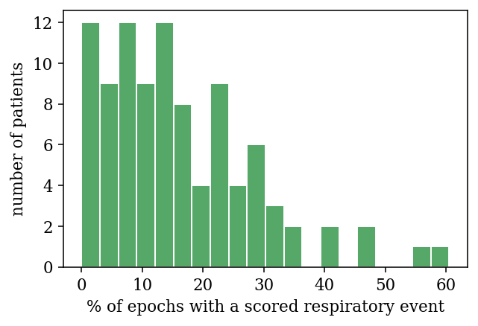
Dataset
• iSLEEPS is the first public polysomnography corpus of subacute ischemic stroke (NIMHANS, 100 patients).
• We use 96 patients (SN28 is a byte-identical duplicate and is dropped; three recordings lacked the raw signal file), totalling 89,532 epochs.
• Stage distribution is imbalanced: N2 42%, Wake 27%, REM 12%, N1 10%, N3 9%.
• Heavy sleep-disordered-breathing burden: 16% of epochs carry a scored event; median 13% per patient.
• Protocol: ten-fold patient-independent cross-validation on a fixed fold assignment.

Slide 4
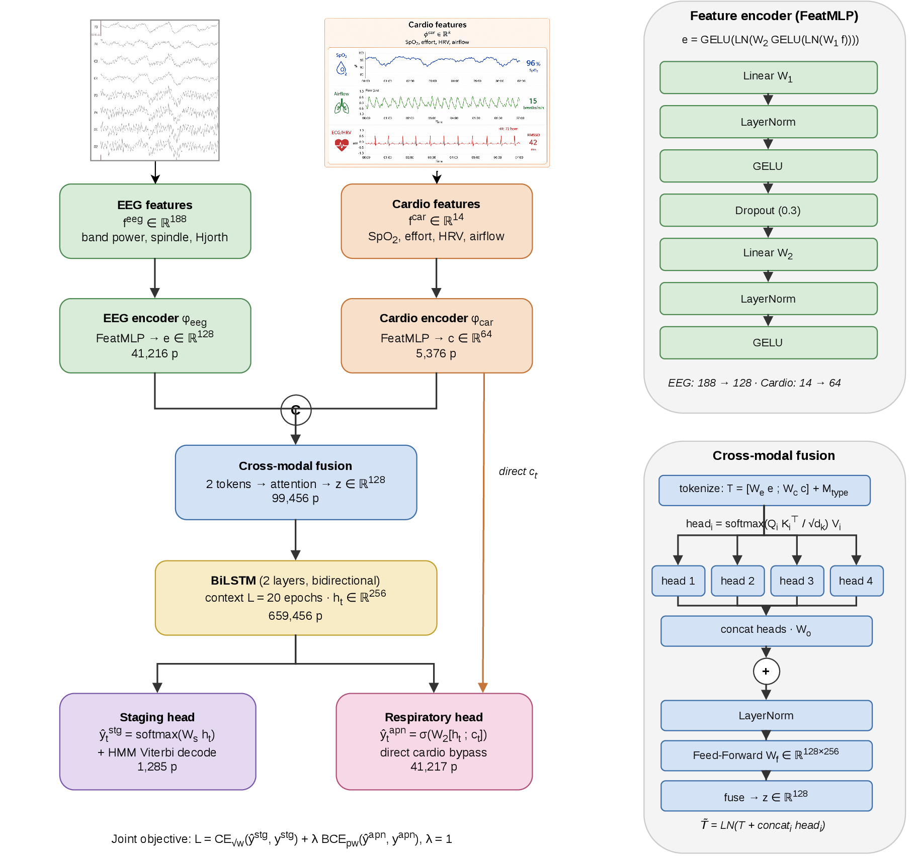
Architecture

Slide 5
Architecture: Components
• Two feature streams. Engineered EEG/EOG/EMG features (188) and cardiorespiratory features (14) are each encoded by a two-layer perceptron.
• Cross-modal fusion combines the two per-epoch embeddings; concatenation is the reported model, attention is an ablation.
• Bidirectional LSTM reads the night, modelling the sequential structure of sleep.
• Two heads. A staging head reads the recurrent state; a respiratory head reads it together with a direct copy of the cardiorespiratory embedding.
• Compact: 0.86M parameters, with a hidden-Markov smoothing pass on the staging output.

Slide 6
Architecture: Why Each Component
• Engineered features over raw signal. On 96 patients a convolutional network cannot rediscover what decades of sleep science put into the features; a raw model plateaus at 0.65.
• Direct cardiorespiratory path to the respiratory head. Oxygen-desaturation cues reach the decision without a staging-oriented bottleneck (apnea AUC 0.66 to 0.71).
• BiLSTM with hidden-Markov smoothing. Sleep transitions are highly structured; the temporal model restores realistic persistence.
• Square-root class weighting. Corrects the scarce N1 and N3 stages without giving up overall accuracy.
• Multi-task training. The respiratory head keeps the cardiorespiratory stream load-bearing by construction.

Slide 7
Results: Staging Benchmark
• Deep models built for healthy sleep fail here: DeepSleepNet 0.615, CNN-ResNet18 0.617, Raw multimodal CNN 0.655 — each 15 to 20 points below its healthy accuracy.
• The proposed model reaches 0.722, above every deep baseline, at 0.86M parameters.
• Classical pipelines saturate at 0.735 to 0.747 — staging is capped for every model family, a cohort ceiling.
• 72% is the cohort ceiling — our contribution is the second output, the respiratory read-out.
Model | Input | Params | Acc
CNN-ResNet18 | 1 EEG | ~11M | 0.617
DeepSleepNet | 1 EEG | ~21M | 0.615
AttnSleep | 1 EEG | ~0.5M | 0.686
CNN + BiLSTM | 4 EEG | ~0.6M | 0.613
Sleep-EDF transfer | 4 EEG | ~0.6M | 0.623
Raw multimodal CNN | 14 ch | 0.95M | 0.655
MM-Net (ours) | 14 ch feat | 0.86M | 0.721

Slide 8
Results: Modality Ablation
• Remove each modality, keep the rest, on the same folds.
• Removing SpO2 drops respiratory AUC 0.711 to 0.681; removing all cardiorespiratory drops it to 0.673; staging is unchanged.
• Removing EOG drops staging 0.722 to 0.712; respiratory detection holds.
• Paired Wilcoxon confirms the split: cardiorespiratory to respiratory p=0.004, cardiorespiratory to staging p=0.91.
• A clean physiological line: cardiorespiratory channels carry breathing, neural channels carry stage.
Modality removed | Staging | Resp. AUC
none (full model) | 0.723 | 0.711
SpO2 | 0.727 | 0.681
respiratory effort | 0.728 | 0.726
pulse / HRV | 0.723 | 0.700
ECG | 0.723 | 0.711
airflow | 0.722 | 0.704
EOG (ocular) | 0.712 | 0.705
EMG (muscle) | 0.724 | 0.707
all cardiorespiratory | 0.724 | 0.673

Slide 9
Results: Respiratory-Event Detection
• Headline apnea AUC 0.711, average precision 0.337 (event prevalence 0.16).
• Beats gradient boosting (0.670) only modestly — the contribution is the joint single pass and physiological attribution.
• By event type: hypopnea 0.692, obstructive 0.763, central 0.840 — strongest on the most severe events.
• Non-circular: removing the airflow channel the events were scored from leaves detection unchanged (0.704).
Detector (14 cardio feat.) | AUC | AP
Desaturation rule | 0.596 | 0.214
Logistic regression | 0.582 | 0.193
Gradient boosting | 0.670 | 0.290
MM-Net (ours) | 0.711 | 0.337
Event type | AUC
Hypopnea | 0.692
Obstructive apnea | 0.763
Central apnea | 0.840

Slide 10
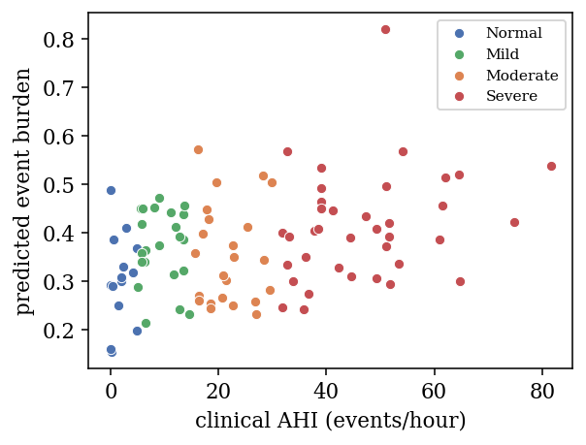
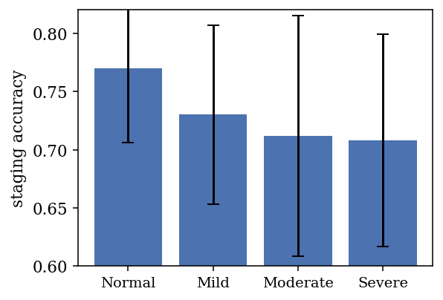
Results: Clinical Validation
• Predicted per-patient burden tracks clinical AHI (Spearman rho=0.315, p=0.002, n=96).
• Staging degrades with severity: accuracy falls from 0.770 (normal AHI) to 0.708 (severe).
• The pathology that motivates the second output also makes the first harder — the clinical reality of this cohort.

Slide 11
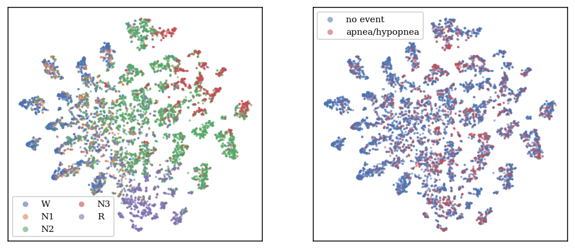
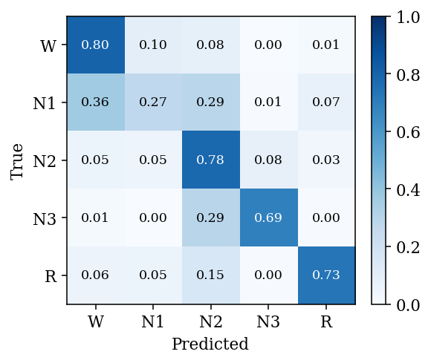
Results: Learned Representation
• Embeddings separate by sleep stage (t-SNE); the respiratory structure is diffuse, matching the modest AUC.
• Errors concentrate on N1, the rare, transient stage that is hard field-wide.

Slide 12
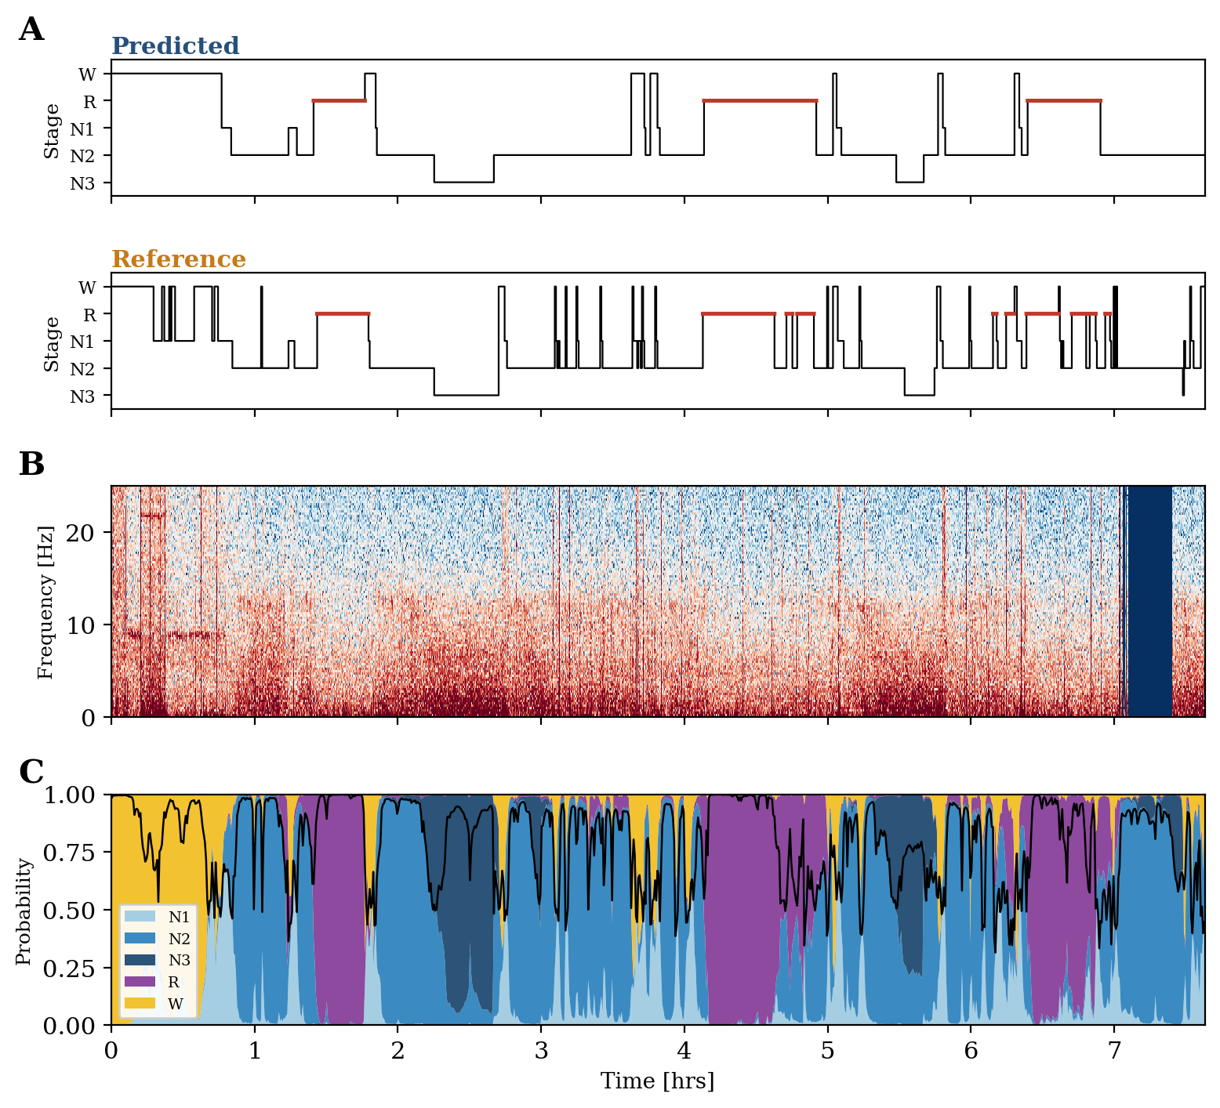
Results: A Whole Night
• Predicted hypnogram follows the reference through the night's cycles, on a held-out patient.
• The spectrogram shows deep sleep as low-frequency power, aligned with the staged N3 periods.
• The stage-probability ribbon exposes the model's confidence; it dips exactly at stage transitions.
• A qualitative check that the model tracks real sleep architecture across the whole night.

Slide 13
Conclusion
• Healthy-sleep deep learning fails on the injured brain; this cohort requires cohort-specific, physiologically grounded, multimodal modelling.
• One compact model (0.86M) stages sleep and detects respiratory events from a single pass over the recording.
• Attribution is causal: the modality-ablation grid shows each channel carries the task its physiology governs.
• The respiratory read-out is non-circular (survives airflow removal) and clinically anchored (tracks AHI).

