Slide 1
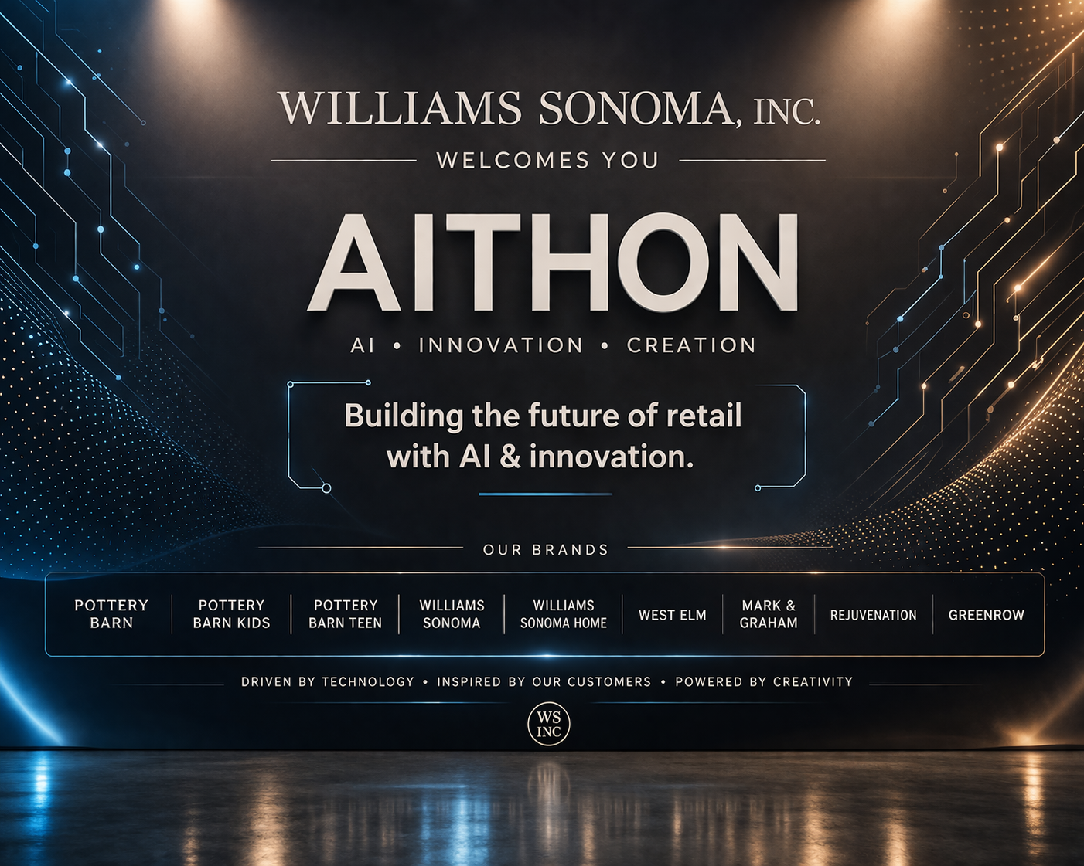
Notes:
https//youtu.be/oqC5FZj-Avo?si=HR_fi6DKzieUDQBG Do it Again, Steely Dan https//music.youtube.com/watch?v=7xvvLT_jRZY&list=RDAMVM7xvvLT_jRZY Lowdown, Boz Scaggs
https//www.youtube.com/watch?v=zF3PKGftlj4 THEE SACRED SOULS, CAN I CALL YOU ROSE

Slide 2
Instructions
1. Problem Statement Selection
Participants may choose one of the provided problem statements or define their own problem statement. If choosing your own, it must be relevant to the retail industry, including (but not limited to): E-commerce, Supply Chain, Data & Analytics, Infrastructure Security
2. Solution Approach
Each provided problem statement includes a suggested solution/output. Participants are encouraged to go beyond these suggestions and propose unique, creative, and well-justified solutions.
3 Use of AI
The use of AI tools and technologies is highly encouraged across all phases, including: Problem understanding, Solution design, Development (final round) . Participants should be prepared to explain how AI influenced their approach and decisions.
4. Judging Criteria
Submissions will be evaluated based on multiple criteria with different weightages. Participants are strongly advised to review the judging criteria carefully and align their approach accordingly.
5. Submission Requirements
All submissions must be made using the official template provided. Additional material can be added as required.
6. Presentation Format
Each team will have a total of 15 minutes, divided as follows: 10 minutes – Presentation, 5 minutes – Q&A with judges

Slide 3
Judging Criteria
Criteria | Explanation | Weightage
Solution alignment to problem statement | Ability to understand/clearly state the problem statement. Does the solution address the problem effectively? | 15%
AI assisted problem solving | How effective AI was used to break down the problem statement, thought process used to iterate intelligently with AI, how AI influenced the final design of the solution. | 20%
Innovation & Creativity | Is the solution provided unique in nature? How different it is from the current solutions available in the industry | 10%
AI Engineering | How effectively AI tools were used to build the solution. Prompt design/engineering quality, Tool selection (LLMs, agents, MCP, A2A, etc.), Handling hallucinations / errors | 20%
Technical implementation | Quality of code generate by AI , architecture , tech stack used, data handling, API’s /Frameworks used, Security considerations | 15%
Business impact & Practicality | Real-world usefulness, scalability, and potential adoption | 15%
User experience | App design, ease of use, navigation, and visual appeal | 5%

Slide 4
TEAM SLIDE
Team Name
Project Title/Name
Members

Slide 5
Problem Statement
Clearly Define the problem
Why it matters?

Slide 6
Solution Overview
High-Level Solution. Explain how this solution solves the problem
Key Features

Slide 7
AI Assisted Problem Solving
How AI helped break down the problem
Iterations & learning

Slide 8
AI Engineering
Tools used (LLMs, API, MCP servers, etc)
Prompt strategy
Hallucination & Error handling

Slide 9
Technical Architecture
Systems design
Tech Stack

Slide 10
Prototype/Demo

Slide 11
Challenges & Learning
Challenges faced in using AI
How did your team overcome?
If you have unlimited time and money how can you make the product better?

Slide 12
Feedback
Anything else you would like to mention to us ?
How was your experience with the WSI AI-thon? What can we do to improve next year?

