Slide 1
VIEW (HTML5)
Front-End
HTML5, Bootstrap 4.0, jQuery 3.3.1, Datatables,
jQuery:
Ajax
Json
PHP Service
Json Encoder
Back-End
PHP, PDO
PHP Manager(Library)
PDO
PDO_MySQL
My SQL
Stored Procedure
Database
MySQL, Stored Procedures

Slide 2
Used "php" as the extension of the file, but rarely coded as php. Because, it is to distinguish between front end and back end clearly and prevent spaghetti code from being generated.
VIEW (HTML5)
Front-End
HTML5, Bootstrap 4.0, jQuery 3.3.1, Datatables,
jQuery:
Ajax
All screen operations on the front end are developed using jQuery. It can be developed with less code than regular JavaScript. I have considered using AngularJS, but only jQuery is used because it is a group project.
Communications with the backend were organized in a Json format using jQuery.Ajax. Ajax is asynchronous communication that allows flexible screens to be developed.

Slide 3
The end-point of the back-end is the service. The services will communicate with the front-end. Data received from the front end is delivered to the Manager library for storage through the service. In addition, data is collected from each manager library and sent to the front-end.
PHP Service
Json Encoder
Back-End
PHP, PDO
PHP Manager(Library)
PDO
The Manager library associated with the database is the smallest unit in which data is collected. You may need to collect data from several manager libraries to form a single screen on the front end.
Call the stored procedure using the PDO class.

Slide 4
My SQL
Stored Procedure
Database
MySQL, Stored Procedures

Slide 5
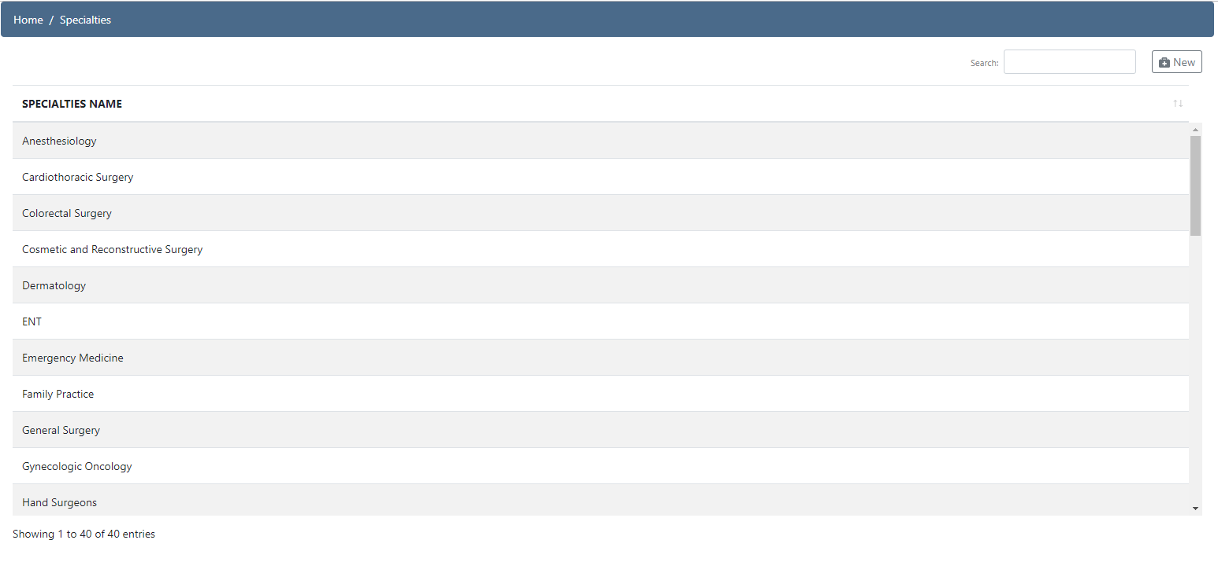
DataTables with Bootstrap Click on the column header to change the sort order
You can search if you put a letter in the search box.

Slide 6
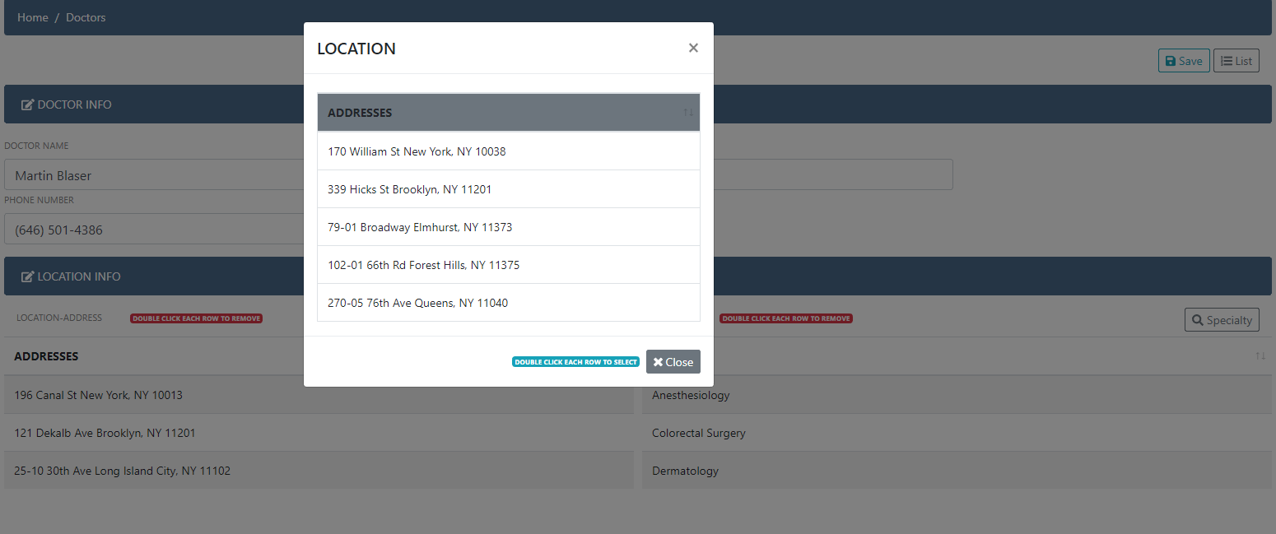
You can Double-click an item to add the value to the parent window on the base. On the other hand, if you double-click an item in the parent window, you can remove it from the parent window.

Slide 7
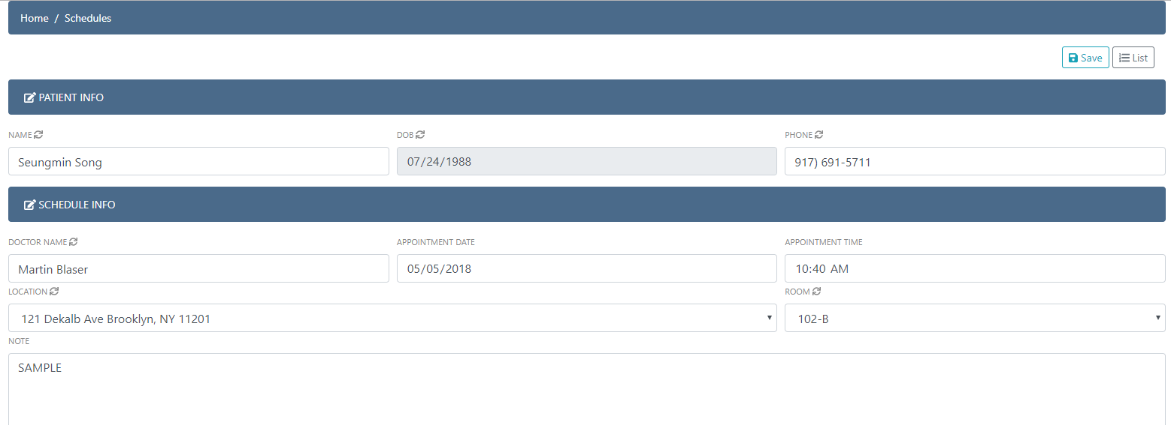
Enter the patient name, phone number, and doctor name to activate the autocomplete function below. Also, if the doctor name and location are changed, bring and binding in dropbox through asynchronous communication.
User save function and login not complete yet

