Slide 1
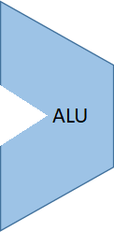
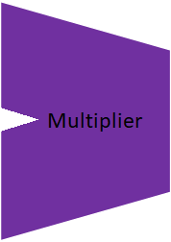
Control Signal
(6-bits)
ALU
control
InputA
(32-bits)
M
u
x
Output
(32-bits)
InputB
(32-bits)
Hi
Lo
Clock
Shifter

