Slide 1
Comp 3311 Database Management Systems
3. Relational Data Model
Exercise 3

Slide 2
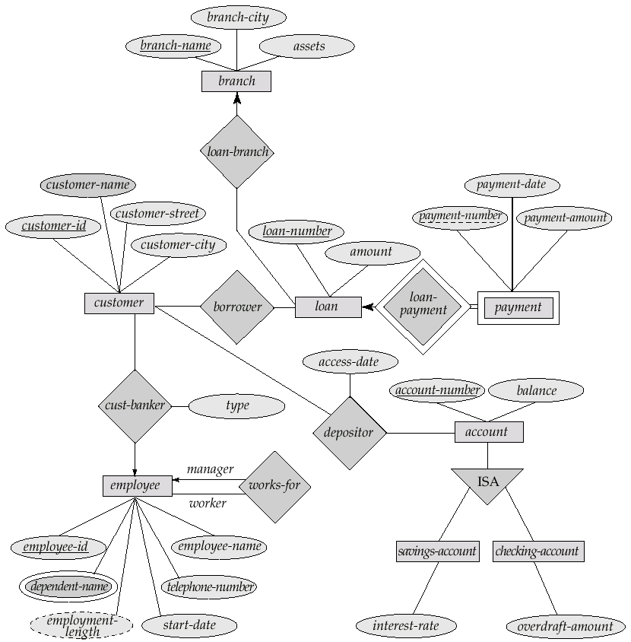
Question 1 Convert the Banking Enterprise ERD to Relational Schema

Slide 3
Schema I
Entities
Branch (branch-name, branch-city, assets)
Customer (customer-id, customer-name, customer-street, customer-city)
Loan (loan-number, amount)
Employee (employee-id, employee-name, telephone-number, start-date)
Account (account-number, balance)
Savings-account (account-number, interest-rate)
Checking-account (account-number, overdraft-amount)

Slide 4
Schema II
Weak Entity
Payment (loan-number, payment-number, payment-date, payment-amount)
Multi-valued attribute
Dependent (employee-id, dependent-name)

Slide 5
Schema III
Many-to-many relationships
Borrower (customer-id, loan-number)
Depositor (customer-id, account-number, access-date)
One-to-many relationships
Loan-branch is represented in Loan (loan-number, amount, branch-name)
Cust-banker is represented in Customer (customer-id, customer-name, customer-street, customer-city, employee-id, type)
Works-for is represented in Employee (employee-id, employee-name, telephone-number, start-date, manager-id)

Slide 6
Question 2 Convert the BUS COMPANY ERD to Relational Schema
Convert the ER diagram into tables.

Slide 7
Schema
Entities
Route (number, departure, destination)
Driver (id, name, phone)
Bus (license, capacity)
Weak Entity
Schedule (number, departure-time)
Relationships
Drives (number, departure-time, id)
Bus-in-use (license, number, departure-time)

Slide 8
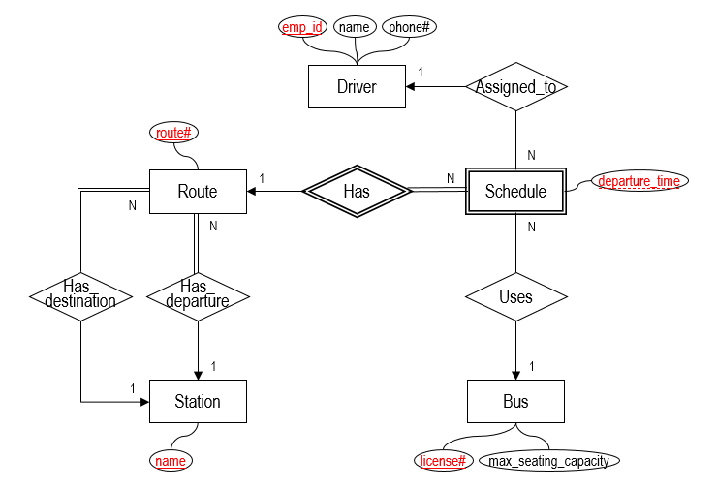
Question 3 Convert the Extended BUS COMPANY ERD to Relational Schema and Specify Referential Constraints
8

Slide 9
ENTITIES
emp_id
name
phone#
license#
max_seating_capacity
Strong Entities
Driver(emp_id, name, phone#)
Bus(license#, max_seating_capacity)
Route(route#)
Station(name)
Weak Entities
Schedule(route#, departure_time)
route# references Route
on delete cascade
Driver
Bus
route#
name
Route
Station
route#
Route
1
Has
N
Schedule
departure_time

Slide 10
RELATIONSHIPS: 1 to N
emp_id
name
phone#
Assigned_to relationship between Driver and Schedule
Schedule(route#, departure_time, emp_id)
emp_id references Driver
on delete set null
Uses relationship between Bus and Schedule
Schedule(route#, departure_time, license#)
license# references Bus
on delete set null
Driver
1
Assigned_to
N
Schedule
departure_time
N
Uses
1
Bus
license#
max_seating_capacity

Slide 11
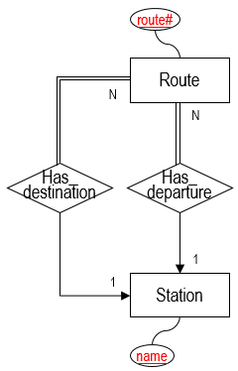
RELATIONSHIPS: 1 to N
Has_departure relationship between Route and Station
Route(route#, departure_station_name)
departure_station_name references Station
on delete cascade
Has_destination relationship between Route and Station
Route(route#, departure_station_name, destination_station_name)
destination_station_name references Station
on delete cascade

Slide 12
BUS COMPANY RELATIONAL SCHEMA
Driver(emp_id, name, phone#)
Bus(license#, max_seating_capacity)
Route(route#, departure_station_name, destination_station_name)
departure_station_name references Station
on delete cascade
destination_station_name references Station
on delete cascade
Station(name)
Schedule(route#, departure_time, emp_id, license#)
route# references Route
on delete cascade
emp_id references Driver
on delete set null
license# references Bus
on delete set null

Slide 13
Question 4 Reverse Relational Schema to ERD
Assume the following relational schema:
B(X,W),
C(P,Q,X) where X is defined as NOT NULL,
D(P,X,R)
Give an ER diagram for the above relational schema.

Slide 14
ERD

