Slide 1
COMP 3311 Spring 2020 Database Management Systems
Introduction

Slide 2
Course Administrative
WWW: http://course.cse.ust.hk/comp3311/
Textbook
Database System Concepts, A. Silberschatz, H. Korth, and S. Sudarshan.
Principles of Database Management, W. Lemahieu, S.V. Broucke, B. Baesens
Reference
Database Management Systems, Raghu Ramakrishnan and Johannes Gehrke.
Tutorials will start the week of 2 Mar (check the course web site)
Labs will start the week of 2 Mar (check the course web site)

Slide 3
Course Outline
Introduction - Overview
Logical Database Perspective:
Entity-Relationship (E-R) Model and Database Design
Relational Model and Relational Database Design
Relational Algebra and Structured Query Language (SQL)
Functional Dependencies and Database Normalization
Physical Database Perspective:
Storage Management and Indexing
Query Processing and Optimization
Transaction Management and Concurrency Control
Database Connectivity
NOSQL and Big Data Analytics

Slide 4
What is a Database Management System (DBMS)
User 1
User 2
…
User n
?
Stored data
How to organize, access, share, protect, … stored data?

Slide 5
What is a Database Management System (DBMS)
Data are facts such as age, salary, name, address, etc.
A database has the following properties.
It usually represents some aspect of the real world.
The data have some inherent meaning.
It is designed, built and populated with data for a specific purpose.
sales, human resources, manufacturing, banking, real estate, stock trading, inventory management, …
Databases touch all aspects of our lives!
A database is a collection of related data

Slide 6
What is a Database Management System (DBMS)
A database management system (DBMS) is a general purpose software package that manages databases.
Company | Product
Oracle | Oracle
IBM | DB2
Microsoft | Access, SQL Server
Sybase | Adaptive Server
Informix | Dynamic Server
A DBMS provides support/facilities for:
defining types, structures, constraints on data
storing data on some storage device
manipulating data (querying, updating)
sharing data among many users
protecting data from loss, corruption, unauthorized access
A DBMS provides an environment for managing data that is both convenient and efficient to use.

Slide 7
DBMS vs File Systems
In file processing, applications access stored data using the facilities provided by an operating system file system.
Marketing
Sales
…
Accounting
Drawbacks
Data redundancy & inconsistency
Difficulty in accessing data
Data isolation
Integrity problems
Atomicity of updates
Concurrent access
Security problems
OS file system
Marketing data
Sales data
…
Accounting data

Slide 8
DBMS vs File Systems (cont)
In database processing, applications access stored data using the facilities provided by a DBMS
Marketing
Sales
…
Accounting
Major Principles
integrates an organization’s data.
separates meta-data (description of data) and data.
supports multiple views of data.
controls definition and access of data centrally.
DBMS
The system catalog contains the meta-data.
Database =
Marketing + Sales + … + Accounting data
The database contains the data.
System Catalog
A DBMS provides automated solutions for the data management problems encountered when using file systems

Slide 9
Data Independence
One big problem in application development is the separation of applications from data
Do I have to change my program when I …
replace my hard drive?
store the data in a B-tree instead of a hash file?
partition the data into two physical files (or merge two physical files into one)?
store salary as floating point number instead of integer?
develop other applications that use the same set of data?
add more data fields to support other applications?
Solution: introduce levels of abstraction.
A DBMS provides separation of applications and data via several levels of abstraction.

Slide 10
Three Levels of Abstraction
ARR
CSE Dept
Financial Office
view 1
view 2
..……...
view n
Logical
view
HKUST database
Physical
view
Files on disks/cloud

Slide 11
Three Levels of Abstraction (cont.)
Physical level: describe how a record is stored on disks.
e.g., “Divide the customer records into 3 partitions and store them on disks 1, 2 and 3.”
Logical level: describe how data are structured in database, and the relationships among the data. Similar to defining a record type in a textbook programming language: Type customer = record
name: string;
street: string;
city: integer; end;
View level: Define a subset of the database for a particular application. Views can hide information (e.g. salary) for security purposes or add information (e.g., age).

Slide 12
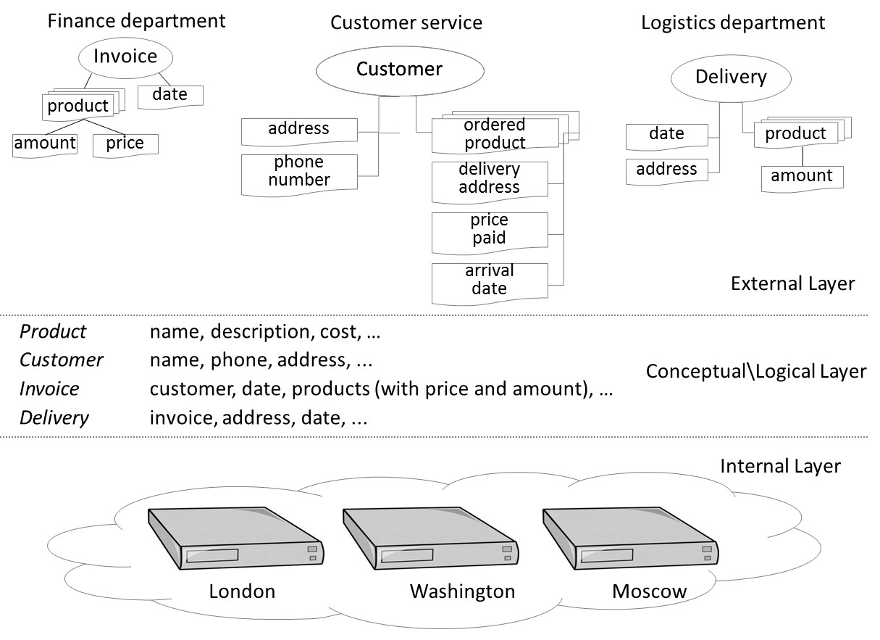
Three Levels of Abstraction (cont.)

Slide 13
Instances and Schemas
Each level is defined by a schema, which describes the data at the corresponding level
A logical schema defines the logical structure of the database (e.g., set of customers and accounts and the relationship between them)
A physical schema defines the file formats and locations
A database instance refers to the actual content of the database at a particular point in time. A database instance must conform to the corresponding schema

Slide 14
Data Independence
Application
Data independence is the ability to modify a schema definition in one level of abstraction without affecting a schema definition in a higher level.
View
(described by)
View (subschema)
Logical data independence
(shields users from changes in the logical structure)
Logical view
(described by)
Logical schema
Physical data independence
(shields users from changes in the physical structure)
Physical view
(described by)
Physical schema

Slide 15
An Example of Data Independence
Data on disk
1129
John Law
… …
Program accessing data directly has to know:
first 4 bytes is an ID number
next 10 bytes is an employee name
program
Schema
Data on disk
1129
John Law
… …
Student:
ID: integer
Name: char(10)
DBMS
program

Slide 16
Data Models
A collection of tools for describing:
Data
Relationships among data
Data semantics
Constraints on data

Slide 17
Entity-Relationship Model
Example of entity-relationship model
social-security
customer-street
balance
account-number
customer-city
customer-name
DEPOSITOR
CUSTOMER
ACCOUNT

Slide 18
Relational Model
Example of tabular data in the relational model:
customer-
social-
customer-
customer-
account-
name
security
street
city
number
Johnson
192-83-7465
Alma
Palo Alto
A-101
Smith
019-28-3746
North
Rye
A-215
Johnson
192-83-7465
Alma
Palo Alto
A-201
Jones
321-12-3123
Main
Harrison
A-217
Smith
019-28-3746
North
Rye
A-201
account-number
balance
A-101
500
A-201
900
A-215
700
A-217
750

Slide 19
Data Definition Language (DDL)
Notation for defining the database schema
Express how data are organized in a formal language
Examples:
create table customer (customer-name varchar(40),
social-security char(11),
customer-street varchar(100),
customer-city varchar(20),
account-number varchar(10));
create table account (account-number char(10), balance integer);

Slide 20
Data Manipulation Language (DML)
Language for accessing and manipulating the data organized by the data model
Two types of theoretical DML
Algebra (Procedural) - user specifies what data is required and how to get those data.
Calculus (Nonprocedural) - user specifies what data is required without specifying how to get those data
DML in practice
SQL

Slide 21
SQL
Most common language – used in all commercial DBMS
Including DML, DDL and more.
Example
SELECT account-number
FROM account
WHERE balance <= 0

Slide 22
Transaction Management
A transaction is a collection of operations that performs a single logical function in the database
Example: ATM withdrawal
Read account record
Modify balance
Write back modified record
The transaction-management component ensures that the database remains in a consistent (correct) state despite system failures (e.g., power failures and operating system crashes) and transaction failures.

Slide 23
Concurrency-control Management
Concurrency-control manager controls the interaction among the concurrent transactions, to ensure the consistency of the database.
Transaction 1
Transaction 2
Conflicting read/write

Slide 24
Storage/Buffer Management
The storage manager provides an interface to the buffer manager in the DBMS to access the data stored on disk.
The buffer manager is responsible for fetching data from the storage manager into main memory (the buffer) and deciding what data to keep in the buffer.

Slide 25
Overall System Architecture
naïve users (tellers, web users)
application programmers
sophisticated users (analysts)
database administrators
use
write
use
use
application interfaces
application programs
query tools
administration tools
compiler and linker
DML queries
DDL interpreter
application program object code
DML compiler and organizer
query evaluation engine
query processor
buffer manager
file manager
authorization and integrity manager
transaction manager
storage manager
indices
system catalog
(data dictionary)
disk storage
data
statistical data

Slide 26
Database Users
End Users
Naïve users
Invoke existing application programs (e.g., print monthly sales report).
Interact with applications through a graphical user interface (GUI).
Application programmers
Develop applications that interact with DBMS through DML calls.
Sophisticated users
Issue queries either directly using a database query language (e.g., SQL) or via tools such as data analysis software.
Database Administrator (DBA)
Coordinates all activities of the database system.
Defines and maintains the schemas.
Defines and maintains the physical organization.
Monitors and optimizes the database performance.
Monitors access and grants access rights.
A DBA must have a good understanding of an enterprise’s information resources and needs.

Slide 27
Database Professional Salaries (USA)
Job Title | 2016 Salary | 2017 Salary | 2018 Salary (50 – 95th percentile
Database Admin. | $95,750 - $142,750 | $98,500 - $148,500 | $95,000 - $156,000
Database Developer | $103,250 - $153,250 | $108,000 - $161,500 | $116,000 - $164,500
Database Manager | $118,000 - $170,500 | $122,250 - $177,000 | $127,000 - $180,000
Data Architect | $127,250 - $175,500 | $131,250 - $184,000 | $130,000 - $184,000
2018 Add these percentages to the database salaries above for the following skill sets:
Add 5 to 10% for
Oracle Database Skills
MS SQL Server Database Skills
Source: Robert Half Technology Salary Guide for Technology Professionals
https://www.roberthalf.com/sites/default/files/Media_Root/images/rht-pdfs/robert_half_technology_2016_salary_guide.pdf
https://www.fosster.com/industry-reports/2017_RHT_salary-guide.pdf
https://cec.nova.edu/documents/Robert%20Half%20Tech%202018_salary_guide.pdf

Slide 28
Summary
Database management systems (DBMSs) address the limitations of file systems for managing an enterprise’s data.
Data independence is fundamental to understanding a database at different abstraction levels.
Data models are the foundation for developing a database—the entity-relationship (E-R) model and relational model are commonly used in practice.
Database languages (DDL and DML) are an integral part of a DBMS; SQL is the common database language for relational DBMSs.
A DBMS provides many facilities—query processing, storage management, transaction management—to efficiently manage the data management and access needs of various users.

