Slide 1
Comp 3311 Database Management Systems
11. Midterm Review

Slide 2
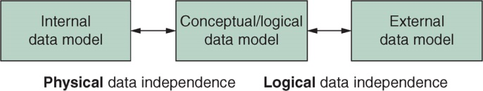
Main Topics at Logical Data Level
ER model (ER Diagram)
Notation
Conversion between ERD and RDM
Relational data model
Structures
RA
SQL
DML
DDL
Database design
FDs
Normal Forms (3NF and BCNF)
Zoom proctored, Canvas-based
https://hkust.zoom.us/j/507698956
Midterm | Question Type | Weight | Start time | End time
Answer the honor code questions (checking the boxes) as required by the university for the online exam. Please join the zoom meeting shown in the above URL 15 mins before the exam.
Part I | Multiple Choice 45 mins | 50% (at least 2% will be given for proper setting of video cam throughout) | 7:00pm | 7:45pm
Part II | Oracle Databases 60 mins | 50% (at least 2% will be given for proper setting of video cam throughout) | 8:00pm | 9:00pm

Slide 3
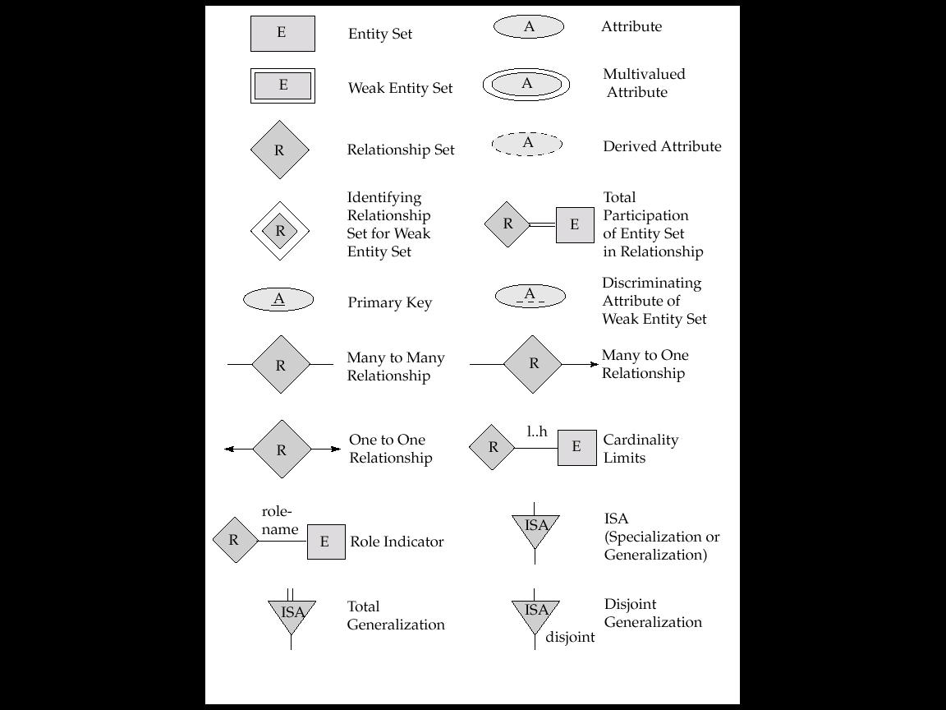
Summary of ER Symbols I

Slide 4
Summary of ER Symbols II

Slide 5
Symbols of ER Diagram (Cont.)
(a) one-to-one
All employees
have a dept;
a dept has only one employee
Department
1
Managed- by
1
Employee
(b) one-to-many
All employees
have a dept;
a dept has many employees
Department
1
Works-in
M
Employee
(c) many-to-many
N:M
Employee
N
Member-
of
M
Project
(e)relationship attribute
Employee
N
Member-
of
M
Project
time

Slide 6
Symbols of ER Diagram (Cont.)
(f) recursive
(with role names)
1
boss
Employee
Manager- of
N
worker
(g) ternary relationship
Employee
N
Uses
M
Project
P
Language
(h) generalization/specialization
Employee
ISA
Manager
Engineer
Technician

Slide 7
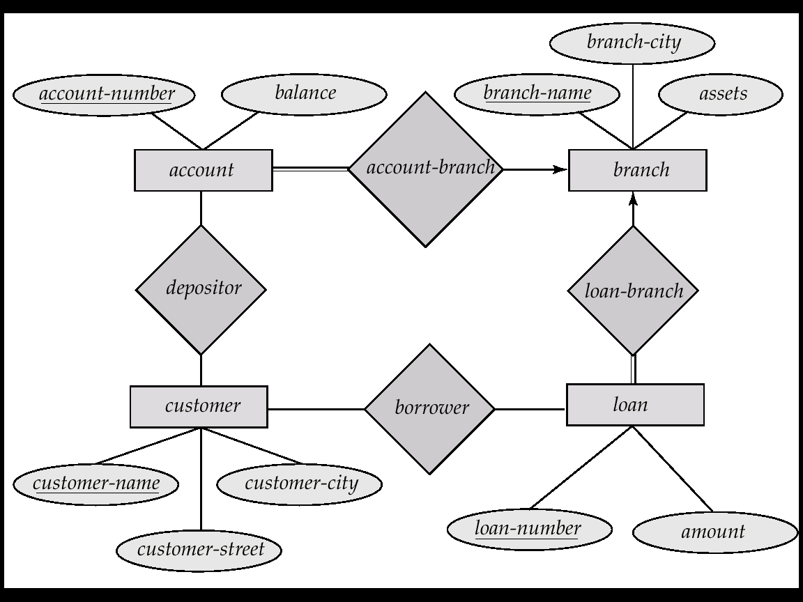
E-R Diagram of a Bank

Slide 8
RELATIONAL MODEL
The relational model represents the data for an application as a collection of tables.
Relational Model |  | Representation | Notation
Relation | ⬄ | table | R(A₁, A₂, …, A_{n})
Attribute | ⬄ | column | A_{i}
Domain | ⬄ | type and range of attribute values | dom(A_{i})
Tuple / Record | ⬄ | row
Attribute value | ⬄ | value in table cell
A set of relation schemas define a relational database.
Tables show the instances of relation schemas.

Slide 9
Relational Model
Automatic conversion between relational tables and ERD
Entities
Relationships
branch_name
city
assets
Branch
1
Gives
street
city
state
account_number
balance
access_date
customer_id
name
address
phone#
N
Account
N
Deposits_to
M
Customer
N
Takes_out
M
Loan
loan#
amount
1
Guarantor_of
N
1
interest_rate
overdraft
Disjoint
Saving
Checking
Has
N
Payment
number
date
amount

Slide 10
BANK RELATIONAL SCHEMA
Account(account_number, balance)
Saving(account_number, interest_rate)
account_number references Account
on delete cascade
Checking(account_number, overdraft)
account_number references Account
on delete cascade
Customer(customer_id, name, address)*
Branch(branch_name, city assets)
Loan(loan#, amount, branch_name, customer_id)
branch_name references Branch
on delete cascade
customer_id references Customer
on delete set null
* Using option 1 for address composite attribute.
Payment(loan#, number, date, amount)
loan# references Loan
on delete cascade
Deposits_to(account_number, customer_id, access_date)
account_number references Account
on delete cascade
customer_id references Customer
on delete cascade
Takes_out(customer_id, loan#)
customer_id references Customer
on delete cascade
loan# references Loan
on delete cascade
Customer_phone(customer_id, phone#)
customer_id references Customer
on delete cascade

Slide 11
Relational Algebra
Basic operations:
Selection ( σ )
Projection ( π )
Cross-product ( x )
Set-difference ( - )
Union ( ∪ )
renaming ( ρ )
Additional operations:
Intersection (∩), join ( ), division (/)
Notes:
6

Slide 12
SQL: BASIC STRUCTURE
SQL is based on set and relational algebra operations with certain modifications and enhancements.
A SQL query has the form (where […] means optional):
select select-clause
from from-clause
[where where-clause]
[order by order-by-expression]
[group by group-by-attributes]
[having condition-for-each-group];
The result of an SQL query is a relation (but it may contain duplicates).
SQL statements can be nested.

Slide 13
SQL FEATURES
Duplicate removal: distinct.
An aggregation function (e.g., max, sum, …)
without group by returns a single value.
with group by returns a single value for each group.
Null is ignored except count(*)
Count always return a non-negative integer
All non-aggregation attributes in the select clause with a group by must also appear in the group by clause.
If an attribute appears in a group by clause, it may not necessarily appear in the select clause.
Notes:
6

Slide 14
Functional Dependencies (FDs)
A FD X → Y holds on R, if and only if, for any legal relations r(R), whenever any two tuples t₁ and t₂ of r agree on the attributes X, they also agree on the attributes Y
The set of all functional dependencies logically implied by F is the FD closure of F. (i.e. F⁺)
For computing the closure we use Armstrong’s axioms
A1 if Y ⊆ X, then X → Y (reflexivity)
A2 if X → Y, then ZX → ZY (augmentation)
A3 if X → Y, and Y → Z, then X → Z (transitivity)
Given a set of attributes X, the attribute closure of X under F (denoted by X⁺) is the set of attributes that are functionally determined by X under F
If X determines all attributes, then it is a superkey. If it is also minimal, then it is a candidate key. One candidate key is chosen to be the primary key to id a tuple
A canonical cover of F is a minimal set of functional dependencies equivalent to F, without any redundant dependencies or redundant attributes

Slide 15
Database Design
Goal
remove redundancy & preserve constraints
Major normal forms
BCNF: for every non-trivial FD without useless attributes X  → Y, X is a candidate key.
3NF: a table in BCNF also satisfies 3NF. In addition, 3NF allows FDs where every attribute in Y is prime.
2NF: a table in 3NF also satisfies 2NF. In addition, 2NF allows FDs where X is not a proper subset of a candidate key.
1NF: every relational table is 1NF because all attribute values are atomic.

Slide 16
3NF Decomposition Algorithm
Let F_{c} be a canonical cover for F
for each X → Y in canonical cover F_{c}
create (X,Y)
if none of the created tables contains a candidate key
create a table with any candidate key for R;
The final tables are in 3NF. The decomposition from the algorithm is both lossless-join and dependency-preserving, but the tables may have redundancy.

Slide 17
BCNF Decomposition Algorithm
Compute F⁺;
Result = {R};
While (any X→Y in F⁺ on a schema R_{i} in Result violates BCNF) {
Create a new table (X,Y);
Result = (Result-{R_{i}}) U {(R_{i} - Y)} U {(X,Y)};
}
The final tables are in BCNF, which do not have redundancy. The decomposition from the algorithm is lossless-join, but may not preserve FDs.

Slide 18


That’s all, folks!

