Slide 1
NoSQL Databases

Slide 2
Introduction
The NoSQL movement
NOSQL Databases
Key–value stores
More Key–Value Stores Issues
Tuple and document stores
More Tuple and document stores Issues
Column-oriented Databases
Evaluating NOSQL Databases
Appendix
Example of key-value stores: Memcached
Graph Databases
Other NoSQL DB categories

Slide 3
The NoSQL Movement

Slide 4
The NoSQL Movement
RDBMSs put a lot of emphasis on keeping data consistent
Entire database is consistent at all times (ACID)
Focus on consistency may hamper flexibility and scalability
As the data volumes or number of parallel transactions increase, capacity can be increased by
Vertical scaling: extending storage capacity and/or CPU power of the database server
Horizontal scaling: multiple DBMS servers being arranged in a cluster

Slide 5
The NoSQL Movement
RDBMSs are not good at extensive horizontal scaling
Large coordination overhead because of focus on consistency
Rigid database schemas
Need databases for situations dealing with
massive volumes
flexible data structures
scalability and availability
New requirements are more important ➔ NoSQL databases

Slide 6
The NoSQL Movement
NoSQL databases
Describes databases that store and manipulate data in formats other than tabular relations → non-relational databases
NoSQL databases aim at near-linear horizontal scalability
By distributing data over a cluster of database nodes for the sake of performance as well as availability
New concept of eventual consistency
Data (and its replicas) will become consistent at some point in time after each transaction

Slide 7
The NoSQL Movement
 | Relational Databases | NoSQL Databases
Data paradigm | Relational tables | Key–value (tuple) based Document based Column based Graph based XML, object based Others: time series, probabilistic, etc.
Distribution | Single-node and distributed | Mainly distributed
Scalability | Vertical scaling, harder to scale horizontally | Easy to scale horizontally, easy data replication
Openness | Closed and open source | Mainly open source
Schema role | Schema-driven | Mainly schema-free or flexible schema
Query language | SQL as query language | No or simple querying facilities, or special-purpose languages
Transaction mechanism | ACID: Atomicity, Consistency, Isolation, Durability | BASE: Basically Available, Soft state, Eventual consistency
Feature set | Many features (triggers, views, stored procedures, etc.) | Simple API
Data volume | Capable of handling normal-sized datasets | Capable of handling huge amounts of data and/or very high frequencies of read/write requests

Slide 8
Introduction
The NoSQL movement
NOSQL Databases
Key–value stores
More Key–Value Stores Issues
Tuple and document stores
More Tuple and document stores Issues
Column-oriented Databases
Evaluating NOSQL Databases
Appendix
Example of key-value stores: Memcached
Graph Databases
Other NoSQL DB categories

Slide 9
NOSQL Databases: Key Value Stores

Slide 10
NOSQL Databases
Key–value stores
More Key–Value Stores Issues
Tuple and document stores
More Tuple and document stores Issues
Column-oriented Databases
Evaluating NOSQL Databases

Slide 11
Key–Value Stores
Key–value-based database stores data as (key, value) pairs
Keys are unique
Use hash map, or hash table or dictionary
Distribute hash table over different locations (support horizontal scalability)

Slide 12
Key–Value Stores
import java.util.HashMap;
import java.util.Map;
public class KeyValueStoreExample {
public static void main(String... args) {
// Keep track of age based on name
Map<String, Integer> age_by_name = new HashMap<>();
// Store some entries
age_by_name.put("wilfried", 34);
age_by_name.put("seppe", 30);
age_by_name.put("bart", 46);
age_by_name.put("jeanne", 19);
// Get an entry
int age_of_wilfried = age_by_name.get("wilfried");
System.out.println("Wilfried's age: " + age_of_wilfried);
// Overrides the age of an entry using the unique key
age_by_name.put("seppe", 50);
}
}
Java provides HashMap class
Create a HashMap object
Add four entries using the put method
Update an entry
Notes:
Reference: https://www.w3schools.com/java/java_hashmap.asp

Slide 13
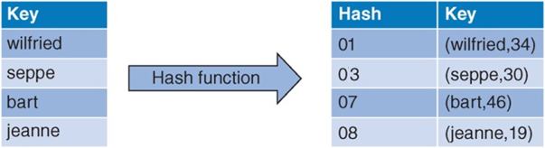
Key–Value Stores
Keys (e.g., “bart”, “seppe”) are hashed by a hash function
Recall: a hash function takes an arbitrary value of arbitrary size and maps it to a key with a fixed size, which is called the hash value
Each hash value can then be mapped to a memory address
Sharding: to spread our hashes over three servers
Hash every key (“wilfried”, “seppe”) to a server identifier
index(hash) = mod(hash, nrServers) + 1 (i.e. hash of key hashes)
Example

Slide 14
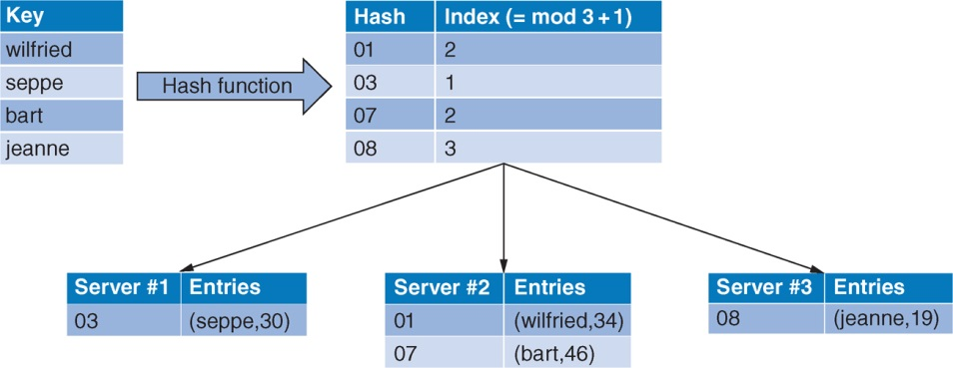
Key–Value Stores
Sharding- partitioning data and assigning it to different nodes (shards)
Example
index(hash) =
mod(hash, nrServers) + 1
For instance, hash 08 divided by 3 has a remainder of 2, which results in index 3 after adding 1

Slide 15
NOSQL Databases
Key–value stores
More Key–Value Stores Issues
Tuple and document stores
More Tuple and document stores Issues
Column-oriented Databases
Evaluating NOSQL Databases

Slide 16
More Key-Value Stores Issues

Slide 17
More Key–Value Stores Issues
More issues of key-value store DB in the network
Request coordination
Consistent hashing
Replication and redundancy
Eventual consistency
Integrity constraints and querying

Slide 18
Request Coordination
In many NoSQL implementations (e.g., Cassandra, Google’s BigTable, Amazon’s DynamoDB), all nodes (data partitioning units) implement the same functionality (i.e. node transparent to users)
So all nodes in the network are able to perform the role of request coordinator (RC)
Two basic components of a membership protocol in RC
Dissemination: Membership list updates are based on periodic and pairwise communications (support node awareness)
Failure detection: Checking that nodes are not available in the network (to avoid nodes being down)

Slide 19
Consistent Hashing
Consistent hashing schemes are often used, which avoid having to remap too many keys to a new node when nodes are added or removed
Problem of simple server hashing:
Suppose we have a situation in which ten keys are distributed over three servers (n = 3) with the following hash function:
h(key) = key modulo n
What happens to the key distribution, if we
Remove one node (n =2)
Add one node (n= 4)

Slide 20
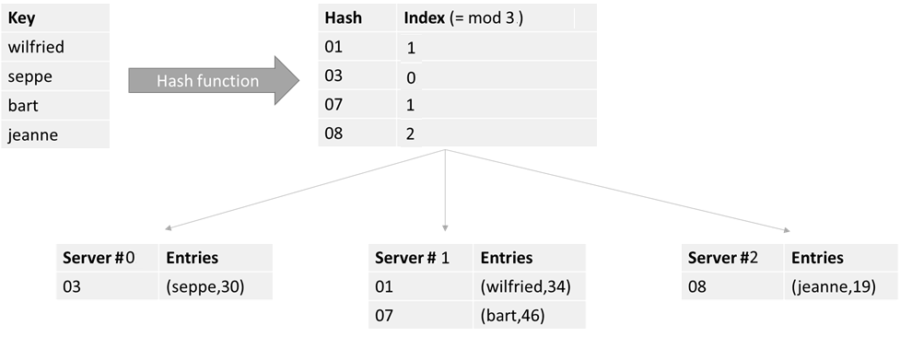
Consistent Hashing
 | n
key | 3 | 2 | 4
0 | 0 | 0 | 0
1 | 1 | 1 | 1
2 | 2 | 0 | 2
3 | 0 | 1 | 3
4 | 1 | 0 | 0
5 | 2 | 1 | 1
6 | 0 | 0 | 2
7 | 1 | 1 | 3
8 | 2 | 0 | 0
9 | 0 | 1 | 1
Example
Change of the number of servers n → many items have to be moved to a different server (highlighted in red). This is not desirable outcome where servers are likely to be removed or added.

Slide 21
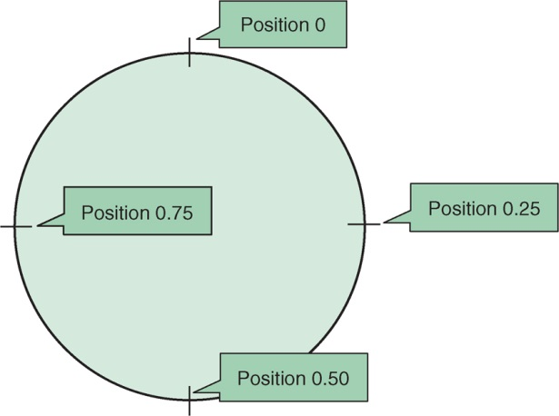
Consistent Hashing
At the core of a consistent hashing setup is a so-called ring-topology (conceptual), which is basically a representation of the number range [0,1]:
Example

Slide 22
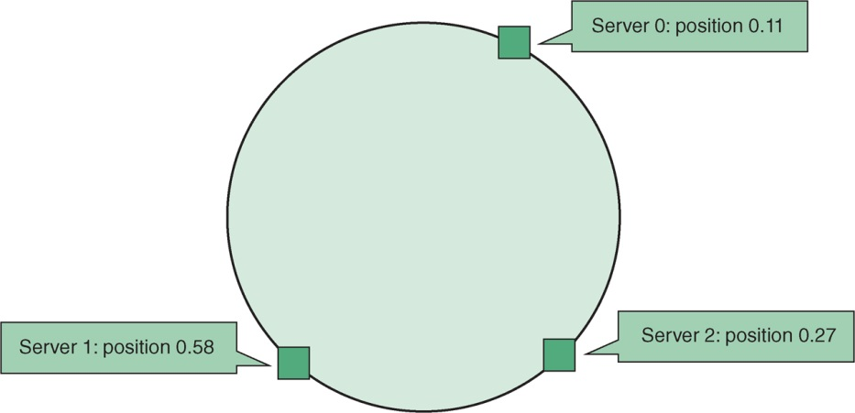
Consistent Hashing
All three servers with identifiers 0, 1, 2 are hashed to place them in a position on this ring
Example

Slide 23
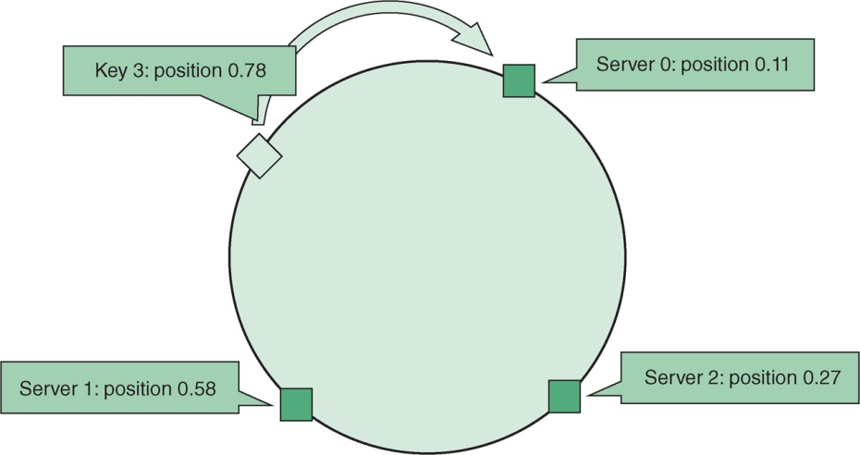
Consistent Hashing
Hash each key to a position on the ring, and store the actual key–value pair on the first server that appears clockwise of the hashed point on the ring
Example

Slide 24
Consistent Hashing
Because of the uniformity property of a “good” hash function, roughly 1/n of key–value pairs will end up being stored on each server
Most of the key–value pairs will remain unaffected in the event that a machine is added or removed
If we add a new server, server #3, to the ring (next slide). Only the keys positioned on the blue highlighted section of the ring in the figure would have to be moved to the new server
Typically, the fraction of keys that need to be moved when using this setup is about k/(n + 1), with k being the number of keys and n the number of servers. This is a much smaller fraction than was the case for modulo-based hashing

Slide 25
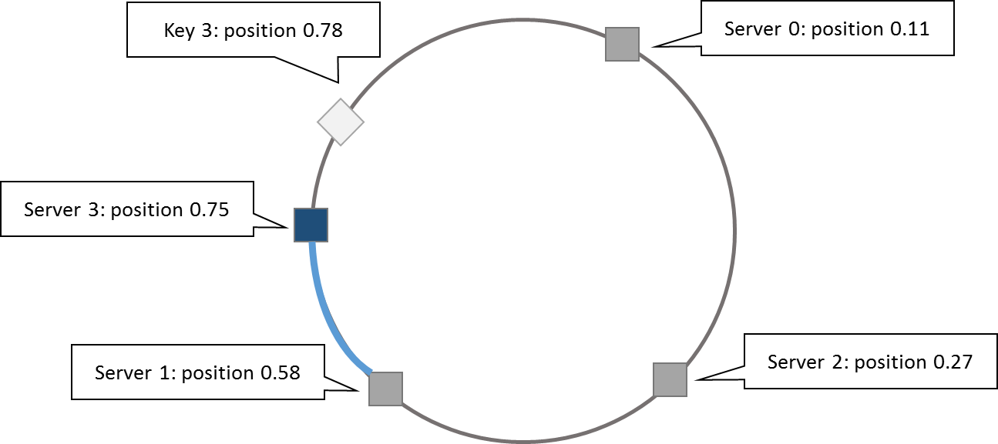
Consistent Hashing
Example
Data moving to Server 3

Slide 26
Replication and Redundancy
Problems with consistent hashing:
If two servers end up being mapped too close to one another, one of these nodes ends up with few keys to store
In the case that a server is added, all of the keys moved to this new node originate from just one other server
Instead of mapping a server s to a single point on our ring, we map it to multiple positions, called replicas
For each physical server s, we hence end up with r replicas on the ring (virtual nodes)
Note: each of the replicas still represents the same physical server (do not confuse with data redundancy here)

Slide 27
Replication and Redundancy
Key–value pairs are possibly duplicated across multiple nodes:
by storing the key–value pair on two or more nodes clockwise from the key’s position on the ring
It is also possible to set up a full redundancy scheme in each node
Server 2 being backed up (full redundant copy) over three hard drives or machines (e.g. RAID 1)

Slide 28
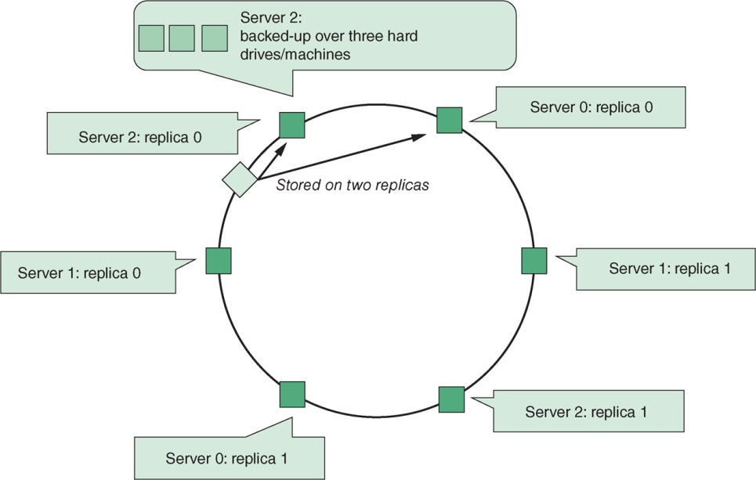
Replication and Redundancy
Example

Slide 29
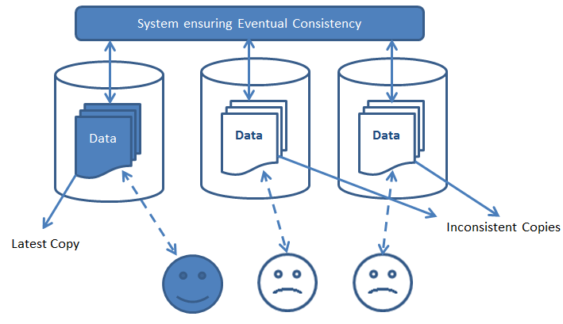
Eventual Consistency
Membership protocol does not guarantee that every node is aware of every other node at all times
it will reach a consistent state over time (e.g. via continuous pairwise communications)
State of the network might not be perfectly consistent at any moment in time, though will become eventually consistent at a future point in time

Slide 30
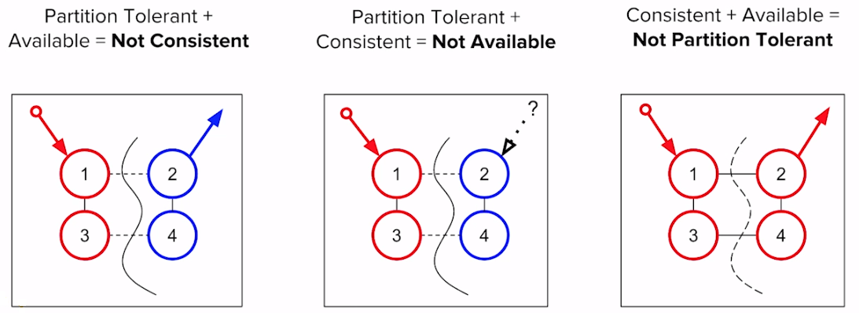
Eventual Consistency
CAP theorem states that a distributed computer system cannot guarantee the following three properties at the same time:
Consistency (all nodes see the same data at the same time)
Availability (guarantees that every request receives a response indicating a success or failure result)
Partition tolerance (the system continues to work even some nodes go down)
Most NoSQL databases sacrifice the consistency part of CAP in their setup, instead striving for eventual consistency

Slide 31
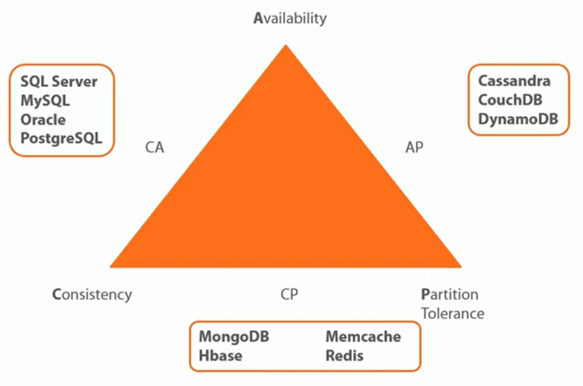
Eventual Consistency
Examples of NOSQL Systems

Slide 32
Eventual Consistency
The full BASE acronym stands for:
Basically Available: NoSQL databases adhere to the availability guarantee of the CAP theorem
Soft state: the system can change over time, even without receiving input
Eventual consistency: the system will become consistent over time
Most NoSQL databases follow the BASE principle

Slide 33
Integrity Constraints and Querying
Limitations of existing work of non-relational systems:
Key–value stores represent a very diverse gamut of systems:
Full-blown DBMSs versus cache Layered Relational DBMSs
Only limited query facilities are offered
e.g. put and set
No means to enforce structural constraints
DBMS remains agnostic to the internal structure
No relationships, referential integrity constraints, or database schema can be defined over key-value stores

Slide 34
NOSQL Databases
Key–value stores
More Key–Value Stores Issues
Tuple and document stores
More Tuple and document stores Issues
Column-oriented Databases
Evaluating NOSQL Databases

Slide 35
Tuple and Document Stores

Slide 36
Tuple and Document Stores
A tuple store is similar to a key–value store
It does not store pairwise combinations of a key and a value
But instead stores a unique key together with a vector of data
Example: marc → ("Marc", "McLastName", 25, "Germany")
No requirement to have the same length or semantic ordering (schema-less)
Various NoSQL implementations do permit organizing entries in semantical groups (similar to collections or tables)
Examples:
Person:marc → ("Marc", "McLastName", 25, "Germany")
Person:harry → ("Harry", "Smith", 29, "Belgium")

Slide 37
Tuple and Document Stores
Document stores store a collection of attributes that are labeled and unordered, representing items that are semi-structured (similar to XML, YAML, CSV data)
Example:
{
Title = "Harry Potter"
ISBN = "111-1111111111"
Authors = [ "J.K. Rowling" ]
Price = 32
Dimensions = "8.5 x 11.0 x 0.5"
PageCount = 234
Genre = "Fantasy"
}

Slide 38
Tuple and Document Stores
Example of JSON (JavaScript Object Notation) – a light weight data interchange format to share data {
"title": "Harry Potter",
"authors": ["J.K. Rowling", "R.J. Kowling"],
"price": 32.00,
"genres": ["fantasy"],
"dimensions": {
"width": 8.5,
"height": 11.0,
"depth": 0.5
},
"pages": 234,
"in_publication": true,
"subtitle": null
}
Value pair
Array
Name

Slide 39
NOSQL Databases
Key–value stores
More Key–Value Stores Issues
Tuple and document stores
More Tuple and document stores Issues
Column-oriented Databases

Slide 40
More Tuple and Document Store Issues

Slide 41
More Tuple and Document Store Issues
More issues about tuple and document store DB:
Items with keys
Filters and queries
Complex queries and aggregation with MapReduce
SQL after all …

Slide 42
Items with Keys
Most NoSQL document stores will allow you to store items in tables (collections) in a schema-less manner, but will enforce that a primary key be specified
MongoDB uses _id as the PK attribute in an item
User-defined or auto-generated
A primary key will be used as a partitioning key to create a hash and determine where the data will be stored
Example of MongoDB:
{
“_id”: ObjectId(“56349fh4ht49jv4j9jv4jvj94jv49”),
“title”: “Harry Patter”,
“price”: 32
}

Slide 43
Filters and Queries
import org.bson.Document;
import com.mongodb.MongoClient;
import com.mongodb.client.FindIterable;
import com.mongodb.client.MongoDatabase;
import java.util.ArrayList;
import static com.mongodb.client.model.Filters.*;
import static java.util.Arrays.asList;
public class MongoDBExample {
public static void main(String[] args) {
MongoClient mongoClient = new MongoClient();
MongoDatabase db = mongoClient.getDatabase("test");
// Delete all books first
db.getCollection("books").deleteMany(new Document());
// Add some books
db.getCollection("books").insertMany(new ArrayList<Document>() {{
add(getBookDocument("My First Book", "Wilfried", "Lemahieu", 12, new String[]{"drama"}));
add(getBookDocument("My Second Book", "Seppe", “vanden Broucke", 437, new String[]{"fantasy", "thriller"}));
add(getBookDocument("My Third Book", "Seppe", “vanden Broucke", 200, new String[]{"educational"}));
add(getBookDocument("Java Programming", "Bart", "Baesens", 100, new String[]{"educational"}));
}});
Java code here shows how you can connect to a MongoDB instance, insert some documents, query, and update them.
Set up a MongoClient and MongoDatabase
Use the deleteMany and InsertMany methods to delete and insert book entries
Use the helper method to get title, author, nrPages and genres

Slide 44
Filters and Queries
// Perform query
FindIterable<Document> result = db.getCollection("books").find(
and( eq("author.last_name", “vanden Broucke"), eq("genres", "thriller"),
gt("nrPages", 100)));
for (Document r : result) {
System.out.println(r.toString());
// Increase the number of pages:
db.getCollection("books").updateOne(
new Document("_id", r.get("_id")),
new Document("$set", new Document("nrPages", r.getInteger("nrPages") + 100)));
}
mongoClient.close();}
public static Document getBookDocument(String title,
String authorFirst, String authorLast,
int nrPages, String[] genres) {
return new Document("author", new Document()
.append("first_name", authorFirst)
.append("last_name", authorLast))
.append("title", title)
.append("nrPages", nrPages)
.append("genres", asList(genres));}}
Use the “find” method and pass a conjunctive (and) condition
Update the pages in the result set
The helper method “getBookDocument”

Slide 45
Filters and Queries
Running our Java code will produce the result as expected
Document{{_id=567ef62bc0c3081f4c04b16c, author=Document{{first_name=Seppe, last_name=vanden Broucke}}, title=My Second Book, nrPages=437, genres=[fantasy, thriller]}}
The “eq” filter searches through the list in genres

Slide 46
Filters and Queries
// Perform aggregation query
AggregateIterable<Document> result = db.getCollection("books")
.aggregate(asList(
new Document("$group",
new Document("_id", "$author.last_name")
.append("page_sum", new Document("$sum", "$nrPages")))));
for (Document r : result) {
System.out.println(r.toString());
}
The SUM operation is done to find the total number of pages across all books, grouped by authors
Running our Java code will produce the result you see here
Document{{_id=Lemahieu, page_sum=12}}
Document{{_id=Vanden Broucke, page_sum=637}}
Document{{_id=Baesens, page_sum=100}}

Slide 47
Filters and Queries
Queries can be slow because every filter (such as “author.last_name = Baesens”) entails a complete collection or table scan
Most document stores can define a variety of indexes (similar to relational indexes)
unique and non-unique indexes
compound indexes
geospatial indexes
text-based indexes

Slide 48
Complex Queries and Aggregation with MapReduce
Document stores do not support connections between entities but three approaches are as follows:
First approach: embedded documents
{
"title": "Databases for Beginners",
"authors": ["Jay Sequel", "John Smith"],
"pages": 234
}
{
"title": "Databases for Beginners",
"authors": [
{"first_name": "Jay", "last_name": "Sequel", "age": 54},
{"first_name": "John", "last_name": "Smith", "age": 32} ],
"pages": 234
}
BUT this causes much data duplication – recall the update anomalies and normalization problems!

Slide 49
Complex Queries and Aggregation with MapReduce
Second approach: create multiple entity collections
book collection:
{
"title": "Databases for Beginners",
"authors": ["Jay Sequel", "John Smith"],
"pages": 234
}
authors collection:
{
"_id": "Jay Sequel",
"age": 54
"_id": “John Smith",
"age": 32
}
BUT we should resolve complex relational queries over entities in the code level – no join operation!

Slide 50
Complex Queries and Aggregation with MapReduce
Third Approach: MapReduce
A map-reduce pipeline starts from a series of key–value pairs (k1,v1) and maps each pair to one or more output pairs
The output entries are shuffled and distributed to the workers (e.g., each worker can be viewed as a physical machine)
Workers then apply a reduce function to each group of key–value pairs having the same key k2, producing a new list of values per output key (e.g. COUNT, SUM, AVG)
The final outputs are then (optionally) sorted per key k2 to produce the final outcome
MapReduce is a well-known programming model made popular by Google and subsequently implemented by Apache Hadoop

Slide 51
Complex Queries and Aggregation with MapReduce
Query: Get a summed count of pages for books per genre
Create a list of input key–value pairs
Map function is a simple conversion to a genre–nrPages key–value pair (k1, v1)
function map(k1, v1)
emit output record (v1.genre, v1.nrPages)
end function
k1 | v1
1 | {genre: education, nrPages: 120}
2 | {genre: thriller, nrPages: 100}
3 | {genre: fantasy, nrPages: 20}
… | …

Slide 52
Complex Queries and Aggregation with MapReduce
Workers have produced the following three output lists, with the keys corresponding to genres
A working operation will be started per unique key k2, for which its associated list of values will be reduced
function reduce(k2, v2_list)
emit output record (k2, sum(v2_list))
end function
For example (education,[120,200,20]) will be reduced to its sum, 340
Worker 1
k2 | v2
education | 120
thriller | 100
fantasy | 20
Worker 2
k2 | v2
drama | 500
education | 200
Worker 3
k2 | v2
education | 20
fantasy | 10

Slide 53
Complex Queries and Aggregation with MapReduce
Final output looks like this:
Equivalent SQL:
SELECT genre, SUM(nrPages)
FROM books
GROUP BY genre
ORDER BY genre
k2 | v3
education | 340
thriller | 100
drama | 500
fantasy | 30

Slide 54
Complex Queries and Aggregation with MapReduce
Query: Retrieve an average page count per book for each genre
Reduce function now becomes function reduce(k2, v2_list) emit output record (k2, sum(v2_list)/length(v2_list))
end function
After mapping the input list, workers produce the same three output lists as before
Worker 1
k2 | v2
education | 120
thriller | 100
fantasy | 20
Worker 2
k2 | v2
drama | 500
education | 200
Worker 3
k2 | v2
education | 20
fantasy | 10

Slide 55
Complex Queries and Aggregation with MapReduce
Final output (Average) is as follows
Note: reduce operation can happen more than once, and can already start before all mapping operations have finished!
Need to ensure that results are correct by possibly rewriting map and reduce functions
Incremental computing average in reducer should keep the count of books
The above result and reducer do not support Incremental computing!
k2 | v3
education | (120 + 200 + 20) / 3 = 113.33
thriller | 100 / 1 = 100.00
drama | 500 / 1 = 500.00
fantasy | (20 + 10) / 2 = 15.00

Slide 56
Complex Queries and Aggregation with MapReduce
Need to rewrite the map and reduce functions as follows:
function map(k1, v1)
emit output record (v1.genre, (v1.nrPages, 1))
end function
function reduce(k2, v2_list)
for each () in v2_list do
s = s + nrPages * count
newc = newc + count
emit output record (k2, (s/newc, newc))
end function

Slide 57
Complex Queries and Aggregation with MapReduce
Example: After mapping the input list, workers produce the same three output lists as follows:
If we reduce the first two lists (Worker 1 and Worker 2)
Then reduce the above list with Worker 3
Worker 1
k2 | v2
education | 20, 1
education | 50, 1
education | 50, 1
thriller | 100, 1
fantasy | 20, 1
Worker 2
k2 | v2
drama | 100, 1
drama | 200, 1
drama | 200, 1
education | 100, 1
education | 100, 1
Worker 3
k2 | v2
education | 20
fantasy | 10
(20 + 50 + 50 + 100 + 100) / 5 = 64.00
100 / 1 = 100.00
(100 + 200 + 200) / 3 = 166.67
(20 + 10) / 2 = 15.00
k2 | First reduced v3
education | 64.00, 5
thriller | 100.00, 1
drama | 166.7, 3
fantasy | 20.00, 1
(64 * 5 + 20 * 1) / (5 + 1) = 64.00
100 / 1 = 100.00
(166.7 * 3) / 3 = 166.67
(20 * 1 + 10 * 1) / (2 + 1) = 15.00
k2 | Second reduced v3’
education | 56.67, 6
thriller | 100.00, 1
drama | 166.7, 3
fantasy | 15.00, 2

Slide 58
Complex Queries and Aggregation with MapReduce
Example query (in MongoDB) :
Return the average number of pages per genre, but now taking into account that books can have more than one genre associated with them

Slide 59
Complex Queries and Aggregation with MapReduce
import org.bson.Document;
import com.mongodb.MongoClient;
import com.mongodb.client.MongoDatabase;
import java.util.ArrayList;
import java.util.List;
import java.util.Random;
import static java.util.Arrays.asList;
public class MongoDBAggregationExample {
public static Random r = new Random();
public static void main(String... args) {
MongoClient mongoClient = new MongoClient();
MongoDatabase db = mongoClient.getDatabase("test");
setupDatabase(db);
for (Document r : db.getCollection("books").find())
System.out.println(r);
mongoClient.close();}
Set up a MongoClient and MongoDatabase
Generate a random collection of books

Slide 60
Complex Queries and Aggregation with MapReduce
public static void setupDatabase(MongoDatabase db) {
db.getCollection("books").deleteMany(new Document());
String[] possibleGenres = new String[] {
"drama", "thriller", "romance", "detective",
"action", "educational", "humor", "fantasy" };
for (int i = 0; i < 100; i++) {
db.getCollection("books").insertOne(
new Document("_id", i)
.append("nrPages", r.nextInt(900) + 100)
.append("genres", getRandom(asList(possibleGenres), r.nextInt(3) + 1)));
}
}
Create 100 books and generate number of pages and genres randomly

Slide 61
Complex Queries and Aggregation with MapReduce
public static List<String> getRandom(List<String> els, int number) {
List<String> selected = new ArrayList<>();
List<String> remaining = new ArrayList<>(els);
for (int i = 0; i < number; i++) {
int s = r.nextInt(remaining.size());
selected.add(remaining.get(s));
remaining.remove(s);
}
return selected;
}
}
Document{{_id=0, nrPages=188, genres=[action, detective, romance]}}
Document{{_id=1, nrPages=976, genres=[romance, detective, humor]}}
Document{{_id=2, nrPages=652, genres=[thriller, fantasy, action]}}
Document{{_id=3, nrPages=590, genres=[fantasy]}}
Document{{_id=4, nrPages=703, genres=[educational, drama, thriller]}}
Document{{_id=5, nrPages=913, genres=[detective]}}
. . .
. . .
. . .
The “getRandom” method returns a list of strings representing the genres
Output of getRandom

Slide 62
Complex Queries and Aggregation with MapReduce
Manual construction (badly scale!) of the aggregation query:
public static void reportAggregate(MongoDatabase db) {
Map<String, List<Integer>> counts = new HashMap<>();
for (Document r : db.getCollection("books").find()) {
for (Object genre : r.get("genres", List.class)) {
if (!counts.containsKey(genre.toString()))
counts.put(genre.toString(), new ArrayList<Integer>());
counts.get(genre.toString()).add(r.getInteger("nrPages"));
}
}
for (Entry<String, List<Integer>> entry : counts.entrySet()) {
System.out.println(entry.getKey() + " --> AVG = " +
sum(entry.getValue()) / (double) entry.getValue().size());
}
}
private static int sum(List<Integer> value) {
int sum = 0;
for (int i : value) sum += i;
return sum;
}
Loop through all books in the collection, iterates over its genres, and keep track of all page counts per genre in a hashmap structure.
romance --> AVG = 497.39285714285717
drama --> AVG = 536.88
detective --> AVG = 597.1724137931035
humor --> AVG = 603.5357142857143
fantasy --> AVG = 540.0434782608696
educational --> AVG = 536.1739130434783
action --> AVG = 398.9032258064516
thriller --> AVG = 513.5862068965517
Output:

Slide 63
Complex Queries and Aggregation with MapReduce
If the list of genres is known beforehand, we can optimize by performing the aggregation per genre directly in MongoDB itself:
public static void reportAggregate(MongoDatabase db) {
String[] possibleGenres = new String[] {
"drama", "thriller", "romance", "detective",
"action", "educational", "humor", "fantasy" };
for (String genre : possibleGenres) {
AggregateIterable<Document> iterable =
db.getCollection("books").aggregate(asList(
new Document("$match", new Document("genres", genre)),
new Document("$group", new Document("_id", genre)
.append("average", new Document("$avg", "$nrPages")))));
for (Document r : iterable) {
System.out.println(r);
}
}
}
Document{{_id=drama, average=536.88}}
Document{{_id=thriller, average=513.5862068965517}}
Document{{_id=romance, average=497.39285714285717}}
Document{{_id=detective, average=597.1724137931035}}
Document{{_id=action, average=398.9032258064516}}
…
Output:

Slide 64
Complex Queries and Aggregation with MapReduce
Assume now that we have millions of books in our database and we do not know the number of genres beforehand ➔ use MapReduce
Map in MongoDB:
function() {
// No arguments, use “this” to refer to the // local document item being processed
emit(key, value);
}
Reduce in MongoDB:
function(key, values) {
return result;
}

Slide 65
Complex Queries and Aggregation with MapReduce
Map function
function() {
var nrPages = this.nrPages;
this.genres.forEach(function(genre) {
emit(genre, {average: nrPages, count: 1});
});
}
Reduce function
function(genre, values) {
var s = 0;
var newc = 0;
values.forEach(function(curAvg) {
s += curAvg.average * curAvg.count;
newc += curAvg.count;
});
return {average: (s / newc), count: newc};
}

Slide 66
Complex Queries and Aggregation with MapReduce
public static void reportAggregate(MongoDatabase db) {
String map = "function() { " +
" var nrPages = this.nrPages; " +
" this.genres.forEach(function(genre) { " +
" emit(genre, {average: nrPages, count: 1}); " +
" }); " +
"} ";
String reduce = "function(genre, values) { " +
" var s = 0; var newc = 0; " +
" values.forEach(function(curAvg) { " +
" s += curAvg.average * curAvg.count; " +
" newc += curAvg.count; " +
" }); " +
" return {average: (s / newc), count: newc}; " +
"} ";
MapReduceIterable<Document> result = db.getCollection("books").mapReduce(map, reduce); for (Document r : result)
System.out.println(r);}

Slide 67
Complex Queries and Aggregation with MapReduce
Document{{_id=action, value=Document{{average=398.9032258064516, count=31.0}}}}
Document{{_id=detective, value=Document{{average=597.1724137931035, count=29.0}}}}
Document{{_id=drama, value=Document{{average=536.88, count=25.0}}}}
Document{{_id=educational, value=Document{{average=536.1739130434783, count=23.0}}}}
Document{{_id=fantasy, value=Document{{average=540.0434782608696, count=23.0}}}}
Document{{_id=humor, value=Document{{average=603.5357142857143, count=28.0}}}}
Document{{_id=romance, value=Document{{average=497.39285714285717, count=28.0}}}}
Document{{_id=thriller, value=Document{{average=513.5862068965517, count=29.0}}}}
Running the Java code gives us the same result as before, but now achieved in a map–reduce fashion.

Slide 68
SQL After All
GROUP BY-style SQL queries are convertible to an equivalent map–reduce pipeline
Many document store implementations express queries using an SQL interface
Couchbase also allows defining foreign keys and performing join operations (note: not standard SQL)
SELECT books.title, books.genres, authors.name
FROM books
JOIN authors ON KEYS books.authorId

Slide 69
SQL After All
Many RDBMS vendors start implementing NoSQL by the following:
Focusing on horizontal scalability and distributed querying
Dropping schema requirements
Support for nested data types or allowing storing JSON directly in tables
Support for map–reduce operations
Support for special data types, such as geospatial data

Slide 70
NOSQL Databases
Key–value stores
More Key–Value Stores Issues
Tuple and document stores
More Tuple and document stores Issues
Column-oriented Databases
Evaluating NOSQL Databases

Slide 71
Column-Oriented Databases

Slide 72
Column-Oriented Databases
A column-oriented DBMS is a database management system that stores data tables as sections of columns of data
Useful if:
Aggregates are regularly computed over large numbers of similar data items
Data are sparse, i.e., columns with many null values
Can also be an RDBMS, key–value, or document store

Slide 73
Column-Oriented Databases
Example
Id Genre Title Price Audiobook price
1 fantasy My first book 20 30
2 education Beginners guide 10 null
3 education SQL strikes back 40 null
fantasy The rise of SQL 10 null
Row-based databases are not efficient at performing operations that apply to the entire dataset
Query: Finding books with Price = 10
Need indexes which add overhead when frequent updates are done

Slide 74
Column-Oriented Databases
In a column-oriented database, all values of a column are placed together on disk
Genre: fantasy:1,4 education:2,3
Title: My first book:1 Beginners guide:2 SQL strikes back:3 The rise of SQL:4
Price: 20:1 10:2,4 40:3
Audiobook price: 30:1
Operations such as “find all records with price equal to 10” can now be executed directly using “primary key 10” in Price to find book ids (i.e. 2, 4)
Null values do not take up storage space anymore (Audiobook price has only one book id, 1)

Slide 75
Column-Oriented Databases
Disadvantages
Retrieving all attributes pertaining to a single entity becomes less efficient
Join operations will be slowed down
Examples
Google BigTable, Cassandra, HBase, and Parquet

Slide 76
NOSQL Databases
Key–value stores
More Key–Value Stores Issues
Tuple and document stores
More Tuple and document stores Issues
Column-oriented Databases
Evaluating NOSQL Databases

Slide 77
Evaluating NOSQL DBMSs

Slide 78
Evaluating NoSQL DBMSs
Most NoSQL implementations have yet to prove their true worth in the field
Some queries or aggregations are particularly difficult
map–reduce interfaces are harder to learn and use
Some early adopters of NoSQL were confronted with some sour lessons
e.g., Twitter and HealthCare.gov
NoSQL vendors start focusing again on robustness and durability, whereas RDBMS vendors start implementing features to build schema-free, scalable data stores
NewSQL: blend the scalable performance and flexibility of NoSQL systems with the robustness guarantees of a traditional RDBMS

Slide 79
Evaluating NoSQL DBMSs
Database Issues: | RDBMSs | NoSQL Databases | NewSQL
Relational | Yes | No | Yes
SQL | Yes | No | Yes
Column stores | No | Yes | Yes
Scalability | Limited | Yes | Yes
Eventually consistent | Yes | Yes | Yes
BASE | No | Yes | No
Big volumes of data | No | Yes | Yes
Schema-less | No | Yes | No

Slide 80
Conclusion
The NoSQL movement
NOSQL Databases
Key–value stores
More Key–Value Stores Issues
Tuple and document stores
More Tuple and document stores Issues
Column-oriented Databases
Evaluating NOSQL Databases
Further Demo: https://www.youtube.com/watch?v=b84kll5BBw8&t=895s

Slide 81
Appendix

Slide 82
Key–Value Stores Example

Slide 83
Key–Value Stores Example
Example: Memcached
Implements a distributed memory-driven hash table (i.e., a key–value store), which is put in front of a traditional database to speed up queries by caching recently accessed objects in RAM
Caching solution only (not persistent object stores)

Slide 84
Key–Value Stores Example
import java.util.ArrayList;
import java.util.List;
import net.spy.memcached.AddrUtil;
import net.spy.memcached.MemcachedClient;
public class MemCachedExample {
public static void main(String[] args) throws Exception {
List<String> serverList = new ArrayList<String>() {
{
this.add("memcachedserver1.servers:11211");
this.add("memcachedserver2.servers:11211");
this.add("memcachedserver3.servers:11211");
}
};

Slide 85
Key–Value Stores Example
MemcachedClient memcachedClient = new MemcachedClient( AddrUtil.getAddresses(serverList));
// ADD adds an entry and does nothing if the key already exists
// Think of it as an INSERT
// The second parameter (0) indicates the expiration - 0 means no expiry
memcachedClient.add("marc", 0, 34);
memcachedClient.add("seppe", 0, 32);
memcachedClient.add("bart", 0, 66);
memcachedClient.add("jeanne", 0, 19);
// SET sets an entry regardless of whether it exists
// Think of it as an UPDATE-OR-INSERT
memcachedClient.add("marc", 0, 1111); // <- ADD will have no effect
memcachedClient.set("jeanne", 0, 12); // <- But SET will

Slide 86
Key–Value Stores Example
// REPLACE replaces an entry and does nothing if the key does not exist
// Think of it as an UPDATE
memcachedClient.replace("not_existing_name", 0, 12); // <- Will have no effect
memcachedClient.replace("jeanne", 0, 10);
// DELETE deletes an entry, similar to an SQL DELETE statement
memcachedClient.delete("seppe");
// GET retrieves an entry
Integer age_of_marc = (Integer) memcachedClient.get("marc");
Integer age_of_short_lived = (Integer) memcachedClient.get("short_lived_name");
Integer age_of_not_existing = (Integer) memcachedClient.get("not_existing_name");
Integer age_of_seppe = (Integer) memcachedClient.get("seppe");
System.out.println("Age of Marc: " + age_of_marc);
System.out.println("Age of Seppe (deleted): " + age_of_seppe);
System.out.println("Age of not existing name: " + age_of_not_existing);
System.out.println("Age of short lived name (expired): " + age_of_short_lived);
memcachedClient.shutdown();
}
}

Slide 87
Graph-Based Databases

Slide 88
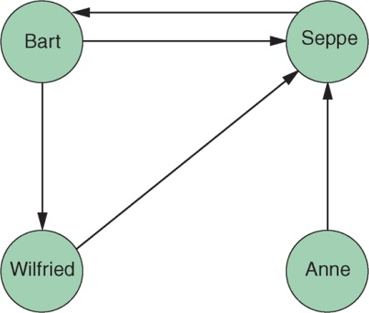
Graph-Based Databases
Graph databases apply graph theory to the storage of information of records
Graphs consist of nodes and edges

Slide 89
Graph-Based Databases
One-to-one, one-to-many, and many-to-many structures can easily be modeled in a graph
Consider the N–M relationship between books and authors
RDBMS needs three tables: Book, Author and Books_Authors
SQL query to return all book titles for books written by a particular author would look like this:
SELECT title
FROM books, authors, books_authors
WHERE author.id = books_authors.author_id
AND books.id = books_authors.book_id AND author.name = "Bart Baesens"

Slide 90
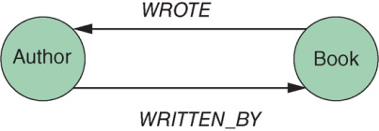
Graph-Based Databases
In a graph database (using Cypher query language from Neo4j)
MATCH (b:Book)<-[:WRITTEN_BY]-(a:Author)
WHERE a.name = "Bart Baesens"
RETURN b.title

Slide 91
Graph-Based Databases
A graph database is a hyper-relational database, in which JOIN tables are replaced by more interesting and semantically meaningful relationships that can be navigated and/or queried using graph traversal based on graph pattern matching.
Applications
Location-based services
Recommender systems
Social media (e.g., Twitter and FlockDB)
Knowledge-based systems

Slide 92
More NoSQL DB Categories
XML databases
OO databases
Database systems to deal with time series and streaming events
Database systems to store and query geospatial data
Database systems such as BayesDB which let users query the probable implication of their data

Slide 93
Acknowledgment This set of slides is mainly adopted from the course materials provided by the textbook: Principles of Database Management

