Slide 1
Accessing Databases and Database APIs

Slide 2
Introduction
Database system architectures
Centralized and Tier Architectures
Database APIs
Database access in the World Wide Web
Appendix
API Summary
More WWW Databases

Slide 3
Database System Architectures

Slide 4
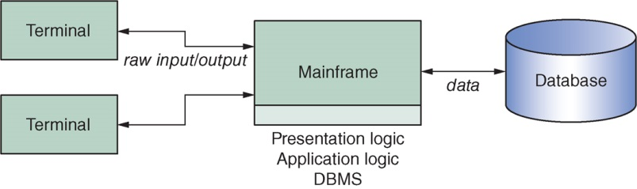
Database System Architectures
Centralized system architecture I (mainframe)
All responsibilities of the DBMSs are handled by one centralized entity (e.g., mainframe database)
Nowadays, this system architecture has become rare, expensive, and difficult to maintain

Slide 5
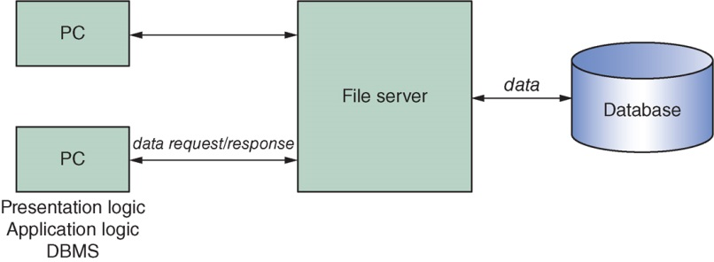
Database System Architectures
Centralized system architecture II (PC)
PCs are employed to execute the presentation logic, application logic, DBMS (as a client)
Still needs a file server to transfer data (very busy network)

Slide 6
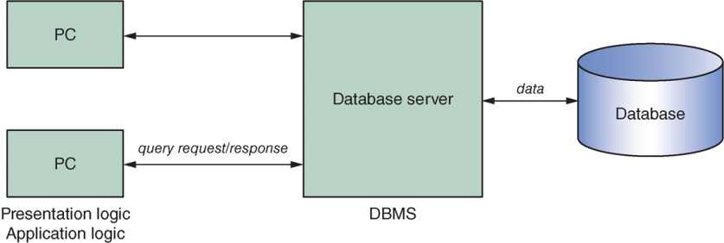
Database System Architectures
Tiered system architectures
Aim to decouple the centralized setup by combining the computing capabilities of powerful central computers with the flexibility of PCs
Multiple variants of this architecture
e.g., two-tier architecture (aka client–server architecture)
fat clients

Slide 7
Database System Architectures
In the fat client variant, the presentation logic and application logic are handled by the client (i.e., the PC)
Common in cases where it makes sense to couple an application’s workflow (e.g., opening of windows, screens, and forms) with its look and feel (i.e., its front-end)
DBMS now fully runs on the database server
In the thin client variant, only the presentation logic is handled by the client
Applications and database commands are both executed on the server(s)
Common when application logic and database logic are tightly coupled or similar (fat server/thin client architecture)

Slide 8
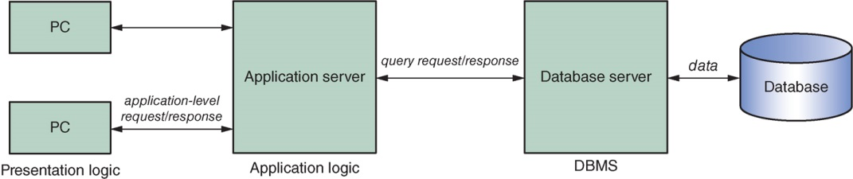
Database System Architectures
Possible to decouple application logic from the DBMS and place this in a separate layer (i.e., application server). Such a setup is referred to as a three-tier architecture
An application server or a database server may consist of multiple physical, distributed machines (Cloud databases)
thin clients

Slide 9
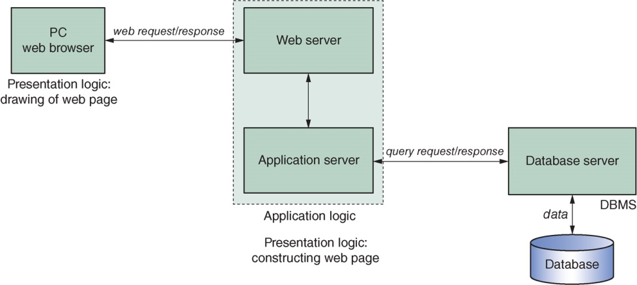
Database System Architectures
For more demanding applications with database connectivity, it can be generalized as a n-tier architecture
Web database connectivity is a typical example

Slide 10
Introduction
Database system architectures
Database APIs
Database access in the World Wide Web
Appendix
API Summary
More WWW Databases

Slide 11
Database APIs

Slide 12
Database APIs
API Basics and Database API Taxonomies
Proprietary vs Universal APIs
Embedded vs Call-level APIs
Early binding vs Late binding
ODBC, OLE DB, ADO.NET, JDBC, SQLJ

Slide 13
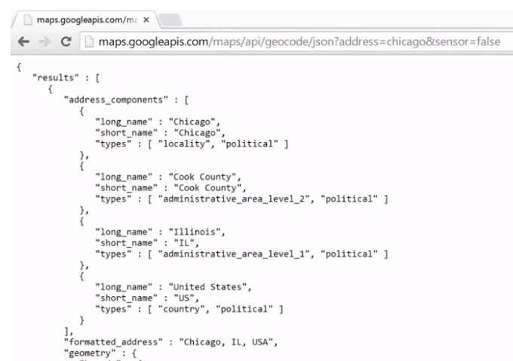
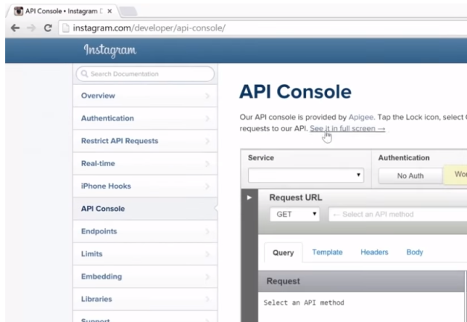
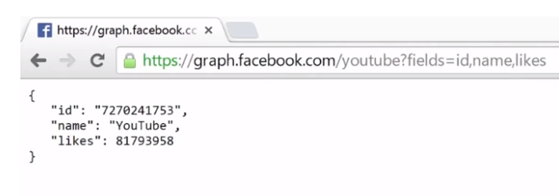
Database APIs
Client applications that wish to utilize the services provided by a DBMS use a specific application programming interface (API) provided by the DBMS
Examples
Of APIs
Google
Instagram
Facebook

Slide 14
Database APIs
The database server receives calls made by the clients and executes the relevant operations before returning the results
In many cases, the client and server interfaces are implemented to work over a computer network (network socket via port)
The main goal of database APIs is to expose an interface through which other parties can utilize the services provided by the DBMS, though the API can also serve additional objectives (e.g., hiding network-related aspects, protecting databases)

Slide 15
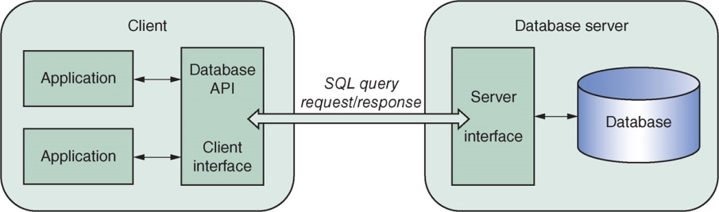
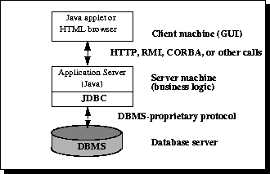
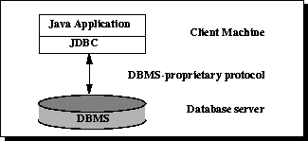
Database APIs
Fat client
Example: JDBC supports two-tier and three-tier architectures
Sources: https://docs.oracle.com/javase/tutorial/jdbc/overview/index.html

Slide 16
Database APIs
API Basics
Proprietary vs Universal APIs
Embedded vs Call-level APIs
Early binding vs Late binding
ODBC, OLE DB, ADO.NET, JDBC, SQLJ

Slide 17
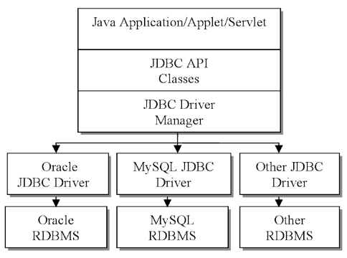
Proprietary versus Universal APIs
Most DBMS vendors provide a proprietary, DBMS-specific API
Disadvantage is that client applications must be aware of the DBMS that will be utilized on the server side
Alternatively, generic, vendor-agnostic universal APIs have been proposed
Allows easily porting of applications to multiple DBMSs
Disadv: Some specific vendor-specific optimization may not be used
Example: JDBC, ODBC, ADO.NET

Slide 18
Database APIs
API Basics
Proprietary vs Universal APIs
Embedded vs Call-level APIs
Early binding vs Late binding
ODBC, OLE DB, ADO.NET, JDBC, SQLJ

Slide 19
Embedded versus Call-level APIs
APIs can be embedded or call-level
An embedded API embeds SQL statements in the host programming language (host language), meaning that SQL statement(s) will be part of the source code of a program
Before the program is compiled, an SQL pre-compiler parses the SQL-related instructions and replaces these with source code instructions native to the host programming language used
Converted source code is then sent to the actual compiler
#sql { INSERT
INTO person
VALUES ('999999999', 'Doug Barry');
};
Example
of SQLJ
SQLJ Embedded SQL in Java: http://www.service-architecture.com/database/articles/sqlj.html

Slide 20
Embedded versus Call-level APIs
Advantages of embedded APIs
Pre-compiler can perform specific syntax checks
Pre-compiler can also perform an early binding step which helps to generate an efficient query plan before the program is run, hence improving performance (see later)
Disadvantages of embedded APIs
Harder to maintain mixed code
Embedded database APIs are not very popular nowadays
Example: SQLJ is still used

Slide 21
Embedded versus Call-level APIs
Call-level APIs work by passing SQL instructions to the DBMS by means of direct calls to a series of procedures, functions, or methods as provided by the API to perform the necessary actions (e.g., setting up a database connection, sending queries, and iterating over the query result)
Example: ODBC

Slide 22
Database APIs
API Basics
Proprietary vs Universal APIs
Embedded vs Call-level APIs
Early binding vs Late binding
ODBC, OLE DB, ADO.NET, JDBC, SQLJ

Slide 23
Early Binding versus Late Binding
SQL binding refers to the translation of SQL code to a lower-level representation that can be executed by the DBMS, after performing tasks such as validation of table and field names, checking whether the user or client has sufficient access rights, and generating a query plan to access the physical data in the most performant way possible
Early versus late binding then refers to the actual moment when this binding step is performed

Slide 24
Early Binding versus Late Binding
Early binding is possible only in the case that a pre-compiler is used, which will then perform this binding step, and can hence only be applied when an embedded API is used
Beneficial in terms of performance, as the binding step happens before the program is executed
Binding only needs to be performed once
Pre-compiler can perform specific syntax checks such that errors are detected before the actual execution of the code
Exception: stored procedures (see later)

Slide 25
Early Binding versus Late Binding
Late binding performs the binding of SQL-statements at runtime
Additional flexibility is offered: SQL statements can be generated at runtime ( dynamic SQL)
Drawback is that syntax errors or authorization issues will remain hidden until the program is executed
Testing the application can be harder
Less efficient for queries that must be executed multiple times (can be tackled using parameterized prepared SQL statements)

Slide 26
Early Binding versus Late Binding
For embedded APIs, the involvement of a pre-compiler implies early binding
For call-level APIs, late-binding will be used
But it is still possible even when using call-level APIs to pre-compile SQL statements and call these at runtime, by defining such statements as stored procedures in the DBMS
CREATE PROCEDURE procedure_demo
AS
sql_statements
GO;
Example
of Stored
Procedure
EXEC procedure_demo;

Slide 27
Early Binding versus Late Binding
 | Embedded APIs | Call-level APIs
Early binding (“static” SQL) | Possible as a pre-compiler is used Performance benefit, especially when the same query must be executed many times Pre-compiler detects errors before the actual execution of the code SQL queries must be known upfront | Only possible through stored procedures
Late binding (“dynamic” SQL) | Not used with embedded APIs | Necessary as no pre-compiler is used Flexibility benefit: SQL statements can be dynamically generated and used during execution Errors are only detected during program execution Possibility to use prepared SQL statements to perform binding once during execution

Slide 28
Database APIs
API Basics
Proprietary vs Universal APIs
Embedded vs Call-level APIs
Early binding vs Late binding
ODBC, OLE DB, ADO.NET, JDBC, SQLJ

Slide 29
Universal Database APIs
Many different universal API standards have been proposed over the years, which differ in terms of
embedded or call-level
programming language(s)
Functionalities
Appendix: Comparison box showing ODBC, JDBC, SQLJ, LIQT, OLE DB and ADO, ADO.NET, EJB, JDA, JDO

Slide 30
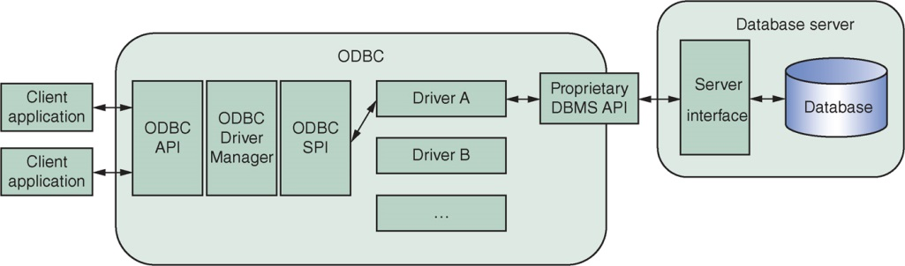
ODBC
ODBC stands for Open DataBase Connectivity
An open standard, developed by Microsoft, with the aim to offer applications a common, uniform interface to various DBMSs

Slide 31
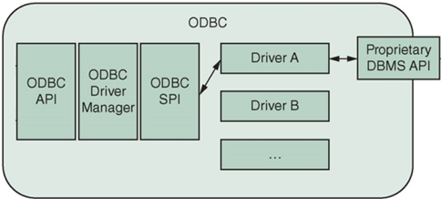
ODBC
ODBC consists of four main components
ODBC API, which is the universal interface through which client applications will interact with a DBMS (a call-level API)
ODBC Driver Manager, which is responsible for selecting the correct Database Driver to communicate with a DBMS
Database Driver, which is a collection of routines that contain the actual code to communicate with a DBMS
Service Provider Interface (SPI), a separate interface implemented by the DBMS vendor by which the Driver Manager interacts with various drivers

Slide 32
ODBC
ODBC allows applications to be easily ported between DBMSs
Disadvantages
ODBC is native to Microsoft-based platforms, so ODBC remains mainly popular on Windows
ODBC is based on the C language, so it does not utilize the programmer-friendly object-oriented paradigm
ODBC middleware introduces an extra layer of indirection and therefore some extra performance lag

Slide 33
OLE DB and ADO
OLE DB (Object Linking and Embedding for DataBases) was a follow-up specification to ODBC to allow uniform access to a variety of data sources using Microsoft’s Component Object Model (COM)
OLE DB also supports object databases, spreadsheets, and other data sources
Functionality such as querying can be provided by the data provider (e.g., an RDBMS), but also by other components
As such, OLE DB represents Microsoft’s attempt to move toward a “universal data access” approach

Slide 34
OLE DB and ADO
OLE DB can be combined with ActiveX Data Objects (ADOs), which provides a richer, more “programmer-friendly” programming model on top of OLE DB
Dim conn As ADODB.Connection
Dim recordSet As ADODB.Recordset
Set conn = New ADODB.Connection
conn.Open(“my_database”)
Set qry = “select nr, name from suppliers where status < 30”
Set recordSet = cnn.Execute(qry)
Do While Not recordSet.EOF
MsgBox(recordSet.Fields(0).Name & “ = “ & recordSet.Fields(0).Value & vbCrLf & _ recordSet.Fields(1).Name & “ = “ & recordSet.Fields(1).Value)
recordSet.MoveNext
Loop
recordSet.Close
conn.Close
Example
Set up a connection to the DB
Perform a query
Loop over the result set
Close the connection

Slide 35
ADO.NET
OLE DB and ADO were merged into ADO.NET (based on the MS .NET framework)
Like OLE DB, ADO.NET breaks down all database-related access features into a set of components.
To access data, ADO.NET offers a series of data providers, which are broken down into a series of objects handling creation of database connections, sending queries, and reading results
C# code fragment in MS shows the Connection, Command, and DataReader objects in action using the .NET Framework Data Provider for SQL server (next slide)

Slide 36
ADO.NET
SqlConnection: Set up a connection to the DB
String connectionString = "Data Source=(local);Initial Catalog=example";
SqlConnection conn = new SqlConnection(connectionString)
conn.Open();
String query1 = "select avg(num_pages) from books";
String query2 = "select title, author from books where num_pages > 30";
SqlCommand command1 = conn.CreateCommand();
SqlCommand command2 = conn.CreateCommand();
command1.CommandText = query1;
command2.CommandText = query2;
int average_pages = command1.ExecuteScalar();
SqlDataReader dataReader = command2.ExecuteReader();
String title;
String author;
while (dataReader.Read()) {
title = dataReader.GetString(0);
author = dataReader.GetString(1);
Console.Writeln(title + " by " + author);
}
dataReader.Close();
conn.Close();
SqlCommand: Set the two queries
SqlReader: Perform the two queries
Example
Loop over the result set

Slide 37
JDBC
Java DataBase Connectivity (JDBC) offers a call-level database API
Inspired by ODBC with an important difference being that JDBC was developed to be used in Java
Many benefits, such as high portability and the ability to program in an object-oriented manner
Database connections, drivers, queries, and results are thus all expressed as objects, based on uniform interfaces and hence exposing a uniform set of methods, no matter which DBMS is utilized

Slide 38
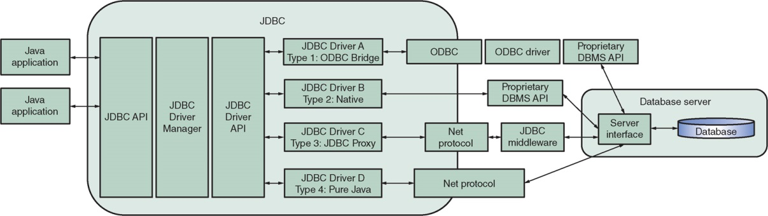
JDBC

Slide 39
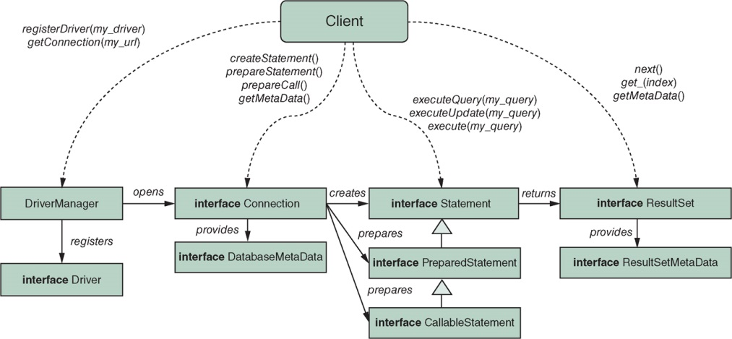
JDBC
JDBC exposes a series of object interfaces through which drivers, connections, SQL statements, and results are expressed

Slide 40
JDBC
DriverManager is a singleton object which acts as the basic service to manage JDBC drivers
DBMS driver must be registered with the DriverManager, using the registerDriver method
Database connections can be created using one of the registered drivers by means of the getConnection method
This method takes a string as a parameter, representing a connection URL to indicate which DBMS one wishes to connect to, which should be of the form “jdbc:subprotocol:subname”, e.g., “jdbc:sqlite:my_database”
Can also take optional username and password parameters as follows:
DriverManager.getConnection("jdbc:oracle:thin:@dbsvr1.cse.ust.hk:1521/comp3311.cse.ust.hk", "comp3311stu999", "password");

Slide 41
JDBC
DriverManager.registerDriver(new org.sqlite.JDBC());
String dbURL = "jdbc:sqlite:my_database";
Connection conn = DriverManager.getConnection(dbURL);
if (conn != null) {
System.out.println("Connected to the database");
DatabaseMetaData dm = conn.getMetaData();
System.out.println("Driver name: " + dm.getDriverName);
conn.close();
}
Example

Slide 42
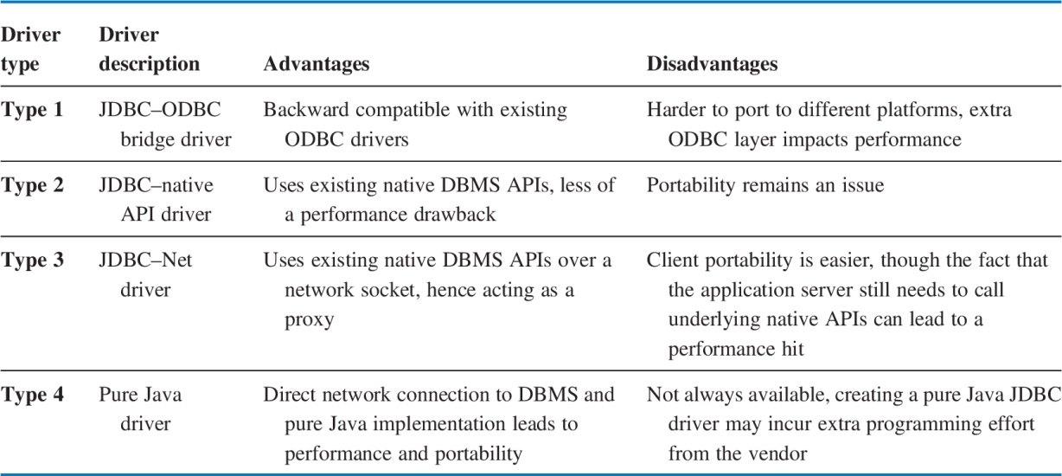
JDBC
Many drivers will also register themselves automatically (version 4 of the JDBC standard need not to register drivers)
The driver objects registered with the DriverManager implement the Driver interface and enable the communication between the DriverManager and the DBMS
To implement the interface, database vendors can decide four driver types:

Slide 43
SQLJ
SQLJ - Java’s embedded, static SQL API, was developed after JDBC and allows embedding SQL statements directly into Java programs
DriverManager.registerDriver(new oracle.jdbc.driver.OracleDriver());
Connection conn = DriverManager.getConnection(dbUrl);
DefaultContext.setDefaultContext(new DefaultContext(conn));
// Define an SQLJ iterator
#sql iterator BookIterator(String, String, int);
// Perform query and fetch results
BookIterator books;
int min_pages = 100;
#sql books = {select title, author, num_pages from books where num_pages >= :min_pages };
String title; String author; int num_pages;
#sql {fetch :books into :title, :author, :num_pages};
while (!books.endFetch()) {
System.out.println(title + " by " + author + ": " + num_pages);
#sql {fetch :books into :title, :author, :num_pages};
}
conn.close();
Register the driver and set up a connection to DB
Define an SQL Iterator with 3 parameters
Define an SQL Iterator with 3 parameters
Fetch results into three host variables
Loop over the result set

Slide 44
SQLJ
Queries are no longer expressed as strings but directly embedded in the Java source code
Pre-compiler converts these statements into native Java code (by converting them, for instance, to JDBC instructions)
Pre-compiler also performs additional checks, such as checking whether our SQL statements are correctly spelled, all table fields are known, and more
Such compile-time checking cannot be performed when using early-bound parameters (recall JDBC example). So errors will then be thrown during program execution
SQLJ has not experienced the level of adoption compared to JDBC due to
lack of support for dynamic SQL
extra overhead for programmers

Slide 45
Introduction
Database system architectures
Database APIs
Database access in the World Wide Web
Appendix
API Summary
More WWW Databases

Slide 46
Database Access in the World Wide Web

Slide 47
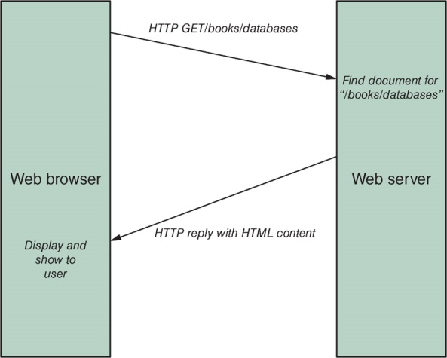
Database Access in the World Wide Web
Basics: a web browser will send HTTP (HyperText Transfer Protocol) requests to a web server, which will reply with the content (static or dynamic) written in HTML corresponding with the URL (the Uniform Resource Locator) the client requested

Slide 48
Database Access in the World Wide Web
To allow for basic markup and layout aspects, this content is oftentimes formatted using HTML (HyperText Markup Language)
Other content types can be requested and retrieved: XML, JSON, or multimedia (e.g. jpeg, mp4)
Also need to access dynamic documents (most updated data) and visualize them in a web browser
Web server constructs HTML document “on-the-fly” based on a database query → database web connectivity!

Slide 49
Database Access in the World Wide Web
The rising popularity of JavaScript and web-based APIs and protocols have caused many database vendors to offer Web querying APIs to outside clients, such as REST (REpresentational State Transfer) and SOAP (Simple Object Access Protocol)
REST has become especially popular in recent NoSQL databases (which then acts as the client directly connecting to the database server)
As an example, a JavaScript fragment embedded inside a web application can perform a synchronous HTTP call to the following endpoint (e.g., using Oracle’s NoSQL data services):
http://database_server:8080/book_database/books/

Slide 50
Database Access in the World Wide Web
The following answer is returned by the server, formatted as JSON, as a standard HTTP reply:
HTTP/1.1 200 OK
Content-Type: application/json
Transfer-Encoding: chunked
{
"items":[
{"id":7369,"title":"Book One"}, {"id":7499,"title":"My Second Book"}, {"id":7521,"title":"Third Book"}
],
"hasMore":true, "limit":3, "offset":0, "count":3,
"links":[
{"rel":"self", "href":" http://database_server:8080/book_database/books/"},
{"rel":"describedby", "href":"http://database_server:8080/metadata-catalog/book_database/books/"},
{"rel":"first", "href":"http://database_server:8080/book_database/books/"},
{"rel":"next", "href":"http://database_server:8080/book_database/books/?offset=3"}
]
}

Slide 51
Database Access in the World Wide Web
REST web services can expose basic querying capabilities – in some cases also supporting filtering, e.g., by means of specifying additional URL parameters: http://database_server:8080/book_database/books/?filter={'id':{'gt':7400}}
Some DBMS systems also support SQL queries on the server side, which can then be called using a REST call, similar to stored procedures http://database_server:8080/book_database/query/my_stored_query?param1=100

Slide 52
Database Access in the World Wide Web
Although REST and other web-service-based technologies have become popular in recent years, but many of the functionalities provided were already implemented before in other universal APIs such as JDBC or ADO.NET
The key selling point of REST is its relative simplicity (as it is built on the HTTP protocol), which allows it to be called directly from a web browser (e.g., using JavaScript as a client-side scripting language)
Nevertheless, the rising popularity of web-based applications, together with the interest in highly scalable NoSQL databases, is causing DBMS vendors to adapt their products: outdated protocols and APIs are replaced by web-based ones, and database users are putting more emphasis on scalability, speed, and schema flexibility

Slide 53
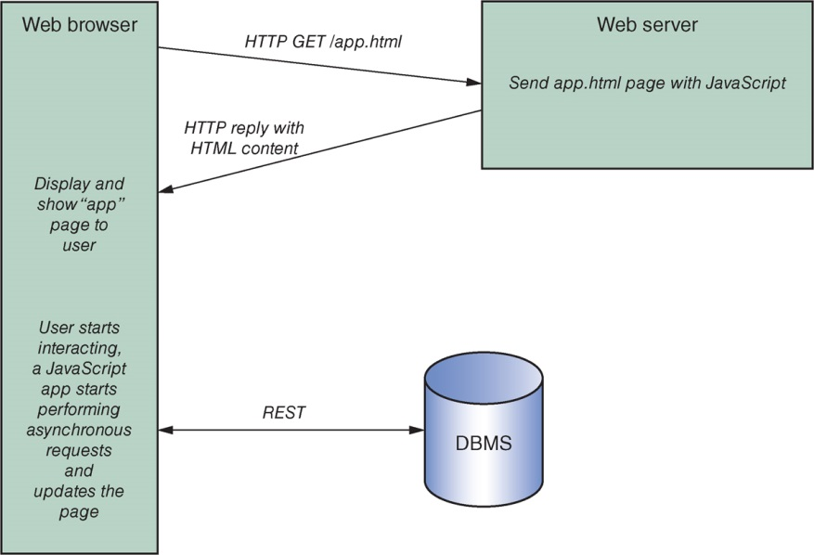
Database Access in the World Wide Web

Slide 54
Conclusion
Database system architectures
Centralized and Tiered Systems
Database APIs
Universal vs Proprietary, Embedded vs Call-level, Early Binding vs Late Binding
ODBC, OLE DB, .NET, JDBC, SQLJ
Database access in the World Wide Web
HTTP, Static and dynamic contents, interactivity
CGI, PHP, REST, SOAP
Appendix
API Summary Box
More Client-sided WWW Connectivity : AJAX, Applet

Slide 55
Appendix

Slide 56
Database API Summary
Technology | Embedded or call-level | Early or late binding | Objects in host programming language represent | Data sources | Other
ODBC | Call-level | Late binding, though prepared SQL statements possible as well as calling stored procedures | A result set with rows of fields | Mainly relational databases, though other structured tabular sources possible as well | Microsoft-based technology, not object-oriented, mostly outdated

Slide 57
Database API Summary
Technology | Embedded or call-level | Early or late binding | Objects in host programming language represent | Data sources | Other
JDBC | Call-level | Late binding, though prepared SQL statements possible as well as calling stored procedures | A result set with rows of fields | Mainly relational databases, though other structured tabular sources possible as well | Java-based technology, portable, still in wide use

Slide 58
Database API Summary
Technology | Embedded or call-level | Early or late binding | Objects in host programming language represent | Data sources | Other
SQLJ | Embedded | Early binding | A result set with rows of fields | Relational databases supporting SQL | Java-based technology, uses a pre-compiler, mostly outdated

Slide 59
Database API Summary
Technology | Embedded or call-level | Early or late binding | Objects in host programming language represent | Data sources | Other
Language-integrated query technologies | Uses an underlying call-level API | Uses an underlying late-binding API | A result set with rows of fields, sometimes converted to a plain collection of objects representing entities | Relational databases supporting SQL or other data sources | Examples: jOOQ and LINQ, works together with another API to convert expressions to SQL

Slide 60
Database API Summary
Technology | Embedded or call-level | Early or late binding | Objects in host programming language represent | Data sources | Other
OLE DB and ADO | Call-level | Late binding, though prepared SQL statements possible as well as calling stored procedures | A result set with rows of fields | Mainly relational databases, though other structured tabular sources possible as well | Microsoft-based technology, backwards compatible with ODBC, mostly outdated

Slide 61
Database API Summary
Technology | Embedded or call-level | Early or late binding | Objects in host programming language represent | Data sources | Other
ADO.NET | Call-level | Late binding, though prepared SQL statements possible as well as calling stored procedures | A result set with rows of fields provided by a DataReader, or a DataSet: a collection of tables, rows, and fields, retrieved and stored by DataAdapters | Various data sources | Microsoft-based technology, backwards compatible with ODBC and OLE DB

Slide 62
Database API Summary
Technology | Embedded or call-level | Early or late binding | Objects in host programming language represent | Data sources | Other
Enterprise JavaBeans (EJB 2.0) | Uses an underlying call-level API | Uses an underlying late-binding API | Plain Java entity Beans as the main representation | Mainly relational databases, though other structured tabular sources possible as well | Java-based technology, works together with another API to convert expressions to SQL

Slide 63
Database API Summary
Technology | Embedded or call-level | Early or late binding | Objects in host programming language represent | Data sources | Other
Java Persistence API (JDA in EJB 3.0) | Uses an underlying call-level API | Uses an underlying late-binding API | Plain Java objects as the main representation | Mainly relational databases, though other structured tabular sources possible as well | Java-based technology, works together with another API to convert expressions to SQL

Slide 64
Database API Summary
Technology | Embedded or call-level | Early or late binding | Objects in host programming language represent | Data sources | Other
Java Database Objects (JDO) | Uses an underlying call-level API | Uses an underlying late-binding API | Plain Java objects as the main representation | Various data sources | Java-based technology

Slide 65
Database API Summary
Technology | Embedded or call-level | Early or late binding | Objects in host programming language represent | Data sources | Other
ORM APIs (ActiveRecord, Entity Framework, SQL Alchemy) | Uses an underlying call-level API | Uses an underlying late-binding API | Plain objects defined in the programming language as the main representation | Relational databases | Various implementations available for each programming language

Slide 66
More Database Access in the WWW
Newer CGI-derived technologies have been proposed, as well as web servers which directly integrate the possibility to deliver dynamic web pages, without having to resort to external programs: JSP (Java Server Pages), ASP (Active Server Pages), and ASP.NET
In many cases, the web server then actually becomes the “application server,” as the web server is now the central entity handling business logic and business entity management, with HTTP as the main language spoken between the client and the server
Client will be a web browser in most cases, though HTTP is also rapidly replacing older remoting protocols such as RMI, CORBA, and DCOM to become the lingua franca of the web

Slide 67
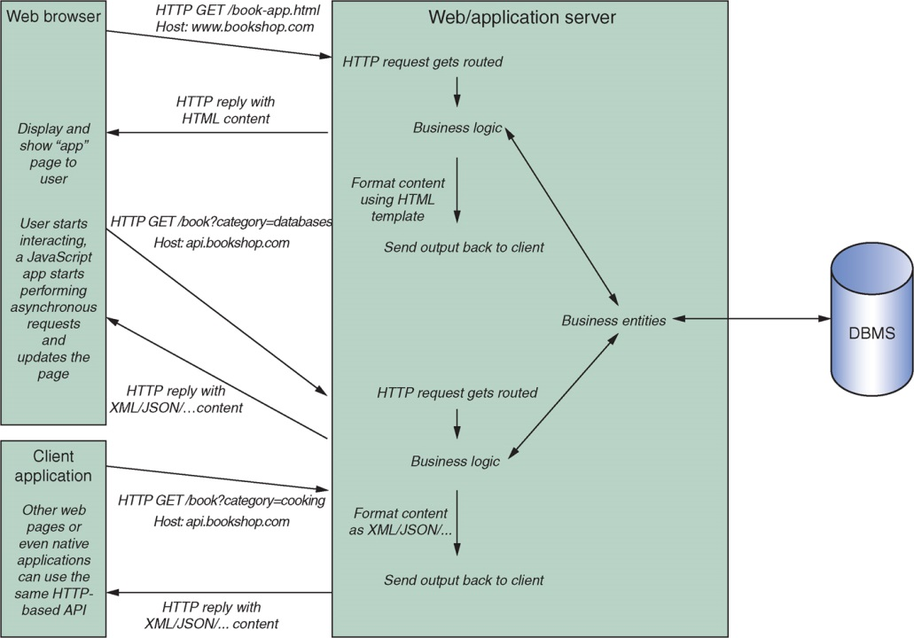
More Database Access in the WWW

Slide 68
More Database Access in the WWW
Both HTTP and HTML are limited regarding the user interfaces. More dynamic, interactive elements in the web browser quickly arose: Netscape and Microsoft proposing client-side scripting languages such as JavaScript, VBScript, and Jscript. These scripts are embedded inside HTML docs, interpreted, and run by the browser
Adoption of client-side scripting languages was initially hampered by the different languages available, which all received different levels of support from different browser vendors. Functionality of client-side scripting languages was still bound to the markup and layout capabilities of HTML
Other types of client-side programs appeared, which inject themselves into the web browser and then take over complete functionality, e.g., Java’s Applet technology, Microsoft’s ActiveX controls, Windows Forms, and Adobe’s Flash

Slide 69
More Database Access in the WWW
In recent years, client-side plugins such as Applets, Flash, and ActiveX have mostly been pushed aside
Require the installation of a separate plugin, which might not be available for every browser or platform
A number of security issues arose
Don’t work well on mobile platforms
Standards such as HTML and CSS (Cascading Style Sheets), together with JavaScript, have evolved to the point where all major browser vendors support a solid, common stack, causing JavaScript to re-arise as the most popular choice

Slide 70
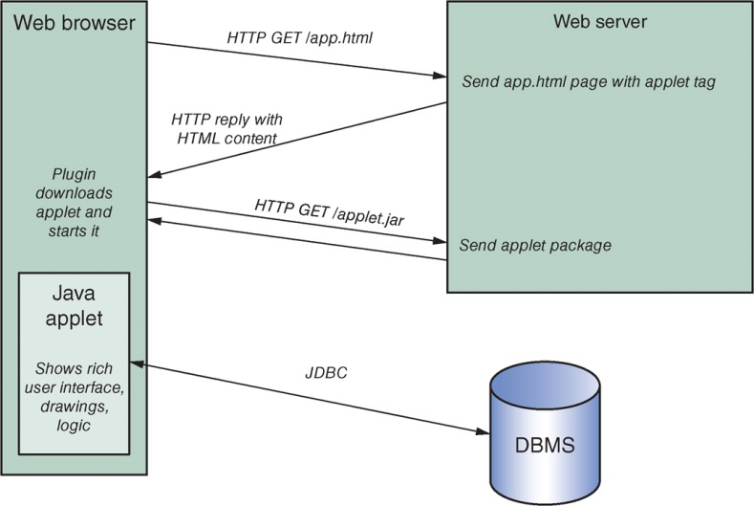
More Database Access in the WWW

Slide 71
More Database Access in the WWW
The main reason for the re-adoption of JavaScript was the rising usage of AJAX-based (Asynchronous JavaScript and XML) development techniques
AJAX started as an ActiveX component, developed by Microsoft, but implemented by other vendors as the “XMLHttpRequest” JavaScript object, originally created to perform asynchronous calls to URLs in the background with the expectation to receive back XML data
First used by Gmail in 2004 and Google Maps in 2005 to dynamically fetch updates from a web server to update parts of a web page without having to perform a complete new request and redraw the whole page
JavaScript libraries offer a set of functionalities that would work on all browsers, including the ability to perform asynchronous, background HTTP requests
Combined with HTML and CSS has allowed for the development of true web applications which work, look, and feel the same as native applications, and has become the development stack of choice for all modern web projects

Slide 72
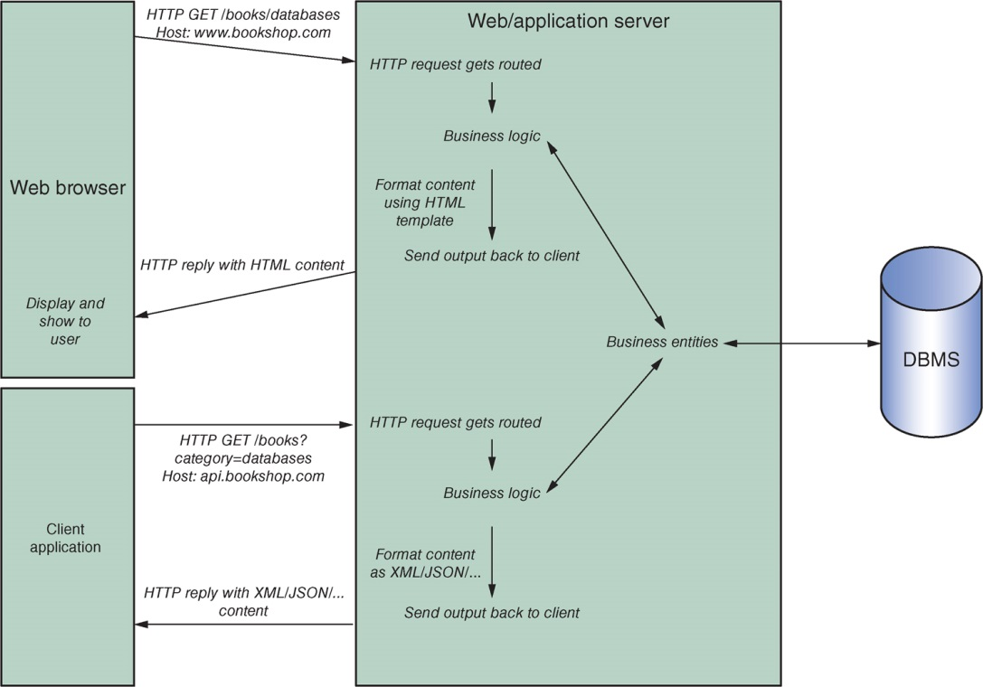
More Database Access in the WWW

Slide 73
JDBC
Type-1 drivers (JDBC-ODBC bridge drivers) do not communicate with a DBMS directly, but instead translate JDBC calls to corresponding ODBC calls
Type-2 drivers (JDBC-native API drivers) are written in Java, but will communicate to a DBMS using its native database API
Type-3 drivers (JDBC-Net drivers) are written in Java. The JDBC client will use standard networking sockets to communicate with an application server, which converts the calls into a native database API call or utilizes a different JDBC type-1, 2, or 4 driver on its end
Type-4 drivers are also written in Java and use networking functionality, though here a direct connection is made with the database server. The driver thus communicates directly with the DBMS over the network

Slide 74
JDBC
Opening a connection returns a Connection object, representing a session to a specific database
SQL statements will be executed and results returned within the context of such a connection
The createStatement method can be used to create SQL statements, with which an SQL query can be executed. The prepareStatement and prepareCall methods can be used to create objects representing prepared statements and stored procedure calls respectively
A Statement object represents an SQL instruction. For a SELECT query, the executeQuery method should be invoked, which returns a ResultSet representing the returned data. This method takes one parameter, namely the SQL query itself, passed as a string
Statement selectStatement = conn.createStatement("select * from books");
ResultSet selectResult = selectStatement.executeQuery();
Example

Slide 75
JDBC
A ResultSet object contains the result of a SELECT query that was executed by a Statement object
Because SQL is a set-oriented language, the query result (the ResultSet object) will generally comprise multiple tuples (set-oriented)
Host languages such as Java are essentially record-oriented
Cannot handle more than one record/tuple at a time
To overcome this impedance mismatch, JDBC (like ODBC) uses a cursor mechanism in order to loop through result sets
A cursor is a programmatic control structure that enables one-by-one traversal over the records in a query result set
while (selectResult.next()) {
String bookTitle = selectResult.getString("title");// or: .getString(1);
int bookPages = selectResult.getInt("num_pages"); // or: .getInt(2);
System.out.println(bookTitle + “ has " + bookPages + " pages");
}
Example

Slide 76
JDBC
For INSERT, UPDATE, or DELETE queries, the executeUpdate method should be called for DDL queries.
Return value is an integer representing the number of rows affected
The generic execute method returns a Boolean value (true for a result set object returned → SQL queries) representing whether the just-executed query was a SELECT query, based on which the program can decide to call the getResultSet method
String deleteQuery = "delete from books where num_pages <= 30";
Statement deleteStatement = conn.createStatement();
int deletedRows = deleteStatement.executeUpdate(deleteQuery);
System.out.println(deletedRows + " books were deleted");
Example

Slide 77
JDBC
The PreparedStatement interface extends Statement with functionalities to bind a query once and then execute it multiple times in an efficient manner
Prepared statements also provide support to pass query parameters, which should then be instantiated using setter methods such as setInt, setString, … (parameterized query)
Use question marks (“?”) inside the SQL query to indicate that this represents a parameter value that will be bound later
Example:
String selectQuery = "select * from books where num_pages < ? and num_pages > ?";

Slide 78
JDBC
String selectQuery = "select * from books where num_pages < ? and num_pages > ?";
Statement preparedSelectStatement = conn.prepareStatement(selectQuery);
int min_pages = 50;
int max_pages = 200;
// Set the value to the first parameter (1):
preparedSelectStatement.setInt(1, min_pages);
// Set the value to the second parameter (2):
preparedSelectStatement.setInt(2, max_pages);
ResultSet resultSet1 = preparedSelectStatement.executeQuery();
// Execute the same query a second time with different parameter values:
preparedSelectStatement.setInt(1, 10);
preparedSelectStatement.setInt(2, 20);
ResultSet resultSet2 = preparedSelectStatement.executeQuery();
Bind once, execute many times

Slide 79
JDBC
CallableStatement extends PreparedStatement and offers support to execute stored procedures
JDBC supports updatable result sets, where rows in a result set can be updated on the fly
Not supported by all JDBC drivers
More recent versions also add the RowSet interface, which extends the ResultSet interface. RowSet objects can act as a wrapper around a normal ResultSet object, adding support for scrollable and updateable cursors even if the underlying DBMS driver does not support this
JDBC remains widely popular!

Slide 80
Acknowledgment This set of slides is mainly adopted from the course materials provided by the textbook: Principles of Database Management

