Slide 1
Comp 3311 Database Management Systems
2. Entity Relationship (ER) Model
Exercise 2

Slide 2
Question 1
Check how much you understand the ERD examples.
Review the notation we introduced in the course.
Explain the connection of all entities.

Slide 3
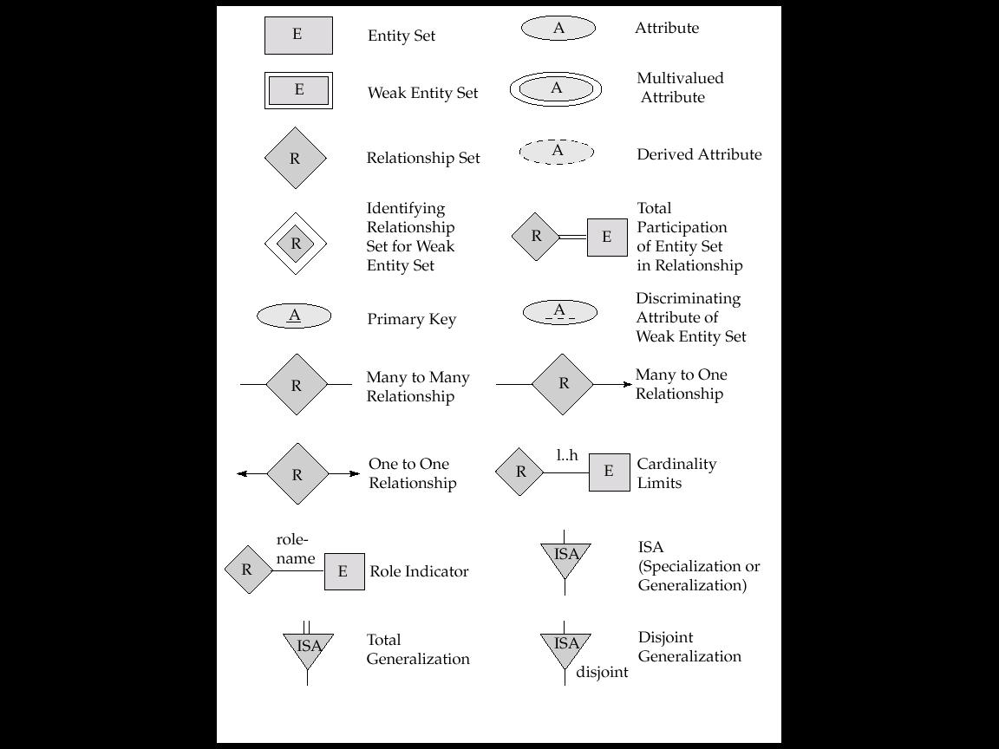
Notation in ER Model

Slide 4
Notation in ER Model

Slide 5
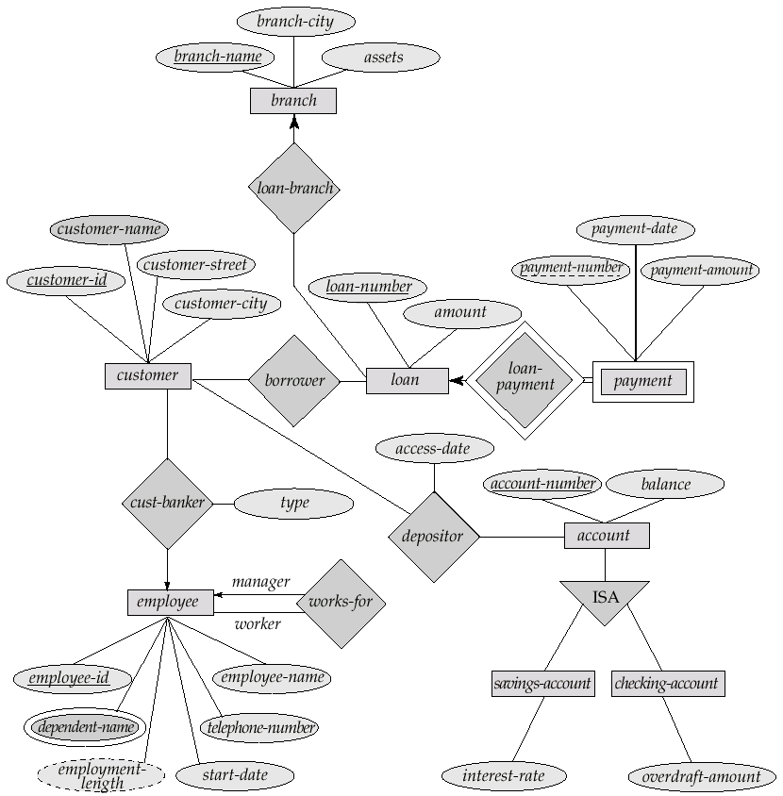
ERD for a Banking Enterprise

Slide 6
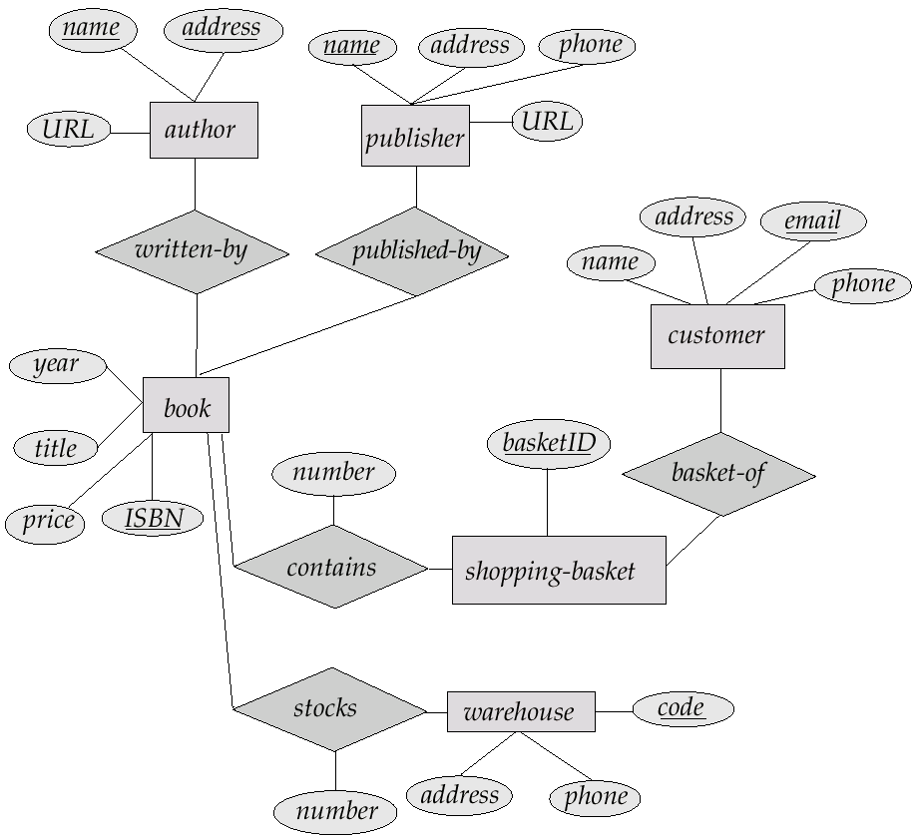
ERD for a Publisher Enterprise

Slide 7
ERD for a Company Database
Number
Fname
Minit
Lname
Locations
WORKS_FOR
Name
Address
Name
Sex
Salary
Ssn
Number Of Employees
DEPARTMENT
EMPLOYEE
Startdate
Bdate
MANAGES
CONTROLS
supervisor
supervisee
SUPERVISION
Hours
WORKS_ON
PROJECT
DEPENDENTS_OF
Name
Location
Number
DEPENDENT
Name
Sex
Birthdate
Relationship
Can you translate it back into English?

Slide 8
Question 2
We want to create a simple course database for HKUST to record information about students, courses and course teaching teams.
For each student we store the student id and name.
For each course we store a unique course id, name and none or many prerequisites.
For each offering of a course we store the section, semester and year.
For each staff assigned to a course offering's teaching team we store the hkid, name and office number.
Each student must enroll in one or more course offerings.
Each course offering can enroll none or many students.
For each course offering that a student takes we store the grade.
Each course offering’s teaching team has one or more staff, who is either an instructor or a TA (but not both).
For each instructor we store their academic title (i.e., professor, lecturer, etc.).
Construct an E-R diagram for the HKUST course database.
Identify all keys of entities and constraints on relationships.

Slide 9
ENTITY TYPES
For each student we store the student id and name.
For each course we store a unique course id, name and prerequisites.
For each offering of a course we store the section, semester and year.
For each staff assigned to a course offering's teaching team we store the hkid, name and office number.
For each course offering that a student takes we store the grade.
Each course offering’s teaching team has one or more staff, who is either an instructor or a T
For each instructor we store their academic title (i.e., professor, lecturer, etc.).
student
course
offering
staff
instructor
TA
Student
Course
Offering
Staff
Instructor
TA

Slide 10
ATTRIBUTES OF ENTITY TYPES
For each student we store the student id and name.
For each course we store a unique course id, name and prerequisites.
For each offering of a course we store the section, semester and year.
For each staff assigned to a course offering's teaching team we store the hkid, name and office number.
For each course offering that a student takes we store the grade.
Each course offering’s teaching team has one or more staff, who is either an instructor or a TA.
For each instructor we store their academic title (i.e., professor, lecturer, etc.)
student id
name
course id
name
section
semester
year
hkid
name
office number
title
student_id
name
section
semester
year
title
course_id
name
hkid
name
office#
Student
Offering
Instructor
Course
Staff
TA

Slide 11
GENERALIZATION
Each course offering’s teaching team has one or more staff, who is either an instructor or a TA (but not both).
hkid
name
office#
Staff
title
disjoint
Instructor
TA
What should be the generalization?
What should be the completeness constraint?
What should be the disjointness constraint?
→ Staff superclass; Instructor, TA subclasses
→ total
→ disjoint

Slide 12
RELATIONSHIP TYPES
For each course we store a unique course id, name and none or many prerequisites.
course_id
name
course
?
Course
Has_
prerequisite
?
?
prerequisite
→ Course related to Course (reflexive)
What should be related?
What should be the cardinality constraints?
What should be the participation constraints?
Anything else?
→ N to M
→ partial
→ Yes, add role names

Slide 13
RELATIONSHIP TYPES
For each offering of a course we store the section, semester and year.
course_id
name
section
section
semester
semester
year
year
Course
?
Has
?
Has
discriminator (i.e., unique for a given course)
Offering
Offering
What should be related?
What kind of entity is Offering?
Is there a discriminator for Offering?
What should be the cardinality constraint for Offering?
What should be the participation constraint for Offering?
What about for Course?
Anything else?
→ Course related to Offering
→ weak entity dependent on Course
→ Yes — section, semester, year
→ 1 to N
→ total
→ unknown (leave unspecified)
→ No

Slide 14
RELATIONSHIP TYPES
For each course that a student takes we store the grade.
grade
student_id
name
grade
section
semester
year
?
?
Enrolls_in
Student
Offering
What should be related?
What should be the participation constraint for Student?
Anything else?
Does the participation constraint for Student make sense?
→ Student related to Offering
→ total
→ add grade attribute
Where?
to Enrolls_in relationship

Slide 15
RELATIONSHIP TYPES
Each course offering’s teaching team has one or more staff, who is either an instructor or a TA
one or more
hkid
name
office#
section
semester
year
Staff
?
?
Assigned_to
?
Offering
What should be related?
What should be the cardinality constraint for Offering?
What should be the participation constraint for Offering?
What about for Staff?
Does the participation constraint for Offering make sense?
→ Staff related to Offering
→ M to N
→ total
→ unknown (leave unspecified)

Slide 16
HKUST COURSE DATABASE: E-R DIAGRAM
course_id
name
course
Course
Has_
prerequisite
prerequisite
Has
hkid
name
office#
section
Staff
Assigned_to
Offering
semester
year
title
Disjoint
grade
Enrolls_in
Instructor
TA
Student
student_id
name

Slide 17
Question 3: BUS COMPANY
A bus company wants to keep track of its bus routes and schedules.
Each bus route has a unique route number, a departure station and a destination station.
For each bus route, there is a schedule, which records the departure times of buses.
For each departure time of each route, a driver and a bus can be assigned; however, information about the driver or the bus may sometimes be missing.
A driver has a unique employee id, a name and a phone number.
A bus is identified by its license number and has a maximum seating capacity.
Construct an E-R diagram for the bus company.
Identify all keys of entities and constraints on relationships.

Slide 18
ENTITY TYPES
A bus company wants to keep track of its bus routes and schedules.
Each bus route has a unique route number, a departure station and a destination station.
For each bus route, there is a schedule, which records the departure times of buses.
For each departure time of each route, a driver and a bus can be assigned; however, information about the driver or the bus may sometimes be missing.
A driver has a unique employee id, a name and a phone number.
A bus is identified by its license number and has a maximum seating capacity.
route
schedule
driver
bus
Route
Schedule
Driver
Bus

Slide 19
ATTRIBUTES OF ENTITIES
Each bus route has a unique route number, a departure station and a destination station.
For each bus route, there is a schedule, which records the departure times of buses.
A driver has a unique employee id, a name and a phone number.
A bus is identified by its license number and has a maximum seating capacity.
route#
departure_station
destination_station
departure_time
Route
Schedule
emp_id
name
phone#
license#
max_seating_capacity
Driver
Bus

Slide 20
RELATIONSHIP TYPES: ROUTE, SCHEDULE
Each bus route has a unique route number, a departure station and a destination station.
Some bus routes have schedules, which record the departure times of buses.
discriminator (i.e., unique for a given route)
route#
departure_station
destination_station
departure_time
departure_time
?
?
?
1
Has
N
Route
Has
Schedule
Schedule
What type of entity is Schedule?
Is there a discriminator for Schedule?
What should be the cardinality constraint for Schedule?
What should be the participation constraint for Schedule?
What about for Route?
→ weak entity dependent on Route
→ Yes — departure_time
→ 1 to N
→ total
→ cardinality N; participation unknown

Slide 21
RELATIONSHIP TYPES: DRIVER, BUS
For each departure time of each route, a driver and a bus can be assigned; however, information about the driver or the bus may sometimes be missing.
emp_id
name
phone#
license#
max_seating_capacity
Driver
Bus
?
departure_time
?
?
1
1
?
?
?
Assigned_to
N
Schedule
N
Uses
How should Driver and Bus be related?
What should be the cardinality constraints for Assigned_to?
What should be the participation constraint for Schedule?
What should be the cardinality constraints for Uses?
What should be the participation constraint for Schedule?
→ through Schedule
→ 1 to N
→ partial
→ 1 to N
→ partial

Slide 22
BUS COMPANY: E-R DIAGRAM
emp_id
name
phone#
Driver
1
Assigned_to
route#
departure_station
destination station
N
Route
1
Has
N
Schedule
departure_time
N
Uses
1
Bus
license#
max_seating_capacity

Slide 23
BUS COMPANY: E-R DIAGRAM (POSSIBLE REFINEMENT)
emp_id
name
phone#
Driver
1
Assigned_to
route#
N
Route
1
Has
N
Schedule
departure_time
N
N
N
Has_destination
Has_departure
Uses
1
1
1
Station
Bus
name
license#
max_seating_capacity

