Slide 1
COMP 3311 Database Management Systems Spring 2020
Lab 7. A brief introduction to the ODBC interface
1

Slide 2
Objectives of the Lab
You have seen how to connect to the Oracle server through the SQL Developer client.
This lab will teach you doing the same connection using another interface, the ODBC interface:
After this lab, you will be able to
connect to the Oracle server of COMP3311 through the ODBC interface using the program(C-language) running on Visual Studio
issue SQL queries using the ODBC interface
2

Slide 3
Brief introduction to ODBC 1
ODBC stands for Open DataBase Connectivity.
It provides a standardized database accessing interface that is independent of the actual DBMS being accessed.
It supports high-level programming languages like C, C++, C#, VB, PHP etc…
3

Slide 4
Brief introduction to ODBC 2
The Key components of the ODBC interface are:
Driver manager: that loads the proper DBMS driver on the behalf of an application
Driver: that processes the ODBC function calls and submit SQL requests to the specified data source
Data source: the DBMS (Oracle)
4

Slide 5
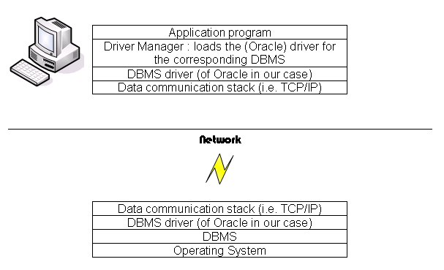
Brief introduction to ODBC 3
5

Slide 6
This Lab
In this lab, you will learn how to interact with the OBDC environment with visual studio
Set up OBDC environment for visual studio
Build the SQL database
Perform queries in visual studio
Connect to data source
Perform queries

Slide 7
This Lab
In this lab, you will learn how to interact with the OBDC environment with visual studio
Set up OBDC environment for visual studio
Build the SQL database
Perform queries in visual studio
Connect to data source
Perform queries

Slide 8
Set up OBDC environment for visual studio
You must set up the ODBC data source before your program will run successfully
This will designate the SQL server for visual studio to connect to

Slide 9
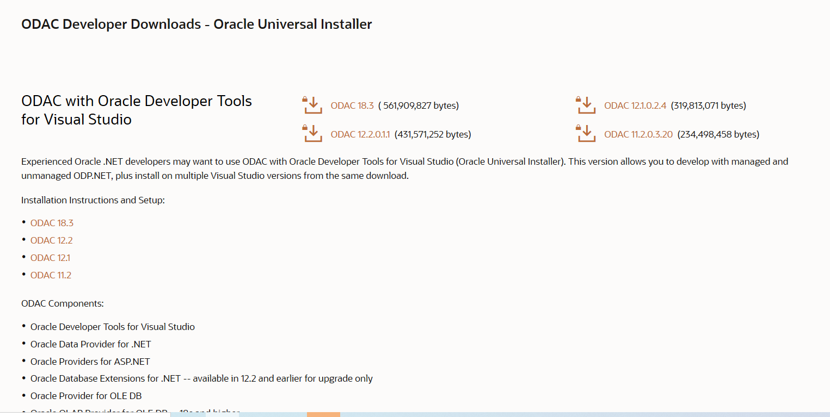
Download ODBC interface:
https://www.oracle.com/database/technologies/dotnet-odacdev-downloads.html
Click ODAC 18.3

Slide 10
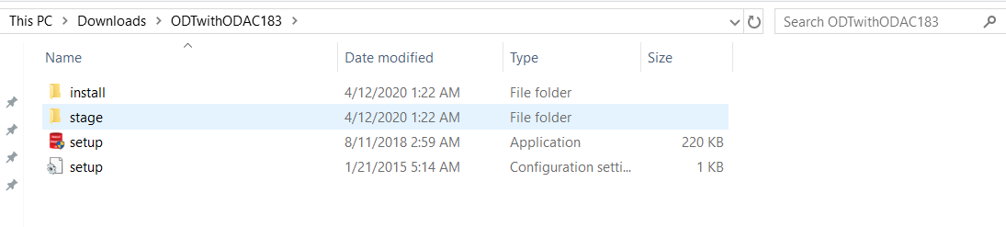
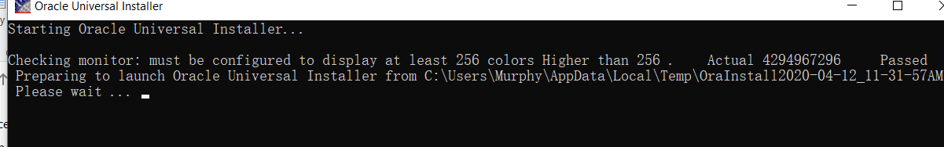
Extract the zipped file:
Run setup.exe in the folder “ODTwithODAC32”

Slide 11
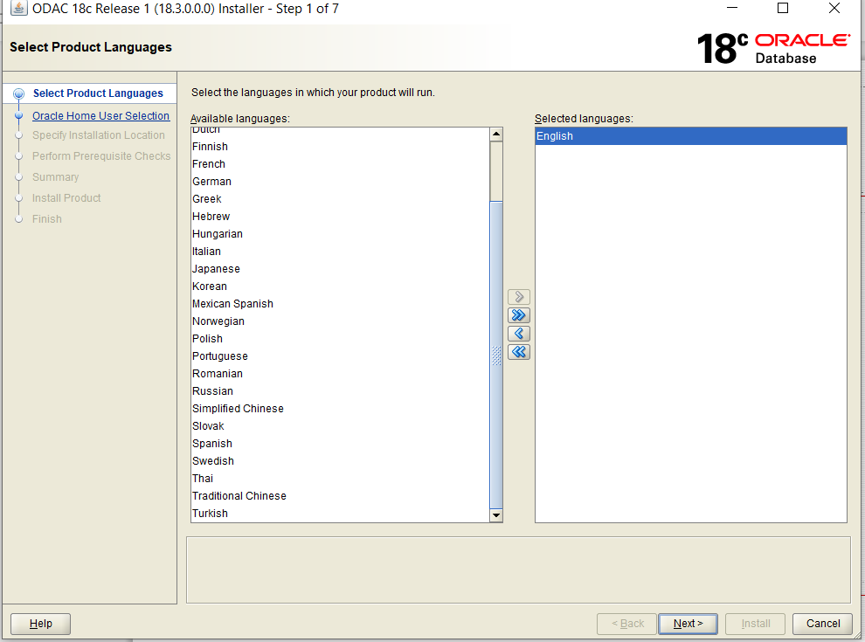
Next – choose language

Slide 12
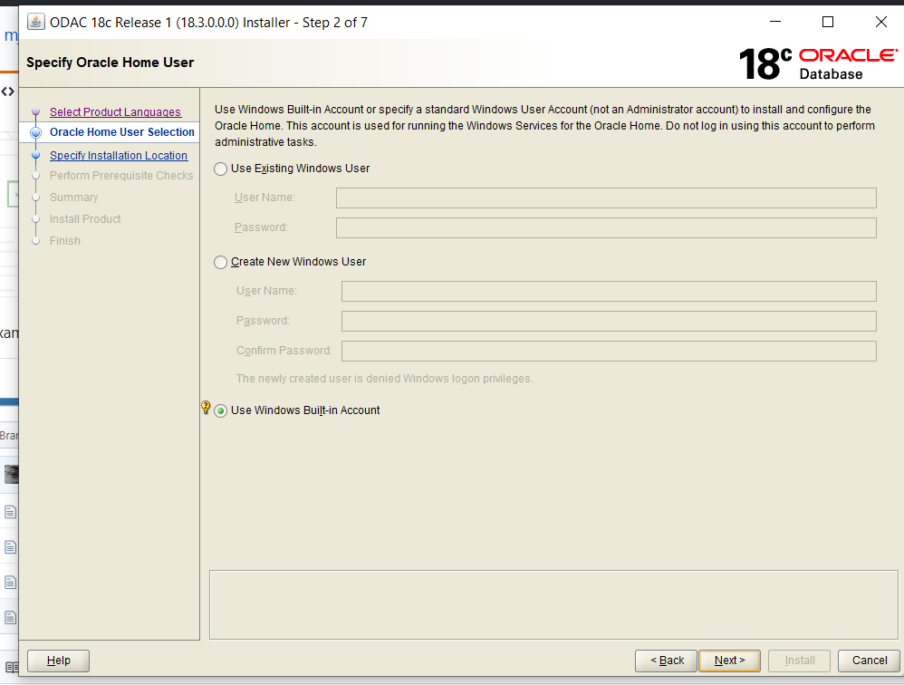
Next Use Windows Build in Account

Slide 13
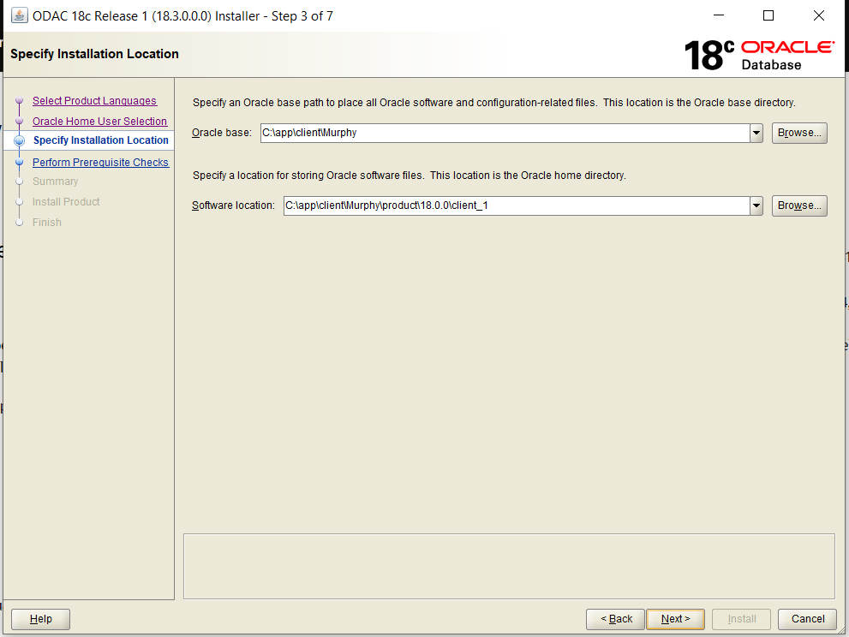
Set up the path of the driver- Remember it

Slide 14
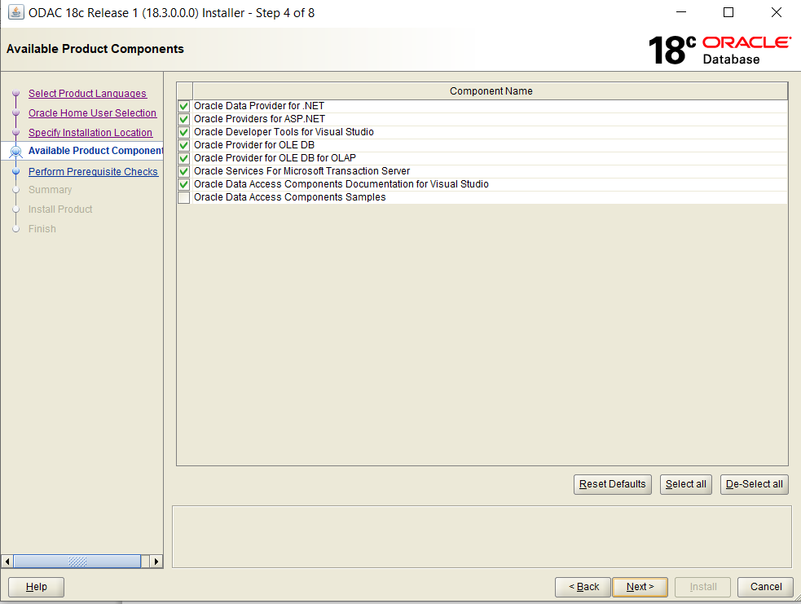
If you do not have VS 2019, there will be an error

Slide 15
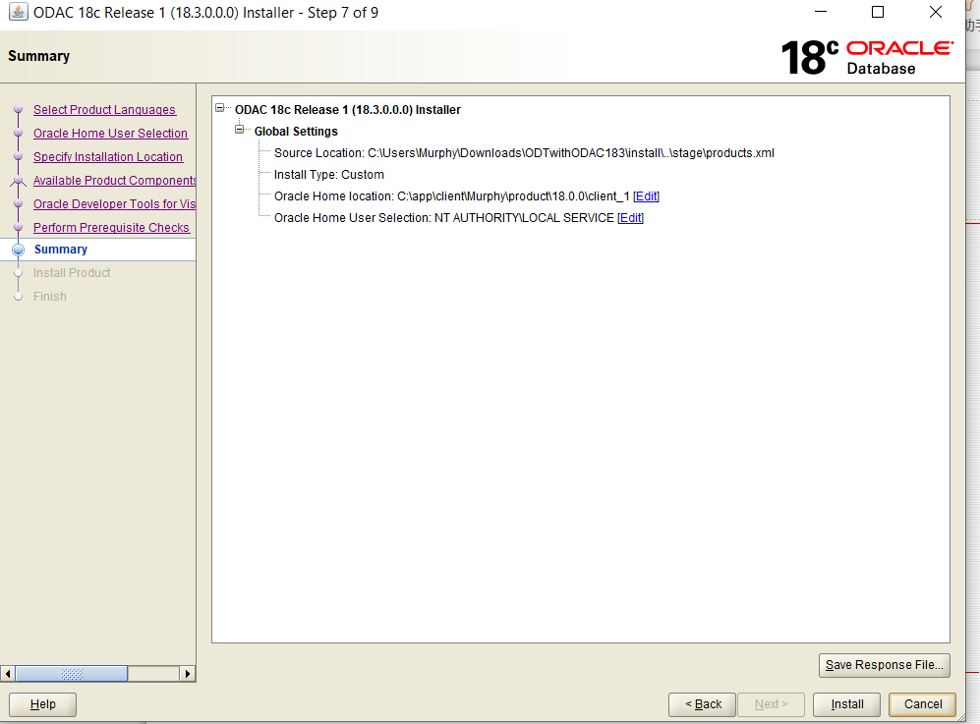
Click install

Slide 16
Set TNSNAME
host name: dbsvr1.cse.ust.hk
Service Name: comp3311.cse.ust.hk
Type could be shared/dedicated

Slide 17
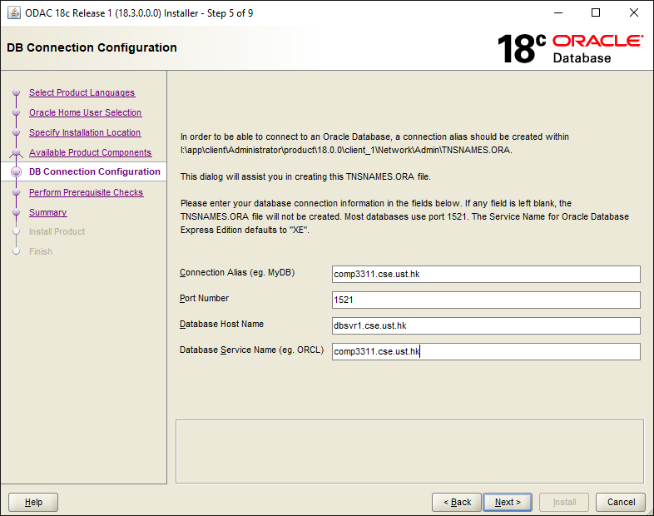
Set TNSNAME

Slide 18
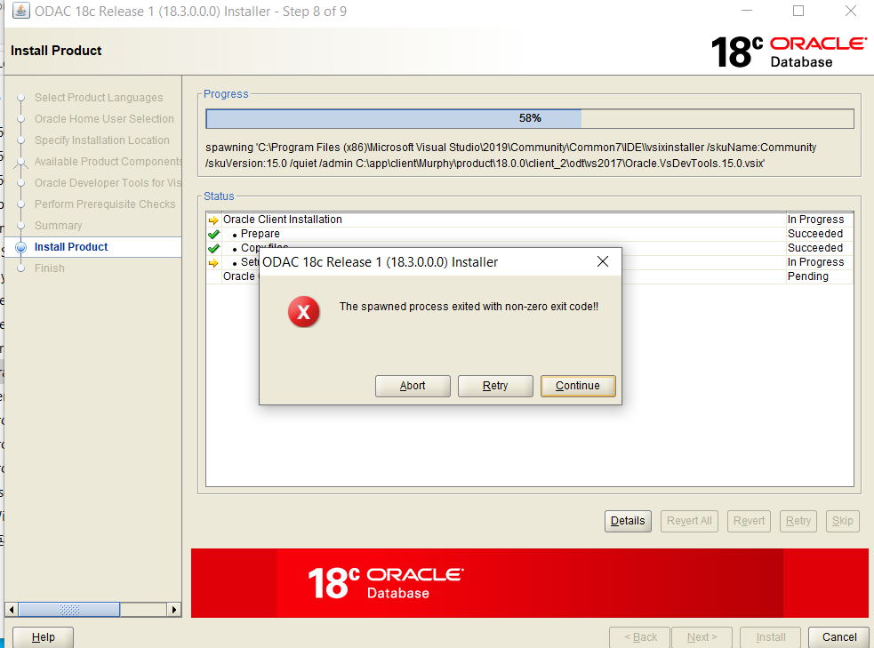
Installing No worry about the warning below
If you met this, click continue

Slide 19
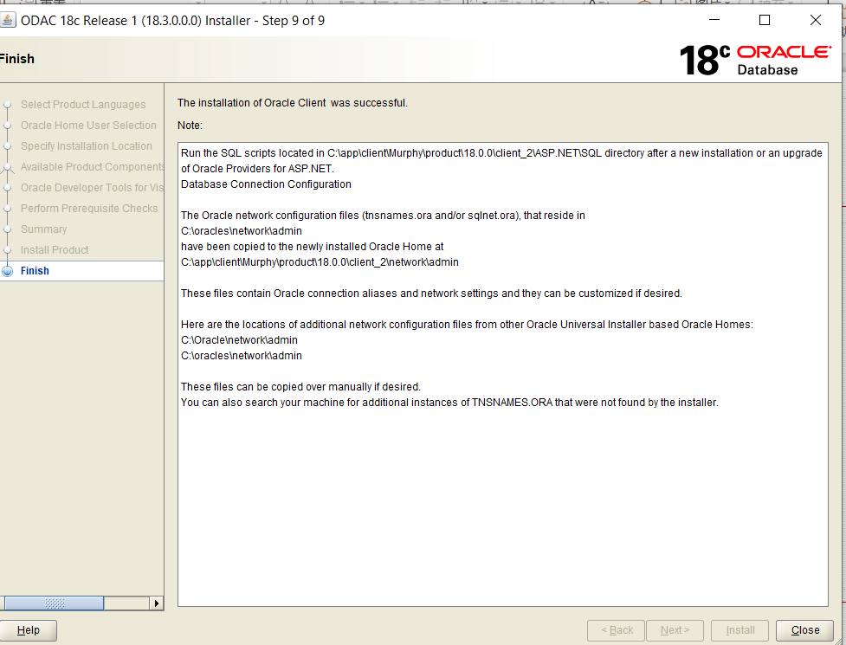
Finish

Slide 20
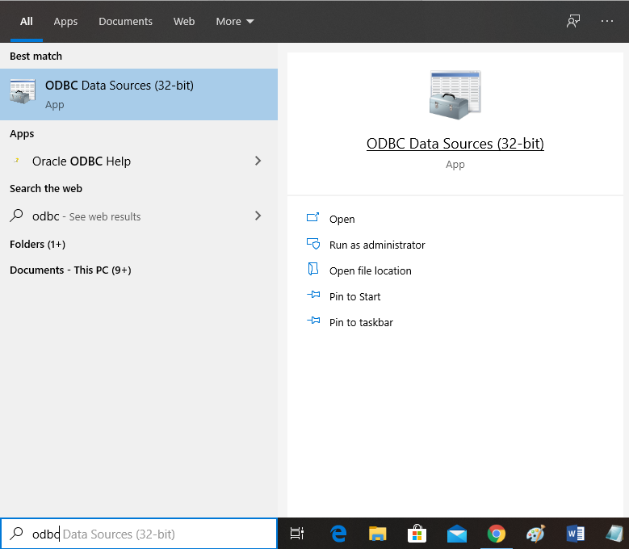
Search ODBC

Slide 21
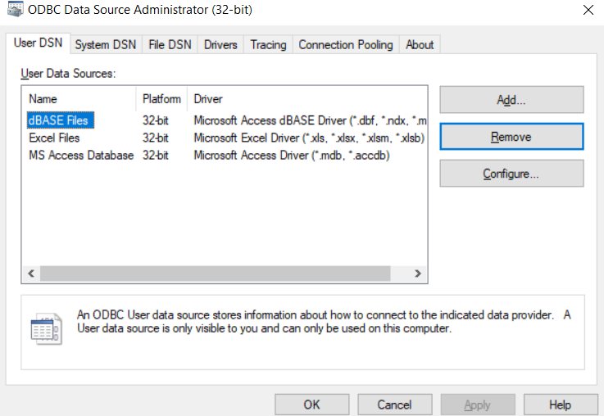
Remove dBASE and Add ODBC driver

Slide 22
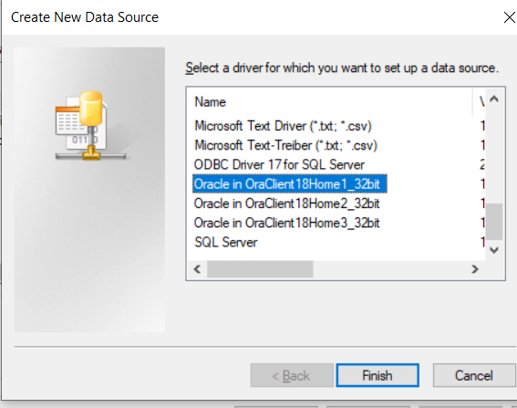
Select Oracle OraClient18Home

Slide 23
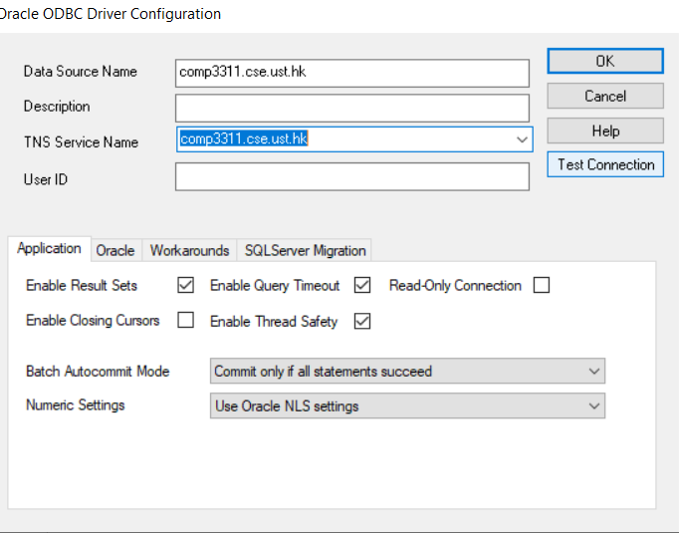
Test Oracle Connection:

Slide 24
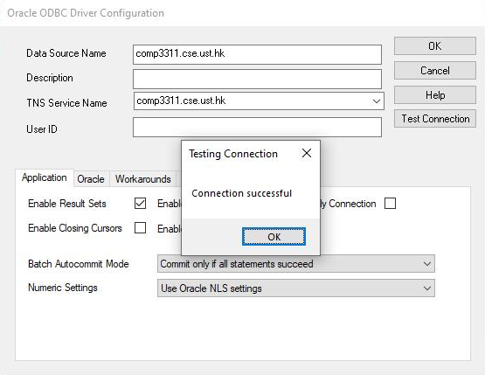
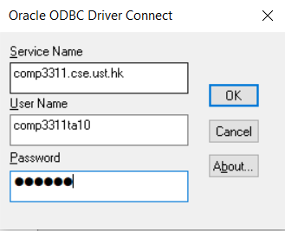
Test Oracle Connection and successful:
Don't forget to connect to HKUST VPN if you are not in UST
Fill in your Oracle account details

Slide 25
This Lab
In this lab, you will learn how to interact with the OBDC environment with visual studio (VS2019)
Set up OBDC environment for visual studio
Build the SQL database
Perform queries in visual studio
Connect to data source
Perform queries

Slide 26
Building the SQL database 1
For this lab, we will initialize the database for future queries with lab7.sql
We must run lab7.sql in SQL developer and commit for the ODBC to be able to interact with the data

Slide 27
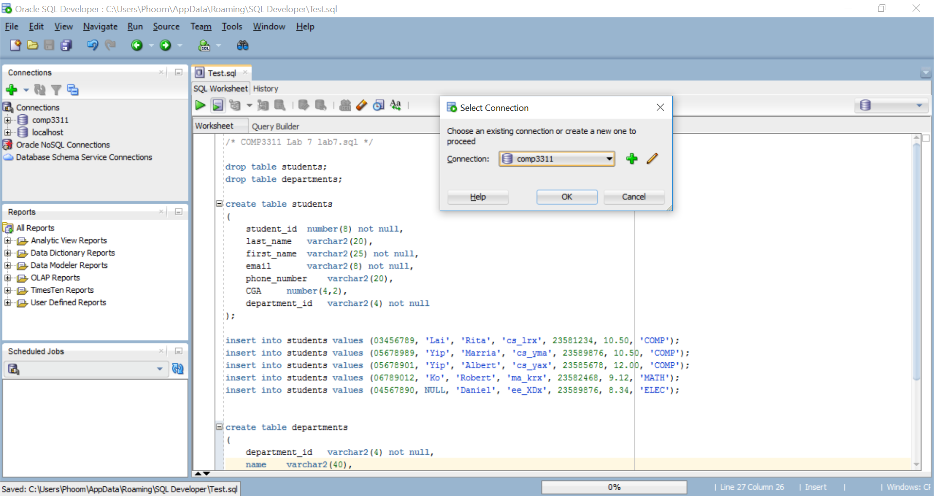
Building the SQL database 2
Run lab7.sql in SQL Developer (http://course.cse.ust.hk/comp3311/labs/lab7.sql)

Slide 28
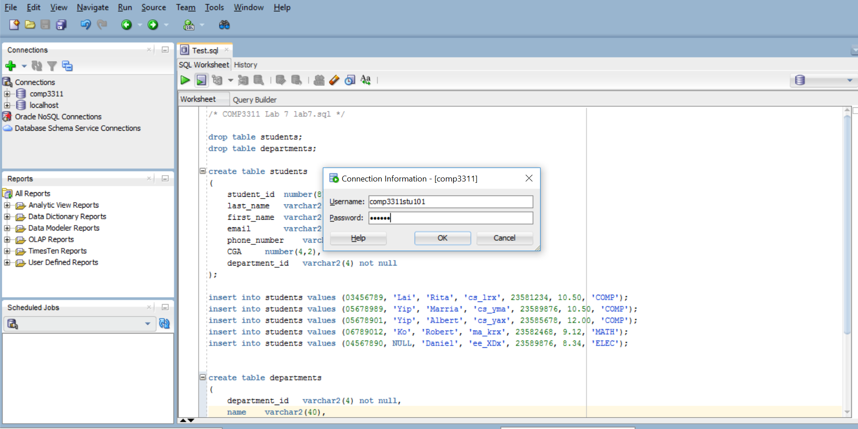
Building the SQL database 3
Input your username and password for the SQL server

Slide 29
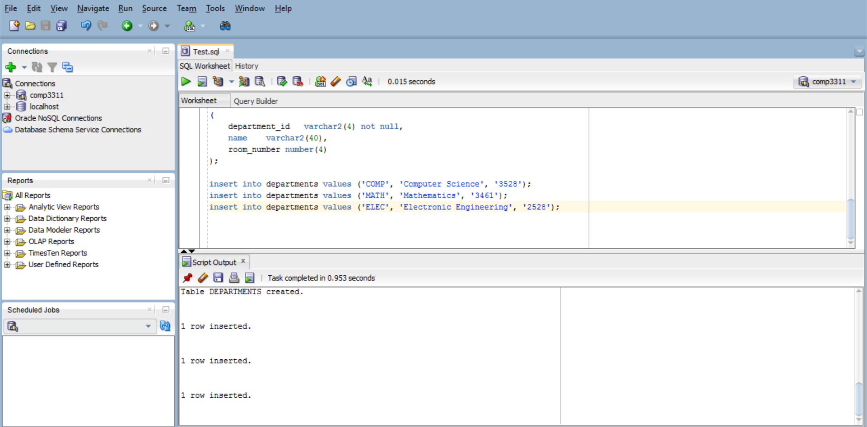
Building the SQL database 4
Check the script output to see that the tables were successfully created and the rows were successfully inserted

Slide 30
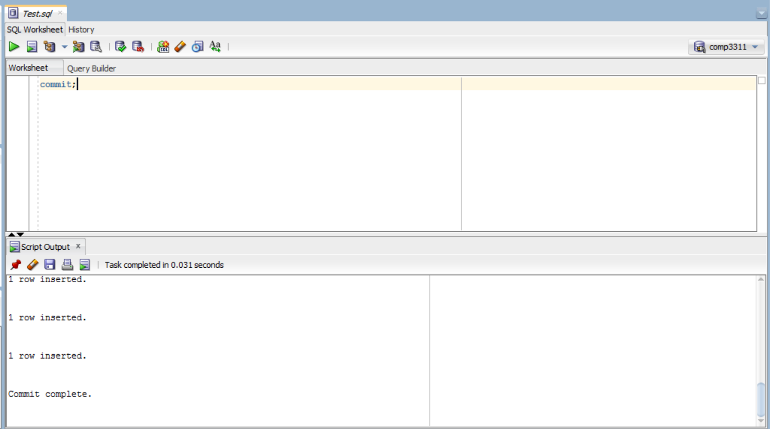
Building the SQL database 5
Commit the changes to the database by running
Check from the script output that the commit was successful
commit;

Slide 31
This Lab
In this lab, you will learn how to interact with the OBDC environment with visual studio
Set up OBDC environment for visual studio
Build the SQL database
Perform queries in visual studio
Connect to data source
Perform queries

Slide 32
Perform queries in visual studio
Now that the ODBC environment and the database has been set up, we can use visual studio to perform queries in C++ code
This code must:
Connect to the data source
Perform queries

Slide 33
This Lab
In this lab, you will learn how to interact with the OBDC environment with visual studio
Set up OBDC environment for visual studio
Build the SQL database
Perform queries in visual studio
Connect to data source
Perform queries

Slide 34
Connecting to a data source 1
To connect to the Oracle server through the ODBC interface, one needs to:
Include the proper headers (<sql.h>, <sqlext.h>) to the C program,
Initialize ODBC environment,
Allocate a connection handle,
Connect to the data source which corresponds to the Oracle server.
34

Slide 35
Connecting to a data source 1
Include the proper headers (<sql.h>, <sqlext.h>) to the C program
#include <iostream>
#include <windows.h>
#include <sql.h>
#include <sqlext.h>
#include <sqltypes.h>

Slide 36
Connecting to a data source 2
To initialize ODBC environment, one needs to
Declare a variable of the type HENV,
Call the SQLAllocEnv() function and pass it the address of the variable:
HENV henv;
/* Allocate environment handle */
SQLAllocEnv( &henv);
36

Slide 37
Connecting to a data source 3
To allocate a connection handle one needs to
Declare a variable of the type HDBC
Call the SQLAllocConnect() function and pass it the address of the variable. The ODBC driver would allocate memory for storing the connection information:
HDBC hdbc;
/* Allocate connection handle */
SQLAllocConnect(henv, &hdbc);
37

Slide 38
Connecting to a data source 4
To connect to the Oracle data source, one needs to call the SQLConnect() function and provide it with:
Data source name (in our case comp3311.cse.ust.hk)
Oracle account (your comp3311stuxxx account)
Oracle account password (your password)
SQLConnectA(hdbc, (SQLCHAR*) "comp3311.cse.ust.hk", SQL_NTS, (SQLCHAR*) "comp3311stu120", SQL_NTS, (SQLCHAR*) “123456", SQL_NTS);
“comp3311.cse.ust.hk” is the data source name
“comp3311stu120” is an Oracle account name
“123456” is the password of the account
SQLCHAR is a char type of SQL
SQL_NTS denotes that the previous argument in the function is a Null Terminated String
38

Slide 39
This Lab
In this lab, you will learn how to interact with the OBDC environment with visual studio
Set up OBDC environment for visual studio
Build the SQL database
Perform queries in visual studio
Connect to data source
Perform queries

Slide 40
Performing Query 1
To perform the SQL operations using the ODBC interface, you need to:
allocate a statement handle
submit an SQL statement for execution
retrieve the results
40

Slide 41
Performing Query 2
To allocate a statement handle, you need to:
declare a variable of the type HSTMT,
call SQLAllocStmt() function and pass the connection handle (hdbc) and the address of the HSTMT-typed variable.
HSTMT hstmt;
/*allocate the statement handle*/
SQLAllocStmt(hdbc, &hstmt);
41

Slide 42
Performing Query 3
To submit an SQL statement for direct execution (prepared statement will be covered next time), you need to:
Call SQLExecDirect() function and pass it with the SQL statement as well as the statement handle (hstmt)
SQLExecDirectA(hstmt, (SQLCHAR *) “SELECT department_ID FROM departments",SQL_NTS);
42

Slide 43
Performing Query 4
To retrieve the results you need to:
Bind variables to the attributes of the query results using SQLBindCol() function:
/* bind the char string variable "deptid" to get the result (column 1) from the query*/
SQLBindCol(hstmt,1,SQL_C_CHAR,deptid,50,&deptid_n);
column value target type
target variable
target buffer length
string length of the returned data
43

Slide 44
Performing Query 5
Fetch the results using the SQLFetch() function:
/* fetch the results into the variable "deptid" and then display*/
while (TRUE){
retcode=SQLFetch(hstmt);
if (retcode==SQL_SUCCESS || retcode \
==SQL_SUCCESS_WITH_INFO)
{printf("%s\n",deptid);}
else break;
}
44

Slide 45
Terminating the program
To gracefully terminate, you need to
Disconnect from the Oracle data source
Free the environment variable and the handle:
The complete code for connecting to the Oracle server of COMP3311 is available at:
http://course.cse.ust.hk/comp3311/labs/odbc1.cpp
SQLFreeStmt(hstmt,SQL_CLOSE);
SQLDisconnect(hdbc);
SQLFreeConnect(hdbc);
SQLFreeEnv(henv);
45

Slide 46
Putting everything together 1
#include <iostream>
#include <windows.h>
#include <sql.h>
#include <sqlext.h>
#include <sqltypes.h>
int main()
{
HENV henv;
HDBC hdbc;
HSTMT hstmt;
RETCODE retcode;
SQLINTEGER sqlcode,deptid_n;
SQLSMALLINT len;
SQLCHAR deptid[50];
/* Allocate environment handle */
retcode = SQLAllocEnv( &henv);
/* Allocate connection handle */
retcode = SQLAllocConnect(henv, &hdbc);
/* Connect to the service */
retcode = SQLConnectA(hdbc, (SQLCHAR*) "comp3311.cse.ust.hk", SQL_NTS, (SQLCHAR*) "comp3311stu120", SQL_NTS, (SQLCHAR*) “123456", SQL_NTS);
if (retcode == SQL_SUCCESS || retcode == SQL_SUCCESS_WITH_INFO){
printf ("Connected to Oracle.\n");}
46

Slide 47
Putting everything together 2
/* execute a SELECT statement*/
SQLAllocStmt(hdbc, &hstmt);
SQLExecDirectA(hstmt, (SQLCHAR *) "select department_ID from departments",SQL_NTS);
/* bind the char string variable "deptid" to get the result from the query*/
SQLBindCol(hstmt,1,SQL_C_CHAR,deptid,50,&deptid_n);
/* fetch the results into the variable "deptid" and the display*/
while (TRUE){
retcode=SQLFetch(hstmt);
if (retcode==SQL_SUCCESS || retcode ==SQL_SUCCESS_WITH_INFO)
{printf("department_id = %s\n",deptid);}
else break;
}
/* free resources */
SQLFreeStmt(hstmt,SQL_CLOSE);
SQLDisconnect(hdbc);
SQLFreeConnect(hdbc);
SQLFreeEnv(henv);
return 0;
}
47

Slide 48
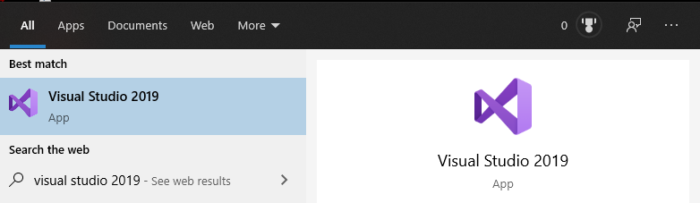
Working with Visual Studio 2019 1
To start Visual Studio, one need to locate the visual studio 2019 package.
Click the “start” button, and type “Visual Studio 2019”.
Click on the “Visual Studio 2019” icon as shown at the right to start it.

Slide 49
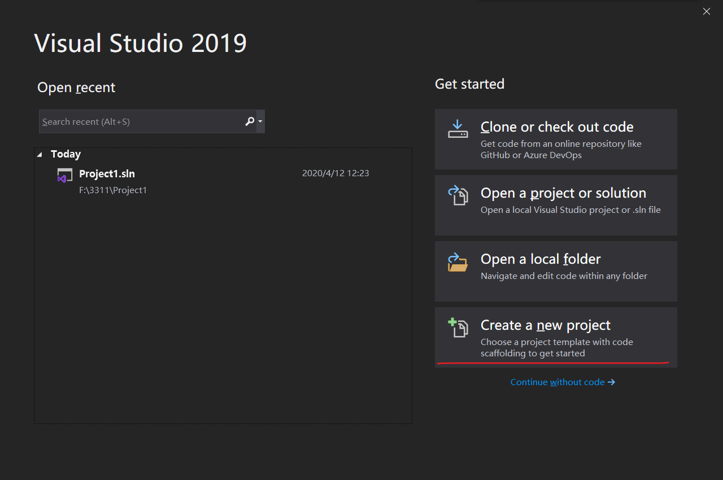
Working with Visual Studio 2019 2

Slide 50
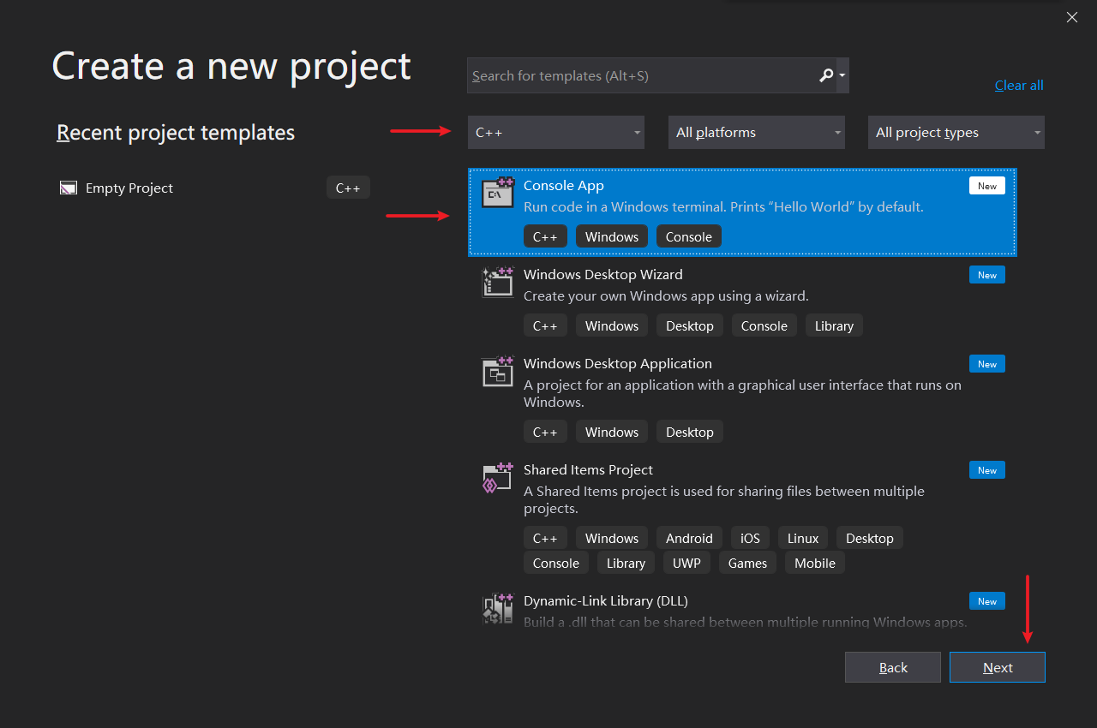
Working with Visual Studio 2019 3

Slide 51
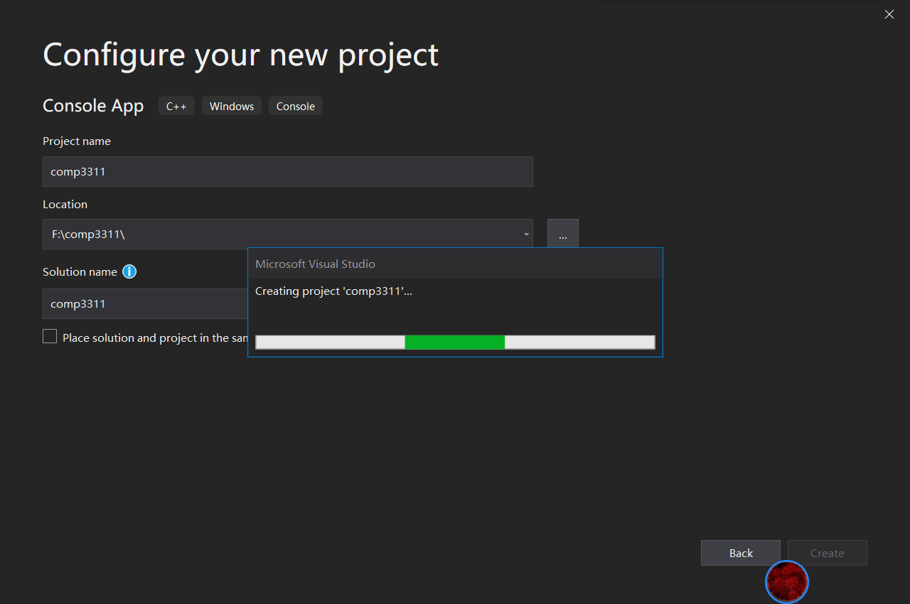
Working with Visual Studio 2019 4

Slide 52
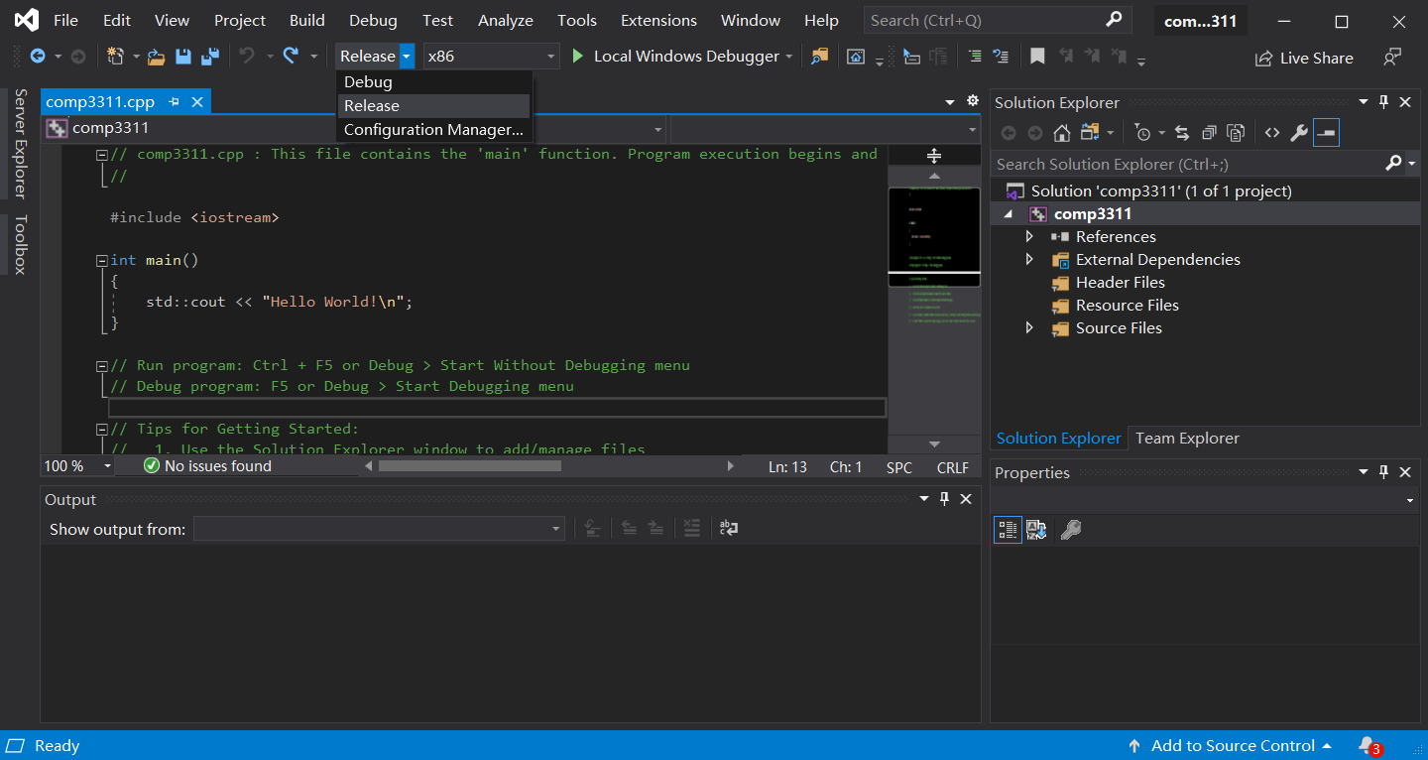
Working with Visual Studio 2019 5
Replace the C-codes with odbc1.cpp you have downloaded, and select “Release” for the compilation option.

Slide 53
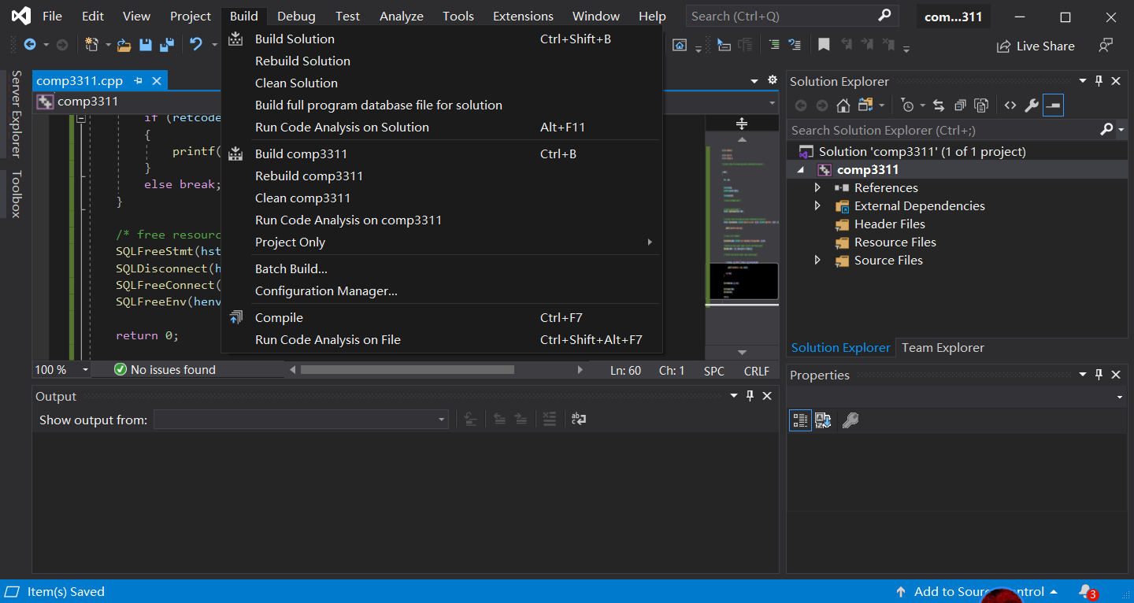
Working with Visual Studio 2019 6
Save the file and compile the program by selecting “Build Solution”.

Slide 54
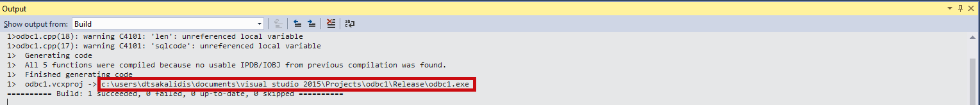
Working with Visual Studio 2019 7
Open a Windows command prompt window (type “cmd” to choose Command Prompt)
Change to the directory where the executable is located:
Here is the location of the executable code of the program

Slide 55
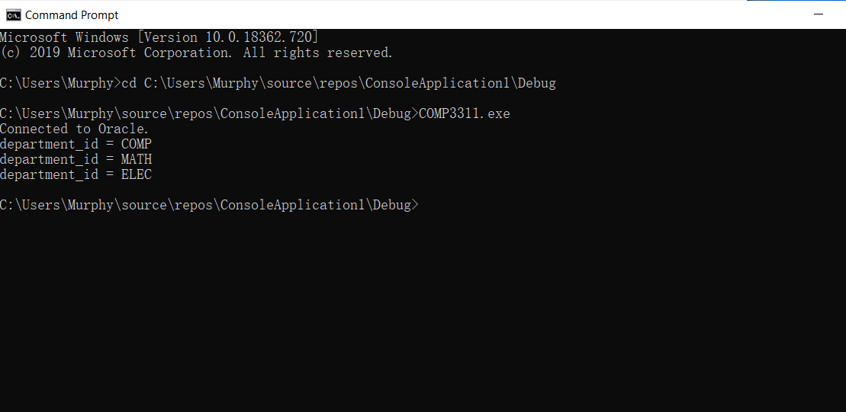
Working with Visual Studio 2019 8
Then run the executable (…exe) from the path.
Note the output that the connection to the Oracle server is successful, and results of three rows are returned.

Slide 56
Conclusions
We covered the following topics in this lab:
connect to the Oracle server of COMP3311 through the ODBC interface,
issue a simple SQL query using the ODBC interface.
56

Slide 57
Downloaded Sites
Oracle ODBC –ODAC 18.3
Visual Studio 2019 – vs 2019 community version
Database Programs
C Programs

