Slide 1
Comp 3311 Database Management Systems
2. Entity Relationship (ER) Model

Slide 2
Basic Concepts of ER
ER is a model for the logical level
it describes the structure of the database at a high abstraction level
A database can be modeled as
a collection of entities
relationships among entities
An entity is an object that exists independently and is distinguishable from other objects.
an employee, a company, a car, a student, a class etc.
color, age, etc. are not entities

Slide 3
Entities
Entity: an entity set is a set of entities of the same type
E.g., a set of employees, a set of departments
Entity Type :
Employee
A general specification
Entity set:
e₁
e₂
e₃
The actual employees
…

Slide 4
Attributes
Properties of an entity or a relationship
name, address, weight, height are properties of a Person entity.
“date of marriage” is a property of the relationship Marriage.

Slide 5
Types of Attributes
Simple attribute: contains a single value.
EmpNo
Employee
Name
Address

Slide 6
Types of Attributes
Composite attribute: consists of several components (e.g., address)
EmpNo
Name
Employee
Street
Address
City
Country

Slide 7
Types of Attributes
Multivalued attribute: contains more than one value
Phone
Employee
Email

Slide 8
Types of Attributes
Derived attribute: computed from other attributes (e.g., age can be computed from the date of birth and the current date)
Age
Employee
Date of birth

Slide 9
Key Attributes
A set of attributes that can uniquely identify an entity
EmpNo
Employee
Name

Slide 10
Key Attributes
An entity may have more than one key
A minimal set of attributes that uniquely identifies an entity is called a candidate key
What are possible candidate keys of HKUST students?
Only one candidate key is selected to be the primary key
What attribute(s) would you use as the primary key of HKUST students?
Sometimes artificial keys maybe created
Example: assume that we want to store information about the current offering of COMP 3311. We can select a unique number (e.g., 1235) to serve as the key.
What alternatives are there for this example, without introducing additional attributes?
Composite Key: contains two or more attributes

Slide 11
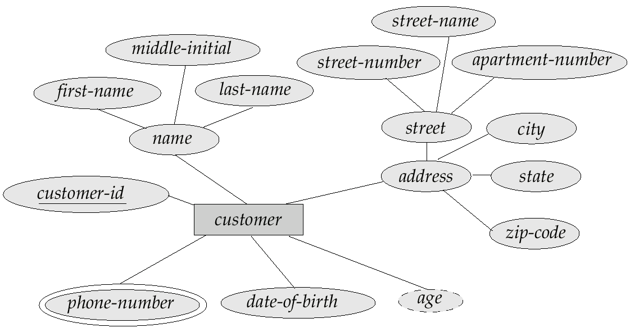
Example Entity (Customer)

Slide 12
Relationship
A relationship is an association among entities
The degree refers to the number of entity sets that participate in a relationship set
Relationship sets that involve two entity sets are binary (or degree two)
Relationships among more than two entity sets are rare

Slide 13
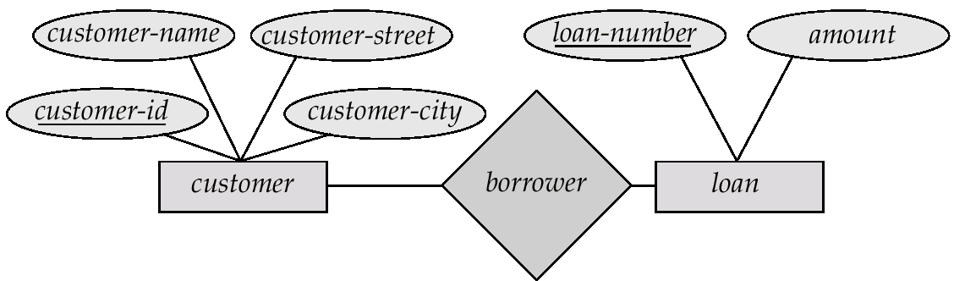
Example of Binary Relationship
Borrower is a relationship between Customers and Loans (it means that a customer can be associated with zero or more loans and vice versa).

Slide 14
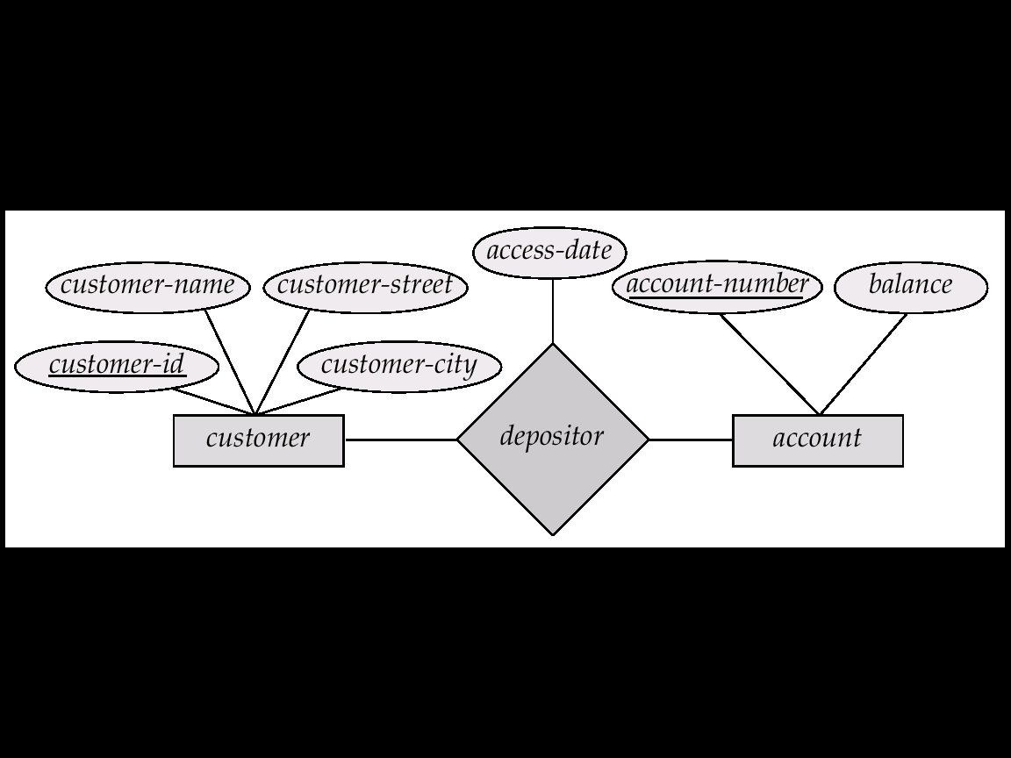
Relationship Sets with Attributes
Depositor is a relationship between Customers and Accounts
Access-date is an attribute of Depositor

Slide 15
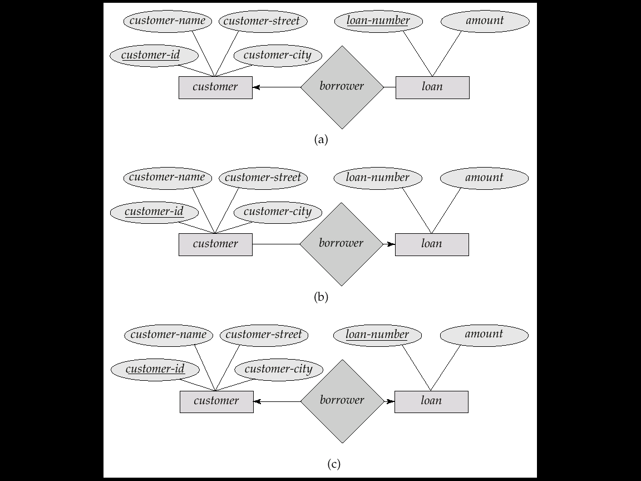
Cardinality Constraints
We express cardinality constraints by drawing either a directed line (→), signifying “one,” or an undirected line (—), signifying “many,” between the relationship set and the entity set.
E.g.: One-to-one relationship:
A customer is associated with at most one loan via the relationship borrower
A loan is associated with at most one customer via borrower

Slide 16
One-To-Many Relationships
In the one-to-many relationship
a loan is associated with at most one customer via borrower,
a customer is associated with zero or more loans via borrower

Slide 17
Many-To-One Relationships
In a many-to-one relationship
a loan is associated with zero or more customers via borrower,
a customer is associated with at most one loan via borrower

Slide 18

Many-To-Many Relationships
A customer is associated with zero or more loans via borrower
A loan is associated with zero or more customers via borrower

Slide 19
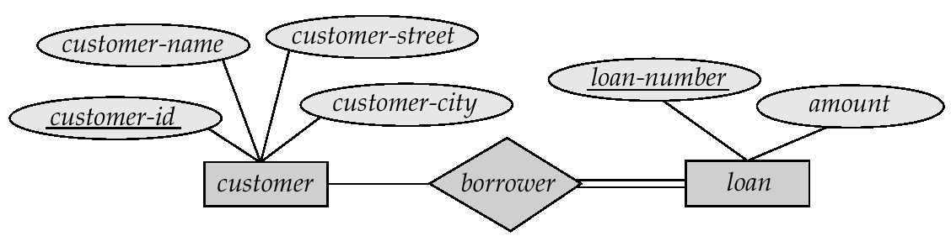
Participation of Entity Sets in Relationships
Total participation (indicated by double line): every entity in the entity set participates in at least one relationship in the relationship set
E.g. participation of loan in borrower is total:
every loan must have at least a customer associated to it via borrower
Partial participation: some entities may not participate in any relationship in the relationship set
E.g. participation of customer in borrower is partial:
some customers may not have any loan

Slide 20
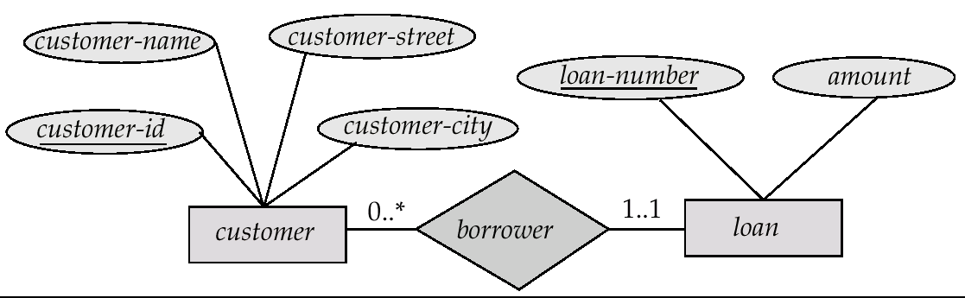
Alternative Notation for Cardinality Limits
Cardinality limits can also express participation constraints

Slide 21
Cardinality Limits
The edge between loan and borrower has a cardinality constraint of 1..1,
meaning the minimum and the maximum cardinality are both 1.
each loan must have exactly one associated customer.
The limit 0..∗ on the edge from customer to borrower indicates that a customer can have zero or more loans.
Thus, the relationship borrower is
one to many from customer to loan,
the participation of loan in borrower is total.

Slide 22
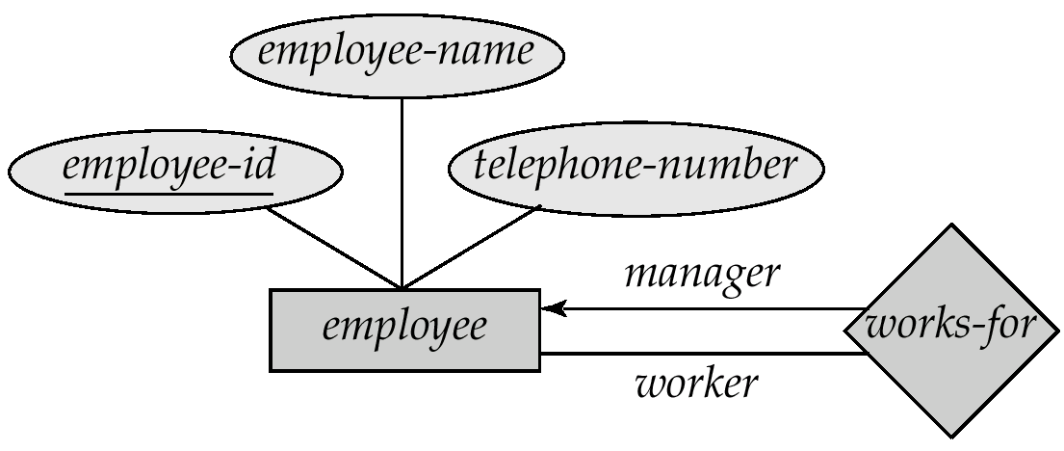
Roles
Entity sets of a relationship need not be distinct.
The labels “manager” and “worker” are called roles; they specify how employee entities interact via the works-for relationship set.
Roles are indicated in E-R diagrams by labeling the lines that connect diamonds to rectangles.
Role labels are optional, and are used to clarify semantics of the relationship

Slide 23
Keys for Relationships
The combination of primary keys of the participating entity sets forms a super key of a relationship set.
(customer-id, account-number) is the super key of depositor
This means that a pair of entities can have at most one relationship in a particular relationship set.
E.g. if we wish to track all access-dates to each account by each customer, we cannot assume a relationship for each access. Solution: use a multivalued attribute for access dates.
Must consider the cardinality constraints when deciding the candidate keys for a relationship set
Many to many, one to many, many to one

Slide 24
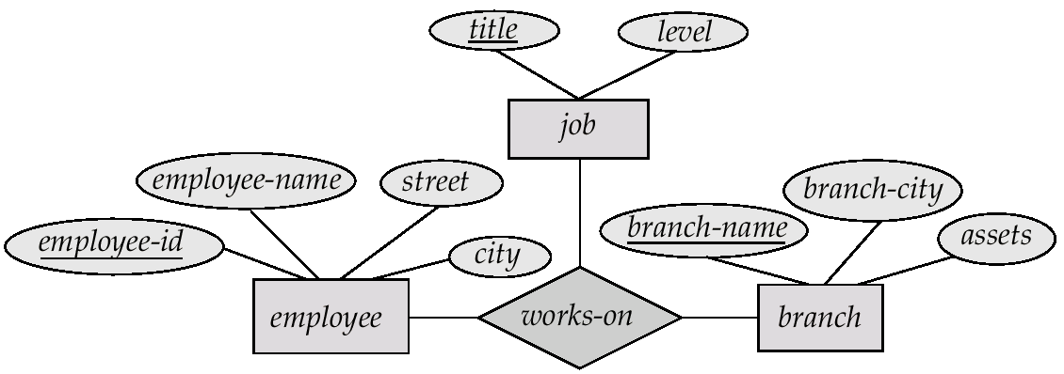
Ternary Relationships
Suppose employees of a bank may have jobs (responsibilities) at multiple branches, with different jobs at different branches. Then there is a ternary relationship set between entity sets employee, job and branch

Slide 25
Weak Entity Sets
An entity set that does not have a primary key is referred to as a weak entity set.
The existence of a weak entity set depends on the existence of an identifying entity set
it must relate to the identifying entity set via a total, one-to-many relationship set from the identifying to the weak entity set
Identifying relationship is depicted using a double diamond
The discriminator (or partial key) of a weak entity set is the set of attributes that distinguishes among groups of the entities of a weak entity set.
The primary key of a weak entity set is formed by the primary key of the strong entity set on which the weak entity set dependents, plus the weak entity set’s discriminator.

Slide 26
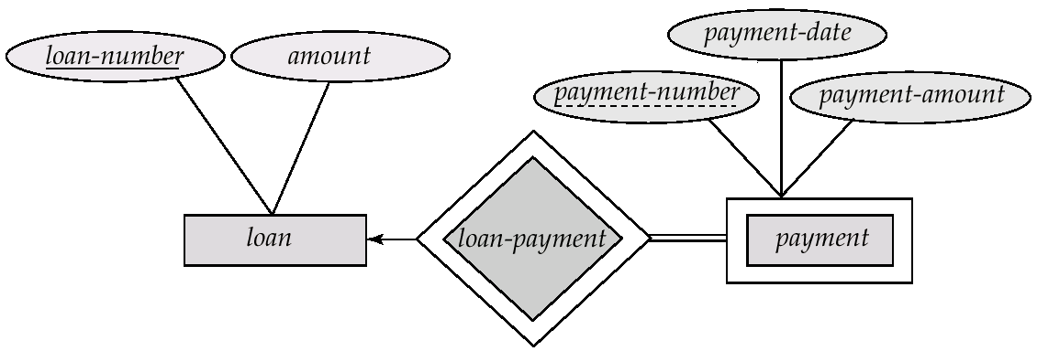
Weak Entity Sets
We depict a weak entity set by double rectangles.
We underline the discriminator of a weak entity set with a dashed line.
payment-number – discriminator of the payment entity set
Primary key for payment – (loan-number, payment-number)

Slide 27
Another Example of Weak Entity Set
EmpNo
Name
Age
Employee
Emp_Dep
Dependent
A dependent child may not be old enough to have a HKID number
Even if he/she has a HKID number, the company may not be interested in keeping it in the database.

Slide 28
ISA (`is a’) Hierarchies
name
ssn
lot
Employees
hourly_wages
hours_worked
ISA
contractid
As in C++, or other languages, attributes are inherited.
If we declare A ISA B, every A entity is also considered to be a B entity.
Hourly_Emps
Contract_Emps
Overlap constraints: Can Joe be an Hourly_Emps as well as a Contract_Emps entity? (Allowed/disallowed)
Covering constraints: Does every Employees entity have to be either an Hourly_Emps or a Contract_Emps entity? (Yes/no)
Reasons for using ISA:
To add descriptive attributes specific to a subclass.
To identify subsets of entities that participate in a relationship.
Notes:
12

Slide 29
Degree of Relationship
The number of entity types that participate in a relationship type.
unary (reflexive) - relates one entity (to itself)
Employee
Manager_of
binary - relates two entities
Employee
Works_on
Project
ternary - relates three entities
Uses
Employee
Language
A ternary relationship often can be expressed as two binary relationship, but not always.
Higher degrees are extremely rare!
Project
In practice, the vast majority of relationships are binary.

Slide 30
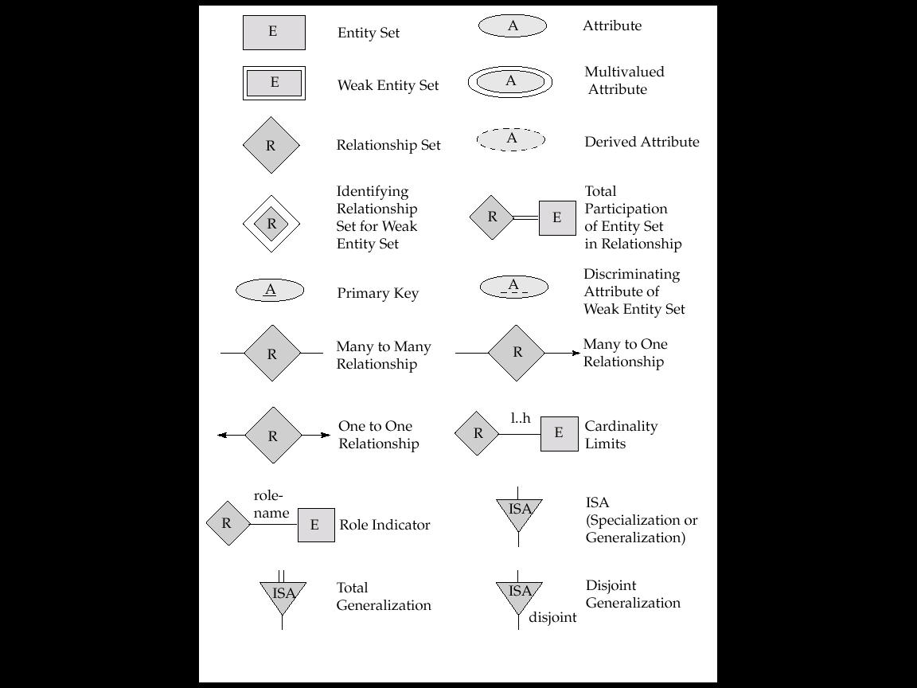
Summary of ER Symbols I

Slide 31
Summary of ER Symbols II

Slide 32
ER Design Decisions - Attribute vs Entity
Choosing between an entity and an attribute
entity: When several properties can be associated with the concept.
attribute: When the concept has a simple atomic structure or no property of interest.
Office as attribute
employee_id
name
office_number
office_phone
Employee
Office as entity
employee_id
name
number
phone
Employee
Assigned_to
Office

Slide 33
ER Design Decisions - Entity vs Relationship
Choosing between an entity and a relationship
entity: When the concept represents something distinct in the application domain with several properties.
relationship: When the concept is not a distinct application domain concept and/or has no property of interest.
Account as entity
Customer
Holds
Account
Is_at
Branch
Account as relationship
Customer
Account
Branch
What if you want to have several accounts for a customer?

Slide 34
ER Design Decisions - Entity vs Relationship
We want to represent the fact that James has two accounts at the same branch.
account#
balance
Customer
Account
Branch
Customer
Branch
1234
3,000
Central, …
John, …
James, …
5678
10,000
Wanchai, …
Alan, …
Tsimshatsui, …
Bill, …
An entity can be related to another entity at most once by a given relationship.
Tsing Yi, …

Slide 35
ER Design Decisions - Entity vs Relationship
We need to use an entity for Account!
name
…
account#
balance
name
…
Customer
Holds
Account
Is_at
Branch
Customer
Branch
Account
John, …
Central, …
1234, 3,000
James, …
Wanchai, …
5678, 10,000
Alan, …
Tsimshatsui, …
Bill, …
Tsing Yi, …
There can be only one relationship instance of a given relationship type between the same two entity instances.

Slide 36
ER Design Decisions – Attributes Placement
Choosing where to place an attribute.
?
name
hkid
address
salary
name
address
Person
Works_for
Company
Where to place salary?
Relationship attributes are usually needed only for many to many relationships!
(But can also be used in one to one and one to many relationships.)

Slide 37
ER Design Decisions - Strong vs. Weak Entity
Choosing between a strong entity and a weak entity
strong entity:When the concept can be uniquely identified in the application domain (i.e., it has a key).
weak entity: When the concept has no unique identifier.
Suppose an account must be associated with exactly one branch and two different branches are allowed to have accounts with the same number.
Should Account be a strong or weak entity?
branch_id
account#
Branch
Is_at
Account
branch_id
account#
Branch
Is_at
Account
✔

Slide 38
Summary
Entity Relationship Model (ER Model) is used to support database design before implementation
Two components in ERM: Entities and Relationships
Entity: Type, Set, Attributes (underline the key)
Icon: labelled rectangles and ellipses
Special cases of attributes: multi-valued, composite, derived
Relationship: Type, Set, Attributes (underline the key)
Icon: labelled diamond and ellipses
Cardinality Constraints, Participations, Roles describe a relationship
Special cases of relationships: weak, ISA

Slide 39
HKUST COURSE DATABASE
For each student we store the student id and name.
For each course we store a unique course id, name and none or many prerequisites.
For each offering of a course we store the section, semester and year.
For each staff assigned to a course offering's teaching team we store the hkid, name and office number.
Each student must enroll in one or more course offerings.
Each course offering can enroll none or many students.
For each course offering that a student takes we store the grade.
Each course offering’s teaching team has one or more staff, who is either an instructor or a TA (but not both).
For each instructor we store their academic title (i.e., professor, lecturer, etc.).
student_id
student_id
name
section
semester
year
title
course_id
course_id
name
hkid
hkid
name
office#
Student
Offering
Instructor
Course
Staff
TA

Slide 40
HKUST COURSE DATABASE: ERD
course_id
name
course
Course
Has_
prerequisite
prerequisite
Has
hkid
name
office#
section
Staff
Assigned_to
Offering
semester
year
title
disjoint
grade
Enrolls_in
Instructor
TA
Student
student_id
name

