Slide 1
Comp 3311 Database Management Systems
3. Relational Data Model

Slide 2
Basic Concepts
Entities and relationships are represented by tables
Generalizations/Specializations
Composite Attributes
Multivalued Attributes
Strong Entities
Weak Entities
Relationships
Schema Combination
Formal semantics and languages for manipulating the tables
Ease of implementation – write queries on tables without caring about the physical level and optimization issues
All popular DBMSs today are based on relational data model (or an extension of it, e.g., object-relational data model)

Slide 3
RELATIONAL MODEL
The relational model represents the data for an application as a collection of tables.
Relational Model |  | Representation | Notation
Relation | ⬄ | table | R(A₁, A₂, …, A_{n})
Attribute | ⬄ | column | A_{i}
Domain | ⬄ | type and range of attribute values | dom(A_{i})
Tuple / Record | ⬄ | row
Attribute value | ⬄ | value in table cell
Attribute | Domain
age | [0-100]
name | 50 alphabetic characters
salary | non-negative integer
Examples of attribute domains:

Slide 4
RELATIONAL MODEL: SCHEMAS & INSTANCES
A set of relation schemas define a relational database.
Employee(emp#, name, address, hkid, works_on_project)
Project(proj#, name, budget)
A table can be used to show the instances of a relation schema.
relation schema
Employee
emp# | name | address | hkid | works_on_project
1 | Holmes D. | 86 Queen | A450361 | 3
5 | Chan B. | 21 Minto | C461378 | 2
35 | Hui J. | 16 Peak | F562916 | 1
8 | Bell G. | 53 Water | A417394 | 2
15 | Wing R. | 58 Aster | C538294 | 3
Project
proj# | name | budget
1 | E-commerce | 200,000
2 | Stock control | 100,000
3 | Web store | 500,000

Slide 5
RELATIONAL MODEL: CARTESIAN PRODUCT
A relation (instance) is any subset of the Cartesian product of the domains of values.
Example: Let dom(name) = { Lee, Cheung }
dom(grade) = { A, B, C }
Then the Cartesian product of the domains is
dom(name) ⨉ dom(grade) = { <Lee, A>, <Lee, B>, <Lee, C>, <Cheung, A>, <Cheung, B>, <Cheung C> }
A relation (instance), r, according to the relation schema StudentGrade(name, grade) can be defined as any subset of the Cartesian product dom(name) ⨉ dom(grade).
r(StudentGrade) = { <Lee, A>, <Cheung C> } ⊆ dom(name) ⨉ dom(grade)

Slide 6
RELATIONAL MODEL: PROPERTIES OF RELATIONS
Tuples in a relation are not ordered, even though they are represented in a tabular form.
Recall that a relation is a set of tuples.
All attribute values are atomic.
Multivalued and composite attribute values are not allowed in relations, although they are permitted in the E-R model.
A special null value is used to represent values that are:
not applicable (phone number for a client that has no phone).
missing (there is a phone number, but we do not know it yet).
not known (we do not know whether or not there is a phone number).

Slide 7
RELATIONAL MODEL: KEYS
Superkey
A superkey, S, of relation R={A₁, A₂, …, A_{n}} is a set of attributes S ⊆ R such that for any two tuples t₁ and t₂ ∈ r(R), t₁[S]≠t₂[S].
A superkey is any set of attributes that can identify a unique tuple in r(R).
Employee(emp#, name, address, hkid, works_on_project)
where emp# and hkid are unique.
Possible superkeys: emp# hkid {emp#, name} {hkid, name, address} plus many others
Note
In the relational model, every relation is required to have a candidate key.
In a relational DBMS, a relation is not required to have a candidate key.
Candidate key
A superkey that is minimal. (A relation may have several candidate keys.)
Primary key
One of the candidate keys. (Chosen by the database designer.)

Slide 8
RELATIONAL MODEL: CONSTRAINTS
Entity integrity constraint
If X is a primary key of R, then X cannot contain null values.
Referential integrity (foreign key) constraint
Given two relations R and S, relation S may reference relation R via a set of attributes FK_{R} that forms the primary key K_{R} of R.
The attributes FK_{R} in S are called a foreign key.
The value of the foreign key FK_{R} in a tuple of S must either be equal to the value of the primary key K_{R} of a tuple in R or be entirely null.
S(K_{S}, A2,…, FK_{R}), R(K_{R}, B2, … ,Bm )
FK_{R} references R
on delete cascade OR on delete set null

Slide 9
RELATIONAL MODEL: CONSTRAINTS
Referential integrity (foreign key) constraint
The attribute works_on_project in Employee is a foreign key since it references the primary key proj# of Project.
Employee(emp#, …, works_on_project) Project(proj#, name, budget)
Employee(emp#, … , works_on_project)
Works_on_project references Project
on delete set null
Employee
emp# | name | address | hkid | works_on_project
1 | Holmes D. | 86 Queen | A450361 | 3
5 | Chan B. | 21 Minto | C461378 | 2
35 | Hui J. | 16 Peak | F562916 | 1
8 | Bell G. | 53 Water | A417394 | 2
15 | Wing R. | 58 Aster | C538294 | 3
Project
proj# | name | budget
1 | E-commerce | 200,000
2 | Stock control | 100,000
3 | Web store | 500,000
Value of works_on_project must be equal to proj# or be null.

Slide 10
ERD TO RELATIONAL SCHEMA REDUCTION: OVERVIEW
We need to reduce:
attributes → composite, multivalued
entities → strong, weak
relationships → degree (e.g., unary, binary, ternary, etc.)
→ cardinality and participation constraints
Cardinality/participation constraints in the E-R model
are reduced to
Referential integrity constraints in the relational model.

Slide 11
Composite and Multivalued Attributes
Composite attributes are flattened out by creating a separate attribute for each component attribute
E.g. given entity set customer with composite attribute name with component attributes first-name and last-name the customer table has two attributes name.first-name and name.last-name
A multivalued attribute M of an entity E is represented by a separate table EM
Table EM has attributes corresponding to the primary key of E and an attribute corresponding to multivalued attribute M
E.g. Multivalued attribute phone-number of employee is represented by a table employee-phone(employee-id, phone-number)
Each value of the multivalued attribute maps to a separate row of the table EM
E.g., an employee with primary key 19444 and phones 23580000, 95555555 maps to two rows:
(19444, 23580000) and (19444, 95555555)

Slide 12
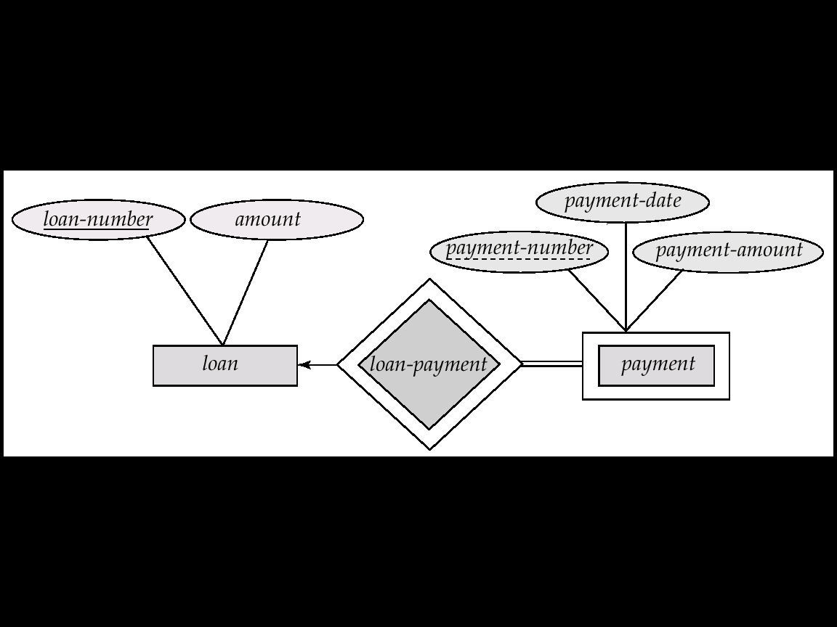
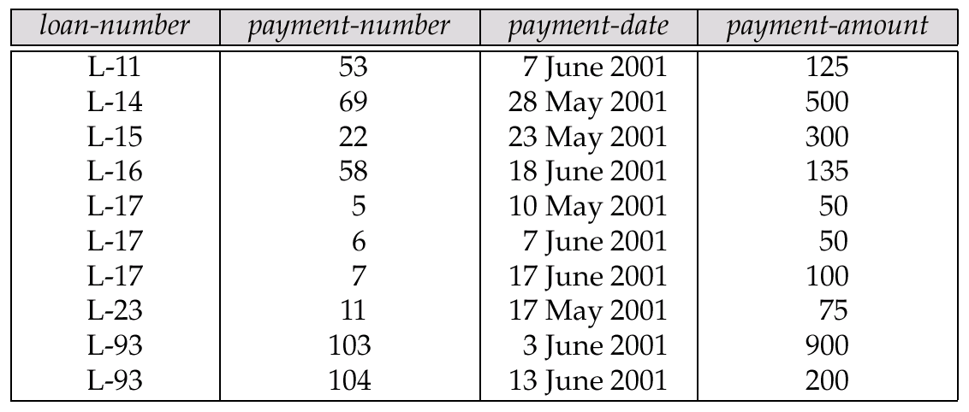
Representing Weak Entity Sets
A weak entity set becomes a table that includes a column for the primary key of the identifying strong entity set

Slide 13
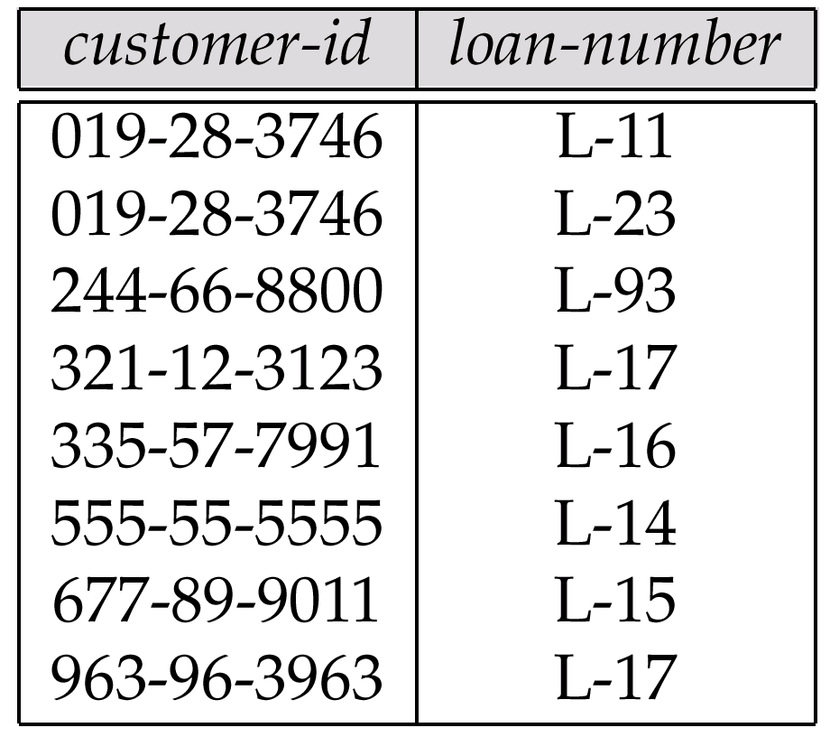
Representing Relationship Sets as Tables
A many-to-many relationship set is represented as a table with columns for the primary keys of the two participating entity sets, and any descriptive attributes of the relationship set.
E.g.: table for relationship set borrower

Slide 14
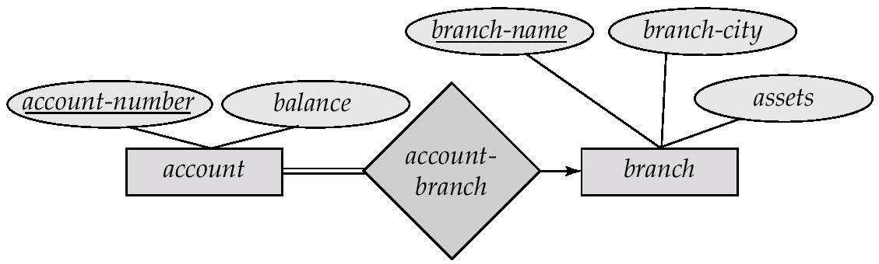
Redundancy of Tables
Many-to-one and one-to-many relationship sets that are total on the many-side can be represented by adding an extra attribute to the many side, containing the primary key of the one side
Instead of creating a table for relationship account-branch, add the key of branch (branch-name) to the entity set account
branch-name in account is a foreign key

Slide 15
Redundancy of Tables
For one-to-one relationship sets, either side can be chosen to act as the “many” side
That is, extra attribute can be added to either of the tables corresponding to the two entity sets
If participation is partial on the many side, replacing a table by an extra attribute in the relation corresponding to the “many” side could result in null values
The table corresponding to a relationship set linking a weak entity set to its identifying strong entity set is redundant.
E.g. The payment table already contains the information that would appear in the loan-payment table (i.e., the columns loan-number and payment-number).

Slide 16
Representing Specialization as Tables
Method 1:
Form a table for the higher level entity
Form a table for each lower level entity set, include primary key of higher level entity set and local attributes table table attributes person id, name, street, city customer id, credit-rating employee id, salary
Drawback: getting information about, e.g., employee requires accessing two tables

Slide 17
Specialization as Tables
Method 2:
Form a table for each entity set with all local and inherited attributes table table attributes person id, name, street, city customer id, name, street, city, credit-rating employee id, name, street, city, salary If specialization is total, no need to create table for generalized entity (person)
Drawback: street and city may be stored redundantly for persons who are both customers and employees

Slide 18
Summary
Representation and Terminologies in Relational Data Model (RDM)
Translating ERM into RDM: From Design to Implementation
Translating Attributes to Tables: Composite Attributes and Multivalued Attributes
Translating Entities to Tables: Regular Entities and Weak Entities
Translating Relationships to Tables: Cardinality issues, ID relationship, Specialization

Slide 19
Example: BANK Relational Schema
Convert the bank E-R schema to a relational schema.
Specify all referential integrity constraints.
branch_name
city
assets
Branch
1
Gives
street
city
state
account_number
balance
access_date
customer_id
name
address
phone#
N
Account
N
Deposits_to
M
Customer
N
Takes_out
M
Loan
loan#
amount
1
Guarantor_of
N
1
interest_rate
overdraft
Disjoint
Saving
Checking
Has
N
Payment
number
date
amount

Slide 20
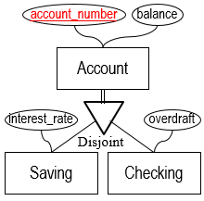
BANK Relational Schema: ACCOUNT GENERALIZATION
Account(account_number, balance)
Saving(interest_rate)
account_number references Account
on delete cascade
Checking(overdraft)
account_number references Account
on delete cascade
account_number
balance
Account(account_number, balance)
Saving(account_number, interest_rate)
account_number references Account
on delete cascade
Checking(account_number, overdraft)
account_number references Account
on delete cascade
Account
interest_rate
d
overdraft
U
U
Saving
Checking
Option 1: Reduce all entities to relation schemas.
Create a relation schema for each entity (superclass and subclass)
For each relation schema created for a subclass entity:
Add: 1. the primary key of the superclass entity as a foreign key FK_{S}
Note: the foreign key FK_{S} becomes the primary key
2. a foreign key constraint: FK_{S} references superclass relation schema
3. a referential integrity action: on delete cascade

Slide 21
BANK Relational Schema: ACCOUNT GENERALIZATION
account_number
balance
Account
Saving(interest_rate)
Checking(overdraft)
Saving(account_number, balance, interest_rate)
Checking(account_number, balance, overdraft)
interest_rate
d
overdraft
U
U
Saving
Checking
Option 2: Reduce only subclass entities to relation schemas.
Create a relation schema for each subclass entity
For each relation schema created for a subclass entity:
Add: 1. all the attributes of the superclass entity
Note: the primary key is the primary key of the superclass entity

Slide 22
BANK Relational Schema: ACCOUNT GENERALIZATION
Which option to select?
account_number
balance
Option 1
Account(account_number, balance)
Saving(account_number, interest_rate)
account_number references Account
on delete cascade
Checking(account_number, overdraft)
account_number references Account
on delete cascade
Account
interest_rate
d
overdraft
U
U
Saving
Checking
Option 2
Saving(account_number, balance, interest_rate)
Checking(account_number, balance, overdraft)
Select Option 1 since Account has a relationship to other entities and all the subclass entities have their own attributes.

Slide 23
BANK Relational Schema: ADDRESS COMPOSITE ATTRIBUTE
street
city
state
Option 1
Customer(customer_id, name, address, {phone#})
customer_id
name
address
phone#
Customer
Option 2
Customer(customer_id, name, street, city, state, {phone#})
For a composite attribute C in a strong entity S:
Option 1: Create a single attribute by “concatenating” the components of the composite attribute.
Option 2: Create a separate attribute for each component of the composite attribute.
Which option to select will depend on the requirements of the applications.

Slide 24
BANK Relational Schema: PHONE# MULTIVALUED ATTRIBUTE
customer_id
name
address
phone#
Customer
Customer_phone(customer_id, phone#)
customer_id references Customer
on delete cascade
For a multivalued attribute M in a strong entity S:
Create a relation schema SM with an attribute A that corresponds to M and attributes, FK_{S}, corresponding to the primary key of entity S
The primary key of relation SM is the union of all its attributes
Add: 1. a foreign key constraint: FK_{S} references S
2. a referential integrity action: on delete cascade

Slide 25
BANK Relational Schema: CUSTOMER, BRANCH, LOAN STRONG ENTITIES
customer_id
name
address
Customer
Customer(customer_id, name, address)
branch_name
city
assets
Branch
Branch(branch_name, city assets)
loan#
amount
Loan
Loan(loan#, amount)
For a strong entity S:
Create a relation R_{S} with all the attributes of entity S
The primary key of relation R_{S} is the primary key of entity S

Slide 26
BANK Relational Schema: PAYMENT WEAK ENTITY
loan#
1
Has
N
number
Loan
Payment
date
amount
amount
Payment(loan#, number, date, amount)
loan# references Loan
on delete cascade
Payment(loan#, number, date, amount)
Payment(number, date, amount)
For a weak entity T that depends on only one strong entity S:
Create a relation R_{T} with attributes of the weak entity T
Include attributes of relationship R in relation R_{T}
Include as foreign key attributes FK_{S} in relation R_{T}, the primary key attributes of the strong entity S
The primary key of relation R_{T} is the union of the foreign key attributes FK_{S} and the discriminator d_{a} of the weak entity T
Add: 1. a foreign key constraint: FK_{S} references S
2. a referential integrity action: on delete cascade

Slide 27
BANK Relational Schema: GIVES 1 to N RELATIONSHIP
branch_name
1
Gives
N
loan#
city
Branch
Loan
assets
amount
Gives(loan#, branch_name)
Gives(loan#, branch_name)
loan# references Loan
on delete cascade
branch_name references Branch
on delete cascade
For each binary 1 to N relationship R:
Create a new relation schema R_{R}
Include as foreign key attributes in relation R_{R} the primary keys of all the entities related by relationship R
Include attributes of relationship R, if any, as attributes of relation R_{R}
The primary key of relation R_{R} is the primary key of the entity on the N-side of the relationship
Add: 1. a foreign key constraint for each foreign key
2. a referential integrity action for each foreign key

Slide 28
SCHEMA COMBINATION
For 1 to 1 relationships, the relation schema for the relationship can be combined with the relation schema for either entity.
For 1 to N relationships, the relation schema for the relationship can be combined with the relation schema for the entity on the N-side.
Add:1. a foreign key constraint for the foreign key.
2. a referential integrity action for the foreign key that depends on the participation constraint of the entity on the N-side.
partial: on delete set null
total: on delete cascade

Slide 29
BANK Relational Schema: GIVES RELATIONSHIP USING SCHEMA COMBINATION
branch_name
1
Gives
N
loan#
city
Branch
Loan
assets
amount
Gives(loan#, branch_name)
loan# references Loan
on delete cascade
branch_name references Branch
on delete cascade
Branch(branch_name, city, assets)
Loan(loan#, amount)
Loan(loan#, amount, branch_name)
branch_name references Branch
on delete cascade
Which relation do we use?
→ Loan (add branch_name, the key of Branch, as a foreign key).
What is the foreign key constraint?
What is the referential integrity action?

Slide 30
BANK Relational Schema: GUARANTOR_OF RELATIONSHIP USING SCHEMA COMBINATION
customer_id
name
address
Customer
Loan
loan#
amount
1
Guarantor_of
N
Loan(loan#, amount, customer_id)
customer_id references Customer
on delete set null
Customer(customer_id, name, address) Loan(loan#, amount)
Which relation do we use?
→ Loan (add customer_id, the key of Customer, as a foreign key).
What is the foreign key constraint?
What is the referential integrity action?

Slide 31
BANK Relational Schema: DEPOSITS_TO N to M RELATIONSHIP
account_number
balance
access_date
customer_id
name
address
Account
N
Deposits_to
M
Customer
account_number, customer_id,
Deposits_to(account_number, customer_id)
Deposits_to(account_number, customer_id, access_date)
account_number references Account
on delete cascade
customer_id references Customer
on delete cascade
For each binary N to M relationship R:
Create a new relation schema R_{R}.
Include as foreign key attributes in relation R_{R} the primary keys of all the entities related by relationship R.
Include attributes of relationship R, if any, as attributes of relation R_{R}.
The primary key of relation R_{R} is the union of the primary keys of the two participating entities.
Add: 1. a foreign key constraint for each foreign key.
2. a referential integrity action for each foreign key.

Slide 32
BANK Relational Schema: TAKES_OUT N:M RELATIONSHIP
customer_id
name
address
phone#
Customer
N
Takes_out
M
Loan
loan#
amount
Takes_out(customer_id, loan#)
customer_id references Customer
on delete cascade
loan# references Loan
on delete cascade
How do we reduce this relationship?
→ Create a relation Takes_out with the key of Customer and Loan.
Anything else?
What is the key of the relation?
What are the foreign key constraints?
What are the referential integrity actions?
customer_id, loan#
→ No.

Slide 33
BANK Relational Schema
Account(account_number, balance)
Saving(account_number, interest_rate)
account_number references Account
on delete cascade
Checking(account_number, overdraft)
account_number references Account
on delete cascade
Customer(customer_id, name, address)*
Branch(branch_name, city assets)
Loan(loan#, amount, branch_name, customer_id)
branch_name references Branch
on delete cascade
customer_id references Customer
on delete set null
* Using option 1 for address composite attribute.
Payment(loan#, number, date, amount)
loan# references Loan
on delete cascade
Deposits_to(account_number, customer_id, access_date)
account_number references Account
on delete cascade
customer_id references Customer
on delete cascade
Takes_out(customer_id, loan#)
customer_id references Customer
on delete cascade
loan# references Loan
on delete cascade
Customer_phone(customer_id, phone#)
customer_id references Customer
on delete cascade

