Slide 1
Physical File Organization and Indexing

Slide 2
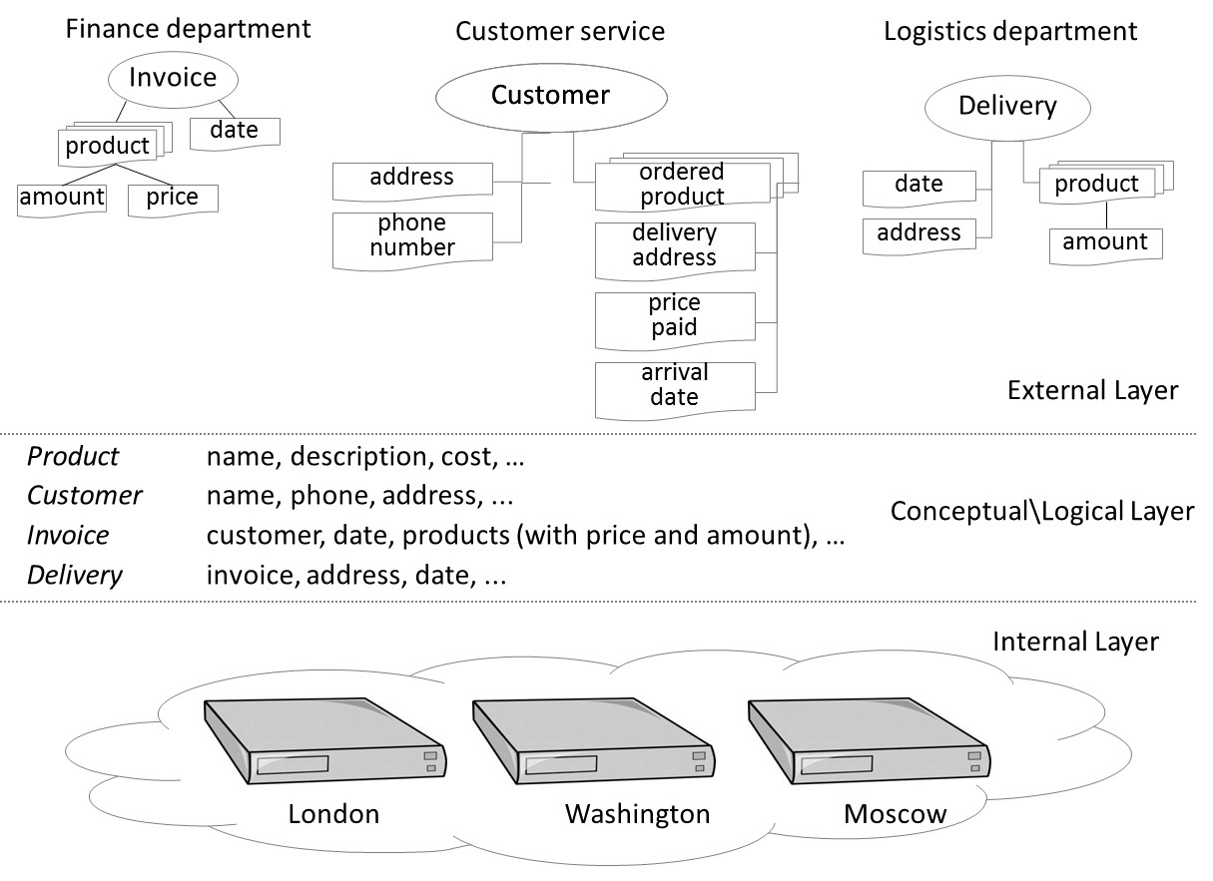
Introduction
Storage Hardware and Physical Database Design: Basics
Record Organization: Data Items
File Organizations: Primary and Secondary
Appendix
Dynamic Hashing

Slide 3
Stroage Hardware and Physical Database Design

Slide 4
Storage Hardware and Physical Database Design
The storage hierarchy
Internals of hard disk drives
From logical concepts to physical constructs

Slide 5
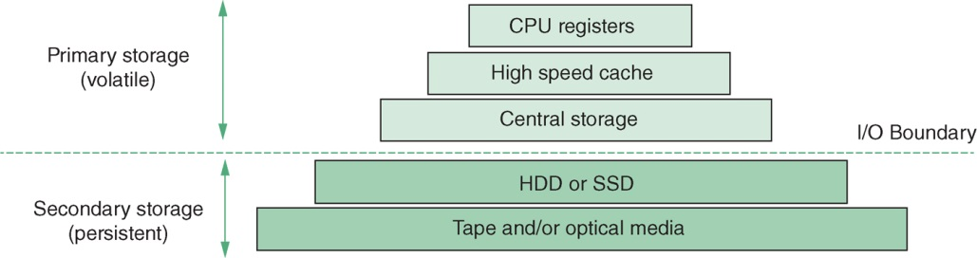
The Storage Hierarchy
A computer system’s memory can be looked upon as a hierarchy: high-speed memory that is very expensive and limited in capacity at the top, and slower memory that is relatively cheap and much larger in size at the bottom

Slide 6
The Storage Hierarchy
Primary Storage
Volatile memory (required power to maintain the content)
Central storage (main memory): consists of memory chips (RAM) of which the performance is expressed in nanoseconds
Contains database buffer and runtime code of the applications and DBMS
Secondary storage
Persistent storage media (not required power to maintain the content)
Hard disk drive (HDD) and solid state drive (SSD) based on flash memory
Contains physical database files

Slide 7
The Storage Hierarchy
Primary and secondary storage are divided by the I/O boundary
Exchange of data between secondary storage and primary storage is called I/O (input/output) and is supervised by the operating system
Still lower in the hierarchy: optical drives (e.g., rewritable DVD, Blu-ray) and tape
Assuming hard disk drive is the storage medium!

Slide 8
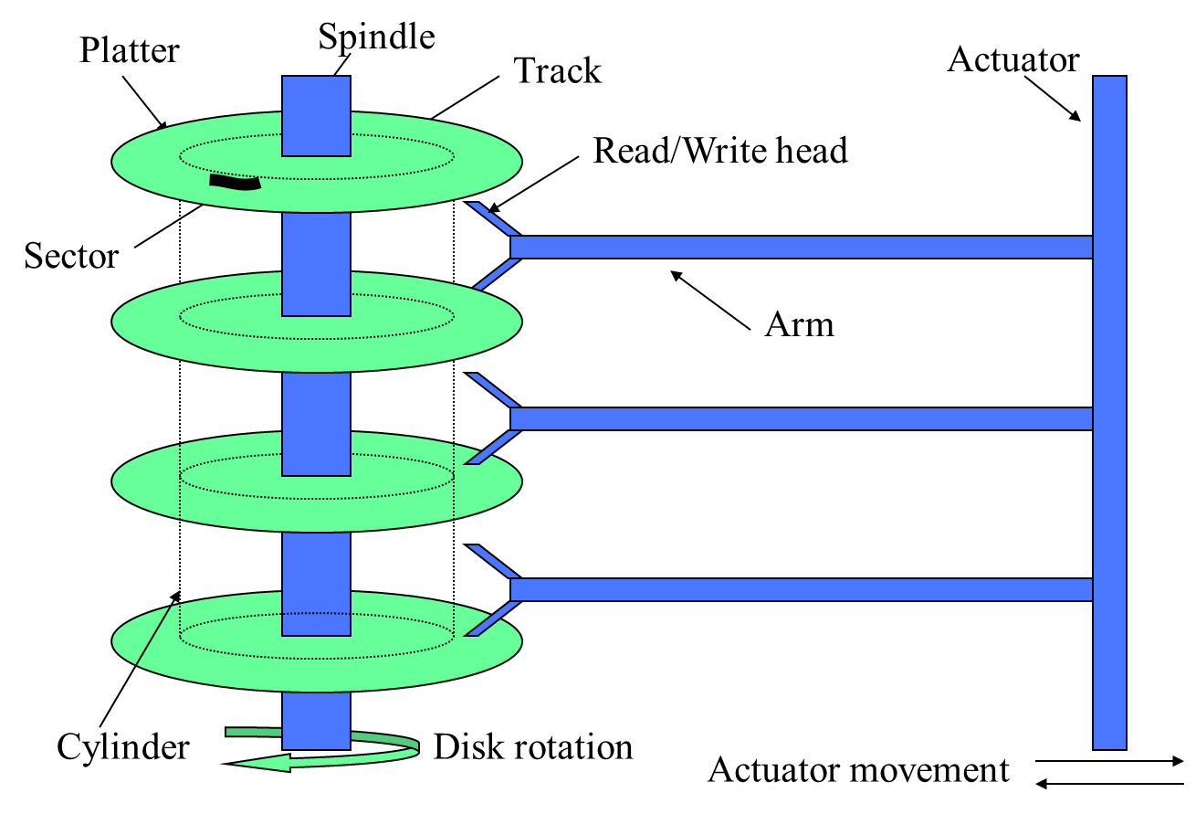
Internals of Hard Disk Drives
Hard disk drive (HDD) stores data on circular platters, which are covered with magnetic particles
HDDs are directly accessible storage devices (DASDs)
Platters are secured on a spindle, which rotates at a constant speed
Read/write heads can be positioned on arms, which are fixed to an actuator

Slide 9
Internals of Hard Disk Drives
DASDs - By combining disk rotation with actuator movement, each individual section of the disk is reachable
Magnetic particles on the platters are organized in concentric circular tracks, with each track consisting of sectors
Physical Data File Assumptions
Sector is the smallest addressable unit on an HDD
Traditionally: 512 bytes; more recently: 4096 bytes
A set of tracks, with the same diameter, is called a cylinder
Disk blocks (clusters, pages, or allocation units) consist of two or more physically adjacent sectors – basic unit for physical database computation

Slide 10
Internals of Hard Disk Drives
Reading from a block, or writing to a block implies:
positioning the actuator (seek time)
waiting until the desired sector has rotated under the read/write head (rotational delay or latency)
Transfer time depends on the block size and the rotation speed of the disks
Response time = service time + queuing time
Service time = seek time + rotational delay + transfer time

Slide 11
Internals of Hard Disk Drives
BS - block size
ROT - rotation time
TR - transfer rate
rba - random block access
sba - sequential block access
T_{rba} refers to the expected time to retrieve/write a disk block independently of the previous read/write:
T_{rba} = seek + ROT/2 + BS/TR
T_{sba} refers to the expected time to sequentially retrieve a disk block with the RW head already in the correct position of its adjacent block:
T_{sba} = ROT/2 + BS/TR

Slide 12
Internals of Hard Disk Drives
Example
Average seek time | 8.9 ms
Spindle speed | 7200 rpm
Transfer rate | 150 MBps
Block size | 4096 bytes
T_{rba} = seek + ROT/2 + BS/TR
T_{sba} = ROT/2 + BS/TR
T_{rba} = 8.9 ms + 4.167 ms + 0.026 ms = 13.093 ms
T_{sba} = 4.167 ms + 0.026 ms = 4.193 ms

Slide 13
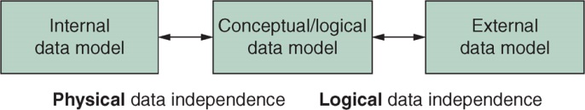
From Logical Concepts to Physical Constructs
Physical database design: translate logical data model into an internal data model (physical data model)
Optimal trade-off between efficient update/retrieval and efficient use of storage space
Focus on the physical organization of relational data

Slide 14
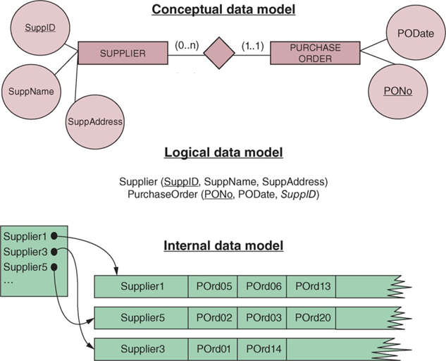
From Logical Concepts to Physical Constructs
Example
One to many relationship
Two Relation Schemas
To optimize processing: Orders for each Supplier connected in records

Slide 15
Introduction
Storage Hardware and Physical Database Design: Basics
Record Organization: Data Items
File Organizations: Primary and Secondary
Appendix
Dynamic Hashing

Slide 16
Record Organization: Data Items

Slide 17
Record Organization
Record organization refers to the organization of data items into stored records
Physical implementation of a data item is a series of bits
Common techniques
Relative location
Embedded identification
Pointers and lists

Slide 18
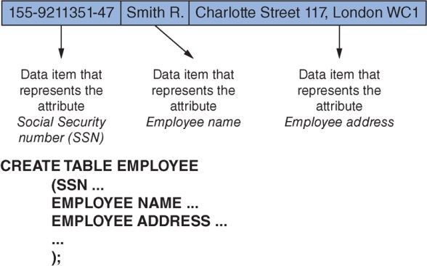
Record Organization
Relative Location
Simplest and most widespread
Data items that represent the attributes of the same entity are stored on physically adjacent addresses
Attribute types are determined by the relative ordering
Example

Slide 19
Record Organization
Embedded identification
Data items representing attributes are always preceded by the attribute type
Only non-empty attributes of the record are included
Missing attributes are not a problem and there is no need to store the attributes in a fixed order to identify them
Quite similar to XML and JSON
Example

Slide 20
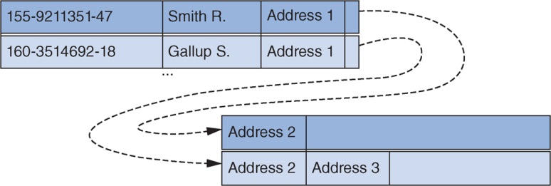
Record Organization
Pointers and lists
Ideal for dealing with variable-length records (due to, e.g., variable length data type, multi-valued attribute type, optional attribute type, etc.)
Multiple valued attribute can be flexibly stored

Slide 21
Record Organization
Blocking factor (BF) indicates how many records are stored in a single disk block
For a file with fixed-length records, BF is calculated as follows: BF= ⌊BS/RS⌋ (I.e. Block Size/Record Size)
For variable-length records, BF denotes the average number of records in a block
BF determines how many records are retrieved with a single read operation

Slide 22
Record Organization
Example
Consider a movie database with the following relations and sizes of each attribute:
Film(title: 40 bytes, director_name: 20 bytes, release_year: 4 bytes, company: 20 bytes)
Actor(id: 4 bytes, name: 20 bytes, date_of_birth: 4 bytes)
What is the blocking factor BF_{F} for the Film relation and BF_{A} for the Actor relation?
BF_{Film}:
BF_{Actor}:
Assuming that we have 30,000 films and 100,000 actors. What are the sizes of the Film file and the Actor file?
Film:
Actor:
84 bytes/record
28 bytes/record
⎣512 bytes per page / 84 bytes per Film record⎦ = 6
⎣512 bytes per page / 28 bytes per Actor record⎦ = 18
⎡(30,000 Film records / 6 Film records per page)⎤ = 5000 pages
⎡(100,000 Actor records / 18 Actor records per page)⎤ = 556 pages

Slide 23
Introduction
Storage Hardware and Physical Database Design: Basics
Record Organization: Data Items
File Organizations: Primary and Secondary
Appendix
Dynamic Hashing

Slide 24
File Organization: Primary and Secondary

Slide 25
File Organization
Introductory concepts
Heap file organization
Sequential file organization
Random file organization (hashing)
Indexed sequential file organization
Secondary indexes and inverted files
B-trees and B⁺-trees

Slide 26
Introductory Concepts
Search key: single attribute type, or set of attribute types
Can be simply the primary key or one or more non-primary key attributes
Can be composite, e.g., (country, gender)
Can specify point queries, e.g., find the student with StudentID = 007
Can also be used to specify range queries, e.g., find all students with YearOfBirth between 1980 and 1990
Primary file organization methods: determine the physical positioning of stored records on a storage medium
Heap file, random file, indexed sequential file organizations
Can only have one primary file organization choosing from above

Slide 27
Introductory Concepts
Linear search (full scan): each record in the file is retrieved and assessed against the search key
Hashing and (B+ tree) indexing: techniques that specify a relationship between a record’s search key and its physical location
Secondary file organization methods: provide other constructs to efficiently retrieve records according to a search key that is not used for the primary file organization.
Example
In addition, we impose a B+-tree for secondary file organization (using a non-primary search key)
Records are sorted according to one primary search key

Slide 28
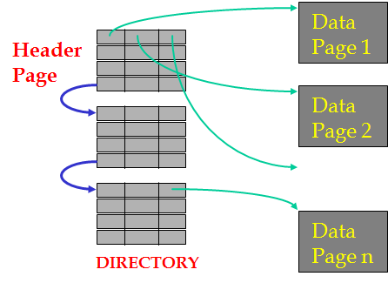
Heap File Organization
Basic primary file organization method
New records are inserted at the end of the file but no relationship between a record’s attributes and its physical location → Only option for record retrieval is linear search
For a file with NBLK (Number of BLock) blocks, it takes on average NBLK/2 sequential block accesses to find a record according to a unique search key
Searching records according to a non-unique search key requires scanning the entire file
Linked list and directory implementation of Heap: the directory is a collection of pages and their info
Example

Slide 29
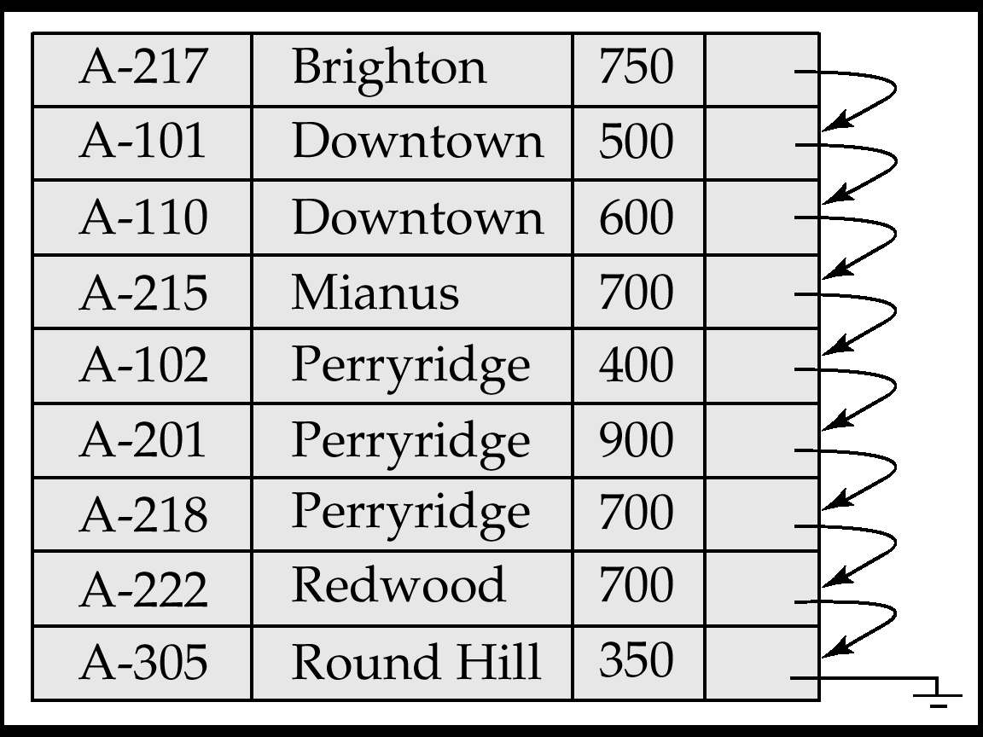
Sequential File Organization
Records are stored in ascending or descending order of a search key
It is much more efficient to retrieve records in the order determined by the search key
Records can still be retrieved by means of linear search, but now a more effective stopping criterion can be used, i.e., once the first higher/lower key value than the required one is found (binary search)
Search Key: Branch
Example
When updates happen frequently- need to reorganize the file from time to time to restore sequential order

Slide 30
Sequential File Organization
Binary search technique can be used
For a unique search key K, with values K_{i}, the algorithm to retrieve a record with key value K_{μ} is as follows:
Selection criterion: record with search key value K_{μ}
Set l = 1; h = number of blocks in the file (suppose the records are in ascending order of the search key K)
Repeat until h ≥ l
i = (l + h) / 2, rounded to the nearest integer
Retrieve block i and examine each key value K_{j} in block i
if any K_{j} = K_{μ} → the record is found!
else if K_{μ} > all K_{j} → continue with l = i+1
else if K_{μ} < all K_{j} → continue with h = i-1
else record is not in the file

Slide 31
Sequential File Organization
Expected number of block accesses to retrieve a record according to its primary key by means of
Linear search: NBLK/2 sequential block accesses (sba)
Binary search: log₂(NBLK) random block accesses (rba)
Updating a sequential file is more cumbersome than updating a heap file
Often done in batches
Sequential files are often combined with one or more indexes (indexed sequential file organization)

Slide 32
Sequential File Organization
Number of records (NR) | 30,000
Block size (BS) | 2048 bytes
Records size (RS) | 100 bytes
Example
To retrieve a single record using a primary key
BF = ⌊BS/RS⌋ = ⌊2048/100⌋ = 20
NBLK = 30,000/20 = 1500
If linear search is used, the expected number of block accesses is ⎡1500/2⎤ = 750 sba
If binary search is used, the expected number of block accesses is
⎡log₂(1500)⎤ =11 rba

Slide 33
Random File Organization (Hashing)
Random file organization (or hash file organization) assumes a relationship between the value of the search key and a record’s physical location (memory address)
A hashing algorithm defines a key-to-address transformation
Generated addresses pertain to a bucket (a number of blocks), which is a contiguous area of record addresses
Most effective when using a primary key or other candidate key as a search key

Slide 34
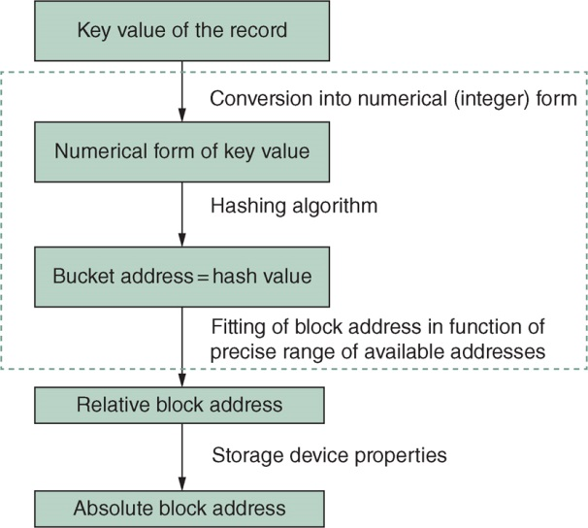
Random File Organization (Hashing)

Slide 35
Random File Organization (Hashing)
Hashing cannot guarantee that all keys are mapped to different hash values, hence bucket addresses
Collision occurs when several records are assigned to the same bucket (also called synonyms)
If there are more synonyms than slots for a certain bucket, the bucket is said to be in overflow
Additional block accesses are needed to retrieve overflow records
One popular hashing technique is division:
address(key_{i}) = f(key_{i})mod M, where f is a hash function and M is the number of buckets (bucket space)
Hashing algorithm should distribute keys as evenly as possible over the bucket space (see next example)

Slide 36
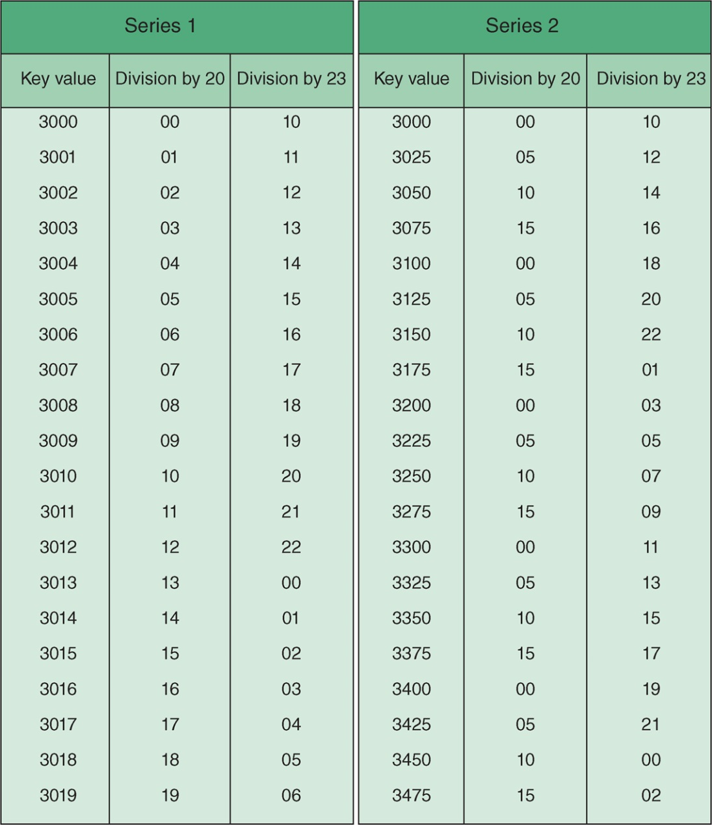
Random File Organization (Hashing)
Example
The effect of different hash function on key distributions

Slide 37
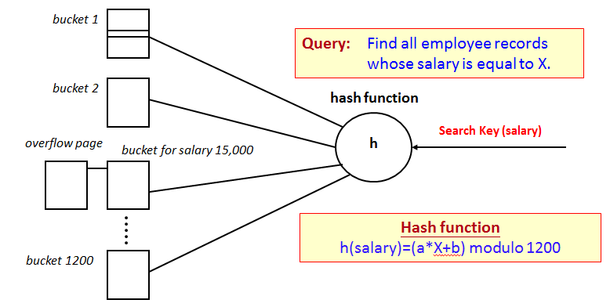
Random File Organization (Hashing)
Efficiency of hashing algorithm is measured by the expected number of rba and sba
Retrieving a non-overflow record:
One rba to the first block of the bucket denoted by the hashing algorithm, possibly followed by one or more sba for other blocks of the bucket
Additional block accesses needed for overflow record depending on percentage of overflow records and overflow handling techniques
Example
Using chaining for
overflow handling
Salary = 15,000

Slide 38
Random File Organization (Hashing)
Percentage of overflow records depends on hashing algorithm and key set
The aim is to achieve a uniform distribution, spreading the set of records evenly over the bucket space
Required number of buckets NB becomes: NB = ⌈NR / (BS × LF)⌉, with NR the number of records, BS the bucket size, and LF the loading factor
Trade-off between BS and NB: larger bucket size implies smaller chance of overflow, but more additional overhead to retrieve non-overflow records (more number of sba for a larger bucket)

Slide 39
Random File Organization (Hashing)
Loading factor (LF) represents the average number of records in a bucket divided by the bucket size
Indicates how “full” every bucket is on average
Embodies tradeoff between efficient use of storage capacity and retrieval performance
Often set between 0.7 and 0.9

Slide 40
Random File Organization (Hashing)
Chaining
Overflow records stored in separate overflow area, with subsequent records that overflow from the same bucket being chained together by pointers (a linked list)
Pro: no interruption of basic bucket space by additional overflow
Con: need additional rba for the chained overflow buckets
Other overflow-handling techniques
Using another hash function or pushing to nearest non-full block
In practice, dynamic hashing techniques allow for a file to shrink or grow without completely rearranged the records (see the technique in Appendix)

Slide 41
Indexed Sequential File Organization
Random file organization is efficient to retrieve individual records by their search key value (hashing)
Sequential file organization is efficient if many records are to be retrieved in a certain order (sorting)
Indexed sequential file organization method reconciles both concerns
Indexed sequential file organization combines sequential file organization with the use of one or more indexes

Slide 42
Indexed Sequential File Organization
The file is divided into intervals (or partitions)
Each interval is represented by an index entry containing
the search key value of the first record in the interval
a pointer to the physical position of the first record in the interval
The index itself is then a sequential file, ordered according to the search key values with entries having the following format: <search key, pointer>
Pointer can be block pointer (referring to the physical block address) or record pointer (consisting of the combination of a block address and a record id or offset within this block)
Search key can be atomic (e.g., a CustomerID) or composite (e.g., Year of Birth and Gender)

Slide 43
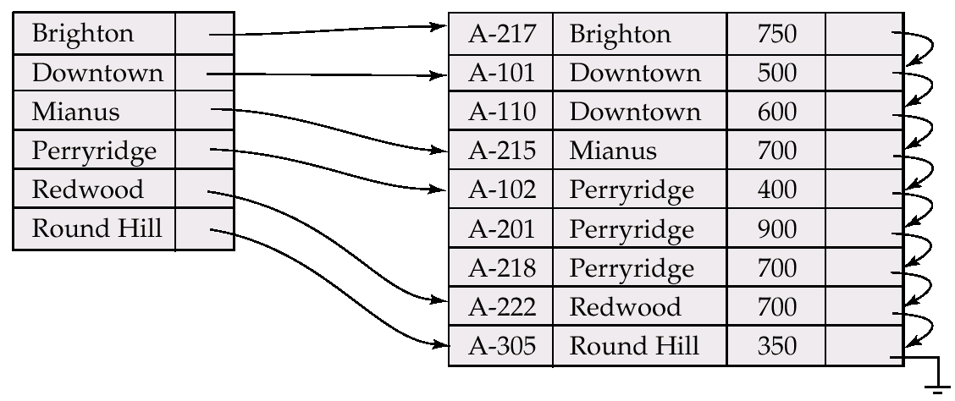
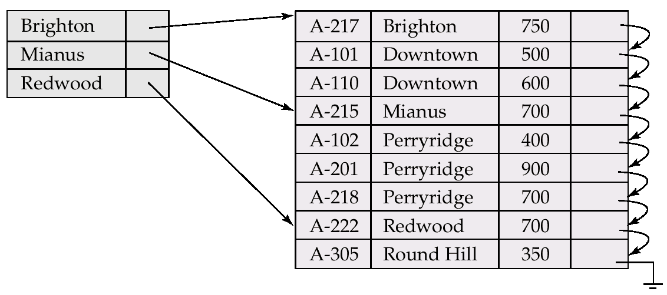
Indexed Sequential File Organization
A dense index has an index entry for every possible value of the search key
A sparse index has an index entry for only some of the search key values
Dense indexes are generally faster, but require more storage space and are more complex to maintain than sparse indexes
Note: the index file occupies fewer disk blocks than the data file and can be searched much quicker
Index using Branch
Search Key: Branch
Example: assuming one record per block
dense index
sparse index

Slide 44
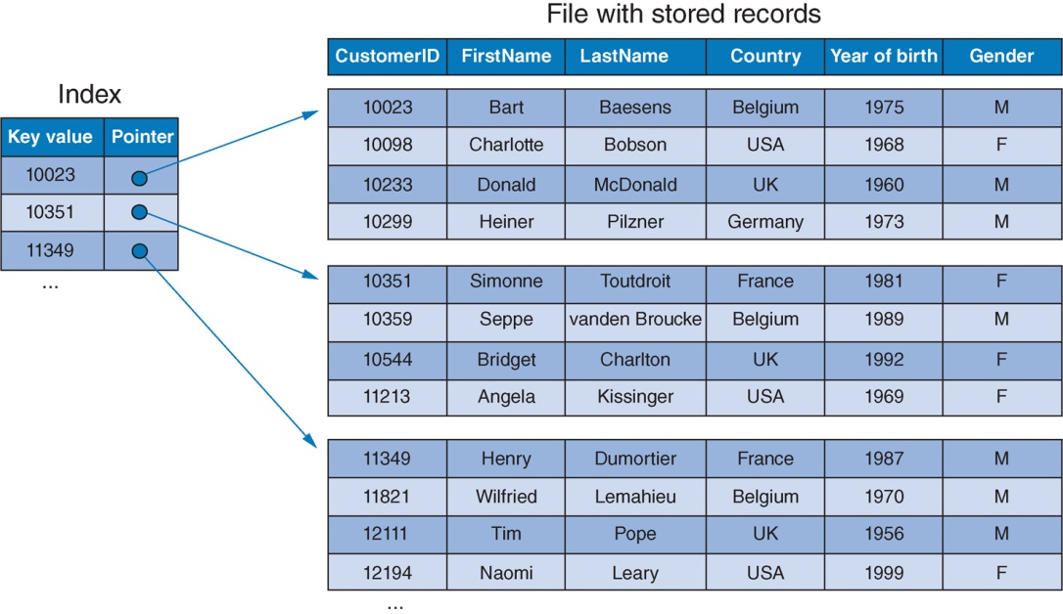
Indexed Sequential File Organization
With primary index file organization, the data file is ordered on a unique key (e.g., primary key, candidate key) and an index is defined over this unique search key
Search Key (Primary Key)
Example
A block of
stored records
A sparse index on primary index file organization

Slide 45
Indexed Sequential File Organization
Linear search | NBLK sba
Binary search | log₂(NBLK) rba
Index-based search | (log₂(NBLKI) + 1) rba, with NBLKI << NBLK
Note: NBLKI represents the number of blocks in the index!

Slide 46
Indexed Sequential File Organization
Number of records (NR) | 30,000
Block size (BS) | 2048 bytes
Records size (RS) | 100 bytes
Index entry | 15 bytes
Example
To retrieve a single record
using a sparse index (one index per data block)
Blocking factor of the index (BFI) = ⌊2048/15⌋ = 136
NBLKI = ⌈1500/136⌉ = 12 blocks
Binary search on the index requires ⌈log₂(12)⌉ + 1 = 5 rba (compare to 750 sba and 11 rba using sequential file organization!)

Slide 47
Indexed Sequential File Organization
Clustered index is similar to a primary index, with the difference that the ordering criterion, and therefore the search key, is a non-key attribute type or set of attribute types
Can be dense or sparse
Search process is the same as with a primary index, except additional sba may be required after the first rba to the data file, to retrieve all subsequent records with the same search key value using the previous example:
Binary search on the first block of clustered index requires ⌈log₂(12)⌉ + 1 = 5 rba as before
After the first block, it requires (n-1) sba to obtain other blocks, where n is the total number of blocks holding the clustered records

Slide 48
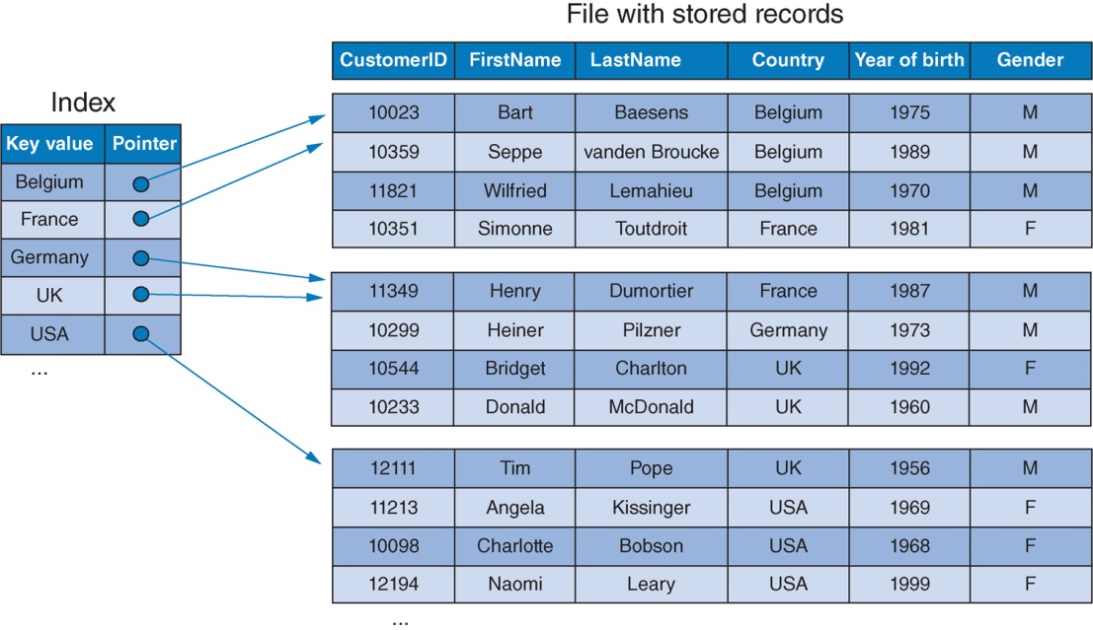
Indexed Sequential File Organization
Example
A (dense) clustered index file organization

Slide 49
Indexed Sequential File Organization
Similar to primary indexes, clustered indexes assume keeping the index up-to-date if records in the data file are inserted or deleted or if their search key value is updated
Options:
Start a new block in the data file for every new value of the search key
Provide a separate overflow section for records that cannot be stored in the appropriate position in the regular sequential file

Slide 50
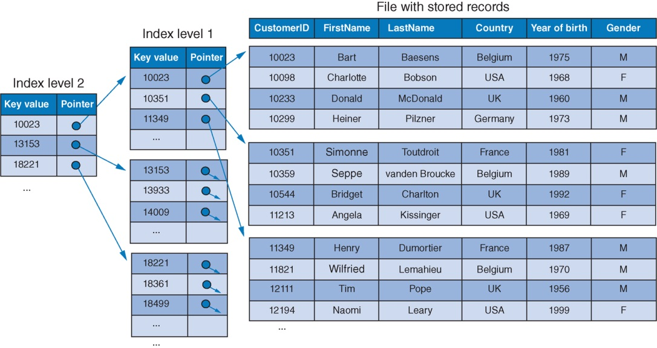
Indexed Sequential File Organization
Creating an index-to-an-index results in multilevel indexes
Example

Slide 51
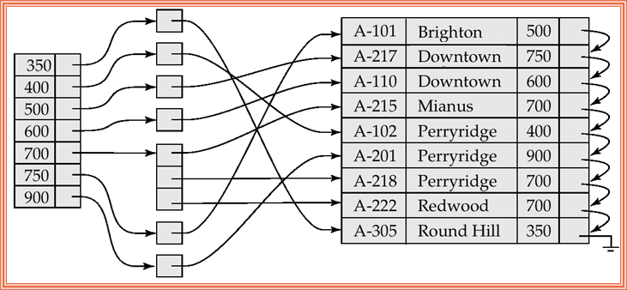
Indexed Sequential File Organization
Primary index and clustered index can never occur together since there is only one way to physically order a file
Secondary indexes can be defined over other search keys
No impact on the physical ordering of the records
Secondary Index on balance
Clustered Index on Branch
Example
Clustered Index on city name
Secondary Index on balance field of account
Account# Branch balance

Slide 52
Secondary Indexes and Inverted files
Characteristics of secondary indexes
Inverted files
Multicolumn indexes
Other index types

Slide 53
Characteristics of Secondary Indexes
A secondary index is based on an attribute type or set of attribute types that is/are not used as ordering criteria of the actual data file
A secondary index’s search key can be
atomic or composite
primary key, other candidate key, or a non-key attribute type or combination of attribute types
A secondary index is again a sequential file that can be searched by means of binary search

Slide 54
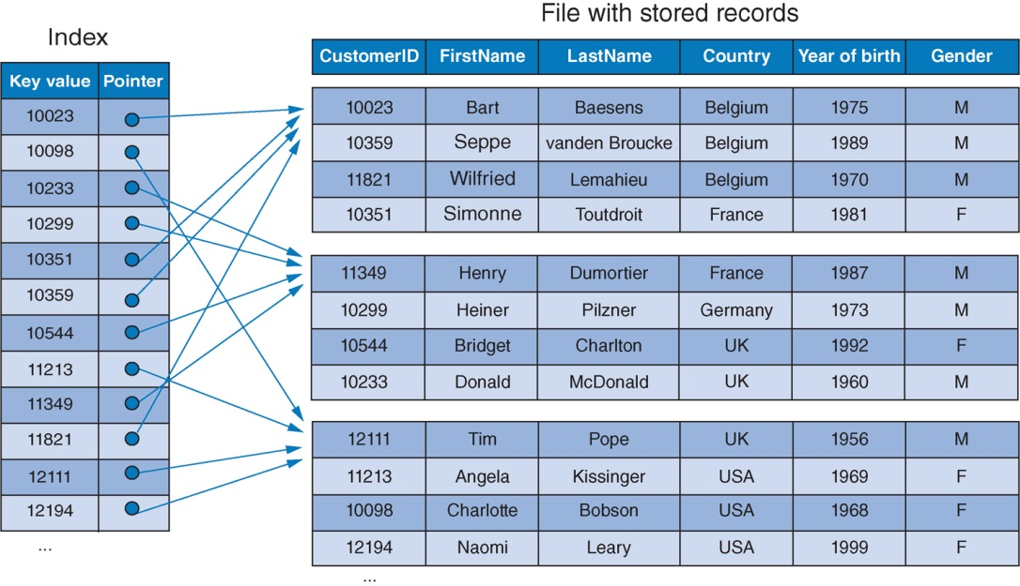
Characteristics of Secondary Indexes
Secondary Index on CustomerID
Clustered Index on Country
Example
The secondary index (CustomerID) is a
unique search key

Slide 55
Characteristics of Secondary Indexes
If the search key is non-unique
Dense index, with an index entry for each record and multiple entries with the same key value
Add a level of indirection, with each index entry referring to a separate block that contains all pointers to records with the corresponding search key value (inverted file)
Level of indirection
Example

Slide 56
Characteristics of Secondary Indexes
Number of records (NR) | 30,000
Block size (BS) | 2048 bytes
Records size (RS) | 100 bytes
Index entry | 15 bytes
Example
To retrieve a single record using a secondary index
Secondary index defined over a unique search key. Index contains 30,000 index entries (one for each search key value!)
NBLKI = ⌈30,000/136⌉ = 221 blocks
Expected number of block accesses to retrieve a record by means of the secondary index then equals ⌈ Log₂(221) + 1 ⌉ = 9 rba
(Compare to: without a secondary index, it would take a full file scan, hence on average 1500/2 = 750 sba)

Slide 57
Inverted Files
An inverted file defines an index over a non-unique, non-ordering search key of a dataset
Index entries have the format <key value, block address>
Block address refers to a block containing record pointers or block pointers to all records with that particular key value
Requires an additional rba to the block with pointers to records
Queries that involve multiple attribute types can be executed efficiently by taking the intersection of the blocks with pointers

Slide 58
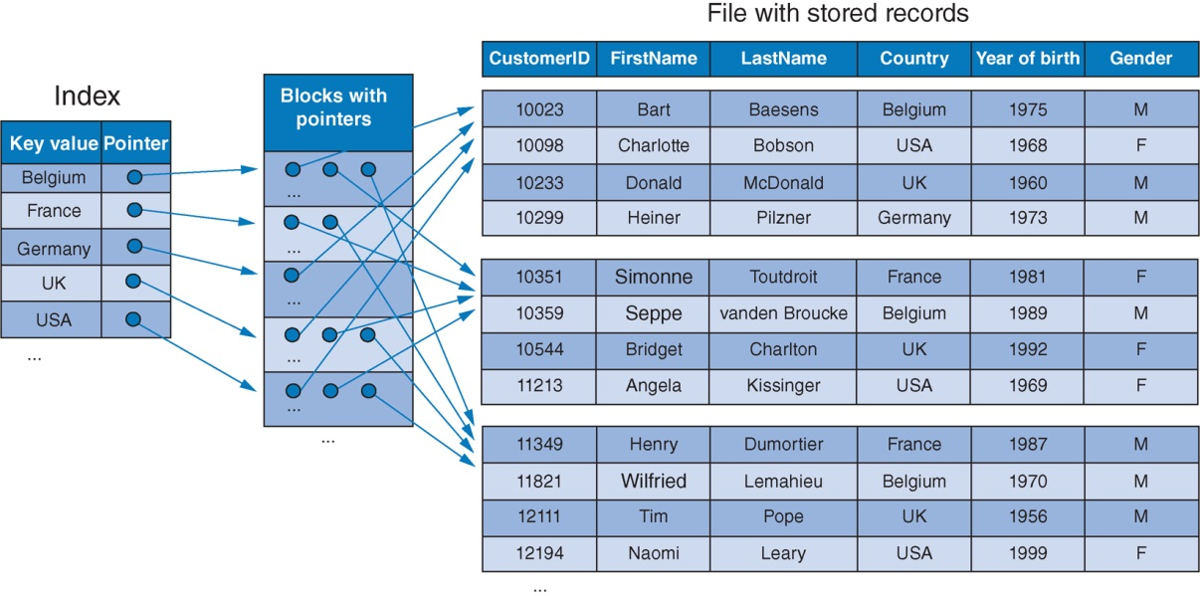
Inverted Files
Primary Index on CustomerID
Secondary Index on Country
Example
Inverted file index – index to
a block of pointers

Slide 59
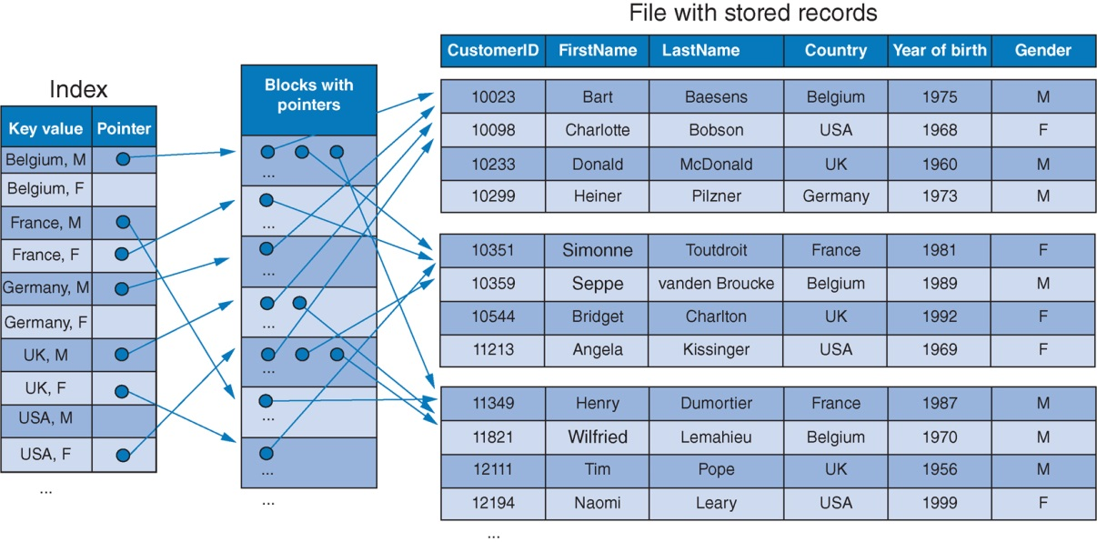
Multicolumn Indexes
A multicolumn index is an index over a composite search key
Implemented using inverted files
Efficient to retrieve all records with the desired (Country, Gender) values or all people living in a certain country, regardless of their gender!
Not efficient to retrieve all males regardless of the country!
Multicolumn index Index on (Country, Gender)
Example

Slide 60
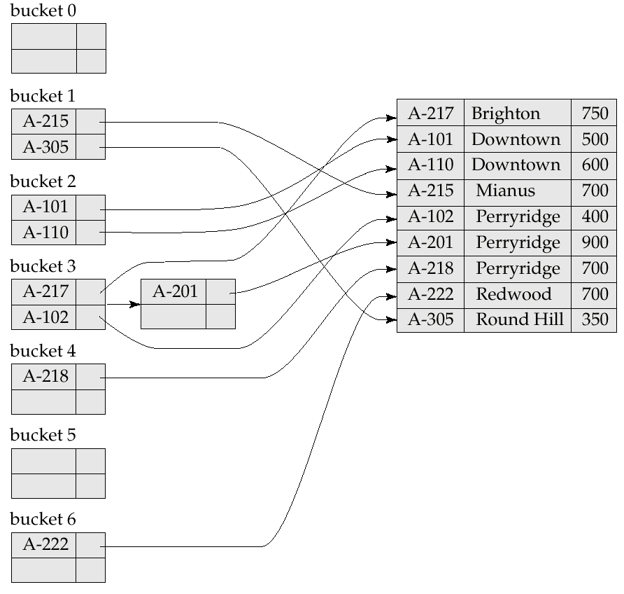
Other Indexes
Hash indexes (always!) provide a secondary file organization method
Index entries have the format: <key value, pointer>
Index is organized as a hash file
Applying the hash function to the search key yields the index block where the corresponding index entry can be found
Example

Slide 61
Other Indexes
Bitmap index
For attribute types with only a limited set of possible values
Contain a row ID and a series of bits – one bit for each possible value of the indexed attribute type
Bit position that corresponds to the actual value for the row at hand is set to “1”
Row IDs can be mapped to record pointers
By applying Boolean operations to bit vectors from multiple bitmap indexes, it becomes efficient to identify records that satisfy certain criteria

Slide 62
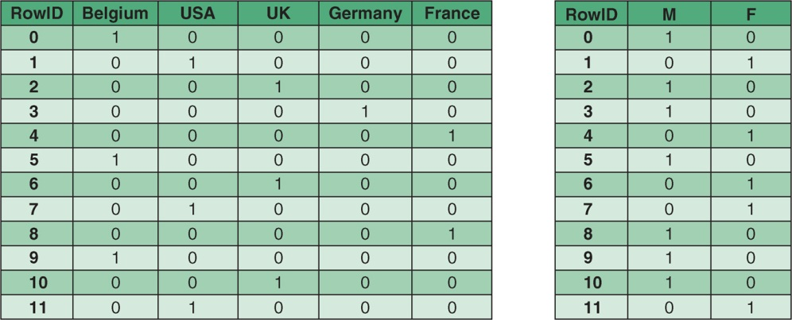
Other Indexes
Example
Join index
A multicolumn index that combines attribute types from two or more tables in such a way that it contains the precalculated result of a join between these tables

Slide 63
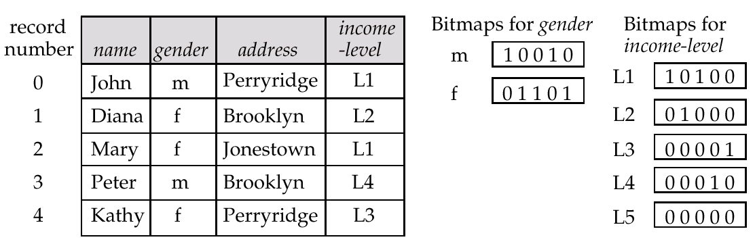
Other Indexes
Example
Each operation takes two bitmaps of the same size and applies the operation on corresponding bits to get the result bitmap
Query: Males with income level L1: 10010 AND 10100 = 10000
Can then retrieve required tuples. (I.e. the 0th record as the answer)
Counting number of matching tuples is even faster! (especially useful for aggregation queries) (count = 1 as the answer)

Slide 64
File Organization
Introductory concepts
Heap file organization
Sequential file organization
Random file organization (hashing)
Indexed sequential file organization
List data organization
Secondary indexes and inverted files
B-trees and B⁺-trees
Index type | Impacts physical ordering of tuples | Unique search key | Dense or sparse
Primary | Yes | Yes | Sparse
Clustered | Yes | No | Dense or sparse
Secondary | No | Yes | Dense
 |  | No | Dense or inverted file

Slide 65
B-Trees and B⁺-Trees
Multilevel indexes revisited
Binary search trees
B-trees
B⁺-trees

Slide 66
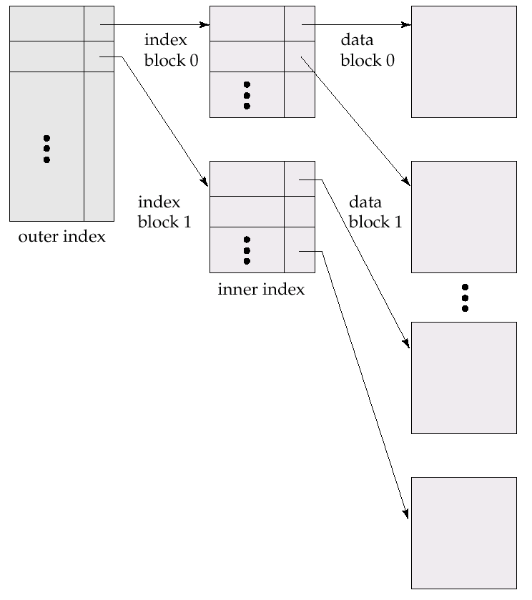
Multilevel Indexes Revisited
Multilevel indexes are useful for speeding up data access if the lowest level index itself becomes too large. Need to add index levels until the highest level index fits within a single disk block
A multilevel index can be considered as a search tree, with each index level representing a level in the tree, each index block representing a node, and each access to the index resulting in navigation toward a subtree in the tree
Multilevel indexes may speed-up data retrieval, but large multilevel indexes require a lot of maintenance in the event of updates
Multilevel indexes

Slide 67
Multilevel Indexes Revisited
With a binary search on a single index, the search interval, consisting of disk blocks, is reduced by a factor of two with every iteration
Requires approximately log₂(NBLKI) rba to search an index consisting of NBLKI blocks (search sorted indexes)
One additional rba is needed to the actual data file
With a multilevel index, the search interval is reduced by a factor BFI with every index level (BFI = blocking factor of the index)
BFI denotes how many index entries fit within a single disk block
Also called the fan-out of the index
Claim: a multilevel index is more efficient than a binary search on a single-level index. Retrieval cost = ⌈log_{BFI}⁡(NBLKI)+2⌉ rba (NBLKI = number of blocks in first-level index).
BFI is typically much higher than two, so using a multilevel index is more efficient than a binary search on a single-level index
The proof the claim is detailed in next slide

Slide 68
Multilevel Indexes Revisited
Proof: Searching a data file according to a multilevel index requires ⌈log_{BFI}⁡(NBLKI)+2⌉ rba (NBLKI = number of blocks in first-level index).
The number of required blocks for index level i can be calculated as follows: NBLKI_{i} = ⌈NBLKI_{i-1}/BFI ⌉ for i = 2,3,…
By applying the previous formula (i – 1) times, we derive that
NBLKI_{i} = ⌈NBLKI/(BFI)^{i-1} ⌉ for i = 2,3,… and with NBLKI the number of blocks in the lowest level index (i.e. NBLKI₁)
For the highest-level index, consisting of only one block, it then holds that 1 = ⌈NBLKI/(BFI)^{h-1}⌉, with h denoting the highest index level
Therefore h – 1 = ⌈log_{BFI}⁡(NBLKI) ⌉ and hence h = ⌈log_{BFI}⁡(NBLKI) + 1⌉
The number of block accesses to retrieve a record by means of a multilevel index then corresponds to an rba for each index level, plus an rba to the data file, which thus equals ⌈log_{BFI}⁡(NBLKI) + 2⌉ rba

Slide 69
Multilevel Indexes Revisited
Number of blocks in the first-level (dense) index (NBLKI) = ⌈30000/136⌉ = 221
The second-level index then contains 221 entries and consumes ⌈221/136⌉ = 2 disk blocks
If a third index level is introduced, it contains two index entries and fits within a single disk block
Searching a record by means of the multilevel index requires four rba; three to the respective index levels and one to the actual data file
Can also be calculated as follows: ⌈log₁₃₆⁡(221) + 2⌉ = 4 rba
Compare to 5 rba using sequential indexed file as before!
Number of records (NR) | 30,000
Block size (BS) | 2048 bytes
Records size (RS) | 100 bytes
Index entry | 15 bytes
Example
To retrieve a single record using a multilevel index

Slide 70
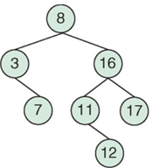
Binary Search Trees
A binary search tree is a physical tree structure, in which each node has at most two children
Each tree node contains a search key value and maximum two pointers to children
Both children are the root nodes of subtrees, with one subtree only containing key values that are lower than the key value in the original node, and the other subtree only containing key values that are higher
Example

Slide 71
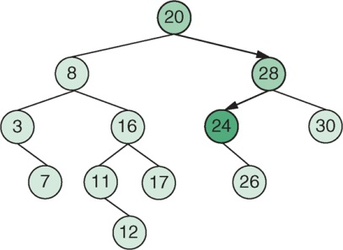
Binary Search Trees
Search efficiency is improved by “skipping” half of the search key values with every step (similar to binary search)
Suppose the search key is used with values K_{i}
To find the node with search key value K _{μ}, the key value K_{i} in the root node is compared to K_{μ}
If K_{i} = K_{μ}, the search key is found
If K_{i} > K _{μ}, then the pointer to the root of the “left” subtree is followed
Otherwise, if K_{i} < K _{μ}, the pointer to the root of the “right” subtree is followed
Apply recursively to search K_{i}= 24
Example

Slide 72
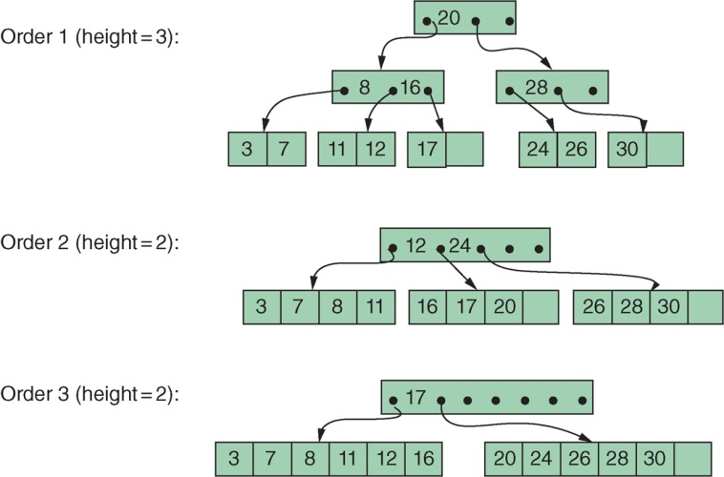
B-trees
Example

Slide 73
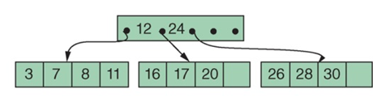
B-trees
A B-tree is a tree-structured index
Can be considered a variation of a search tree
Node capacity requirement: each node corresponds to a disk block and nodes are kept between half-full and full to cater for a certain dynamism
Every node contains a set of search key values, a set of tree pointers that refer to child nodes, and a set of data pointers that refer to data records, or blocks with data records, that correspond to the search key values
Note: data records are stored separately and are not part of the B-tree
Data pointers not shown. Only tree pointers being here

Slide 74
B-trees
A B-tree of order k holds the following properties (contd.):
The root node has a number of key values, and an equal number of data pointers between 1 and 2k. The number of tree pointers and child nodes varies between 2 and 2k + 1. ((2k +1) is called fanout)
All non-leaf nodes (except the root) have a number of key values and data pointers between k and 2k. The number of tree pointers and child nodes varies between k + 1 and 2k + 1.
Every leaf node has a number of key values and data pointers between k and 2k and no tree pointers.
If the indexed search key is non-unique, a level of indirection is introduced (e.g., inverted file approach)
The data pointers Pd_{i} then point to a block containing pointers to all records satisfying the search key value K_{i}

Slide 75
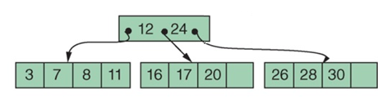
B-trees
A B-tree of order k holds the following properties:
Every non-leaf node is of the format:
<P₀, <K₁, Pd₁>, P₁, <K₂, Pd₂>, … P_{q-1} <K_{q}, Pd_{q}>, P_{q}>, with q ≤ 2k.
P_{i} is a tree pointer: it points to another node in the tree. This node is the root of the subtree that P_{i} refers to.
Every Pd_{i} is a data pointer: it points to the record with key value K_{i}, or to the disk block that contains this record.
Leaf nodes have the same structure as non-leaf nodes, except that all their tree pointers P_{i} are null.
A B-tree is a balanced tree. Every path from the root of the B-tree to any leaf node thus has the same length, which is called the height of the B-tree.
Within a node, the property holds that K₁ < K₂ < … < K_{q}.
For every key value X in the subtree referred to by P_{i}, the following holds:
K_{i} < X < K_{i+1} for 0 < i < q
X < K_{i+1} for i = 0
K_{i} < X for i = q
<P₀, <K₁, Pd₁>, P₁, <K₂, Pd₂>, P₂ >

Slide 76
B-trees
A B-tree is searched recursively starting from the root
If the desired key value X is found in a node (say K_{i} = X), then the corresponding data record(s) can be accessed in the data file by following Pd_{i}
If the desired value is not found in the node, the subtree pointer P_{i} to be followed is the one corresponding to the smallest value of i for which X < K_{i+1}. If X > all K_{i} then the tree pointer P_{i+1} is followed
Note: fan-out and search efficiency is much higher than with a binary search!

Slide 77
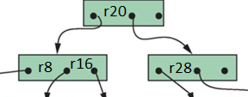
B-trees
Capacity of a node equals the size of a disk block
All nodes, except for the root, are filled to at least 50%
Impact on additions and removals
It is complex to make exact predictions about the required number of block accesses when searching a B-tree
B-trees can also be used as a primary file organization technique
Instead of data pointers, the nodes contain the actual data fields of the records that correspond to the search key values

Slide 78
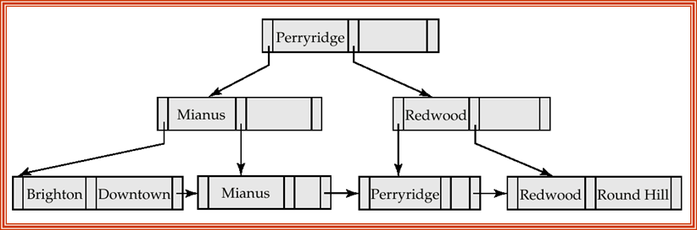
B⁺-trees
In a B⁺-tree the following apply:
Only the leaf nodes contain data pointers
All key values that exist in the non-leaf nodes are repeated in the leaf nodes, such that every key value occurs in a leaf node, along with a corresponding data pointer
Higher-level nodes only contain a subset of the key values present in the leaf nodes
Every leaf node of a B⁺-tree also has one tree pointer, pointing to its next sibling
Data pointers in leaf-nodes are not shown. Only tree pointers of all nodes are shown here
Example

Slide 79
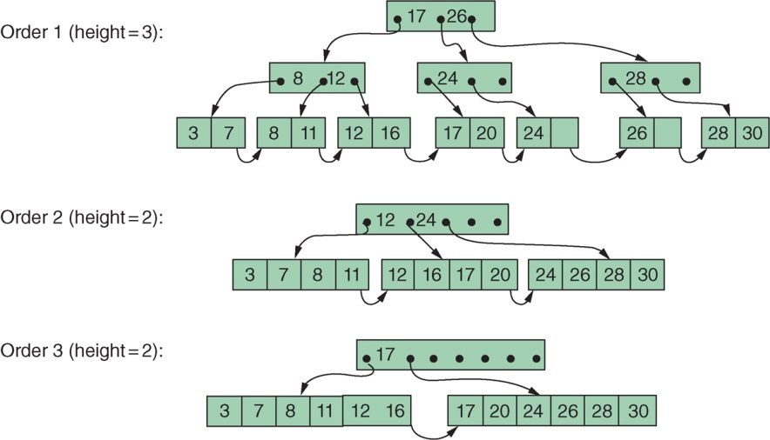
B⁺-trees
Example

Slide 80
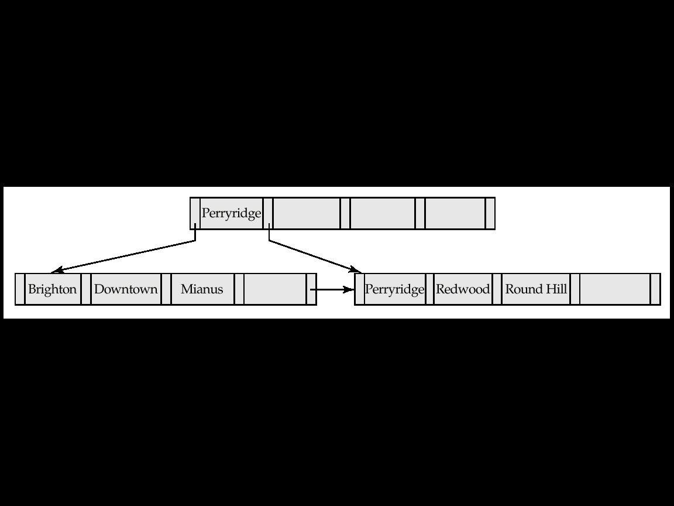
B⁺-tree Example
A B⁺-tree built for account file with fanout n = 5 (i.e. q = 4, k = 2)
Leaf nodes must have between 2 and 4 key values
I.e. ⎡(n–1)/2⎤ and n –1, with n = 5
Non-leaf nodes other than root must have between 3 and 5 children
I.e. ⎡(n/2)⎤ and n, with n =5
Root must have at least 2 children
Example

Slide 81
Observations about B⁺-trees
The inter-node connections are done by tree pointers
Thus, the close blocks need not be “physically” close
That is, no need for sequential storage
The non-leaf levels of the B⁺-tree form a hierarchy of sparse indices
The B⁺-tree contains a relatively small number of levels
Equal to the logarithmic in the size of the main file
If there are K search-key values in the file, the height is no larger than ⎡log_{⎡n/2⎤}(K)⎤ (n is the fanout)
Insertions and deletions can be handled efficiently
Since the index can be restructured in logarithmic time (see later slides)

Slide 82
Queries on B⁺-Trees
Find all records with a search-key value of k
Non-leaf nodes contain m pointers
Start with the root node
If find an entry with key K_{j} = k, follow pointer P_{j+1};
Otherwise, if k < K_{m–1}, follow pointer P_{j}, where K_{j} is the smallest search-key value > k;
Otherwise, if k ≥ K_{m–1}, follow P_{m} to the child node
If the current tree node is not a leaf node
repeat the above procedure on the node;
follow the corresponding pointer
Eventually reach a leaf node
If find an entry with key K_{i} = k, follow pointer P_{i} to the desired record(s);
Else no record with key value k exists

Slide 83
Queries on B⁺⁻Trees (Cont)
When processing a search query,
We traverse the tree from the root to some leaf node
Cost estimation: a node is generally the same size as a disk block, typically 4KB; fanout n is typically around 100 if 40B per index entry (key k + pointer)
If there are 1 million key values
n/2 = 50
Access at most log₅₀(1,000,000) ~ 4 nodes for a query (⎡log_{⎡n/2⎤}(K)⎤ )
1 root page residing in buffer and 3 block/page (rba) accesses are needed
In contrast, a balanced binary tree with 1 million key values
Access around log₂(1,000,000) ~ 20 nodes for a search query
B+-trees are short and fat, while binary trees are long and thin

Slide 84
Insertion to B+ Tree
Insert a data entry with search-key k
Search the tree using k
Find the correct leaf node L
Insert data entry into L
If L has enough space, done!
Else, split L (into L and a new node L2)
Redistribute entries evenly, then copy up middle key
Update the parent of L by insert index entry pointing to L2
Updating can happen recursively
To split index node, redistribute entries evenly, but push up middle key
Splits “grow” tree; root split increases height
Tree growth: gets wider or one level taller at top
Notes:
6

Slide 85
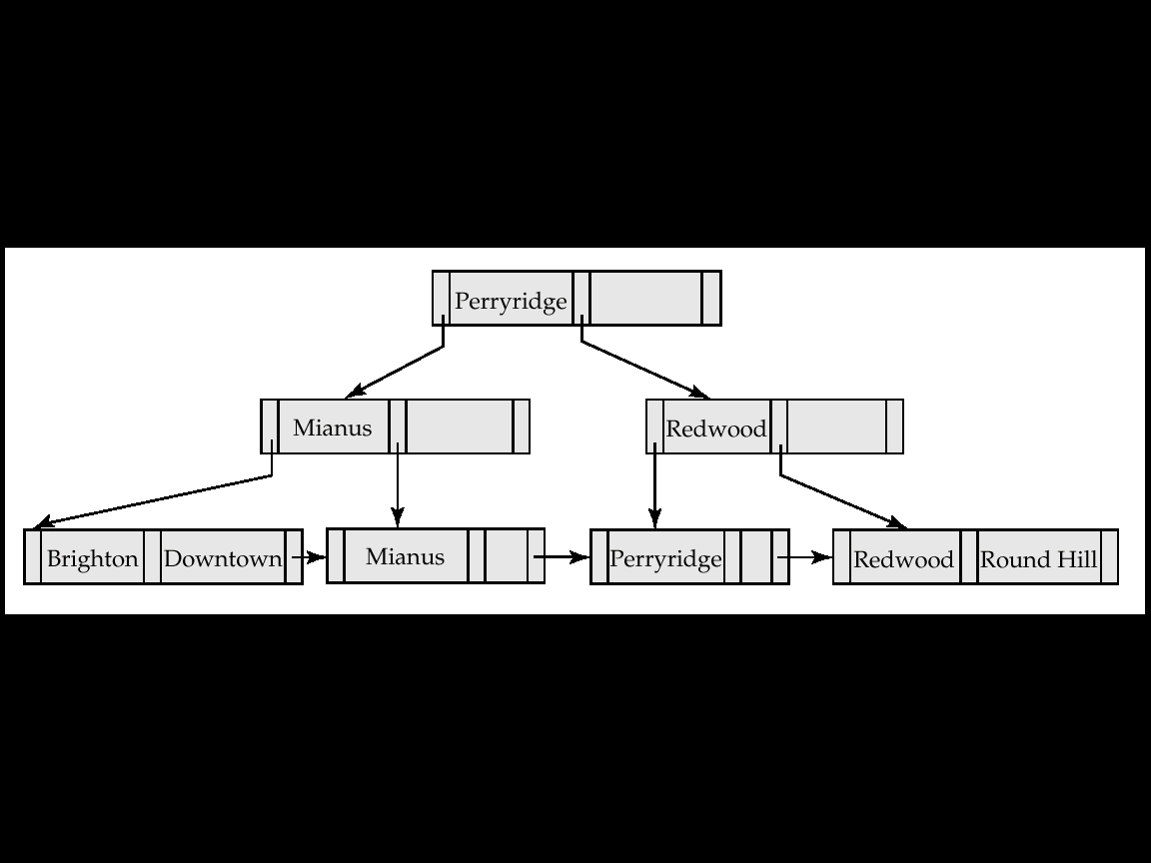
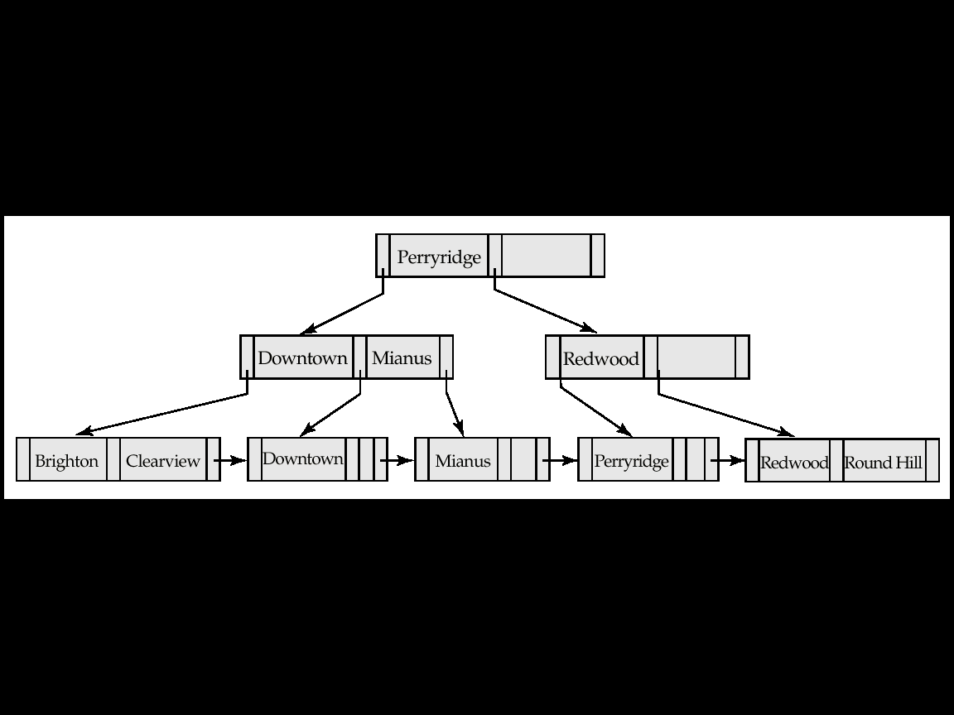
Updates on B⁺-Trees: Insertion (Cont)
Before insertion
Example
Insertion of “Clearview”
After insertion
Split into two leaf nodes

Slide 86
Deletion from B⁺-Tree
Delete a data entry with search-key k
Search the tree with k
Find the leaf node L where entry belongs
Remove the entry
If L is at least half-full, done!
If L is less than half-full,
re-distribute, borrowing from sibling (adjacent node to the right)
If re-distribution fails, merge L and its sibling
If merge occurred,
Delete entry (pointing to L or sibling) from parent of L
Merge could propagate to the root, decreasing height

Slide 87
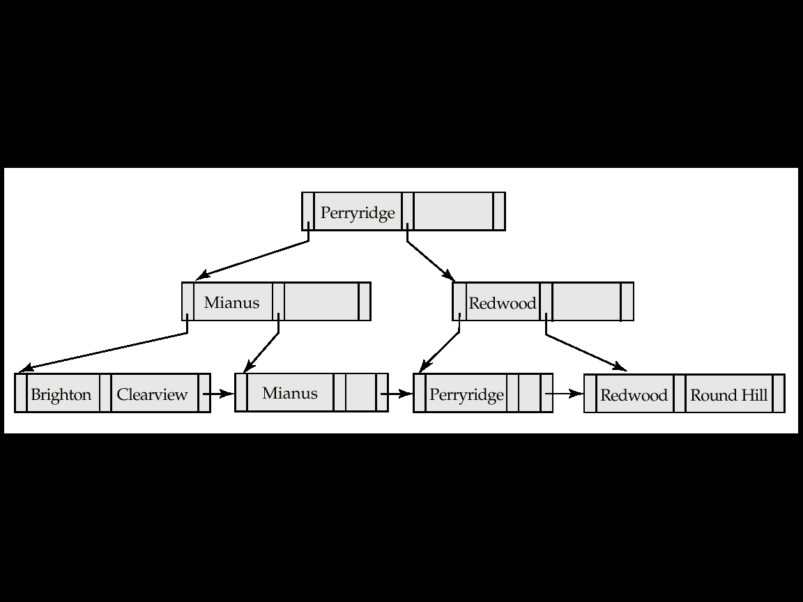
Examples of B⁺-Tree Deletion
Before deletion
Example
Deleting “Downtown”
After deletion
The removal does not result in its parent having too few pointers. So the cascaded deletions stopped with the deleted leaf node’s parent

Slide 88
B+-tree Update Examples
Consider the B+-tree below with order 2 (each node except the root must contain at least two key values and 3 pointers)
Show the tree that would result after successively applying each of the following operations
Example
Remove 1
After removing 1
Remove 41

Slide 89
B+-tree problem (Cont)
Example
After removing 41
Remove 3
Insert 41

Slide 90
B+-tree problem (Cont)
After inserting 41
Example
Insert 1

Slide 91
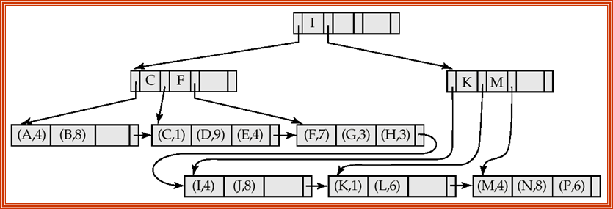
B⁺-trees
Searching and updating a B⁺-tree occurs in a similar way as with a B-tree
B⁺-trees are often more efficient than B-trees, because the non-leaf nodes do not contain any data pointers
The height of a B⁺-tree is often smaller, resulting in fewer block accesses to search the tree
Variations on the fill factor, which is 50% for both standard B-trees and B⁺-trees
e.g., a B-tree with a fill factor of 2/3 is called a B*-tree
B⁺-trees can also be used as a primary file organization technique
Example

Slide 92
Conclusions
Storage hardware basics
From Logical Design to Physical Implementation
Record organizations
Relative location, Embedded identification, Pointers and lists
File organizations
Heap, Sequential, Hash, Indexed Sequential, Tree
Indexes
Primary, Clustered and Secondary (+ Inverted)
Multilevel and Tree indexes (B, B⁺, B*)

Slide 93
Appendix

Slide 94
Dynamic Hashing
Static hashing: Function h maps search-key values to a fixed set of B of bucket addresses
Databases grow with time
If initial number of buckets is too small, performance will degrade due to too much overflows
May allocate more buckets as anticipated but waste space
If database shrinks, again space will be wasted
Periodic re-organization of the file with a new hash function, but it is very expensive
Dynamic hashing:
Allows the number of buckets to be modified dynamically

Slide 95
Dynamic Hashing
Basic ideas:
Bucket (primary page) becomes full
Why not re-organize file by doubling # of buckets?
Reading and writing all pages are expensive!
Use directory of pointers to buckets, double the number of buckets by doubling the directory, splitting just the overflowed bucket!
Directory is much smaller than file, so doubling it is much cheaper
Only one page of data entries is split. No overflow page!
Important: how hash function is adjusted?

Slide 96
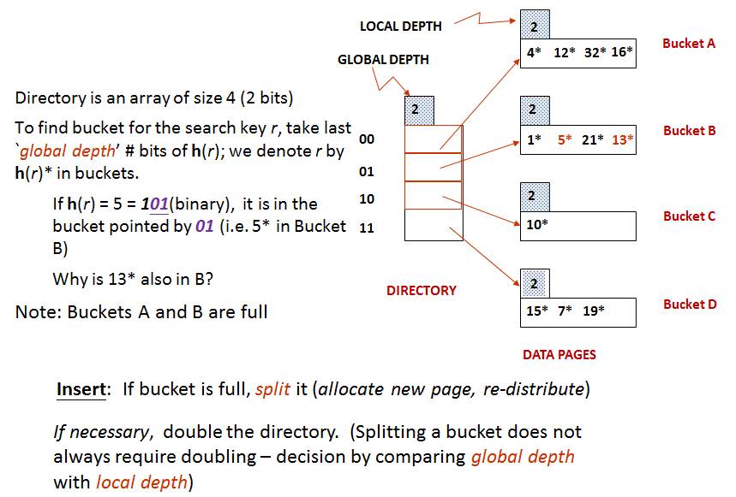
Dynamic Hashing
Extendable hashing

Slide 97
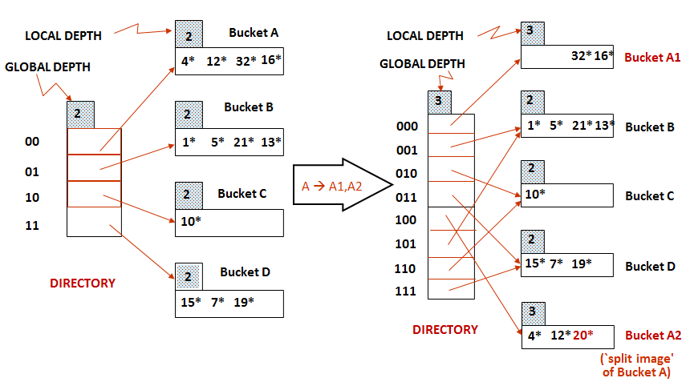
Dynamic Hashing
Example
Insert h(r)=20 (10100) causes split image

Slide 98
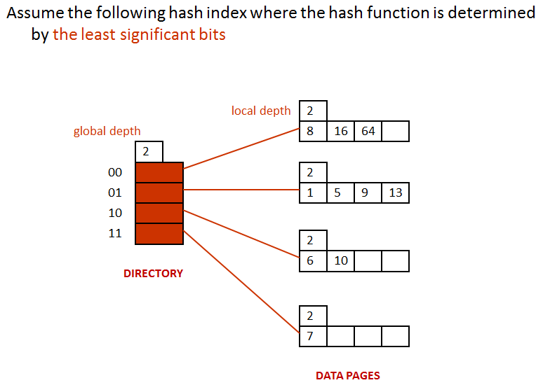
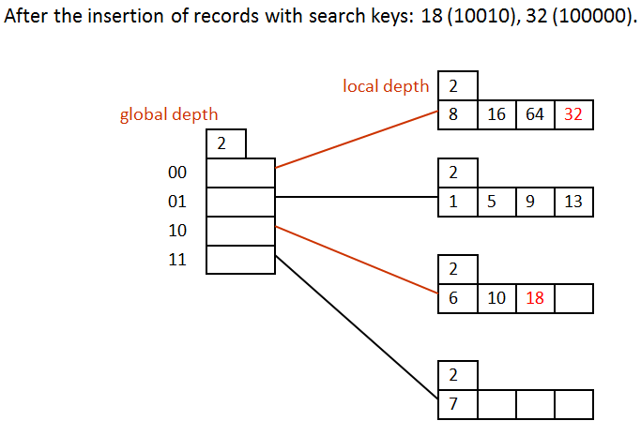

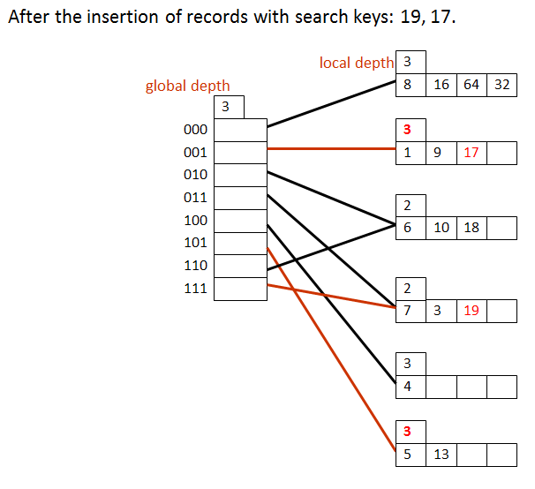
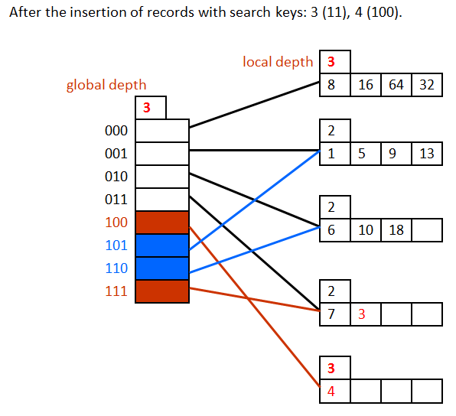

Dynamic Hashing
Example

Slide 99
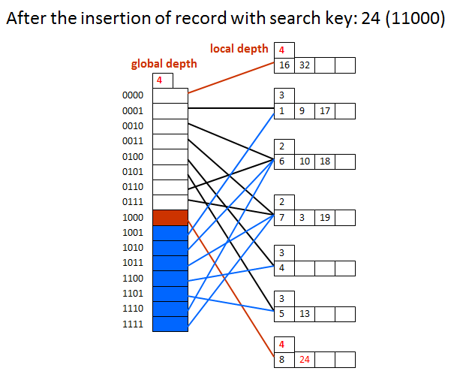
Dynamic Hashing

Slide 100
Acknowledgment This set of slides is mainly adopted from the course materials provided by the textbook: Principles of Database Management

