Slide 1
Comp 3311 Database Management Systems
12-14. Physical File Organization and Indexing
Exercises

Slide 2
Question 1
What is the expected time for a sequential block access and the expected time for a random block access give a hard disk drive with the following characteristics?
Average seek time = 7.5ms
Spindle speed = 5400rpm
Transfer rate = 200MBps
Block size = 512 bytes

Slide 3
Question 1
ROT = 60000/RPM = 11.111ms
T_{rba} = 7.5 ms + 5.555 ms + 0.003 ms = 13.058 ms
T_{sba} = 5.555 ms + 0.003 ms = 5.558 ms
T_{rba} = seek + ROT/2 + BS/TR
T_{sba} = ROT/2 + BS/TR

Slide 4
Question 2
Consider a movie database with the following relations and sizes of each attribute:
Film(title: 40 bytes, director_name: 20 bytes, release_year: 4 bytes, company: 20 bytes)
Actor(id: 4 bytes, name: 20 bytes, date_of_birth: 4 bytes)
There exist 30,000 films in the database and 100,000 actors. Each page is 512 bytes and each pointer is 6 bytes.
1. What is the blocking factor bf_{F} for the Film relation and bf_{A} for the Actor relation?
bf_{F}:
bf_{A}:
84 bytes/record
28 bytes/record
⎣512 bytes per page / 84 bytes per Film record⎦ = 6
⎣512 bytes per page / 28 bytes per Actor record⎦ = 18

Slide 5
Question 2 (cont’d)
Consider a movie database with the following relations and sizes of each attribute:
Film(title: 40 bytes, director_name: 20 bytes, release_year: 4 bytes, company: 20 bytes)
Actor(id: 4 bytes, name: 20 bytes, date_of_birth: 4 bytes)
There exist 30,000 films in the database and 100,000 actors. Each page is 512 bytes and each pointer is 6 bytes.
2. Assuming that the relation Film is sorted on title and there is no index, what is the cost (in terms of page reads) for:
2a. Finding the film with title "Titanic”?
Pages needed:
Search cost:
84 bytes/record; bf_{F} = 6
28 bytes/record; bf_{A} = 18
⎡(30,000 Film records / 6 Film records per page)⎤ = 5000 pages
⎡log₂5000⎤ = 13 pages accesses (binary search)

Slide 6
Question 2 (cont’d)
Consider a movie database with the following relations and sizes of each attribute:
Film(title: 40 bytes, director_name: 20 bytes, release_year: 4 bytes, company: 20 bytes)
Actor(id: 4 bytes, name: 20 bytes, date_of_birth: 4 bytes)
There exist 30,000 films in the database and 100,000 actors. Each page is 512 bytes and each pointer is 6 bytes.
2. Assuming that the relation Film is sorted on title and there is no index, what is the cost (in terms of page reads) for:
2b. Finding all the films directed by director “John Woo”?
Search cost:
84 bytes/record; bf_{F} = 6
28 bytes/record; bf_{A} = 18
5000 pages
A sequential scan is needed since the file is not sorted based on director.

Slide 7
Question 2 (cont’d)
Consider a movie database with the following relations and sizes of each attribute:
Film(title: 40 bytes, director_name: 20 bytes, release_year: 4 bytes, company: 20 bytes)
Actor(id: 4 bytes, name: 20 bytes, date_of_birth: 4 bytes)
There exist 30,000 films in the database and 100,000 actors. Each page is 512 bytes and each pointer is 6 bytes.
3. Assume that the Actor relation is sorted on the name and we want to create an ordered index on id where each index entry has the form <id, pointer>.
3a. What is bf_{Aindex} if the index is single-level?
bf_{Aindex}:
84 bytes/record; bf_{F} = 6
28 bytes/record; bf_{A} = 18
⎣512 bytes per page / (4 + 6) bytes per index entry⎦ = 51

Slide 8
Question 2 (cont’d)
Consider a movie database with the following relations and sizes of each attribute:
Film(title: 40 bytes, director_name: 20 bytes, release_year: 4 bytes, company: 20 bytes)
Actor(id: 4 bytes, name: 20 bytes, date_of_birth: 4 bytes)
There exist 30,000 films in the database and 100,000 actors. Each page is 512 bytes and each pointer is 6 bytes.
3. Assume that the Actor relation is sorted on the name and we want to create an ordered index on id where each index entry has the form <id, pointer>.
3b. How many index entries are needed?
Index entries:
84 bytes/record; bf_{F} = 6
28 bytes/record; bf_{A} = 18
100,000 index entries Why?
A dense index is needed (i.e., one entry per Actor record) since the file is sorted on name, not on id.

Slide 9
Question 2 (cont’d)
Consider a movie database with the following relations and sizes of each attribute:
Film(title: 40 bytes, director_name: 20 bytes, release_year: 4 bytes, company: 20 bytes)
Actor(id: 4 bytes, name: 20 bytes, date_of_birth: 4 bytes)
There exist 30,000 films in the database and 100,000 actors. Each page is 512 bytes and each pointer is 6 bytes.
3. Assume that the Actor relation is sorted on the name and we want to create an ordered index on id where each index entry has the form <id, pointer>.
3c. How many pages are required for the index entries?
Pages needed:
84 bytes/record; bf_{F} = 6
28 bytes/record; bf_{A} = 18
bf_{Aindex} = 51
⎡100,000 Actor records / 51 index entries per page⎤ = 1961

Slide 10
Question 2 (cont’d)
Consider a movie database with the following relations and sizes of each attribute:
Film(title: 40 bytes, director_name: 20 bytes, release_year: 4 bytes, company: 20 bytes)
Actor(id: 4 bytes, name: 20 bytes, date_of_birth: 4 bytes)
There exist 30,000 films in the database and 100,000 actors. Each page is 512 bytes and each pointer is 6 bytes.
3. Assume that the Actor relation is sorted on the name and we want to create an ordered index on id where each index entry has the form <id, pointer>.
3d. What is the cost of retrieval based on a single id using this index (e.g., “Find actor with id=100”)?
Search cost:
84 bytes/record; bf_{F} = 6
28 bytes/record; bf_{A} = 18
⎡log₂1961⎤ + 1 = 12 page I/Os

Slide 11
Question 2 (cont’d)
bf_{Aindex} = 51
3e. If we convert the single-level index into a multiple-level index, how many levels are needed (assuming full pages)?
Levels needed:
At the next level we index 1961 index pages (i.e., the index contains ⎡1961 pages / 51 index entries per page⎤ = 39 pages.
We also need an additional top level with 1 page.
3f. Using the multi-level index, what is the cost of answering the query “Find the actor with id = 100”?
Search cost:
3 Why?
4 page I/Os

Slide 12
Question 3
Consider a company that keeps a file with records of its employees
Employee(eid: 6 bytes, ename: 10 bytes, did: 4 bytes)
where did is the id of the department where the employee works.
There are 100,000 employee records and 1,000 departments (each department has 100 employees). A page is 1,000 bytes and a pointer is 4 bytes.
For this example company, answer the questions on the worksheet.
20 bytes/record

Slide 13
Question 3 (cont’d)
Employee records: 100,000
Departments: 1,000
Page size: 1000 bytes
Record size: 20 bytes
Pointer size: 4 bytes
1. Assume that the Employee file is sorted sequentially on did and there is no index. What is the cost (in terms of page I/Os) for retrieving the records of all employees working in a department with a given did (e.g., did = 64)?
bf_{Employee}:
Pages needed:
Search cost:
Finding the first record requires ⎡log₂2000⎤ = 11 page I/Os plus 1 more page access to search the remaining records since each department has 100 employees distributed in 2 pages.
The answer ⎡log₂2000⎤ plus 2 can also be considered correct if a department’s employee records are distributed across three pages (e.g., the first page contains 25 records – the second one 50 – and the third one 25). Total page I/Os = 13.
⎣1000 bytes per page / 20 bytes per record⎦ = 50
⎡100,000 records / 50 records per page⎤ = 2000
12 page I/Os Why?

Slide 14
Question 3 (cont’d)
Employee records: 100,000
Department records: 1,000
Page size: 1000 bytes
Record size: 20 bytes
Pointer size: 4 bytes
2. Assume that we add a single-level ordered index on eid (6 bytes) for the above file where each entry has the form <eid, pointer> and the number of pointers is the same as the number of search keys.
2a. How many index entries are needed? (Explain briefly.)
Index entries needed:
Since the file is sorted on did, the index must be dense. Therefore, one index entry is needed for each employee.
100,000 Why?

Slide 15
Question 3 (cont’d)
Employee records: 100,000
Department records: 1,000
Page size: 1000 bytes
Record size: 20 bytes
Pointer size: 4 bytes
2. Assume that we add a single-level ordered index on eid (6 bytes) for the above file where each entry has the form <eid, pointer> and the number of pointers is the same as the number of search keys.
2b. How many pages are required for these entries and what is the cost of retrieving the record of an employee with a given eid?
bf_{eidindex}:
Index pages:
Search cost:
⎡1000 bytes per page / 10 bytes per index entry⎤ = 100
⎡100,000 records / 100 index entries per page⎤ = 1000
⎡log₂1000⎤ + 1 = 10 +1 = 11 page I/Os

Slide 16
Question 3 (cont’d)
Employee records: 100,000
Department records: 1,000
Page size: 1000 bytes
Record size: 20 bytes
Pointer size: 4 bytes
2c. If we convert the single-level index into a multiple-level index, how many levels are needed (assuming full pages)?
Levels needed:
At the next level we index 1000 index pages (i.e., the index contains ⎡1000 pages / 100 index entries per page⎤ = 10 pages.
We also need an additional top level with 1 page.
3 Why?

Slide 17
Question 3 (cont’d)
Employee records: 100,000
Department records: 1,000
Page size: 1000 bytes
Record size: 20 bytes
Pointer size: 4 bytes
3. Assume that instead of an ordered index, we want to build a hash index on eid (6 bytes) on the above file where each entry has again the form <eid, pointer>.
3a. How many index entries are needed?
Index entries needed:
Since a hash index is always secondary, it must be dense.
3b. How many pages are required for these entries?
Pages needed:
3c. Using the hash index, what is the cost of retrieving the record of an employee with a given eid, assuming that there are no overflow buckets?
Search cost:
1 access for the hash index + 1 access to retrieve the record.
100,000 Why?
⎡100,000 index entries / 100 index entries per page⎤ = 1000
2 page I/Os Why?

Slide 18
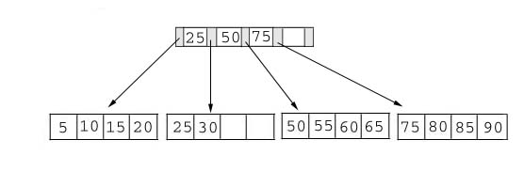
Question 4 B+ Tree Problem 1
Suppose we are using the following B+ tree index with fanout n = 5. The tree nodes are based on the simplified notation used in the course exercises. Update the tree by performing the sequence operations from (i) to (v) in order. You may draw only the portion of the tree that is different from the previous result for simplicity.

Slide 19
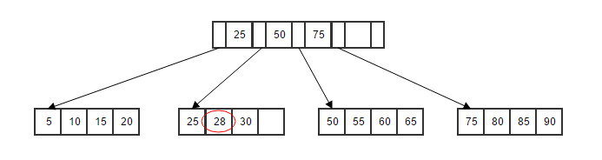
B+ Tree Problem 1
(i) Insert key = 28

Slide 20
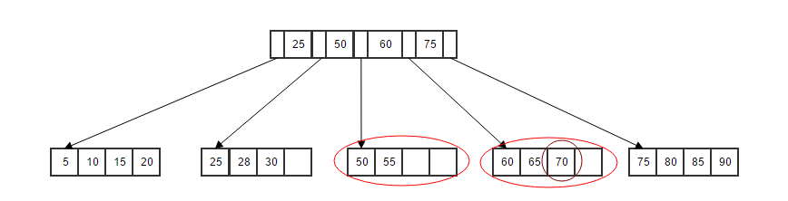
B+ Tree Problem 1
(ii) Insert key = 70

Slide 21
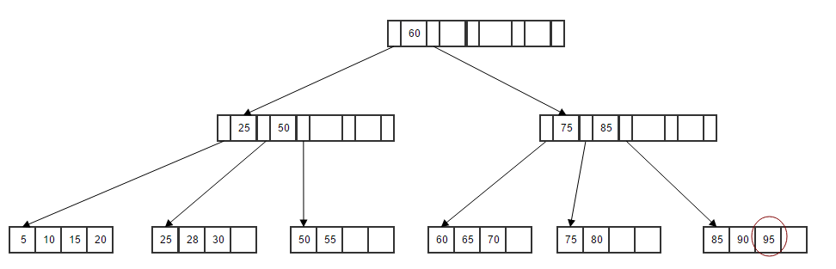
B+ Tree Problem 1
(iii) Insert key = 95

Slide 22
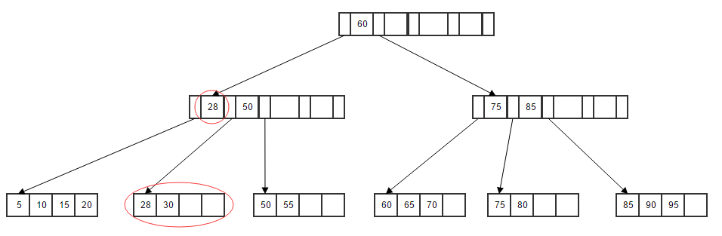
B+ Tree Problem 1
(v) delete key = 25

Slide 23
Question 5 B+ Tree Problem 2
Suppose we are using the following B+ tree index with fanout n = 4. The tree nodes are based on the simplified notation used in the course exercises. Update the tree by performing the sequence operations from (i) to (v) in order. You may draw only the portion of the tree that is different from the previous result for simplicity.
 | 60
 | 20 |  | 40
 | 80
2 | 4 | 6
20 | 24
40 | 50
60 | 64
80 | 90

Slide 24
B+ Tree Problem 2
(i) Insert key = 70
 | 60
 | 20 |  | 40
 | 80
2 | 4 | 6
20 | 24
40 | 50
60 | 64 | 70
80 | 90

Slide 25
B+ Tree Problem 2
(ii) Insert key = 5
 | 60
 | 5 |  | 20 |  | 40
 | 80
2 | 4
5 | 6
20 | 24
40 | 50
60 | 64 | 70
80 | 90

Slide 26
B+ Tree Problem 2
(iii) delete key = 40
 | 60
 | 60
 | 5 |  | 20 |  | 40
 | 80
 | 5 |  | 20
 | 80
2 | 4
5 | 6
20 | 24
40 | 50
60 | 64 | 70
80 | 90
2 | 4
5 | 6
20 | 24 | 50
60 | 64 | 70
80 | 90

Slide 27
B+ Tree Problem 2
(iv) delete key = 60
 | 64
 | 5 |  | 20
 | 80
2 | 4
5 | 6
20 | 24 | 50
64 | 70
80 | 90

Slide 28
B+ Tree Problem 2
(v) delete key = 64
remove the node 64
If L is at least half-full, done
If L is less than half-full,
re-distribute, borrowing from sibling(adjacent node to the right)
If re-distribution fails, merge L and its sibling
If merge occurred, delete entry(pointing to L or sibling) from parent of L
 | 5 |  | 20 |  | 70
2 | 4
5 | 6
20 | 24 | 50
70 | 80 | 90

Slide 29
B+ Tree Problem 2
(v) delete key = 64
Re-distribute 2
 | 50
 | 5 |  | 20
 | 80
2 | 4
5 | 6
20 | 24
50 | 70
80 | 90

Slide 30
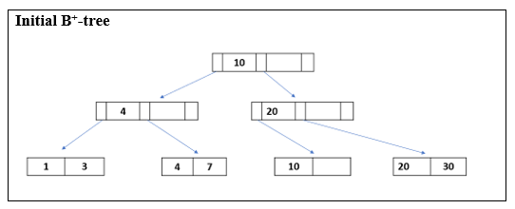
Question 5 B+ Tree Problem 3
You are given the following B⁺-tree with fanout n=3. The tree is based on commonly used simplified notation.
Draw clearly the B⁺-tree for each of the following insertion operations: first insert 15, then insert 2. (i.e. two updated B⁺-trees in total)
Draw clearly the B⁺-trees for each of the following deletion operations: first delete 3, then delete 20, finally delete 10. (i.e. three updated B⁺-trees in total)
The insertions and deletions are performed in the described orders. Both parts (i and ii) should begin with the initial B⁺-tree given below.

Slide 31
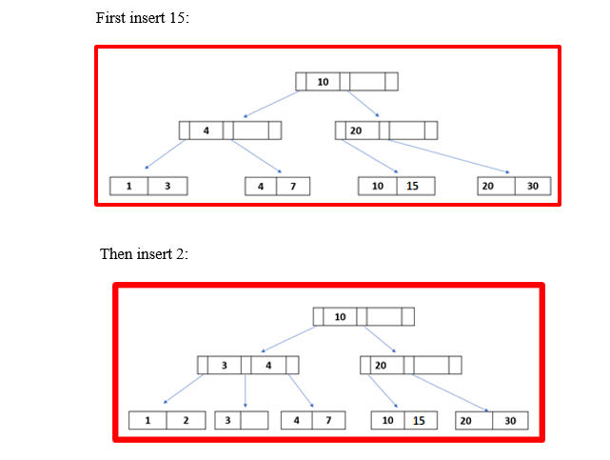
B+ Tree Problem 3
(i)

Slide 32
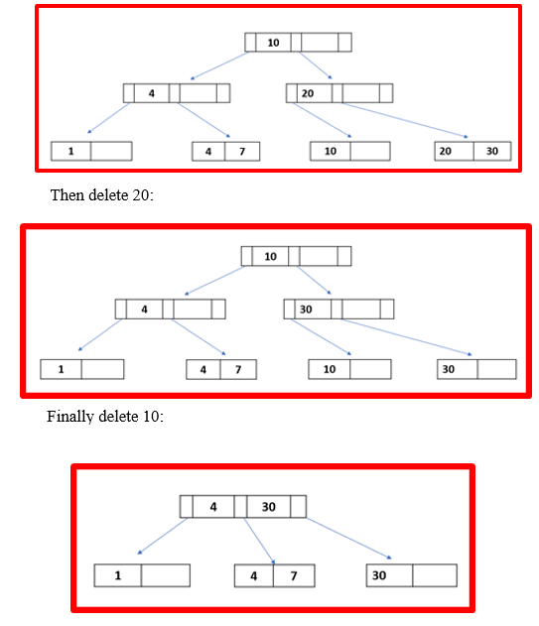
B+ Tree Problem 3
Start from the initial B⁺-tree again, first delete 3:
(ii)

Slide 33
APPENDIX

Slide 34
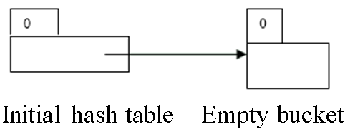
Question 6 Hashing Problem 1
Suppose that we are using extendable hashing index that contains the following search-key values K: 17, 20, 25, 30, 22, 23, 37. Assuming the search-key values arrive in the given order (i.e. 17 being the first coming key and 37 being the last one). Show the extendable hash structure for each insertion of the above key values file if the hash function is h(x) = x mod 8 and buckets can hold two keys. You should follow the convention used by lecture slides: binary hash indices starting from the least significant bit. The initial configuration of the structure should be used as the given diagram below. (I.e. time stamps start from 0.)

Slide 35

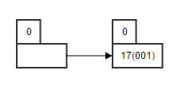
Hashing Problem 1
The binary values of all keys K
(1) Insert 17

Slide 36

Hashing Problem 1
The binary values of all keys K
(2) Insert 20

Slide 37
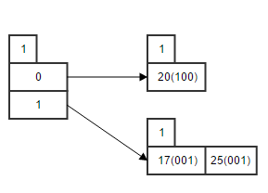
Hashing Problem 1
The binary values of all keys K
(3) Insert 25

Slide 38
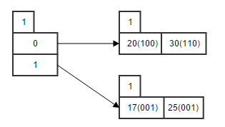
Hashing Problem 1
The binary values of all keys K
(4) Insert 30

Slide 39
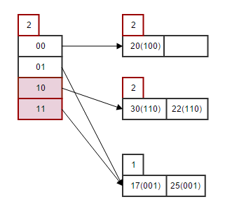
Hashing Problem 1
The binary values of all keys K
(5) Insert 22

Slide 40
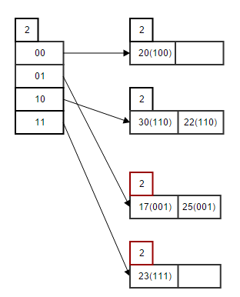
Hashing Problem 1
The binary values of all keys K
(6) Insert 23

Slide 41
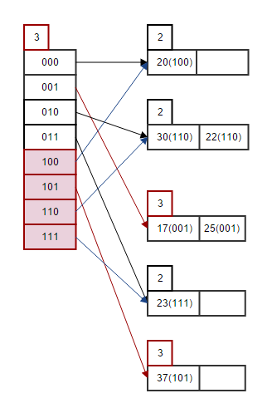
Hashing Problem 1
The binary values of all keys K
(7) Insert 37

