Slide 1
Comp 3311 Database Management Systems
18-20. Exercises on Transaction Management

Slide 2
Question 1: SERIALIZABILITY
Indicate which of the following schedules involving T₁ and T₂ is serial, serializable or not serializable. R_{i} denotes a READ (of Transaction T_{i}) and W_{i} is a WRITE (of Transaction T_{i}).
R₁(A) W₁(A) R₂(A) W₂(A)
Serial
R₁(A) R₂(A) W₁(A) W₂(B)
Serializable
What is the equivalent serial schedule?
T₂T₁
T₁
T₂
T₁ | T₂
read(A)
write(A)
 | read(A)
 | write(A)
T₁
T₂
T₁ | T₂
read(A)
 | read(A)
write(A)
 | write(B)

Slide 3
Question 1 : SERIALIZABILITY
R₁(A) R₂(A) W₁(A) W₂(A)
Not Serializable
R₂(A) R₁(A) W₂(B) W₁(A)
Serializable
What is the equivalent serial schedule?
T₂T₁
T₁
T₂
T₁ | T₂
read(A)
 | read(A)
write(A)
 | write(A)
T₁
T₂
T₁ | T₂
 | read(A)
read(A)
 | write(B)
write(A)

Slide 4
Question 2: SERIALIZABILITY
Is the following schedule conflict serializable?
T₁ | T₂ | T₃
read(X)
 | read(Y)
 | write(Y)
 |  | write(Z)
write(X)
 | read(X)
 | write(X)
 |  | read(Y)
 |  | write(Y)
write(Z)
T₁
T₃
T₂
The schedule is not serializable because there is a cycle T₁, T₂, T₃, T₁.

Slide 5
Question 3: SERIALIZABILITY, RECOVERABLE AND CASCADELESS
Is the schedule W₂(B) R₁(A) W₁(A) R₂(A) C₁ C₂ serializable, recoverable and cascadeless? (C₁ and C₂ indicate the commit statements).
It is serializable
The equivalent serial schedule is T₁T₂.
It is recoverable
T₂ reads A, written by T₁ and commits after T₁.
Not cascadeless
If T₁ aborts, T₂ must also abort.
T₁ | T₂
 | write(B)
read(A)
write(A)
 | read(A)
commit
 | commit
T₁
T₂
How would you place the commit statements in order to make the schedule cascadeless?
W₂(B) R₁(A) W₁(A) C₁ R₂(A) C₂

Slide 6
Question 4: RECOVERABLE AND CASCADELESS SCHEDULES
Is the schedule R₂(A) R₁(A) W₁(A) W₂(B) C₂ C₁ recoverable and cascadeless?
T₁ | T₂
 | read(A)
read(A)
write(A)
 | write(B)
 | commit
commit
Both recoverable and cascadeless since no transaction reads items after they have been written by the other.

Slide 7
Question 5
Consider schedule S that consists of four transactions as follows:
S = <T1_R(X), T1_W(X), T2_R(X), T3_R(Y), T3_W(Y),
T2_W(X), T3_R(Z), T4_R(Z), T4_W(Z), T1_W(Y), T2_R(Y)>
The notation is self-explanatory. For example, T1_R(X) means that transaction T1 reads item X.

Slide 8
Question 5
(a) Fill in the following table representing S with the usual notations in lecture slides.
T1 | T2 | T3 | T4

Slide 9
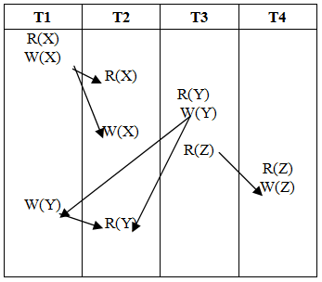
Question 5
(a) Fill in the following table representing S with the usual notations in lecture slides.

Slide 10
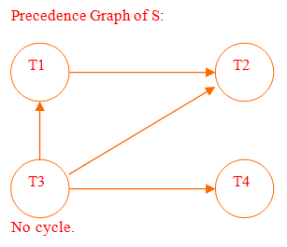
Question 5
(b) Construct the precedence graph of S. Explain why or why not the schedule is conflict-serializable.

Slide 11
Question 5
(c) Write down all equivalent serial schedules of S.
Find out all Topological Order lists from the Precedence Graph
T3, T4, T1, T2;
T3, T1, T4, T2;
T3, T1, T2, T4;

Slide 12
Question 5
(d) Using the “commit” operation (For example, the operation T1_C shows that the transaction T1 commits), add the commit statements into S so that the schedule becomes recoverable
(You should not change the order of operations other than inserting commit statements).
Just use the result from (c), because the precedence graph exactly means the read-after-write relationship
Answer:(S, C3, C4, C1, C2)
or (S, C3, C1, C4, C2)
or (S, C3, C1, C2, C4)

Slide 13
Question 5
(e) Explain why or why not the schedule in (d) is cascadeless?
The schedule cannot be made cascadeless
For example, in order for T2_R(X) to be allowed, T1 must commit first.
However this is not possible before the last operation T1_W(Y) in the schedule.

Slide 14
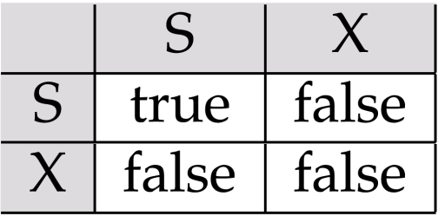
Multiple Choice Questions
Which of the following statements is true?
When a data item is locked in shared mode, it can be read and written.
When a data item is locked in exclusive mode, it can be read and written
When a data item is locked in shared mode, an exclusive lock can be granted on it
When a data item is locked in exclusive mode, a shared lock can be granted on it.
Answer: (b)
Data items can be locked in two modes :
exclusive (X) mode. Data item can be both read as well as written.
shared (S) mode. Data item can only be read.
Lock-compatibility matrix

Slide 15
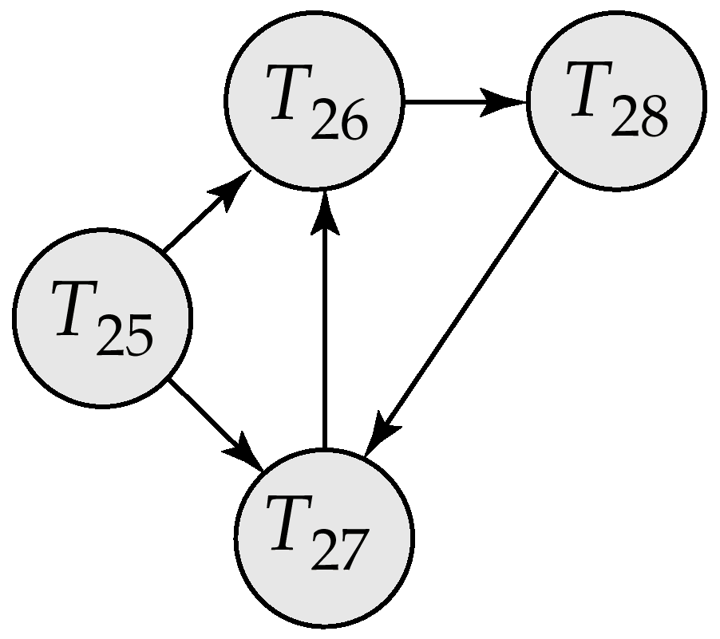
Multiple Choice Questions
Which of the following statements is true about this wait-for graph?
Transaction 27 is waiting for Transaction 25 to release a data item
The system is in a deadlock state if after removing the edge between T28 and T27
The system is in a deadlock state after removing the edge between T25 and T27
The system is in a deadlock state when Transaction 26 no longer holding a data item needed by Transaction 27
Answer: (c)
is not correct since T25 is waiting for T27.
and (c) are not correct since after removing edges, there does not exist a circle in the wait-for graph

Slide 16
Multiple Choice Questions
Find out all positions A to E in the schedule that we can insert ‘unlock(X)’ there
(1) When according to Strict 2PL
{A} {B} {C} {D}
{A} {B} {C} {D} {E}
{A} {C} {D}
{B} {E}
{A} {C} {D} {E}
Answer: (b)
(2) When according to Rigorous 2PL
{A} {B} {C} {D}
{A} {B} {C} {D} {E}
{A} {C} {D}
{B} {E}
{A} {C} {D} {E}
Answer: (d)
T1 | T2
s-lock(X) read(X)
 | s-lock(X)
x-lock(Y) {A} read(Y) write(Y)
 | read(X) {C}
commit T1 unlock(Y) {B}
 | {D} commit T2 {E}

Slide 17
Question 6
Is the following schedule conflict serializable?
T₁ | T₂ | T₃
read(X)
 | read(Y)
 | write(Y)
 |  | write(Z)
write(X)
 | read(X)
 | write(X)
 |  | read(Y)
 |  | write(Y)
write(Z)
17

Slide 18
Question 6
Is the following schedule conflict serializable?
T₁ | T₂ | T₃
read(X)
 | read(Y)
 | write(Y)
 |  | write(Z)
write(X)
 | read(X)
 | write(X)
 |  | read(Y)
 |  | write(Y)
write(Z)
T₁
T₃
T₂
The schedule is not serializable because there is a cycle T₁, T₂, T₃, T₁. Therefore, the schedule will fail under any protocol that aims at conflict serializability.
18

Slide 19
Question 6 (cont’d)
T₁ | T₂ | T₃
lock-S(X)
read(X)
 | lock-S(Y)
 | read(Y)
 | lock-X(Y)
 | write(Y)
 |  | lock-X(Z)
 |  | write(Z)
lock-X(X)
write(X)
 | lock-S(X)
 | read(X)
 | write(X)
 |  | lock-S(Y)
 |  | read(Y)
 |  | write(Y)
lock-X(Z)
write(Z)
✓
✓
Wait-for graph
✓
T₁
✓
T₃
T₂
✓
✗ cannot be granted – T₂ has to wait
✗ cannot be granted – T₃ has to wait
✗ cannot be granted – T₁ has to wait
deadlock!

Slide 20
Question 7
Is the following schedule conflict serializable?
If yes, (i) give the equivalent serial schedule and rewrite the schedule according to 2PL.
T₁ | T₂ | T₃ | T₄
read(X)
write(X)
 | read(X)
 |  | read(Y)
 |  | write(Y)
 | write(X)
 |  |  | read(Y)
write(Y)
20

Slide 21
Question 7 (cont’d)
T₁ | T₂ | T₃ | T₄
lock-S(X)
read(X)
lock-X(X)
write(X)
 | lock-S(X)
 | read(X)
 |  | lock-S(Y)
 |  | read(Y)
 |  | lock-X(Y)
 |  | write(Y)
 |  | unlock(Y)
 | write(X)
 |  |  | lock-S(Y)
 |  |  | read(Y)
 |  |  | unlock(Y)
lock-X(Y)
write(Y)
unlock(Y)
unlock(X)
T₁
✓
T₃
T₂
✓
T₄
✗ cannot be granted – T₂ has to wait
✓
The schedule is conflict serializable.
The equivalent serial schedule is T₃, T₄, T₁, T₂.
✓
✓
✓
21

Slide 22
Question 7: 2PL SCHEDULE (cont’d)
T₁ | T₂ | T₃ | T₄
lock-S(X)
read(X)
lock-X(X)
write(X)
 | lock-S(X)
 |  | lock-S(Y)
 |  | read(Y)
 |  | lock-X(Y)
 |  | write(Y)
 |  | unlock(Y)
 |  |  | lock-S(Y)
 |  |  | read(Y)
 |  |  | unlock(Y)
lock-X(Y)
write(Y)
unlock(Y)
unlock(X)
 | read(X)
 | lock-X(X)
 | write(X)
 | unlock(X)
T₂ waits
22

Slide 23
Exercises on Database Recovery

Slide 24
EXERCISE 1
Consider the log corresponding to a schedule of three serially executing transactions T₁, T₂, and T₃ where a system crash occurs at the point indicated. Assume that we use the immediate update protocol.
Which transactions are undone?
Undo:
Which transactions are redone?
Redo:
<T₁, start>
<T₁, write, B, 15, 12>
<T₁ commit>
<T₂, start>
<T₂, write, B, 12, 18>
<T₂, write, D, 25, 26>
<T₂ commit>
<T₃, start>
<T₃, write, D, 20, 25>
 | ← system crash
T₃
T₁
T₂
24

Slide 25
EXERCISE 2
Consider the log corresponding to a schedule of three concurrently executing transactions T₁, T₂, and T₃ where a system crash occurs at the point indicated. Assume that we use the immediate update protocol with checkpointing.
Which transactions are undone?
Which transactions are redone?
<T₁, start>
<T₁, write, A, 2, 5>
<T₁, write, B, 1, 2>
<T₂, start>
<T₁, write, C, 2, 8>
<T₂, write, B, 2, 5>
<checkpoint, {T₁, T₂}>
<T₁, commit>
<T₂, write, B, 5, 6>
<T₃, start>
<T₃, write, A, 5, 3>
<T₃, commit>
<T₂, write, C, 8, 2>
<T₂, write, A, 3, 5>
 | ← system crash
25

Slide 26
EXERCISE 2: SOLUTION
Scan the log backward
Undo:
Redo:
<T₁, start>
<T₁, write, A, 2, 5>
<T₁, write, B, 1, 2>
<T₂, start>
<T₁, write, C, 2, 8>
<T₂, write, B, 2, 5>
<checkpoint, {T₁, T₂}>
<T₁, commit>
<T₂, write, B, 5, 6>
<T₃, start>
<T₃, write, A, 5, 3>
<T₃, commit>
<T₂, write, C, 8, 2>
<T₂, write, A, 3, 5>
 | ← system crash
<T_{i} commit> → redo-list
<T_{i} start> → undo-list if not in redo-list
For every T_{i} in <checkpoint, {T_{i}, …}>
T_{i} not in redo-list → undo-list
T₂
T₃
T₁
← add T₂ to undo-list
← add to redo-list
√ on redo-list
← add to redo-list
26

Slide 27
EXERCISE 3
Consider the log corresponding to a schedule of three concurrently executing transactions T₁, T₂, and T₃ where a system crash occurs at the point indicated. Assume that we use the immediate update protocol with checkpointing.
Which transactions are undone?
Which transactions are redone?
<T₃, start>
<T₃, write, B, 15, 12>
<T₂, start>
<T₂, write, B, 12, 18>
<checkpoint, {T₂, T₃}>
<T₂ commit>
<T₁, start>
<T₁, write, D, 20, 25>
<T₁, write, D, 25, 26>
 | ← system crash
27

Slide 28
EXERCISE 3: SOLUTION
Scan the log backward
Undo:
Redo:
<T₃, start>
<T₃, write, B, 15, 12>
<T₂, start>
<T₂, write, B, 12, 18>
<checkpoint, {T₂, T₃}>
<T₂ commit>
<T₁, start>
<T₁, write, D, 20, 25>
<T₁, write, D, 25, 26>
 | ← system crash
<T_{i} commit> → redo-list
<T_{i} start> → undo-list if not in redo-list
For every T_{i} in <checkpoint, {T_{i}, …}>
T_{i} not in redo-list → undo-list
← add T₃ to undo-list
T₁
T₃
← add to redo-list
T₂
← add to undo-list
28

