Slide 1
Comp 3311 Database Management Systems
21-23. Exercises on NoSQL Databases and API

Slide 2
Question 1: GENERAL
Which is the best description of NOSQL databases?
A NOSQL database does not need to support selection on data.
A NOSQL database does not need to use relational tables to store data.
A NOSQL database does not need to obey key constraint.
A NOSQL database does not need to handle requests from multiple sites.

Slide 3
Question 1: GENERAL
2. Which of the following statements about column-oriented database (COD) when comparing with relational database is true?
A COD is more efficient when we want to project on multiple columns of a table.
A COD is more efficient when we want to insert a new record in a table.
A COD is more efficient when we want to compute aggregates on a column.
A COD is more efficient when we want to join tables.

Slide 4
Question 1: GENERAL
3. Which of the following statements about database API is true?
An embedded database API cannot use early binding.
An embedded database API cannot use late binding.
A call-level database API cannot use early binding.
A call-level database API cannot use late binding.

Slide 5
Question 1: GENERAL
4. Consider the following statements about database APIs:
The application code related to ODBC in an application needs to be modified whenever the database driver is changed.
Different JDBC driver types provide tradeoffs in terms of portability and performance.
SQLJ is able to perform SQL syntax checking in a source program before the runtime.
Only I and II are true.
Only I and III are true.
Only II and III are true.
All are true.

Slide 6
Question 1: GENERAL
5. Which of the following sequence of operations in a mapReduce pipeline should be performed simultaneously?
Map and Reduce
Map and Sort
Shuffle and Reduce
Sort and Shuffle

Slide 7
Question 1: GENERAL
ANSWERS
B
C
B
C
D

Slide 8
Question 2: KEY-VALUE STORE
We use a mongoDB database to generate a key-value store “wdb” for recording the quantity of products per type of wine. Some data samples are given as follows:
The following code (next slide) is to execute a MapReduce query with MongoDB wdb and the query is given as follows:
Query: Find the average quantity of products per wine type.
k1 | v1
1 | {WineType: Merlot, Quantity in bottle: 1000}
2 | {WineType: Sparkling, Quantity in bottle: 4000}
3 | {WineType: Barbera, Quantity in bottle: 3000}
... | ...

Slide 9
Question 2: KEY-VALUE STORE
// We implement in our Java code by passing plain strings “map” and “reduce” to the mapReduce()
// to compute the average quantity of products per wine type
public static void reportAggregate(MongoDatabase wdb) {
String map = "function() { " +
" var Quantity = this.Quantity; " +
" this.WineType.forEach(function(WineType) { " +
" emit(WineType, {average: Quantity, count: 1}); " +
" }); " +
"} ";
String reduce = "function(WineType, Values) { " +
" var s = 0; var newc = 0; " +
" Values.forEach(function(curAvg) { " +
" s += curAvg.average * curAvg.count; " +
" newc += curAvg.count; " +
" }); " +
" return {average: (s / newc), count: newc}; " +
"} ";
MapReduceIterable<Document> result = wdb.getCollection("wines").mapReduce(map, reduce); for (Document r : result)
System.out.println(r);}

Slide 10
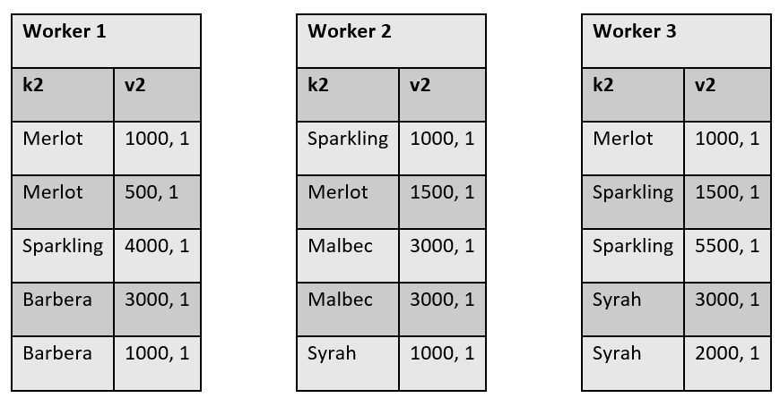
Question 2: KEY-VALUE STORE
After running the program and invoke the mapReduce function, we represent the key-value pairs in different workers (machines) after the mapping process as follows:
Suppose we first reduce the Worker 1 and Worker 2.
Write down the result in the following table (next slide) and assume that the sort and shuffle process is ignored (note: the number of rows may be more or less than necessary and you could add more rows or leave some rows blank).

Slide 11
Question 2: KEY-VALUE STORE
k2 | v3

Slide 12
Question 2: KEY-VALUE STORE
ANS
k2 | v3
Merlot | 1000,3
Sparkling | 2500,2
Barbera | 2000,2
Malbec | 3000,2
Syrah | 1000,1

Slide 13
Question 2: KEY-VALUE STORE
Finally, we reduce the above result with Worker 3. Write down the final result in the following table.
k2 | v3’

Slide 14
Question 2: KEY-VALUE STORE
ANS
k2 | v3’
Merlot | 1000,4
Sparkling | 3000,4
Barbera | 2000,2
Malbec | 3000,2
Syrah | 2000,3

Slide 15
Question 2: KEY-VALUE STORE
(b) Fill in the two blank sections (light green) of the following code to execute the following query on wdb:
Query: Find the maximum quantity of products per wine type. You may assume the function Math.max(x, y) returns a maximum between x and y in JS code.
Note: Your variables should be consistent with all the parameters in the code.

Slide 16
Question 2: KEY-VALUE STORE
public static void reportAggregate(MongoDatabase wdb) { String map = "function() { " + " var Quantity = this.Quantity; " +
" }); " + "} "; String reduce = "function(WineType, Values) { " + " var newMax = 0; " +
" }); " + " return {max: newMax}; " + "} "; MapReduceIterable<Document> result = wdb.getCollection("wines").mapReduce(map, reduce); for (Document r : result) System.out.println(r);}

Slide 17
Question 2: KEY-VALUE STORE
public static void reportAggregate(MongoDatabase wdb) { String map = "function() { " + " var Quantity = this.Quantity; " +
" this.WineType.forEach(function(WineType) { " + " emit(WineType, {max: Quantity}); " +
" }); " + "} "; String reduce = "function(WineType, Values) { " + " var newMax = 0; " +
" Values.forEach(function(curMax) { " + " newMax = Math.max(newMax, curMax.max); " +
" }); " + " return {max: newMax}; " + "} "; MapReduceIterable<Document> result = wdb.getCollection("wines").mapReduce(map, reduce); for (Document r : result) System.out.println(r);}
ANS

Slide 18
Question 3: DOCUMENT-VALUE STORE
We need to find the number of patient visiting to Medical Practice (Hospital/Clinic) by their visit reason. The Visit document structure is:
{
"_id" : NumberLong(1),
"name":"Amelia Watson",
"visitReason" : "Broken leg, Fever"
}
We insert the following documents into the database.
db.visit.insert({name:"John Doe", visitReason:"Cold, Cough"});
db.visit.insert({name: "Amenda", visitReason:"Regular Health Check-up"});
db.visit.insert({name: "William", visitReason:"Regular Health Check-up"});
db.visit.insert({name: "Mark", visitReason:"High Blood Pressure, Fever"});
db.visit.insert({name: "Milly", visitReason:"Bleeding gums"});
db.visit.insert({name: "Bosco", visitReason:"Food poisoning"});
db.visit.insert({name: "Bart", visitReason:"Migrane"});
db.visit.insert({name: "Harry", visitReason:"Headache"});
db.visit.insert({name: "Nova", visitReason:"Skin test"});
db.visit.insert({name: "Sunny", visitReason:"Cold"});
db.visit.insert({name: "Leelo", visitReason:"Fever"});
db.visit.insert({name: "Martin", visitReason:"Joint problem"});

Slide 19
Question 3: DOCUMENT-VALUE STORE
What is the output of the MongoDB query below? (Note that dbStats in {out: "dbStats"} is the name of the collection where the operation outputs the result.)
db.visit.mapReduce(
function() {
if(this.visitReason != undefined){
this.visitReason.split(',').forEach(function (v) {
emit(v.trim(), 1);
});
}
},
function (key, values) {
return Array.sum(values);
},
{out: "dbStats"}
).find();

Slide 20
Question 3: DOCUMENT-VALUE STORE
Answer:
{ "_id" : "Bleeding gums", "value" : 1 }
{ "_id" : "Cold", "value" : 2 }
{ "_id" : "Cough", "value" : 1 }
{ "_id" : "Fever", "value" : 2 }
{ "_id" : "Food poisoning", "value" : 1 }
{ "_id" : "Headache", "value" : 1 }
{ "_id" : "High Blood Pressure", "value" : 1 }
{ "_id" : "Joint problem", "value" : 1 }
{ "_id" : "Migrane", "value" : 1 }
{ "_id" : "Regular Health Check-up", "value" : 2 }
{ "_id" : "Skin test", "value" : 1 }

