Slide 1
COMP 3311 Database Management Systems
Spring 2018
Lab 9. Assignment Four

Slide 2
Objectives of the Lab
After this lab, you will
  know how to build up the database for assignment 4,
  know how to set up the data source,
  know how to compile the ODBC/C++ program,
  Know more about the TODOs.

Slide 3
The assignment Script files 1
You need to use the three script files to build the database before you can start doing the assignment.
As usual, three steps are involved:
  Download the script files,
  Execute the script files in SQL Developer
  Commit the changes to the database

Slide 4
The assignment Script files 2
Step 1: download the script files at
http://course.cse.ust.hk/comp3311/assignments/drop_tables.sql
http://course.cse.ust.hk/comp3311/assignments/create_tables.sql
http://course.cse.ust.hk/comp3311/assignments/insert_records.sql
Step 2: Execute the script files in SQL Developer in the following order:
  drop_tables.sql
  create_tables.sql
  insert_records.sql
Step 3: Run the statement "commit;" to save the changes
Remember to “commit”, otherwise the data will not be written to ORACLE

Slide 5
Setting up the ODBC environment 1
After building the database, the next step is to set up the ODBC environment and the data source that corresponds to the Oracle Server.
In the CS Labs, we have already set up the ODBC environment.
But you still need to set up the data source.

Slide 6
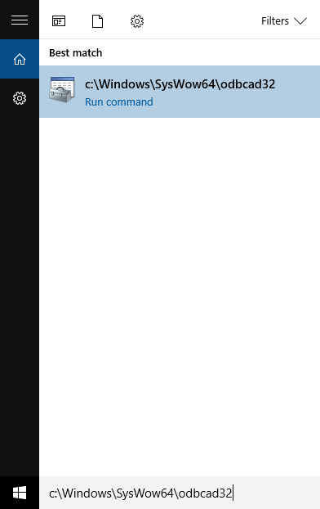
Steps to set up ODBC environment for visual studio 2
1. You can setup the Oracle ODBC source in MS windows (the most important steps!)
  Click the “start” button , then key in “c:\windows\syswow64\odbcad32.exe”

Slide 7
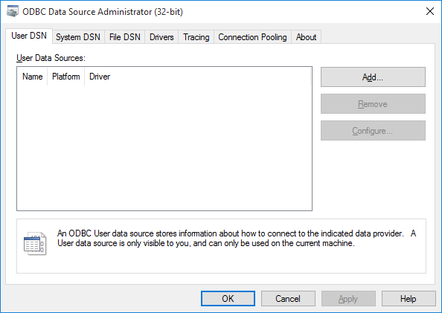
Steps to set up ODBC environment for visual studio 3
2. You should see the below window and click the “Add” button

Slide 8
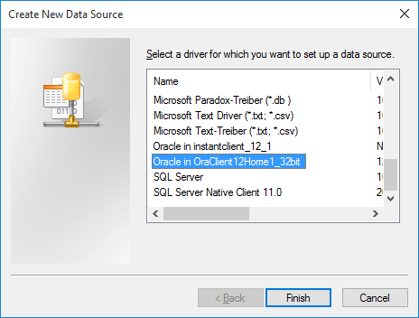
Steps to set up ODBC environment for visual studio 4
  3. Add the Oracle data source.

Slide 9
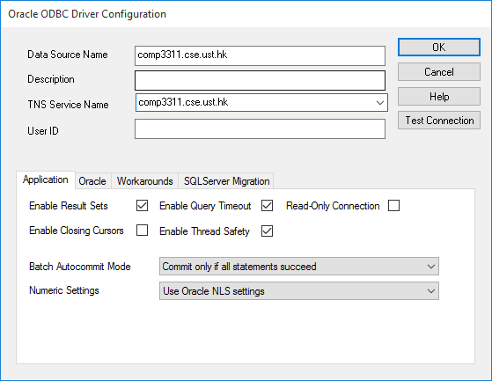
Steps to set up ODBC environment for visual studio 5
  4. Give a name to the Data Source (you need this name in the SQLConnect() function, the name here is “comp3311.cse.ust.hk”)

Slide 10
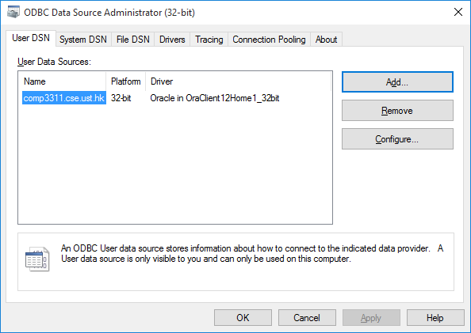
Steps to set up ODBC environment for visual studio 6
  5. The name “comp3311.cse.ust.hk” appears in the data source administrator window. You are now ready to write ODBC codes!

Slide 11
Steps to set up ODBC environment for visual studio 7
  (Optional) Only laptops connected to the UST network can access the CSE Oracle server. To enable setting up the data-source you should download following two files to the laptop:
      http://course.cse.ust.hk/comp3311/labs/sqlnet.ora
      http://course.cse.ust.hk/comp3311/labs/tnsnames.ora
  (Optional) Store the two files to the default Oracle_path that you selected for installing the ODBC driver (for me that was c:\app\lamngok\product\11.2.0\client_1\Network\Admin).

Slide 12
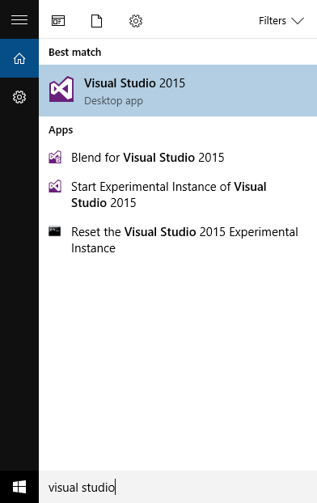
Working with Visual Studio 2015 1
To start Visual Studio, one need to locate the visual studio 2015 package.
Click the “start” button, and type “Visual Studio 2015”.
Click on the “Visual Studio 2015” icon as shown at the right to start it.

Slide 13
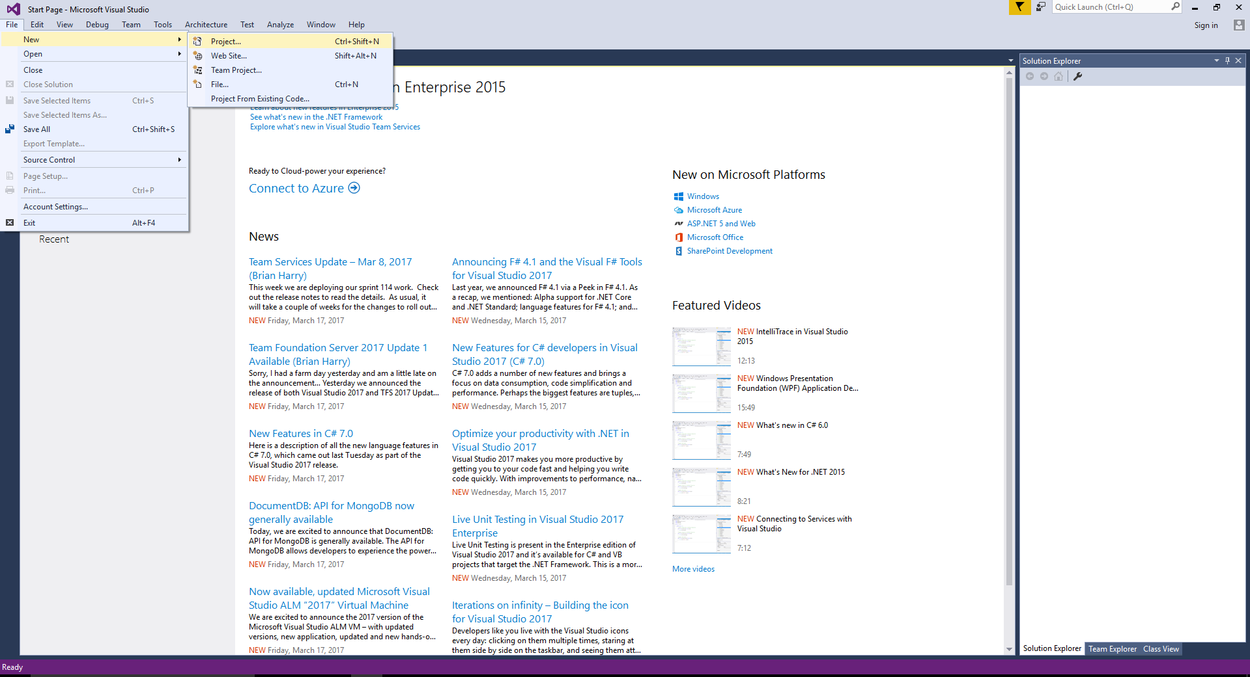
Working with Visual Studio 2015 2
Select “File->New-> Project…” from the toolbar

Slide 14
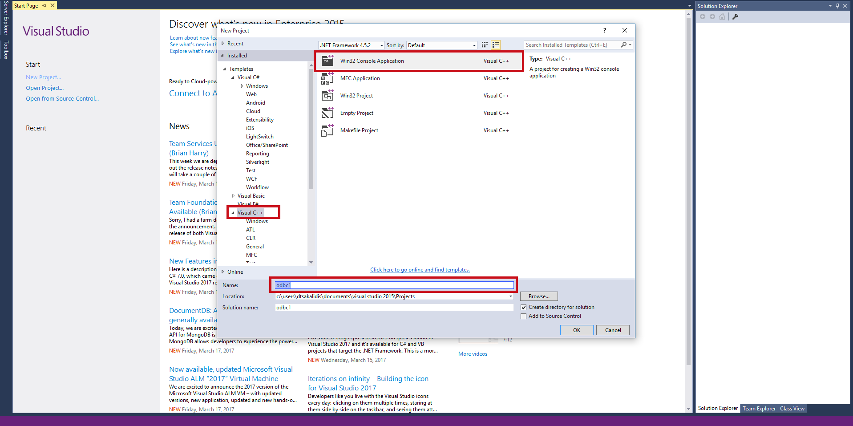
Working with Visual Studio 2015 3
Select “Win32 Console Application”, and give the C++ project a name.

Slide 15
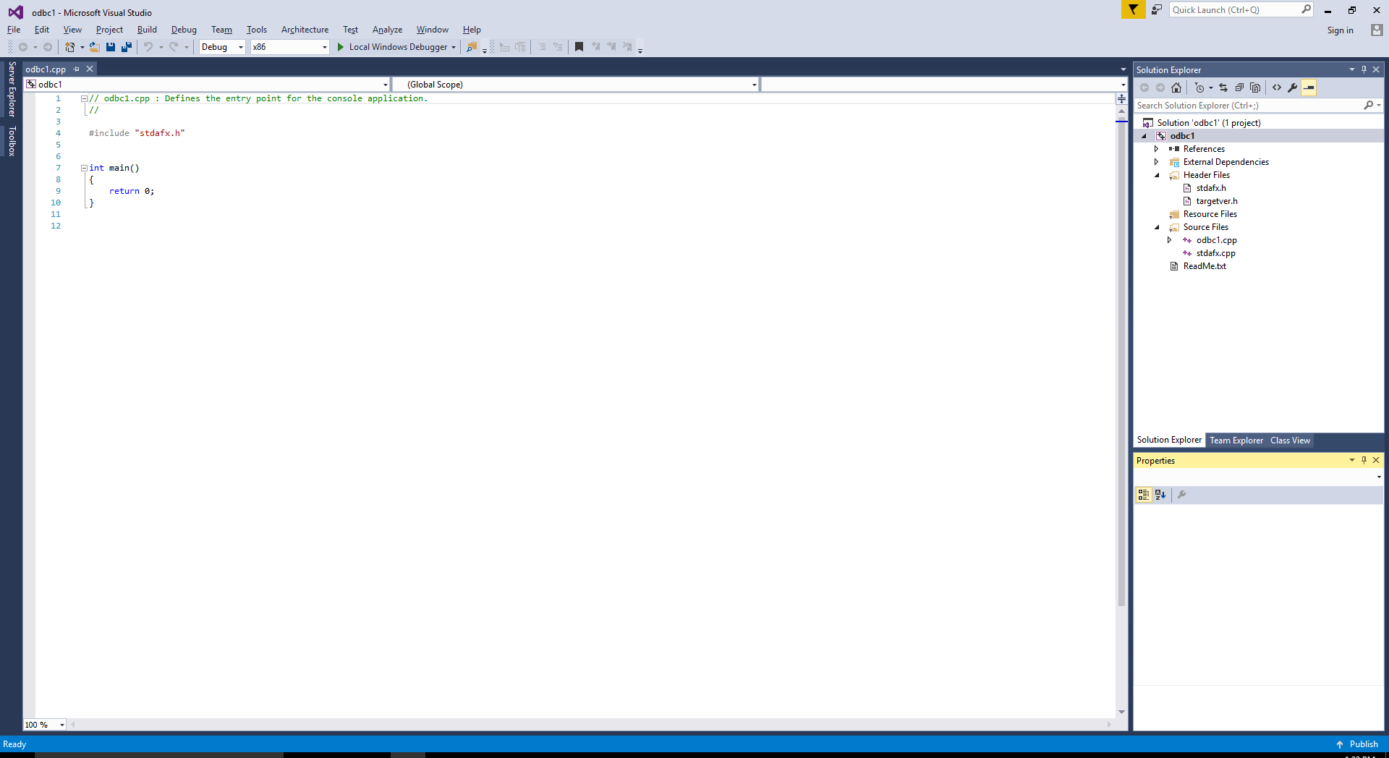
Working with Visual Studio 2015 4
Then click “next” and “finish”, and you will see the following:

Slide 16
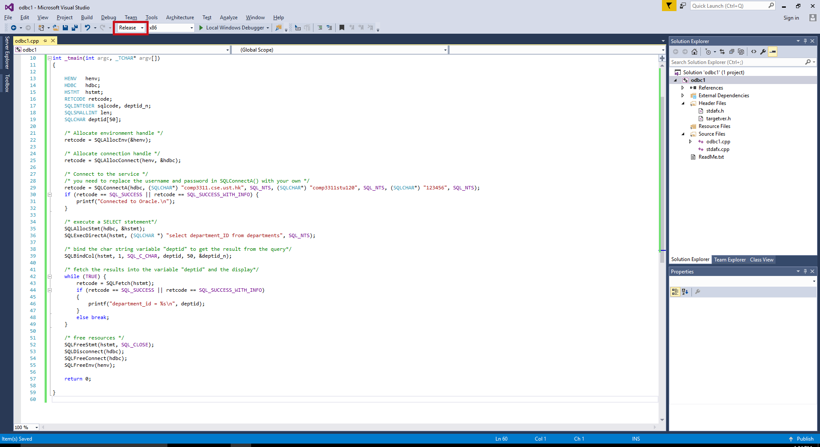
Working with Visual Studio 2015 5
Replace the C-codes with odbc1.cpp you have downloaded, and select “Release” for the compilation option.

Slide 17
The assignment 4 skeleton program
You can download the skeleton program from:
  https://course.cse.ust.hk/comp3311
  There are altogether of 9 places to fill in your code (labeled “TODO #”), (under the assignments section)
You can MODIFY any contents inside assign3.cpp,
You can INCLUDE any standard libraries,
Your program MUST be compiled and tested to run on a CS Lab machine,
If we can not compile your code, you will have zero mark for the project!
No Partial Marks will be given for each tudos!
You should submit ONLY the assign4.cpp file.

Slide 18
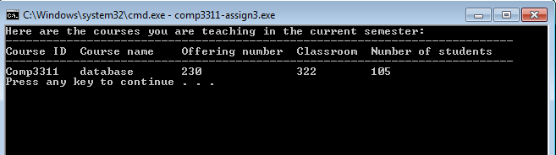
TODO 1
TODO 1: display course information of the courses the Prof is teaching in the current semester (his/her staff ID value “staff_id” is a global variable).

Slide 19
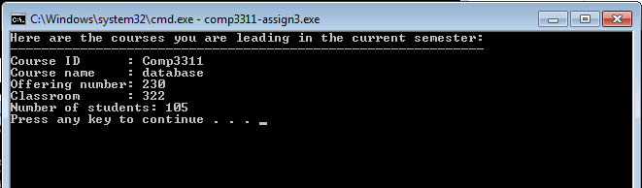
TODO 2
TODO 2: display course information of the courses the Prof is leading in the current semester.

Slide 20
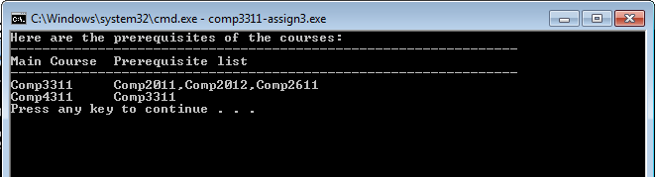
TODO 3
TODO 3: Show the prerequisites (course_IDs) of all the main courses.

Slide 21
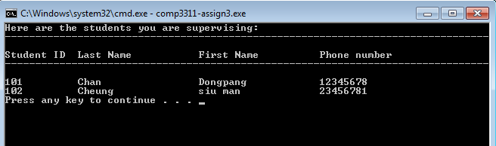
TODO 4
TODO 4: display all the students supervised by the Prof.

Slide 22
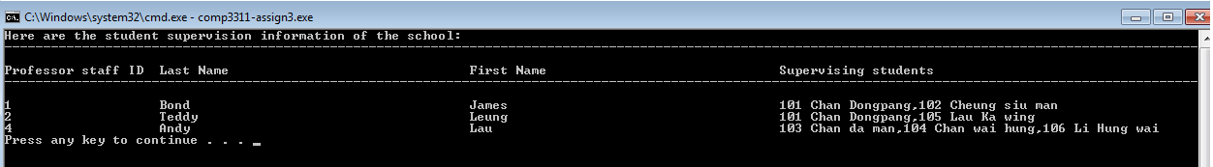
TODO 5
TODO 5: show supervising information of all the profs.

Slide 23
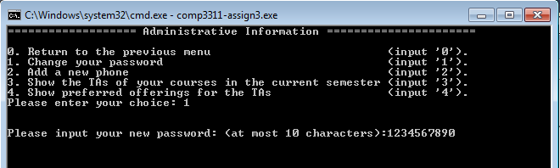
TODO 6
TODO 6: Change the password for the Prof.

Slide 24
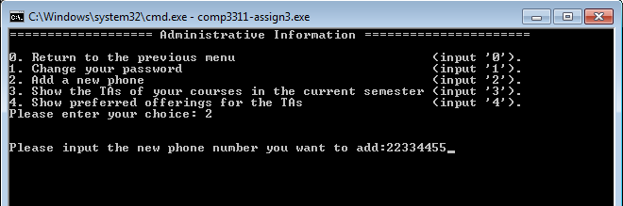
TODO 7
TODO 7: add a new phone number for the Prof.

Slide 25
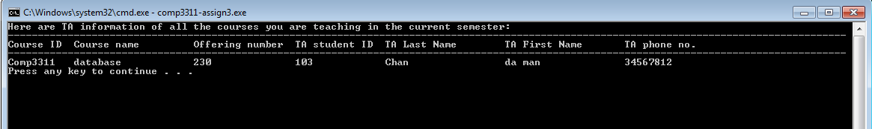
TODO 8
TODO 8: shows all the TAs working with the Prof in the current semester.

Slide 26
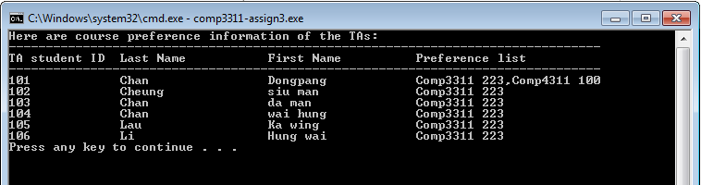
TODO 9
TODO 9: show the offering preference information of all the TAs.

Slide 27
The provided Printing Functions 1
The printRecordIntoCol() function prints the query result into a single column.
You need to have “executed” the SQL query first.
Then you pass the statement handle to printRecordIntoCol(), it will print the result automatically.
Always remember to free the statement handle in a function before the function returns.
*Warning : DO NOT “fetch” the result, if you are using printRecordIntoCol(). The function will fetch itself.

Slide 28
The provided Printing Functions 2
The printIntoRow () is a similar function that prints the query results into rows.
You can specify the maximum column width for each column of the result.
You need to have “executed” the SQL query first.
Then you pass the statement handle and the maximum column width (integer) to printIntoRow(), it will print the result automatically.
You can download the following example program to see how they work:
https://course.cse.ust.hk/comp3311/labs/lab9.cpp
*Warning : DO NOT “fetch” the result, if you are using printIntoRow(). The function will fetch itself.

Slide 29
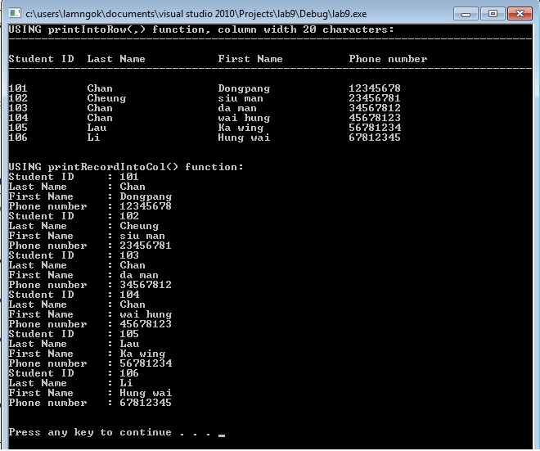
Sample Execution of the two provieded functions

Slide 30
Conclusions
We covered the following topics in this lab:
  building the database for assignment 4,
  setting up the data source,
  the TODOs, and the two provided function.

