Slide 1
COMP3311 Spring 2020
Tutorial 10
Database Connectivity (JDBC) and Hadoop

Slide 2
Database connectivity
Databse APIs
  APIs is to expose an interface through which other parties can utilize the services provided by the DBMS, though the API can also serve additional objectives (e.g., hiding network-related aspects, protecting databases
  Java DataBase Connectivity (JDBC) offers a call-level database API

Slide 3
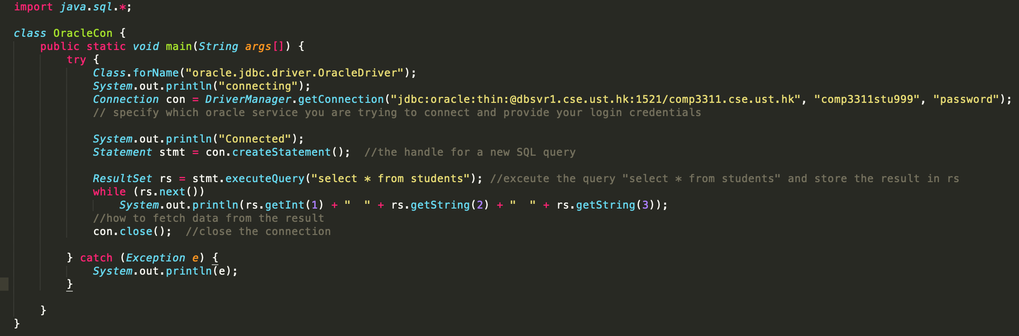
JDBC

Slide 4
Hadoop
Hadoop is open-source implementation for Google’s MapReduce and GFS
Clean and simple programming abstraction
  Users only provide two functions “map” and “reduce”
Automatic parallelization & distribution
  Hidden from the end-user
Fault tolerance and automatic recovery
  Nodes/tasks will fail and will recover automatically

Slide 5


Brief history
Initially developed by Doug Cutting as a filesystem for Apache Nutch, a web search engine
  early name: Nutch Distributed FileSystem (NDFS)
moved out of Nutch and acquired by Yahoo! in 2006 as an independent project called Hadoop

Slide 6
The origin of the name
“Hadoop” is a made-up name, as explained by Doug Cutting:
“The name my kid gave a stuffed yellow elephant. Short, relatively easy to spell and pronounce, meaningless, and not used elsewhere: those are my naming criteria. Kids are good at generating such.”

Slide 7
Hadoop: How it Works

Slide 8
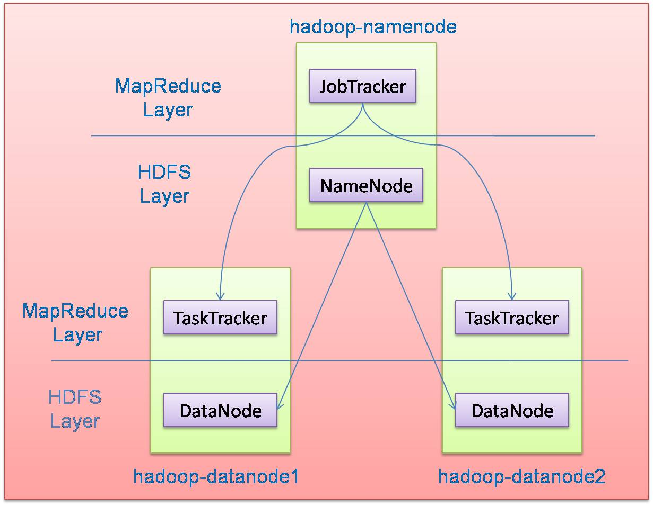
Hadoop Architecture
Hadoop framework consists of two main layers
  Distributed file system (HDFS)
  Execution engine (MapReduce)
Master node (single node)
Many slave nodes

Slide 9
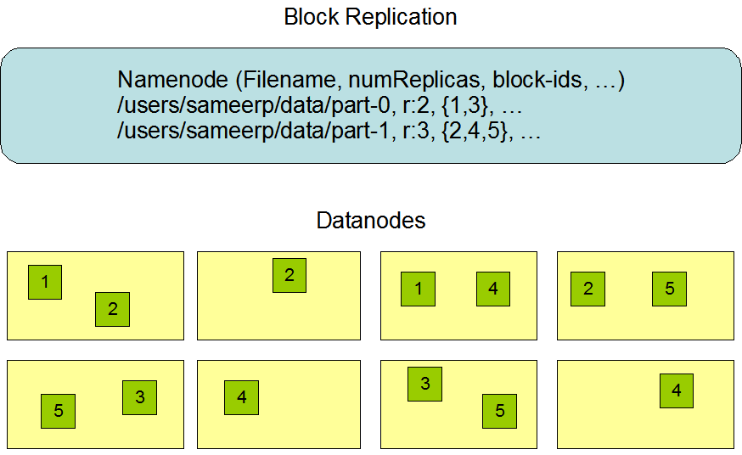
Hadoop Distributed File System (HDFS)
One namenode
Maintains metadata info about files:
Maps a filename to a set of blocks
Maps a block to the DataNodes where it resides
Replication engine for blocks
File F
1
2
3
4
5
Blocks (64 MB)
Many datanode (1000s)
- Store the actual data
- Files are divided into blocks
- Each block is replicated r times
(Default = 3)
- Communicates with NameNode through periodic “heartbeat” (once per 3 secs)

Slide 10
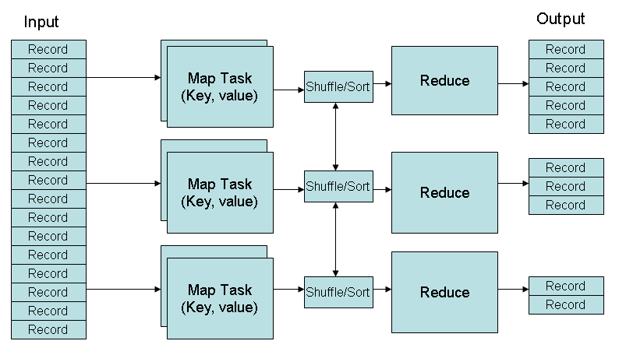
MapReduce
(key, value) pairs are used as the format for both data and intermediate results

Slide 11
MapReduce: Key-Value Pairs
Mappers and Reducers are users’ code (provide as functions)
Just need to obey the Key-Value pairs interface
Mappers:
  Consume <key, value> pairs
  Produce <key, value> pairs
Reducers:
  Consume <key, <list of values>>
  Produce <key, value>
Shuffling and Sorting:
  Hidden phase between mappers and reducers
  Groups all <key, value> pairs with the same key from all mappers, and passes them to a certain reducer in the form of <key, <list of values>>

Slide 12
MapReduce: Processing Granularity
Mappers
  Run on a record-by-record basis
  Your code processes that record and may produce
    Zero, one, or many outputs
Reducers
  Run on a group-of-records (having same key)
  Your code processes that group and may produce
    Zero, one, or many outputs

Slide 13
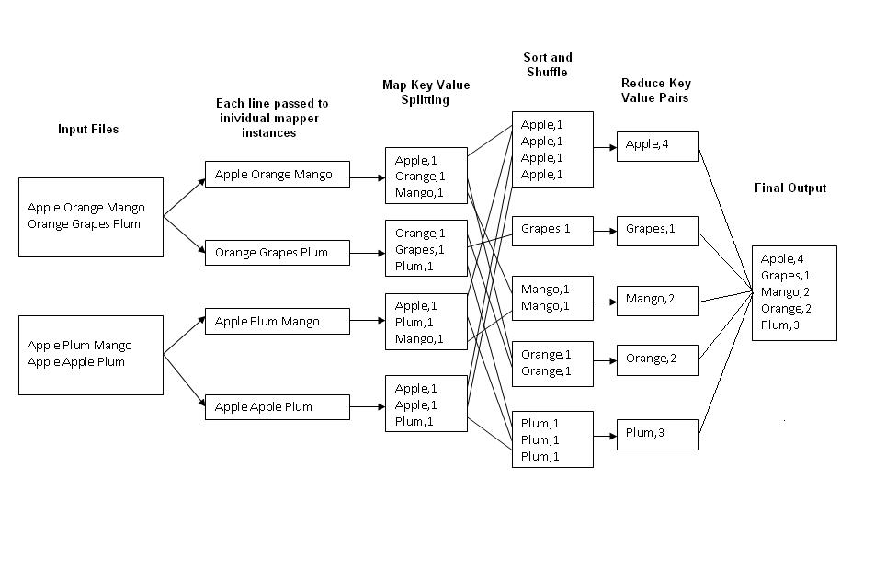
Example 1: Word Count
Job: Count the occurrences of each word in a data set
Map
Tasks
Reduce
Tasks

Slide 14
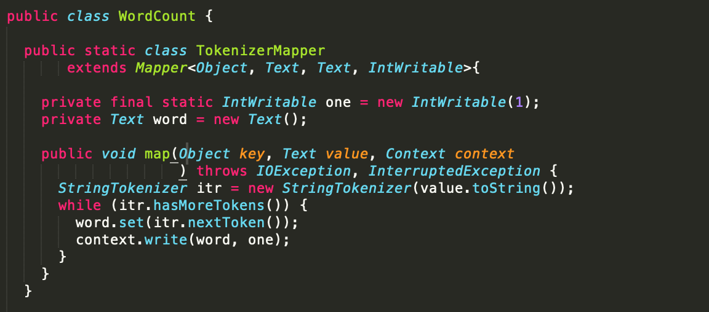
Example 1: Word Count

Slide 15
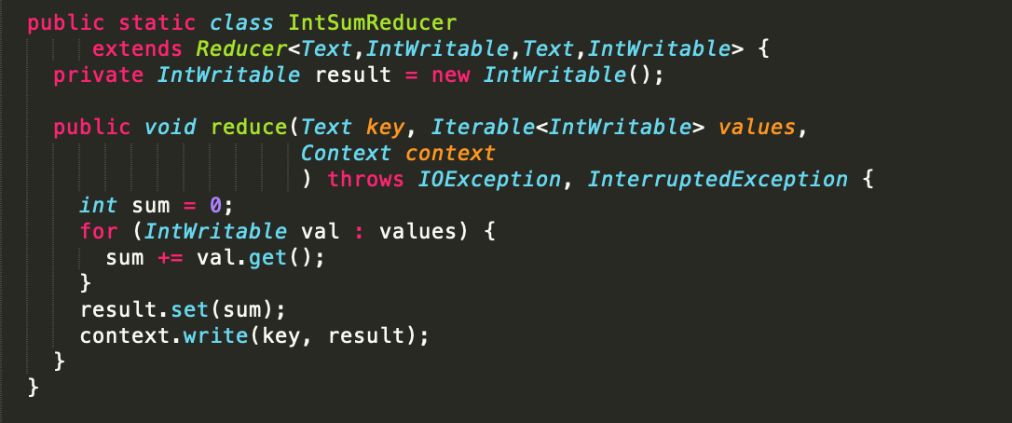
Example 1: Word Count

Slide 16
Sequence of Steps
Set environment
Compile source
Copy files
Make sure files are on hdfs
Run the already compiled jar file
For detailed instruction refer to readme.txt file

