Slide 1
COMP3311 Spring 2020
Tutorial 5
Functional Dependencies and 3NF

Slide 2
Review: Key
Superkey
  K → R
Candidate Key
  K → R
  no K’ ⊂ K, s.t. K’ → R (minimal)
Primary Key
  The candidate key chosen to uniquely identify tuples in a relation
primary key
superkey
candidate key

Slide 3
Review: The Closure of FD
For a set of functional dependencies F, we can get the closure, F⁺, by applying Armstrong’s Axioms.
Armstrong’s Axioms:
  Reflexivity
    If X ⊆ Y, then Y → X
  Augmentation
    If X →Y, then XZ → YZ
  Transitivity
    If X → Y, Y → Z, then X → Z
Derived rules:
  Decomposition
    If X → YZ, then X → Y and X → Z
  Union
    If X → Y and X → Z, then X → YZ
  Pseudo-transitivity
    If X → Y and WY → Z, then WX → Z

Slide 4
Review: The Closure of Attributes
Definition:
X, Y are attributes of a relation R:
X → Y is in F⁺ ⇔ Y ⊆ X⁺
Example:
Given R = (loan_no, amount, branch_name, customer_name)
  If loan_no → amount
  then loan_no⁺ = {loan_no, amount}
  If we also have loan_no → branch_name
  then loan_no⁺ = {loan_no, amount, branch_name}
  If we also have loan_no → customer_name
  then loan_no⁺ = {loan_no, amount, branch_name, customer_name}
Algorithm:
X⁽⁰⁾ := X
Repeat
  X^{(i+1)} := X^{(i)} ∪ Z,
  where Z is the set of attributes such that there exists Y→Z in F, and Y ⊂ X^{(i)}
Until X^{(i+1)} := X^{(i)}
Return X^{(i+1)}

Slide 5
Review: Canonical Cover of FD
Definition:
A canonical cover for F is a set of dependencies F_{c} such that
  F and F_{c} are equivalent
  F_{c} contains no redundancy
  Each left hand side of functional dependency in F_{c} is unique

Slide 6
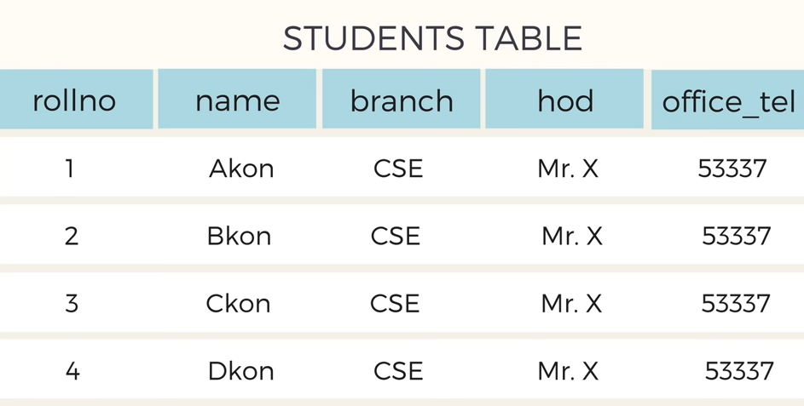
Why Normalization?

Slide 7
Review: Normalization
Decomposition of a relation R with the following goals
  Lossless (necessary)
    Information lost?
  Dependency preservation (desirable)
    (∪_{i} F_{i})⁺ = F⁺ ?
  Good form
    1NF, 2NF, 3NF, BCNF
2NF:
R is in 2NF if and only if
  for each FD: X → {A} in F⁺
  Then
  A ∈ X (the FD is trivial), OR
  X is not a proper subset of a candidate key for R, OR
  A is a prime attribute
3NF:
  R is in 3NF if and only if
  for each FD: X → {A} in F⁺
  Then
  A ∈ X (trivial FD), OR
  X is a superkey for R, OR
  A is prime attribute for R
  A prime attribute is an attribute that is part of a candidate key

Slide 8
Exercise 1: The Closure of Attributes
R = (A, B, C, D, E)
F = {A→BC, CD→E, B→D, E→A}
Compute A⁺ and B⁺:
A⁺ := {A}
:= {A, B, C} A→BC and {A} ⊂ A⁺
:= {A, B, C, D} B→D and {B} ⊂ A⁺
:= {A, B, C, D, E} CD→E and {C, D} ⊂ A⁺
ends because A⁺ stops changing
B⁺ := {B}
:= {B, D} B→D and {B} ⊂ B⁺
ends because B⁺ stops changing

Slide 9
Exercise 2: Candidate Keys
R = (A, B, C, D, E)
F = {A→BC, CD→E, B→D, E→A}
List all candidate keys of R.
We have A⁺ = {A, B, C, D, E} in Exercise 1,
then A→ABCDE, it is a candidate key of R.
Since E→A,
then E→ABCDE. (transitivity)
Since CD→E,
then CD→ABCDE. (transitivity)
Since B→D,
then BC→CD, then BC→ABCDE. (augmentation, transitivity)
So A, E, CD, BC are candidate keys of R.

Slide 10
Exercise 3: Compute Canonical Cover
R = (A, B, C, D, E)
F = {AC→E, ACD→B, CE→D, B→E}
Find the canonical cover of F.
Algorithm:
Repeat
Union
X₁→Y₁ and X₁→Y₂ replaced with X₁→Y₁Y₂
Find an extraneous attribute
  If an extraneous attribute is found in X→Y,
  delete it from X→Y
Until F does not change

Slide 11
Exercise 3: Compute Canonical Cover (cont)
R = (A, B, C, D, E)
F = {AC→E, ACD→B, CE→D, B→E}
Find the canonical cover of F.
First loop:
Union
Fc⁽¹⁾ = {AC→E, ACD→B, CE→D, B→E}
Find an extraneous attribute
Consider ACD→B:
D is extraneous because AC→E and CE→D
Remove D in ACD→B
Fc⁽¹⁾ = {AC→E, AC→B, CE→D, B→E}

Slide 12
Exercise 3: Compute Canonical Cover (cont)
R = (A, B, C, D, E)
Fc⁽¹⁾ = {AC→E, AC→B, CE→D, B→E}
Second loop:
Union
Fc⁽²⁾ = {AC→BE, CE→D, B→E}
Find an extraneous attribute
Consider AC→BE:
E is extraneous because B→E
Remove E in AC→BE
Fc⁽²⁾ = {AC→B, CE→D, B→E}

Slide 13
Exercise 3: Compute Canonical Cover (cont)
R = (A, B, C, D, E)
Fc⁽²⁾ = {AC→B, CE→D, B→E}
Third loop:
Union
Fc⁽³⁾ = {AC→B, CE→D, B→E}
Find an extraneous attribute
No extraneous attributes found
Ends because Fc stops changing
Fc = {AC→B, CE→D, B→E}

Slide 14
Exercise 3: Compute Canonical Cover (cont)
Different order of removing the extraneous attributes may result in different F_{C}
Example:
R=(A, B, C, D)
FD = {A→C, BC→A, ABC→D}
In ABC→D, A is extraneous or C is extraneous
If we remove A first, we get F_{c} = {A→C, BC→AD}
If we remove C first, we get F_{c} = {A→C, BC→A, AB→D}

Slide 15
Exercise 4: Normal forms
2NF:
R is in 2NF if and only if
  for each FD: X → {A} in F⁺
  Then
  A ∈ X (the FD is trivial), OR
  X is not a proper subset of a candidate key for R, OR
  A is a prime attribute
R=(A, B, C, D, E)
FD = {A→BC, CD→E, B→D, E→A}
Is R in 1NF?
  Yes. Relational tables are always in 1NF.
Is R in 2NF?
  We found candidate keys: A, E, CD, BC.
A→BC | BC are prime attribute
CD→E | E is a prime attribute
B→D | D is a prime attribute
E→A | A is a prime attribute
So R is in 2NF

Slide 16
Exercise 4: Normal forms (cont)
3NF:
  R is in 3NF if and only if
  for each FD: X → {A} in F⁺
  Then
  A ∈ X (trivial FD), OR
  X is a superkey for R, OR
  A is prime attribute for R
R=(A, B, C, D, E)
FD = {A→BC, CD→E, B→D, E→A}
Is R in 3NF?
    We found candidate keys: A, E, CD, BC.
A→BC | A is a candidate key
CD→E | CD is a candidate key
B→D | D is a prime attribute
E→A | E is a candidate key
So R is in 3NF

Slide 17
Exercise 4: Normal forms (cont)
2NF:
R is in 2NF if and only if
  for each FD: X → {A} in F⁺
  Then
  A ∈ X (the FD is trivial), OR
  X is not a proper subset of a candidate key for R, OR
  A is a prime attribute
R=(A, B, C, D, E, F)
FD = {A→B, BC→D, C→E, B→F}
Is R in 2NF?
    Candidate key: AC.
A→B | A is a proper subset of candidate key AND B is not a prime attribute
BC→D | BC is not a proper subset of candidate key
C→E | C is a proper subset of candidate key AND E is not a prime attribute
B→F | B is not a proper subset of candidate key
A→B or C→E makes R not in 2NF
Notes:
A candidate key always contains A.

Slide 18
Exercise 4: Normal forms (cont)
R=(A, B, C, D, E, F)
FD = {A→B, BC→D, C→E, B→F}
Is R in 3NF?
    3NF ⊂ 2NF ⊂ 1NF, R is not in 2NF, so R is not in 3NF either.
    Candidate key: AC.
3NF:
  R is in 3NF if and only if
  for each FD: X → {A} in F⁺
  Then
  A ∈ X (trivial FD), OR
  X is a superkey for R, OR
  A is prime attribute for R
A→B | A is not a super-key AND B is not a prime attribute
BC→D | BC is not a super-key AND D is not a prime attribute
C→E | C is not a super-key AND E is not a prime attribute
B→F | B is not a super-key AND F is not a prime attribute
Any one of the FD makes R not in 3NF

Slide 19
Exercise 5: Decomposition
R = (A, B, C, D, E, F, G, H)
F = {AC→G, D→EG, BC→D, CG→BD, ACD→B, CE→AG}
A decomposition of R:
  Table1: (A, B, C, D)
  Table2: (D, E, G)
  Table3: (A, C, D, F, H)
Is it lossless?
Yes
A decomposition of R into R1 and R2 is lossless if and only if the common attributes of R1 and R2 is a candidate key for R1 or R2
  (Table1 ∪ Table3) ∩ Table2 = D (candidate key of Table2)
  Table1 ∩ Table3 = ACD (candidate key of Table1)
R
Table1∪Table3
Table2
Table1
Table3

Slide 20
Exercise 5: Decomposition (cont)
R = (A, B, C, D, E, F, G, H)
F = {AC→G, D→EG, BC→D, CG→BD, ACD→B, CE→AG}
A decomposition of R:
  Table1: (A, B, C, D)
  Table2: (D, E, G)
  Table3: (A, C, D, F, H)
Is it dependency preserving?
  No (CG→BD is lost)

Slide 21
Exercise 6: 3NF
R = (A,B,C,D,E)
F = {AB→C, C→B, A→D}
Algorithm for 3NF Decomposition:
Let R be the initial table with FDs F
  Compute the canonical cover F_{c} of F
  S=∅
  for each FD X→Y in the canonical cover F_{c}
  S=S∪(X,Y)
  if no schema contains a candidate key for R
  Choose any candidate key K
  S=S ∪ K

Slide 22
Exercise 6: 3NF (cont)
R = (A,B,C,D,E)
F = {AB→C, C→B, A→D}
List all candidate keys of R.
  {ABE, ACE}
Compute F_{c}
    F and F_{c} are equivalent
    F_{c} contains no redundancy
    Each left hand side of functional dependency in F_{c} is unique
We get
F_{c} = {AB→C, C→B, A→D}, here F_{c} is the same as F.

Slide 23
Exercise 6: 3NF (cont)
R = (A,B,C,D,E)
F = {AB→C, C→B, A→D}
List all candidate keys of R.
  {ABE, ACE}
Compute F_{c}, we get
F_{c} = {AB→C, C→B, A→D}
For each FD, we generate a table:
R₁ = {A, B, C}, F₁ = {AB→C, C→B}
R₂ = {A, D}, F₂ = {A→D}
No need to generate another table for FD {C→B}, because R₁ already contains B and C.

Slide 24
Exercise 6: 3NF (cont)
R = (A,B,C,D,E)
F = {AB→C, C→B, A→D}
Any table in S contains a candidate key for R?
No
Choose any candidate key (ABE) to generate a new table:
Generate R₃ = {A, B, E}
So a possible 3NF decomposition of R is:
R₁ = {A, B, C}, R₂ = {A, D}, R₃ = {A, B, E}
Lossless?
Yes
Dependency preserving?
Yes

