Slide 1
COMP3311 Spring 2020
Tutorial 9
Transactions, Concurrent Control Locking

Slide 2
Review: Transactions
A transaction is a collection of operations that form a single logical unit of work
  access or update data stored in the database.
A transaction brings the database from one consistent state to another consistent state.
  During transaction execution the database may be inconsistent.
To preserve integrity of data, the database system must ensure:
  Atomicity, Consistency, Isolation, Durability
Two main issues to deal with:
  Various kinds of failures, such as hardware failures and system crashes
  Concurrent execution of multiple transactions

Slide 3
Review: Transactions
ACID properties of transactions:
  Atomicity - either all operations of the transaction are reflected properly in the database, or none are.
  Consistency - execution of a transaction in isolation preserves the consistency of the DB.
  Isolation - Even though multiple transactions may execute concurrently, the system guarantees that each transaction is unaware of other transactions executing concurrently in the system.
  Durability - After a transaction completes successfully, the changes it has made to the DB persist.
Schedules – the chronological order in which operations of concurrent transactions are executed
    must consist of all the operations of all the transactions
    must preserve the order in which the operations appear in each individual transaction.

Slide 4
Serializability
Basic Assumption – Each transaction preserves database consistency.
Thus serial execution of a set of transactions preserves database consistency.
A (possibly concurrent) schedule is serializable if it is equivalent to a serial schedule.
If a schedule S can be transformed into a schedule S´ by a series of swaps of non-conflicting instructions, we say that S and S´ are conflict equivalent.
We say that a schedule S is conflict serializable if it is conflict equivalent to a serial schedule.

Slide 5
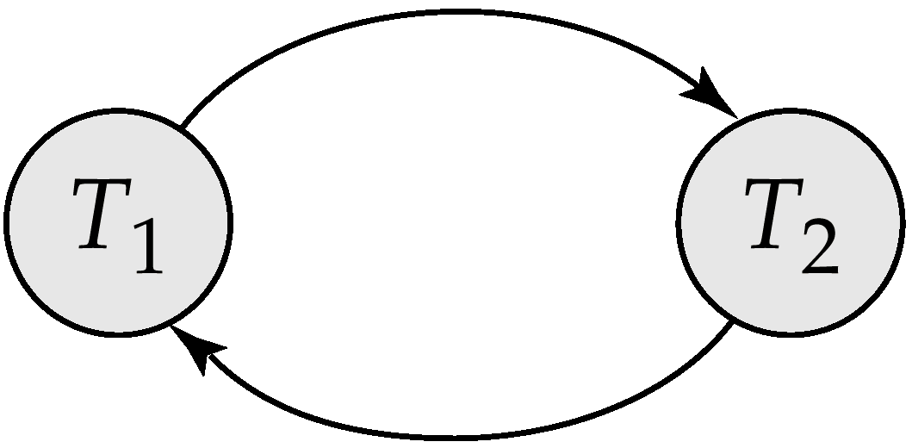
Testing for Serializability
Precedence graph — a direct graph where the vertices are the transactions (names).
We draw an arc from T_{i} to T_{j} if the two transactions conflict, and T_{i} accessed the data item on which the conflict arose earlier.
We may label the arc by the item that was accessed.
A schedule is conflict-serializable if and only if its precedence graph of committed transactions is acyclic

Slide 6
Example: Serializability
Schedule 1
Is it conflict serializable?
Yes. equivalent to T1->T2
T1 | T2
read (A) write (A) read (B) write (B) | read (A) write (A)
T1
T2
No circle!

Slide 7
Example: Serializability
Schedule 2
Is it conflict serializable?
No.
T3 | T4 | T5
read (Q) write (Q) | write (Q) | write (Q)
T3
T4
T5

Slide 8
Review: Recoverability
Recoverable schedule - If a transaction Tj reads a data items previously written by a transaction Ti, the commit operation of Ti appears before the commit operation of Tj.
Non-recoverable schedule
  The following schedule is not recoverable if T2 commits immediately after Read (A).
T1 | T2
write (A) read (B) abort commit | read (A) commit

Slide 9
Example: Recoverability
Cascading Rollback
  A single transaction failure leads to a series of transaction rollbacks.
  Can lead to the undoing of significant amount of work
It is desirable to have cascadeless schedule.
If T3 fails, T4 and T5 must be rolled back.
T3 | T4 | T5
read (A) write (A) abort commit | read (A) write (A) commit | read (A) commit
T3 | T4 | T5
read (A) write (A) commit | read (A) write (A) commit | read (A) commit

Slide 10
Exercise 1: Transactions
Consider the following schedule consisting of four transactions T1, T2, and T3, T4:
S: r1(X), w1(X), r2(X), r3(Y), w3(Y), w2(X), r4(Y), w1(Y), c1, c2, c4, c3
(Note: r1 means T1 read, and so on)
Question:
  Show that the schedule is conflict serializable by constructing the precedence graph.
  What is the equivalent serial schedule?
  Rewrite the schedule so it becomes recoverable.

Slide 11
Exercise 1: Transactions
S: r1(X), w1(X), r2(X), r3(Y), w3(Y), w2(X), r4(Y), w1(Y), c1,c2,c4,c3
a) Show that the schedule is conflict serializable by constructing the precedence graph
b) Which is the equivalent serial schedule?
  T3, T4, T1,T2
T1
T2
T4
T3

Slide 12
Exercise 1: Transactions
S: r1(X), w1(X), r2(X), r3(Y), w3(Y), w2(X), r4(Y), w1(Y), c1,c2,c4,c3
c) Rewrite the schedule so it becomes recoverable
  S: r1(X), w1(X), r2(X), r3(Y), w3(Y), w2(X), r4(Y), w1(Y), c3,c4,c1,c2
T1 | T2 | T3 | T4
Read (X) Write (X) Write(Y) Commit | Read(X) Write(X) Commit | Read(Y) Write(Y) Commit | Read(Y) Commit
T1 | T2 | T3 | T4
Read (X) Write (X) Write(Y) Commit | Read(X) Write(X) Commit | Read(Y) Write(Y) Commit | Read(Y) Commit

Slide 13
Exercise 2: Transactions
Consider the following schedule
  S1:r1(X);r2(Z);r3(X);r3(Y);w1(X);c1;w3(Y);c3;r2(Y);w2(Z);w2(Y);c2.
  S2:r1(X);r2(Z);r1(Z);r3(X);r3(Y);w1(X);w3(Y);r2(Y);w2(Z);w2(Y);c1;c2;c3.
  S3:r1(X);r2(Z);r3(X);w1(Z);r2(Y);r3(Y);w1(X);c1;w2(Z);w3(Y);w2(Y);c3;c2.
Are the schedules serializable?
If they are serializable, are they also recoverable?
If they are serializable and recoverable are they cascade-less?

Slide 14
Exercise 2: Transactions
Consider the following schedule S1:r1(X);r2(Z);r3(X);r3(Y);w1(X);c1;w3(Y);c3;r2(Y);w2(Z);w2(Y);c2.
- This schedule is serializable (can be either T3,T1,T2 or T3,T2,T1).
- This schedule is recoverable, because all the transactions T1, T2, T3 commit later than the transactions that wrote the data.
- It is cascade-less. Because T1,T2,T3 read the data after the earlier transactions that wrote the data have all committed.
T1 | T2 | T3
Read(X) Write(X) Commit | Read(Z) Read(Y) Write(Z) Write(Y) Commit | Read(X) Read(Y) Write(Y) Commit

Slide 15
Exercise 2: Transactions
Consider the following schedule
S2:r1(X);r2(Z);r1(Z);r3(X);r3(Y);w1(X);w3(Y);r2(Y);w2(Z);w2(Y);c1;c2;c3.
T1 | T2 | T3
Read(X) Read(Z) Write(X) Commit | Read(Z) Read(Y) Write(Z) Write(Y) Commit | Read(X) Read(Y) Write(Y) Commit
- This schedule is serializable (can be T3,T1,T2).
- This schedule is non-recoverable, because T2 reads Y after T3 has written Y, but T2 commit earlier than T3.

Slide 16
Exercise 2: Transactions
Consider the following schedule
S3:r1(X);r2(Z);r3(X);w1(Z);r2(Y);r3(Y);w1(X);c1;w2(Z);w3(Y);w2(Y);c3;c2.
T1 | T2 | T3
Read(X) Write(Z) Write(X) Commit | Read(Z) Read(Y) Write(Z) Write(Y) Commit | Read(X) Read(Y) Write(Y) Commit
- This schedule is non-serializable, because the precedence graph contains cycles as shown below.
T1
T2
T3

Slide 17
Review of 2PL
Concurrency Control Protocols ensure serializability of schedules.
Types of protocols:
Locking: Shared and exclusive locks prevent multiple transactions to access the same data item at the same time.
2PL (2-phase locking) idea: you cannot unlock and then lock again. First you finish with all the locks and the you can do the unlocking.

Slide 18
Schedule Example 1
T₁ | T₂ | T₃
 | read(Z)
 | read(Y)
 | write(Y)
 |  | read(Y)
 |  | read(Z)
read(X)
write(X)
 |  | write(Y)
 |  | write(Z)
 | read(X)
read(Y)
write(Y)
 | write(X)
Q. Is the schedule conflict-serializable?
Check by constructing the precedence graph
1
2
3
Cyclic. Not conflict-serializable.
Notes:
10

Slide 19
Schedule Example 1
Dead Lock!
2 Phase Locking of Schedule 1
T₁ | T₂ | T₃
 | read(Z)
 | read(Y)
 | write(Y)
 |  | read(Y)
 |  | read(Z)
read(X)
write(X)
 |  | write(Y)
 |  | write(Z)
 | read(X)
read(Y)
write(Y)
 | write(X)
T₁
T₂
T₃
Lock_s(Z)
read(Z)
Lock_s(Y)
read(Y)
Lock_x(Y)
write(Y)
Lock_s(Y)
read(Y)
read(Z)
Lock_s(X)
read(X)
Lock_x(X)
write(X)
write(Y)
write(Z)
Lock_s(X)
read(X)
Lock_s(Y)
read(Y)
write(Y)
write(X)

Slide 20
Schedule Example 2
Q: The schedule is conflict-serializable. The equivalent serial schedule is:
T₁ | T₂ | T₃
 |  | read(Y)
 |  | read(Z)
read(X)
write(X)
 |  | write(Y)
 |  | write(Z)
 | read(Z)
read(Y)
write(Y)
 | read(Y)
 | write(Y)
 | read(X)
 | write(X)
1
2
3
T3-T1-T2
Notes:
10

Slide 21
Schedule Example 2
2 Phase Locking of Schedule 1
T₁ | T₂ | T₃
 |  | LOCK-S(Y), read(Y)
 |  | LOCK-S(Z), read(Z)
LOCK-S(X), read(X)
LOCK-X(X), write(X)
 |  | LOCK-X(Y), write(Y)
 |  | LOCK-X(Z), write(Z) UNLOCK(Z), UNLOCK(Y)
 | LOCK-S(Z), read(Z)
LOCK-S(Y), read(Y)
LOCK-X(Y), write(Y) UNLOCK(Y), UNLOCK(X)
 | LOCK-S(Y), read(Y)
 | LOCK-X(Y), write(Y)
 | LOCK-S(X), read(X)
 | LOCK-X(X), write(X) UNLOCK(X), UNLOCK(Y). UNLOCK(Z)
T₁ | T₂ | T₃
 |  | read(Y)
 |  | read(Z)
read(X)
write(X)
 |  | write(Y)
 |  | write(Z)
 | read(Z)
read(Y)
write(Y)
 | read(Y)
 | write(Y)
 | read(X)
 | write(X)

