Slide 1
COMP 3311 Database
Management Systems
Spring 2020
Lab 8. Programming with ODBC 2

Slide 2
Objectives of the Lab
After this lab, you should be able to:
  know about the different data-types of ODBC (which is important in calling the functions),
  issue prepared statements using the ODBC interface,
  check for error messages under ODBC.

Slide 3
Reminder: connecting to ODBC 1
You have seen how to connect to the Oracle server through the ODBC interface in Lab 7.
Four steps are involved in connecting to the Oracle through the ODBC interface:
  Include the proper headers (<sql.h>, <sqlext.h>) to the C program,
  Initialize ODBC environment,
  Allocate a connection handle,
  Connect to the data source corresponds to the Oracle server.

Slide 4
Reminder: connecting to ODBC 2
To initialize the ODBC environment:
HENV henv;
  /* Allocate environment handle */
  SQLAllocEnv( &henv);
To allocate a connection handle:
  HDBC hdbc;
  /* Allocate connection handle */
  SQLAllocConnect(henv, &hdbc);
To call the SQLConnect() function:
SQLConnectA(hdbc, (SQLCHAR*) "comp3311.cse.ust.hk", SQL_NTS, (SQLCHAR*) argv[1], SQL_NTS, (SQLCHAR*) argv[2], SQL_NTS);
This time you need to enter your id and password as input to execute the connect function.

Slide 5
ODBC Data types 1
To enable real ODBC programming, one needs to be able to declare ODBC data types.
ODBC defines two sets of data types:
  C data types – indicate the data type of the data stored in the local variables of
  the ODBC programs.
  SQL data types – indicate the data type of data stored at the data source (i.e. the DataBase Management System)

Slide 6
ODBC Data types 2
Some common C data types
C type identifier (i.e. parameter passed to SQLBindCol and SQLGetData functions to specify target variable datatype) | ODBC C typedef (define variables in the program | Corresponding C data type
SQL_C_CHAR | SQLCHAR * | unsigned char *
SQL_C_WCHAR | SQLWCHAR * | wchar_t *
SQL_C_SSHORT | SQLSMALLINT | short int
SQL_C_USHORT | SQLUSMALLINT | unsigned short int
SQL_C_SLONG | SQLINTEGER | long int
SQL_C_ULONG | SQLUINTEGER | unsigned long int
SQL_C_FLOAT | SQLREAL | float
SQL_C_DOUBLE | SQLDOUBLE, SQLFLOAT | double

Slide 7
ODBC Data types 3
Some common SQL data types
SQL type identifier (i.e. the SQL data type of the data being stored in the DBMS) | Actual SQL data type | Type description
SQL_CHAR | CHAR(n) | Character string of length n
SQL_VARCHAR | VARCHAR(n) | Variable length character string upto n characters
SQL_DECIMAL | DECIMAL(p,s) | Signed numeric value with precision of at least p and scale of s ( p significant digits and s digits after the decimal point, p<=15)
SQL_NUMERIC | NUMERIC(p,s) | Signed numeric value with precision of exactly p and scale of s (p<=15)
SQL_SMALLINT | SMALLINT | Numeric value with precision 5 and scale 0
SQL_INTEGER | INTEGER | Numeric value with precision 10 and scale 0
SQL_FLOAT | FLOAT(p) | Signed numeric value with a binary precision of at least p
SQL_DOUBLE | DOUBLE PRECISION | Signed numeric value with a binary precision 53.

Slide 8
The prepared statement 1
To Prepare and execute a SQL statement, one needs to:
  call SQLPrepare() function to prepare the statement (pre-compiled at the server to improve efficiency),
  call the SQLBindParameter() function to set the value(s) of the parameter(s),
  call SQLExecute() function to execute the statement.

Slide 9
The prepared statement 2
The SQL statement could contain place-holders which indicate values obtained from the program during the execution.
The SQLBindParameter() function binds local variables to the place-holders and specify the data types of the variables and the columns associated with the parameters.

Slide 10
The prepared statement 3
To call SQLPrepare(), one needs to pass a statement handle and the SQL query as the parameters, a question mark in the SQL query indicates the location of a place-holder:
SQLPrepareA(hstmt, (SQLCHAR*) "SELECT room_number FROM departments WHERE department_id=?", SQL_NTS);
The possible return codes of SQLPrepare() are SQL_SUCCESS, SQL_ERROR, SQL_SUCCESS_WITH_INFO, and SQL_INVALID_HANDLE

Slide 11
The prepared statement 4
To bind parameters to the placeholders in the SQL query, one needs the SQLBindParameter() function. The following example binds the string deptid to the question mark on the last slide:
SQLBindParameter(hstmt, 1, SQL_PARAM_INPUT, SQL_C_CHAR, SQL_CHAR, 0, 0, deptid, 50, &deptid_n);
The possible return codes of SQLBindParameter() are SQL_SUCCESS, SQL_ERROR, SQL_SUCCESS_WITH_INFO, and SQL_INVALID_HANDLE

Slide 12
The prepared statement 5
The full syntax of calling the SQLBindParameter() function:
SQLBindParameter( SQLHSTMT StatementHandle, SQLUSMALLINT ParameterNumber, SQLSMALLINT InputOutputType, SQLSMALLINT ValueType, SQLSMALLINT ParameterType, SQLULEN ColumnSize, SQLSMALLINT DecimalDigits, SQLPOINTER ParameterValuePtr, SQLLEN BufferLength, SQLLEN * StrLen_or_IndPtr);

Slide 13
The prepared statement 6
ParameterNumber indicates the particular placeholder (question mark) you want the local variable to be bound with.
InputOutputType indicates the type of the variable to be bound. Possible values for this parameter are :
  SQL_PARAM_INPUT, SQL_PARAM_OUTPUT, SQL_PARAM_OUTPUT_STREAM, SQL_PARAM_INPUT_OUTPUT and SQL_PARAM_INPUT_OUTPUT_STREAM
  (see http://msdn.microsoft.com/en-us/library/ms710963(v=VS.85).aspx for the details)
ValueType indicates the C data type of the parameter (see slide 6 for the list of data types)
ParameterType indicates the SQL data type of the parameter (see slide 7 for the list)
ColumnSize indicates the max length of the parameter, it is used by the function if ParameterType equals to SQL_CHAR, SQL_GRAPHIC, SQL_DECIMAL or SQL_NUMERIC. For other parameter types, this parameter is unused/ignored.
DecimalDigits indicates the number of digits of the parameter, it is used by the function if the ParameterType equals to SQL_DECIMAL,SQL_NUMERIC, or SQL_TIMESTAMP. For other parameter types, this parameter is unused/ignored.
ParameterValuePtr is the pointer that points to a buffer that contains the actual data for the parameter, i.e. a local variable/array is been bound to the SQL parameter through this pointer.
BufferLength indicates the length of the buffer pointed to by the ParameterValuePtr (50 for the previous example).
strLen_or_IndPtr holds the length of the parameter value stored in *ParameterValuePtr , in the previous example we initialize it to SQL_NTS.

Slide 14
The prepared statement 7
  To execute the SQL statement, one needs to call the SQLExecute() function:
  SQLExecute(hstmt);
  Where hstmt is the statement handle.
  The possible return codes of SQLExecute() are SQL_SUCCESS, SQL_SUCCESS_WITH_INFO, SQL_NEED_DATA, SQL_STILL_EXECUTING, SQL_ERROR, SQL_NO_DATA, SQL_INVALID_HANDLE, and SQL_PARAM_DATA_AVAILABLE.

Slide 15
The prepared statement 8
Finally retrieve the result by binding the result to a local variable.
SQLBindCol(hstmt,1, SQL_C_SLONG,&room,1,&room_n);
The possible return codes of SQLBindCol() are SQL_SUCCESS, SQL_SUCCESS_WITH_INFO, SQL_NEED_DATA, SQL_STILL_EXECUTING, SQL_ERROR, SQL_NO_DATA, SQL_INVALID_HANDLE, and SQL_PARAM_DATA_AVAILABLE.
The script file for building the database is available at⁺: http://course.cse.ust.hk/comp3311/labs/lab8.sql
The complete piece of code is available at:
http://course.cse.ust.hk/comp3311/labs/odbc2.cpp
⁺ make sure you run “commit;” in SQL Developer after running
the script. Before you “commit” (or “exit”), the data will not be written.

Slide 16
Running the example 1
First, make sure the data source has been set up properly as “comp3311.cse.ust.hk” (refer to the “Steps to set up ODBC environment for visual studio” section of lab 7 for the detailed steps).
Second, make sure you have ran the script lab8.sql in SQL Developer (and “commit” it by runnning “commit;” as shown in the “Building the SQL database 2” part of lab 7).
Finally, start a new project and compile the code under Visual Studio (as shown in lab 7), and run the compiled program.

Slide 17
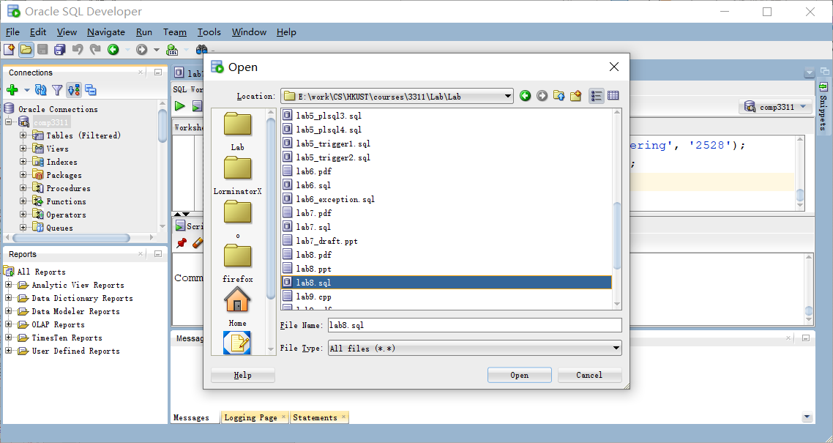
Running the example 1

Slide 18
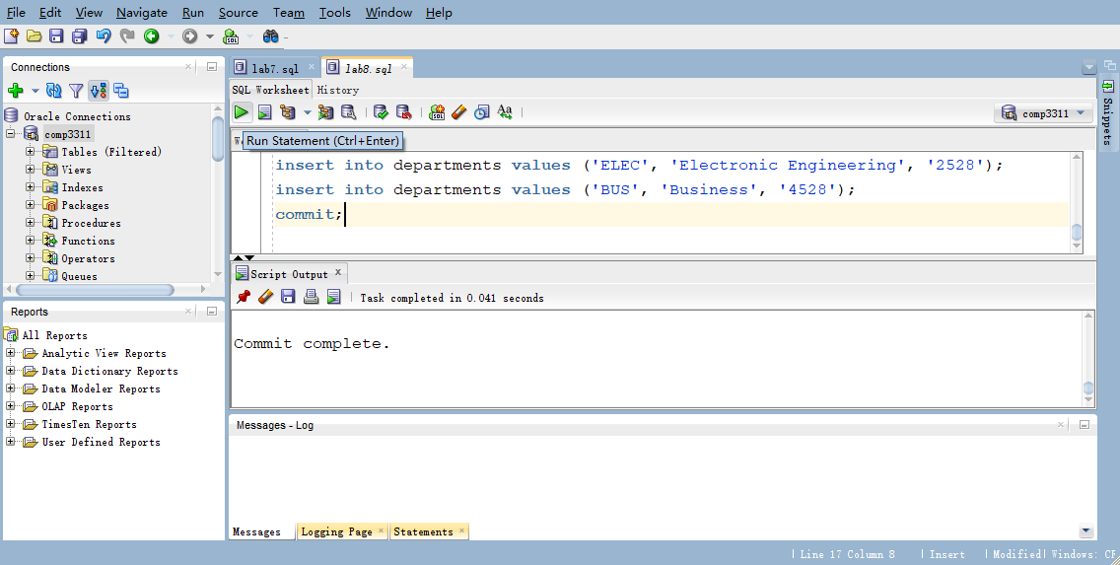
Running the example 1

Slide 19

Running the example 2

Slide 20
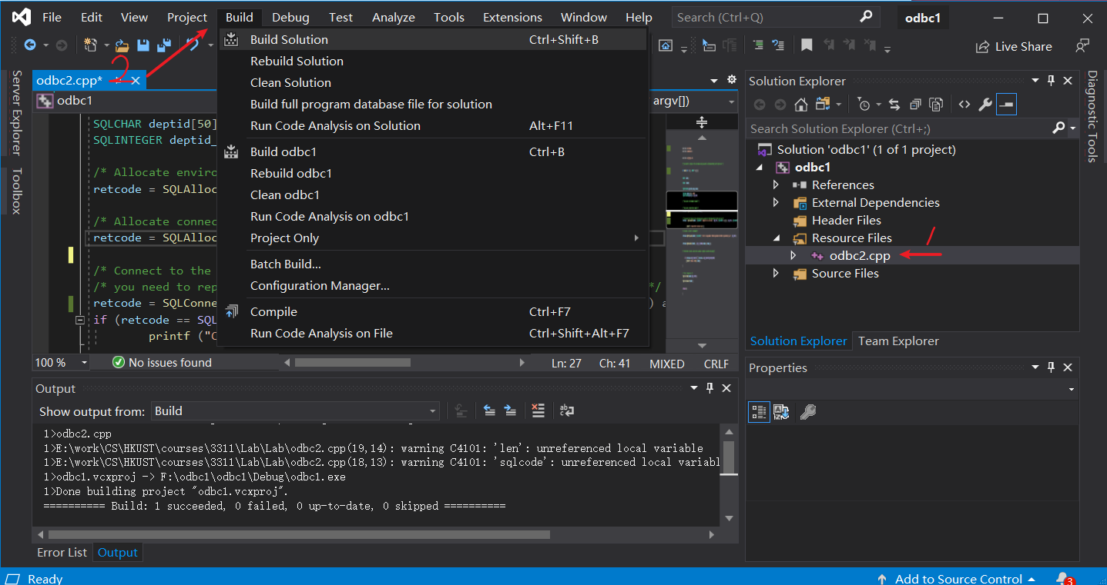
Running the example 2

Slide 21
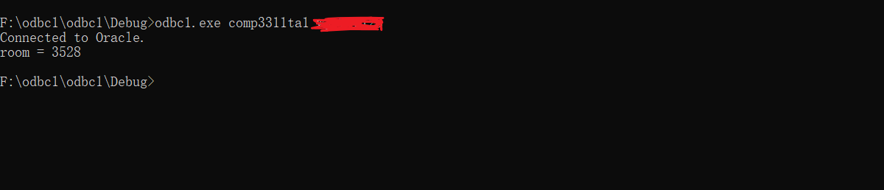
Running the example 2
Executable_file User_name Password
Connection to Oracle through ODBC is successful!
Prepared statement ran successfully, retrieved value is bound
to a C++ local variable “room” and is displayed to the screen

Slide 22
Getting error information 1
To obtain ODBC error information, one can use the SQLGetDiagRec() function.
The function will return the
  SQLSTATE,
  the native error code
  the diagnostic message
  for the error.

Slide 23
Getting error information 2
The syntax of the SQLGetDiagRec() function:
SQLGetDiagRec( SQLSMALLINT HandleType,
SQLHANDLE Handle, SQLSMALLINT RecNumber,
SQLCHAR * SQLState, SQLINTEGER * NativeErrorPtr,
SQLCHAR * MessageText, SQLSMALLINT BufferLength,
SQLSMALLINT * TextLengthPtr);
The possible return codes are SQL_SUCCESS, SQL_SUCCESS_WITH_INFO, SQL_ERROR, and SQL_INVALID_HANDLE.

Slide 24
Getting error information 3
HandleType is a handle identifier and the value can be SQL_HANDLE_ENV, SQL_HANDLE_DBC, SQL_HANDLE_STMT or SQL_HANDLE_DESC.
Handle is the input handle for getting the specific error. It must be of the same type as declared by HandleType.
When there are multiple errors, RecNumber allows the programmer to indicate which error to be retrieved. The first error message starts at RecNumber=1.
SQLState is a pointer that points to the buffer that the five-character SQLSTATE code will be stored.
NativeErrorPtr is a pointer that points to the buffer where the native error code will be stored. The native error code is specific to the particular data source (DMBS).
MessageText is a pointer to the buffer where the diagnostic message (a character string) will be stored.
BufferLength is the length of the MessageText buffer in characters.
TextLengthPtr is a pointer to the buffer where the size of the MessageText string (in number of characters) is stored.

Slide 25
Getting error information 4
A piece of code that calls the SQLGetDiagRec() function to retrieve the error message:
retcode = SQLConnectA(hdbc, (SQLCHAR*) "comp1234.cse.ust.hk", SQL_NTS, (SQLCHAR*) argv[1], SQL_NTS, (SQLCHAR*) argv[2], SQL_NTS);
if (retcode == SQL_SUCCESS || retcode == SQL_SUCCESS_WITH_INFO){
printf ("Connected to Oracle.\n");}
else {
SQLGetDiagRecA(SQL_HANDLE_DBC,hdbc,1,sqlstate, &sqlcode, msg,4000,&len);
printf("%s(%s)\n",msg,sqlstate);
exit;}
In the above code, the data source name is incorrect. So we should expect the error message to complain about that.

Slide 26
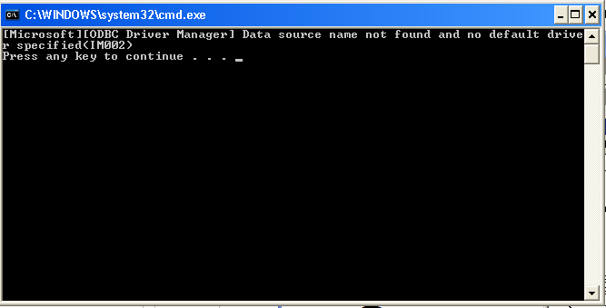
Getting error information 5
The following is the error message returned:
The complete code is available at:
  http://course.cse.ust.hk/comp3311/labs/odbc3.cpp

Slide 27
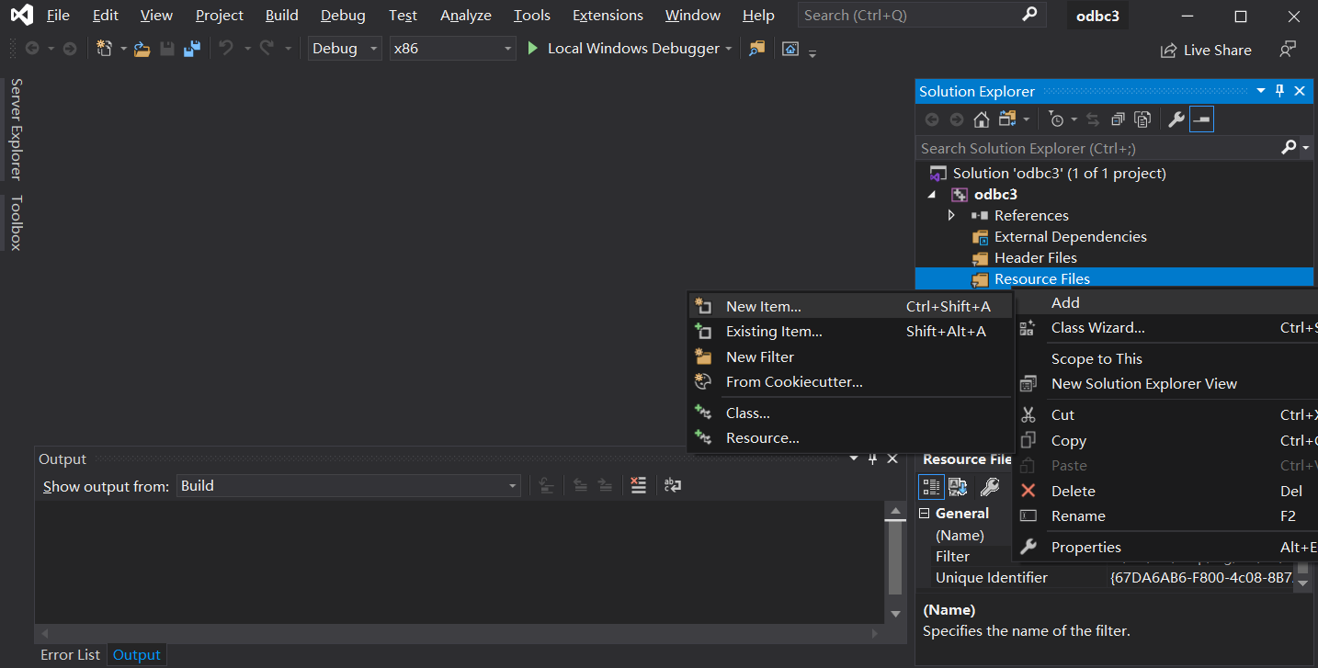
Getting error information 5

Slide 28
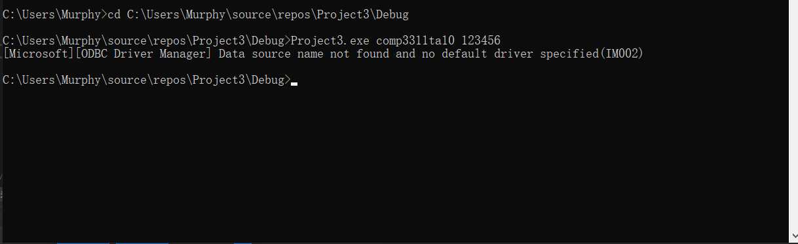
Getting error information 5

Slide 29
Getting error information 6
Some common error codes:
The complete list of error codes is available at:
http://msdn.microsoft.com/en-us/library/ms714687(v=VS.85).aspx
SQLSTATE | Error
01000 | General warning
08002 | Connection name in use
08003 | Connection not open
08007 | Connection failure during transaction
22012 | Division by zero
28000 | Invalid authorization specification

Slide 30
Conclusion
We covered the following topics in this lab:
  the different data-types of ODBC,
  the prepared statement,
  function for getting ODBC error messages.

Slide 31
Appendix 1: List of all ODBC functions and datatypes
The following page contains detailed information about all the ODBC functions:
http://msdn.microsoft.com/en-us/library/ms712628(v=VS.85).aspx
More C datatypes are available at:
http://msdn.microsoft.com/en-us/library/ms714556(v=VS.85).aspx
More SQL datatypes are available at:
http://msdn.microsoft.com/en-us/library/ms710150(v=VS.85).aspx

Slide 32
About char[] usage in C++
What does the %d, %s means?
http://www.cplusplus.com/reference/cstdio/printf/
A simple way to do char[] string operation in C++.
http://www.cplusplus.com/reference/cstdio/sprintf/

Slide 33
Using sprintf
sprintf can be used to prepare statements for SQLDirectExecA
The result of this statement is that the variable query will contain "SELECT * from departments where department_id='MATH’”
Now, these two statements will have the same effect:
char dept_id[100]="MATH";
char query[100];
sprintf(query,"SELECT * from departments where department_id=\'%s\'",dept_id);
SQLExecDirectA(hstmt, (SQLCHAR *) "select * from departments where department_id=\'MATH\'",SQL_NTS);
SQLExecDirectA(hstmt, (SQLCHAR *) query, SQL_NTS);
Note than in strings in C++, \' is need to get ' in the result

