Slide 1
COMP3311 Spring 2020
Tutorial 2
Relational Data Model
Relational Algebra

Slide 2
Review of Relational Model
The relational model represents the data for an application as a collection of tables.
Relational Model |  | Representation | Notation
Relation | ⬄ | table | R(A₁, A₂, …, A_{n})
Attribute | ⬄ | column | A_{i}
Domain | ⬄ | type and range of attribute values | dom(A_{i})
Tuple / Record | ⬄ | row
Attribute value | ⬄ | value in table cell
Attribute | Domain
age | [0-100]
name | 50 alphabetic characters
salary | non-negative integer
Examples of attribute domains:

Slide 3
ER Diagram to Relational Model (1)
Entities are transformed into tables
Attributes of relationships or entities are transformed into columns
  Composite attributes are flattened out by creating a separate attribute for each component attribute. For example, if attribute “name” consists of attributes “first-name” and “last-name” then we create two separate columns.
  A multivalued attribute M of an entity E is represented by a separate table EM. For example, multivalued attribute phone-number of employee is represented by a table employee-phone(employee-id, phone-number).
A weak entity set becomes a table that includes a column for the primary key of the identifying strong entity set.

Slide 4
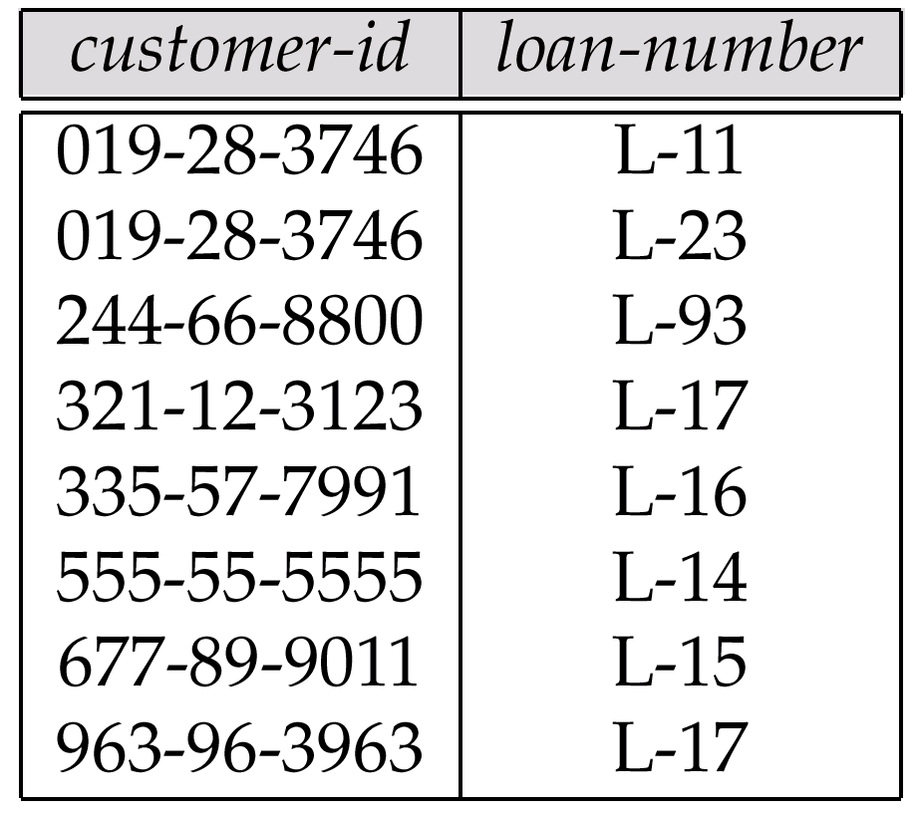
ER Diagram to Relational Model (2)
Relationship sets are also transformed into tables
  A many-to-many relationship set is represented as a table with columns for the primary keys of the two participating entity sets, and any descriptive attributes of the relationship set.
  Many-to-one and one-to-many relationship sets that are total on the many-side can be represented by adding an extra attribute to the many side, containing the primary key of the one side. (Example on next slide)
  If participation is partial on the many side, replacing a table by an extra attribute in the relation corresponding to the “many” side could result in null values. (Example on next slide)
  For one-to-one relationship sets, either side can be chosen to act as the “many” side.

Slide 5
Example(1)
Suppose that we have employee and project entities.
Each employee works on exactly one project.
works_on
employee
project
Employee
emp# | name | address | hkid | works_on_project
1 | Holmes D. | 86 Queen | A450361 | 3
5 | Chan B. | 21 Minto | C461378 | 2
35 | Hui J. | 16 Peak | F562916 | 1
8 | Bell G. | 53 Water | A417394 | 2
15 | Wing R. | 58 Aster | C538294 | 3
Project
proj# | name | budget
1 | E-commerce | 200,000
2 | Stock control | 100,000
3 | Web store | 500,000

Slide 6
Example(2)
What if we had partial participation from the many side?
works_on
employee
project
Employee
emp# | name | address | hkid | works_on_project
1 | Holmes D. | 86 Queen | A450361 | 3
5 | Chan B. | 21 Minto | C461378 | null
35 | Hui J. | 16 Peak | F562916 | 1
8 | Bell G. | 53 Water | A417394 | 2
15 | Wing R. | 58 Aster | C538294 | null
Project
proj# | name | budget
1 | E-commerce | 200,000
2 | Stock control | 100,000
3 | Web store | 500,000
We may have null values!

Slide 7
Exercise: Convert E-R Diagram into tables
semester
time
room
sid
name
iid
name
student
enrols
course- offerings
teaches
instructor
program
year
section_no
dept
title
grade
is offered
course_no
credits
requires
prerequisite
course
maincourse
title
syllabus
E-R diagram for a university.

Slide 8
Entities (Not Weak)
semester
time
room
sid
name
iid
name
student
enrols
course- offerings
teaches
instructor
program
year
section_no
dept
title
grade
is offered
course_no
credits
requires
prerequisite
course
maincourse
title
syllabus
E-R diagram for a university.

Slide 9
Tables of Entities (Not Weak)
These entities participate in many-to-many relationships OR
are on the one side in one-to-many relationships!
student (sid, name, program)
course (course_no, title, syllabus, credits)
instructor (iid, name, dept, title)
semester
time
room
sid
name
iid
name
student
enrols
course- offerings
teaches
instructor
program
grade
year
section_no
dept
title
is offered
course_no
credits
requires
prerequisite
course
maincourse
title
syllabus

Slide 10
Weak Entity
semester
time
room
sid
name
iid
name
student
enrols
course- offerings
teaches
instructor
program
year
section_no
dept
title
grade
is offered
course_no
credits
requires
prerequisite
course
maincourse
title
syllabus
E-R diagram for a university.

Slide 11
Table of Weak Entity
course-offerings (course_no, section_no, year, semester, time, room)
  course_no references course
  on delete cascade
Foreign key constraint?
Referential integrity action?
semester
time
room
sid
name
iid
name
student
enrols
course- offerings
teaches
instructor
program
grade
year
section_no
dept
title
is offered
course_no
credits
requires
prerequisite
course
maincourse
title
syllabus

Slide 12
Relationships (weak entity relationship excluded)
semester
time
room
sid
name
iid
name
student
enrols
course- offerings
teaches
instructor
program
year
section_no
dept
title
grade
is offered
Search for many-to-many relationships!
course_no
credits
requires
prerequisite
course
maincourse
title
syllabus
E-R diagram for a university.

Slide 13
Tables of Relationships (without weak entities)
enrols (sid, course_no, section_no, semester, year, grade)
teaches (iid, course_no, section_no, semester, year)
requires (main_course_no, prerequisite_no)
semester
time
room
sid
name
iid
name
student
enrols
course- offerings
teaches
instructor
program
grade
year
section_no
dept
title
is offered
course_no
credits
requires
prerequisite
course
maincourse
title
syllabus

Slide 14
Tables of Relationships (without weak entities)
With Foregin Key Constraints
enrols (sid, course_no, section_no, semester, year, grade)
  sid references student
  on delete cascade
  (course_no, section_no,semester,year) references course-offering
  on delete cascade
teaches (iid, course_no, section_no, semester, year)
  (course_no, section_no,semester,year) references course-offering
  on delete cascade
  iid references instructor
  on delete cascade
requires (main_course_no, prerequisite_no)
  main_course references course
  on delete cascade
  prerequisite_no references course
  on delete cascade
Whenever we have a many-to-many relationship
we create a separate table for it
and put the primary keys of the participating entities
as its attributes!
  Add: 1. a foreign key constraint for each foreign key.
  2. a referential integrity action for each foreign key.

Slide 15
Identifying set – Weak entity set relationship
semester
time
room
sid
name
iid
name
student
enrols
course- offerings
teaches
instructor
program
year
section_no
dept
title
grade
is offered
course_no
credits
requires
prerequisite
course
maincourse
title
syllabus
E-R diagram for a university.

Slide 16
Table of Relationship with Weak Entity
There is no extra table for the relationship between a weak entity and its “owner/strong” entity.
The relationship is already present in the table for the weak entity.
  course-offerings (courseno, secno, year, semester, time, room)
  course_no references course
  on delete cascade

Slide 17
Ν to 1 with partial participation
What if we had a N to 1 cardinality constraint on “teaches” relationship?
employee
works_on
project
employee (emp_no, name, address, proj_no)
  proj_no references project
  on delete set null
Referential integrity actions?

Slide 18
Ν to 1 with partial participation
What if we had a N to 1 cardinality constraint on “teaches” relationship?
course- offerings
teaches
instructor
course-offerings (course_no, section_no, year, semester, time, room, iid)
  course_no references course
  on delete cascade
  iid references instructor
  on delete set null

Slide 19
Key
Superkey – A superkey is any set of attributes that can identify a unique tuple in a relation.
Candidate Key – A minimal superkey (a superkey where removal of any attribute makes it no longer a superkey).
Primary Key – A candidate key used in the relation to identify tuples.
Employee(emp#, name, address, hkid, works_on_project)
where emp# and hkid are unique.
Possible superkeys: emp#
hkid
{emp#, name}
{hkid, name, address}
plus many others

Slide 20
Relational Algebra overview
Query languages (QL): Allow retrieval of data from a database.
Relational Algebra: Procedural, very useful for representing execution plans.
Basic operations:
  Projection (π ) Deletes unwanted columns from relation.
  Selection (σ ) Selects a subset of rows from relation.
  Set-difference ( - ) Finds tuples in table 1, but not in table 2.
  Union ( ∪ ) Finds tuples that belong to table 1 or table 2.
  Cross-product ( x ) Allows us to combine two relations.
  Rename (ρ) Allows us to rename a relation and/or its attributes.
Additional operations:
  Intersection, join, division: Not essential, but (very!) useful.
Each operation returns a relation, and operations can be composed! Algebra is “closed”.

Slide 21
Set operations - Union
Plane₁ ∪ Plane₂
  Duplicate elimination
Maker
Model_No
Airbus
A310
Maker
Model_No
Maker
Model_No
Airbus
A320
Airbus
A310
Boeing
B727
Airbus
A330
Airbus
A320
Boeing
B747
Airbus
A340
Airbus
A330
∪
=
Boeing
B757
Boeing
B727
Airbus
A340
Boeing
B747
MD
DC10
MD
DC10
MD
DC9
Boeing
B757
MD
DC9
MD
DC10
MD
DC9

Slide 22
Set operations – Set difference
Plane₁ — Plane₂
  Contains records that appear in Plane₁ but not Plane₂
Maker
Model_No
Maker
Model_No
Airbus
A310
Boeing
B727
Maker
Model_No
Airbus
A320
Boeing
B747
Airbus
A310
Airbus
A330
—
Boeing
B757
=
Airbus
A320
Airbus
A340
MD
DC10
Airbus
A330
MD
DC10
MD
DC9
Airbus
A340
MD
DC9

Slide 23
Set operations - Intersection
Plane₁ ∩ Plane₂
  Contains records that appear in both tables
Maker
Model_No
Maker
Model_No
Airbus
A310
Boeing
B727
Maker
Model_No
Airbus
A320
∩
Boeing
B747
=
Airbus
A330
MD
DC9
Boeing
B757
Airbus
A340
MD
DC10
MD
DC10
MD
DC10
MD
DC9
MD
DC9

Slide 24
Cartesian product
Combines each row of one table with every row of another table
Can_fly × Plane
Emp_No | Model_No | Maker | Model_No
1001 | B727 | Airbus | A310
1001 | B727 | Airbus | A320
1001 | B727 | Airbus | A330
1001 | B727 | Airbus | A340
1001 | B727 | Boeing | B727
1001 | B727 | Boeing | B747
1001 | B727 | Boeing | B757
1001 | B727 | MD | DC10
1001 | B727 | MD | DC9
1001 | B747 | Airbus | A310
1001 | B747 | Airbus | A320
1001 | B747 | Airbus | A330
1001 | B747 | Airbus | A340
1001 | B747 | Boeing | B727
1001 | B747 | Boeing | B747
1001 | B747 | Boeing | B757
1001 | B747 | MD | DC10
1001 | B747 | MD | DC9
1001 | B727 | Airbus | A310
1001 | B727 | Airbus | A320
… | … | … | …
Emp_No
Model_No
Maker
Model_No
1001
B727
Airbus
A310
1001
B747
Airbus
A320
1001
DC10
Airbus
A330
1002
A320
×
Airbus
A340
=
1002
A340
Boeing
B727
1002
B757
Boeing
B747
1002
DC9
Boeing
B757
1003
A310
MD
DC10
1003
DC9
MD
DC9

Slide 25
Natural Join
Can_fly _{n} Plane
Can_fly JOIN_{n} Plane
Can_fly JOIN_{Model_No}Plane
Can_fly JOINCan_fly.Model_No=Plane.Model_NoPlane
Emp_No
Model_No
Maker
Model_No
Emp_No
Model_No
Maker
1001
B727
Airbus
A310
1003
A310
Airbus
1001
B747
Airbus
A320
1002
A320
Airbus
1001
DC10
Airbus
A330
1002
A340
Airbus
1002
A320
Airbus
A340
=
1001
B727
Boeing
_{n}
Boeing
B727
1001
B747
Boeing
1002
A340
1002
B757
Boeing
B747
1002
B757
Boeing
1002
DC9
Boeing
B757
1001
DC10
MD
1003
A310
MD
DC10
1002
DC9
MD
1003
DC9
MD
DC9
1003
DC9
MD

Slide 26
Division
Let A have two fields x and y
Let B have one field y
A/B contains all x tuples, such that for every y tuple in B there is a xy tuple in A
A
x | y
s1 | p1
s1 | p2
s1 | p3
s1 | p4
s2 | p1
s2 | p2
s3 | p2
s4 | p2
s4 | p4
B
/
y
x
p2
=
s1
A/B
p4
s4

Slide 27
Renaming ρ
If attributes or relations have the same name it may be convenient to rename one.
For example we may want to join employee table with itself in order to find employees that live in the same city.
employee (person_name, street, city)

Slide 28
Relational Algebra - operations
Given the following tables:
employee (person_name, street, city)
works (person_name, company_name, salary)
company (company_name, city)
manages (person_name, manager_name)
Select: Find all people who work in “First Bank Corporation”
Project: Find all person names that have a job to work.
Union: Find every person who is either an employee or a manager (there is automatic duplicate elimination in all algebra operations)
Intersection: Find all persons that are both employee and manager.
Set Difference: Find all persons that are employee but not manager.
Rename: Rename the table employee to employee2
Cartesian Product: Produce all possible combinations of records from employee and works.
Natural Join: Show the employee names, city, and the salary for their jobs (for employees who work in some company).
Division: Find all persons that work in all companies.

Slide 29
Relational Algebra - operations
employee (person_name, street, city)
works (person_name, company_name, salary)
company (company_name, city)
manages (person_name, manager_name)
Select: Find all people who work in “First Bank Corporation”
σcompany_name=“First Bank Corporation”(works)
Projection: Find all names of people that work.
π_{person_name}(works)
Union: Find every person (name) who is either an employee or a manager (there is automatic duplicate elimination in all algebra operations)
π_{person_name}(employee)∪π_{manager_name}(manages)
Intersection: Find all persons that are both employee and manager.
π_{person_name}(employee)∩π_{manager_name}(manages)

Slide 30
Relational Algebra - operations
employee (person_name, street, city)
works (person_name, company_name, salary)
company (company_name, city)
manages (person_name, manager_name)
Set difference: Find all persons that are employee but NOT manager.
π_{person_name}(employee) – π_{manager_name}(manages)
Rename: Rename the table employee to employee2
ρ(employee2, employee)
Cartesian Product: Produce all possible combinations of records from employee and works.
employee × works
Natural Join: Show the employee names, city, and the salary for their jobs (for employees who work in some company).
π_{person_name, city, salary}(employee works)
Join on person_name

Slide 31
Relational Algebra - operations
employee (person_name, street, city)
works (person_name, company_name, salary)
company (company_name, city)
manages (person_naame, manager_name)
Division: Find all persons that work in ALL companies.
(π_{person_name, company_name}(works)) / (π_{company_name}(company))
Keep all company names
Keep all person_name – company_name combinations

Slide 32
Relational Algebra Exercise
Given the following tables:
employee (person_name, street, city)
works (person_name, company_name, salary)
company (company_name, city)
manages (person_name, manager_name)
Find the names of all persons who work for “First Bank Corporation”
Find the names and cities of employees who work for “First Bank Corporation”
Find the name of all managers who earn more than $10,000
Find the worker(s) with highest salary
Find the names of employees who do not work for “First Bank Corporation”
Find the employees that hold a job in all companies located in Hong Kong
Find the names of employees who live in the same city and on the same street as their managers
Notes:
Emphasize that the scope of s is indicated by the following bracket and should be carefully specified.

Slide 33
Relational Algebra Exercise
employee (person_name, street, city)
works (person_name, company_name, salary)
company (company_name, city)
manages (person_naame, manager_name)
Find the names of all persons who work for “First Bank Corporation”
π_{person_name} (σcompany_name = “First Bank Corporation” (works))

Slide 34
Relational Algebra Exercise
employee (person_name, street, city)
works (person_name, company_name, salary)
company (company_name, city)
manages (person_name, manager_name)
Find the names and cities of employees who work for “First Bank Corporation”
π_{person_name, city} (employee (σcompany_name = “First Bank Corporation” (works)))
Join on person_name
Notes:
Emphasize that the scope of s is indicated by the following bracket and should be carefully specified.

Slide 35
Relational Algebra Exercise
employee (person_name, street, city)
works (person_name, company_name, salary)
company (company_name, city)
manages (person_name, manager_name)
Find the name of all managers who earn more than $10,000
π_{person_name} (σ_{salary > “10000”} (works))∩ π_{manager_name} (manages)
All manager names
All employees that earn more than $10,000

Slide 36
Relational Algebra Exercise
employee (person_name, street, city)
works (person_name, company_name, salary)
company (company_name, city)
manages (person_name, manager_name)
Find the employee(s) with highest salary
π _{person_name} (works) - π _{w1.person_name} (
σ _{w1.salary<w2.salary} (ρ(w1, works) ×ρ(w2, works)))
All the employees that have smaller salary from some other employees

Slide 37
Relational Algebra Exercise
employee (person_name, street, city)
works (person_name, company_name, salary)
company (company_name, city)
manages (person_name, manager_name)
Find the names of employees who do not work for “First Bank Corporation”
π_{person_name}(employee) -
π_{person_name}(σ company_name = “First Bank Corporation” works)

Slide 38
Relational Algebra Exercise
employee (person_name, street, city)
works (person_name, company_name, salary)
company (company_name, city)
manages (person_name, manager_name)
Find the employees that hold a job in ALL companies located in Hong Kong.
π_{person_name, company_name} works /
π _{company_name}(σ _{city = “Hong Kong”} company)

Slide 39
Relational Algebra Exercise
employee (person_name, street, city)
works (person_name, company_name, salary)
company (company_name, city)
manages (person_name, manager_name)
Find the names of employees who live in the same city and on the same street as their managers
  π_{employee.person_name}(
  (σ _{employee.city= employee2.city} ∧ employee.street= employee2.street
  (employee employee.person_name=manages. person_name manages
  manages. manager_name=employee2.person_name ρ (employee2,employee))))

