Slide 1
COMP3311 Spring 2020
Tutorial 8
Join Algorithms and Query Optimization

Slide 2
Part 1: Join Algorithms
Block Nested-Loop Join
Sort-Merge Join
Hash Join

Slide 3
Review: Block Nested-Loop Join
Read in the outer relation r page by page
For each page of r, scan the entire inner relation s.
Best cost: b_{r} + b_{s} (if s is small enough to fit in memory)
  b_{r} (b_{s}): no. of pages of r (s)
Buffer needed at least: 3 pages (1 for r, 1 for s, 1 for output)
  If memory has M pages, read M – 2 pages of r at a time and use the remaining two pages for s and the output.
  Cost = ⎡b_{r} / (M – 2)⎤ ∗ b_{s} + b_{r}
r
s
0005
0005
0002
0002
0004
0002
0002
0003
0002
0002
0001
0005
0005
Notes:
Best cost: memory >=bs +2

Slide 4
Review: Sort-Merge Join
Sort both relations on the join attribute (if not already sorted)
Merge the sorted relations to join them
    Join step is similar to the merge stage of the MergeSort algorithm
    Main difference is the handling of duplicate values in join attribute — every pair with the same value on join attribute must be matched
Can be used only for equal-joins and natural joins
Each block needs to be read only once
    Cost = b_{r} + b_{s} + the cost of sorting if relations are unsorted
0001
0002
0002
0002
0002
0002
0002
0003
0004
0005
0005
0005
0005
Notes:
Sort in external memory
Equal-join, natural join
For each tuple in R, cont s to find r.attr = s.attr until s > r

Slide 5
Review: Hash Join
Applicable for equi-joins and natural joins
A hash function h is used to partition tuples of both relations
    h maps JoinAttrs values to {0, 1, ..., n}, where JoinAttrs denotes the common attributes of r and s used in the natural join.
    r0, r1, . . ., rn denote partitions of r tuples; each tuple tr ∈ r is put in partition ri,
  where i = h(tr [JoinAttrs]).
  s0,, s1. . ., sn denotes partitions of s tuples; each tuple ts ∈s is put in partition si, where i = h(ts [JoinAttrs]).
0001
0002
0002
0002
0004
0001
0002
0003
0004
0005
0005
0002
0005
0005
0002
0005
0002
0002
0005
0002
0002
0002
0002
0003
0005
0005

Slide 6
Exercise 1: Join Algorithms
Relations: R1(A,B,C) and R2(C,D,E)
  R1 has 20,000 tuples.
  R2 has 45,000 tuples.
  25 tuples of R1 fit in one block (blocking factor): 800 pages.
  30 tuples of R2 fit in one block (blocking factor): 1,500 pages.
Estimate the number of disk accesses required, using each of the following join algorithms for R1⋈R2:
  Block nested-loop join
  Sort-merge join
  Hash join
  Hybrid hash join
Assume 100 pages of main memory (buffer)

Slide 7
Exercise 1: Block Nested Loop Join
Cost: b_{r} + ⎡b_{r} / (M – 2)⎤ * b_{s}
  M=100 buffer pages available
When R1 is the outer relation
  Cost = ⎡800 / (100 – 2)⎤ * 1,500 + 800 = 14300
When R2 is the outer relation
  Cost = ⎡1,500 / (100 – 2)⎤ * 800 + 1,500 = 14300

Slide 8
Exercise 1: Sort-Merge Join
Assume R1 and R2 are sorted on the join attribute. We want to compute R1⋈R2.
Cost = b_{r} + b_{s}
The total cost is 1,500 + 800 = 2,300

Slide 9
Exercise 1: Hash Join
The memory size is M=100 pages
b_{r}= 800 and b_{s} = 1500.
R1 is the build input. Partition R1 into 10 buckets, each of size 80 pages. This partitioning can be done in one pass.
R2 is the probe input. Partition R2 into 10 buckets, each of size 150 pages. This is also done in one pass.
Read each bucket in turn of the build input in memory, and probe against records of the corresponding probe bucket.
Therefore total cost: 3*(800 + 1500) = 6900 page transfers
Ignore cost of writing partially filled pages
Any improvements?

Slide 10
Exercise 1: Hybrid Hash Join
Since we partition R1 into 10 partitions with 80 pages per partition. We can keep one partition in memory and give one page per partition for the other 9 partitions. Cost of writing the 9 partitions out: 800+800-80.
When partitioning R2, we probe the first partition of R1 in memory with R2 tuples to immediately output join results on the first partition. For the other 9 partitions of R2, give them one memory page per partition. Cost of writing the 9 partitions of R2 out: 1500+1500-150.
For the 9 partitions of R1 and R2, read each partition of R1 and probe with the corresponding partition of R2: 800-80+1500-150.
The total cost is 3*(800+1500) - 2*(80+150) = 6440.

Slide 11
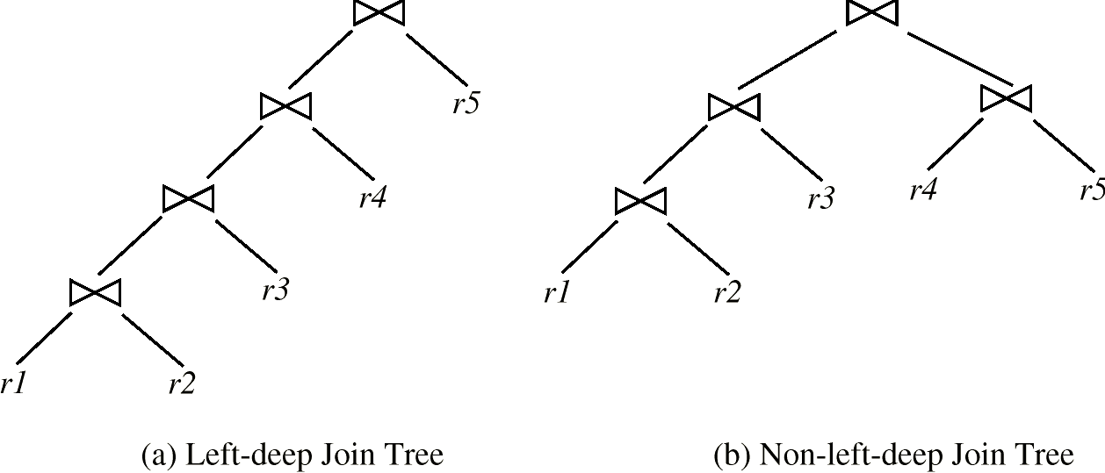
Part 2: Query Optimization
Heuristic optimization
  perform selections early
  perform projections early
  perform most restrictive selections and join operations before other similar operations - create left-deep join trees
Notes:
Selection -> reduce #tuples
Projections -> reduce # attr
Exe plan

Slide 12
Exercise 2: Query processing and Optimization
Consider three files:
  Student(sid, sname, gender); clustered index on sid
  Enroll(sid, cid, year); clustered index on cid
  course(cid, cname, area, credit); clustered index on area
Given the query:
  SELECT sname
  FROM Student as s, Enroll as e, Course as c
  WHERE s.sid=e.sid AND e.cid=c.cid AND c.area=“DB”

Slide 13
Exercise 2: Query processing and Optimization
Student(sid, sname, gender); clustered index on sid
Enroll(sid, cid, year); clustered index on cid
Course(cid, cname, area, credit); clustered index on area
SELECT sname FROM Student as s, Enroll as e, Course as c WHERE s.sid=e.sid AND e.cid=c.cid AND c.area=“DB”
Describe a plan to process the query.
π_{s.sname}
join
use index on s.sid
join
use index on e.cid
Student
σ_{c.area=DB}
use index on c.area
Enroll
Course

Slide 14
Exercise 2: Query processing and Optimization
Student(sid, sname, gender); 1,000 records.
Enroll(sid, cid, year); 6,000 records.
Course(cid, cname, area, credit); 200 records; there are 10 different areas, each of which contains 20 records.
Suppose the enrollments are uniformly distributed (i.e. each course is enrolled 30 times; each student enrolls 6 courses).
SELECT sname FROM Student as s, Enroll as e, Course as c WHERE s.sid=e.sid AND e.cid=c.cid AND c.area=“DB”
Estimate the result size of the query.
π_{s.sname}
join
use index on s.sid
join
use index on e.cid
S
σ_{c.area=DB}
use index on c.area
E
C

Slide 15
Exercise 2: Query processing and Optimization
Student(sid, sname, gender); 1,000 records.
Enroll(sid, cid, year); 6,000 records.
Course(cid, cname, area, credit); 200 records; there are 10 different areas, each of which contains 20 records.
Suppose the enrollments are uniformly distributed (i.e. each course is enrolled 30 times; each student enrolls 6 courses).
SELECT sname FROM Student as s, Enroll as e, Course as c WHERE s.sid=e.sid AND e.cid=c.cid AND c.area=“DB”
Since Enroll ∩ Course in Enroll is a foreign key referencing Course, the size of (Enroll _{cid} Course) is the same as the size of Enroll.
Since Student ∩ (Enroll _{cid} Course) in (Enroll _{cid} Course) is a foreign key referencing Student, the size of (Student _{sid} (Enroll _{cid} Course)) is the same as the size of (Enroll _{cid} Course), which is the same as the size of Enroll.
π_{sname} σ_{area=DB} (Student _{sid} Enroll _{cid} Course)
  Condition area=DB, selectivity = 1/10.
  Estimated size = 6,000/10 = 600.

Slide 16
Exercise 2: Query processing and Optimization
Student(sid, sname, gender); clustered index on sid; 1,000 records; 100 pages.
Enroll(sid, cid, year); clustered index on cid; 6,000 records; 600 pages.
Course(cid, cname, area, credit); clustered index on area; 200 records; 40 pages; there are 10 different areas, each of which contains 20 records.
Suppose for all cluster indices, we use B+-trees with 4 levels.
Suppose the enrollments are uniformly distributed (i.e. each course is enrolled 30 times; each student enrolls 6 courses).
Query: SELECT sname FROM Student as s, Enroll as e, Course as c WHERE s.sid=e.sid AND e.cid=c.cid AND c.area=“DB”
Estimate the cost for
this query in the previous
plan.
π_{s.sname}
join
use index on s.sid
join
use index on e.cid
S
σ_{c.area=DB}
use index on c.area
E
C

Slide 17
Exercise 2: Query processing and Optimization
Student(sid, sname, gender); clustered index on sid; 1,000 records; 100 pages.
Enroll(sid, cid, year); clustered index on cid; 6,000 records; 600 pages.
Course(cid, cname, area, credit); clustered index on area; 200 records; 40 pages; there are 10 different areas, each of which contains 20 records.
Suppose for all cluster indices, we use B+-trees with 4 levels.
Suppose the enrollments are uniformly distributed (i.e. each course is enrolled 30 times, each student enrolls 6 courses).
In the file of Course:
  There are 20 records (4 pages) whose area=“DB”.
  To get all these records, we spend 4+4=8 page accesses.
π_{s.sname}
join
use index on s.sid
join
use index on e.cid
S
σ_{c.area=DB}
use index on c.area
E
C

Slide 18
Exercise 2: Query processing and Optimization
Student(sid, sname, gender); clustered index on sid; 1,000 records; 100 pages.
Enroll(sid, cid, year); clustered index on cid; 6,000 records; 600 pages.
Course(cid, cname, area, credit); clustered index on area; 200 records; 40 pages; there are 10 different areas, each of which contains 20 records.
Suppose for all cluster indices, we use B+-trees with 4 levels.
Suppose the enrollments are uniformly distributed (i.e. each course is enrolled 30 times, each student enrolls 6 courses).
In the file of Enroll:
  For each cid selected from Course, we use the clustered index
  to locate all related records (in Enroll) and get
  the corresponding sid.
  For each cid, there are 30 records (3 pages) in Enroll,
  We spend 4+3=7 page accesses to get these
  records.
  Since there are 20 cids, the total cost is
  7*20=140 page accesses in Enroll.
π_{s.sname}
join
use index on s.sid
join
use index on e.cid
S
σ_{c.area=DB}
use index on c.area
E
C

Slide 19
Exercise 2: Query processing and Optimization
Student(sid, sname, gender); clustered index on sid; 1,000 records; 100 pages.
Enroll(sid, cid, year); clustered index on cid; 6,000 records; 600 pages.
Course(cid, cname, area, credit); clustered index on area; 200 records; 40 pages; there are 10 different areas, each of which contains 20 records.
Suppose for all cluster indices, we use B+-trees with 4 levels.
Suppose the enrollments are uniformly distributed (i.e. each course is enrolled 30 times, each student enrolls 6 courses).
In the file of Student:
  For each sid selected from Enroll, we use the clustered index
  to locate all related records (in Student) and get the
  corresponding sname.
  For each sid, spend 4+1=5 page accesses to get
  the corresponding sname.
  Since there are 20*30=600 sids, the total cost is
  600*5=3,000 page accesses in Student.
π_{s.sname}
join
use index on s.sid
join
use index on e.cid
S
σ_{c.area=DB}
use index on c.area
E
C

Slide 20
Exercise 2: Query processing and Optimization
Student(sid, sname, gender); clustered index on sid; 1,000 records; 100 pages.
Enroll(sid, cid, year); clustered index on cid; 6,000 records; 600 pages.
Course(cid, cname, area, credit); clustered index on area; 200 records; 40 pages; there are 10 different areas, each of which contains 20 records.
Suppose for all cluster indices, we use B+-trees with 4 levels.
Suppose the enrollments are uniformly distributed (i.e. each course is enrolled 30 times, each student enrolls 6 courses).
The total cost is 8+140+3,000=3148 page accesses.
π_{s.sname}
join
use index on s.sid
join
use index on e.cid
S
σ_{c.area=DB}
use index on c.area
E
C

