Slide 1

Lecture 4.
Yuan YAO

Slide 2
Summary
In the past lectures, we have shown
PCA as best k-affine space approximation of Euclidean data
Sample mean and Covariance as the maximum likelihood estimation (MLE) with Normal distribution assumption
Sample mean as MLE is unbiased estimate, yet with large variance in high dimensional statistics
Many other estimators which are biased, yet with less variance, resulting in a low risk:
Ridge Regression (L2)
James-Stein
LASSO (L1): minimax risk (L2-consistency, RE condition) and model selection consistency (IRR/Incoherence condition)
Nonconvex (SCAD, MCP, Lp)
Differential Inclusion (Linearized Bregman Iterations)
Some students are interested in model selection/l2 consistency proofs, we shall come back to this later

Slide 3
Today
A. PCA is also a low rank approximation of sample covariance matrix. But how meaningful is the low rank part in the presence of the noise?
In practice, parallel analysis use random permutations or simulations to decide the spectrum of random matrices without correlations among variables, then remove the noise spectrum
In theory, random matrix theory also tells us a phase transition phenomenon of PCA to capture the signals against the noise
B. Mini-Project 1

Slide 4
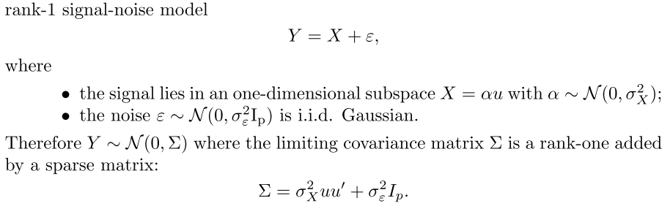
Rank-one spike model
Can we recover the signal direction u by the first component of PCA?

Slide 5
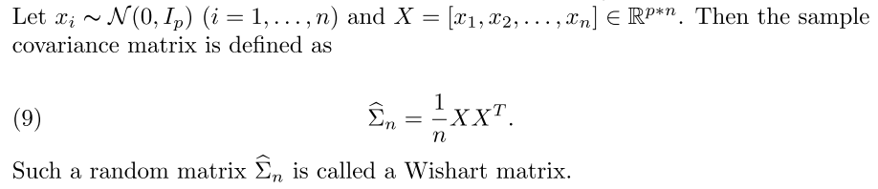
Wishart Random Matrices

Slide 6
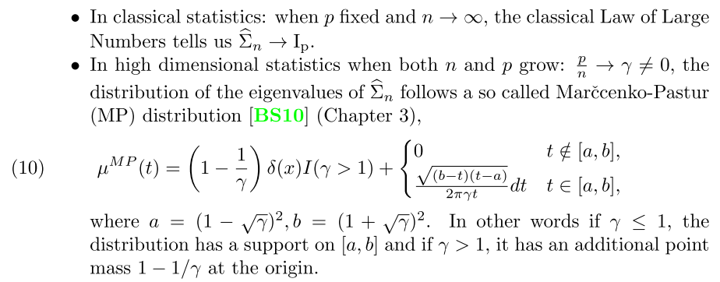
Marcenko-Pastur Distribution

Slide 7
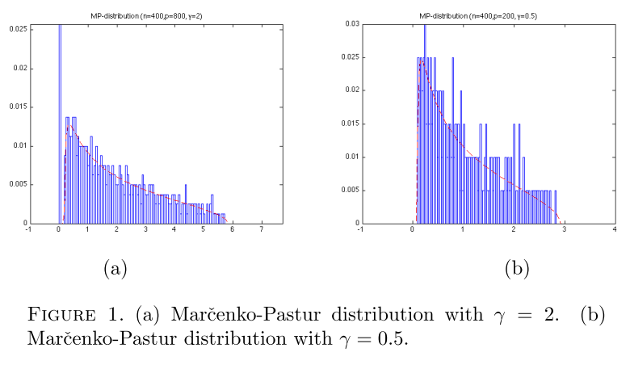
Simulation by http://math.stanford.edu/~yuany/course/2017.spring/mp.m

Slide 8

Conversion to Wishart Matrix
Consider n-samples from the normal distribution
Linear transformation
Then we have a Wishart matrix subject to MP-distribution

Slide 9
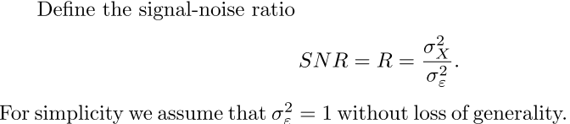
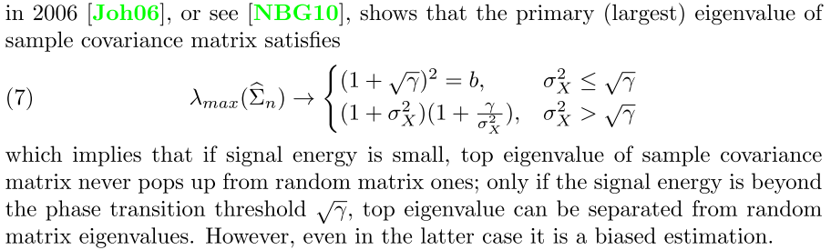
Phase Transition on Primary Eigenvalue

Slide 10
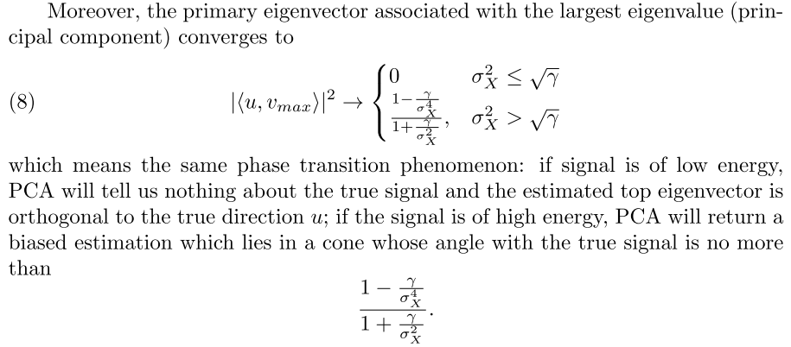
Phase Transition on Primary Eigenvector

Slide 11
Miniproject I
Deadline: Monday 13 Mar, 2017
Teamwork: up to 3 persons per team
Submission: poster report to datascience.hw@gmail.com before Monday class on deadline
Email title: Math 6380: Project 1
Description: http://math.stanford.edu/~yuany/course/2017.spring/project1.pdf

Slide 12
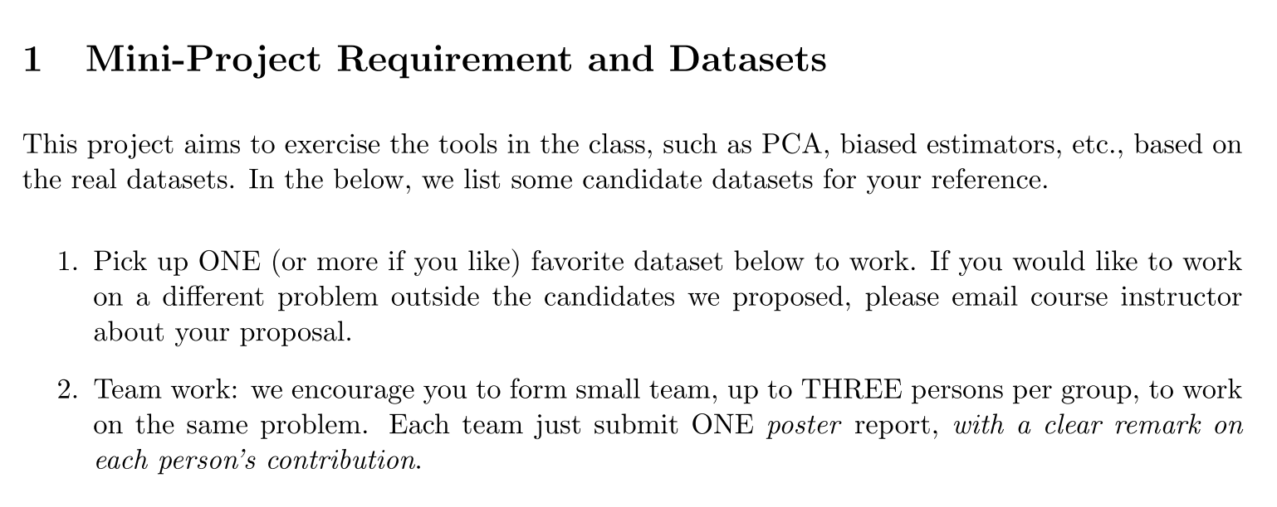
Requirement I

Slide 13
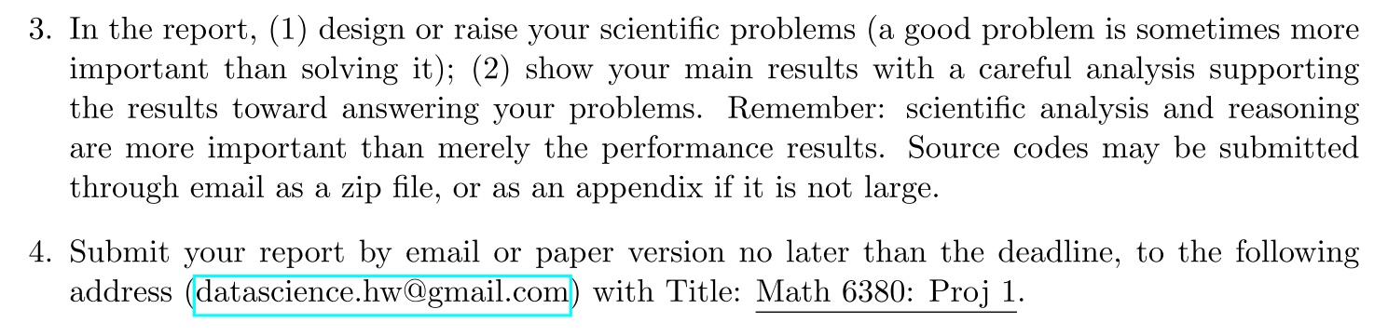
Requirement II

Slide 14
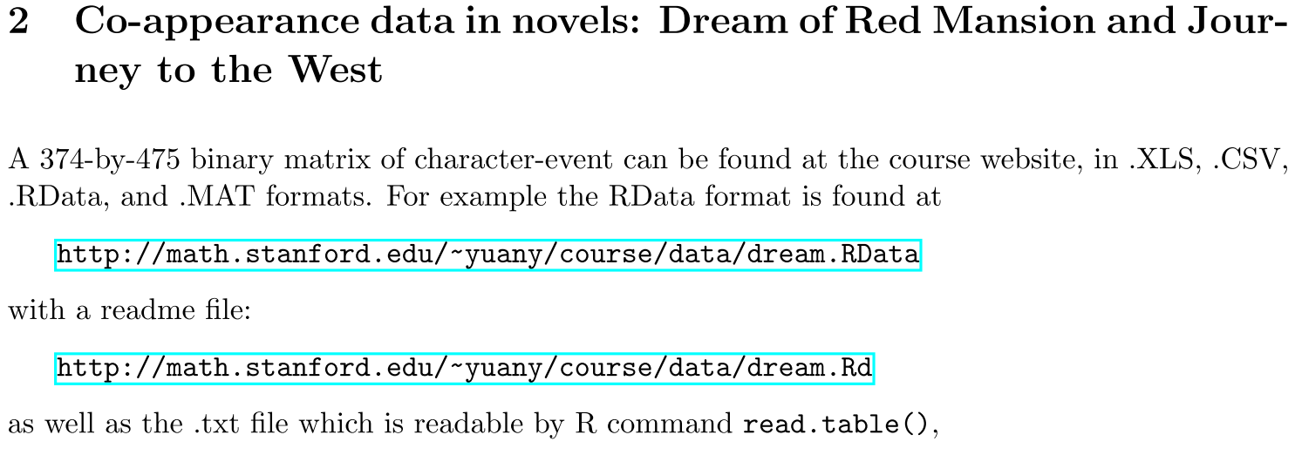
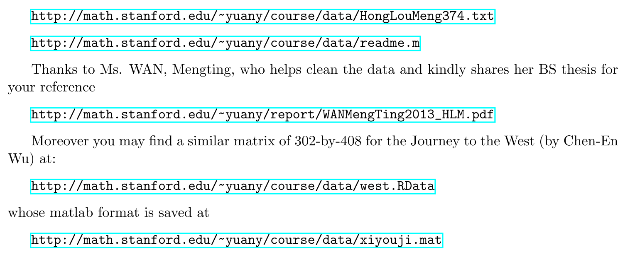

Slide 15
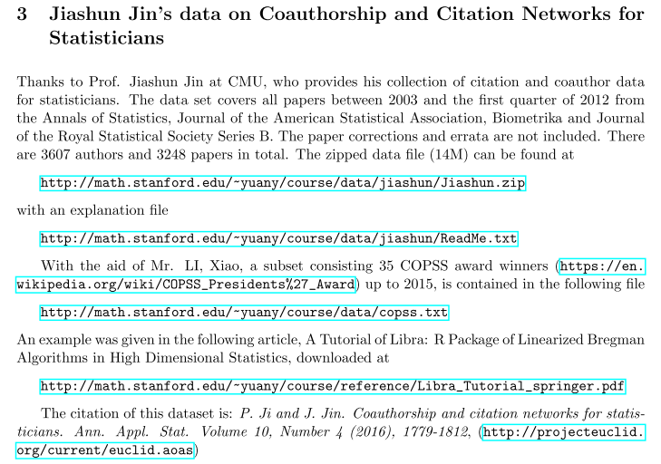

Slide 16
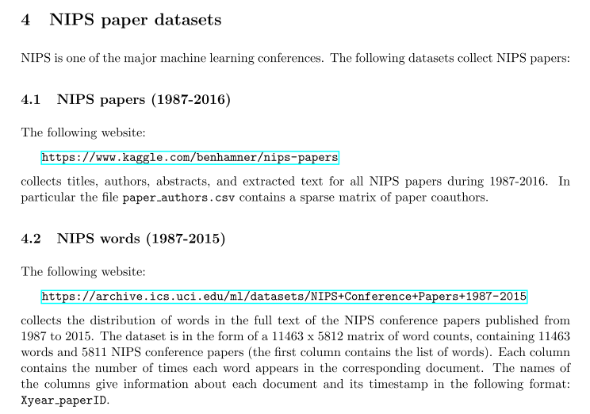

Slide 17
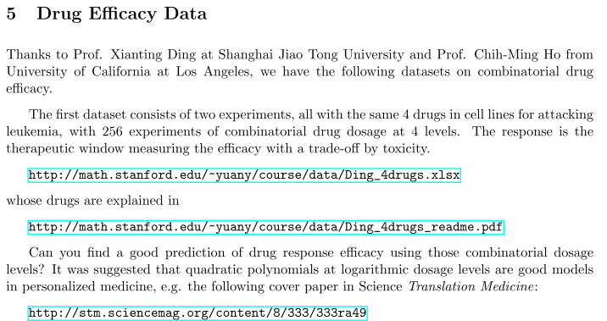

Slide 18
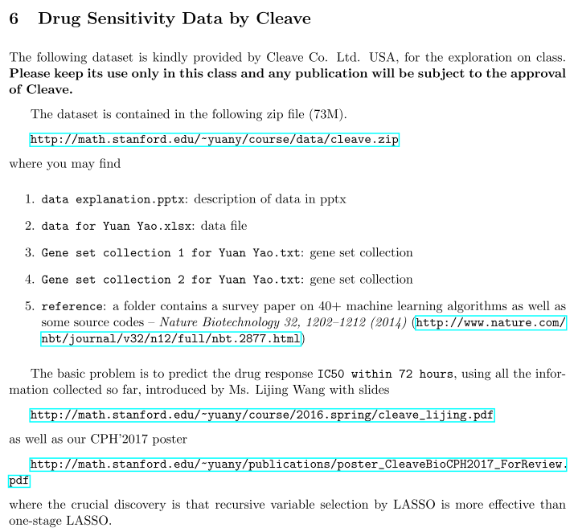

Slide 19
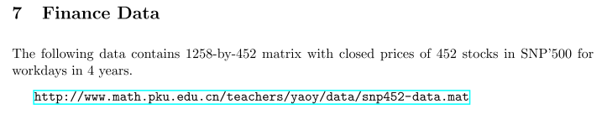

Slide 20
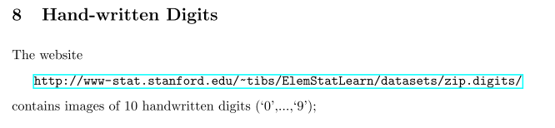

Slide 21
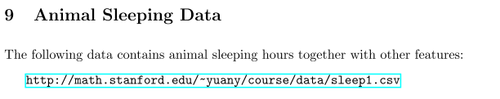
species,slowWaveSleep,dreamSleep,sleep,body,brain,life,gestation,predation,sleepExposure,danger African_elephant,NA,NA,3.3,6654,5712,38.6,645,3,5,3 African_giant_pouched_rat,6.3,2,8.3,1,6.6,4.5,42,3,1,3 Arctic_Fox,NA,NA,12.5,3.385,44.5,14,60,1,1,1 Arctic_ground_squirrel,NA,NA,16.5,0.92,5.7,NA,25,5,2,3 Asian_elephant,2.1,1.8,3.9,2547,4603,69,624,3,5,4 Baboon,9.1,0.7,9.8,10.55,179.5,27,180,4,4,4 Big_brown_bat,15.8,3.9,19.7,0.023,0.3,19,35,1,1,1 Brazilian_tapir,5.2,1,6.2,160,169,30.4,392,4,5,4 Cat,10.9,3.6,14.5,3.3,25.6,28,63,1,2,1 Chimpanzee,8.3,1.4,9.7,52.16,440,50,230,1,1,1 Chinchilla,11,1.5,12.5,0.425,6.4,7,112,5,4,4

Slide 22
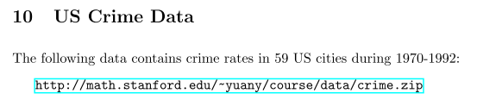
The folder contains:
crime2.xls -- data file
crime.txt -- description of variables
readme.txt -- description of dataset

