Slide 1
Reinforcement Learning
Akhan Ismailov

Slide 2
About me
Computer Science Department
Double gold medal winner of IMO (International Mathematical Olympiad)
high school olympiad, 100 countries, 600 participants

Slide 3
Outline
Overview
Basic Reinforcement Learning
Deep Reinforcement Learning
Big picture

Slide 4
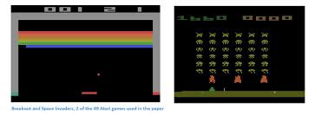
Overview
Atari, playing from raw pixels 2013.

Slide 5
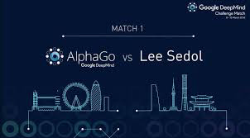
Overview
AlphaGo, beating world champion 2016.

Slide 6
Overview - neural networks
Universal Approximation Theorem
Neural Network with single hidden layer can approximate any continuous function
In most cases people use at least 2 hidden layers in feed-forward neural network
And use CNN (convolutional nn) when deal with images, due to its structure that is suited for image inputs

Slide 7
Basic Reinforcement Learning
Q-learning table lookup case, created at ~1990s.
It is name because it solves values of Q table, defined later.
After this case we will generalize to continuous state space by approximating Q values using neural network.

Slide 8
Basic Reinforcement Learning
Environment state number 11, finite discrete.
Initial position of agent random 1-10.
Possible actions - left, right.
From state s perform action a, receive reward r and get new state s’.
Action leading to final state gives reward +10, other action reward -1.

Slide 9
Basic Reinforcement Learning
Goal is to find policy that for any s gives best a that maximizes total reward.
But agent can learn it only from rewards it is receiving each time step.

Slide 10



Basic Reinforcement Learning
Discounted future reward -
Define Q function -
Bellman equation -
If Q solved or known, best policy is -
Q(s, a) is representing the maximum discounted future reward when we perform action a in state s, and continue optimally from that point on. Q stands for quality of a certain action in a given state.

Slide 11
Basic Reinforcement Learning
Q is a table, 11 x 2 array or matrix. Given (s, a) returns real value. It is a function!
We need to solve Q values, get their true values only from agent’s playing experience.
Solution:
First, fill array Q with zeros.

Slide 12

Basic Reinforcement Learning
Second, at each time step given state s, perform random action a with probability Epsilon, and with probability (1 - Epsilon) action a =
This is done for exploration when your Q values are not yet converged.
At the beginning Epsilon usually ~0.1, and slowly decreased after each episode.

Slide 13
Basic Reinforcement Learning
Third, at each step when you get <s, a, r, s’> values, perform update:
If s’ not termination step:
Else Q(s, a) = r.
Eventually Q values will converge to true values.
After solving Q values you will know best policy

Slide 14
Basic RL demo
https://www.youtube.com/watch?v=4MOx2_e5tug

Slide 15
Deep Reinforcement Learning
Deep Q-learning paper by Google Deepmind 2013, that learnt to play several Atari games from raw pixels.
Setup is same, agent performs actions a from state s and receives reward and new state.

Slide 16
Deep Reinforcement Learning
Main difference at each time step s that it receives is an image that after preprocessing becomes 84x84 two-dimensional array of real numbers representing luminance. Not a toy example where we had 11 possible states.
May think now that state space is continuous, cannot store Q values in a table.

Slide 17
Deep Reinforcement Learning
Approximate Q values with nn, particularly in case of Atari with cnn (convolutional neural networks).

Slide 18
Link to Supervised Learning
In supervised learning setting we have X and labels Y. We can fit neural net from X to Y. F(X) ~ Y. Training is well known.
Now, we have (s, a) as our X. But don’t have future total reward, which are labels Y in this case. Q(s, a) ~ ?
Solution use Bellman equation.
Where right side of equation will be labels.

Slide 19
Deep Reinforcement Learning
Scratch of the deep q-learning algorithm.
Initialize experience replay buffer of size ~10^5 or 10^6 that will save <s, a, r, s’> values.
Play in environment, pushing <s, a, r, s’> into experience replay buffer.

Slide 20
Deep Reinforcement Learning
Sample mini-batch of size 32 or 64 from experience replay buffer.
So now you have array of <s, a, r, s’> with size n as your training set.
Set x = (s, a), if state is terminal y = r, else y =
Minimize mean square error 1/n*sum_all_x_y(Q(x) - y)^2.
Using Gradient Descent for example, or any other update on parameters of Q.

Slide 21
Deep Reinforcement Learning
That is all, only differences from table example are:
Approximate Q function with CNN.
Use experience replay buffer for stabilizing learning of huge number of parameters, also for decorrelating X, Y using long distance experience, otherwise update is biased only towards local experience.

Slide 22
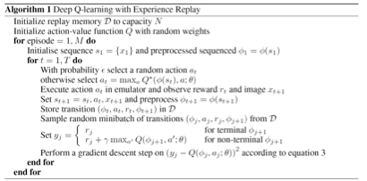
Deep Q Learning - from original paper
https://www.cs.toronto.edu/~vmnih/docs/dqn.pdf

Slide 23
Big Picture
Model Free Algorithms:
Deep Q Learning
Policy gradient
Instead of using Q values, finds policy directly by ascending towards increasing expected total return
Phd Stanford guy’s blog about it http://karpathy.github.io/2016/05/31/rl/
In model free algorithms you decide action directly from current state, there is no planning or strategy that can exist only when you have a model of the world.

Slide 24
Useful Links
Stanford’s Convolutional Neural Networks course.
http://cs231n.github.io/
UCL’s Reinforcement Learning course.
http://www0.cs.ucl.ac.uk/staff/d.silver/web/Teaching.html
For practicing Reinforcement Learning.
https://gym.openai.com/

Slide 25
Useful Links
There are many other courses online including Recurrent Neural Nets for NLP, Deep Reinforcement Learning, Neural Networks for Machine Learning and much more just google!
AlphaGo in Nature, 2016, by David Silver et al.:
https://www.nature.com/nature/journal/v529/n7587/full/nature16961.html

